Slide 1
CITS 5506 The Internet of Things Mandatory Slides for Project Presentation

Slide 2
Mandatory Slides for Project Presentation
These are mandatory slides for the project presentation, but
every group as per need can add additional slides. But keep in consideration the presentation time limit.

Slide 3
TITLE
Smart Guidance: An IoT-Enhanced Cane for the Visually Impaired
Yuyan Yang (24358018); Yanxi Liu (24305445); Xiaoyi Liu (24071255); Icy Chen (23965953); Anirudh Somnath Menon (23825886)
Date: 17/10/2024
University of Western Australia

Slide 4
Introduction
Problem Statement:
Visual impairment limits safe navigation, leading to difficulties with obstacle detection, emergency response, and low-light navigation.
In Australia, 9.4% of people aged 55+ are visually impaired.
Traditional aids like canes and guide dogs are limited or expensive.
Objectives:
Develop a smart cane integrating IoT to provide real-time obstacle detection, fall alerts, GPS tracking, and automatic lighting for visually impaired individuals.

Slide 5
Literature Review (Optional, depending upon the project)
- Summary of relevant previous work
- How the project builds on or differs from existing solutions

Slide 6
Project Description
System Overview:The smart cane includes four main subsystems:
Automatic Lighting
Obstacle Detection
Fall Detection
GPS Tracking
Block Diagram: Insert your block diagram showing how the subsystems work together.

Slide 7
Methodology
Tools and Technologies:
Raspberry Pi, LILYGO T-Beam (GPS), Arduino IDE, ultrasonic sensors, light sensors, accelerometers, gyroscope, LoRa communication.
System Architecture:
Mention hardware selection based on cost, power, availability, and accuracy.
Highlight software integration through Arduino IDE and data processing via the Raspberry Pi.

Slide 8
Design and Development Process
Challenges & Solutions:
Challenge: Synchronizing GPS data with fall detection for real-time alerts.
Solution: Using LILYGO T-Beam for continuous GPS data collection and Raspberry Pi for processing and integration.
Hardware & Software Integration:
Diagram showing integration of subsystems (light sensor with Raspberry Pi, ultrasonic sensors for obstacle detection, accelerometer for fall detection).

Slide 9
Subsystems Overview
The smart cane integrates four key subsystems to enhance the mobility and safety of visually impaired users:
Automatic Lighting ensures visibility.
Obstacle Detection warns the user of potential hazards.
Fall Detection triggers emergency alerts.
GPS Tracking provides real-time location data during emergencies.
Each subsystem works together to provide real-time feedback and assistance, ensuring the user’s safety in various environments.

Slide 10
Automatic Lighting Subsystem
Function:
Automatically activates or deactivates LED lights based on ambient light conditions to ensure visibility in low-light environments.
Key Components:
PiicoDev Ambient Light Sensor (VEML6030) and LED.
Demonstration:
The LED turns on when the environment gets dark and off in bright conditions, improving safety during nighttime travel.

Slide 11
Obstacle Detection Subsystem
Function:
Uses two ultrasonic sensors to detect obstacles at different heights and triggers a buzzer to alert the user.
Key Components:
Two ultrasonic sensors and a piezo buzzer.
Demonstration:
When an obstacle is detected within a predefined range, the buzzer sounds to warn the user.

Slide 12
Fall Detection Subsystem
Function:
Monitors changes in acceleration and angular velocity to detect falls and triggers an alert.
Key Components:
PiicoDev 3-Axis Accelerometer (LIS3DH), Gyro Sensor, and buzzer.
Demonstration:
If a fall is detected, the system sounds an alarm and alerts the user’s contacts with their GPS location.

Slide 13
GPS Tracking Subsystem
Function:
Provides real-time location tracking and sends the user’s precise location to designated contacts in case of an emergency.
Key Components:
LILYGO T-Beam with GPS NEO-6M module, Raspberry Pi.
Demonstration:
GPS data is collected continuously and sent along with fall detection alerts to provide the user’s current location.

Slide 14
Testing and Validation
Testing Procedures:
Subsystems tested in isolation (lighting, obstacle detection, fall detection).
Integrated testing for real-time data communication between subsystems.
Results:
Accurate obstacle detection (within 30 cm range).
GPS provides precise location data for emergency alerts.
Fall detection system successfully sends alerts when sudden movement is detected.

Slide 15
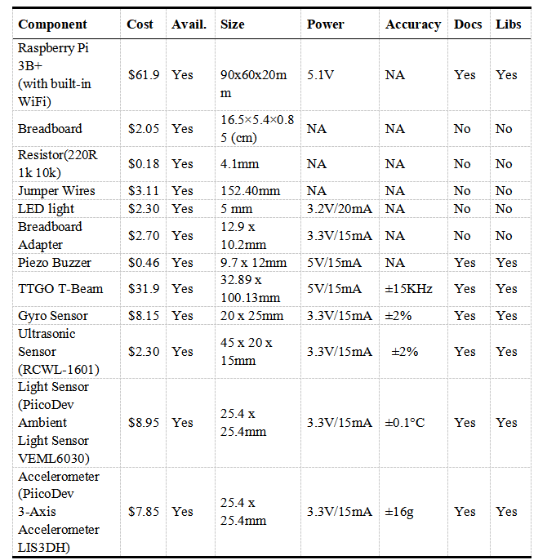
Cost

Slide 16
Results and Discussion
Final Results:
Successfully integrated a smart cane with real-time obstacle detection, fall alerts, GPS tracking, and automatic lighting.
Unexpected Findings:
Fall detection accuracy improved after sensor adjustment.
GPS tracking maintained accuracy even in low-signal environments.

Slide 17
Conclusion
Summary of Outcomes:
Project successfully addresses mobility and safety challenges for visually impaired users.
Future Work:
Explore integrating voice commands for more interactive feedback.
Improve battery life for longer usability in real-world conditions.

Slide 18
References
- List of references cited during the presentation
- Any relevant literature, tools, or resources

Slide 19
Q&A Slide
Thank the audience and invite questions.

