Slide 1
Day 7: Building Medallion Architecture Pipelines
Medallion Pipeline Training — Week 2
Spark Fundamentals · Bronze · Silver · Gold · Labs
Bronze Raw, immutable full fidelity
Silver Cleaned, conformed quality checked
Gold Business-ready KPIs and marts
→
→
Day 7 · Spark & Medallion | 1

Slide 2
Learning Objectives
1
Understand Apache Spark architecture and distributed computing
2
Work with DataFrames, SQL, and Spark transformations
3
Explain storage formats (Parquet, JSON, CSV) and partitioning
4
Build Bronze layer with raw ingestion and metadata tracking
5
Implement Silver layer with cleaning, quality gates, and CDC
6
Create Gold layer with business KPIs and aggregations
7
Publish Bronze, Silver, Gold, and quarantine outputs into MinIO buckets
Day 7 · Spark & Medallion | 2

Slide 3
Agenda
09:00
Welcome, Recap of Day 6 & Objectives
14:00
Module 4: Silver Layer — CDC & Enrichment
30 min
60 min
09:30
Module 1: Apache Spark Fundamentals
15:00
Break
60 min
15 min
10:30
Break
15:15
Module 5: Gold Layer — KPIs & Aggregations
15 min
60 min
10:45
Module 2: Bronze Layer — Raw Data Ingestion
16:15
Break
60 min
15 min
11:45
Break
16:30
Module 6: Full Pipeline, MinIO & Incremental Processing
15 min
20 min
12:00
Module 3: Silver Layer — Cleaning & Quality
16:50
Wrap-up, Q&A & Day 8 Preview
60 min
10 min
13:00
Lunch Break
60 min
Day 7 · Spark & Medallion | 3

Slide 4
Recap: Day 6 — Apache Hop
• Built visual Hop pipelines to move data through repeatable ETL steps.
• Used workflows to orchestrate dependencies and handle execution order.
• Connected PostgreSQL sources and targets for structured relational data.
• Introduced Kafka as a streaming source for event-driven ingestion.
CSV / JSON
Hop Pipeline
Transforms
PostgreSQL
→
→
→
Kafka Topic
Hop Streaming
Transform
Target Table
→
→
→
Day 7 · Spark & Medallion | 4

Slide 5
MODULE 1: Apache Spark Fundamentals
MODULE 1: Apache Spark Fundamentals
Day 7 · Spark & Medallion | 5

Slide 6
What is Apache Spark?
• Open-source distributed processing engine for large-scale data workloads.
• Started at UC Berkeley AMPLab in 2009 and became an Apache top-level project.
• Keeps intermediate data in memory to reduce repeated disk reads.
• Unifies batch, SQL, streaming, machine learning, and graph processing.
• Replaced many MapReduce workloads because it is faster and easier to compose.
Spark Web UI — Jobs | Stages | Storage | Environment | Executors
Active Jobs: 1 Completed: 14 Failed: 0
Executors: 4 Cores: 8 Memory: 8 GB
Day 7 · Spark & Medallion | 6

Slide 7
Spark Ecosystem Overview
• Spark Core schedules distributed work and manages memory.
• Spark SQL provides DataFrames, SQL parsing, and query optimization.
• Streaming, MLlib, and GraphX extend Spark into specialized workloads.
Spark SQL DataFrames, Datasets
Spark Streaming Micro-batching
One engine, multiple workload libraries
Spark Core Engine
MLlib ML pipelines
GraphX Graph computation
Day 7 · Spark & Medallion | 7

Slide 8
Spark Architecture Diagram
• The driver builds the logical plan and asks the cluster manager for resources.
• Executors run tasks, cache data, and report results back to the driver.
• Workers host executors and provide CPU, memory, and local storage.
Worker 1: Executor
Driver Program SparkSession
Cluster Manager Standalone / YARN / K8s
→
→
Worker 2: Executor
Worker 3: Executor
Job
Stage
Task partitions
→
→
Day 7 · Spark & Medallion | 8

Slide 9
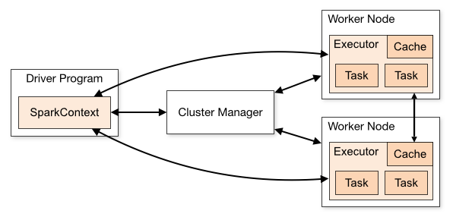
How a Spark Cluster Works
• The driver converts user code into jobs and stages.
• The cluster manager allocates executors across worker nodes.
• Executors process partitions in parallel and shuffle data when needed.
Day 7 · Spark & Medallion | 9

Slide 10
SparkSession — the Unified Entry Point
• Creates the Spark application and exposes DataFrame, SQL, and catalog APIs.
• Replaces older separate SQLContext and HiveContext entry points.
• The same SparkSession is reused across the labs for consistent configuration.
from pyspark.sql import SparkSession spark = ( SparkSession.builder .appName("day7-medallion") .master("local[*]") .getOrCreate() )
Day 7 · Spark & Medallion | 10

Slide 11
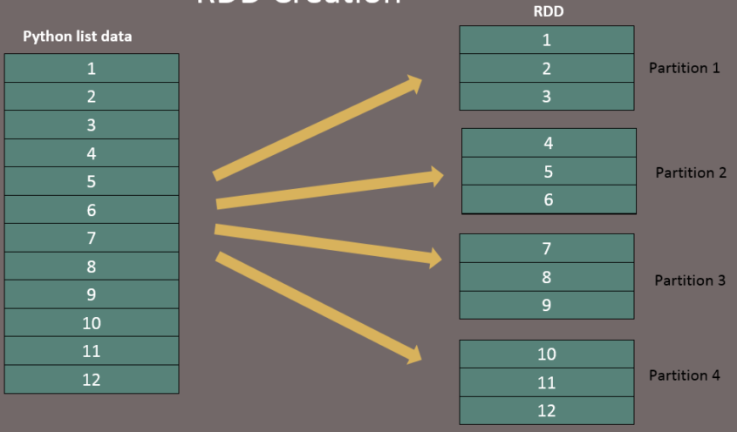
Resilient Distributed Datasets (RDDs)
Resilient Distributed Datasets (RDDs) are a fundamental data structure in Apache Spark. They represent a fault-tolerant collection of elements that can be operated on in parallel across a cluster. RDDs are immutable, meaning once created, they cannot be changed. Instead, transformations on RDDs produce new RDDs.
Key Principles of RDDs
Fault Tolerance: RDDs automatically recover from node failures. If a partition of an RDD is lost, it can be recomputed using the lineage information.
Immutability: Once an RDD is created, it cannot be modified. This immutability ensures consistency and fault tolerance.
Partitioning: RDDs are divided into logical partitions, which can be computed on different nodes of the cluster. This allows for parallel processing.
Day 7 · Spark & Medallion | 10

Slide 12
RDDs vs DataFrames vs Datasets
Dimension | RDD | DataFrame | Dataset
Type safety | Yes | No | Yes
Optimization | No | Yes: Catalyst | Yes
API | Functional | Declarative | Both
Schema | None | Inferred or explicit | Explicit
Language | All | All | Scala/Java only
Performance | Lowest | Highest | High
Day 7 · Spark & Medallion | 13

Slide 13
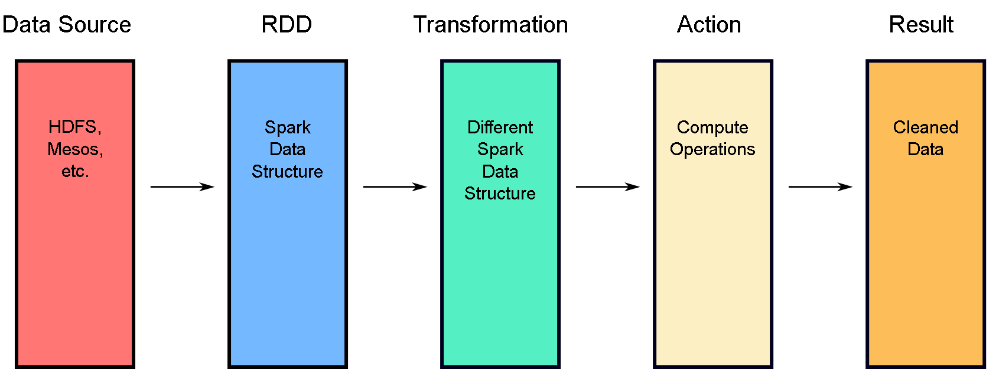
Transformation
Transformations are functions that produce new RDDs from existing ones.
They are lazy in nature, meaning they do not execute immediately but build up a logical execution plan known as the Directed Acyclic Graph (DAG). Transformations are only executed when an action is called. Some common transformations include:
map(func): Applies a function to each element of the RDD and returns a new RDD.
flatMap(func): Similar to map, but each input item can be mapped to zero or more output items.
filter(func): Returns a new RDD containing only the elements that satisfy a predicate.
Transformations can be further categorized into narrow and wide transformations. Narrow transformations (e.g., map, filter) do not require data shuffling across partitions, while wide transformations (e.g., groupByKey, reduceByKey) involve shuffling data across partitions.
Day 7 · Spark & Medallion | 10

Slide 14
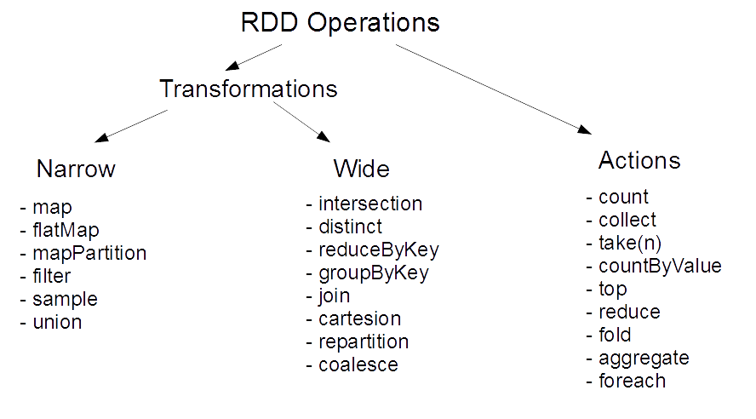
Actions
Actions trigger the execution of the transformations and return a value to the driver program or write data to an external storage system. Actions are responsible for materializing the RDDs and bringing the laziness of transformations into motion. Some common actions include:
count(): Returns the number of elements in the RDD.
collect(): Returns all the elements of the RDD as an array to the driver program.
take(n): Returns the first n elements of the RDD.
Actions are essential for triggering the execution of the DAG and obtaining the final results.
Day 7 · Spark & Medallion | 10

Slide 15
Transformations vs Actions
• Transformation = Spark records the next step in a plan; no cluster work yet.
• Action = Spark must return or write a result; a job starts in the Spark UI.
• Ask: does this line produce data for the driver or storage?
Code line | Type | What happens
orders.filter(status != 'CANCELLED') | Transformation | Adds a filter node to the plan
orders.withColumn('event_date', ...) | Transformation | Adds a derived column to the plan
orders.groupBy('event_date').sum() | Transformation | Adds an aggregate and future shuffle
orders.count() | Action | Launches a job and returns one number
orders.write.parquet(path) | Action | Launches jobs and writes files
Day 7 · Spark & Medallion | 11

Slide 16
Common Spark Actions You Actually Use
• Actions are where time is spent, Spark UI changes, and files appear.
• Some actions are safe for learning; some can overload the driver.
• In production, prefer writing or aggregating over collecting full datasets.
Action | Use it for | Scale warning
show(10) | Preview a few rows | Triggers a small job
count() | Validate row counts | Scans data unless cached/optimized
take(5) | Bring a tiny sample to driver | Keep the number small
collect() | Bring all rows to driver | Dangerous on large data
write.parquet() | Persist lakehouse output | Creates output files and jobs
Day 7 · Spark & Medallion | 12

Slide 17
Lazy Evaluation Explained
• This line is still only a plan: orders.filter(...).select(...).
• This line starts work: filtered_orders.count() or filtered_orders.write.parquet(...).
• Lazy planning lets Spark push filters early and avoid reading unused columns.
read() Transformation
filter() Transformation
select() Transformation
groupBy() Transformation
ACTION → run
→
→
→
→
Spark plans transformations first; count/show/write triggers the result.
Day 7 · Spark & Medallion | 14

Slide 18
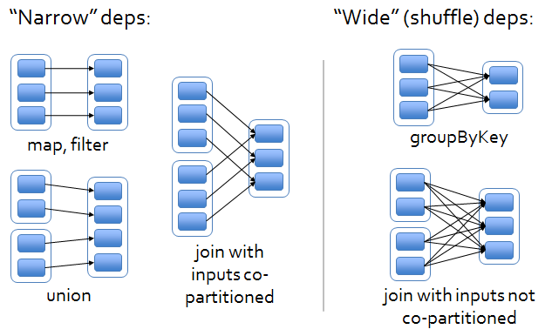
Narrow vs Wide Transformations
• Narrow: filter/select/withColumn can run inside each partition with no network shuffle.
• Wide: groupBy/join/distinct must move rows with the same key to the same executor.
• In real clusters, wide dependencies are where network, disk spill, and slow stages appear.
Narrow dependency: filter / select / withColumn
Wide dependency: groupBy / join / distinct
Day 7 · Spark & Medallion | 15

Slide 19
Narrow vs Wide — Order Data Examples
• Filter CANCELLED orders: each executor drops local rows; no repartition needed.
• Add event_date: each row is updated locally; no other executor is needed.
• Group by event_date: all same-date rows must meet; Spark shuffles across network.
• Join orders to customers: large-side data may shuffle unless the dimension is broadcast.
Operation | Dependency | Why
filter(status != 'CANCELLED') | Narrow | Each input partition produces its own output
withColumn(event_date) | Narrow | No rows move between executors
groupBy(event_date).sum() | Wide | Rows with same date are regrouped
join(orders, customers) | Often wide | Keys must align across partitions
Day 7 · Spark & Medallion | 16

Slide 20
Mini-Exercise: Identify which of this is a transformation
select()
filter()
count()
show()
withColumn()
groupBy()
collect()
orderBy()
Write()
Join()
Letter | Type
A | Transformation
B | Action
C | Neither / Utility Operation
Day 7 · Spark & Medallion | 27

Slide 21
Answers: Identify Actions and transformation
1 - A Transformation 2 - A Transformation 3 - B Action 4 - B Action 5 - A Transformation 6 - A Transformation 7 - B Action 8 - A Transformation 9 - B Action
10 - A Transformation
Day 7 · Spark & Medallion | 28

Slide 22
Mini exercise on narrow and wide transformation
Q1. Which of the following is a narrow transformation?
a) groupBy() b) reduceByKey() c) filter() d) join()
Q2. Which of the following is a wide transformation?
a) select() b) map() c) withColumn() d) groupBy()
Q3. Which operation usually causes a shuffle in Spark?
a) select() b) filter() c) map() d) orderBy()
Day 7 · Spark & Medallion | 28

Slide 23
Answers: Identify Actions and transformation
Q1. Which of the following is a narrow transformation?
Answer: c) filter()
Q2. Which of the following is a wide transformation?
Answer: d) groupBy()
Q3. Which operation usually causes a shuffle in Spark?
Answer: d) orderBy()
Narrow transformation: Data stays mostly within the same partition. Examples: filter(), map(), select(), withColumn()
Wide transformation: Data moves between partitions, usually causing a shuffle. Examples: groupBy(), join(), distinct(), orderBy(), reduceByKey()
Day 7 · Spark & Medallion | 28

Slide 24
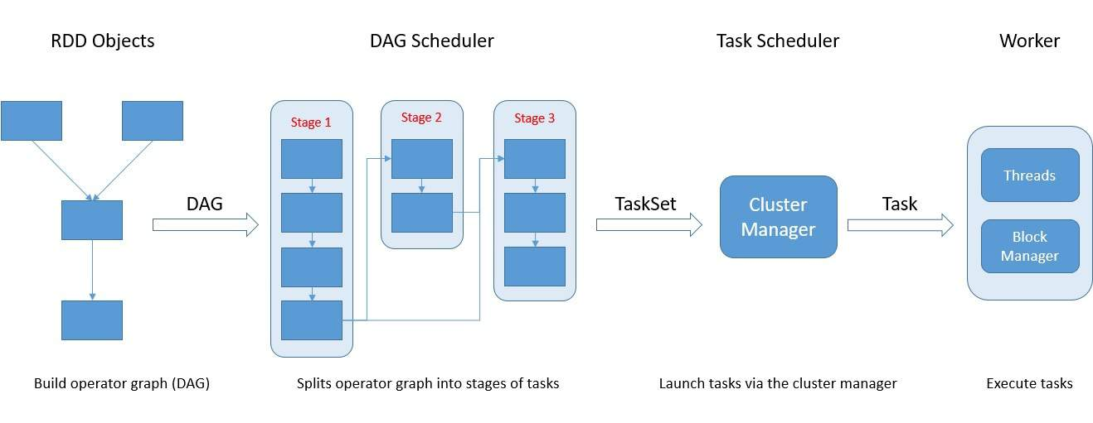
DAG Execution Model
• Spark builds a Directed Acyclic Graph of transformations.
• The DAG scheduler splits work into stages around shuffle boundaries.
• Tasks run the stage logic against individual data partitions.
Day 7 · Spark & Medallion | 17

Slide 25
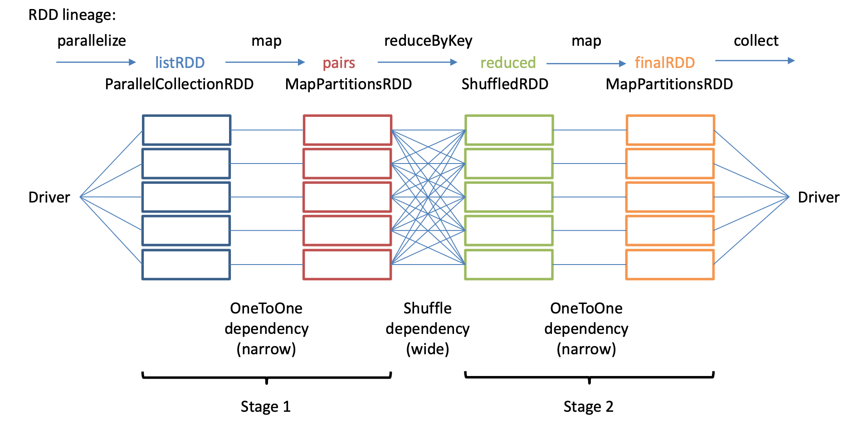
Data lineage
In Apache Spark, lineage refers to the logical representation of dependencies between Resilient Distributed Datasets (RDDs) or DataFrames in a Spark application. This is captured in a Lineage Graph, which is essentially a Directed Acyclic Graph (DAG). The lineage tracks all transformations and actions applied to the data, enabling Spark to manage fault tolerance, optimize execution, and efficiently utilize cluster resources.
Day 7 · Spark & Medallion | 17

Slide 26
Spark Execution Plan: Job → Stage → Task
• One action can create one or more jobs in the Spark UI.
• Wide dependencies split a job into multiple stages.
• A stage launches many tasks; usually one task per partition.
Job
Stage boundaries appear when data must move across partitions.
Stage 1
Shuffle wide dependency
Stage 2
Task
Task
Task
Task
Task
Task
Task
Task
Day 7 · Spark & Medallion | 18

Slide 27
Catalyst Optimizer — How Spark Optimizes Queries
• Parses DataFrame and SQL operations into a logical plan.
• Resolves column names, data types, and catalog references.
• Applies rules such as predicate pushdown and projection pruning.
• Chooses a physical plan that can run across the cluster.
SQL / DataFrame API
Unresolved Logical Plan
Analyzed Logical Plan
Optimized Logical Plan
Physical Plans
Selected Physical Plan
RDDs
→
→
→
→
→
→
Analysis
Logical optimization
Physical planning
Code generation
Day 7 · Spark & Medallion | 19

Slide 28
DataFrame API — Creating DataFrames
• DataFrames combine schema, distributed partitions, and optimized operations.
• Explicit schemas avoid inference surprises and speed up file reads.
customers_df = ( spark.read .option("header", "true") .schema(CUSTOMER_SCHEMA) .csv("data/customers.csv") )
Day 7 · Spark & Medallion | 20

Slide 29
DataFrame Operations: select, filter, withColumn, groupBy
• Use select to project only needed columns.
• Use filter to reduce rows before expensive operations.
• Use groupBy for aggregations that produce KPI-ready summaries.
from pyspark.sql import functions as F summary = ( orders .filter(F.col("status") != "CANCELLED") .groupBy("event_date") .agg(F.round(F.sum("amount"), 2).alias("daily_revenue")) )
Day 7 · Spark & Medallion | 21

Slide 30
Column Expressions and Functions
• F.col references existing columns in a composable way.
• F.lit injects constants into expressions.
• F.when creates conditional logic without leaving the DataFrame API.
from pyspark.sql import functions as F orders = ( orders .withColumn("status_norm", F.upper(F.trim(F.col("status")))) .withColumn("is_revenue", F.col("status_norm") != F.lit("CANCELLED")) .withColumn( "priority", F.when(F.col("amount") >= 500, F.lit("HIGH")).otherwise(F.lit("STANDARD")), ) )
Day 7 · Spark & Medallion | 22

Slide 31
Schema Definition with StructType
• StructType defines the column contract before reading raw files.
• StructField captures name, type, and nullability.
• Schema contracts are the first defense against silent data drift.
from pyspark.sql.types import StructField, StructType, StringType CUSTOMER_SCHEMA = StructType([ StructField("customer_id", StringType(), False), StructField("customer_name", StringType(), True), StructField("email", StringType(), True), StructField("country", StringType(), True), StructField("segment", StringType(), True), ])
Day 7 · Spark & Medallion | 23

Slide 32
Reading CSV Files with Explicit Schema
• Use header=true when the first row contains column names.
• Use mode=PERMISSIVE for lab exploration, then tighten in production.
• Attach the same schema every time to keep reads repeatable.
customers = ( spark.read .option("header", "true") .option("mode", "PERMISSIVE") .schema(CUSTOMER_SCHEMA) .csv("data/raw/customers.csv") )
Day 7 · Spark & Medallion | 24

Slide 33
Reading JSON Files
• JSON Lines keeps one event per line and is friendly to distributed reads.
• Explicit schemas protect nested or semi-structured event feeds.
• Order events are the fact stream used throughout the Medallion labs.
order_events = ( spark.read .schema(ORDER_EVENT_SCHEMA) .json("data/raw/order_events/*.jsonl") )
Day 7 · Spark & Medallion | 25

Slide 34
Writing Data — Parquet Format
• Parquet is columnar, compressed, and optimized for analytics.
• Overwrite is useful for deterministic lab outputs.
• Append is common for production Bronze ingestion.
( customers .write .mode("overwrite") .format("parquet") .save("output/bronze/customers") )
Day 7 · Spark & Medallion | 26

Slide 35
Spark SQL — Temp Views and SQL Queries
• Temp views let SQL and DataFrame workflows share the same data.
• This is useful when analysts and engineers collaborate on logic.
orders.createOrReplaceTempView("orders") spark.sql(""" SELECT status, COUNT(*) AS order_count FROM orders GROUP BY status ORDER BY order_count DESC """).show()
Day 7 · Spark & Medallion | 29

Slide 36
Spark SQL — GROUP BY, Aggregations, ORDER BY
• GROUP BY defines the grain of the result.
• Aggregations calculate metrics at that grain.
• ORDER BY makes small inspection outputs easier to read.
spark.sql(""" SELECT event_date, status, ROUND(SUM(amount), 2) AS raw_amount_total FROM orders GROUP BY event_date, status ORDER BY event_date, status """)
Day 7 · Spark & Medallion | 30

Slide 37
Quiz: What is Lazy Evaluation?
Choose the best answer.
A. Spark executes every transformation immediately.
B. Spark builds a plan and runs it only when an action is called.
C. Spark stores all data permanently in memory.
D. Spark disables query optimization for DataFrames.
Day 7 · Spark & Medallion | 31

Slide 38
Answer: What is Lazy Evaluation?
Review the correct answer and why it matters.
A. Spark executes every transformation immediately.
✓ B. Spark builds a plan and runs it only when an action is called.
C. Spark stores all data permanently in memory.
D. Spark disables query optimization for DataFrames.
Correct: transformations are deferred until an action gives Spark a reason to execute the plan.
Day 7 · Spark & Medallion | 32

Slide 39
Storage Formats Compared
Feature | CSV | JSON | Parquet | ORC
Format type | Text | Text | Binary columnar | Binary columnar
Schema | None | Self-describing | Embedded | Embedded
Compression | Poor | Poor | Excellent: Snappy | Excellent: Zlib
Predicate pushdown | No | No | Yes | Yes
Splittable | Yes | Yes if line-delimited | Yes | Yes
Best for | Simple export | APIs and logs | Analytics | Hive workloads
Day 7 · Spark & Medallion | 33

Slide 40
Parquet Deep Dive
• Stores data by column, so Spark reads only the columns used in a query.
• Compression works better because values in a column are similar.
• File statistics enable predicate pushdown and partition pruning.
• Parquet is the default storage format for most lakehouse pipelines.
Parquet File
Row Group 0 Col A | Col B | Col C
Row Group 1 Col A | Col B | Col C
Footer: schema, offsets, column statistics
Row Storage (CSV)
Columnar Storage (Parquet)
Row 1: A1 | B1 | C1
Col A A1 A2 A3
Col B B1 B2 B3
Col C C1 C2 C3
Row 2: A2 | B2 | C2
Row 3: A3 | B3 | C3
Day 7 · Spark & Medallion | 34

Slide 41
Partitioning — partitionBy Explained
• Partitioning writes folder paths based on one or more column values.
• Common choices are event_date, country, tenant, or ingestion batch.
• Good partitions make reads faster; too many small partitions hurt performance.
[folder] orders_by_status_parquet/
[folder] status=NEW/ part-0000.parquet
[folder] status=PAID/ part-0000.parquet
[folder] status=SHIPPED/ part-0000.parquet
[folder] status=CANCELLED/ part-0000.parquet
Day 7 · Spark & Medallion | 35

Slide 42
Partition Pruning
• Spark inspects filter predicates before reading files.
• If a filter matches partition columns, irrelevant folders are skipped.
• Pruning reduces I/O and can dramatically improve dashboard queries.
Filter event_date='2026-06-02'
Read matching folder
Skip other dates
→
→
Day 7 · Spark & Medallion | 36

Slide 43
Code Example: Writing Partitioned Parquet
• Partition by a column that is often used in filters.
• Keep partition cardinality moderate to avoid small-file pressure.
( orders .withColumn("event_date", F.to_date("event_time_ts")) .write .mode("overwrite") .partitionBy("event_date") .parquet("output/partitioned/orders") )
Day 7 · Spark & Medallion | 37

Slide 44
☕ Break — 15 Minutes
Day 7 · Spark & Medallion | 39

Slide 45
MODULE 2: Bronze Layer — Raw Data Ingestion
MODULE 2: Bronze Layer — Raw Data Ingestion
Day 7 · Spark & Medallion | 40

Slide 46
Source Data for Our Lab
Source | Format | Role | Key fields
customers.csv | CSV | Customer dimension | customer_id, name, email, country, region, signup_date, loyalty_tier
products.csv | CSV | Product dimension | product_id, name, category, unit_cost
fx_rates.csv | CSV | Currency reference | currency, rate_to_usd, as_of_date
order_events.jsonl | JSON Lines | Order event fact stream | event_id, order_id, customer_id, product_id, status, amount, currency, channel, event_time
Day 7 · Spark & Medallion | 44

Slide 47
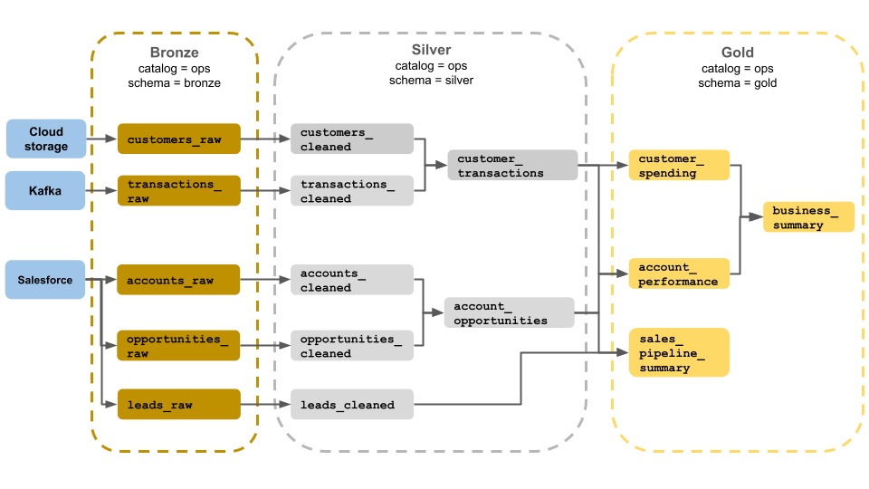
What is the Medallion Architecture?
• A layered pattern for progressively improving data quality and usability.
• Bronze stores raw source-aligned data.
• Silver cleans, validates, deduplicates, and enriches data.
• Gold serves business-ready aggregates and curated marts.
Day 7 · Spark & Medallion | 41

Slide 48
Bronze Layer Overview — Purpose and Characteristics
• Captures source data with minimal transformation.
• Preserves the original grain, columns, and operational context.
• Provides a replayable history for downstream reprocessing.
• Adds ingestion metadata for auditability and lineage.
data/raw
bronze/customers
bronze/products
bronze/order_events
→
→
→
Day 7 · Spark & Medallion | 42

Slide 49
Bronze Design Principles
• Append-only: new batches add new records or files.
• Immutable: do not silently alter what arrived from the source.
• Full fidelity: preserve raw fields even when they are messy.
• Metadata-enriched: attach source file, batch ID, and ingestion timestamp.
• Replayable: downstream logic can be rebuilt from Bronze history.
Day 7 · Spark & Medallion | 43

Slide 50
Data Model Diagram
• Order events reference customers, products, and currency rates.
• Bronze keeps each source independently before Silver joins them.
• The model mirrors a common fact-plus-dimensions analytics pattern.
customers.csv customer_id name email country region signup_date loyalty_tier
products.csv product_id name category unit_cost
fx_rates.csv currency rate_to_usd as_of_date
order_events.jsonl event_id order_id customer_id product_id status amount currency channel event_time
Day 7 · Spark & Medallion | 45

Slide 51
Raw Ingestion Pattern
• Read source files using explicit schemas where possible.
• Add standard Bronze metadata columns.
• Write Parquet outputs in source-aligned Bronze folders.
• Keep ingestion logic repeatable for batch reruns.
[file] Source Files CSV + JSONL
[spark] Spark Read
[tag] Add Metadata _source_file _batch_id _ingested_at
[disk] Write Parquet
[db] Bronze Layer lake/bronze/orders_raw/
→
→
→
→
Day 7 · Spark & Medallion | 46

Slide 52
Adding Bronze Metadata Columns
• _source_file records the exact file path or file name.
• _ingestion_batch_id groups records loaded together.
• _bronze_ingested_at captures processing time for lineage.
• Metadata turns raw data into auditable raw data.
bronze = ( raw_df .withColumn("_source_file", F.input_file_name()) .withColumn("_ingestion_batch_id", F.lit(batch_id)) .withColumn("_bronze_ingested_at", F.current_timestamp()) )
Day 7 · Spark & Medallion | 47

Slide 53
Code: with_bronze_metadata Function
• A small helper keeps metadata columns identical across sources.
• Consistent metadata makes downstream quality checks and manifests easier.
def with_bronze_metadata(df, batch_id): return ( df .withColumn("_source_file", F.input_file_name()) .withColumn("_ingestion_batch_id", F.lit(batch_id)) .withColumn("_bronze_ingested_at", F.current_timestamp()) )
Day 7 · Spark & Medallion | 48

Slide 54
Code: Lab 04 — Bronze Raw Ingestion Walkthrough
• Read both raw order-event batches.
• Add Bronze metadata for file, batch, and ingest time.
• Write one raw orders table to the Bronze lake path.
bronze_path = LAKE_DIR / "bronze" / "orders_raw" bronze = with_bronze_metadata( read_order_events(spark), "manual-full-load-001", ) bronze.write.mode("overwrite").parquet(str(bronze_path))
Day 7 · Spark & Medallion | 49

Slide 55
Mini-Exercise: Bronze Audit Metadata
Fill in the three metadata fields that make Bronze data traceable.
1. Which file did the row come from?: ______________________________
2. Which ingestion run loaded it?: ______________________________
3. When did Bronze receive it?: ______________________________
Hint: These columns should appear on every raw Bronze table.
Day 7 · Spark & Medallion | 50

Slide 56
Answers: Bronze Audit Metadata
Compare your blanks with the reference answers.
✓ Which file did the row come from?: _source_file
✓ Which ingestion run loaded it?: _ingestion_batch_id
✓ When did Bronze receive it?: _bronze_ingested_at
Day 7 · Spark & Medallion | 51

Slide 57
Schema Drift — What It Is and Why It Matters
• Schema drift happens when a source adds, removes, renames, or changes columns.
• Raw ingestion should detect drift without losing the arriving payload.
• Undetected drift can break Silver logic or silently corrupt business metrics.
Batch 1 Schema
Batch 2 Schema (drifted)
order_id
order_id
status
status
amount
amount
currency
currency
coupon_code ← NEW
delivery_promise ← NEW
Day 7 · Spark & Medallion | 52

Slide 58
Schema Drift Detection — Profiling Columns for Nulls
• Column profiles reveal unexpected null spikes and missing fields.
• Profiling at Bronze gives early warning before Silver transformations fail.
• Lab 05 turns column-level observations into a repeatable drift report.
profile = raw_df.select([ F.count(F.when(F.col(c).isNull(), c)).alias(f"{c}_nulls") for c in raw_df.columns ]) profile.show(truncate=False)
Day 7 · Spark & Medallion | 53

Slide 59
Handling Schema Evolution
• Schema-on-read allows Bronze to store data before all downstream contracts are updated.
• Merge schemas can help combine compatible Parquet evolutions.
• Production pipelines should alert on drift and document accepted changes.
• Silver decides which fields are trusted and conformed.
evolved = ( spark.read .option("mergeSchema", "true") .parquet("output/bronze/order_events") )
Day 7 · Spark & Medallion | 54

Slide 60
Quiz: Which is NOT a Bronze Layer Principle?
Choose the best answer.
A. Append-only ingestion.
B. Preserve raw source fidelity.
C. Overwrite raw history with only business aggregates.
D. Add ingestion metadata for auditability.
Day 7 · Spark & Medallion | 55

Slide 61
Answer: Which is NOT a Bronze Layer Principle?
Review the correct answer and why it matters.
A. Append-only ingestion.
B. Preserve raw source fidelity.
✓ C. Overwrite raw history with only business aggregates.
D. Add ingestion metadata for auditability.
Correct: business aggregates belong in Gold, not in the raw Bronze layer.
Day 7 · Spark & Medallion | 56

Slide 62
Bronze Layer in Production — Real-World Considerations
• Use idempotent file tracking to avoid duplicate ingestion.
• Capture schema and file-level manifests for audit and replay.
• Design folder layout around source system and ingestion date.
• Separate raw ingestion from quality rejection decisions.
• Monitor file sizes, late arrivals, and batch completeness.
Day 7 · Spark & Medallion | 57

Slide 63
Architecture: Bronze in Our Lab
• Each raw source lands in its own Bronze Parquet output path.
• Order events remain event-grained; dimensions remain source-grained.
• Metadata columns make every downstream row traceable to ingestion.
data/raw
bronze/customers
bronze/products
bronze/order_events
→
→
→
Day 7 · Spark & Medallion | 58

Slide 64
Key Takeaways: Bronze Layer
• Bronze is raw, immutable, metadata-rich, and replayable.
• Explicit schemas reduce ingestion surprises.
• Schema drift should be detected early and recorded.
• Do not apply business curation in Bronze.
• Good Bronze design makes Silver rebuilds possible.
Day 7 · Spark & Medallion | 59

Slide 65
☕ Break — 15 Minutes
Day 7 · Spark & Medallion | 60

Slide 66
MODULE 3: Silver Layer — Cleaning & Quality
MODULE 3: Silver Layer — Cleaning & Quality
Day 7 · Spark & Medallion | 61

Slide 67
Silver Layer Overview — Cleaned, Conformed, Validated
• Silver transforms raw data into reliable analytical entities.
• Data types are corrected and names are standardized.
• Quality rules classify valid and invalid records.
• Silver is the main source for downstream joins and enrichment.
Bronze Raw, immutable full fidelity
Silver Cleaned, conformed quality checked
Gold Business-ready KPIs and marts
→
→
Day 7 · Spark & Medallion | 62

Slide 68
Silver Design Principles
• Type-safe: cast strings into dates, numbers, and timestamps.
• Standardized: normalize casing, whitespace, codes, and naming.
• Quality-checked: apply explicit validation rules.
• Queryable: store outputs in analytics-friendly Parquet structures.
• Traceable: keep enough source metadata to investigate problems.
Day 7 · Spark & Medallion | 63

Slide 69
Data Cleaning Operations
Operation | Before | After
Trim whitespace | ' shipped ' | 'shipped'
Normalize case | 'usd' | 'USD'
Cast number | '19.95' | 19.95
Parse timestamp | '2026-05-29T02:00:01Z' | timestamp
Derive date | event_time_ts | event_date
Day 7 · Spark & Medallion | 64

Slide 70
Type Casting & Standardization
• Raw strings become typed columns for downstream reliability.
• Casting failures should be visible in quality checks.
• Standard naming keeps join and aggregation logic predictable.
cleaned = ( bronze_orders .withColumn("amount", F.col("amount").cast("double")) .withColumn("order_id", F.col("order_id").cast("int")) .withColumn("currency", F.upper(F.trim("currency"))) .withColumn("status", F.upper(F.trim("status"))) )
Day 7 · Spark & Medallion | 65

Slide 71
String Normalization
• Normalize categorical columns before joins, filters, and KPI rules.
• Trim whitespace that often arrives from CSV exports or manual systems.
• Use upper or lower consistently for status, currency, and channel.
normalized = ( orders .withColumn("status", F.upper(F.trim(F.col("status")))) .withColumn("currency", F.upper(F.trim(F.col("currency")))) .withColumn("channel", F.lower(F.trim(F.col("channel")))) )
Day 7 · Spark & Medallion | 66

Slide 72
Timestamp Parsing
• Raw event_time strings are parsed into timestamp columns.
• event_date is derived for partitioning and date-based KPIs.
• Invalid timestamps are retained for quarantine analysis.
with_time = ( orders .withColumn("event_time_ts", F.to_timestamp("event_time")) .withColumn("event_date", F.to_date("event_time_ts")) )
Day 7 · Spark & Medallion | 67

Slide 73
Code Walkthrough: Lab 06 — Silver Cleaning
• Start with Bronze order events.
• Normalize strings, cast numeric fields, and parse timestamps.
• Write a clean Silver candidate table for quality validation.
silver_orders = ( bronze_orders .transform(cleaned_orders) .repartition("event_date") ) silver_orders.write.mode("overwrite").parquet("output/silver/orders_clean")
Day 7 · Spark & Medallion | 68

Slide 74
Mini-Exercise: Silver Cleaning Checks
Match each raw-data issue to the Silver cleaning action.
1. ' usd ' currency text: ______________________________
2. '2026-05-29T02:00:01Z' event time: ______________________________
3. '19.95' amount text: ______________________________
Hint: Silver makes values typed and consistent before quality gates.
Day 7 · Spark & Medallion | 69

Slide 75
Answers: Silver Cleaning Checks
Compare your blanks with the reference answers.
✓ ' usd ' currency text: trim + upper
✓ '2026-05-29T02:00:01Z' event time: parse to timestamp/date
✓ '19.95' amount text: cast to numeric
Day 7 · Spark & Medallion | 70

Slide 76
Data Quality — Why It Matters
• Bad data creates rework, broken dashboards, and mistrust in metrics.
• Quality checks make assumptions explicit and testable.
• Catching invalid rows in Silver protects Gold consumers.
• Quality metrics give teams a trend line, not just pass/fail status.
12 Total
10 Valid
2 Invalid
83% Rate
Top errors: missing_product_id (1) · non_positive_amount (1)
Day 7 · Spark & Medallion | 71

Slide 77
Quality Rules as Code — Defining Validation Checks
• Rules should be readable, repeatable, and owned like application code.
• Each rule should map to a clear business or technical expectation.
• Keep the error label stable so metrics are comparable over time.
rules = [ ("MISSING_ORDER_ID", F.col("order_id").isNull()), ("NON_POSITIVE_AMOUNT", F.col("amount") <= 0), ("INVALID_STATUS", ~F.col("status").isin("PLACED", "SHIPPED", "CANCELLED")), ("MISSING_EVENT_TIME", F.col("event_time_ts").isNull()), ]
Day 7 · Spark & Medallion | 72

Slide 78
Quality Error Arrays — Collecting All Errors Per Row
• Collecting all errors avoids repeated reruns to discover one issue at a time.
• An array column keeps failed rule labels attached to the record.
• Valid rows have an empty error array.
error_cols = [ F.when(condition, F.lit(name)) for name, condition in rules ] checked = orders.withColumn( "quality_errors", F.array_remove(F.array(*error_cols), None) )
Day 7 · Spark & Medallion | 73

Slide 79
Valid vs Invalid Row Classification
• Valid rows move forward into trusted Silver outputs.
• Invalid rows are kept with error details for remediation.
• Classification is deterministic and rerunnable.
checked = checked.withColumn( "is_valid", F.size(F.col("quality_errors")) == 0 ) valid_rows = checked.filter("is_valid") invalid_rows = checked.filter("NOT is_valid")
Day 7 · Spark & Medallion | 74

Slide 80
Quarantine Pattern — Separating Bad Data
• Do not discard invalid records; isolate them with reasons.
• Quarantine data supports source-system fixes and audit requests.
• Valid Silver outputs remain clean for downstream consumers.
Quality Check
Valid Rows Silver orders_valid
Bronze Data
Cleaning
→
→
→
Invalid Rows Quarantine
→
Day 7 · Spark & Medallion | 75

Slide 81
Code Walkthrough: Lab 07 — Quality Quarantine
• Apply quality rules to cleaned orders.
• Write valid records to Silver.
• Write invalid records and error arrays to quarantine.
checked = quality_checked_orders(cleaned_orders) valid = checked.filter(F.col("is_valid")) quarantine = checked.filter(~F.col("is_valid")) valid.write.mode("overwrite").parquet("output/silver/orders_valid") quarantine.write.mode("overwrite").parquet("output/quarantine/orders")
Day 7 · Spark & Medallion | 76

Slide 82
Quality Metrics Dashboard
Metric | Value | Use
Total rows | 12 | Batch completeness
Valid rows | 10 | Silver readiness
Invalid rows | 2 | Remediation queue
Invalid rate | 16.7% | Trend monitoring
Top errors | missing_product_id, non_positive_amount | Source feedback
Day 7 · Spark & Medallion | 77

Slide 83
Quiz: What Happens to Rows That Fail Quality Checks?
Choose the best answer.
A. They are silently dropped.
B. They are corrected with random defaults.
C. They are separated into quarantine with error details.
D. They are written directly to Gold.
Day 7 · Spark & Medallion | 78

Slide 84
Answer: What Happens to Rows That Fail Quality Checks?
Review the correct answer and why it matters.
A. They are silently dropped.
B. They are corrected with random defaults.
✓ C. They are separated into quarantine with error details.
D. They are written directly to Gold.
Correct: failed rows are quarantined so trusted Silver data stays clean while bad records remain auditable.
Day 7 · Spark & Medallion | 79

Slide 85
Real-World Quality Patterns
• Great Expectations provides declarative expectations and validation reports.
• Deequ brings scalable data quality checks on Spark.
• Custom rules are common when business semantics are domain-specific.
• Quality metrics should be monitored like pipeline reliability metrics.
Day 7 · Spark & Medallion | 80

Slide 86
Key Takeaways: Silver Cleaning & Quality
• Silver makes raw data typed, standardized, and trustworthy.
• Quality rules encode expectations as executable checks.
• Error arrays preserve all validation failures per row.
• Quarantine protects consumers without losing bad records.
• Silver is where downstream contracts start to become dependable.
Day 7 · Spark & Medallion | 81

Slide 87
🍽️ Lunch Break — 60 Minutes
Day 7 · Spark & Medallion | 82

Slide 88
MODULE 4: Silver Layer — CDC & Enrichment
MODULE 4: Silver Layer — CDC & Enrichment
Day 7 · Spark & Medallion | 83

Slide 89
Change Data Capture (CDC) — What and Why
• CDC means we receive changes as events, not just one final row.
• The same order can appear multiple times: NEW, PAID, SHIPPED, CANCELLED.
• Our Silver goal is simple: keep history, but publish one latest row per order.
Order 1001 Event Timeline
evt-1001 NEW — May 29 02:00
evt-1007 SHIPPED — May 30 09:00
→
CDC keeps only SHIPPED (latest event_time) → current state
Day 7 · Spark & Medallion | 84

Slide 90
CDC Patterns
Pattern | Description | Common use
Event sourcing | Store every event in order | Auditable state reconstruction
Change logs | Store inserts, updates, deletes | Database replication
Last-writer-wins | Keep latest record per key | Current-state dimensions
Soft deletes | Represent delete as a flag | Historical analytics
Day 7 · Spark & Medallion | 85

Slide 91
Window Functions in Spark — ROW_NUMBER, RANK, DENSE_RANK
• Window functions compare rows inside a business group, such as one order_id.
• ROW_NUMBER lets Spark label the latest event as 1 without losing the row.
• For CDC, partition by order_id and sort by event_time descending.
from pyspark.sql import Window w = Window.partitionBy("order_id").orderBy(F.col("event_time_ts").desc()) ranked = orders.withColumn("rn", F.row_number().over(w))
Day 7 · Spark & Medallion | 86

Slide 92
Window Specification: partitionBy + orderBy
• partitionBy defines the group of rows evaluated together.
• orderBy defines which row is first, latest, earliest, or highest.
• The window specification is reused by one or more window functions.
partitionBy(order_id)
orderBy(event_time desc)
row_number()
order_id | event_time | rn
1002 | 10:03 | 1
1002 | 09:59 | 2
1001 | 09:10 | 1
Day 7 · Spark & Medallion | 87

Slide 93
Latest Order State — Current Row with ROW_NUMBER
• Deduplicate repeated source events before CDC latest-state logic.
• Rank all remaining events for the same order by newest event_time first.
• Keep rn = 1 as the current Silver order state.
• Do not delete Bronze history; the current table is just the serving view.
deduplicated = valid_orders.dropDuplicates([ "order_id", "customer_id", "product_id", "status", "amount", "currency", "channel", "event_time_ts", ]) def latest_order_state(orders): w = Window.partitionBy("order_id").orderBy(F.col("event_time_ts").desc()) return ( orders .withColumn("rn", F.row_number().over(w)) .filter(F.col("rn") == 1) .drop("rn") )
Day 7 · Spark & Medallion | 88

Slide 94
Code Walkthrough: Lab 08 — CDC Latest State
• Start from valid Silver order events.
• Deduplicate repeated source events before latest-state CDC.
• Write one current record per order_id.
deduplicated = deduplicate_order_events(valid_order_events) current_orders = latest_order_state(deduplicated) deduplicated.write.mode("overwrite").parquet( "lake/silver/orders_deduplicated" ) current_orders.write.mode("overwrite").parquet( "lake/silver/orders_current" )
Day 7 · Spark & Medallion | 89

Slide 95
Before/After CDC: Duplicate Events → Current State
• Before: one order has multiple event rows over time.
• After: Silver current keeps the latest business state only.
• This is useful for dashboards that need one row per order.
All Events | status | event_time
1002 | NEW | 09:58
1002 | NEW | 09:59
1002 | CANCELLED | 10:03
1003 | PAID | 10:05
Current State | status
1002 | CANCELLED
1003 | PAID
ROW_NUMBER() PARTITION BY order_id ORDER BY event_time DESC
→
→
Day 7 · Spark & Medallion | 90

Slide 96
Mini-Exercise: Latest Status per Order
Fill in the window-function pieces for a current-state table.
1. Group rows by: ______________________________
2. Sort rows by: ______________________________
3. Keep the row where: ______________________________
Hint: CDC latest-state logic is partition, order, rank, filter.
Day 7 · Spark & Medallion | 91

Slide 97
Answers: Latest Status per Order
Compare your blanks with the reference answers.
✓ Group rows by: order_id
✓ Sort rows by: event_time_ts descending
✓ Keep the row where: row_number = 1
Day 7 · Spark & Medallion | 92

Slide 98
Dimension Tables — Star Schema Context
• Dimension tables describe business entities such as customers and products.
• Fact tables capture measurable events such as orders.
• Joining facts to dimensions turns event data into analytical data.
dim_customers
dim_products
fact_orders
dim_fx_rates
Day 7 · Spark & Medallion | 93

Slide 99
Join Types in Spark
Join type | Keeps | Typical use
inner | Only matching keys | Strict conformance
left | All fact rows plus matches | Preserve events while enriching
right | All dimension rows plus matches | Less common in fact enrichment
cross | Every combination | Small parameter grids only
broadcast | Replicated small side | Fast fact-to-dimension joins
Day 7 · Spark & Medallion | 94

Slide 100
Broadcast Joins — Why and When to Use F.broadcast()
• Broadcast a small dimension to every executor.
• Avoids shuffling a large fact table for the join.
• Best when dimension size comfortably fits executor memory.
Executor 1 Fact partition + dimension copy Local Join
Executor 2 Fact partition + dimension copy Local Join
Executor 3 Fact partition + dimension copy Local Join
Small Dimension 6 rows
→
→
→
No shuffle of the large fact table is needed.
Day 7 · Spark & Medallion | 95

Slide 101
Enrichment Pipeline
• Start with latest valid order state.
• Join to customers, products, and FX rates.
• Derive business fields such as category, segment, and amount_usd.
customers customer_id
→
orders_current fact
orders_enriched customer + product + USD
→
products product_id
→
fx_rates currency
→
Day 7 · Spark & Medallion | 96

Slide 102
Code: enriched_orders Function Walkthrough
• The helper reads the small dimension tables.
• Broadcast joins keep lookup tables local to executors.
• The output adds USD revenue and match-status columns.
def enriched_orders(spark, current_orders): customers = read_customers(spark) products = read_products(spark) fx_rates = read_fx_rates(spark) return ( current_orders .join(F.broadcast(customers), "customer_id", "left") .join(F.broadcast(products), "product_id", "left") .join(F.broadcast(fx_rates), "currency", "left") .withColumn("amount_usd", F.round(F.col("amount") * F.col("rate_to_usd"), 2)) .withColumn("gross_margin_usd", F.round(F.col("amount_usd") - F.col("unit_cost"), 2)) )
Day 7 · Spark & Medallion | 97

Slide 103
Currency Normalization — Converting to USD
• Gold KPIs need a common currency before revenue is aggregated.
• FX rates are joined by source currency.
• Missing FX rates should be tracked as an enrichment issue.
enriched = ( orders .join(F.broadcast(fx_rates), "currency", "left") .withColumn("amount_usd", F.round(F.col("amount") * F.col("rate_to_usd"), 2)) )
Day 7 · Spark & Medallion | 98

Slide 104
Match Status Columns — Tracking Missing Dimensions
• A left join can keep the fact row while still flagging missing lookups.
• Status columns make enrichment quality measurable.
• Gold can include or exclude rows based on explicit match policy.
enriched = ( enriched .withColumn( "customer_match_status", F.when(F.col("customer_name").isNull(), "MISSING_CUSTOMER").otherwise("MATCHED"), ) .withColumn( "product_match_status", F.when(F.col("category").isNull(), "MISSING_PRODUCT").otherwise("MATCHED"), ) )
Day 7 · Spark & Medallion | 99

Slide 105
Quiz: Why Use Broadcast Joins for Dimension Tables?
Choose the best answer.
A. They always make any join correct.
B. They send a small table to executors to avoid shuffling the large fact table.
C. They remove duplicate fact records automatically.
D. They write results directly to Gold.
Day 7 · Spark & Medallion | 100

Slide 106
Answer: Why Use Broadcast Joins for Dimension Tables?
Review the correct answer and why it matters.
A. They always make any join correct.
✓ B. They send a small table to executors to avoid shuffling the large fact table.
C. They remove duplicate fact records automatically.
D. They write results directly to Gold.
Correct: broadcasting the small side can avoid expensive shuffles during fact-to-dimension enrichment.
Day 7 · Spark & Medallion | 101

Slide 107
Key Takeaways: CDC & Enrichment
• CDC turns event history into current trusted state when needed.
• Window functions provide deterministic latest-record logic.
• Dimensions add business context to facts.
• Broadcast joins are useful for small lookup tables.
• Match status fields make enrichment gaps visible.
Day 7 · Spark & Medallion | 102

Slide 108
☕ Break — 15 Minutes
Day 7 · Spark & Medallion | 103

Slide 109
MODULE 5: Gold Layer — KPIs & Aggregations
MODULE 5: Gold Layer — KPIs & Aggregations
Day 7 · Spark & Medallion | 104

Slide 110
Gold Layer Overview — Business-Ready Outputs
• Gold is curated for dashboards, reports, products, and stakeholders.
• Tables are named in business terms and shaped for consumption.
• Gold often trades storage for faster and simpler reads.
Bronze Raw, immutable full fidelity
Silver Cleaned, conformed quality checked
Gold Business-ready KPIs and marts
→
→
Day 7 · Spark & Medallion | 105

Slide 111
Gold Design Principles
• Pre-aggregated: reduce repeated work for common questions.
• Business-named: use terms stakeholders recognize.
• Slowly changing: manage history for dimensions and business definitions.
• Metric-governed: centralize KPI rules instead of duplicating them in BI tools.
• Consumer-focused: optimize for query patterns and service-level expectations.
Day 7 · Spark & Medallion | 106

Slide 112
Business KPIs We'll Build
KPI | Grain | Business question
Daily revenue | event_date | How much revenue did we book each day?
Category revenue | product_category | Which product categories drive revenue?
Segment revenue | region + loyalty_tier | Which customer groups perform best?
Day 7 · Spark & Medallion | 107

Slide 113
Daily Revenue KPI
daily_revenue = ( enriched .filter(F.col("status") != "CANCELLED") .groupBy(F.col("event_date").alias("order_date")) .agg( F.countDistinct("order_id").alias("order_count"), F.round(F.sum("amount_usd"), 2).alias("total_revenue_usd"), ) .orderBy("order_date") )
order_date | order_count | total_revenue_usd
2026-05-29 | 1 | 149.50
2026-05-30 | 4 | 1887.18
Day 7 · Spark & Medallion | 108

Slide 114
Category Revenue KPI
category_revenue = ( enriched .filter(F.col("status") != "CANCELLED") .groupBy("product_category") .agg(F.round(F.sum("amount_usd"), 2).alias("total_revenue_usd")) .orderBy(F.desc("total_revenue_usd")) )
product_category | total_revenue_usd
ELECTRONICS | 1749.99
ACCESSORIES | 149.50
TRAVEL | 97.19
SERVICES | 40.00
Day 7 · Spark & Medallion | 109

Slide 115
Customer Segment Revenue
segment_revenue = ( enriched .filter(F.col("status") != "CANCELLED") .groupBy("region", "loyalty_tier") .agg(F.round(F.sum("amount_usd"), 2).alias("total_revenue_usd")) .orderBy("region", "loyalty_tier") )
region | loyalty_tier | total_revenue_usd
EMEA | Bronze | 149.50
EMEA | Gold | 97.19
MEA | Silver | 40.00
NA | Gold | 1299.99
UNKNOWN | UNKNOWN | 450.00
Day 7 · Spark & Medallion | 110

Slide 116
Revenue Rules: Excluding CANCELLED Orders
• Cancelled orders should not contribute to booked revenue.
• The rule must be applied consistently across every Gold revenue table.
• Centralizing the filter reduces metric drift between dashboards.
revenue_base = enriched.filter( F.col("status") != F.lit("CANCELLED") ) # All revenue KPIs aggregate from revenue_base.
Day 7 · Spark & Medallion | 111

Slide 117
Code Walkthrough: Lab 10 gold_frames Function
• Create one reusable base DataFrame for valid revenue rows.
• Build daily, category, and segment aggregates from the same base.
• Return named DataFrames so orchestration can write each output.
def gold_frames(enriched): revenue_base = enriched.filter(F.col("status") != "CANCELLED") return { "daily_revenue": daily_revenue(revenue_base), "category_revenue": category_revenue(revenue_base), "segment_revenue": segment_revenue(revenue_base), }
Day 7 · Spark & Medallion | 112

Slide 118
Gold Layer Output Structure
• Separate folders make each Gold table independently consumable.
• A manifest can record counts, write paths, and run status.
• The folder layout mirrors how BI tools discover curated datasets.
[folder] lake/gold/
[folder] daily_revenue/ part-0000.parquet
[folder] category_revenue/ part-0000.parquet
[folder] segment_revenue/ part-0000.parquet
Day 7 · Spark & Medallion | 113

Slide 119
Mini-Exercise: Gold KPI Design
Fill in the business choices for average order value by channel.
1. KPI grain: ______________________________
2. Revenue exclusion rule: ______________________________
3. Average order value formula: ______________________________
Hint: Gold tables should answer a business question at a clear grain.
Day 7 · Spark & Medallion | 114

Slide 120
Answers: Gold KPI Design
Compare your blanks with the reference answers.
✓ KPI grain: event_date + channel
✓ Revenue exclusion rule: exclude CANCELLED orders
✓ Average order value formula: total_revenue_usd / order_count
Day 7 · Spark & Medallion | 115

Slide 121
Quiz: Which Orders Are Excluded from Revenue Calculations?
Choose the best answer.
A. All SHIPPED orders.
B. All PLACED orders.
C. All CANCELLED orders.
D. All orders with matched customers.
Day 7 · Spark & Medallion | 116

Slide 122
Answer: Which Orders Are Excluded from Revenue Calculations?
Review the correct answer and why it matters.
A. All SHIPPED orders.
B. All PLACED orders.
✓ C. All CANCELLED orders.
D. All orders with matched customers.
Correct: CANCELLED orders are excluded from the Gold revenue base.
Day 7 · Spark & Medallion | 117

Slide 123
Real-World Gold Layer
• Dashboards read Gold tables for fast and governed metrics.
• BI tools benefit from clear table names and stable column contracts.
• Data mesh consumers often treat Gold datasets as domain products.
• Gold can serve both aggregate tables and curated detail tables.
Executive Revenue Dashboard
Total Revenue $2,036.68 5 revenue orders
Top Category ELECTRONICS $1,749.99
Data Quality 10 valid / 2 invalid 7 current orders
Numbers match the generated 12-row Day 7 classroom dataset.
Day 7 · Spark & Medallion | 118

Slide 124
Key Takeaways: Gold Layer
• Gold is business-ready and consumer-focused.
• KPI rules should be centralized and consistently reused.
• Aggregates should be named at a clear grain.
• Gold tables trade processing effort for simpler consumption.
• Metric trust depends on transparent Silver-to-Gold rules.
Day 7 · Spark & Medallion | 119

Slide 125
☕ Break — 15 Minutes
Day 7 · Spark & Medallion | 120

Slide 126
MODULE 6: Full Pipeline, MinIO & Incremental Processing
MODULE 6: Full Pipeline, MinIO & Incremental Processing
Day 7 · Spark & Medallion | 121

Slide 127
End-to-End Pipeline Overview
• Bronze ingests raw source-aligned files with metadata.
• Silver cleans, validates, deduplicates, and enriches.
• Gold aggregates trusted data into stakeholder-ready outputs.
• The final lab wires every step into one orchestrated run.
Bronze
Silver
Gold
Clean
Quality gate
daily_revenue
Sources
→
→
category_revenue
Raw + metadata
CDC
Enriched
segment_revenue
MinIO day7-lakehouse bucket: bronze/ silver/ gold/ quarantine/
Day 7 · Spark & Medallion | 122

Slide 128
Incremental Processing — Why Batch-at-a-Time Matters
• Production pipelines should process new arrivals without reprocessing everything.
• Batch identifiers make each run observable and auditable.
• Incremental processing reduces cost and shortens recovery windows.
[file] Source Files CSV + JSONL
[spark] Spark Read
[tag] Add Metadata _source_file _batch_id _ingested_at
[disk] Write Parquet
[db] Bronze Layer lake/bronze/orders_raw/
→
→
→
→
Day 7 · Spark & Medallion | 123

Slide 129
File Manifest Pattern — Tracking Processed Files with JSON
• The manifest records which files have already been ingested.
• New runs compare source files against the manifest before reading.
• A JSON manifest is simple enough for the lab and illustrates the pattern.
Batch 1 file A
Manifest + file A
Batch 2 file B
Manifest + file B
→
→
→
Re-run: skip file A process only new files
Day 7 · Spark & Medallion | 124

Slide 130
Idempotent Ingestion — Skip Already-Processed Files
• Idempotent code can be rerun without duplicating results.
• File-level tracking is a common first step for batch ingestion.
• Production systems may use transaction logs, checkpoints, or table metadata.
all_files = list_source_files(raw_path) processed = set(manifest["processed_files"]) new_files = [path for path in all_files if path.name not in processed] if not new_files: print("No new files to ingest")
Day 7 · Spark & Medallion | 125

Slide 131
Code Walkthrough: Lab 11 — Incremental Processing
• Load the previous file manifest.
• Identify files not yet processed.
• Ingest only the new files and then update the manifest.
manifest = load_manifest(manifest_path) new_files = discover_new_files(raw_dir, manifest) if new_files: bronze = ingest_files(new_files, batch_id) write_bronze(bronze) save_manifest(manifest_path, manifest, new_files, batch_id)
Day 7 · Spark & Medallion | 126

Slide 132
Full Medallion Pipeline — Lab 12 Orchestration
• Orchestration stitches individual lab functions into a full run.
• Each layer writes outputs consumed by the next layer.
• A single pipeline entry point makes validation and reruns easier.
def run_pipeline(batch_id): bronze = run_bronze_ingestion(batch_id) clean = run_silver_cleaning(bronze) checked = run_quality_checks(clean) deduplicated = deduplicate_order_events(checked.valid_orders) current = latest_order_state(deduplicated) enriched = enriched_orders(current, bronze.customers, bronze.products, bronze.fx_rates) gold = gold_frames(enriched) write_outputs(gold)
Day 7 · Spark & Medallion | 127

Slide 133
Assertion-Based Validation
• Assertions turn expected row counts into executable contracts.
• They catch accidental data loss between layers.
• Small lab datasets make expected counts easy to understand.
• In production, assertions often become data quality monitors.
assert bronze.orders.count() == expected["bronze_orders"] assert silver.valid_orders.count() == expected["silver_valid_orders"] assert silver.deduplicated_orders.count() == expected["silver_deduplicated_rows"] assert gold["daily_revenue"].count() == expected["daily_revenue_rows"]
Day 7 · Spark & Medallion | 128

Slide 134
Pipeline Manifest — Production-Style Run Reporting
• A run manifest captures inputs, outputs, counts, timings, and status.
• It gives operators a compact record of what happened.
• It also supports audit, incident response, and SLA reporting.
run_report = { "batch_id": batch_id, "status": "SUCCESS", "bronze_rows": bronze_count, "silver_valid_rows": valid_count, "silver_deduplicated_rows": deduplicated_count, "gold_tables": list(gold.keys()), }
Day 7 · Spark & Medallion | 129

Slide 135
Architecture Diagram: Complete Lab Pipeline
• Labs 01-03 build Spark and storage foundations.
• Labs 04-05 create and inspect Bronze.
• Labs 06-09 clean, validate, deduplicate, and enrich Silver.
• Lab 10 creates Gold KPIs; Labs 11-12 add incremental orchestration.
Layer | Labs
Spark | 01, 02, 03
Bronze | 04, 05
Silver | 06, 07, 08, 09
Gold | 10
Pipeline | 11, 12
Day 7 · Spark & Medallion | 130

Slide 136
Docker Environment
• Spark master coordinates cluster resources.
• Spark worker executes distributed tasks.
• Spark client runs lab scripts.
• MinIO is the Day 7 object-store target; Kafka is only pre-staged.
day7-lab Docker network
spark-master 8081
spark-worker
spark-client
minio bucket UI 9001
→
→
→
zookeeper optional
kafka optional
→
Day 7 focus: Spark writes lakehouse files; MinIO makes Bronze/Silver/Gold buckets visible.
Day 7 · Spark & Medallion | 131

Slide 137
MinIO Bucket Objective
• The visible lab outcome is a lakehouse bucket learners can inspect.
• Bronze, Silver, Gold, and quarantine paths show how data matures.
• Spark writes Parquet; MinIO makes the layer boundaries tangible.
MinIO Object Store: day7-lakehouse bucket
bronze/ Raw files + metadata orders_raw/
silver/ Valid, current, enriched tables
gold/ Revenue KPIs BI-ready outputs
quarantine/ Invalid records with reasons
Spark writes Parquet
MinIO stores lake paths
Learners inspect buckets
→
→
Day 7 · Spark & Medallion | 132

Slide 138
Mini exercise
Q1. What is MinIO mainly used for?
a) Running SQL queries b) Object storage c) Message streaming d) Data visualization
Q2. In a data lake architecture, MinIO is commonly used to store:
a) Only user passwords b) Files such as Parquet, CSV, JSON, Avro, and Iceberg/Delta data c) Only dashboard reports d) Only Kafka offsets
Q3. What is a bucket in MinIO?
a) A Spark cluster b) A storage container for objects/files c) A Kafka topic d) A SQL table
Day 7 · Spark & Medallion | 135

Slide 139
Answers
Q1. What is MinIO mainly used for?
Answer: b) Object storage
Q2. In a data lake architecture, MinIO is commonly used to store:
Answer: b) Files such as Parquet, CSV, JSON, Avro, and Iceberg/Delta data
Q3. What is a bucket in MinIO?
Answer: b) A storage container for objects/files
Day 7 · Spark & Medallion | 135

Slide 140
Key Takeaways: Full Pipeline
• A Medallion pipeline is a sequence of clear layer contracts.
• Incremental processing makes reruns efficient and predictable.
• Manifests record inputs, outputs, and operational status.
• Assertions make pipeline assumptions executable.
• The final orchestration turns separate labs into one complete workflow.
Day 7 · Spark & Medallion | 135

Slide 141
Wrap-Up & Day 8 Preview
Wrap-Up & Day 8 Preview
Day 7 · Spark & Medallion | 136

Slide 142
Day 7 Summary — Visual Recap
• Spark provides the distributed compute foundation.
• Bronze captures raw data with metadata and replayability.
• Silver cleans, validates, deduplicates, and enriches data.
• Gold publishes governed KPIs and business-ready tables.
• Incremental orchestration ties the layers together.
Bronze
Silver
Gold
Clean
Quality gate
daily_revenue
Sources
→
→
category_revenue
Raw + metadata
CDC
Enriched
segment_revenue
MinIO day7-lakehouse bucket: bronze/ silver/ gold/ quarantine/
Day 7 · Spark & Medallion | 137

Slide 143
Lab Exercise Map
Lab | Layer | Description
01 | Spark | DataFrame basics
02 | Spark SQL | Temp views and SQL exploration
03 | Storage | Formats and partitioning
04 | Bronze | Raw ingestion
05 | Bronze | Schema drift
06 | Silver | Cleaning and standardization
07 | Silver | Quality quarantine
08 | Silver | CDC latest state
09 | Silver | Enrichment
10 | Gold | KPI aggregations
11 | Cross-layer | Incremental processing
12 | End-to-end | Full pipeline
Day 7 · Spark & Medallion | 138

Slide 144
Day 8 — Workflow Orchestration with Airflow
• Airflow Architecture and core concepts.
• DAGs (Directed Acyclic Graphs) for pipeline orchestration.
• Operators and Scheduling for automated workflows.
• Integrating Airflow with Kafka and Hop.
Airflow Architecture
DAGs
Operators & Scheduling
Kafka + Hop Integration
Lab: Schedule Pipelines
→
→
→
→
Day 7 · Spark & Medallion | 139

