Slide 1
Day 3
Kafka Advanced Concepts & Tools
Consumer Groups · Replication · Connect · Ecosystem
Data Engineering Workshop
May 2026
[1]

Slide 2






Learning Objectives
Understand how consumer groups coordinate to scale consumption and provide fault tolerance.
Master offset management strategies and achieve exactly‑once processing semantics.
Learn how replication, in‑sync replicas and KRaft ensure high availability.
Explore Kafka Connect architecture and configure source and sink connectors.
Discover the wider Kafka ecosystem: Streams, ksqlDB, Schema Registry and more.
Apply knowledge in labs and exercises to deploy Kafka with Connect.
[1]

Slide 3
Agenda
09:00
Consumer Groups
Fundamentals & Rebalancing
10:30
Offset Management
Commits & Semantics
12:00
Replication & Fault Tolerance
ISR & KRaft
14:00
Kafka Connect
Architecture & Connectors
15:30
Ecosystem Tools
Streams, ksqlDB, Schema, MirrorMaker
17:00
Lab & Quiz
Deploying Kafka with Connect
[1]

Slide 4
Quick Recap: What Day 2 Already Proved
Carry-forward points before the next section.
1
Kafka can run locally as a broker with Kafka UI for inspection.
2
A topic is the named event stream and partitions are ordered lanes.
3
Producers write records with keys and values; consumers read records independently.
4
Offsets identify a record position inside one partition.
5
Day 3 turns those basics into scaling, durability and operations evidence.
[4]

Slide 5
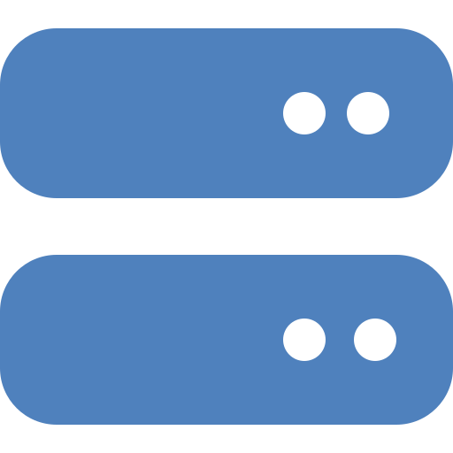
Consumer Groups: What & Why
Topic
Consumer Group (Group ID)
Producers
C1
C2
C3
• A consumer group consists of one or more consumers that share a group ID and divide partitions.
• It enables horizontal scalability — partitions are assigned to different consumers.
• The group coordinator tracks membership and offsets in the __consumer_offsets topic.
[1]

Slide 6
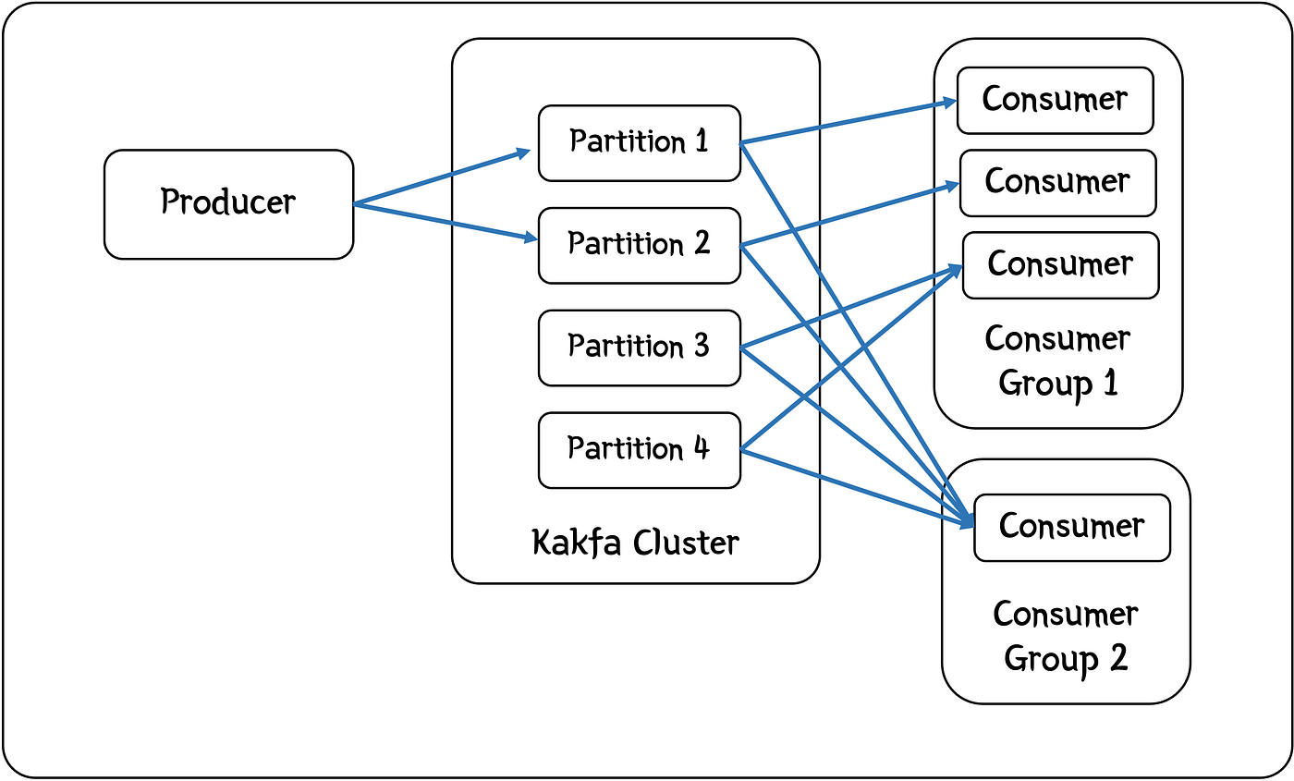
Read the Diagram: Consumer Groups Share Partition Work
Each consumer group receives its own view of the topic. Within one group, a partition is assigned to one active consumer at a time.
Use this picture before the assignment and rebalance exercise.
[1] Hodges, Medium, 1 Apr 2024; terms verified with Apache Kafka documentation

Slide 7
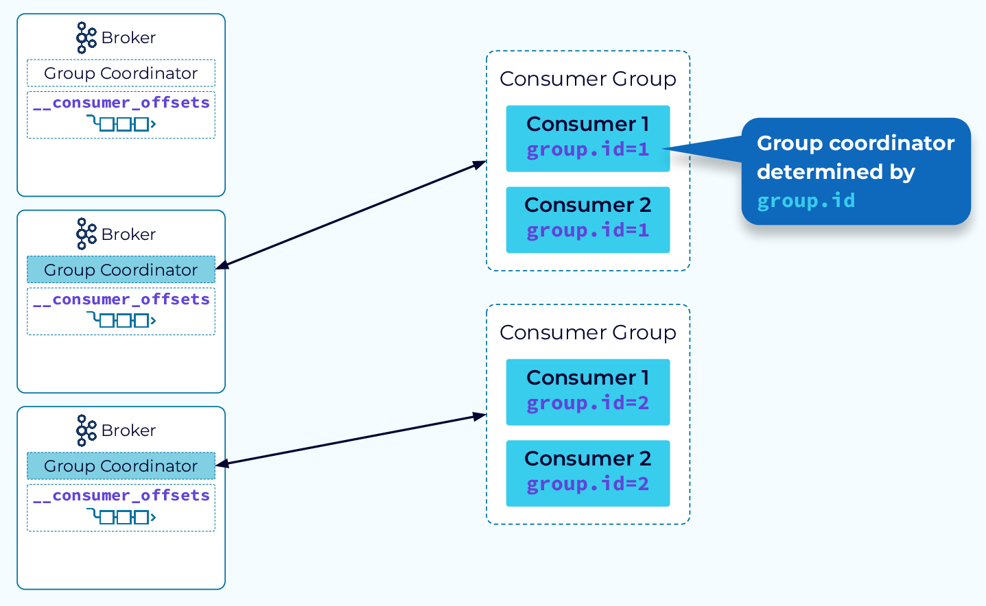
Group Coordinator: The Broker That Manages Membership
One broker coordinates each consumer group.
It tracks members, heartbeats and partition assignments.
It also manages committed offset writes into Kafka internal topics.
Source: Confluent consumer group architecture course.
[8]

Slide 8
Partition Assignment & Scaling
Strategy | Description | Pros / Cons
Range | Assigns consecutive partitions to consumers in order. | Simple; may cause skew if partitions vary.
Round‑Robin | Distributes partitions evenly across consumers. | Balances load; may reorder keys.
Sticky | Keeps previous assignments when possible. | Reduces rebalances but can cause skew.
Cooperative Sticky | Incremental reassignments; minimises disruption. | Recommended default since Kafka 2.4.
Scaling considerations:
• #Consumers ≤ #Partitions to fully utilise resources.
• Extra consumers remain idle when partitions are fewer than consumers.
• Increase partitions for throughput rather than consumer threads.
[1] [2]

Slide 9
Partitioning Strategies & Throughput
Strategies
• Round‑Robin: evenly distributes records across partitions; high variance and small batches.
• Key‑Based: hashes record keys to maintain order for a given key; potential hotspots.
• Sticky (default since 2.4): sends multiple batches to same partition before switching; improves throughput by forming larger batches.
[1] [2]

Slide 10
Rebalancing & Membership
Triggers for Rebalancing
Strategies
• Consumer joins or leaves the group
• Topic partitions are added or removed
• Heartbeats stop due to long processing or failure
Cooperative Rebalancing: Assign partitions incrementally; avoids stopping all consumers.
Static Membership: Set group.instance.id to persist assignments across restarts.
Tune session.timeout.ms, heartbeat.interval.ms, max.poll.interval.ms to avoid unnecessary rebalances.
[1] [2] [3]

Slide 11
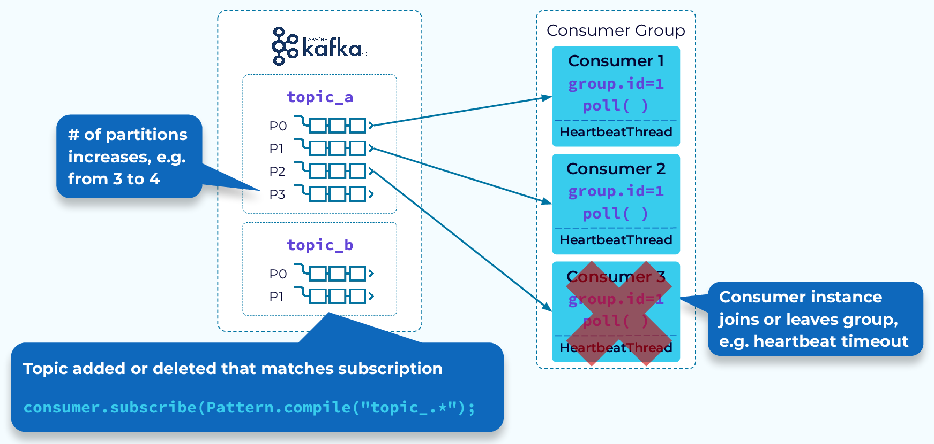
Rebalance Triggers: Why Work Moves Between Consumers
A join, leave, failure or partition-count change can trigger reassignment.
During a rebalance, ownership changes before normal polling resumes.
The lab evidence appears in group membership and lag, not only in app logs.
Source: Confluent consumer group protocol course.
[12]

Slide 12
Offset Management
There’s a moment in every Kafka system where everything looks fine — consumers are running, lag is low, throughput is healthy — and yet, quietly, data is being lost or duplicated.
That moment almost always traces back to one thing: offset management.
Offsets are deceptively simple. A number that says, “I’ve processed up to here.”
Kafka, committing an offset is not tied to processing. Kafka does not know if your business logic succeeded.
It only knows:
“The consumer claims it is safe to move forward.”
This creates three broad models:
Kafka decides (auto commit)
You decide (manual commit)
Kafka + you decide atomically (transactions)

Slide 13
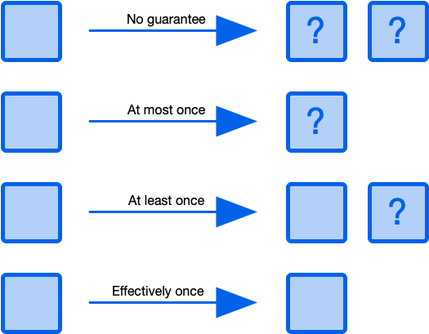
Process guarantee
At this point, you may be asking why is this so complicated? Why isn’t it always effectively once? What’s causing messages to go missing or appear more than once? The short answer to this is system behaviour in the face of failure. The key word in describing these architectures is distributed. Here is a small subset of failure scenarios that you will need to consider:
Producer failure
Consumer publish remote call failure
Messaging system failure
Consumer processing failure
Your consumer process could run out of memory and crash while writing to a downstream database; your broker could run out of disk space; a network partition may form between ZooKeeper instances; a timeout could occur publishing messages to Kafka.

Slide 14
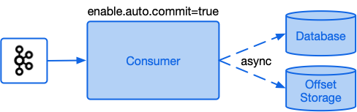
No guarantee
A system that provides no guarantee means any given message could be processed once, multiple times or not at all. With Kafka a simple search where you will end up with these semantics is if you have a consumer with enable.auto.commit set to true (this is the default) and for each batch of messages you asynchronously process and save the results to a database.

Slide 15
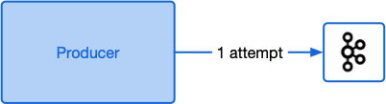
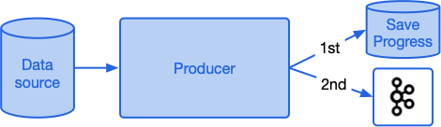
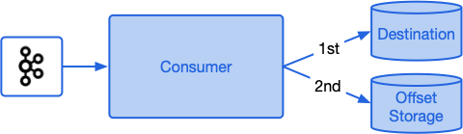
At most once guarantee means the message will be processed exactly once, or not at all. This guarantee is often known as “best effort” semantics.
1. A common example that results in at most once semantics is where a producer performs a ‘fire-and-forget’ approach sending a message to Kafka with no retries and ignoring any response from the broker. This approach is useful where progress is a higher priority than completeness.
At most once
At most once guarantee means the message will be processed exactly once, or not at all. This guarantee is often known as “best effort” semantics.
1. A common example that results in at most once semantics is where a producer performs a ‘fire-and-forget’ approach sending a message to Kafka with no retries and ignoring any response from the broker. This approach is useful where progress is a higher priority than completeness.
2. A producer saves its progress reading from a source system first, then writes data into Kafka. If the producer crashes before the second step, the data will never be delivered to Kafka.
3. A consumer receives a batch of messages from Kafka, transforms these and writes the results to a database. The consumer application has enable.auto.commit set to false and is programmed to commit their offsets back to Kafka prior to writing to the database. If the consumer fails after saving the offsets back to Kafka but before writing the data to the database, it will skip these records next time it runs and data will be lost.

Slide 16
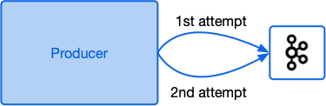
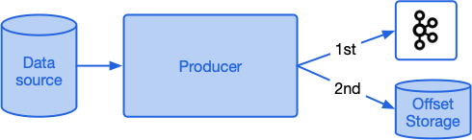
At least once
At least once guarantee means you will definitely receive and process every message, but you may process some messages additional times in the face of a failure. Here’s a few examples of some failure scenarios that can lead to at-least-once semantics:
1. An application sends a batch of messages to Kafka. The application never receives a response so sends the batch again. In this case it may have been the first batch was successfully saved, but the acknowledgement was lost, so the messages end up being added twice.
2. An application processes a large file containing events. It starts processing the file sending a message to Kafka for each event. Half way through processing the file the process dies and is restarted. It then starts processing the file again from the start and only marks it as processed when the whole file has been read. In this case the events from the first half of the file will be in Kafka twice.
3. A consumer receives a batch of messages from Kafka, transforms these and writes the results to a database. The consumer application has enable.auto.commit set to false and is programmed to commit their offsets back to Kafka once the database write succeeds. If the consumer fails after writing the data to the database but before saving the offsets back to Kafka, it will reprocess the same records next time it runs and save them to the database once more.

Slide 17
Offset Commit & Processing Guarantees
Commit Strategies
Processing Semantics
Auto Commit: Auto commit is the simplest approach where Kafka automatically commits offsets at regular intervals (default is every 5 seconds). When offsets committed periodically by the client there is risk of data loss if committed before processing.
Manual Commit: commit after processing a batch; ensures at‑least‑once delivery.
Synchronous vs Asynchronous commit; choose based on latency requirements.
At‑Most‑Once: commit before processing; possible data loss on failure.
At‑Least‑Once: commit after processing; duplicates possible if processing retried.
Exactly‑Once: use idempotent producers, transactions & isolation.level=read_committed; offsets committed within transaction.
[1]

Slide 18
Idempotent writes & Processing Guarantees
Idempotent writes
Transactions
Transactions give us the ability to atomically update data in multiple topic partitions. All the records included in a transaction will be successfully saved, or none of them will be.
Transactions are enabled through producer configuration. Clients need to first enable idempotent writes (enable.idempotence=true) and provide a transactional id (transactional.id=my-tx-id). The producer then needs to register itself with the Kafka cluster by calling initTransactions.
The transactional id is used to identify the same producer across process restarts. When reconnecting with the same transactional id, a producer will be assigned the same pid and an epoch number associated with that pid will be incremented. Kafka will then guarantee that any pending transactions from previous sessions for that pid will either be committed or aborted before the producer can send any new data. Any attempt by an old zombie instance of the producer with an older epoch number to perform operations will now fail.
One of the at least once guarantee scenarios given above covered the case of a producer that is unable to determine if a previous publish call succeeded, so pushes the batch of messages again. In previous versions of Kafka, the broker had no means of determining if the second batch is a retry of the previous batch. From Kafka 0.11 onwards, producers can opt-in to idempotent writes (it’s disabled by default), by setting the configuration
flag enable.idempotence to true.
This causes the client to request a producer id (pid) from a broker. The pid helps the Kafka cluster identify the producer. With idempotence enabled, the producer sends the pid along with a sequence number with each batch of records. The sequence number logically increases by one for each record sent by the same producer.
[1]

Slide 19
Producer Responsibilities & Delivery Semantics
• Serialise data into bytes (e.g. Avro, Protobuf, JSON).
Ack Mode | Guarantee | Trade‑Off
acks=0 | At‑Most‑Once | Fastest but risk data loss
acks=1 | At‑Least‑Once | May duplicate messages
acks=all | Exactly‑Once | Safest but slower; requires idempotence
• Determine partition (hash key, sticky or round‑robin).
• Batch messages and compress to maximise throughput.
• Configure acknowledgments to control durability.
[1] [2]

Slide 20
Exactly‑Once Processing with Transactions
• Enable idempotence and transactions on the producer: set enable.idempotence=true and transactional.id.
• Consumers now have an additional configuration parameter called isolation.level that must be set to either read_uncommitted(the default) or read_committed. When set to read_uncommitted, all messages are consumed as they become available in offset ordering. When set to read_committed, only messages not in a transaction, or messages from committed transactions are read in offset ordering
• On the consumer, set isolation.level=read_committed to avoid reading uncommitted records.
• Use Kafka’s transaction API to send messages and commit offsets atomically; if the transaction aborts, offsets are not committed.
• Combine with min.insync.replicas and acks=all for durability.
[1] [2]

Slide 21
Exactly-Once: Keep the Claim Precise
What Kafka can provide
What still belongs to the app
Idempotent producer removes duplicates caused by retries.
Transactions can atomically write output and commit consumed offsets.
Read-process-write Kafka pipelines can be made exactly-once.
External databases and APIs need idempotent writes.
Side effects outside Kafka must be designed carefully.
The lab uses manual commit to make progress visible.
[16]

Slide 22
Mini Exercise: Consumer Groups
Scenario:
You have 6 partitions in a topic and want to process them concurrently with consumer group G.
• If you launch 3 consumers, how many partitions does each get?
• What happens if you add a 4th consumer?
• Try this with the command:
kafka-console-consumer.sh --bootstrap-server localhost:9092 --topic mytopic --group G
Quick Quiz:
Q1. Which assignment strategy minimises disruption during rebalances?
a) Range
b) Round‑Robin
c) Sticky
d) Cooperative Sticky
Q2. To avoid unnecessary rebalances on pod restarts, which property should you configure?
a) session.timeout.ms
b) group.instance.id
c) max.poll.interval.ms
d) enable.idempotence
[1] [2]

Slide 23
Solution: Consumer Groups
Solution / trainer answer key
With 6 partitions and 3 consumers in one group, each consumer can receive about 2 partitions.
A seventh consumer in the same group would be idle if the topic still has only 6 partitions.
Different group IDs are independent subscribers and each group keeps its own committed offsets.
Cooperative sticky assignment usually minimizes disruption during rebalances.
[18]

Slide 24
Offsets & Internal Topics
Committed Offset
• Every record in a partition has a unique offset — its position in the log.
• The consumer group coordinator stores the last committed offset per partition in a compacted internal topic, __consumer_offsets.
• Upon restart, consumers resume from the committed offset, ensuring no messages are missed.
0
1
2
3
4
5
[1]

Slide 25
Committing Offsets
Auto Commit (enable.auto.commit=true)
• Offsets are periodically committed in the background.
• Simplicity comes at the cost of potential data loss on crash.
Manual Commit (enable.auto.commit=false)
• Application explicitly commits offsets after processing.
• Allows at‑least‑once delivery by placing commit after acking downstream.
Commit APIs
commitSync()
Waits for broker ack, blocks until commit is complete.
commitAsync()
Sends commit and continues; may reorder commits; handle errors in callback.
[1]

Slide 26
Offset Reset & Seeking
Resetting Offsets
• Set auto.offset.reset=earliest or latest to control where a new group starts.
• Use kafka-consumer-groups.sh --reset-offsets to rewind or skip offsets.
Seeking in the API
• consumer.seek(partition, offset) lets you reposition at a specific offset.
• consumer.seekToBeginning() / seekToEnd() can rewind or fast‑forward.
[1]

Slide 27
Monitoring Consumer Lag
Consumer Lag
• Lag is the difference between the latest offset in a partition and the last committed offset.
• Monitor lag to detect slow consumers or backlogs.
Monitoring Tools
• kafka-consumer-groups.sh --describe: CLI tool to list lag per group.
• Kafka metrics (records-lag, records-lag-max) via JMX or Prometheus.
• UI tools (Confluent Control Center, Burrow, Conduktor) provide dashboards for lag.
[1]

Slide 28
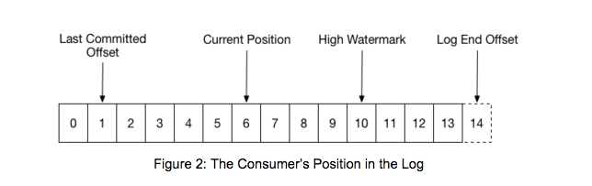
Consumer Position: Current, Committed, High Watermark
Current position is what the consumer has fetched.
Committed offset is the durable group bookmark.
Lag compares committed progress with the log end.
Source: Confluent consumer design documentation.
[23]

Slide 29
Mini Exercise: Offsets & Lag
Exercise:
1. Produce 100 messages to a topic.
2. Start a consumer group and pause for a minute before committing offsets.
3. Use kafka-consumer-groups.sh --describe to observe lag and committed offsets.
4. Reset offsets to earliest and observe message replay.
Quick Quiz:
Q3. Where are committed offsets stored?
a) __consumer_offsets internal topic
b) Each partition log
c) An external database
d) Zookeeper
Q4. Which setting controls where a new consumer group starts reading?
a) enable.auto.commit
b) auto.offset.reset
c) session.timeout.ms
d) max.poll.records
[1]

Slide 30
Solution: Offsets and Lag
Committed offsets are stored in the internal __consumer_offsets topic.
Lag = log end offset minus the consumer group's committed offset for a partition.
auto.offset.reset applies only when the group has no committed offset.
Resetting offsets is useful for replay, but replay can repeat downstream side effects.
Q5. With RF=3 and min.insync.replicas=2, how many broker failures can you tolerate without losing write availability?
Answer: b) 1
With replication factor 3, there are 3 replicas. With min.insync.replicas=2, Kafka needs at least 2 in-sync replicas available to accept writes when producer acks=all is used. So you can lose 1 broker and still continue writing.
Q6. What is the effect of setting unclean.leader.election.enable=true?
Answer: b) Faster failover; non-ISR replicas can become leader risking data loss
This setting allows Kafka to elect a replica that is not in the ISR as leader. It can restore availability faster, but it may lose messages that were not replicated to that out-of-sync replica.
[25]

Slide 31
CLI Evidence: Describe a Consumer Group
The same idea appears in the lab as CURRENT-OFFSET, LOG-END-OFFSET and LAG.
Run: kafka-consumer-groups --describe --group cg-day3-python
CURRENT-OFFSET shows the committed group bookmark.
LOG-END-OFFSET shows the latest topic position.
LAG is the work still waiting for that group.
[26]

Slide 32
Replication & Leaders
• When a topic is created, you specify a replication factor; e.g., RF=3 means each partition has one leader and two followers.
• The leader handles all reads and writes; followers replicate data from the leader.
• On leader failure, a follower in the ISR becomes the new leader automatically.
Leader
Follower
Follower
[1]

Slide 33
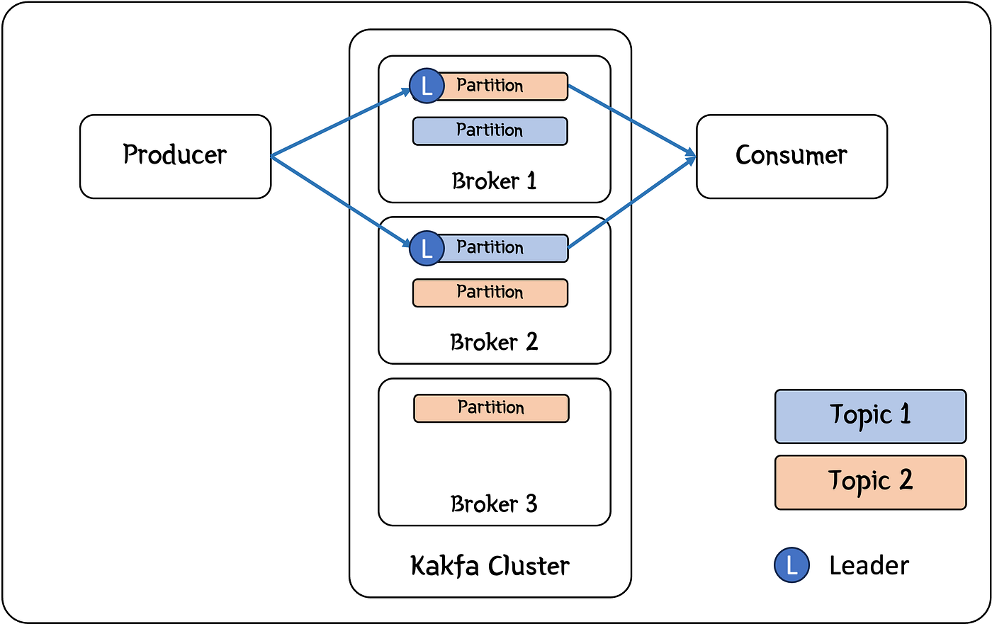
Read the Diagram: Replicas Live on Different Brokers
A partition leader accepts client traffic; replicas on other brokers provide fault tolerance.
Replication protects availability and durability; it does not add independent ordering lanes.
[1] Hodges, Medium, 1 Apr 2024; terms verified with Apache Kafka documentation

Slide 34
In‑Sync Replicas (ISR)
• Followers in the ISR have caught up to the leader’s high watermark within replica.lag.time.max.ms.
• Only ISR members are eligible for leadership on failover.
• min.insync.replicas defines how many replicas (including leader) must be in sync to acknowledge writes when acks=all.
Failures Tolerated
[1]

Slide 35
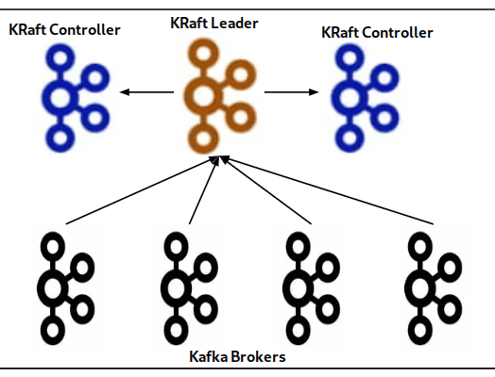
Automatic Failover & KRaft
• The controller quorum detects leader failure and elects a new leader from ISR within seconds.
• KRaft (Kafka Raft) removes ZooKeeper. Controllers use the Raft consensus protocol to manage metadata.
• Faster leader elections and unified storage of metadata reduce failover times.
• Configure dedicated controller nodes and distribute them across availability zones for resilience.
[1]

Slide 36
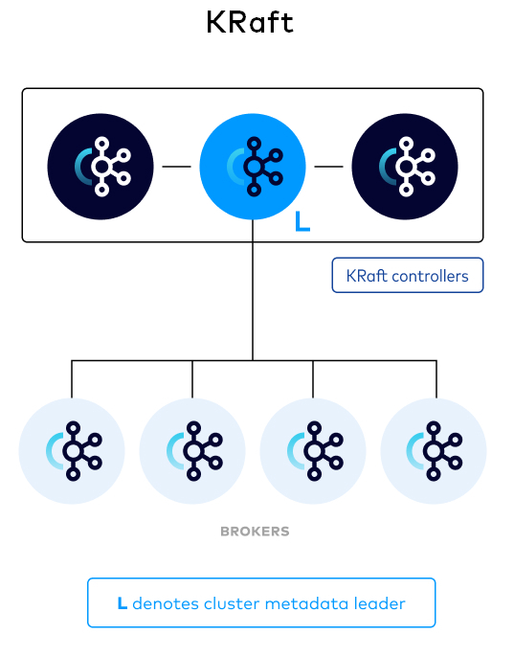
KRaft Controller Quorum: Metadata Has Its Own Log
KRaft removes ZooKeeper by storing metadata in a Raft quorum.
Controllers manage broker registration, topic metadata and leader election.
The lab runs combined broker/controller nodes for local simplicity.
Source: Confluent KRaft overview.
[31]

Slide 37
Configuration Best Practices
Replication Factor
• Use RF≥3 in production to tolerate at least one broker failure.
min.insync.replicas
• Set to RF−1 (e.g., 2 for RF=3) so writes are acknowledged by multiple replicas.
Producer Settings
• Use acks=all for durability; enable.idempotence=true to avoid duplicates; set retries to Integer.MAX_VALUE.
• Limit max.in.flight.requests.per.connection to 5 or fewer when idempotence is enabled.
[1] [2] [3]

Slide 38
Rack Awareness & Unclean Leader Election
Rack Awareness
• Assign replicas across different racks or availability zones using broker.rack property.
• Ensures that a zone failure doesn’t take down all replicas for a partition.
Unclean Leader Election
• If all ISR replicas fail, unclean leader election determines whether a non‑ISR replica can become leader.
• Setting unclean.leader.election.enable=false favours consistency (no data loss) over availability.
Broker 1
Broker 2
Broker 3
AZ1 AZ2 AZ3
[1] [2]

Slide 39
Mini Exercise: Replication & High Availability
Exercise:
1. Create a topic with replication factor 3 and partitions 3.
2. Produce messages with acks=all and observe behaviour when a broker is stopped.
3. Try setting min.insync.replicas=1 and compare.
4. Test unclean leader election by toggling unclean.leader.election.enable.
Quick Quiz:
Q5. With RF=3 and min.insync.replicas=2, how many broker failures can you tolerate without losing write availability?
a) 0
b) 1
c) 2
d) 3
Q6. What is the effect of setting unclean.leader.election.enable=true?
a) Better consistency; leaders elected only from ISR
b) Faster failover; non‑ISR replicas can become leader risking data loss
c) Slower failover
d) No effect
[1] [2]

Slide 40
Solution: Replication and High Availability
With RF=3 and min.insync.replicas=2, Kafka can usually tolerate one broker failure for acks=all writes.
The leader handles client traffic; followers replicate from the leader.
Only in-sync replicas are safe candidates for clean leadership.
KRaft manages metadata and leader election without ZooKeeper.
[35]

Slide 41
Day 3 Replication Lab: What the Commands Prove
The lab command sequence turns RF, ISR and acks=all into visible terminal evidence.
Create RF=3
Describe ISR
Produce acks=all
Stop broker
Describe again
Do not treat this as a new topic-creation lesson; Day 2 already did that.
The Day 3 proof is leader placement, full ISR and durable producer acknowledgement.
[36]

Slide 42
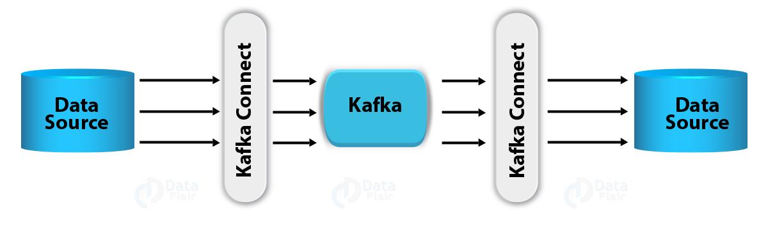
Kafka Connect: Overview & Architecture
• Kafka Connect is a framework for streaming data between Kafka and external systems.
• Runs as a cluster of workers that execute connectors and tasks.
• Connectors define what to copy; tasks perform the data movement; converters and SMTs handle formats and transformations.
[1]

Slide 43
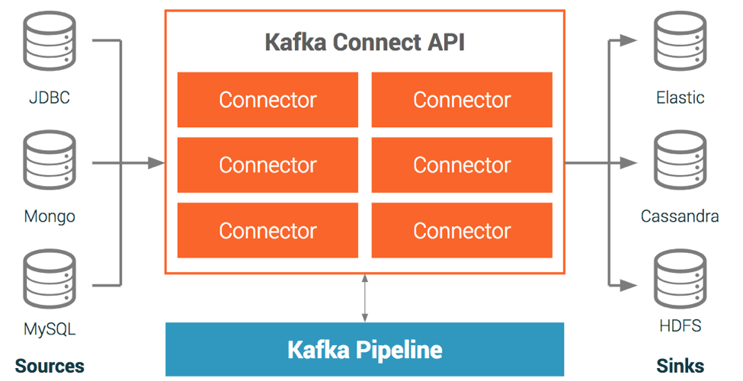
Source Connectors
• Bring data from external systems into Kafka topics.
• Must manage offsets to avoid duplicates and ensure exactly‑once delivery.
• Support various ingestion patterns: query‑based polling, CDC (binlogs/WAL), file tailing, API polling.
• Examples: JDBC, Debezium, SpoolDir, HTTP.
[1]

Slide 44
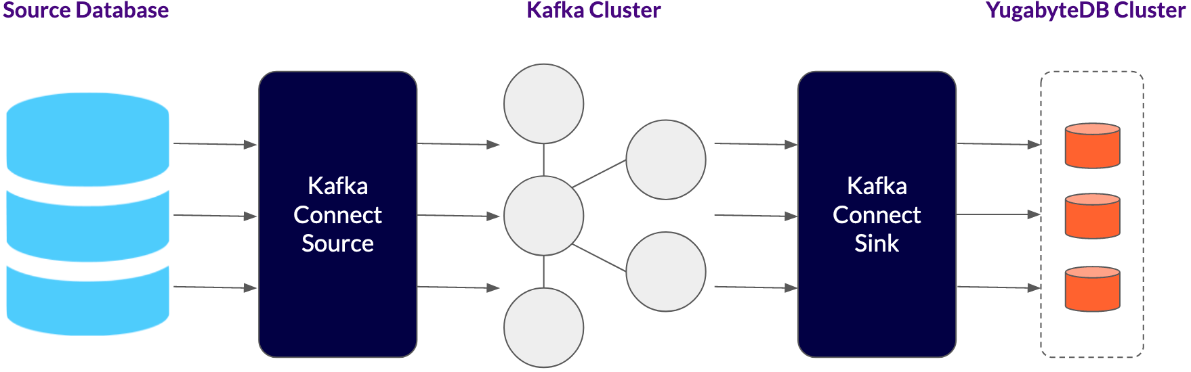
Sink Connectors
• Read from Kafka topics and write to external systems.
• Operate as Kafka consumers; commit offsets back to Kafka to track progress.
• Common patterns: load data into data lakes/warehouses (e.g., S3, GCS), index data into search engines (Elasticsearch), upsert into databases, invoke HTTP APIs.
• Sink connectors must manage idempotency on the destination to achieve exactly‑once semantics.
[1]

Slide 45
Connect Modes & Scaling
Standalone Mode
• Single process runs connectors and tasks; ideal for development.
Distributed Mode
• Multiple worker processes coordinate through Kafka topics; tasks are rebalanced across workers.
• Provides fault tolerance and horizontal scalability.
Scaling Considerations
• Increase tasks per connector to parallelise work.
• Use multiple workers to distribute tasks; tasks are automatically assigned via internal group management.
Worker 1
Worker 2
Worker 3
Kafka
[1] [2]

Slide 46
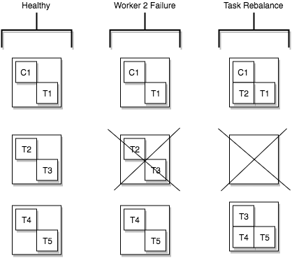
Connect Task Failover: Tasks Are the Work Units
Connectors define the job; tasks perform the data movement.
Distributed workers rebalance tasks when workers join, leave or fail.
The lab uses one worker, but the status model is the same.
Source: Confluent Kafka Connect design documentation.
[41]

Slide 47
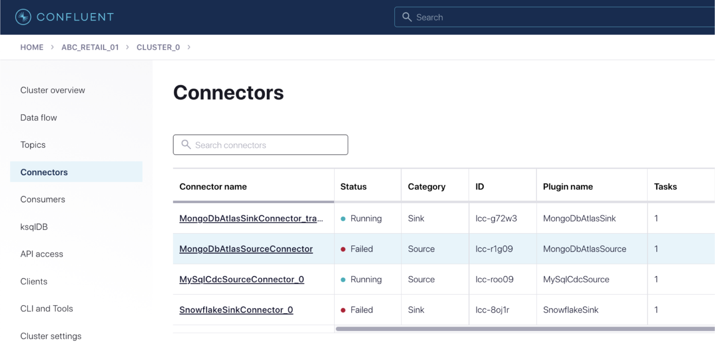

Slide 48
Example: JDBC Source Connector
The JSON below shows a basic configuration for a JDBC source connector that ingests data from PostgreSQL.
{
"name": "postgres-source-connector",
"config": {
"connector.class": "io.confluent.connect.jdbc.JdbcSourceConnector",
"tasks.max": "3",
"connection.url": "jdbc:postgresql://postgres:5432/mydb",
"connection.user": "${secrets:postgres:username}",
"connection.password": "${secrets:postgres:password}",
"mode": "incrementing",
"incrementing.column.name": "id",
"topic.prefix": "postgres-",
"table.whitelist": "orders,customers,products",
"poll.interval.ms": "1000",
"batch.max.rows": "1000"
}
}
[1]

Slide 49
Connector Config Fields Learners Should Read First
Source connector
Sink connector
connector.class names the source plugin.
file is the external input path.
topic is where records enter Kafka.
connector.class names the sink plugin.
topics is the Kafka input.
file is the external output path.
[43]

Slide 50
Mini Exercise: Configure a Connector
Exercise:
1. Use the REST API to deploy the JDBC source connector shown on the previous slide.
2. Verify that records are streaming into the postgres-orders topic.
3. Modify the configuration to ingest only the orders table and change poll interval to 5000 ms.
Quick Quiz:
Q7. Which component in Kafka Connect performs the actual data movement?
a) Worker
b) Connector
c) Task
d) Converter
Q8. Which ingestion pattern provides low‑latency streaming of database changes?
a) Query‑based polling
b) CDC using WAL/binlog
c) API polling
d) File tailing
[1] [2]

Slide 51
Solution: Configure a Connector
Q7. Which component in Kafka Connect performs the actual data movement?
Answer: c) Task
A Connector defines what data source/sink to use and creates one or more Tasks. The Tasks do the actual work of copying/moving data.
Q8. Which ingestion pattern provides low-latency streaming of database changes?
Answer: b) CDC using WAL/binlog
CDC reads database change logs such as WAL in PostgreSQL or binlog in MySQL, so changes can be streamed to Kafka with low latency.
[45]

Slide 52
Lab Topology: Ubuntu Host to Kafka and Back
Your supplied Docker Compose lab:
- Starts one KRaft broker and one Kafka Connect worker.
- Exposes Connect REST at localhost:8083.
- Source: /data/input/produce.txt -> topic fs-source.
- Sink: topic fs-source -> /data/output/consume.txt.
Distributed Connect stores config, offsets and status in Kafka topics.
/data/input
Connect :8083
Kafka fs-source
/data/output
[1] [2]

Slide 53
Client-Ready Lab Topology: Three Brokers Plus Connect
The refreshed lab keeps the original FileStream idea but runs it beside a visible replicated Kafka cluster.
Producer
Broker 1/2/3
Connect
fs-source
Output file
Python clients use localhost:9092.
Kafka UI is localhost:8080 and Connect REST is localhost:8083.
Connect talks to brokers on the Docker network: broker1:29092, broker2:29092, broker3:29092.
[47]

Slide 54
Lab 1: FileStream Source Connector
This supplied configuration reads each new line from the mounted input file and publishes it to Kafka topic fs-source.
{
"name": "fs-source-connector",
"config": {
"connector.class":
"org.apache.kafka.connect.file.FileStreamSourceConnector",
"file": "/data/input/produce.txt",
"topic": "fs-source",
"tasks.max": "1"
}
}
[1]

Slide 55
Lab 2: FileStream Sink Connector
The sink reads records from Kafka topic fs-source and writes the visible output file. It is the other direction of movement.
{
"name": "fs-sink-connector",
"config": {
"connector.class":
"org.apache.kafka.connect.file.FileStreamSinkConnector",
"topics": "fs-source",
"file": "/data/output/consume.txt",
"tasks.max": "1"
}
}
[1]

Slide 56
Lab 3: Register Connectors Through REST
Run on Ubuntu from the lab-code folder:
1. docker compose up -d
2. curl http://localhost:8083/connector-plugins
3. curl -X POST -H "Content-Type: application/json"
--data @connector-source.json http://localhost:8083/connectors
4. Repeat the POST with connector-sink.json.
Explain Before You Run:
Which part of each request defines direction?
Source configuration:
file -> topic
Sink configuration:
topics -> file
Evidence required: both connector names appear from GET /connectors.
[1] [2]

Slide 57
Kafka UI Evidence: What Learners Should Capture
The terminal proves commands worked; Kafka UI proves learners can inspect the system.
Topics: orders-replicated and fs-source are present.
Messages: keys, values, partitions and offsets are visible.
Consumer Groups: lag and committed offsets are visible.
Connect: source and sink connector tasks are RUNNING.
Brokers: replicated topics show leaders and ISR.
[51]

Slide 58
Lab 4: Prove the Round Trip
Collect evidence in this order:
1. GET /connectors/fs-source-connector/status
2. GET /connectors/fs-sink-connector/status
3. Consume topic fs-source from the beginning.
4. cat data/output/consume.txt
5. Trace one line: input file -> Kafka topic -> output file.
Evidence Check:
RUNNING is necessary, but is it sufficient?
No. Status proves the task is alive.
Topic consumption proves ingestion.
Output file proves the sink path.
Capture all three before declaring success.
[1] [2]

Slide 59
Connect Status Is Necessary, Not Sufficient
Status checks
Data-path checks
GET /connectors/{name}/status
Connector state is RUNNING.
Task state is RUNNING.
Consume records from fs-source.
Read data/output/consume.txt.
Append a new input line and observe one new output line.
[53]

Slide 60
Knowledge Check: Lab Evidence
Answer before moving to the next section.
Q1. Which command proves a consumer group is caught up: topic describe or consumer-groups describe?
Q2. Which evidence proves Connect source ingestion: connector RUNNING, fs-source records, or both?
Q3. Which file proves the sink connector wrote output?
Q4. Why should Kafka UI be used after terminal commands?
[54]

Slide 61
Solution: Lab Evidence
Solution / trainer answer key
Q1. consumer-groups describe shows CURRENT-OFFSET, LOG-END-OFFSET and LAG.
Q2. Both matter: RUNNING proves the task is alive; fs-source records prove ingestion.
Q3. data/output/consume.txt proves sink output in this lab.
Q4. Kafka UI verifies the same state visually: topics, messages, groups, brokers and connectors.
[55]

Slide 62
Connector Offsets: A Different Bookmark
Consumer offset
- A consumer group's resume position inside a Kafka partition.
- Kafka stores committed group progress in __consumer_offsets.
Source connector offset
- The external input position a source task has already processed.
- Distributed Connect stores source progress in connect-offsets.
Lab observation
- Append one new line, restart Connect, and prove only new input moves.
[1]

Slide 63
Lab 5: Restart and Recovery Test
Exercise:
1. Append an order-004 line to data/input/produce.txt.
2. Confirm it appears once in data/output/consume.txt.
3. Run: docker restart connect
4. Append order-005 after the worker returns.
5. Confirm continuation without replaying older lines.
Recovery Question:
What remembers the source file position in distributed mode?
a) connect-offsets topic
b) only the output file
c) Schema Registry
d) MirrorMaker
Answer: a. Rewinding that position may repeat downstream effects.
[1]

Slide 64
Lab 6: Diagnose a Failed Connector
Troubleshooting route:
1. GET /connectors/{name}/status and read task state.
2. Check GET /connector-plugins for FileStream support.
3. Inspect docker logs connect.
4. Verify mounted file paths and permissions.
5. Consume fs-source to locate the broken boundary.
Incident Check:
The source connector exists, but the topic is empty.
What is the first useful check?
Answer: read source task status and its error trace.
Do not restart blindly; locate the first missing evidence.
[1] [2]

Slide 65
Troubleshooting Route for the Day 3 Lab
Use this order so learners do not jump randomly between logs.
1. docker compose ps: confirm services are running.
2. curl /connector-plugins: confirm FileStream plugins exist.
3. GET connector status: read connector and task state.
4. Consume fs-source: prove ingestion into Kafka.
5. Read consume.txt: prove sink output.
[59]

Slide 66
Kafka Ecosystem Overview
Streams
Connect
• Kafka Core: brokers, topics, logs, partitions and MirrorMaker.
• Kafka Streams: library for building real‑time stream processing applications in Java.
• Kafka Connect: connector API for ingesting and exporting data.
• Schema Registry: central repository for Avro/JSON/Protobuf schemas.
• REST Proxy: produce and consume records via HTTP.
• MirrorMaker & Replicator: replicate topics between clusters.
Kafka Core
Schema Registry
REST Proxy
MirrorMaker
[1]

Slide 67
Kafka Streams API
• Kafka Streams is a Java library to build event streaming applications.
• Provides high‑level DSL for map, filter, aggregate, join and window operations.
• Manages state and fault tolerance using changelog topics and internal state stores.
• Runs inside your application — no separate cluster required.
[1]

Slide 68
ksqlDB: Streaming SQL
• ksqlDB is Kafka’s SQL engine enabling real‑time querying of streams.
• Use simple SQL statements to filter, transform, join and aggregate streaming data.
• Create persistent streams and tables for continuous processing.
• Ideal for rapid prototyping and dashboards; for complex logic, prefer the Streams API.
CREATE STREAM rides_stream AS
SELECT rider_id, trip_distance
FROM rides_topic
EMIT CHANGES;
[1] [2]

Slide 69
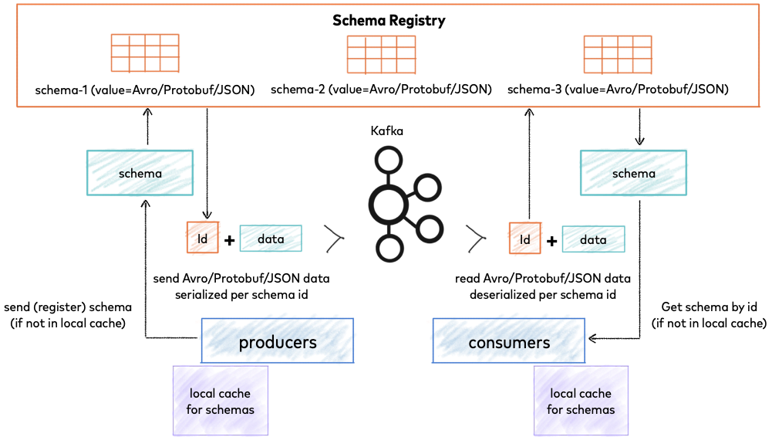
• Central repository for Avro, JSON Schema and Protobuf schemas.
• Validates and stores schemas, enforcing compatibility rules as schemas evolve.
• Allows producers and consumers to exchange data using IDs rather than full schemas, reducing payload size.
• Supports versioning and schema evolution; integrates with Connect, ksqlDB, and REST Proxy.
Schema Registry
[1] [2]

Slide 70
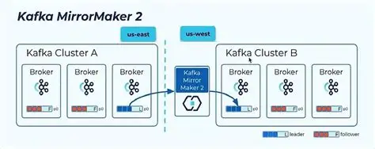
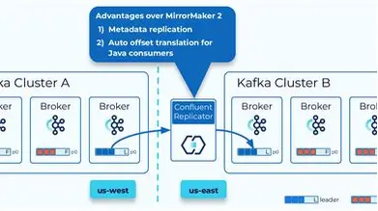
MirrorMaker & Replicator
MirrorMaker
• It is a tool provided by Apache Kafka that allows you to maintain a replica of an existing Kafka cluster. It uses a Kafka consumer to consume messages from the source cluster and re-publishes those messages to the target (mirror) cluster using an embedded Kafka producer.
• Built on Kafka Connect; uses MirrorSource, MirrorCheckpoint and MirrorHeartbeat connectors.
• Replicates topic data, configurations and consumer offsets across clusters.
Confluent Replicator
• It is a proprietary connector designed to replicate topics and their data from one Kafka cluster to another.
• Commercial tool with tighter Schema Registry integration and provenance headers to prevent loops.
• Provides topic and ACL sync, schema migration, and can translate consumer offsets.
[1] [2]

Slide 71
Knowledge check - 1
Match the following tool to its primary use case:
• Kafka Streams
• ksqlDB
• Schema Registry
• MirrorMaker
• REST Proxy
• Kafka Connect
A. Replicating data between clusters
B. Managing data schemas and compatibility
C. Creating SQL‑based streaming pipelines
D. Building clientless producers/consumers over HTTP
E. High‑level Java API for processing streams
F. Ingesting and exporting data between systems
[1] [2] [3] [4]

Slide 72
Solution:
Kafka Streams: Java library for stateful stream processing applications.
ksqlDB: SQL interface for streams and tables.
Schema Registry: central schema storage and compatibility enforcement.
MirrorMaker 2: cross-cluster replication built on Kafka Connect.
Kafka Connect: managed integration framework for source and sink connectors.
[66]

Slide 73
Knowledge check - 2
Which tool would you choose for performing interactive SQL queries on streaming data?
a) Kafka Streams
b) ksqlDB
c) Schema Registry
d) MirrorMaker
Which component ensures that producers and consumers use compatible data formats?
a) Kafka Connect
b) Kafka Streams
c) Schema Registry
d) REST Proxy

Slide 74
Solution:
Which tool would you choose for performing interactive SQL queries on streaming data?
Answer: b) ksqlDB
ksqlDB lets you write SQL-like queries on Kafka topics, so it is used for interactive streaming analytics.
Which component ensures that producers and consumers use compatible data formats?
Answer: c) Schema Registry
Schema Registry stores and validates schemas like Avro, Protobuf, or JSON Schema so producers and consumers remain compatible.

Slide 75
Knowledge Check- 3
Q1. Which service exposes REST endpoints for connector lifecycle?
Q2. Which internal topic stores consumer group committed offsets?
Q3. Which setting tells the producer to wait for all required in-sync replicas?
Q4. Which lab output proves the FileStream sink connector worked?
[67]

Slide 76
Solution: Deployment View
Solution / trainer answer key
Q1. Kafka Connect REST exposes connector lifecycle endpoints.
Q2. __consumer_offsets stores committed group progress.
Q3. acks=all makes the producer wait for required in-sync replicas.
Q4. data/output/consume.txt proves the FileStream sink wrote records.
[68]

Slide 77
Recap & Next Steps
Today you learned:
- How consumer groups, offsets, ISR and KRaft protect event movement.
- How Kafka Connect workers, connectors and tasks divide responsibility.
- How to deploy FileStream source and sink connectors with REST on Ubuntu.
- How to prove file -> Kafka -> file movement and test recovery using connect-offsets.
- Where Streams, ksqlDB, Schema Registry and MirrorMaker fit in the wider platform.
Tomorrow (Day 4):
- Replace the visible file source with database changes using Debezium CDC.
- Reuse today's status and offset reasoning when events originate in a database.
[1]

Slide 78
Quick Recap: Five Sentences to Carry Forward
Carry-forward points before the next section.
1
Consumer groups scale reads, but partition count sets the ceiling.
2
Offsets are progress bookmarks, not proof that side effects are safe.
3
Replication protects availability only when enough replicas remain in sync.
4
Kafka Connect turns integration into managed connector tasks.
5
Good lab evidence combines terminal output, Kafka UI state and data-path proof.
[70]

