Slide 1
Day 2
Apache Kafka Fundamentals on Ubuntu
Events, Topics, Partitions, Brokers and Hands-on Labs
Data Engineering Workshop
Week 1 | Eight-hour instructor-led day

Slide 2






Learning Objectives
Explain event streaming in plain language and identify a useful event.
Trace a record from producer to topic, partition, broker and consumer.
Predict ordering and parallelism when keys and partitions change.
Run a single-broker Kafka KRaft environment on an Ubuntu host.
Create topics and prove message flow with CLI and Python clients.
Compare batch collection with real-time ingestion before Day 3.
[1] Course roadmap; Apache Kafka documentation

Slide 3
Agenda | Eight-Hour Teaching Plan
09:00
Recap + events
Why Kafka exists
10:00
Architecture
Topics and partitions
11:30
Deployment
Broker + KRaft lab
13:30
CLI labs
Produce and consume
15:00
Python labs
Keys and JSON
16:30
Challenge + recap
Evidence and handoff
[1] Includes short breaks and guided mini exercises

Slide 4
Quick Recap: What Changed Since Day 1?
Day 1 batch file
Day 2 event stream
- A saved file captures a completed set.
- The reader waits for the next file.
- Good for scheduled movement.
- A new record can arrive now.
- Readers can react continuously.
- Good for changing operational facts.
[1] Apache Kafka documentation

Slide 5
Events Begin With a Human Question
A fact that changed
An event record
order-104 was paid
shipment-88 departed
sensor-17 exceeded threshold
what happened + when + business key + values needed by a reader
[1] Apache Kafka documentation

Slide 6
Tightly Coupled vs Loosely Coupled
Direct call
Event handoff
Checkout calls inventory now.
If inventory is down, checkout waits or fails.
Checkout publishes OrderPaid.
Inventory reacts when ready; Kafka holds the fact.
[1] Apache Kafka documentation

Slide 7
Mini Exercise 1: Is It an Event?
In pairs, classify each item:
1. Daily customer.csv export
2. PaymentReceived at 10:03:04
3. Weekly report PDF
4. TruckArrived at gate 2
Then write one event name of your own.
Quick Check:
Which two items deserve immediate consumers?
What business key would you put on each event?
[1] Apache Kafka documentation

Slide 8
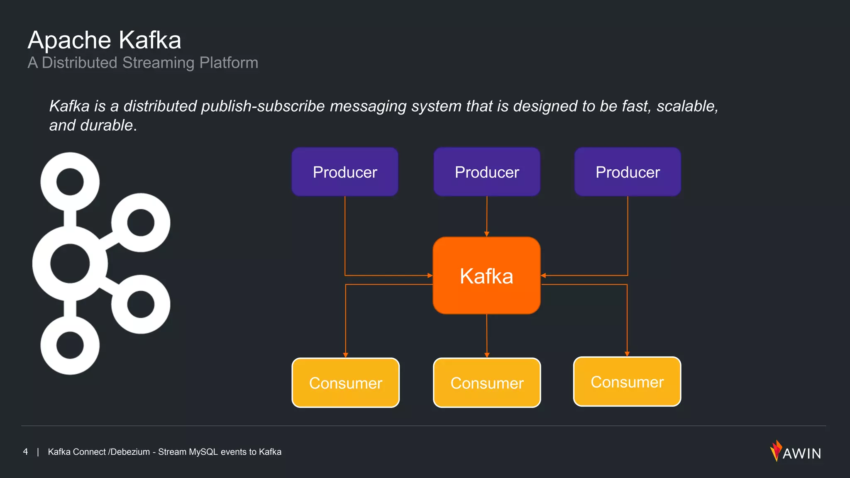
Pub Sub Architecture
Producers
Applications that send records to Kafka topics. Producers serialise data, choose partitions, batch records and specify delivery guarantees.
Consumers
Applications that read records from topics. Consumers maintain offsets, support manual or automatic commits, and coordinate within consumer groups for parallelism.
[1] [2]

Slide 9
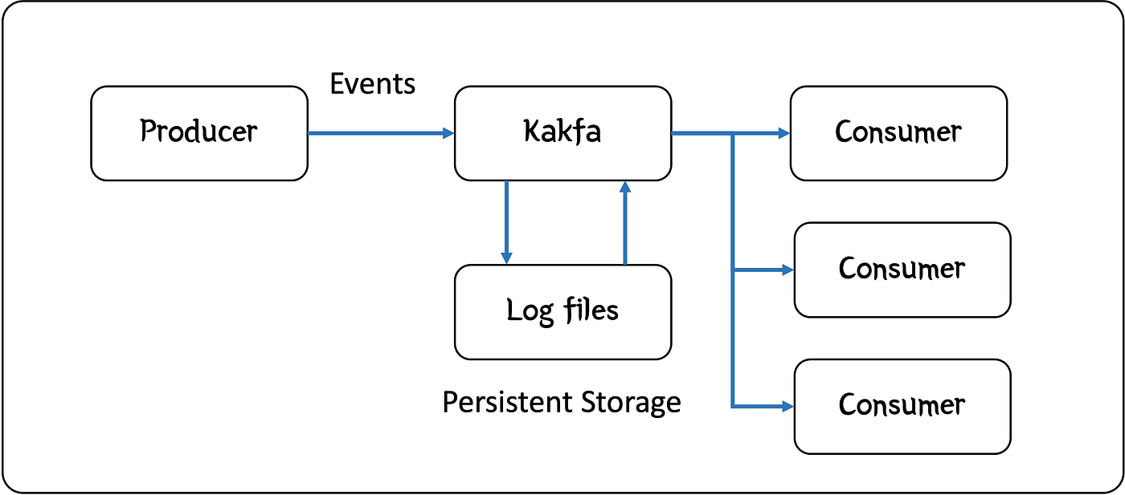
Read Kafka From the Message Perspective
A producer publishes a record. Kafka stores it in a durable log. A consumer reads it later or continuously.
Beginner rule: Kafka is not a phone call; the stored event remains available according to retention.
[1] Hodges, Medium, 1 Apr 2024; verified with Apache Kafka documentation

Slide 10
A Kafka Record Has Data and Delivery Metadata
Payload
Metadata
{"order_id": 104,
"status": "PAID",
"total": 850.00}
topic | partition | offset
key | timestamp | headers
The broker assigns position in a partition.
[1] Apache Kafka documentation

Slide 11


Serialization Fundamentals
Why serialise?
Kafka transports records as bytes. Producers must convert objects (e.g. JSON, Avro) into bytes, and consumers must interpret them. The choice of format impacts performance, compatibility and evolvability.
Schema registry
A schema registry stores versioned schemas centrally. Producers embed a schema ID in each message; consumers fetch the correct schema to deserialise data. Compatibility modes (backward, forward, full) govern how schemas evolve.
Record
Schema Registry
[1] [2] [3]

Slide 12
Comparing Serialization Formats
Avro
Protobuf
JSON Schema
• Binary encoding; small messages
• Compact binary encoding with field numbers
• Human‑readable data and schema
• Schema stored separately; dynamic typing
• Code generation provides strong typing
• Rich validation capabilities
• Excellent schema evolution support
• Schema evolution via reserved field numbers
• Less efficient; larger messages
• Popular in analytical lakes & Kafka
• Great for microservices and multi‑language
• Useful for APIs and configuration
[1] [2] [3]

Slide 13
Schema Evolution & Compatibility
Backward compatibility
Consumers using new schema can read data produced with an older schema. Typically upgrade consumers first.
Forward compatibility
Consumers using old schema can read data produced with a newer schema. Producers upgrade first.
Full compatibility
Both backward and forward compatible. Adds restrictions to ensure both directions work.
Producer v1
Schema change
Producer v2
Consumer v1
Upgrade
Consumer v2
[1]

Slide 14
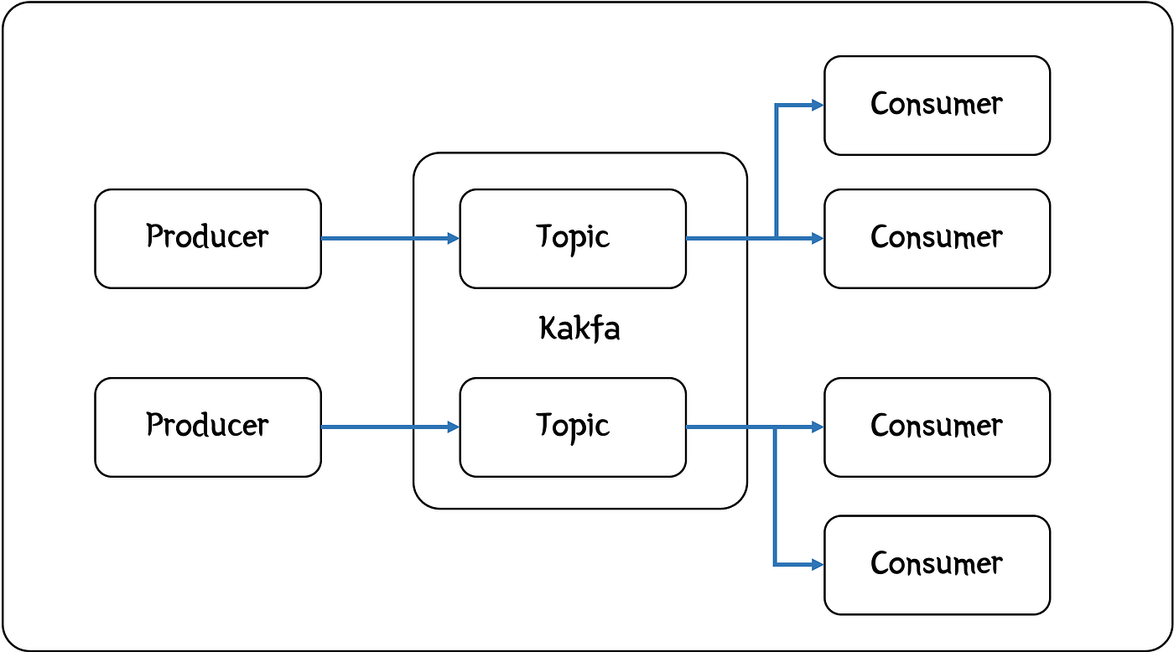
Topic = A Named Stream of Related Events
A topic lets a consumer subscribe to useful events rather than inspect everything.
Examples: order-paid, shipment-status, inventory-adjusted.
[1] Hodges, Medium, 1 Apr 2024; verified with Apache Kafka documentation

Slide 15
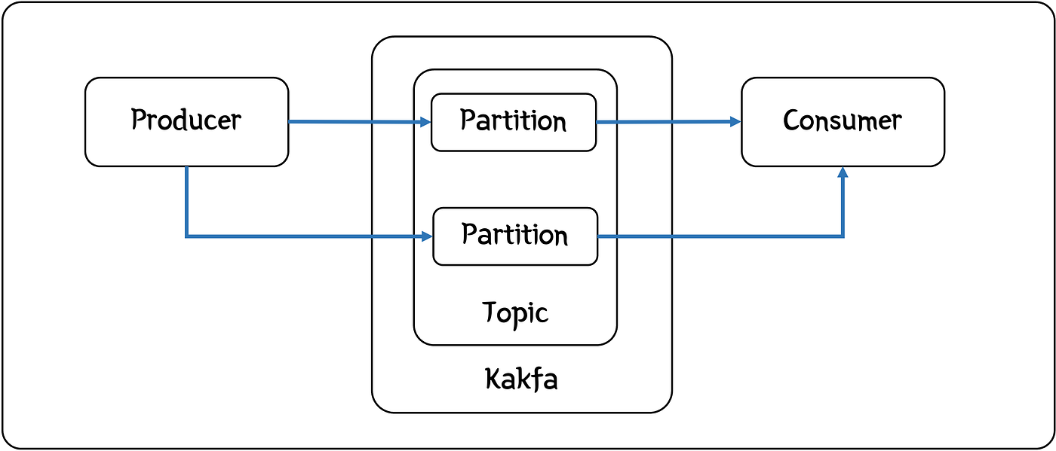
Partition = One Ordered Lane Inside a Topic
Partitions increase parallel throughput. Records are ordered inside one partition, not globally across every partition.
That single sentence prevents many design mistakes.
[1] Hodges, Medium, 1 Apr 2024; verified with Apache Kafka documentation

Slide 16
Ordering: What Kafka Guarantees
Guaranteed
Not guaranteed
Within partition 0:
offset 0 -> offset 1 -> offset 2
Consumers read that lane in order.
Partition 0 and partition 1 may be processed at different speeds.
No global event order across lanes.
[1] Apache Kafka documentation

Slide 17
Keys Keep Related Changes in One Lane
Key = order_id
No useful key
All updates for order-104 hash to the same partition.
PAID -> PACKED -> SHIPPED stays ordered.
Records can spread for throughput.
Updates for one entity may be observed in different lanes.
[1] Apache Kafka documentation

Slide 18
Mini Exercise 2: Predict the Partition Decision
Topic shipment-status has 3 partitions.
Events carry keys: SHIP-01, SHIP-02, SHIP-01, SHIP-03.
Sketch three lanes and place the events conceptually.
Quick Check:
Must both SHIP-01 records share a partition?
Can you claim SHIP-02 happened before SHIP-03 globally?
Explain in one sentence.
[1] Apache Kafka documentation

Slide 19
Kafka Deployment View: From Clients to a Broker
The message view explains records. The deployment view explains where records live.
In today's lab, one broker is enough to observe mechanics.
Producer
Broker :9092
Topic partitions
Consumer
[1] Apache Kafka documentation; Day 3 continues availability

Slide 20
A Broker Is the Kafka Server Students Touch
Broker responsibility
Client responsibility
- Accept producer records.
- Store topic partition log segments.
- Serve consumer fetch requests.
- Producer serializes and sends.
- Consumer deserializes and reads.
- Clients use bootstrap address localhost:9092.
[1] Apache Kafka documentation

Slide 21
KRaft: Cluster Metadata Without ZooKeeper
In this Ubuntu lab
Why only one broker?
One container acts as broker and controller.
KRaft maintains Kafka metadata.
Client listener: 9092.
It exposes concepts with less setup.
It is not a resilience design.
Replication and failure tests are Day 3.
[1] Supplied Ubuntu KRaft lab files

Slide 22
Lab Topology: Ubuntu Host to Kafka and Back
You will start one KRaft broker with Docker Compose, create demo-topic, produce records, and consume them.
Then Python scripts add JSON values and keys.
Ubuntu terminal
day2_kafka
demo-topic
CLI / Python reader
[1] Supplied Ubuntu KRaft lab files

Slide 23
Mini Exercise 3: Label the Architecture
Draw the lab route on paper before typing commands:
Ubuntu -> container -> broker -> topic -> partition -> consumer.
Mark where the record is durable.
Quick Check:
What runs on port 9092?
Where does a topic live?
Which component prints the record?
[1] Supplied Ubuntu KRaft lab files

Slide 24
Checkpoint Before the Lab
Know before you run
Evidence to capture
topic: demo-topic
partitions: 3
broker endpoint: localhost:9092
container: day2_kafka
running container
topic description
produced records
consumed records with metadata
[1] Supplied Ubuntu KRaft lab files

Slide 25
Lab 1: Verify the Ubuntu Host
Run in the supplied lab-code folder:
1. docker --version
2. docker compose version
3. ls
4. Confirm docker-compose.yml, producer.py and consumer.py exist.
Success Evidence:
Record the Docker versions and the visible three supplied files.
Do not start Kafka until this check passes.
[1] Supplied Ubuntu KRaft lab files

Slide 26
Lab 2: Understand the Compose File Before Starting
This supplied configuration starts one Kafka node in KRaft mode. Read the listener and role settings first.
services:
kafka:
container_name: day2_kafka
environment:
KAFKA_PROCESS_ROLES: 'broker,controller'
KAFKA_LISTENERS: 'PLAINTEXT://0.0.0.0:9092,CONTROLLER://0.0.0.0:9093'
KAFKA_ADVERTISED_LISTENERS: 'PLAINTEXT://localhost:9092'
[1] Supplied Ubuntu KRaft lab files

Slide 27
Lab 3: Start One Kafka Broker
Start the service and prove the container is running before creating a topic.
cd "Week1/Day 2/lab-code"
docker compose up -d
docker ps --filter name=day2_kafka
docker logs day2_kafka --tail 30
[1] Supplied Ubuntu KRaft lab files

Slide 28
Lab 4: Create a Topic With Three Ordered Lanes
The three partitions give us visible parallel lanes while keeping the lab small.
docker exec day2_kafka kafka-topics \
--bootstrap-server localhost:9092 \
--create --if-not-exists \
--topic demo-topic --partitions 3 \
--replication-factor 1
[1] Supplied Ubuntu KRaft lab files

Slide 29
Lab 5: Ask Kafka What Was Created
Topic description turns configuration into observable evidence. Read partition count before continuing.
docker exec day2_kafka kafka-topics \
--bootstrap-server localhost:9092 \
--describe --topic demo-topic
Expected observation: PartitionCount: 3, ReplicationFactor: 1
[1] Supplied Ubuntu KRaft lab files

Slide 30
Mini Exercise 4: Read a Topic Description
Circle the evidence in your terminal output:
1. Topic name
2. Partition count
3. Replication factor
4. One line per partition
Quick Check:
Why is replication factor 1 acceptable for this learning lab but not a production availability pattern?
Preview only: Day 3 tests replicas and failures.
[1] Supplied Ubuntu KRaft lab files

Slide 31
Lab 6: Produce Human-Readable Records
Open a terminal producer, type these records, then press Ctrl+C when complete.
docker exec -it day2_kafka kafka-console-producer \
--bootstrap-server localhost:9092 \
--topic demo-topic
{"order_id":104,"status":"PAID"}
{"order_id":105,"status":"PAID"}
{"order_id":104,"status":"PACKED"}
[1] Supplied Ubuntu KRaft lab files

Slide 32
Lab 7: Consume From the Beginning
Read the records stored in the topic. A consumer can arrive after the producer has finished.
docker exec day2_kafka kafka-console-consumer \
--bootstrap-server localhost:9092 \
--topic demo-topic --from-beginning \
--max-messages 3
[1] Supplied Ubuntu KRaft lab files

Slide 33
Evidence Check: Prove Kafka Stored the Events
Collect evidence in this order:
1. Running broker container
2. Topic description
3. Three producer inputs
4. Three consumer outputs
5. A sentence explaining why late reading worked
Explain Before Moving On:
The consumer could read after production because Kafka retains records in a log.
A screenshot of commands alone is not evidence of message movement.
[1] Supplied Ubuntu KRaft lab files

Slide 34
Mini Exercise 5: Observe Parallel Lanes
Create a second topic named keyed-orders with three partitions. Produce a few keyed records using the console producer key options or the Python lab later.
Predict First:
If every record uses key order-104, should the lane stay stable?
Write your prediction before observing output.
[1] Supplied Ubuntu KRaft lab files

Slide 35
Concept Check: Topic, Partition or Broker?
Match each definition:
A. Named stream a reader subscribes to.
B. Ordered lane with offsets.
C. Server storing log segments.
D. Application sending records.
Quick Check:
Answers: A topic; B partition; C broker; D producer.
Then explain why increasing partitions can increase concurrent work.
[1] Apache Kafka documentation

Slide 36
Serialization: Kafka Moves Bytes, Applications Supply Meaning
Text or JSON
Schema preview
Readable in beginner labs.
A JSON record exposes fields such as order_id and status.
As teams evolve fields, contracts matter.
Formal schema evolution is taught later, not in today's lab.
[1] Apache Kafka documentation

Slide 37
JSON Event Anatomy
A useful event is explicit enough that another team can interpret it without asking the producer.
{
"event_type": "OrderPaid",
"event_time": "2026-05-26T10:03:04Z",
"order_id": 104,
"customer_id": 38,
"amount": 850.00,
"currency": "INR"
}
[1] Apache Kafka documentation

Slide 38
Mini Exercise 6: Improve a Weak Event
Weak record: {"id":104,"done":true}
Rewrite it so a fulfilment consumer understands what changed, when it changed and which entity changed.
Quick Check:
Minimum fields:
event_type, event_time, entity key and useful business value.
Which field should become the Kafka key?
[1] Apache Kafka documentation

Slide 39
Lab 8: The Supplied Python Producer
The producer serializes a Python dictionary as JSON and sends ten keyed records to demo-topic.
producer = KafkaProducer(
bootstrap_servers=["localhost:9092"],
value_serializer=json_serializer,
key_serializer=lambda k: k.encode("utf-8"),
acks="all")
key = "partition-key"
producer.send("demo-topic", key=key, value=value)
[1] Supplied Ubuntu KRaft lab files

Slide 40
Lab 9: The Supplied Python Consumer
The reader prints partition and offset so students can observe where records landed. Offset management remains Day 3.
consumer = KafkaConsumer(
"demo-topic",
bootstrap_servers=["localhost:9092"],
group_id="demo-group",
auto_offset_reset="earliest")
print(message.partition, message.offset, message.value)
[1] Supplied Ubuntu KRaft lab files

Slide 41
Lab 10: Run the Python Round Trip
In the lab-code folder:
1. python -m pip install kafka-python
2. Run python consumer.py in terminal A.
3. Run python producer.py in terminal B.
4. Capture records printed by the consumer.
Evidence Required:
At least ten JSON messages printed with partition and offset.
Annotate which fields came from the app and which came from Kafka.
[1] Supplied Ubuntu KRaft lab files

Slide 42
Lab 11: Change Keys and Observe Placement
Run A: keep key = "partition-key".
Run B: change key = f"order-{i % 3}".
Compare observed partition values after each producer run.
Reasoning Check:
A stable key keeps related changes together.
Multiple keys may spread work, but ordering is only within each key's partition lane.
[1] Supplied Ubuntu KRaft lab files

Slide 43
Mini Exercise 7: Explain the Output
Your consumer output contains value, key, partition and offset. In pairs, label which items are business payload and which are Kafka delivery metadata.
Quick Check:
Why is an offset not an order number?
Why should a consumer not assume two partitions are globally ordered?
[1] Apache Kafka documentation

Slide 44
Batch Path vs Streaming Path
Batch reads a completed collection on a schedule. Streaming responds as events arrive.
Both paths can end in medallion layers; the difference is arrival and processing rhythm.
Saved file
Scheduled ingest
Bronze table
Downstream use
[1] Course medallion pipeline; Apache Kafka documentation

Slide 45
Where Kafka Fits in a Medallion Pipeline
Kafka transports raw event records. Bronze persists received facts; Silver cleans and validates; Gold answers analytical questions.
Kafka is transport and retention, not the entire lakehouse.
Kafka topic
Bronze raw
Silver clean
Gold metric
[1] Medallion pipeline curriculum; Apache Kafka documentation

Slide 46
Troubleshooting From the First Broken Boundary
Diagnostic route:
1. docker ps: broker running?
2. docker logs day2_kafka: startup error?
3. kafka-topics --describe: topic present?
4. Producer output: send succeeds?
5. Consumer output: records visible?
Incident Check:
Broker is running, but no consumer records appear.
First confirm the topic name and run a from-beginning consumer before changing code.
[1] Supplied Ubuntu KRaft lab files

Slide 47
Mini Challenge: Design order-events
In pairs:
1. Choose a topic name.
2. Choose number of partitions for the lab.
3. Choose a key and defend ordering.
4. Produce three JSON events.
5. Consume and capture evidence.
Submission Rubric:
Topic described; records readable; key rationale stated; consumed output visible; one batch-versus-stream sentence.
[1] Supplied Ubuntu KRaft lab files

Slide 48
Challenge Debrief: Evidence Beats Definitions
Share in two minutes:
- Your topic and key.
- The partition observation.
- One event payload.
- One command that proves movement.
Instructor Listen-For:
Students distinguish topic from partition; payload from metadata; a learning broker from production availability.
[1] Supplied Ubuntu KRaft lab files

Slide 49
Knowledge Check 1: The Message View
Answer without notes:
1. What does a producer do?
2. Why create topics?
3. Where is ordering guaranteed?
4. What purpose does a key serve?
Quick Check:
Model answers:
Publish; select relevant stream; within one partition; keep related records in a stable lane.
[1] Apache Kafka documentation

Slide 50
Knowledge Check 2: The Deployment View
Answer on paper:
1. What does the broker store?
2. What endpoint did clients use today?
3. Why use KRaft in the Ubuntu lab?
4. Why is replication factor 1 only a learning setup?
Answers:
Partition logs; localhost:9092; metadata without ZooKeeper; one broker cannot demonstrate fault tolerance.
Day 3 owns replication and recovery testing.
[1] Apache Kafka documentation

Slide 51
Day 3 Preview: What We Deliberately Did Not Teach Yet
Today: fundamentals
Tomorrow: operations
Events, topics, partitions, broker, KRaft start-up, producing, consuming, JSON and keys.
Consumer groups, committed offsets, lag, replication, failure tolerance and Kafka Connect.
[1] Apache Kafka documentation

Slide 52
Quick Recap: Five Sentences to Carry Forward
Today you learned:
- Kafka stores event records so producers and consumers do not need to operate in lockstep.
- A topic is a named stream; a partition is an ordered lane.
- A useful key keeps related changes in the same lane.
- A broker stores partition logs; our Ubuntu lab uses one KRaft broker.
- CLI and Python evidence proved produce -> store -> consume flow.
Tomorrow (Day 3): groups, offsets, replicas, recovery and Connect.
[1] Apache Kafka documentation; supplied Ubuntu lab

Slide 53
Exit Ticket and Lab Evidence Pack
Submit before leaving:
1. Topic description for demo-topic.
2. CLI consumed JSON output.
3. Python output showing partition and offset.
4. Key experiment observation.
5. A four-sentence batch-versus-stream comparison.
Final Question:
Your consumer is restarted tomorrow. What state might matter for resuming work?
Do not solve it today; bring the question to Day 3 when we learn offsets.
[1] Supplied Ubuntu KRaft lab files

