Slide 1
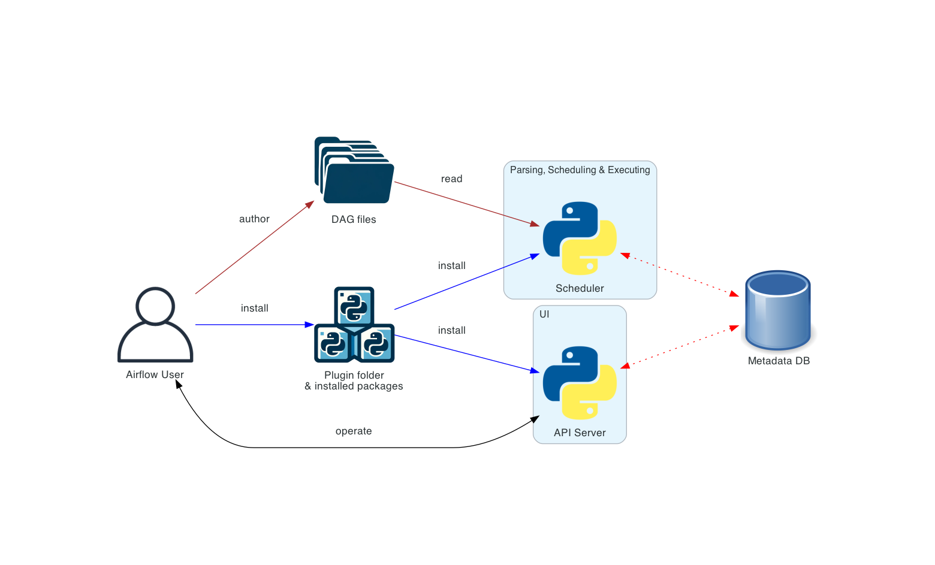
Day 8 Workflow Orchestration with Apache Airflow
Workflow Orchestration with Apache Airflow Design, schedule & monitor your data pipelines
[1] [2]

Slide 2






Learning Objectives
Understand Airflow architecture & components
Author Dags with tasks, operators & sensors
Use TaskFlow API and XCom for data transfer
Configure scheduling, triggers & event-driven workflows
Monitor, debug & manage Airflow via the UI
Hands‑on lab building an orchestrated pipeline
[1] [2]

Slide 3
Agenda
1
Day 7 recap & motivation
2
Airflow architecture & components
3
DAG fundamentals & authoring
4
Tasks: operators, sensors & TaskFlow
5
Scheduling & triggers
6
XComs & variables
7
Best practices & observability
8
Lab & mini exercises
9
Quiz & recap
[1]

Slide 4
Recap: From Table Formats to Orchestration
Yesterday we explored modern table formats (Iceberg, Delta, Hudi) and how to layer data into Bronze, Silver and Gold tables. Today we focus on orchestrating these pipelines: sequencing ingestion, transformation and validation tasks with Airflow.
Bronze
Silver
Gold
transform
load
Airflow orchestrates the movement from Bronze to Gold
[1] [2]

Slide 5


Core Components of Airflow
Scheduler
Monitors DAGs & tasks, schedules execution when dependencies are met.
DAG processor
Parses DAG files and serializes definitions to the metadata database.
Webserver/API
FastAPI server serving the UI and APIs for workers and users.
Metadata DB
Stores DAGs, task states, connections and XComs.
DAG files
Python files defining your DAGs; loaded and parsed by the scheduler.
[1] [2]

Slide 6
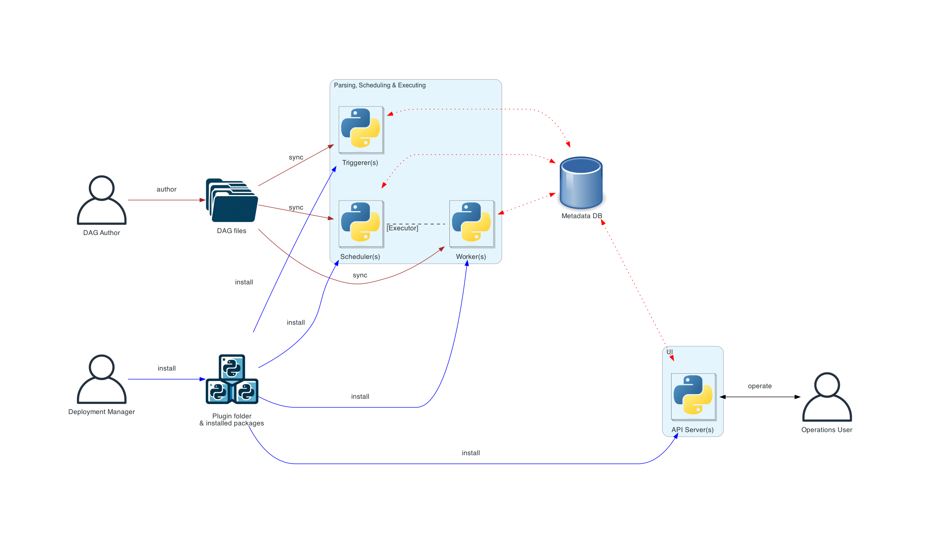
Optional & Distributed Components
Workers
Execute tasks given by the scheduler; run as separate processes (Celery, Kubernetes).
Triggerer
Executes asynchronous deferrable tasks (event-driven scheduling).
Plugins
Extend Airflow with custom operators, sensors & hooks.
Distributed deployment decouples components for scalability & security.
[1] [2] [3]

Slide 7
Component Interaction Workflow
DAG file
DAG Processor
Scheduler
Worker
Metadata DB
1. DAG parsed & serialized
2. Scheduler schedules tasks
3. Worker executes task & sends status
4. Metadata DB stores task states
[1]

Slide 8
Defining Dags
A Dag (Directed Acyclic Graph) defines the order of tasks. There are three ways to declare one:
with DAG(dag_id="my_dag", start_date=..., schedule="@daily"):
task = EmptyOperator(task_id="task")
Tips for DAG definition: • Use unique dag_id; avoid spaces • Provide a timezone-aware start_date • Choose cron presets (@daily, 0 0 * * * etc.) • Set catchup=False unless backfilling
my_dag = DAG(dag_id="my_dag", start_date=..., schedule="0 0 * * *")
EmptyOperator(task_id="task", dag=my_dag)
@dag(start_date=..., schedule="@daily")
def generate_dag():
EmptyOperator(task_id="task")
generate_dag()
[1] [2]

Slide 9
Task Dependencies
Task A
Task B
first_task >> [second, third] third << fourth cross_downstream([op1, op2], [op3, op4]) chain(op1, [op2, op3], op4)
Task D
Task C
[1]

Slide 10

Task Types
Operators
from airflow.sdk import task @task
def extract_data():
return get_data()
file_sensor = FileSensor(task_id="wait_for_file", filepath="data/file.csv")
Templates for defining tasks; examples include BashOperator, PythonOperator, EmailOperator.
Sensors
Tasks that wait for external events (files, API responses). Modes: poke vs reschedule.
TaskFlow @task
Decorated Python functions returning values; dependencies handled via XComArg.
[1] [2] [3]

Slide 11

Sensors & Waiting for Events
• Sensors wait for external events before succeeding. • Modes: poke – occupies a worker for entire runtime reschedule – sleeps between checks and frees the worker • Use poke for frequent checks (e.g., API every second); use reschedule for infrequent events (e.g., daily file arrival). • Examples: FileSensor, TimeSensor, S3KeySensor, ExternalTaskSensor.
Wait for file to appear
Check every minute (reschedule)
Check continuously (poke)
[1]

Slide 12
TaskFlow API
Write pure Python functions with @task decorator – the easiest way to author tasks and pass data between them.
from airflow.sdk import dag, task
import datetime
@task
def extract_orders():
# fetch orders from Bronze table
return orders
@task
def transform_orders(orders):
# filter and aggregate orders
return summary
@task
def load_orders(summary):
# write summary to Gold table
pass
@dag(start_date=datetime.datetime(2024,1,1), schedule='@daily')
def order_pipeline():
orders = extract_orders()
summary = transform_orders(orders)
load_orders(summary)
order_pipeline()
• Returns are automatically XComArg objects • Dependencies inferred from argument order • Recommended for lightweight Python logic
[1] [2]

Slide 13
Scheduling & Event Triggers
Time‑based Scheduling
Event‑Driven Triggers
• Use cron syntax to schedule DAGs: @daily, 0 0 * * * • Catchup=True runs missed intervals on deployment • Use timetables for advanced calendars
• Deferrable operators suspend tasks until events occur (e.g., file arrives) • Triggerer process handles deferred tasks asynchronously • Sensors can act as event triggers
[1] [2]

Slide 14
XComs & Data Exchange
• XComs let tasks exchange small pieces of data across the DAG. • Each XCom is identified by key, task_id & dag_id. • Use xcom_push() and xcom_pull() in Task Context. • Avoid large objects: XComs are stored in the metadata DB.
def produce(**context):
context['task_instance'].xcom_push(key='result', value=42)
def consume(**context):
value = context['task_instance'].xcom_pull(key='result', task_ids='produce')
print(f'Got {value}')
[1] [2]

Slide 15
UI & Observability
Graph View
Visualise DAG structure
Tree/Calendar View
Track runs over time
Code View
Inspect source code
• Each task writes logs accessible via the UI. • Configure remote log storage for production (e.g., S3, GCS). • Use task instance states and colour coding to monitor runs.
[1]

Slide 16
Best Practices & Pitfalls
Best practices:
- Keep tasks bounded, idempotent and deterministic.
- Make retries produce the same target result.
- Use TaskFlow for small Python control tasks; call external engines for heavy transforms.
- Test task behavior before scheduling it.
Pitfalls in this lab:
- load_bronze appends, so reruns can duplicate raw rows unless you add run IDs or deduplication.
- XCom is for small metadata, not datasets.
- Airflow coordinates work; it is not the endless Kafka stream processor.
[1] [2]

Slide 17
Airflow with Kafka & Debezium
orders.cdc
Airflow DAG
Sensor waits for topic offset
PythonOperator processes batch
TaskFlow tasks transform & load
Silver table
inventory.cdc
Gold table
Architecture extension: a production DAG may wait for a bounded readiness condition, then invoke validation or transformation work. It does not replace Debezium or Kafka streaming consumers.
[1] [2] [3]

Slide 18
Lab: Orchestrating a Medallion Pipeline
- Start the supplied Airflow, Redis and Postgres services with Docker Compose.
- Run the included medallion_pipeline DAG: FileSensor -> load_bronze -> transform_silver -> aggregate_gold.
- Inspect task logs and XCom row counts in the Airflow UI.
- Rerun once and explain how append behavior can duplicate Bronze rows.
- Extension design: replace CSV arrival with a Kafka/Hop readiness or execution task.
Postgres DB
Airflow DAG
Kafka topics
Data Lake
[1] [2]

Slide 19
Mini Exercise 1: Components & Roles
Match the description to the Airflow component:
1. Monitors tasks and schedules them once dependencies are met
2. Parses DAG Python files and serializes them to DB
3. Exposes UI and REST APIs for task monitoring
4. Executes tasks using Celery or Kubernetes
Options:
A) Scheduler
B) DAG Processor
C) Worker
D) API Server
[1]

Slide 20
Mini Exercise 2: Building Dependencies
Given tasks A, B, C, D and E, select the correct code to achieve:
• A precedes B and C
• Both B and C must finish before D
• Finally E runs after D
A) A >> B >> D >> E; A >> C
B) A >> [B, C]; [B, C] >> D >> E
C) chain(A, [B, C], D, E)
D) cross_downstream([A], [B, C, D, E])
[1]

Slide 21
Mini Exercise 3: Sensors & Scheduling
1. Which mode frees up the worker slot between checks?
2. What happens if a FileSensor fails to find the file within timeout?
3. Which schedule expression runs at midnight UTC every day?
A) poke, Task fails, @daily
B) reschedule, Sensor retries, 0 0 * * *
C) reschedule, Sensor fails, @hourly
D) poke, Sensor is skipped, None
[1] [2]

Slide 22
Mini Exercise 4: Troubleshooting & Optimisation
The supplied DAG succeeds once, but a manual rerun duplicates Bronze input because the first transform appends rows. What change would make the rerun safe?
A) Ignore the duplicate rows
B) Add a run/file key and idempotent merge or dedup rule
C) Increase scheduler parsing frequency
D) Remove task logs
Discussion prompts:
- Where should row-count validation run?
- Which evidence proves a retry did not double count Gold?
- When should the pipeline invoke Hop rather than transform inside Airflow?
[1] [2]

Slide 23
Quiz: Airflow Fundamentals (1/2)
1. Which component processes DAG files?
A) Scheduler B) DAG Processor C) API Server D) Triggerer
2. What does the @task decorator return?
A) XComArg B) PythonOperator C) Sensor D) Nothing
3. Which statement about sensors is true?
A) They run heavy ETL logic
B) They wait for events then succeed
C) They always require an external API call
D) They do not occupy worker slots
[1] [2] [3]

Slide 24
Quiz: Airflow Fundamentals (2/2)
4. What is the purpose of the metadata database?
A) Store DAG Python files
B) Store task states and XComs
C) Provide UI templates
D) Act as a message queue
5. Which mode should you choose for a sensor that checks a file once per hour?
A) poke B) reschedule C) event-driven D) deferrable
6. Which of the following is NOT a best practice?
A) Use TaskFlow for Python logic
B) Keep tasks idempotent
C) Pass large dataframes via XCom
D) Test DAGs locally
[1] [2] [3]

Slide 25
Quiz Answers & Explanations
1) B – The DAG processor parses and serializes DAGs. 2) A – @task functions return an XComArg representing the output. 3) B – Sensors wait for conditions and then succeed or fail. 4) B – The metadata DB stores DAGs, task states, connections and XComs. 5) B – Reschedule mode is ideal for infrequent checks to free workers. 6) C – You should not pass large dataframes via XCom; use external storage.
[1] [2] [3] [4] [5]

Slide 26
Recap & Looking Ahead
Today you learned how Airflow schedules and observes bounded pipeline tasks through DAGs, sensors, task logs and retries.
- The supplied lab runs CSV-to-Postgres Bronze/Silver/Gold tasks.
- Kafka/Debezium keep streaming independently; a DAG coordinates checks or external jobs.
- Reliable retries require idempotent outputs.
Next: Day 9 operates the pipeline through monitoring, lag analysis, incident diagnosis and recovery evidence.
[1] [2] [3] [4] [5] [6] [7]

