Slide 1
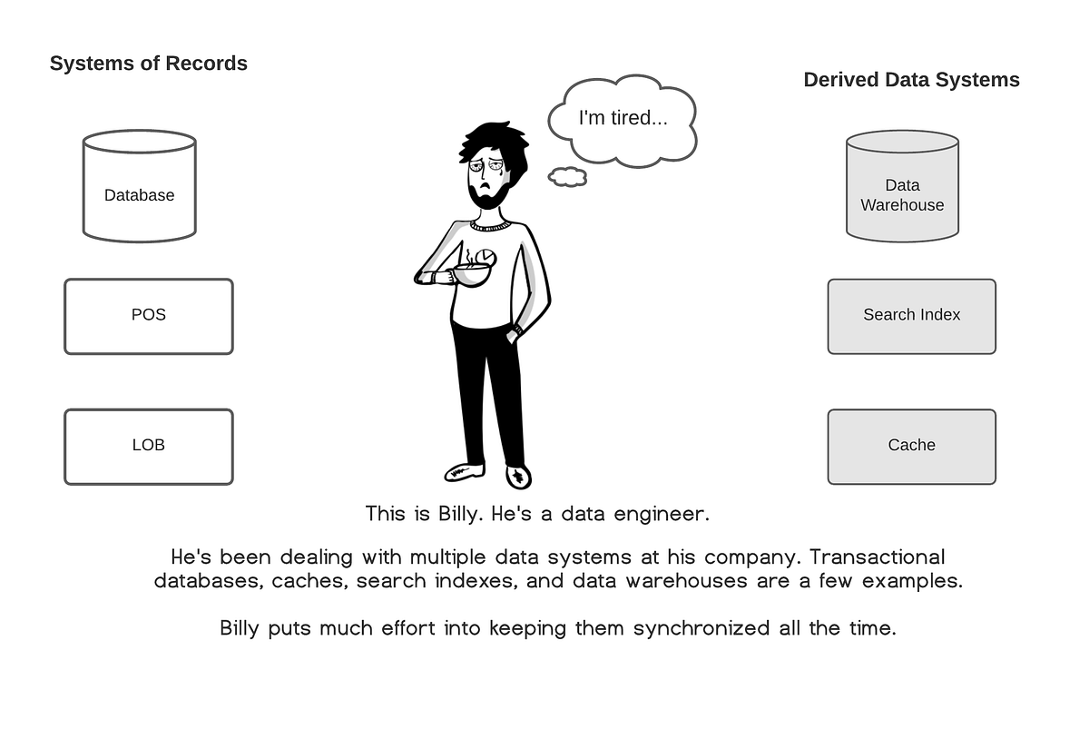
Day 4: Change Data Capture & Debezium
Modern Data Engineering Series
Understanding CDC fundamentals, Debezium internals, connectors, configuration and hands-on lab
[1]

Slide 2






Learning Objectives
Define CDC and its benefits
Compare CDC methods and patterns
Explain Debezium architecture & event structure
Explore connector landscape and deployment
Configure connectors via Kafka Connect
Capture changes hands-on & analyze events
[1]

Slide 3
Agenda
09:00
CDC Fundamentals
10:30
Debezium Architecture
12:00
Connector Landscape
13:30
Connector Configuration
15:00
Hands-On Lab
16:30
Quiz & Recap
[1]

Slide 4
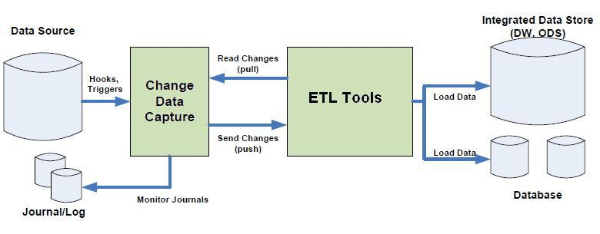
What is Change Data Capture?
CDC is a design pattern that records row-level data changes (inserts, updates, deletes) and propagates them as events in real time.
Why CDC?
• Eliminates heavy batch ETL jobs
• Enables real-time data synchronization
• Supports microservices & event-driven architectures
• Guarantees data consistency and ordering
[1] [2]

Slide 5
CDC vs Traditional ETL
Traditional ETL
• Batch-oriented: runs on schedule (hourly/daily)
• Full or incremental table scans
• High latency: minutes to hours
• Heavy load on source database
• No delete detection without soft-deletes
• Simple to implement and reason about
Change Data Capture
• Event-driven: changes stream in real time
• Reads database transaction log (WAL/binlog)
• Low latency: sub-second to seconds
• Minimal load on source database
• Captures INSERT, UPDATE, DELETE, TRUNCATE
• Requires log-level access and tooling
[1]

Slide 6
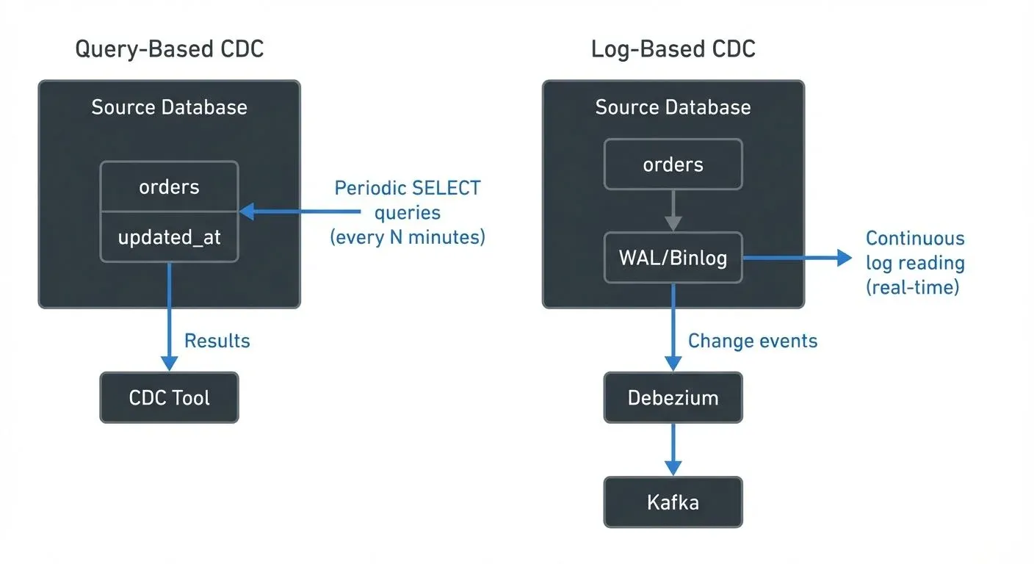

Slide 7
CDC Patterns: Push vs Pull
Push (Log-based)
• Database writes change events to a log
• CDC tool streams events to consumers
• Low overhead, preserves order
• Requires privileges on DB logs
Pull (Query/Trigger)
• Periodic queries or triggers detect changes
• Simple to implement, works on any DB
• Higher overhead, cannot capture deletes
[1]

Slide 8
What is Write ahead log and why WAL Exists
When updating a database record, such as:
UPDATE users SET balance = balance + 100 WHERE id = 42;
What happens if the system crashes mid-operation?
WAL provides safety by capturing the change intent before applying it, ensuring:
Crash recovery
Data consistency
Durable writes
How It Works
The change is first written to a Write-Ahead Log.
Once safely flushed to disk, the actual data pages are updated.
On crash, the database replays the WAL to restore consistency.
What It Guarantees
Ensures Atomicity and Durability (two pillars of ACID).
Used in systems like PostgreSQL, MySQL (InnoDB), and SQLite.

Slide 9
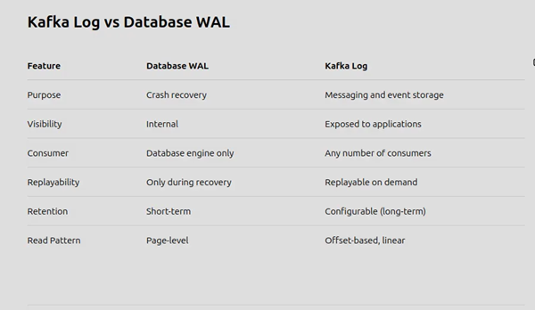

Slide 10
Transaction Log Architecture
How CDC Reads the Write-Ahead Log (WAL)
• Every committed transaction is written to the WAL before the data files
• Logical decoding converts WAL entries into structured change events
• PostgreSQL uses pgoutput plugin for logical replication
• Replication slots track consumer position in the WAL stream
• WAL retention: database keeps WAL segments until all slots have consumed them
• Key PostgreSQL settings: wal_level=logical, max_replication_slots, max_wal_senders
-- Check WAL level
SHOW wal_level; -- Must be 'logical'
-- Check replication slots
SELECT slot_name, active, restart_lsn, confirmed_flush_lsn
FROM pg_replication_slots;
[1] [2]

Slide 11
Kafka’s performance comes directly from its log architecture.
1. Sequential Disk Writes
Kafka only appends data:
No random I/O
Sequential writes are extremely fast (even on HDDs)
Scales linearly with data volume
2. Zero-Copy I/O
Kafka uses OS-level features like sendfile():
Data moves from disk to network socket without entering user-space memory
Low CPU usage
High throughput under load
3. Batching and Compression
Kafka batches and compresses messages:
Reduces disk and network usage
Improves efficiency per I/O operation
Compression (Snappy, LZ4, Zstd) lowers footprint without much CPU cost
4. Partitioning for Scalability
Kafka partitions topics:
Parallel writes from producers
Parallel reads from consumer groups
Adding partitions = more throughput
[1] [2]

Slide 12
CDC Watermark In The Medallion Pipeline
Kafka carries the changes; the watermark tells each layer how far it has processed.
Postgres
Kafka CDC topic
Bronze
Silver
Gold
Watermark
Last processed source point.
Example: source.ts_ms + LSN/offset.
Bronze
Append raw CDC events.
Keep op and source metadata.
Silver
Apply changes in order.
Build current-state tables.
Gold
Serve metrics and business-ready views.
A watermark is not a Kafka feature by itself; it is a pipeline control that says how far the CDC stream has been consumed.
In a production medallion pipeline, Gold should not claim fresh metrics until Bronze and Silver have processed the expected CDC watermark.
[1]

Slide 13
Facts And Dimensions From CDC
Where customer and order changes land after Kafka.
Dimension example
customers
Business entity.
Silver keeps latest customer state.
Fact example
orders
Business event.
Gold measures by time, product, customer.
Watermark check
Publish Gold after CDC reaches the expected point.
Kafka CDC
Bronze events
Silver dim/fact
Gold KPI
Example: customer CDC feeds a customer dimension; order CDC feeds order facts.
The watermark protects freshness claims because it tells the pipeline how far the change stream has been consumed.
[1]

Slide 14
CDC Methods & Trade‑offs
Method | How it works | Pros | Cons
Query‑based | Periodically query tables using timestamp or version columns | Easy to implement | Cannot detect deletes; heavy load
Trigger‑based | Database triggers write changes to audit tables | Captures inserts, updates, deletes | Requires schema changes; overhead
Log‑based | Read database transaction logs (WAL/binlog) | Low overhead, preserves order, captures deletes | Requires privileges; log formats vary
[1] [2] [3]

Slide 15



Benefits & Use Cases for using CDC
Real‑time analytics & reporting
Real‑time analytics and dashboards
Microservices data synchronization
Cache invalidation & search index sync
Cloud migration & replication
Microservices integration & outbox pattern
Audit logging & compliance
Zero‑downtime migrations
[1] [2]

Slide 16
Real‑World CDC Implementations
Industry Examples
• Netflix: CDC from MySQL to Kafka for real-time personalization pipelines
• Uber: Debezium for cross-datacenter MySQL replication and analytics
• Zalando: CDC-based event sourcing for order management microservices
• WePay: Debezium + BigQuery for real-time financial reporting
• Shopify: CDC from MySQL to data warehouse for merchant analytics
• Convoy: Postgres CDC with Debezium for logistics event streaming
• Trivago: CDC to sync hotel data across search and recommendation engines
[1] [2]

Slide 17
Mini Exercise 1: Identify the CDC Method
You will see three scenarios below. For each, decide whether it is best implemented using a query‑based, trigger‑based, or log‑based CDC method.
A. A legacy database cannot be modified, but you need to capture deletes.
B. You only need to track inserts and updates for a small table once a day.
C. A high‑volume transactional database where ordering of events matters.
Discuss with your group and share your answers!
[1] [2] [3]

Slide 18
Mini Exercise 1: Answers
A. Legacy DB that cannot be modified, need to capture deletes:
→ Log-based CDC — reads WAL/binlog without modifying the database
B. Track inserts/updates for a small table once a day:
→ Query-based polling — simple, low volume, batch is fine
C. High-volume transactional DB where event ordering matters:
→ Log-based CDC — WAL preserves commit order; trigger/query cannot
Key takeaway: Log-based CDC is the only method that captures all operations (including deletes) without modifying the source database and preserving transaction order.
[1]

Slide 19
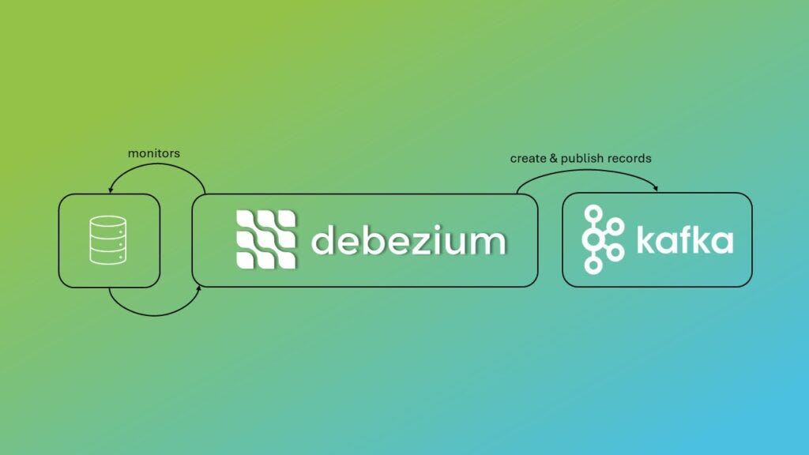
Debezium Overview & Pipeline
Debezium is an open‑source platform that captures row‑level changes from databases and streams them via Kafka.
It reads transaction logs (WAL/binlog) instead of querying tables, producing events with consistent ordering.
Events contain before/after values, metadata and operation type, enabling downstream services to react.
[1] [2]

Slide 20
Kafka Connect vs Debezium
Simple difference before we configure the connector.
Kafka Connect
The platform that runs connectors.
It manages workers, REST API, tasks, offsets.
Debezium
A CDC connector.
It reads database logs and creates change events.
Together
Debezium runs inside Kafka Connect and writes CDC records to Kafka.
Database
Debezium connector
Kafka Connect worker
Kafka topic
[1] [2]

Slide 21
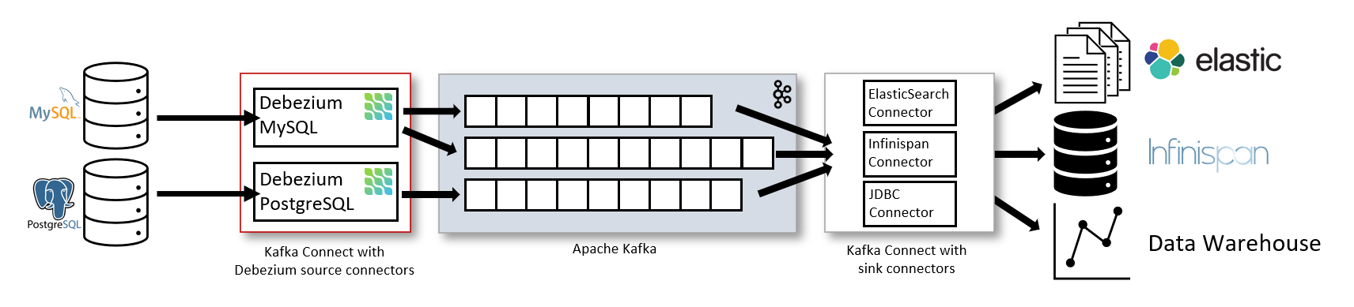
Debezium Architecture: The Full Picture
Architecture Components
• Source connectors read database transaction logs
• Kafka Connect manages connector lifecycle
• Events written to per-table Kafka topics
• Sink connectors deliver to downstream systems
• Offset storage tracks consumer position
Source: debezium.io (Apache 2.0)
[1] [2]

Slide 22
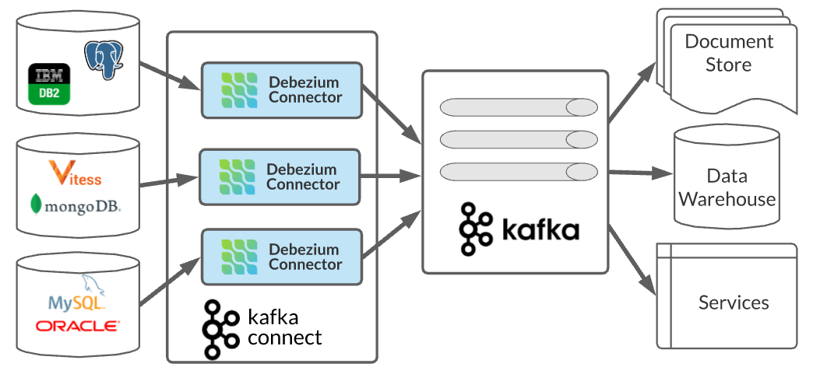
Debezium Architecture Diagram
1. Source connectors tail transaction logs from DBs
2. Kafka Connect executes connectors & persists offsets
3. Events written to Kafka topics (one per table or pattern)
4. Sink connectors & consumers deliver events to targets
[1]

Slide 23
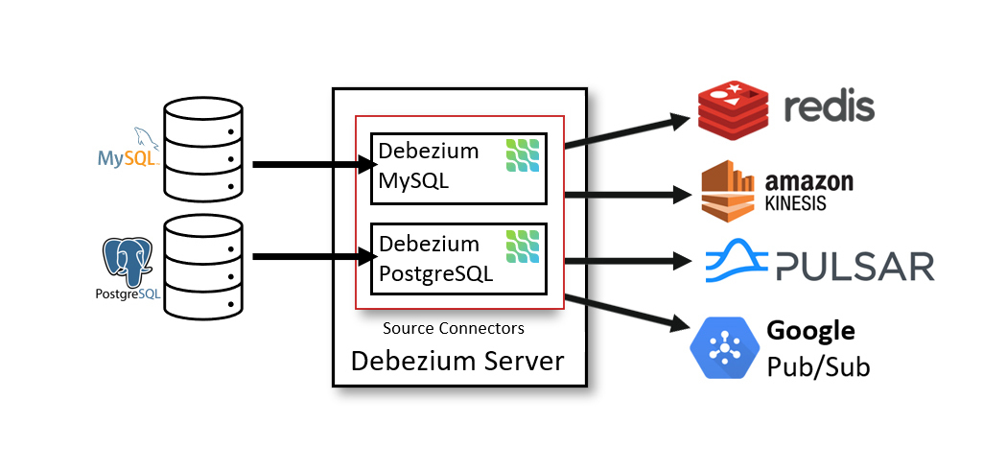
Deployment Options & Server
Debezium Server
Streams events to other messaging systems (Kinesis, Pub/Sub, Pulsar)
Deployment Options
• Embedded in application
• Standalone server
• Kafka Connect (enterprise use cases)
[1] [2]

Slide 24
Debezium Server: Beyond Kafka
Debezium Server
• Standalone application (no Kafka Connect needed)
• Streams CDC events to non-Kafka sinks:
– Amazon Kinesis
– Google Cloud Pub/Sub
– Apache Pulsar
– Azure Event Hubs
• Useful when Kafka isn't available
Source: debezium.io (Apache 2.0)
[1]

Slide 25
Why is snapshot required
A snapshot is required in Debezium because the database transaction log only contains changes from a point in time onward, not the full existing table history.
So when Debezium starts for the first time, it needs a way to load the current existing data before it starts streaming new inserts, updates, and deletes.
Think of it like this:
Database already has 1 million customer rows
Debezium starts today
Transaction log only shows new changes from today onward
Without a snapshot, Kafka would only receive future changes, but it would miss the 1 million rows that already existed before Debezium started.

Slide 26
Debezium Operations table
Debezium op value | Full name | Database operation | before value | after value | When you see it
c | Create | INSERT | null | New row data | When a new row is inserted
u | Update | UPDATE | Old row data | Updated row data | When an existing row is modified
d | Delete | DELETE | Deleted row data | null | When a row is deleted
r | Read | Snapshot read | null | Existing row data | During initial snapshot when Debezium first reads existing table data
t | Truncate | TRUNCATE TABLE | Usually not row-level | Usually not row-level | When an entire table is truncated
m | Message | Logical decoding message | Depends on connector/message | Depends on connector/message | Mainly PostgreSQL logical decoding messages
[1] [2]

Slide 27
Choosing a Snapshot Mode
Mode | When to Use | Behavior
initial (default) | First deployment | Full snapshot then stream
initial_only | One-time data export | Snapshot only, no streaming
no_data | Table already in Kafka | Stream only, skip snapshot
always | After failover / recovery | Re-snapshot every restart
when_needed | Auto-recovery scenarios | Snapshot if offsets lost
Decision Guide:
• New connector? → initial (default)
• Adding tables later? → Use incremental snapshot signal
• Migrating to new Kafka cluster? → always
• Table data loaded via COPY? → Incremental snapshot
[1] [2]

Slide 28
Choosing a Snapshot Mode
Mode | When to Use | Behavior
initial (default) | First deployment | Full snapshot then stream
initial_only | One-time data export | Snapshot only, no streaming
no_data | Table already in Kafka | Stream only, skip snapshot
always | After failover / recovery | Re-snapshot every restart
when_needed | Auto-recovery scenarios | Snapshot if offsets lost
Decision Guide:
• New connector? → initial (default)
• Adding tables later? → Use incremental snapshot signal
• Migrating to new Kafka cluster? → always
• Table data loaded via COPY? → Incremental snapshot
[1] [2]

Slide 29
Choosing a Snapshot Mode
Mode | When to Use | Behavior
initial (default) | First deployment | Full snapshot then stream
initial_only | One-time data export | Snapshot only, no streaming
no_data | Table already in Kafka | Stream only, skip snapshot
always | After failover / recovery | Re-snapshot every restart
when_needed | Auto-recovery scenarios | Snapshot if offsets lost
Decision Guide:
• New connector? → initial (default)
• Adding tables later? → Use incremental snapshot signal
• Migrating to new Kafka cluster? → always
• Table data loaded via COPY? → Incremental snapshot
[1] [2]

Slide 30
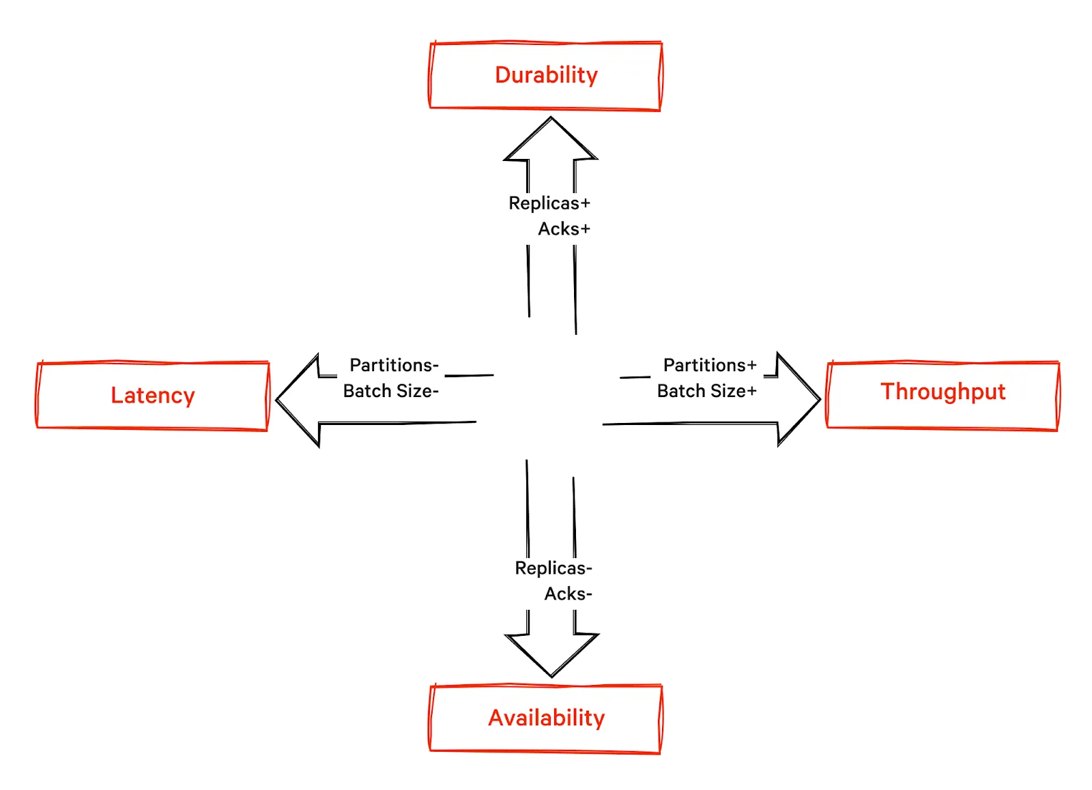

Slide 31
Durability & Fault Tolerance
• Kafka Connect stores connector offsets so Debezium can resume after restart
• A restart can redeliver records around recovery; downstream writes should be idempotent
• Heartbeats help advance WAL positions during quiet tables
• Initial snapshot records use op=r; subsequent committed changes stream from WAL
• Incremental snapshots run in chunks when triggered through signaling
• Monitor connector status, lag, slot health and failed tasks
[1] [2]

Slide 32
Replication Slots & Offset Management
Replication Slots
• Track consumer position in WAL stream
• Prevent WAL segments from being recycled
• One slot per connector (never share!)
• Inactive slots cause WAL accumulation
• Monitor with pg_replication_slots view
• slot.name config property sets the name
Offset Storage
• Kafka Connect stores offsets in internal topic
• Contains LSN (Log Sequence Number) position
• Enables resume after restart or failure
• Offset flush interval: offset.flush.interval.ms
• On restart: reads offset → seeks to LSN
• Exactly-once within Kafka (idempotent)
[1] [2]

Slide 33
Mini Exercise : Decoding an Event
Examine the following event JSON and answer: what operation occurred, and which fields changed?
{
"before": { "id": 3, "balance": 200 },
"after": { "id": 3, "balance": 250 },
"source": { "db": "bank", "table": "accounts" },
"op": "u",
"ts_ms": 1680023459999
}
Discuss with your partner and share your findings.
[1]

Slide 34
Mini Exercise 2: Answers
Event JSON Analysis:
Operation: UPDATE (op = 'u')
What changed:
• before.balance = 200 → after.balance = 250
• The balance field increased by 50
How to identify the operation:
• op='c' → CREATE (insert)
• op='u' → UPDATE
• op='d' → DELETE
• op='r' → READ (snapshot)
• op='t' → TRUNCATE
[1]

Slide 35
Debezium Connector Landscape
MySQL: Reads MySQL binlog; supports GTID and TTL; needs replica user
PostgreSQL: Uses logical replication (WAL); supports slot & publication
SQL Server: Uses SQL Server CDC; requires enabling CDC on tables
Oracle: Uses LogMiner; container or library; additional license
MongoDB: Tails the Oplog; supports change streams; no schema
[1] [2]

Slide 36
MySQL & PostgreSQL Connectors
MySQL Connector
• Tails the MySQL binlog (row/statement/mixed mode)
• Supports GTID, failover, timezone handling
• Requires replication user & binlog format ROW
PostgreSQL Connector
• Uses logical replication publications & slots
• Requires slot & publication privileges
• Supports incremental snapshots & table filtering
[1]

Slide 37
PostgreSQL: WAL & Logical Replication
Logical Decoding Pipeline
• PostgreSQL writes every change to WAL (Write-Ahead Log)
• pgoutput plugin converts WAL to logical replication messages
• Debezium creates a replication slot + publication
• Publication defines which tables to capture (table.include.list)
• Slot tracks position; WAL retained until slot acknowledges
• REPLICA IDENTITY FULL needed for complete before images
-- Create publication for specific tables
CREATE PUBLICATION dbz_pub FOR TABLE customers, orders;
-- Set REPLICA IDENTITY for full before/after
ALTER TABLE customers REPLICA IDENTITY FULL;
-- Check slot status
SELECT slot_name, active, pg_wal_lsn_diff(
pg_current_wal_lsn(), confirmed_flush_lsn
) AS lag_bytes FROM pg_replication_slots;
[1] [2]

Slide 38
Other Database Connectors
SQL Server: Reads CDC tables, requires enabling CDC on each table
Oracle: Uses LogMiner and Mining server, supports RAC/ASM; licensing considerations
MongoDB: Tails the Oplog or Change Streams for replica sets and sharded clusters
Db2, Vitess: Support transaction log capture with similar semantics
[1]

Slide 39
Sink Connectors & Transforms
• Sink connectors deliver events to Elasticsearch, BigQuery, S3, Kinesis, etc.
• Single Message Transforms (SMT) modify records: ExtractNewRecordState, UnwrapFromEnvelope
• Topic routing transforms rename topics based on table or schema name
• Heartbeat topics emit periodic messages to maintain offset progress
[1] [2]

Slide 40
SMT Pipeline: ExtractNewRecordState
Envelope Format (Default)
• Nested structure with before/after/source
• Full audit trail with previous values
• Larger message size
• Ideal for: audit logs, replay, debugging
•
• { "before": {...},
• "after": {...},
• "source": {...},
• "op": "u" }
Flat Format (with SMT)
• Top-level fields only (after values)
• __op, __table metadata added
• __deleted field for delete events
• Ideal for: sinks, warehouses, search
•
• { "id": 1,
• "name": "Alice",
• "__op": "u",
• "__deleted": false }
[1] [2]

Slide 41
Advantages & Limitations of using Debizium
Pros
• Log-based capture is efficient & consistent
• Supports snapshots & incremental snapshots
• Broad ecosystem of connectors & SMT
• Compatible with Kafka Connect & KRaft
Cons
• Requires DB log privileges (binlog/WAL)
• Heavy snapshots on large tables
• Limited DDL support; schema changes may break connectors
• Complexity of deployment & tuning
[1] [2]

Slide 42
Production CDC Best Practices
Deployment & Operations
• Always set REPLICA IDENTITY FULL on captured tables
• Use heartbeat.interval.ms to prevent WAL bloat on low-traffic DBs
• Monitor replication slot lag — alert if > 100 MB
• Set slot.drop.on.stop=false in production (true only for testing)
• Use incremental snapshots instead of restarting with snapshot.mode=initial
• Configure signal.data.collection for operational control
• Set heartbeat.action.query to keep WAL position current
• Use separate replication slot per connector (never share)
• Monitor pg_replication_slots and connector /status endpoint
• Plan for schema evolution: test ALTER TABLE impact before production
[1] [2] [3]

Slide 43
Mini Exercise 3: Match the Connector
Match each database with the appropriate Debezium connector:
Database | Connector
Oracle | ___
MongoDB | ___
SQL Server | ___
MySQL | ___
Discuss with your neighbour to fill in the blanks.
[1]

Slide 44
Mini Exercise 3: Answers
Database | Connector / Mechanism
MySQL 8.0 with GTID | MySQL Connector — reads binlog with GTID tracking
PostgreSQL 15 | PostgreSQL Connector — pgoutput logical replication
SQL Server 2019 | SQL Server Connector — reads CDC tables
MongoDB 6.0 replica set | MongoDB Connector — change streams (oplog)
Oracle 19c RAC | Oracle Connector — LogMiner (additional license)
Key Differentiators:
• MySQL uses binary log (row format required)
• PostgreSQL uses logical decoding with replication slots
• MongoDB uses oplog / change streams (no schema)
• Oracle requires LogMiner and has licensing considerations
[1]

Slide 45
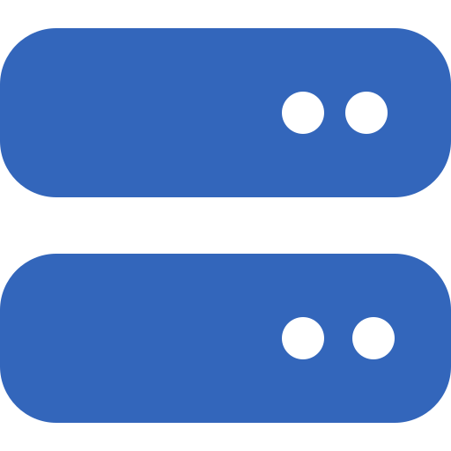
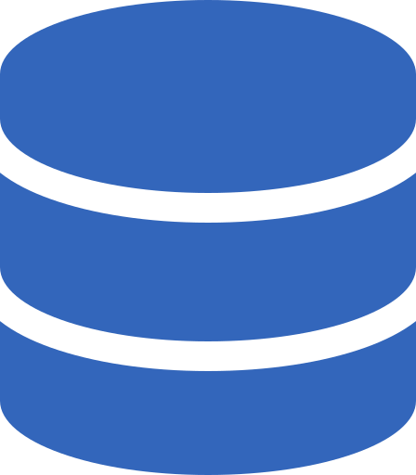

Environment Requirements
Kafka cluster (KRaft or ZooKeeper)
Source database (e.g., Postgres with logical replication)
Kafka Connect & Debezium plugin
Schema Registry (for Avro/JSON if needed)
Client to consume events (Kafka console consumer or Python consumer)
[1]

Slide 46
Quiz Answers
1. C - Log-based streaming
2. B - A snapshot record
3. A - tasks.max
4. B - Send an execute-snapshot signal
5. A - Removes the envelope and exposes row state (configure delete handling deliberately)
[1] [2] [3] [4] [5]

Slide 47
Kafka Connect REST API Reference
Operation | Method | Endpoint
List connectors | GET | /connectors
Create connector | POST | /connectors
Get connector status | GET | /connectors/{name}/status
Get connector config | GET | /connectors/{name}/config
Update config | PUT | /connectors/{name}/config
Pause connector | PUT | /connectors/{name}/pause
Resume connector | PUT | /connectors/{name}/resume
Restart connector | POST | /connectors/{name}/restart
Restart task | POST | /connectors/{name}/tasks/{id}/restart
Delete connector | DELETE | /connectors/{name}
Base URL: http://localhost:8083 | All responses are JSON | PUT config requires full config object
[1] [2]

Slide 48
Heartbeats, Transforms & Monitoring
Heartbeats
• heartbeat.interval.ms: emit heartbeat records to maintain offset commits
• heartbeat.topics.prefix: name prefix for heartbeat topics
Transforms (SMT)
• ExtractNewRecordState: flatten record to after state
• UnwrapFromEnvelope: remove metadata envelopes
• TopicRename: change output topic names
Monitoring
• Monitor lag via JMX or Connect API
• Adjust tasks.max and max.batch.size for throughput
[1] [2]

Slide 49
Envelope vs Flat: Format Comparison
Aspect | Envelope (default) | Flat (ExtractNewRecordState)
Structure | Nested: before/after/source/op | Flat: column values at top level
Before image | Yes — full old row values | No — lost (only after)
Metadata | source block with LSN, ts_ms, txId | __op, __table, __lsn, __source.ts_ms
Delete handling | Tombstone record (key + null value) | __deleted=true with row data
Message size | Larger (2x–3x) | Smaller
Best for | Audit, replay, fraud detection | Sinks, warehouses, search indices
Configuration for flat format:
"transforms": "unwrap"
"transforms.unwrap.type": "io.debezium.transforms.ExtractNewRecordState"
"transforms.unwrap.add.fields": "op,table,lsn,source.ts_ms"
"transforms.unwrap.delete.tombstone.handling.mode": "rewrite"
[1] [2]

Slide 50
Advanced Tuning & KRaft
• Set tasks.max to adjust number of parallel tasks per connector
• Increase max.batch.size & max.queue.size for high throughput
• Tune heartbeat.interval.ms & min.insync.replicas for durability
• With Kafka 4.x KRaft mode, ensure controller & broker nodes have sufficient quorum
• Review connector task logs & metrics to detect lags and backpressure
[1]

Slide 51
WAL Disk Space & Monitoring
Common WAL Issues & Solutions
• Problem: WAL files growing unboundedly
• → Cause: Inactive replication slot retaining WAL segments
• → Fix: Drop orphaned slots or resume the connector
•
• Problem: High-traffic DB on same host as low-traffic captured DB
• → Cause: CDC connector can't acknowledge LSN fast enough
• → Fix: Set heartbeat.interval.ms and heartbeat.action.query
•
• Problem: Connector restart causes re-snapshot of entire database
• → Cause: snapshot.mode=always or offsets lost
• → Fix: Use snapshot.mode=initial (default) and never drop the offset topic
[1] [2]

Slide 52
Schema Evolution & CDC
Schema Changes Debezium Handles
• ADD COLUMN — new field in future events
• ADD COLUMN with DEFAULT — no CDC events for existing rows
• ALTER COLUMN type — schema refresh, new type in events
• RENAME COLUMN — treated as drop + add
• DROP COLUMN — field disappears from future events
Best Practices
• Test ALTER TABLE in staging first
• Use Avro + Schema Registry for schema evolution
• Forward compatibility: add columns, don't remove
• Never run DDL during incremental snapshot
• Use schema.refresh.mode=columns_diff (default)
[1] [2]

Slide 53
Hands‑On Lab: Capture Database Changes
In this lab you will:
• Start a local Kafka & Postgres cluster using Docker Compose
• Create a sample table and insert initial data
• Deploy a Debezium Postgres connector via REST
• Produce updates and observe events using Kafka console consumer or Python
• Explore event structure and snapshot vs streaming phases
[1] [2]

Slide 54
Important Points To Note: Cross-Platform Commands
Docker CLI
Use docker compose commands in any terminal.
curl for REST
Use curl for Kafka Connect API calls.
localhost ports
Kafka 9092, UI 8080, Connect 8083, Postgres 5432.
cd Week_01/Day_04/Lab_Files_Client_Ready docker compose up -d curl -s http://localhost:8083/connectors
[1]

Slide 55
Lab Steps & Commands
1. Start the lab stack
$ cd Week_01/Day_04/Lab_Files_Client_Ready
$ docker compose up -d
2. Register the Debezium connector
$ curl -s -X POST http://localhost:8083/connectors ...
3. Change source data
$ docker compose exec -T postgres psql ...
4. Observe CDC records
$ docker compose exec -T kafka kafka-console-consumer ...
Full commands are in the lab guide.
[1]

Slide 56
Quiz: Question 1
Which CDC method minimizes database load while capturing inserts, updates and deletes in order?
A. Query‑based polling
B. Trigger‑based logging
C. Log‑based streaming
D. Periodic ETL batch
[1]

Slide 57
Quiz Question 1: Answer
Which CDC method minimizes database load while capturing inserts, updates and deletes in order?
✓ C. Log-based streaming
Why:
• Reads the transaction log (WAL/binlog) — no queries on source tables
• Captures all operation types including deletes
• Preserves commit order from the transaction log
• Query-based polling requires table scans and cannot detect deletes
• Trigger-based adds overhead to every write operation
[1]

Slide 58
Quiz: Question 2
In a Debezium event record, what does the "op" field value "r" indicate?
A. A delete operation
B. A snapshot record
C. An update operation
D. A heartbeat record
[1]

Slide 59
Quiz Question 2: Answer
In a Debezium event record, what does the "op" field value "r" indicate?
✓ B. A snapshot record
Explanation:
• op='r' stands for READ — the row was captured during an initial snapshot
• Snapshot events have before=null and after={full row data}
• After the snapshot completes, real-time events use op='c', 'u', 'd', or 't'
[1]

Slide 60
Quiz: Question 3
Which connector property controls the number of parallel tasks for a Debezium connector?
A. tasks.max
B. snapshot.mode
C. heartbeat.interval.ms
D. max.batch.size
[1] [2]

Slide 61
Quiz Question 3: Answer
Which connector property controls the number of parallel tasks?
✓ A. tasks.max
Note:
• For PostgreSQL connector, tasks.max is always effectively 1
• PostgreSQL's logical replication uses a single replication slot
• Some other connectors (e.g., MongoDB) can run multiple tasks
• snapshot.mode and heartbeat.interval.ms are unrelated to parallelism
[1]

Slide 62
Quiz: Question 4
How do you request an ad hoc incremental snapshot for selected PostgreSQL tables?
A. snapshot.mode=never
B. incremental.snapshot.enabled=true
C. snapshot.lock.timeout.ms
D. topic.rename
[1]

Slide 63
Quiz Question 4: Answer
How do you request an ad hoc incremental snapshot?
✓ B. Send an execute-snapshot signal via the signal table
How it works:
• Configure signal.data.collection in the connector config
• Create a signal table: CREATE TABLE debezium_signal (id VARCHAR, type VARCHAR, data VARCHAR);
• Insert signal: INSERT INTO debezium_signal VALUES ('snap-1', 'execute-snapshot', '{"data-collections": ["public.customers"], "type": "incremental"}');
• The connector picks up the signal and snapshots the specified table(s) without stopping
[1] [2]

Slide 64
Quiz: Question 5
In Debezium, the term “snapshot” refers to:
A. Capturing real-time database changes only
B. Capturing the current state of the database at a point in time
C. Adds a heartbeat record
D. A specialized Kafka topic for backups
[1]

Slide 65
Quiz Question 5: Answer
In Debezium, the term “snapshot” refers to:
✓ B. Capturing the current state of the database at a point in time
Details:
In Debezium, a snapshot is the initial capture of existing data from a database before it starts streaming real-time changes (change data capture or CDC).
When a Debezium connector starts, it typically performs a snapshot phase.
During this phase, it reads the entire current state of the database tables and sends that data to Kafka topics.
After completing the snapshot, Debezium switches to capturing ongoing changes such as inserts, updates, and deletes.
[1]

Slide 66
Recap & Next Steps
On Day 5: We design production ingestion from CDC, clickstream and batch files, then protect downstream consumers with schemas, validation and DLQ patterns.
[1] [2] [3]

