Slide 1
Campus Network

Slide 2
Table of contents
Topology
Features
Security
Automation

Slide 3
Topology
Network Structure: An organizational network with 3 branches (1 main, 2 secondary).
Traffic Management: Utilizes an ISP for general network access and physical infrastructure for Site-to-Site VPN.
VLANs: Each branch has 3 VLANs:
Business departments
Local IT team
Management Control (MGMT)
Branch A (main branch):
Features Distribution Switches acting as gateways (GW) with HSRP.
DSW1 is the Primary Root for VLANs 10 and 99; DSW2 for VLAN 20.
Routing:
2 routers, with R1 as the DHCP Server.
OSPF is configured for dynamic routing; static routes are advertised.
Secondary Branches (B & C): Each has one switch and one router serving as DHCP server and gateway (Router on a Stick).

Slide 4
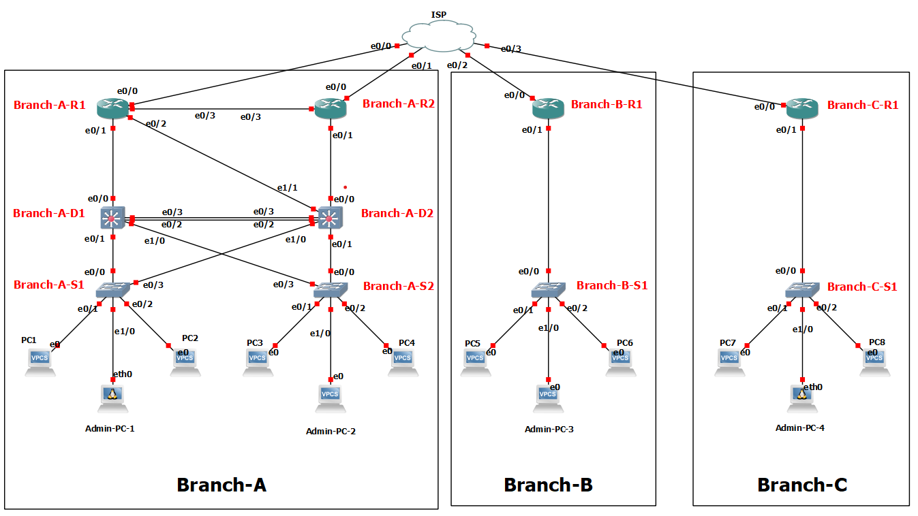
Topology

Slide 5
Features
GRE over IPsec
OSPF
ROAS
HSRP
DHCP
LACP
PVST

Slide 6
GRE over IPsec
GRE over IPsec: Tunnels pass through a switch where no routing protocol is defined except for router interfaces.
Underlay and Overlay: The switch, its interfaces, and physical cards in branch routers serve as the underlay, while the branch networks are the overlay.
Point-to-Point Connection: The protocol creates a point-to-point connection, simulating a direct link between Router A and Router B.
Dynamic Network Sharing: The combination of GRE and IPsec allows for dynamic network sharing using OSPF.
Profile Usage: Profiles were used instead of mapping for simplicity and because lower resolution configurations were unnecessary.
Unique Keys: Each tunnel utilizes different ISAKMP keys and distinct IPsec profiles, with details available in the address table.

Slide 7
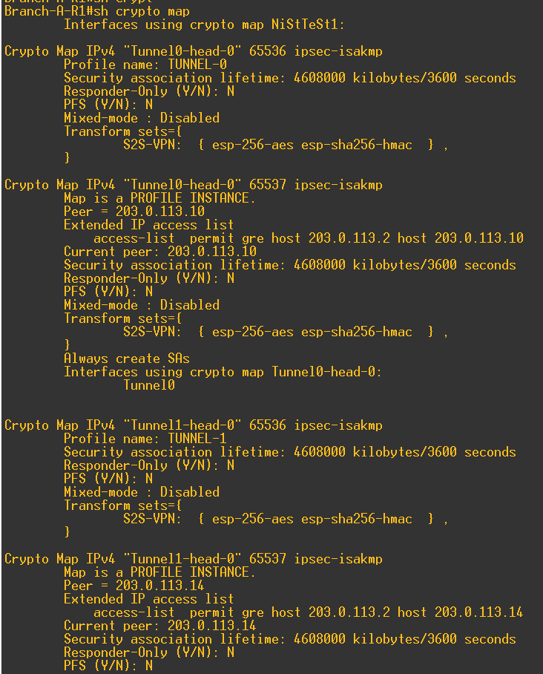
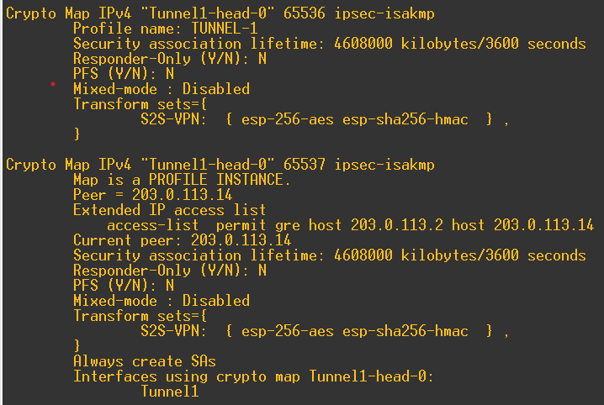
GRE over IPsec-Branch A-R1

Slide 8
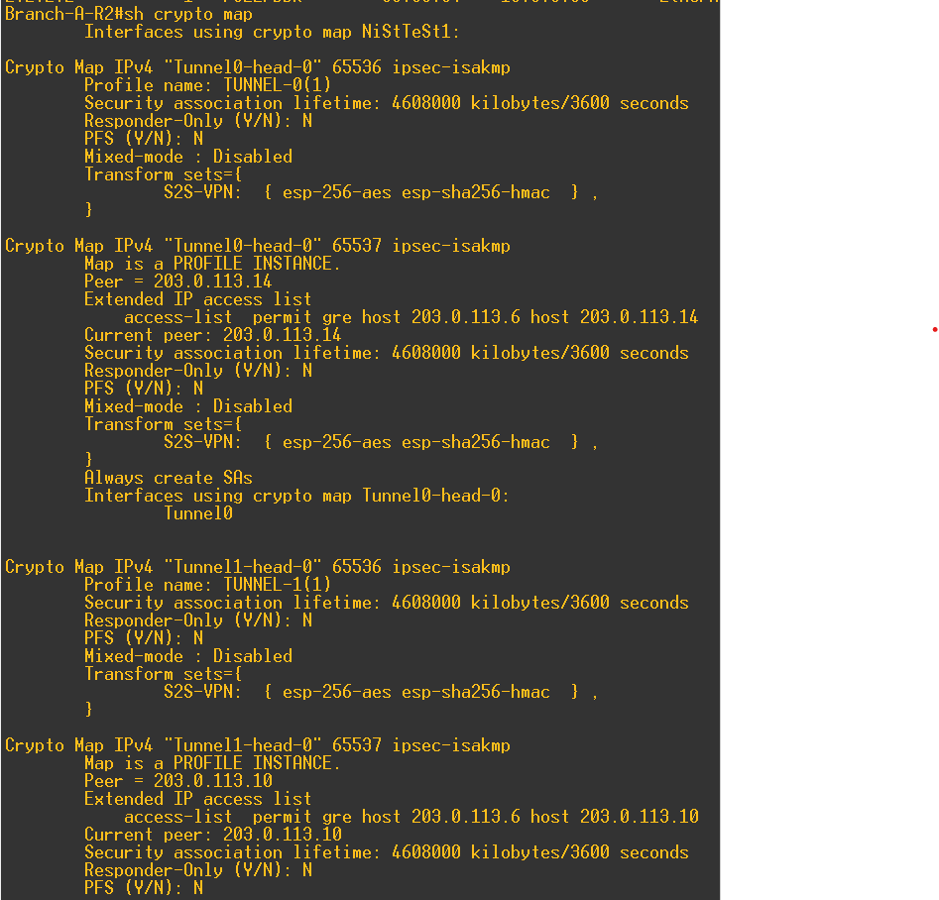
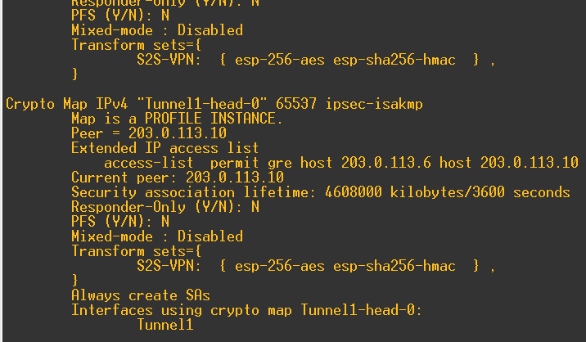
GRE over IPsec-Branch A-R2

Slide 9
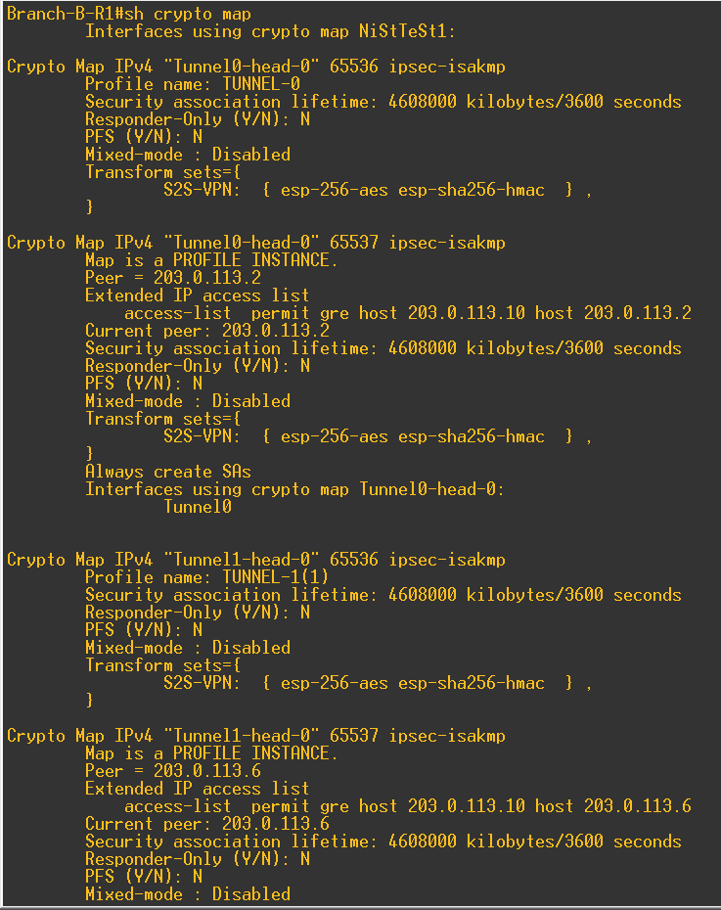
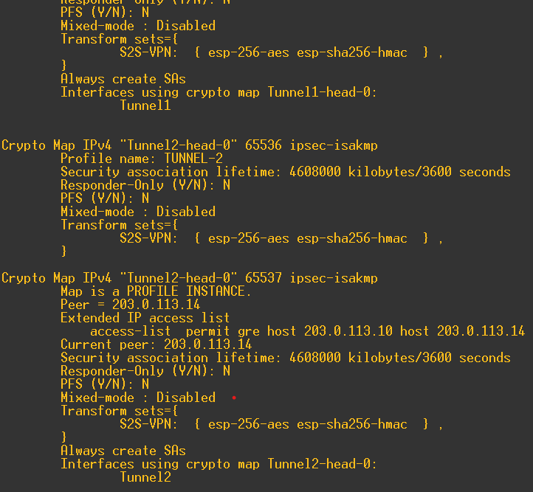
GRE over IPsec-Branch B-R1

Slide 10
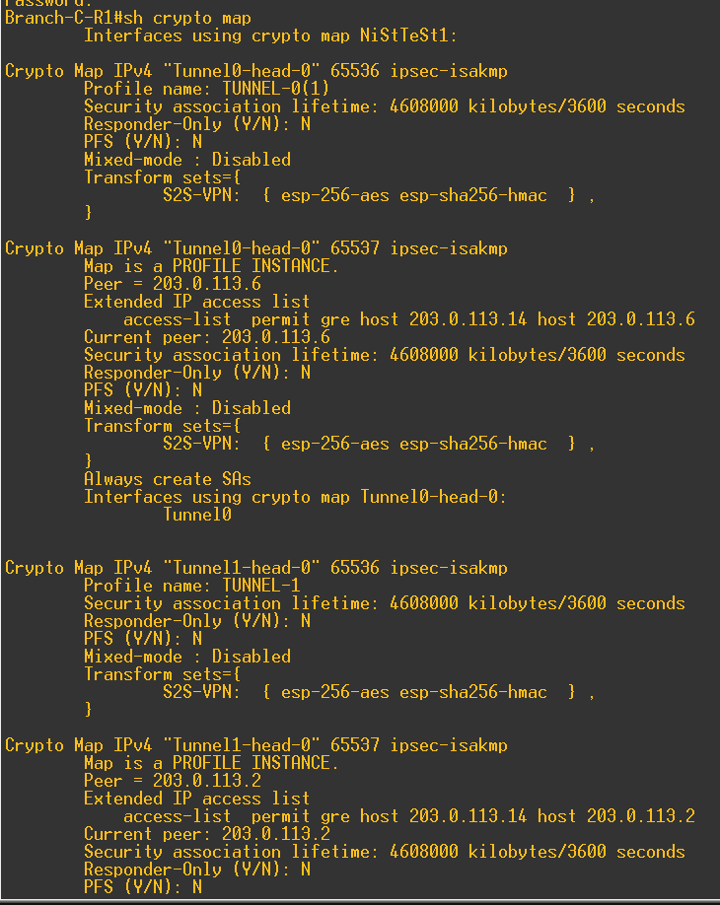
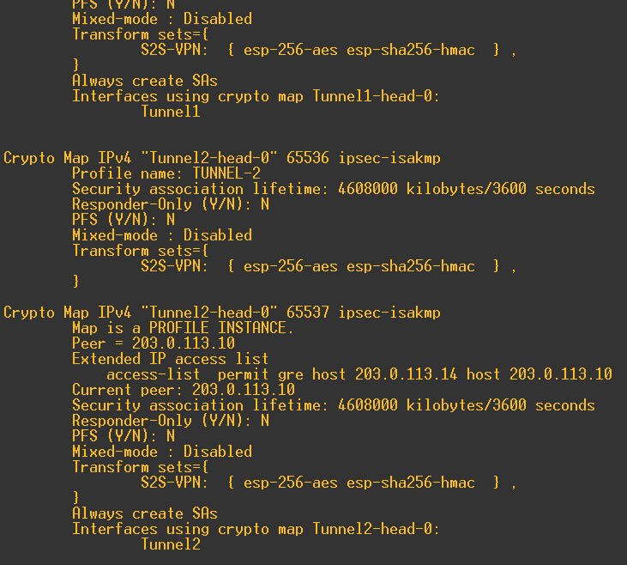
GRE over IPsec-Branch C-R1

Slide 11
OSPF
OSPF Functionality: Each router or MLS recognizes its neighbor's networks in its routing table through OSPF.
S2S Neighboring: OSPF allows for the establishment of neighbor relationships over Site-to-Site (S2S) connections.
Branch A Configuration: In Branch A, component DSW2 is directly connected to both routers (R1 and R2).
Static Routing Awareness: DSW2 is aware of the static routes of R1 and R2 via OSPF.
Routing Strategy: This setup creates an Equal-Cost Multi-Path (ECMP) routing strategy.
Routing Entries: Routing entries for the two routers are as follows:
IP route 0.0.0.0 0.0.0.0 Ethernet0/0
IP route 0.0.0.0 0.0.0.0 Ethernet0/3 5

Slide 12


OSPF-Branch-A-D1&2

Slide 13
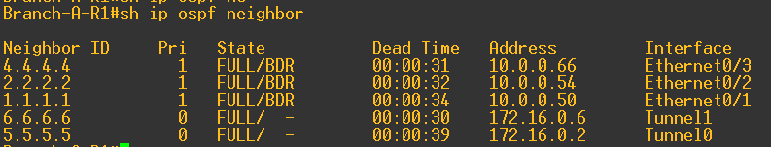
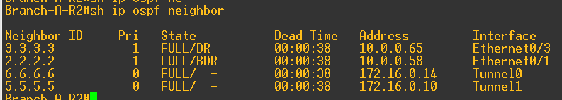
OSPF-Branch-A-R1&2

Slide 14
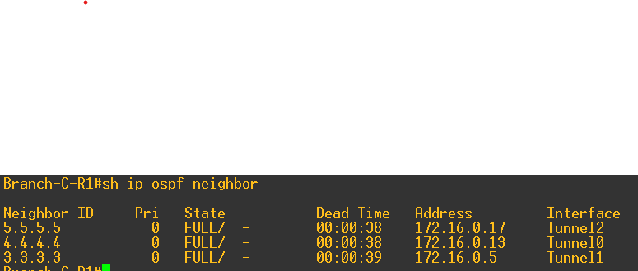
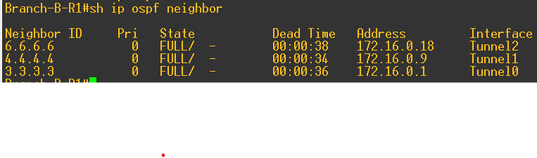
OSPF Branch-B&C Routers

Slide 15
Router on a stick
ROAS Functionality: The ROAS (Router on a Stick) serves as the gateway (GW) for users in all three VLANs present in the secondary branches.
VLAN Support: It provides routing and gateway services for the VLANs configured in those branches.
User Connectivity: Users in the secondary branches can access network resources through the ROAS.
Centralized Routing: The ROAS centralizes routing functions for efficient traffic management across VLANs.
Simplified Network Design: This setup simplifies the network design by using a single router interface for multiple VLANs.
Enhanced Communication: Facilitates communication between different VLANs within the secondary branches.

Slide 16
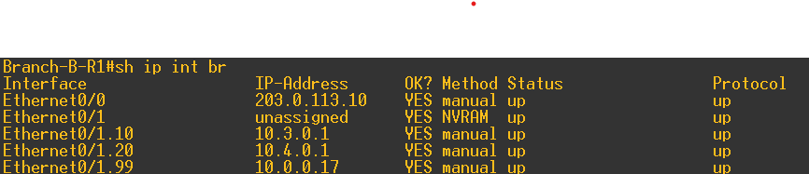
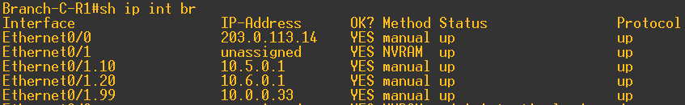
Router on a stick

Slide 17
HSRP
HSRP Configuration: Components DSW1 and DSW2 are configured with HSRP (Hot Standby Router Protocol).
VLAN Representation: Each group represents a VLAN and indicates which router is the Active or Standby router.
Active Routers:
DSW1 is the Active router and serves as the gateway (GW) for VLANs 10 and 99.
DSW2 is the Active router for VLAN 20.
Virtual IP Addresses: Each VLAN has a gateway address that is a virtual IP within the VLAN's subnet and the HSRP group.
Priority Settings: The active gateways are configured with a priority of 105, which is higher than the default.
Preemption Configuration: Preemption is enabled, allowing routers to reclaim the Active status in case of a failure and subsequent recovery.

Slide 18
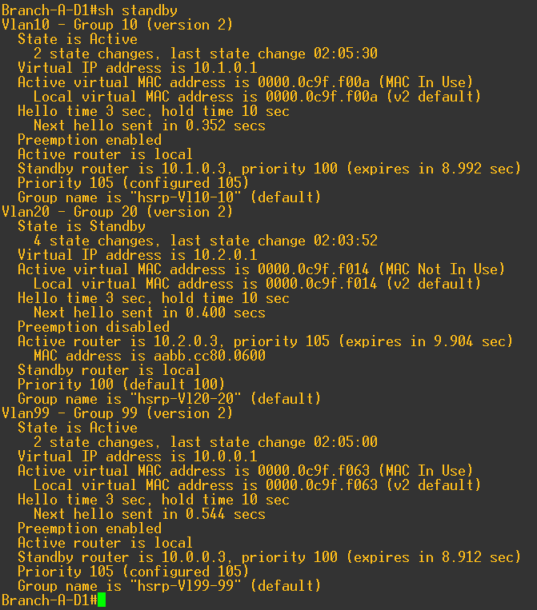
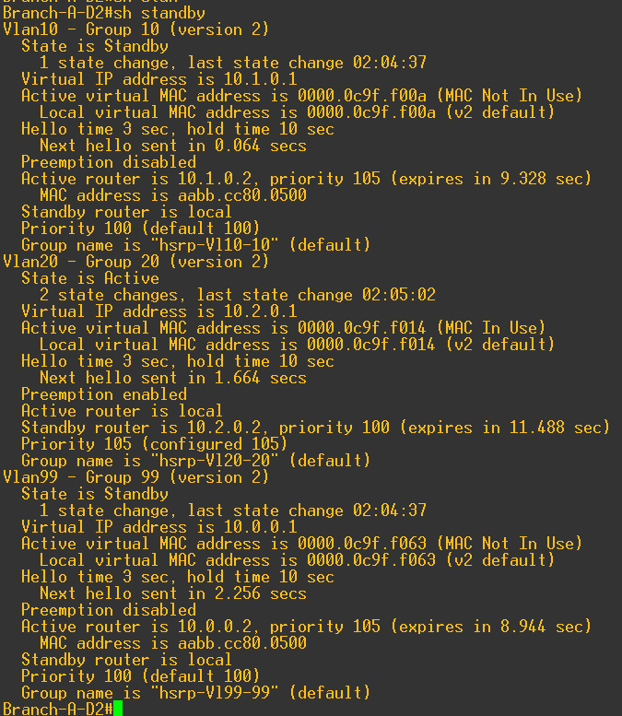
HSRP

Slide 19
DHCP
Address Reservation: Reserve 10 primary addresses from each subnet for management and future use.
IP Helper Configuration: Configure an IP helper address pointing to the Loopback port of the server on another router.
Example: IP helper-address 10.0.0.100
DHCP Utilization: All VLANs across the branches use DHCP for IP address assignment.
Dedicated DHCP Servers: Each branch has its own DHCP server located on router R1.
Network Management: The reserved addresses facilitate network management and future planning.
Traffic Handling: The IP helper address ensures proper traffic routing for DHCP requests to the designated server.

Slide 20
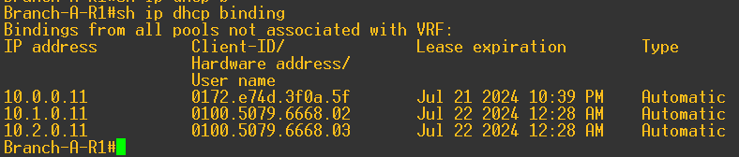
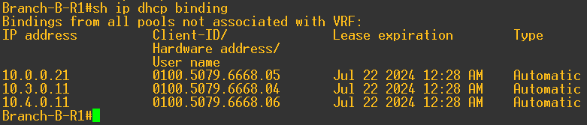
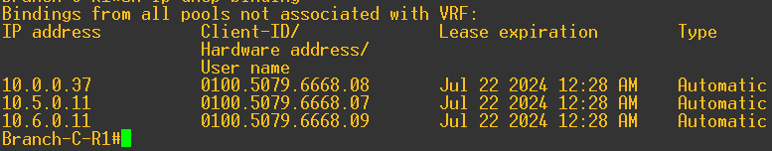
DHCP

Slide 21
LACP
Branch A Configuration: In Branch A, components DSW1 and DSW2 share a port channel.
BPDU Participation: The port participates in Bridge Protocol Data Unit (BPDU) calculations.
DHCP Functionality: It facilitates the transmission of DHCP Discover messages.
Layer 2 Redundancy: The port channel provides redundancy at Layer 2.
Aggregation Bandwidth: The configuration allows for increased bandwidth through link aggregation.
Improved Reliability: This setup enhances network reliability and performance in Branch A.
Load Balancing: The port channel can also support load balancing between the switches.

Slide 22
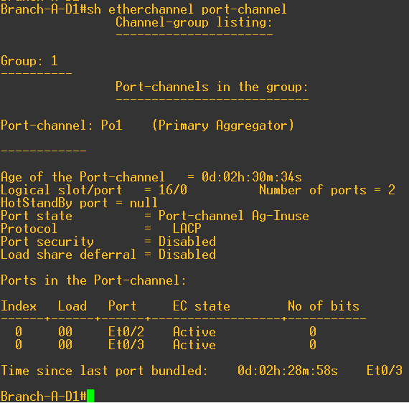
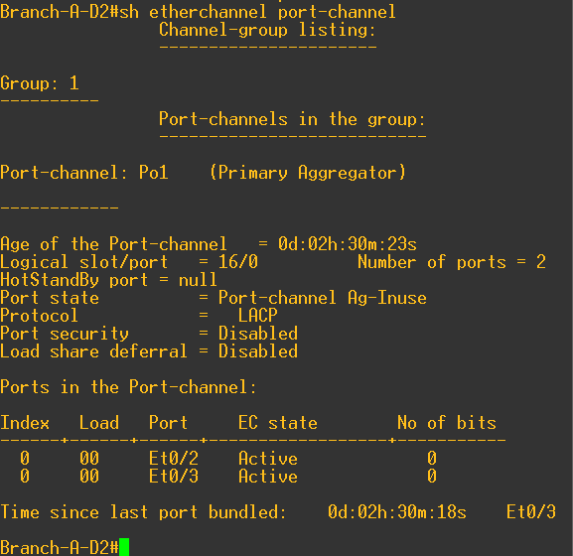
LACP

Slide 23
PVST
Loop Prevention: Measures are in place to prevent loops caused by DHCP Discover, ARP, and similar protocols.
Isolated Broadcast Domains: Each VLAN is assigned its own broadcast domain for better traffic management.
Root Bridge Configuration:
DSW1 is the Root Bridge for VLANs 10 and 99.
DSW2 is the Root Bridge for VLAN 20.
Access Port Configuration: Port Fast is enabled on all access ports to minimize the time they take to transition to the forwarding state.
Enhanced Network Stability: These configurations enhance network stability and reduce the risk of broadcast storms.
Efficient Traffic Handling: Isolated broadcast domains help in efficient handling of broadcast traffic within each VLAN.

Slide 24
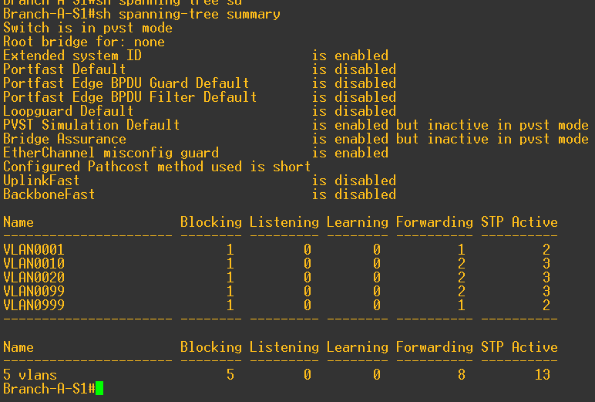
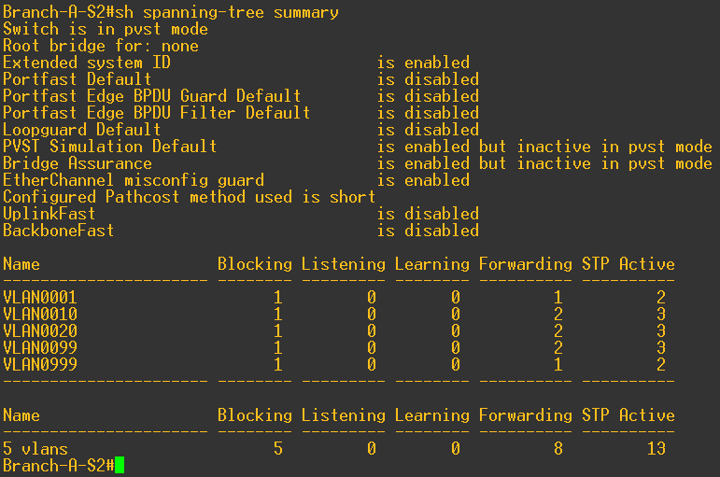
PVST-Branch-A-S1&2

Slide 25
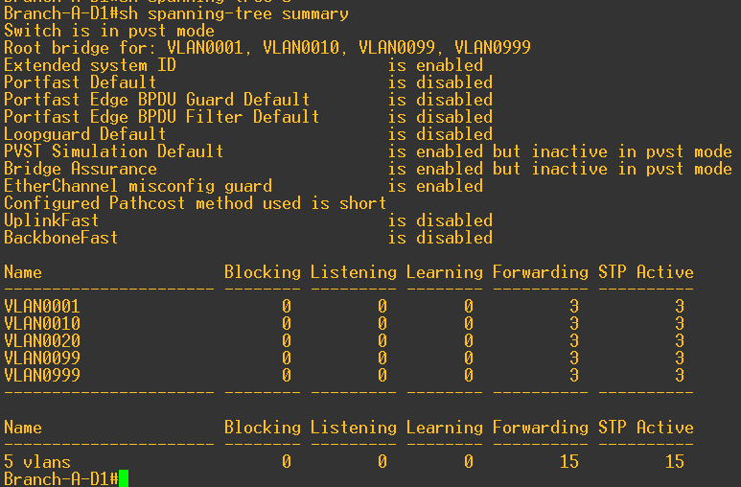
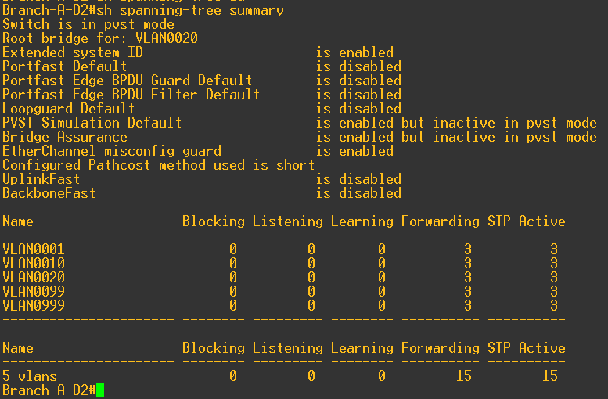
PVST-Branch-A-D1&2

Slide 26
Security measures
Port security
DHCP snooping
Spanning tree guard Root
Black Hole
Unused ports
BPDU guard
Non Default
Secret
No CDP enable
ACL’S-access class
switchport nonegotiate
switchport trunk native

Slide 27
Security measures-Default security
Common Security Settings: All devices share common security configurations, including:
Line console settings
Line VTY configurations
User accounts and secrets/passwords
Access-class settings
Password length requirements
Remote Access Control: All devices are configured to allow remote access based on the same access list, which includes three networks from the MGMT VLAN of each branch.
VTY Line Configuration: The access control is specifically applied to Line VTY for remote connections.
Unused Ports Management: All devices have unused ports that are disabled to enhance security.
Security Enhancements: Security settings are applied to these unused ports to prevent unauthorized access.
Consistent Security Policy: This approach ensures a consistent security policy across all devices in the network.

Slide 28
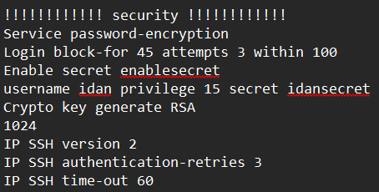
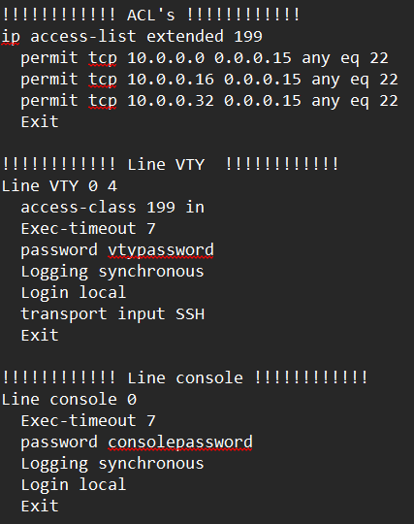
Security measures-Default security

Slide 29
Security measures-Access switches
Information Security: Security at this layer prevents many actions that users can perform on their endpoints.
VLAN Black Hole: Each switch has a VLAN Black Hole that includes all unused ports, which also have security settings similar to active ports.
Security Configurations: Security measures on unused ports include:
Port security violation
Maximum MAC address limits
Sticky MAC address configuration
BPDU guard
No Negotiate
DHCP Snooping: IP DHCP snooping is enabled on all VLANs (1-4094) to enhance security.
Trust Configuration: All active ports are configured as trusted to allow DHCP offers to be forwarded to recipients.
Enhanced Network Protection: These configurations help protect the network from unauthorized access and DHCP spoofing attacks.

Slide 30
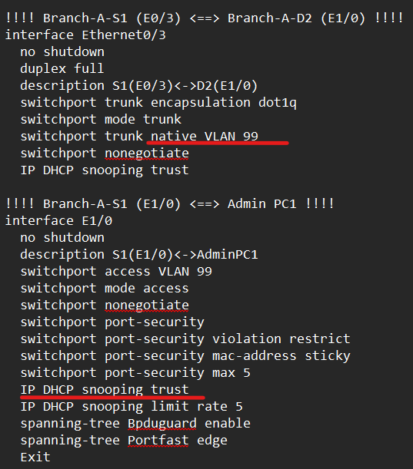
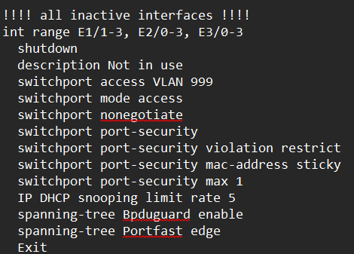
Security measures-Access switches

Slide 31
Security measures-MLS & Routers
Port Configuration in Branch A: The unused ports on DSW1 and DSW2, as well as those connected to the access switches (E0/1, E1/0), are configured with Spanning Tree Guard Root to prevent them from being designated as the Root Bridge.
CDP Disabled: On all routers, CDP (Cisco Discovery Protocol) is disabled on the interfaces leading to the internet.
OSPF Passive Ports: All ports, except those in use, are set to Passive for OSPF to minimize unnecessary OSPF traffic.
End-to-End Encryption: There is end-to-end encryption established between the routers in different branches.
Network Stability: These configurations enhance network stability and security by preventing unauthorized changes to the Root Bridge and reducing exposure to potential attacks.
Traffic Management: The use of passive OSPF ports helps in efficient traffic management while maintaining network performance.

Slide 32
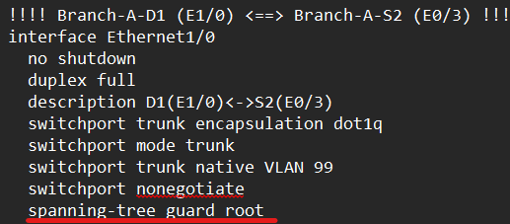
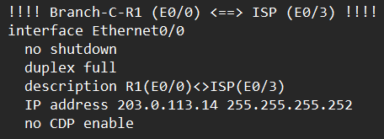
Security measures-MLS & Routers

Slide 33
Automation Tool

Slide 34
Automation tool
Automation Tool: The chosen automation tool is the configuration of the Message of the Day (MOTD) on the login screen and saving it to the startup configuration.
Playbook Format: The playbook is written in YAML format.
MOTD Extraction: A text file containing the MOTD to be published is utilized for extraction.
Host File Configuration: The host file references either the entire network or individual branches as needed.
Password Management: Built-in passwords are used within the code instead of private keys for authentication.
Streamlined Configuration: This approach streamlines the process of updating the MOTD across devices.
Enhanced Network Management: Automating the MOTD configuration improves network management and communication with users.

Slide 35
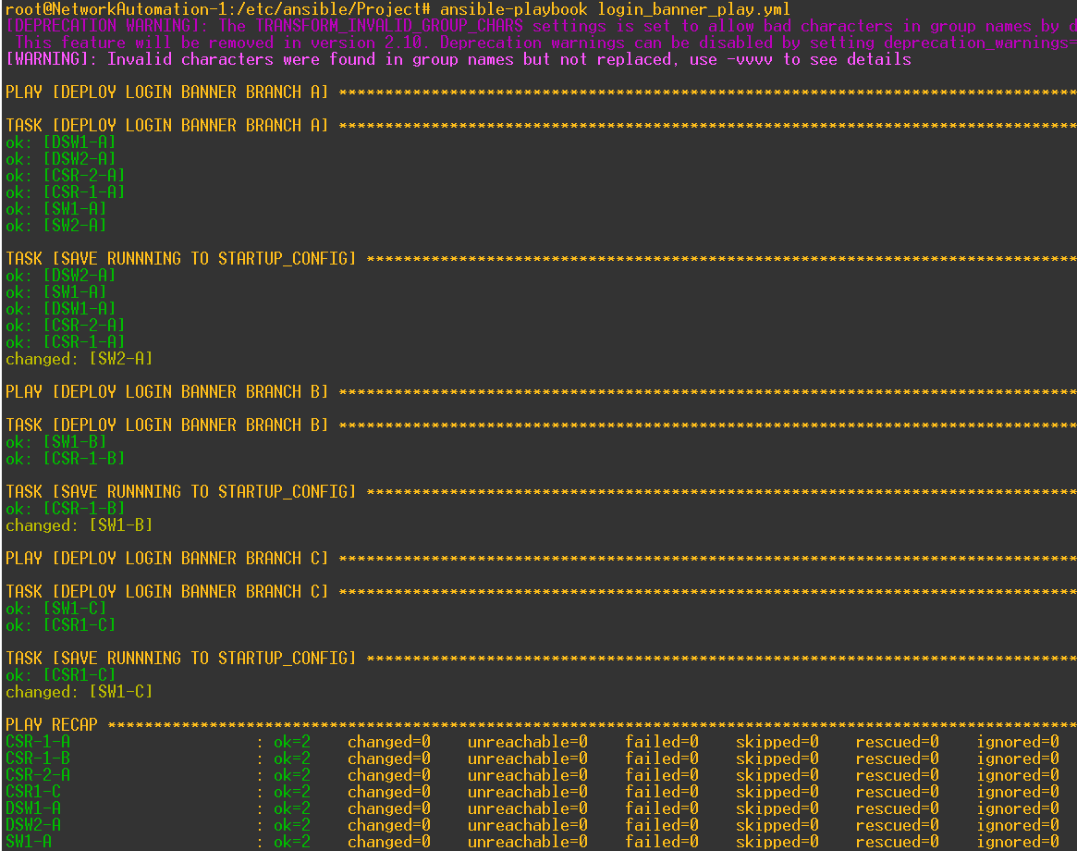
Automation tool

Slide 36
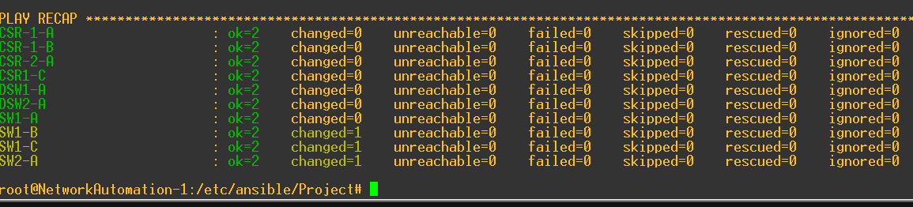
Automation tool

