Slide 1
Android games succession prediction
468
0
STORE
LUCK ROYALE
CHARACTER
VAULT
Presented by:
Idan Zorer & Shaun Suhareanu
PET
COLLECTION
START

Slide 2
Rationale
We chose to work on the Android gaming field, out of our passion and knowledge of games.
Our focus is to predict whether a game will reach Google Play store’s top charts, which is a sign of succession, and deepen our understanding beyond how the Play store works.

Slide 3
Defining the problem we are dealing with
The challenge we faced was a classification problem in which we tried to
classify whether a game app will be featured on the top charts or not.

Slide 4
Defining the problem we are dealing with
To do this, we first tried to get the information with the help of the Selenium library from the Google Play store website, where there is data of the applications, such as the number of installations, the rating count, the number of stars it received and more.
But due to restrictions on the Google Play store website the number of games on which we were able to get the information was insufficient (about 6,500 games).

Slide 5
Defining the problem we are dealing with
Therefore, we finally acquired the data from "Sensor Tower" website, a website that centralizes the information of the game apps in a more accessible way than the Google Play store, and thus it was possible to significantly increase the amount of games on which the information could be drawn (about 120,000 games), and in more efficient way.

Slide 6
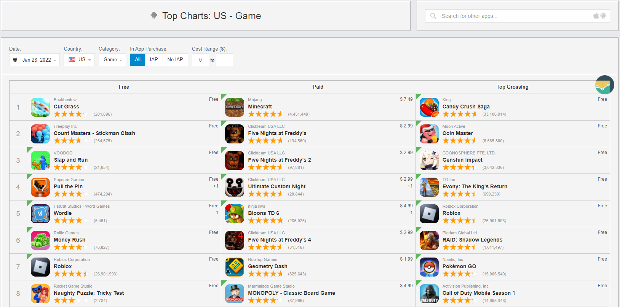
Crawler
“Sensor Tower” website featuring top chart webpage like the one on the Play store website. The scraper begins to extract game data from Sensor Tower’s top chart from which it extracts game information and then gathers suggested games from each game it crawled into. Then it puts them in a queue with the condition that the game wasn’t extracted before.
Sensortower to charts

Slide 7
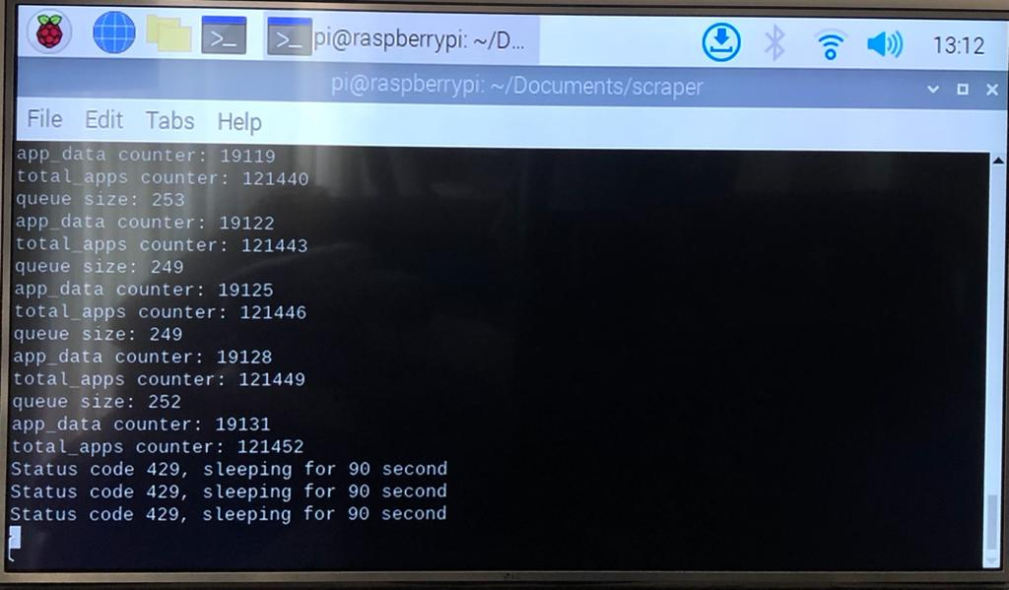
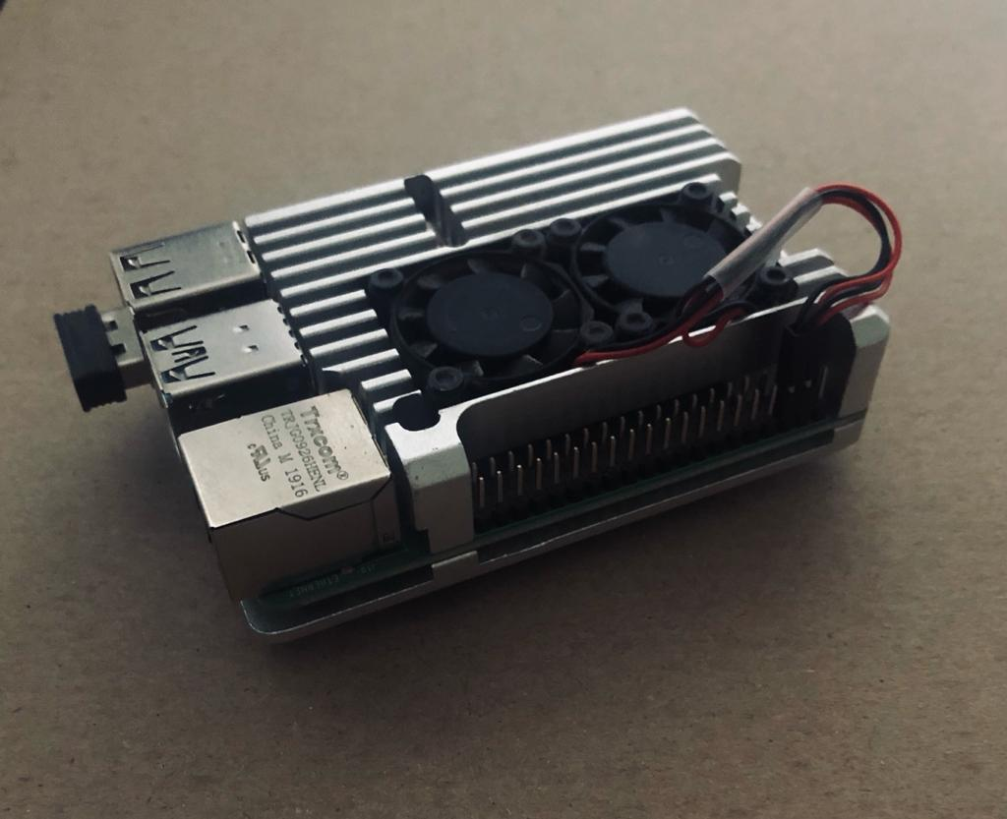
Crawler
(This kind of crawling can by described as a tree which each branch simulates a game and grows more branches which will be the suggesting games, if the condition above wasn’t made a branch would not grow). Furthermore, to speed up the scraping process threads have been used.

Slide 8
Data Processing
After we downloaded the data, we removed irrelevant entries such as: missing values, duplicates, and columns with insufficient information.
In addition, we checked and removed outliers which were found in the 'price' column using z-score method classification.

Slide 9
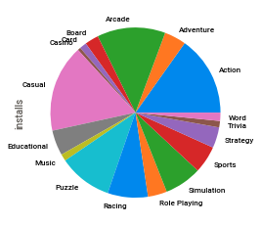
Visualizations
A visualization that shows the number of installations per category:

Slide 10
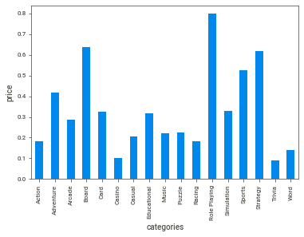
Visualizations
A visualization that shows the average price per category:

Slide 11
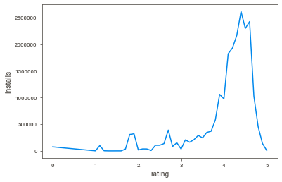
Visualizations
A visualization that shows the connection between the ratings and the average amount of installations:

Slide 12
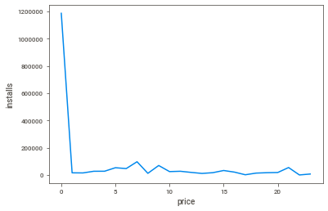
Visualizations
A visualization that shows the connection between the prices and the average amount of installations:

Slide 13
Prediction Algorithm
The prediction algorithm we chose is Naïve Bayes, because it is an algorithm that is suitable for classification problems.
Naïve Bayes is an algorithm which is based on the conditional probability formula, it finds the most reasonable category given certain characteristics.

Slide 14
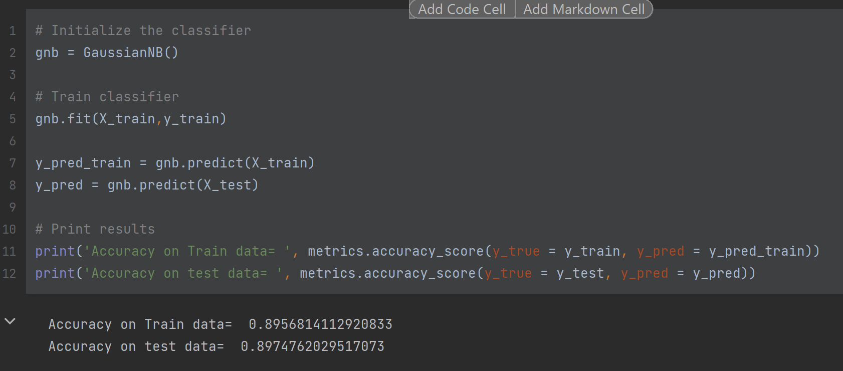
Prediction Algorithm
Accuracy scores ≈ 90 Nice!

Slide 15
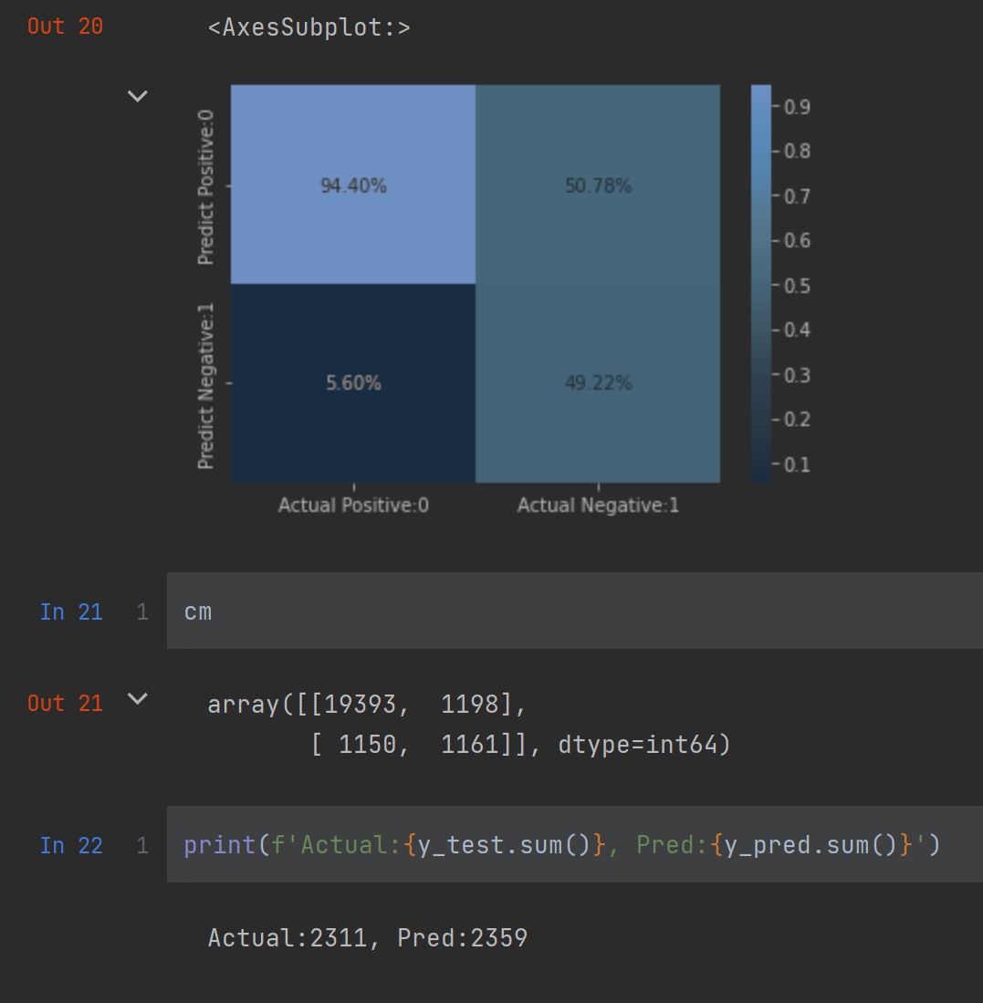
Prediction Algorithm
The Results seems very promising
The Actual game compare to the predicted one
Seems very close meaning our ML prediction
Classifying the games correctly

Slide 16
Conclusion
In conclusion, it can be seen that the prediction score obtained is over 90%, and that the parameters that most affected the prediction are the amount of 5-star ratings, the number of installations.
Therefore, we can tell that the parameters that are used to determine whether a game will be featured in the Google Play store’s top charts are the amount of 5-star ratings and the number of installations.

Slide 17
Libraries
BeautifulSoup
Selenium
Sklearn
Numpy
Matplotlib
Seaborn

Slide 18
Data sources
https://sensortower.com/
https://play.google.com/store/apps

Slide 19
Thank you for listening!
GAME OVER

