Slide 1

BASICS OF ROCKETRY
AND
PARACHUTE DEPLOYMENT
GROUP 5

Slide 2
CONTENTS
introduction
history
Types and components of Rocket
Parachute Deploying system
A brief introduction of reusable rocket
conclusion

Slide 3
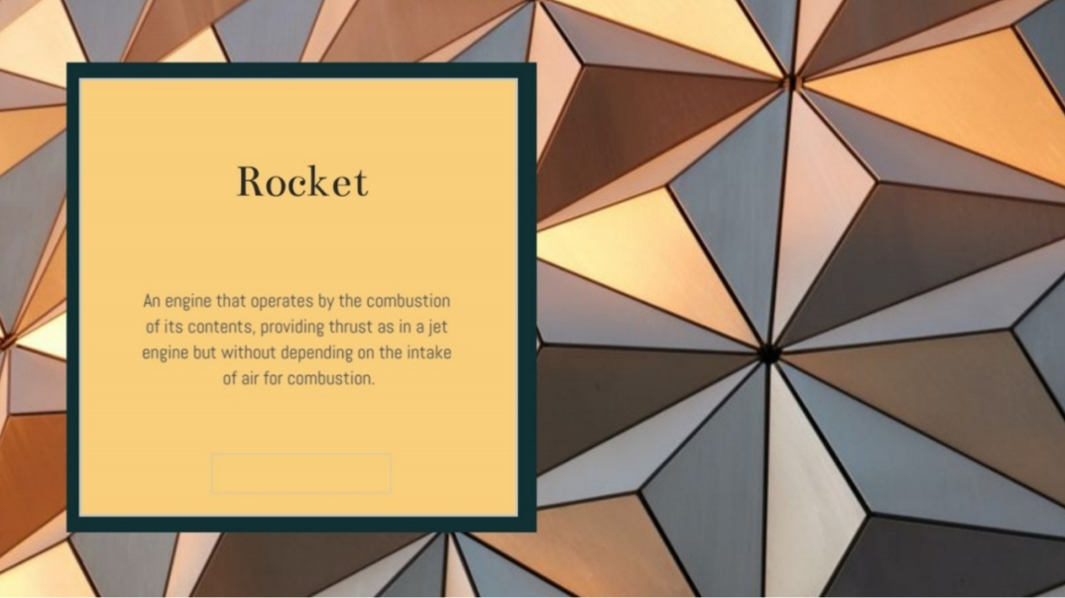

Slide 4
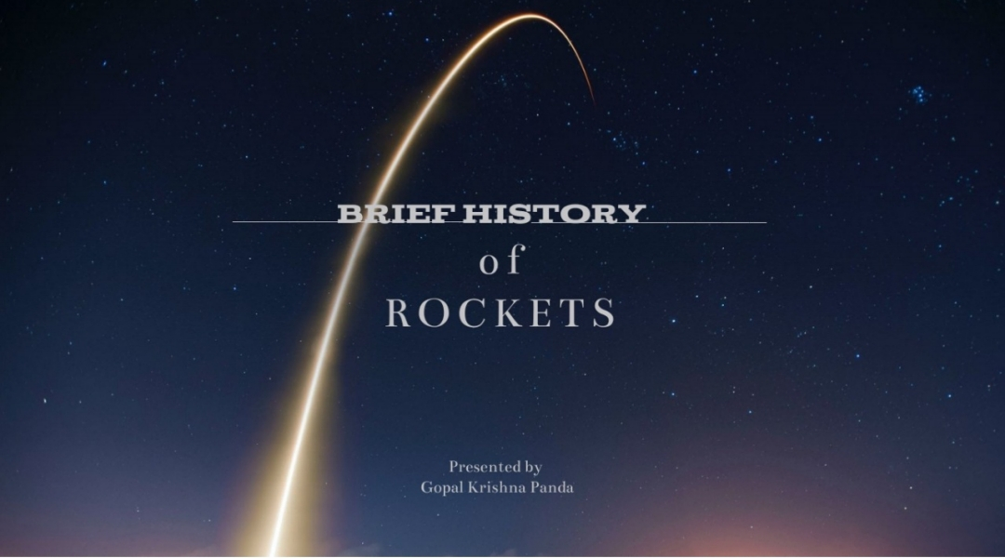

Slide 5


Slide 6
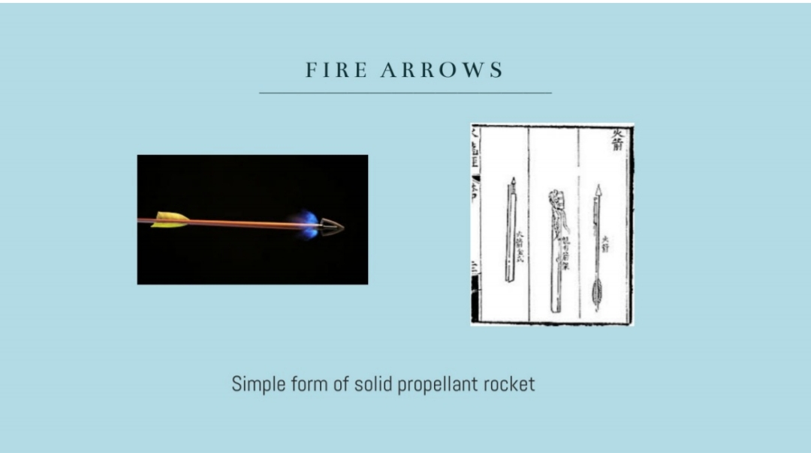

Slide 7


Slide 8
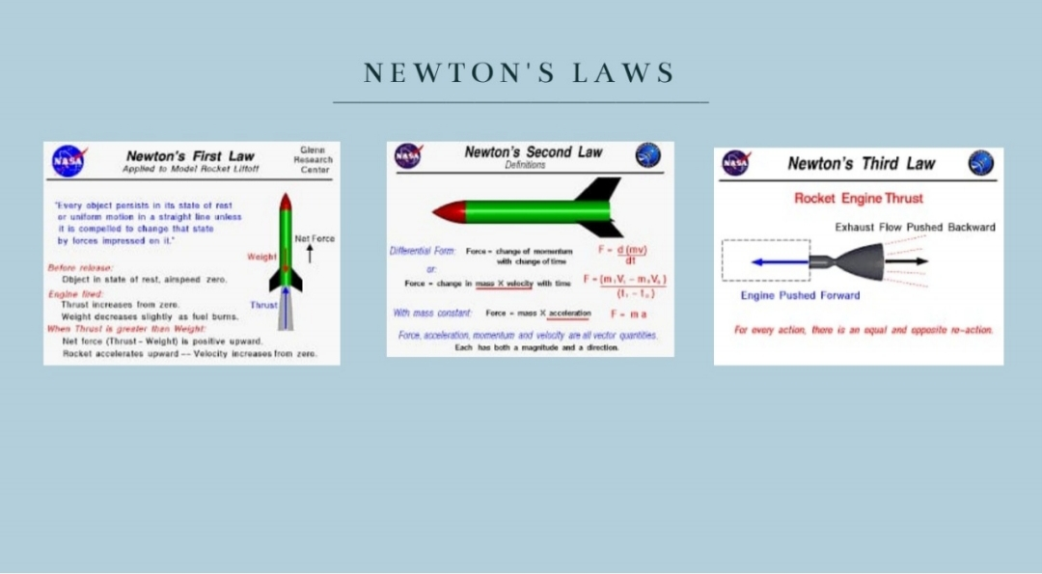

Slide 9
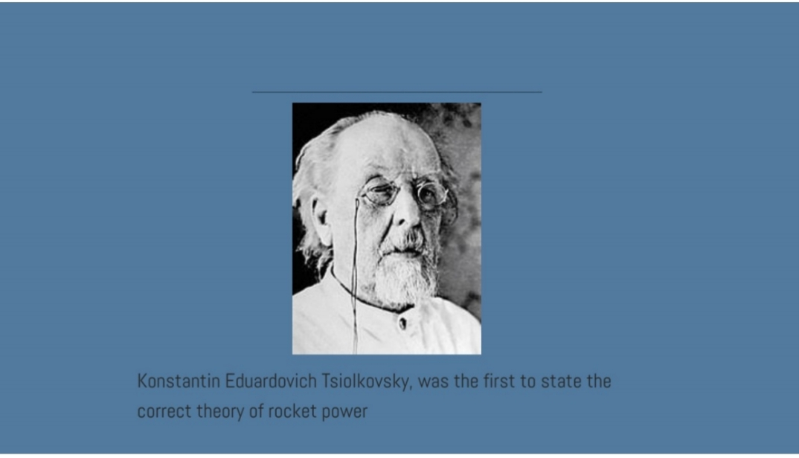

Slide 10
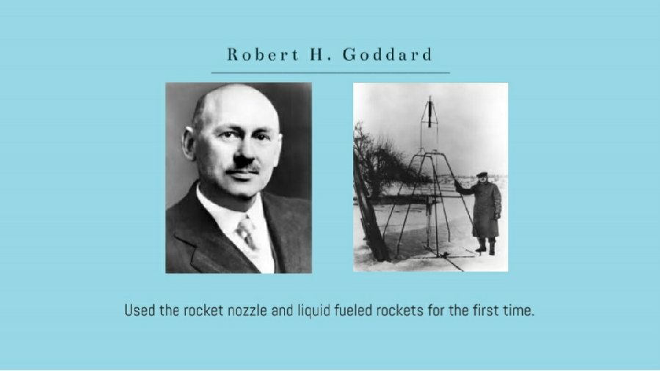

Slide 11
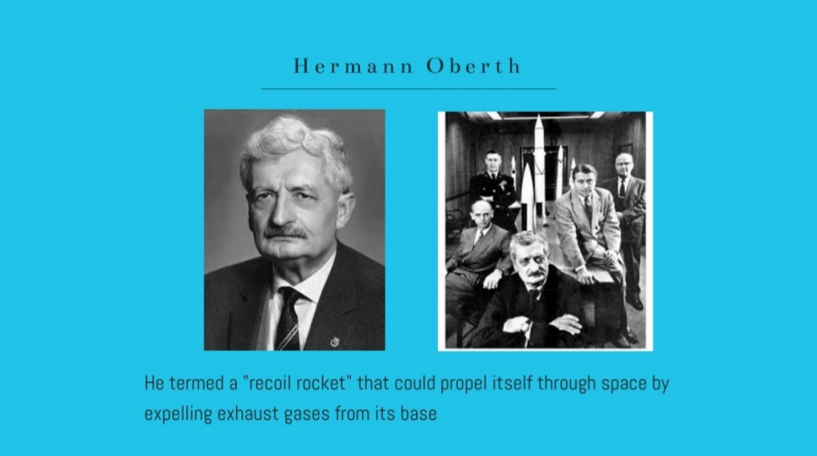

Slide 12
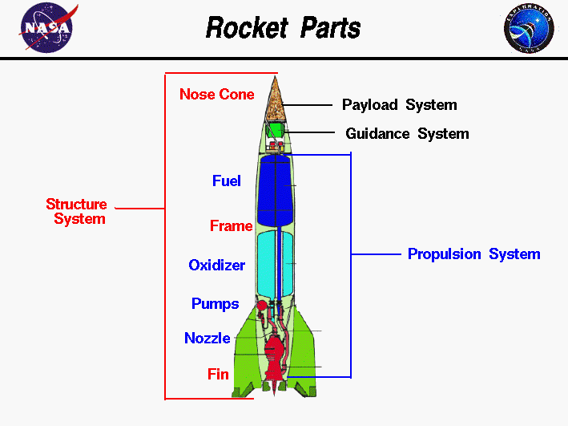
Types and Components of Rocket
Parts of ROCKET
Structural system
Payload system
Guidance system
Propulsion system
The propulsion system include that parts of rocket which is used to create essential thrust to reach the escape velocity and send it to the space like
Fuel tank
Oxidizer
Pumps
Nozzle
fin

Slide 13
Structural system
The structural system, or frame, is similar to the fuselage of an airplane. The frame is made from very strong but light weight materials, like titanium or aluminum, and usually employs long "stringers" which run from the top to the bottom which are connected to "hoops" which run around around the circumference. The "skin" is then attached to the stringers and hoops to form the basic shape of the rocket. The skin may be coated with a thermal protection system to keep out the heat of air friction during flight and to keep in the cold temperatures needed for certain fuels and oxidizers. Fins are attached to some rockets at the bottom of the frame to providestability during the flight
Payload Sytem
The payload system of a rocket depends on the rocket's mission. The earliest payloads on rockets were fireworks for celebrating holidays. The payload of the German V2, shown in the figure, was several thousand pounds of explosives. Following World War II, many countries developed guided ballistic missiles armed with nuclear warheads for payloads. The same rockets were modified to launch satellites with a wide range of missions; communications, weather monitoring, spying, planetary exploration, and observatories, like the Hubble Space Telescope. Special rockets were developed to launch people into earth orbit and onto the surface of the Moon.

Slide 14
Guidance system
The guidance system of a rocket may include very sophisticated sensors, on-board computers, radars, and communication equipment to maneuver the rocket in flight. Many different methods have been developed to control rockets in flight. The V2 guidance system included small vanes in the exhaust of the nozzle to deflect the thrust from the engine. Modern rockets typically rotate the nozzle to maneuver the rocket. The guidance system must also provide some level of stability so that the rocket does not tumble in flight.
Propulsion System
As you can see on the figure, most of a full scale rocket is propulsion system. There are two main classes of propulsion systems, liquid rocket engines and solid rocket engines. The V2 used a liquid rocket engine consisting of fuel and oxidizer (propellant) tanks, pumps, a combustion chamber with nozzle, and the associated plumbing. The Space Shuttle, Delta II, and Titan III all use solid rocket strap-ons

Slide 15
1. Solid-Propellant Rocket :
Solid propellants can be made of numerous compounds, for example, Black powder (contains charcoal, sulfur and potassium nitrate), Zinc-sulfur, potassium nitrate, and composite propellants based on ammonium nitrate or ammonium perchlorate. Although these rockets can provide high thrust for relatively low cost, they are not as efficient as modern, liquid-fuel rockets. They can only be used for launching up to 2 tons of payload into low Earth orbit.
2. Liquid Fueled Rocket:
As the name indicates, liquid-fueled rockets use liquid propellants to generate thrust. In contrast to solid propellants, liquid ones are composed either of single or two chemicals (bipropellants). Liquid propellants are largely preferred over solid propellants due to their high density and high mass ratio for the rocket. An inert gas is stored in an engine tank at an extremely high pressure to force the propellants into the combustion chamber. Although engines have a lower mass ratio, they are more reliable and thus mostly used in satellites for orbit maintenance.
Liquid rockets can be further categorized into three groups: monopropellant rockets (have single propellant), bipropellant rockets (have two different propellants), and more advanced tripropellant rockets (with three propellants). The most popular ones are bipropellant rockets that run on liquid fuel (hydrocarbon or liquid hydrogen) and a liquid oxidizer (liquid oxygen).

Slide 16
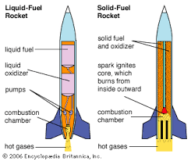
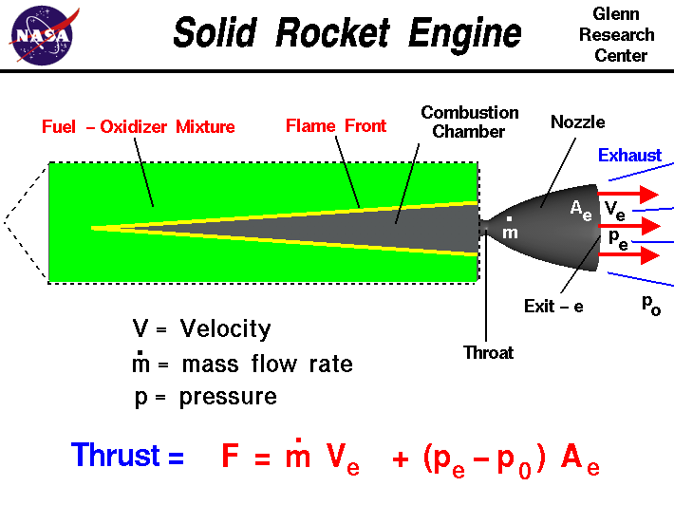
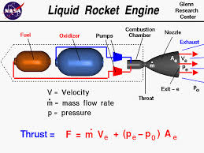

Slide 17
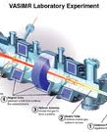
3. Plasma Propulsion Rocket:
In a plasma propulsion engine, the thrust is generated from quasineutral plasma (where ion and electrons are packed in equal numbers) . It’s a type of electric engine that uses currents and potentials (produced internally in the plasma) to accelerate the charged particles in the plasma. Plasma rockets can be easily built and used more than once due to their simple theory of performance and cheap fuel (a large number of gases, and their combinations can be used as fuel). Unlike conventional chemical rockets, plasma rockets do not use all of their fuel all at once, which makes them easily usable in flight.

Slide 18
Different types of Trajectory
Free ballistic flight trajectory.
Typical suborbital trajectory(single-stage sounding rocket).
Guided flight trajectory.
Circular orbit.

Slide 19
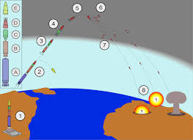
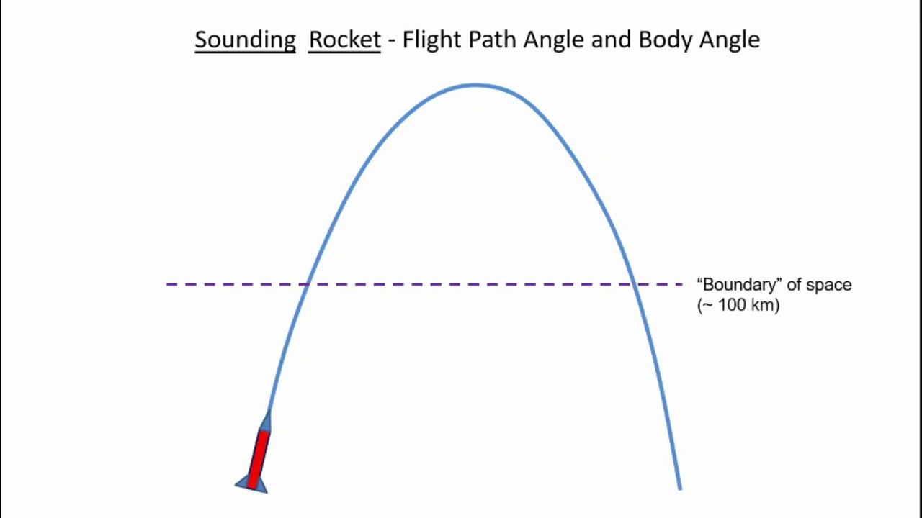
Free ballistic flight trajectory:
A ballistic trajectory is the path of an object that is dropped, thrown, served, launched, or shot but has no active propulsion during its actual flight. Consequently, the trajectory is fully determined by a given initial velocity and the effects of gravity and air resistance. Mortars, bullets, particles, and jumping computer game characters (between key presses) are all examples of ballistics, while actively controlled aircraft and rocket-propelled grenades are not.
Typical suborbital trajectory
A sub-orbital spaceflight is a spaceflight in which the spacecraft reaches space, but its trajectory intersects the atmosphere or surface of the gravitating body from which it was launched, so that it does not complete one orbital revolution.

Slide 20
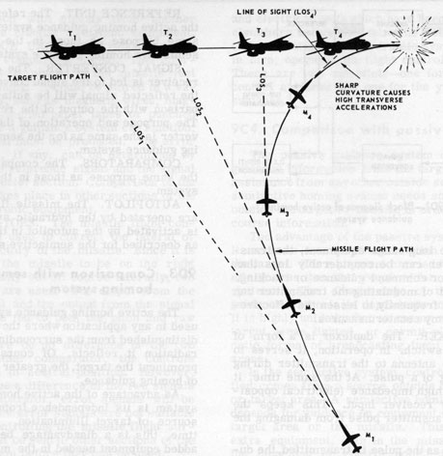
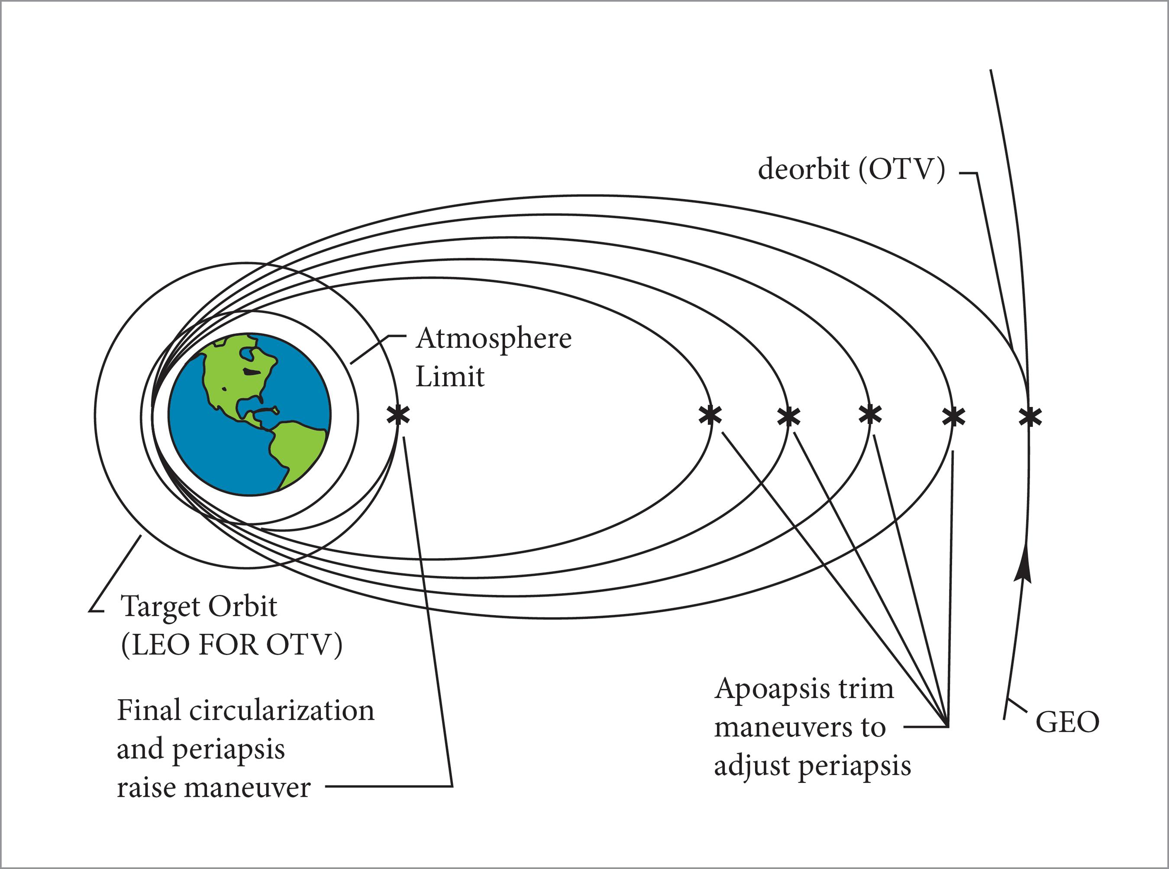
Guided flight trajectory
Preprogrammed Trajectory. Trajectory shaped by i.e. lift, thrust vectoring and modulation; Launch vehicles that places payloads into circular orbit.
Circular Trajectory
If the direction of the velocity is orthogonal to the position vector, the trajectory will clearly be a circular orbit of radius R + d. However, if the velocity is in any other direction, the trajectory will be an ellipse of semi-major axis equal to R+d.

Slide 21
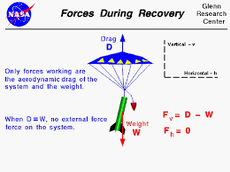
Parachute Deploying System
The parachute of a model rocket is deployed in two stages. The first stage launches the rocket upwards. The second stage deploys the parachute through a small explosive charge upwards inside the rocket tube up to the nosecone, pushing the parachute out and releasing it.
Stage 1 of Model Rocket Parachute Deployment: The Launch
Before the parachute can deploy, the rocket first has to launch. Within a timer-based deployment system, the time of deployment of the parachute is affected by the actual amount of propellant available to the rocket.
The less propellant available to the model rocket’s engine, the shorter the delay in the release of the parachute. The amount of fuel determines both how high the rocket will fly and when the parachute deploys

Slide 22
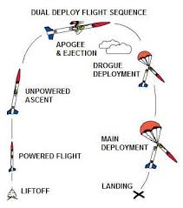
Stage 2 of Model Rocket Parachute Deployment: Release of the parachute
Within a timer-based model rocket parachute deployment system, the amount of propellant that the rocket has in conjunction with the weather patterns and size/ weight of the model rocket is going to determine when the second stage of the model rocket’s parachute is engaged.
At the end of the first stage, the model rocket will engage a small charge that will blast back upwards through the model rocket tube towards the direction of the model rocket’s nosecone. This will force the parachute through the top of the model rocket (nosecone). Once the descent begins, the parachute will catch the air underneath it, causing it to open up and come back down for safe retrieval.

Slide 23
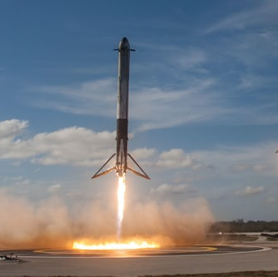
A brief introduction of Reusable Rocket
Space sector has always been seen as a heavy investment sector because space agency puts million of money to build a rocket which will be used only once to send their product to the space .
After a saturated trend space sector,a revolutionary step,reusable rocket is seen due to private company like spacex which will reduce the price by a factor of hundred.
At this point of time,there is no complete reusable rocket,but spaceship like Falcol 9 of spacex has reusable first stage and capsule part.

Slide 24
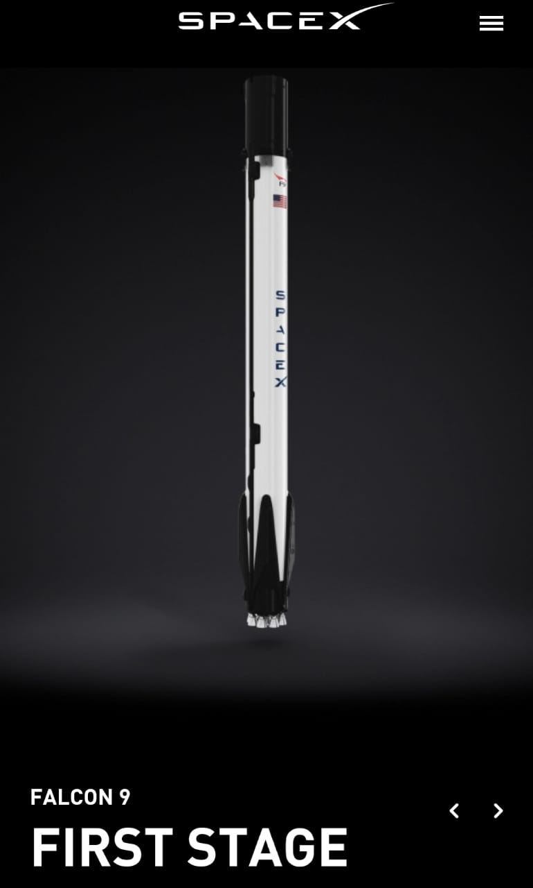
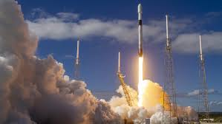

Slide 25
Conclusion
After all of this ,we are still far behind from futuristic space travel and multiplanetory human esablishment.
And to revolutionize commercial space travel ,may oragnization like NASA & ISRO are allowing private company to come to the play and allow them to use their resources.
Government should also invest and give all type of facilities to space sector so that they can show their full potential.

Slide 26
