Slide 1
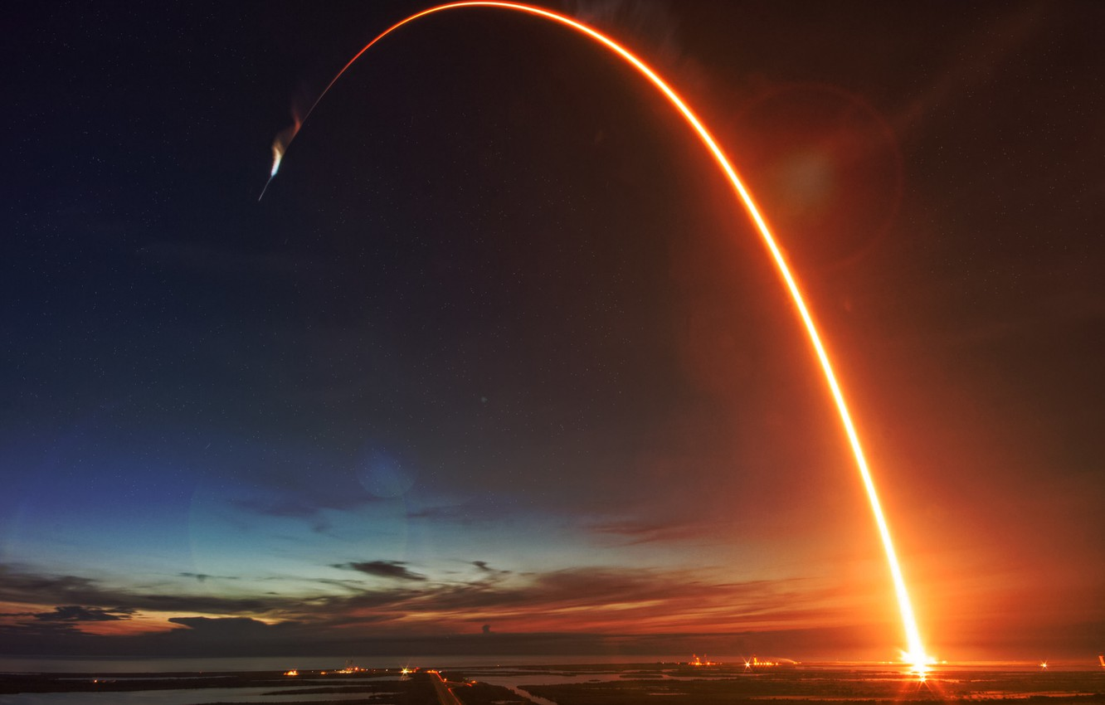
Basics
of
Rocketry

Slide 2

What is a Rocket?
A cylindrical bodied device which uses the propulsion mechanism to travel through maximum altitudes or distance by achieving high speeds.
It has revolutionised the whole world in many sectors like military , space and other science explorations.

Slide 3
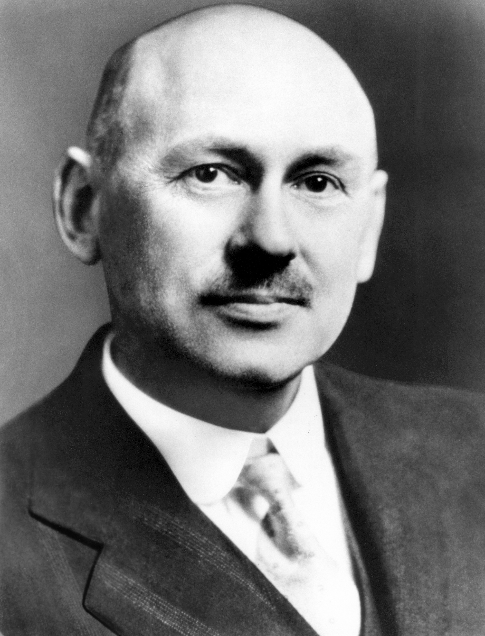
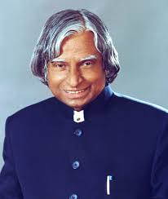
A brief history
One of the first rockets to be ever made was a wooden bird around 400BC and used solid propellent.
1232 was the first time, rockets were used in war by the Chinese against the Mongols in the battle of " Kai Cheng".
Then came many names including Jean Froissart, Joannes de Fontana who made changes in the models over time.
Robert H. Goddard
Father of modern rocket propulsion
In latter 17 th century, sir issac Newton came up with his laws which explained the motion of a rocket. These were considered and understood later hence leading to the modernization of rockets.
In india, ISRO was launched in the year 1969, with Vikram Sarabhai as the chairman and India first launched a rocket in 1963.
APJ Abdul Kalam
Missile man of India

Slide 4





Slide 5
A Model Rocket
These are small versions or prototypes of the real rockets. These are made and used for trials before real rockets are launched.
These help us understand the basics of forces acting on the rockets and the basics of aerodynamics.The parts are a rocket body, a nose cap, recovery wadding, recovery system, igniter, model rocket engine and engine mount.
There are many model rocket kits available in the market which can be used.
They do not reach very high altitudes and can also be reused if they don't have any major damages.

Slide 6
A modern rocket and its parts
The components of a rocket are a part of the structural system of the rocket.
A full scale rocket has 4 major systems: Structural system Payload system Guidance system Propulsion system
These systems according to their names contain the elements required for that task to be accomplished by that system
4. These systems vary from rocket to rocket depending on the size and capacity of the rocket.

Slide 7
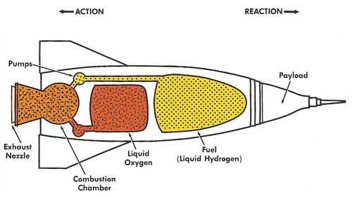
A modern rocket and its parts
Navigation systems and other sensors

Slide 8
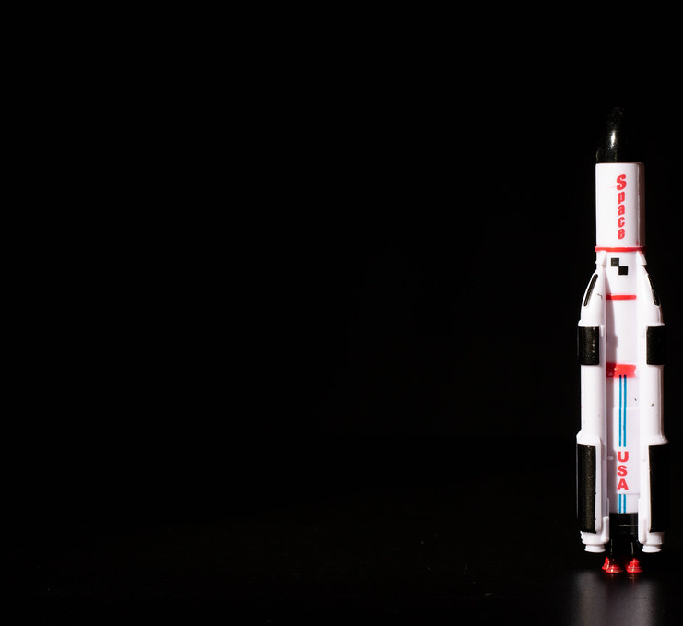
Theories and mechanisms
the vast rocket science includes numerous concepts in its mechanisms yet beginning from a little home made bottle rocket to the ones sent as missiles or as space vehicles all work on the principle of third law of motion that is every action has an equal and opposite reaction.
Through out the trajectory of the rocket it experience 4 different forces that are lift , weight , drag and thrust which accordingly accelerate and deaccelerate the rocket.
Mass ratio is another factor determining its performance which is the ratio of the initial mass to the final mass of the rocket , it should be high bot attaining maximum resultant speed.
Optimization of propulsive efficiency is vital.

Slide 9
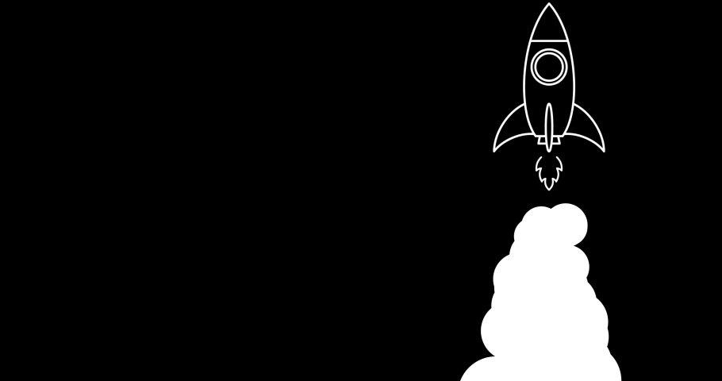
Propellants and its types
The major types of propellants are solid, liquid and hybrid.
Solis propellants are east to store and handle which makes them perfect for military usage.
Liquid fueled rockets have better specific impulse and can be throttled, shut down and restarted.
Propellants are the material used in rocket engines to generate thrust. Generally a propellant consists of a fuel and an oxidizer.
A hybrid propellant mostly consists of a solid fuel and a liquid oxidizer.

Slide 10
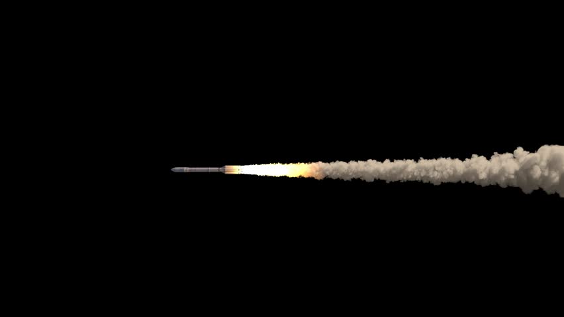
Combustion Process
The fuel and oxidizer are pumped and released into the combustion chamber With the help of pumps and injector plates.
The chemical reaction between the oxidizer and the fuel which is highly exothermic occurs in the chamber and the resultant gas with high pressure is led out through nozzle propelling the rocket.

Slide 11

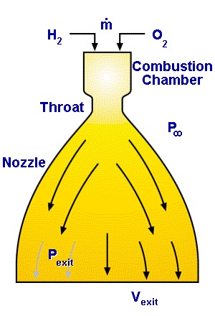
The Nozzle
Function of nozzle: Basically a nozzle converts the chemically prepared thermal energy generated in combustion chamber to kinetic energy.
Importance: Since thrust is a product of mass and velocity, the low velocity and high pressure gases produced in the combustion chamber are to be converted to low pressure high velocity exhaust. That’s the part when nozzle comes in to play.

Slide 12

Motors of a rocket
They are basically the rocket engine parts .
There are 3 types of motor used in rocketry.BP motors –
Black powder or BP, uses ordinary gunpowder like the stuff used in fireworks
AP motor - Ammonium perchlorate-based mixture, generally known as an AP motor
Hybrid motor - normally using nitrous oxide as the oxidiser and plastic as the fuel.
Rocket Motor CodesThe designation for a specific motor looks like C6-3. In this example, the letter (C) represents the total impulse range of the motor, the number (6) before the dash represents the average thrust in newtons, and the number (3) after the dash represents the delay in seconds from propelling charge burnout to the firing of the ejection charge (a gas generator composition, usually black powder, designed to deploy the recovery system).

Slide 13

Igniters and Launch Controls
A Rocket Motor Igniter provides the necessary heat source to ignite rocket engines. This igniter utilizes an electrical input stimulus that ignites.
HBO Igniters are qualified and used to support the safe launching of various U.S. and International space vehicles.
Launch operations are supervised and controlled from several control rooms.
For navigation and other connection purposes sometimes on shore stations are also established .

Slide 14
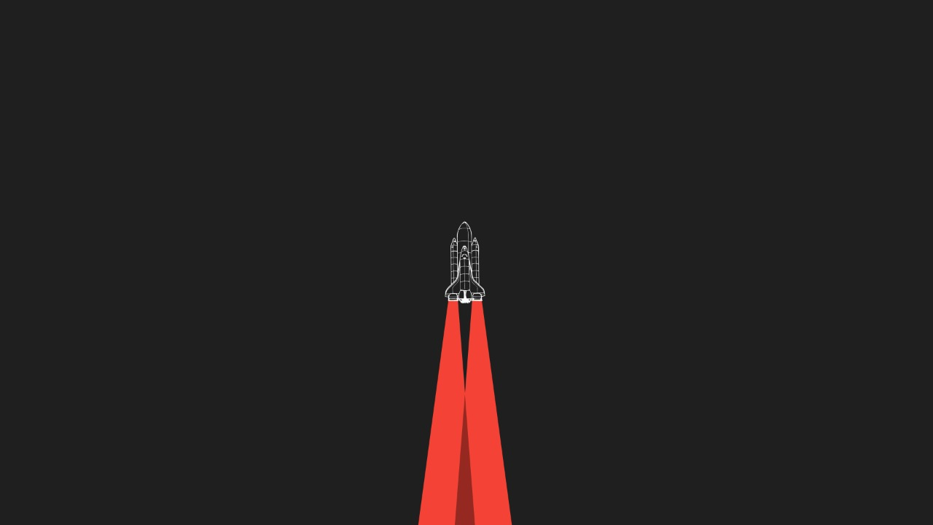
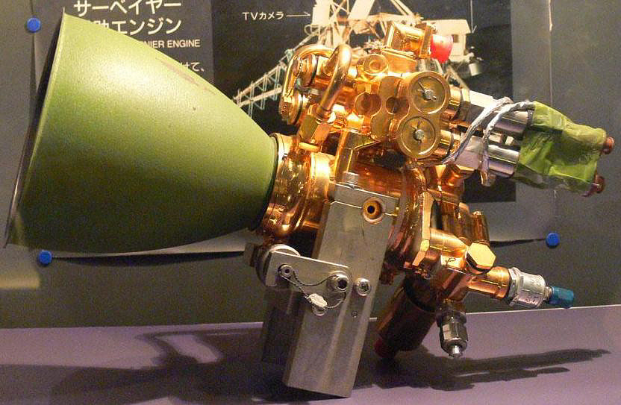
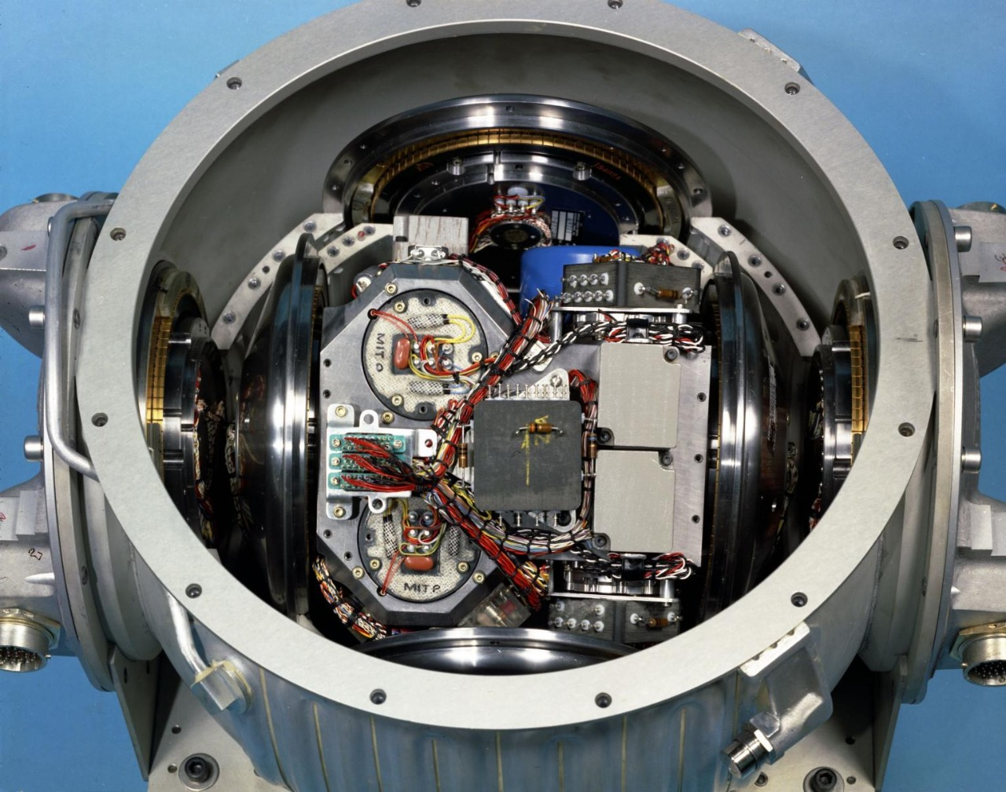
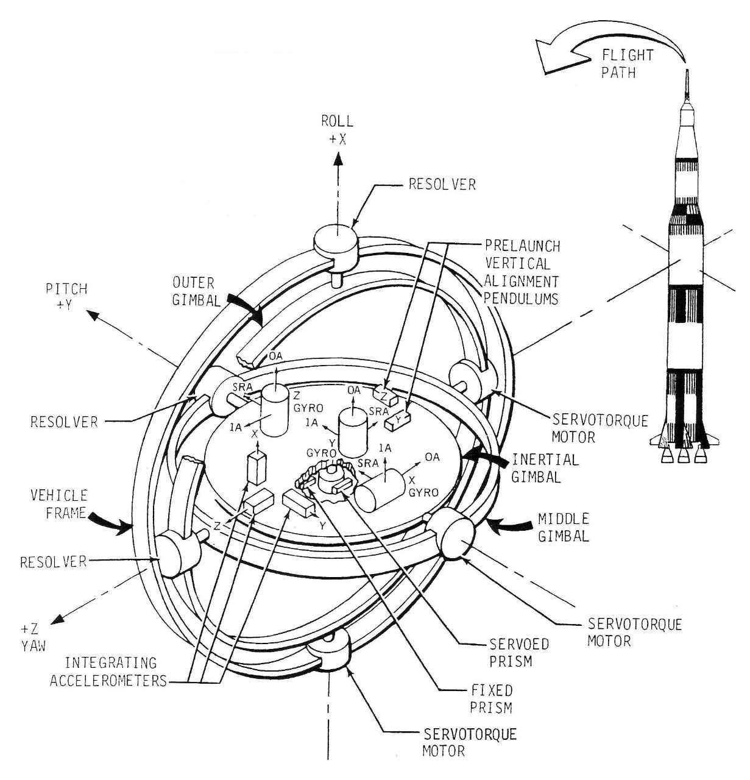
Direction Stabilization Devices
In a gimbaled thrust system, the exhaust nozzle of the rocket can be swiveled from side to side. As the nozzle is moved, the direction of the thrust is changed relative to the center of gravity of the rocket.
A vernier thruster is a rocket engine used on a spacecraft for fine adjustments to the attitude or velocity of a spacecraft. Depending on the design of a craft's maneuvering and stability systems,
Gyroscopes are devices that measure rotation as angles or angular rates. In a moving platform (like aircrafts, rockets or missiles), gyros are used to measures the orientation (roll, pitch and yaw) angles and the rates of change
Inertial Navigation Systems (INS) are navigational systems capable of calculating position, either relative to some reference system/point or to absolute coordinates.

Slide 15

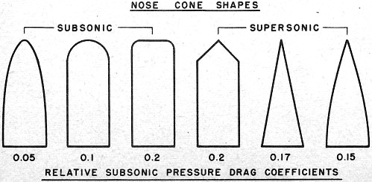
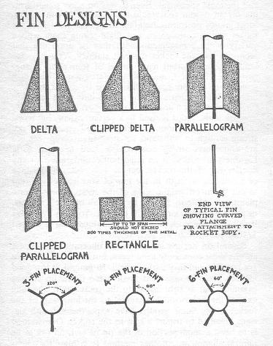
Structural details and their importance
The nose cone is the top most part of a rocket which carries the payload of a rocket are designed to minimise drag and to provide stability and control .
The purpose of putting fins on a rocket is to provide stability during flight, that is, to allow the rocket to maintain its orientation and intended flight path. They are attached to the posterior part of a rocket and are also known a aerofoils.

Slide 16

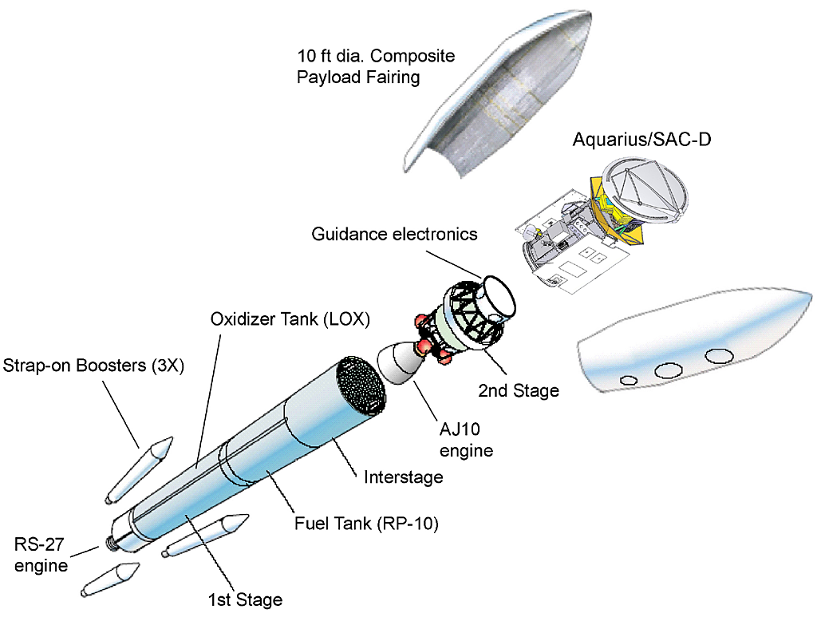
Staging of a Rocket
.
In order to lighten the weight of the vehicle to achieve orbital velocity, a portion is discarded by the launchers from the vehicle and this process is called "staging". There are two types of rocket staging:
Serial staging and Parallel staging-
Modern rockets use staging, because of the high amount of fuel required to launch of a rocket.
Once a stage has emptied all of its fuel, it detaches and returns to the earth and the second stage gets ready.
The three stage to orbit launch system is the most commonly used rocket system to attain earths orbit .The stages help the rocket overall to attain orbital velocity by providing propulsion consecutively.

Slide 17
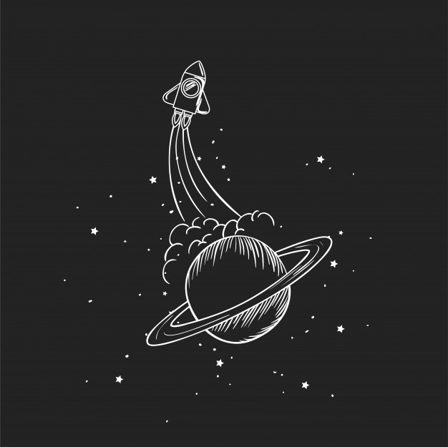
Centre of gravity and Centre of Pressure
the centre of pressure is the point on a rocket through which all aerodynamic forces act on the rocket. In other words air pressure below it and above it is equally distributed.
the point around which total gravitational force appears to act.
Cp is always below cg.
If rocket makes a certain angle with it's vertical motion due to air pressure then the cp would act to push the rocket back into it's original vertical direction.
Cp= ((area of nose*distance of nose) + (area of tube*distance of tube) + (area of fins*distance of fins))/total projected area of the rocket.

Slide 18

Some other important aspects of rocketry
Once it reaches the apogee a parachute is deployed to ensure the safe descent and recovery of the scientific equipment.
The swing test is used to find stability of a rocket using a string is the tied along the centre of mass of the model rocket and is then hanged.
The size and shape of the cross section and boat tail varies for various uses.

Slide 19
Pollution and its measure in Rocketry
Some causes:
Space launches have a hefty carbon foot print due to burning of solid rocket fuels.
one of the major concern is the accumulation of space debris in the planet’s orbit.
Some solutions made:
For space junk, some missions were launched to focus on dead satellites
For the pollution through fuels, a major change was made by using liquid hydrogen

Slide 20
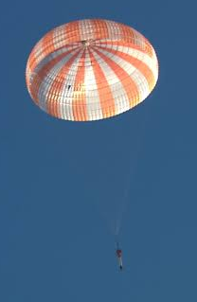
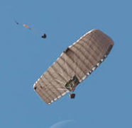
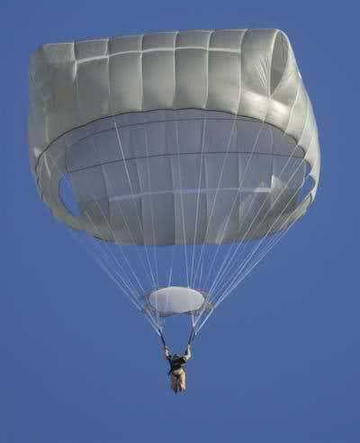
What is a Parachute?
It is a device used to slow the motion of an object through an atmosphere by creating drag.
Ram air Parachutes:-
This is the modern type of Parachutes used for mainly sports jumping.
Round Type Parachutes:-
Made from dome-shaped canopies and it simply relies on drag to slow a descent. It is unsteerable and does hard landing.
Cruciform parachutes;:-
It is modified into a cubical shaped parachute due to which it gives up to 30% more stable landing.

Slide 21
Parachute Deployment
There are 3 parachute deployment systems.
1. Aerodynamic deployment system.
In this system there is a drogue parachute through which the main parachute will be launched.
eg:- Suitable for small sounding rockets.
2. Spring deployment system.
Here a compressed spring is used to deploy the parachute. It can be used even if the weather conditions are not suitable.
3. Parachute deployment using Mortar system.
In this system the parachute is deployed using a pressurised gas through the tubes. It is used where the velocity is high and deployment time of the parachute should be minimised.

Slide 22
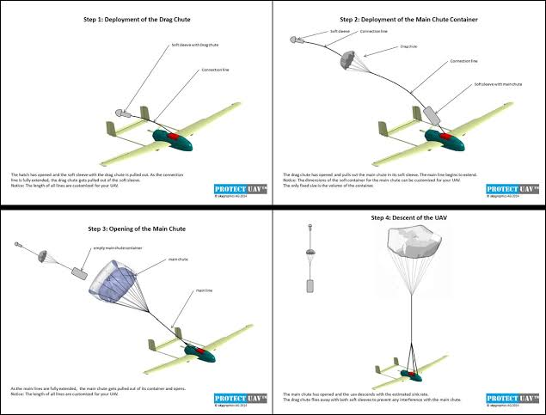

Slide 23
Parachute Deployment
There are 3 parachute deployment systems.
1. Aerodynamic deployment system.
In this system there is a drogue parachute through which the main parachute will be launched.
eg:- Suitable for small sounding rockets.
2. Spring deployment system.
Here a compressed spring is used to deploy the parachute. It can be used even if the weather conditions are not suitable.
3. Parachute deployment using Mortar system.
In this system the parachute is deployed using a pressurised gas through the tubes. It is used where the velocity is high and deployment time of the parachute should be minimised.

Slide 24
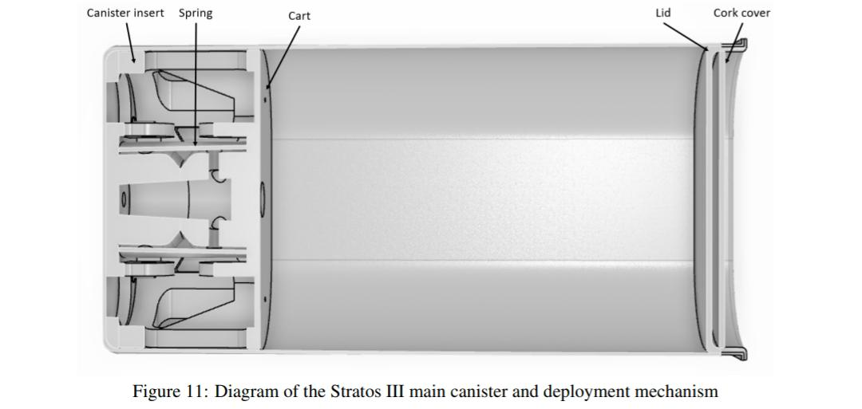
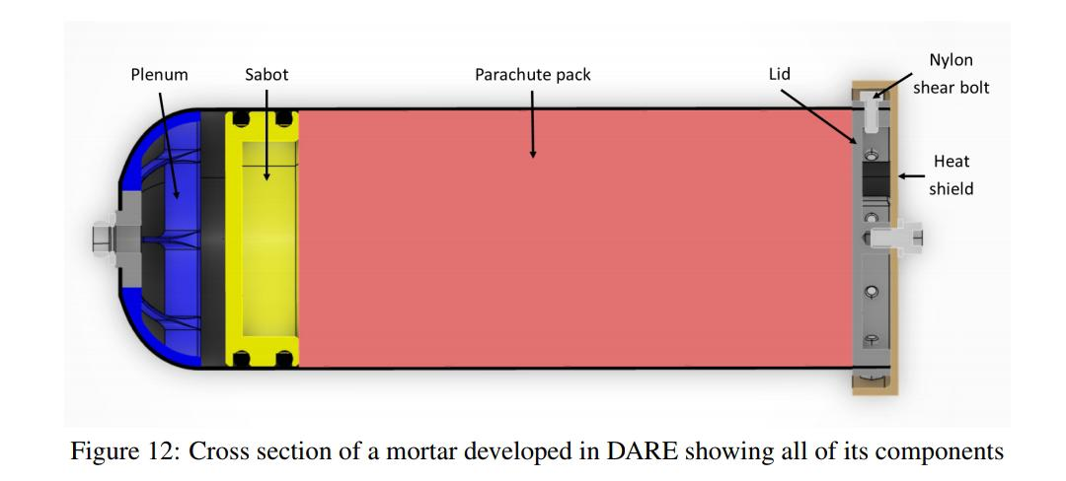

Slide 25
Parachute Deployment
There are 3 parachute deployment systems.
1. Aerodynamic deployment system.
In this system there is a drogue parachute through which the main parachute will be launched.
eg:- Suitable for small sounding rockets.
2. Spring deployment system.
Here a compressed spring is used to deploy the parachute. It can be used even if the weather conditions are not suitable.
3. Parachute deployment using Mortar system.
In this system the parachute is deployed using a pressurised gas through the tubes. It is used where the velocity is high and deployment time of the parachute should be minimised.

Slide 26
Thank you

