Slide 1

BASIC
ROCKETRY

Slide 2
01
ROCKET PRINCIPLES
02
TYPE OF ROCKETS
03
ROCKET SYSTEM AND CONTROLS
04
TYPE OF ROCKETS PROPULSION
05
MODEL ROCKET AND PARACHUTE DEPLOYMENT

Slide 3
ROCKET PRINCIPLES

Slide 4
ROCKET PRINCIPLES
NEWTON’S LAW
AERODYNAMIC FORCE

Slide 5
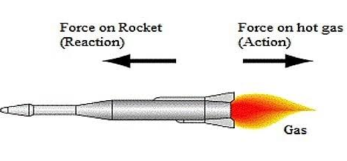
NEWTONS THIRD LAW
NEWTON’S LAW
EVERY ACTION IN NATURE THERE IS AN EQUAL AND OPPOSITE REACTION.

Slide 6
AERODYNAMIC FORCE
THE MAGNITUDE AND DIRECTION OF THE FORCES ACTING ON A ROCKET CHANGE DRAMATICALLY DURING A TYPICAL FIGHT
ON A ROCKET
THRUST IS USED IN OPPOSITION TO WEIGHT
IN ROCKET THE WEIGHT ACT THROUGH CENER OF GRAVITY
WHILE AERO DYNAMIC ACT THOUGH THE CENTER OF PRESSURE
ON A ROCKET AERODYNAMIC FORCES ARE GENERATED BY FINS , NOSE CONES , AND BODY TUBE

Slide 7
TYPE OF ROCKETS

Slide 8

TYPE OF ROCKETS
MISSILE
THE TERM MISSILE ACTUALY MEANS ANY OBJECT THROWN AT AN ENEMY AND INCLUDES ARROW, BULLETS AND OTHER WEAPONS
SOUNDING ROCKETS
SCIENTISTS USE SOUNDING ROCKETS TO CARRY SCIENTIFIC INSTRUMENTS INTO THE UPPER ATMOSPHERE TO TAKE MEASUREMENT OF AIR QUALITY,RADIATION FROM SPACE AND OTHER DATA
LAUNCH VEHICLE
THESE VEHICLES SEND SATELLITES AND OTHER SPACECRAFTS INTO SPACE
THRUSTERS
MANY SPACECRAFT USE ROCKETS CALLED THRUSTERS TO MOVE AROUND IN SPACE

Slide 9
ROCKET SYSTEM AND CONTROLE

Slide 10


ROCKET SYSTEMS
01
STRUCTURAL SYSTEM
02
GUIDANCE SYSTEM
03
PAYLOAD SYSTEM
04
PROPULSION SYSTEM

Slide 11
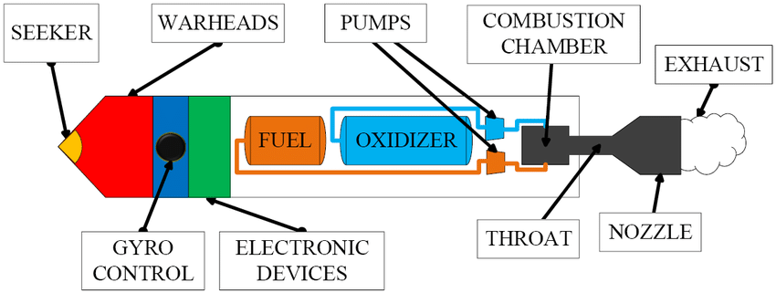
STRUCTURAL SYSTEM
The structural system transmits forces through the frame of the rocket. It must be very strong but light in weight,

Slide 12
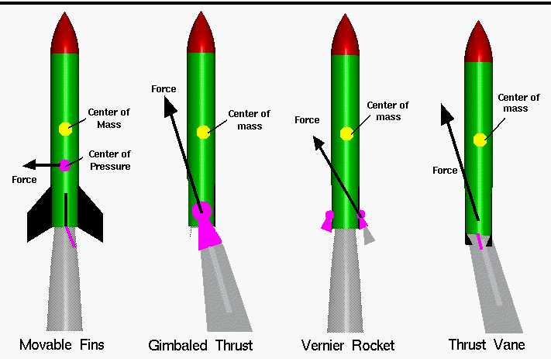
GUIDANCE SYSTEM
The guidance system of a rocket includes very sophisticated sensors, on-board computers, radars, and communication equipment.

Slide 13
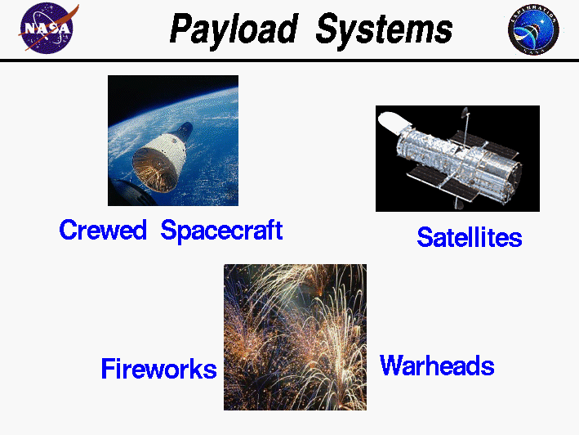
PAYLOAD SYSTEM
The payload of a rocket mainly depends on the rocket's mission.

Slide 14
PROPULSION
SYSTEM

Slide 15
TYPE OF ROCKET
PROPULSION SYSTEM
CHEMICAL ROCKETS
NEUCLEAR ROCKETS
LIQID OXYGEN , LIQUID FLORINE,NITROGEN TRIOXIDE
ELECTRIC ROCKET

Slide 16
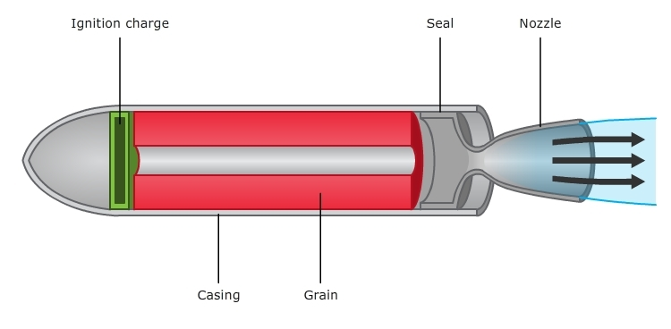
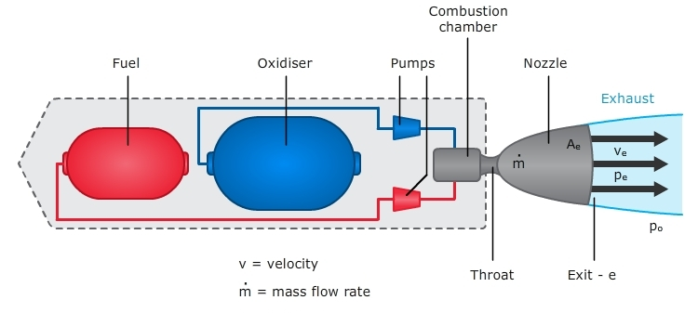
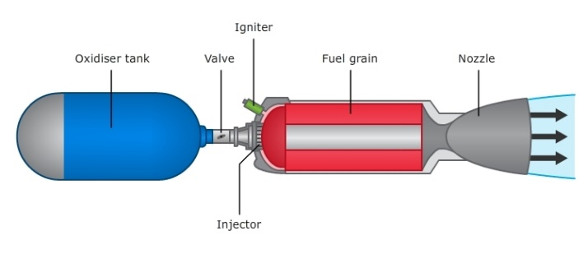
SOLID ROCKET ENGINE
LIQUID ROCKET ENGINE
HYBRID ROCKET ENGINE
CHEMICAL ROCKETS

Slide 17
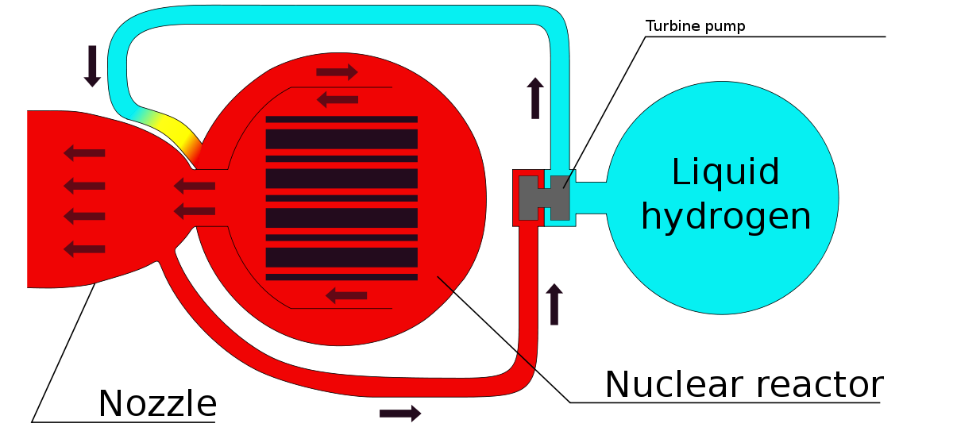
NUECLEAR ROCKET

Slide 18
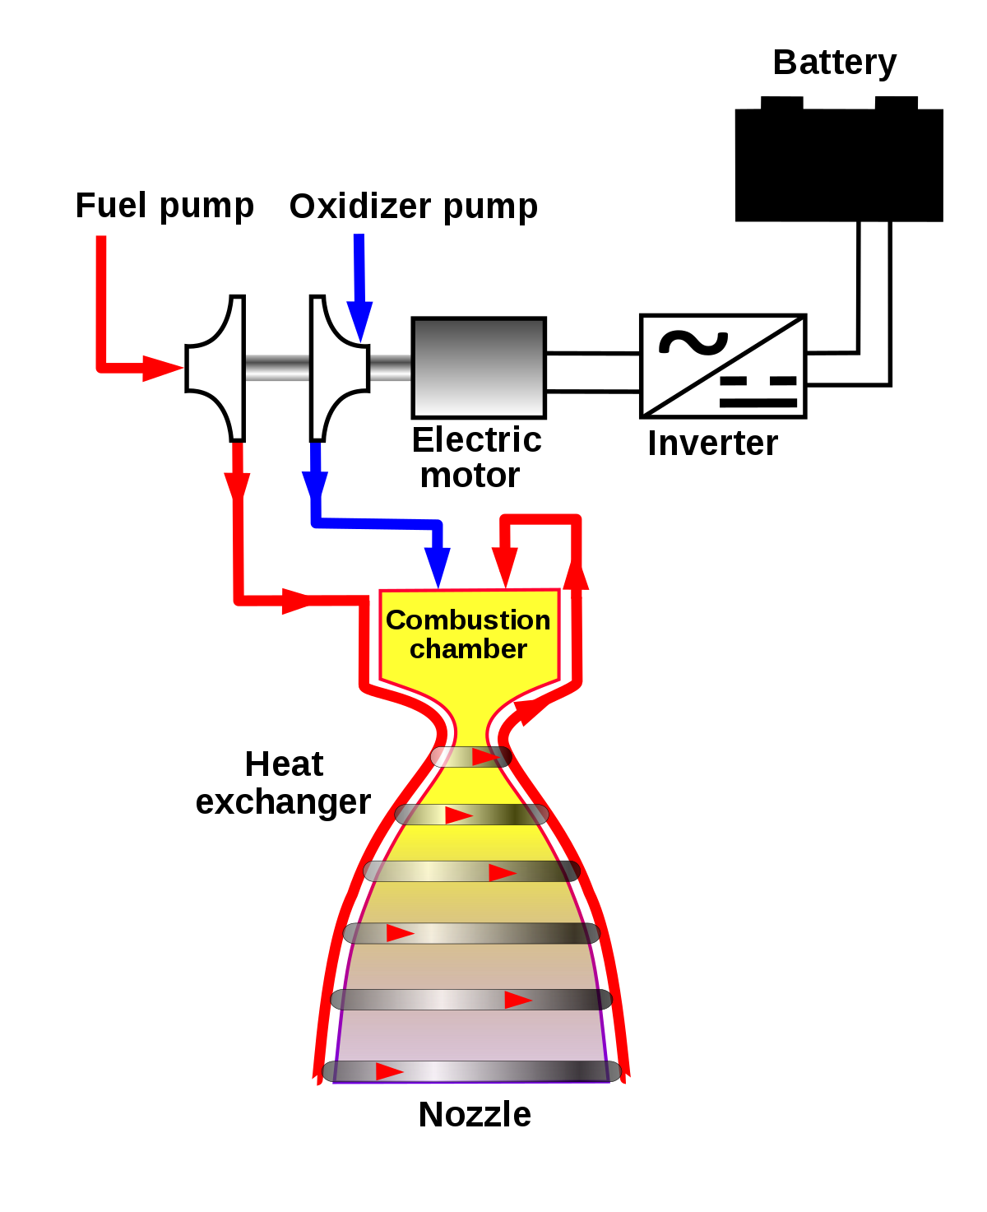
ELECTRIC ROCKETS

Slide 19
MODEL ROCKET
AND
PARACHUTE DEPLOYMENT

Slide 20
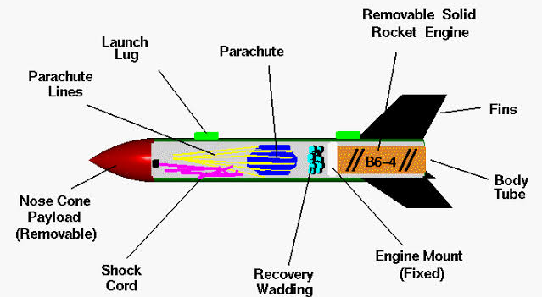
MODEL ROCKET

Slide 21
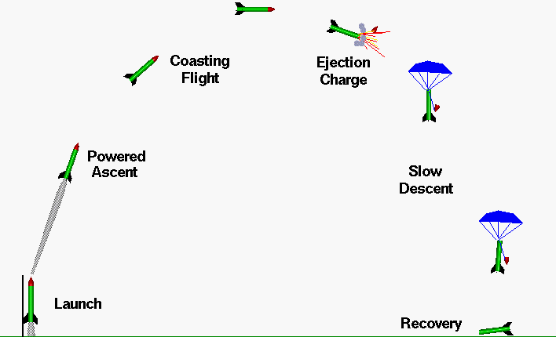
PARACHUTE DEPLOYMENT

Slide 22
Thank you

