Slide 1
EN1190 Engineering Design Project Smart Auto-Off Multiplug Socket for Dry Irons
W.U. Deshan – 230130E
K.T.G.T.N. Dhananjaya – 230138K
D.M.D.P. Dissanayaka - 230155J
U. Saruka - 230585C
Department of Electronic & Telecommunication Engineering University of Moratuwa, Sri Lanka

Slide 2
Abstraction
In many households, users often forget to turn off dry irons, leading to fire hazards, overheating, and energy waste. Despite the availability of smart appliances, most dry irons remain non-automated, increasing the risk of accidents due to human negligence.
We propose a Smart Auto-Off Multiplug Socket, specifically designed for dry irons. The device uses a vibration sensor to detect inactivity and cuts power automatically after a set time.
Goals:
Safety improvement through automatic shutoff
Versatility with dual-mode support
Cost-effective retrofit design
Easy usability and trust-building visual alerts

Slide 3
Microcontroller : PIC12F675 Sensor : SW420 Motion Sensor User Alert : Blinking LED Power Supply : 230V AC to 5V DC Converter
Modules We Use

Slide 4
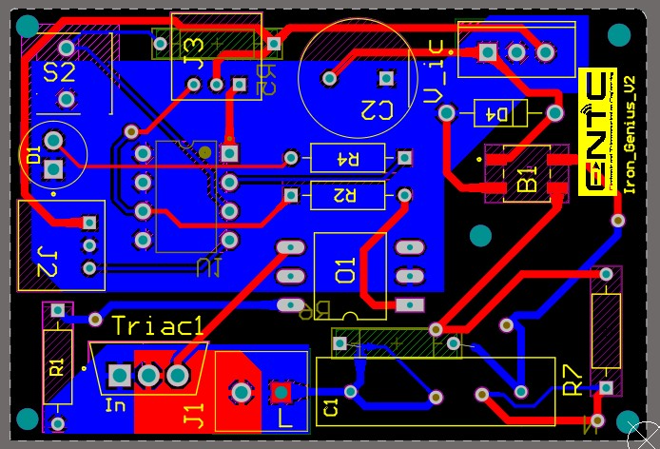
PCB Design
Figure: PCB 2D

Slide 5
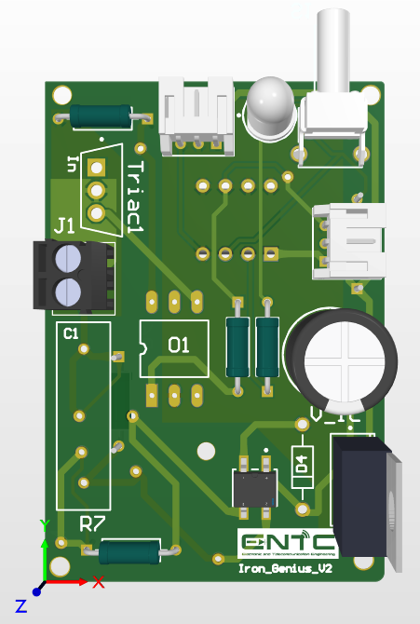
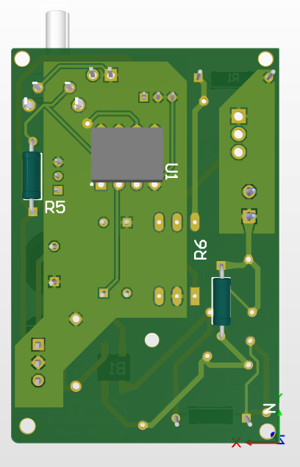
PCB Design
Figure: PCB 3D

Slide 6
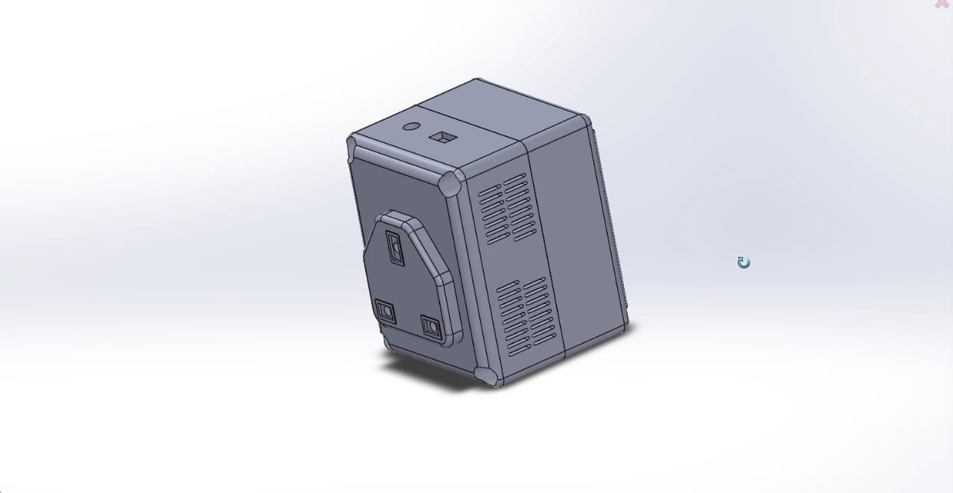
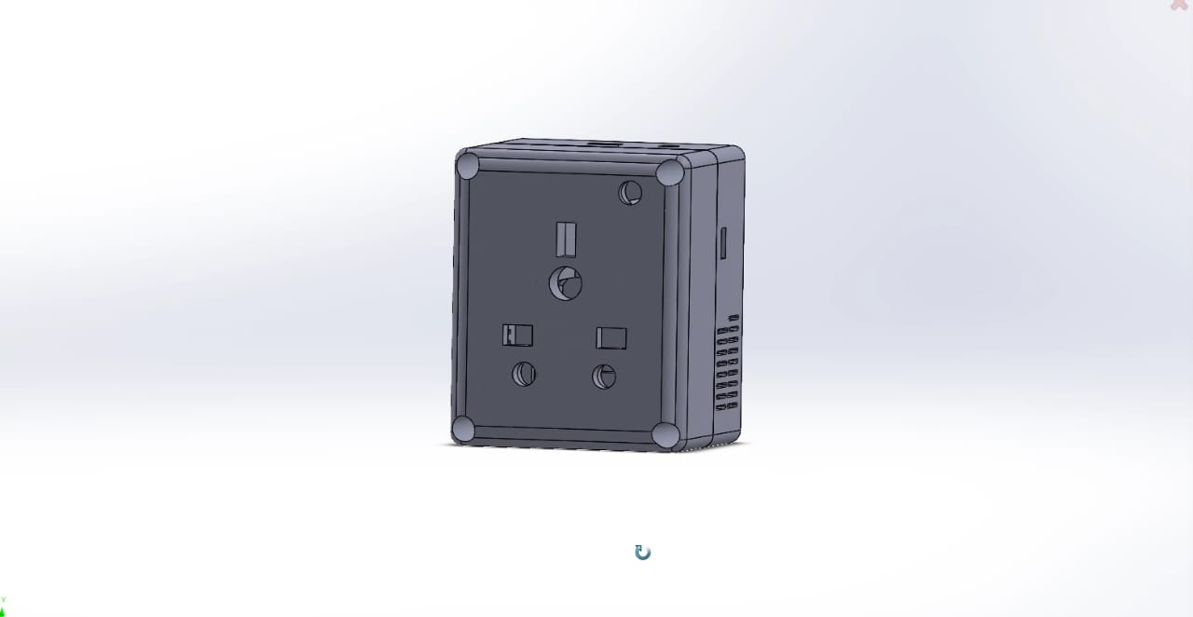
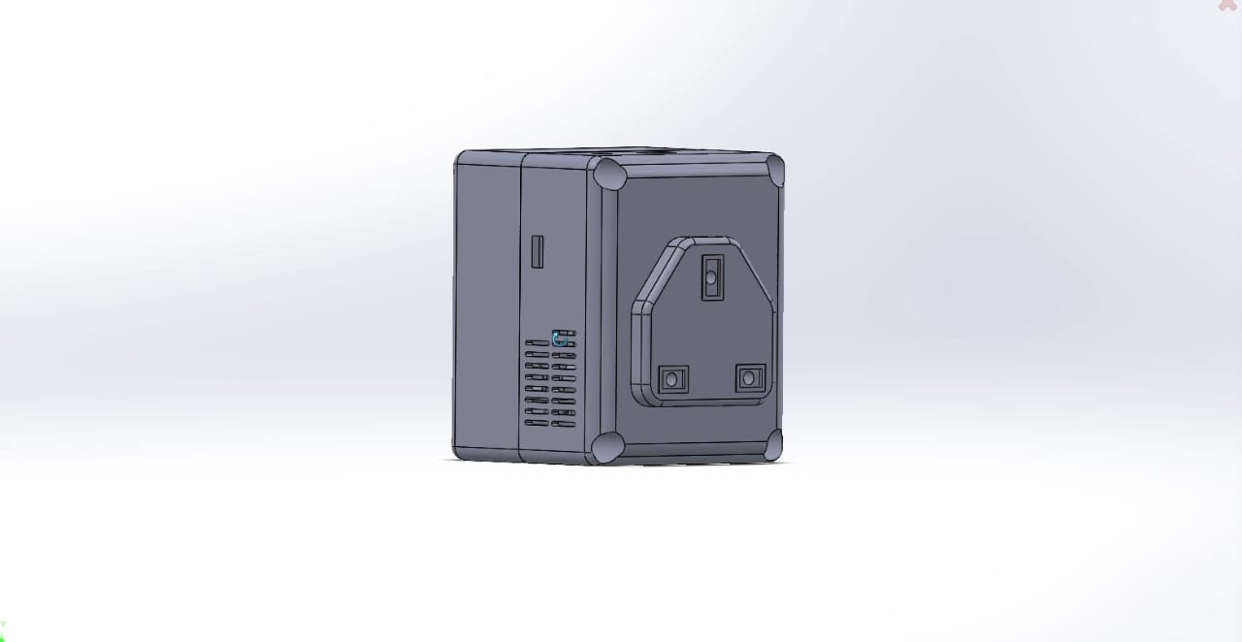
Enclosure Design
Multi Plug Unit

Slide 7
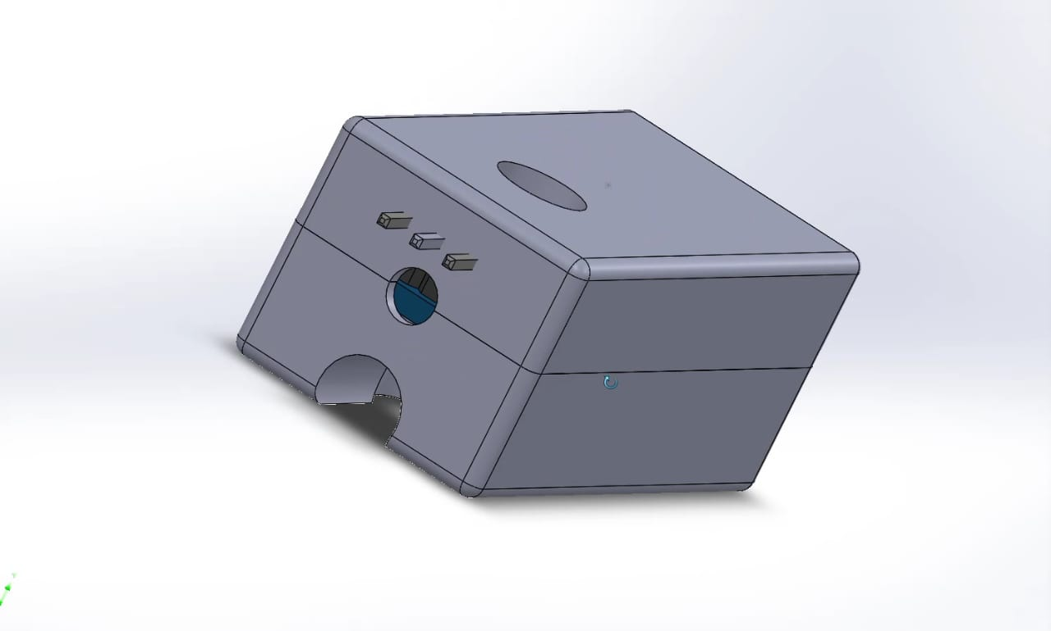
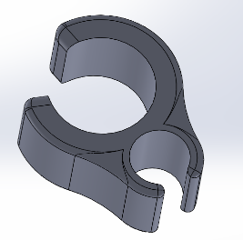
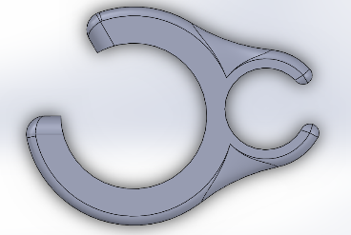
Enclosure Design
Clip
Sensor Module

Slide 8
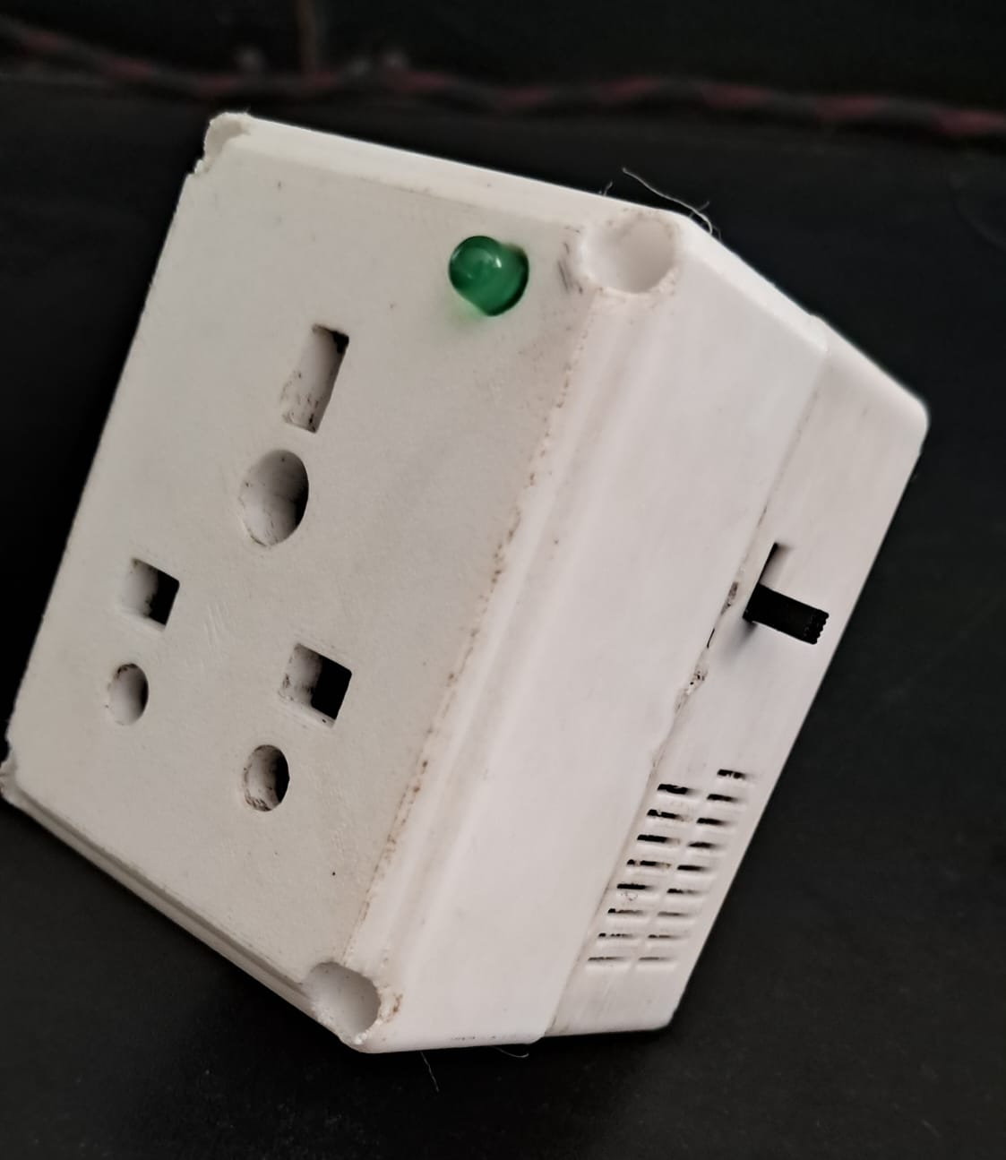
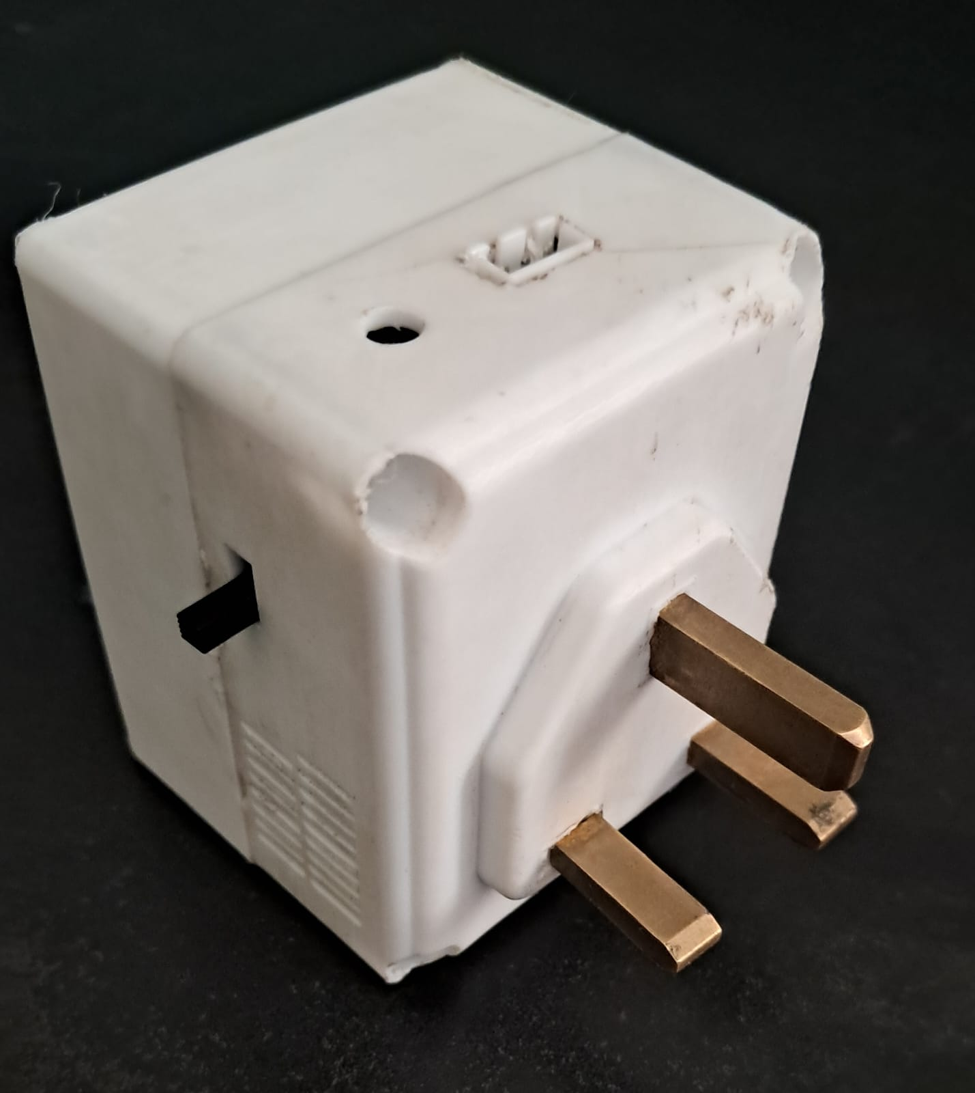
Final Product

Slide 9
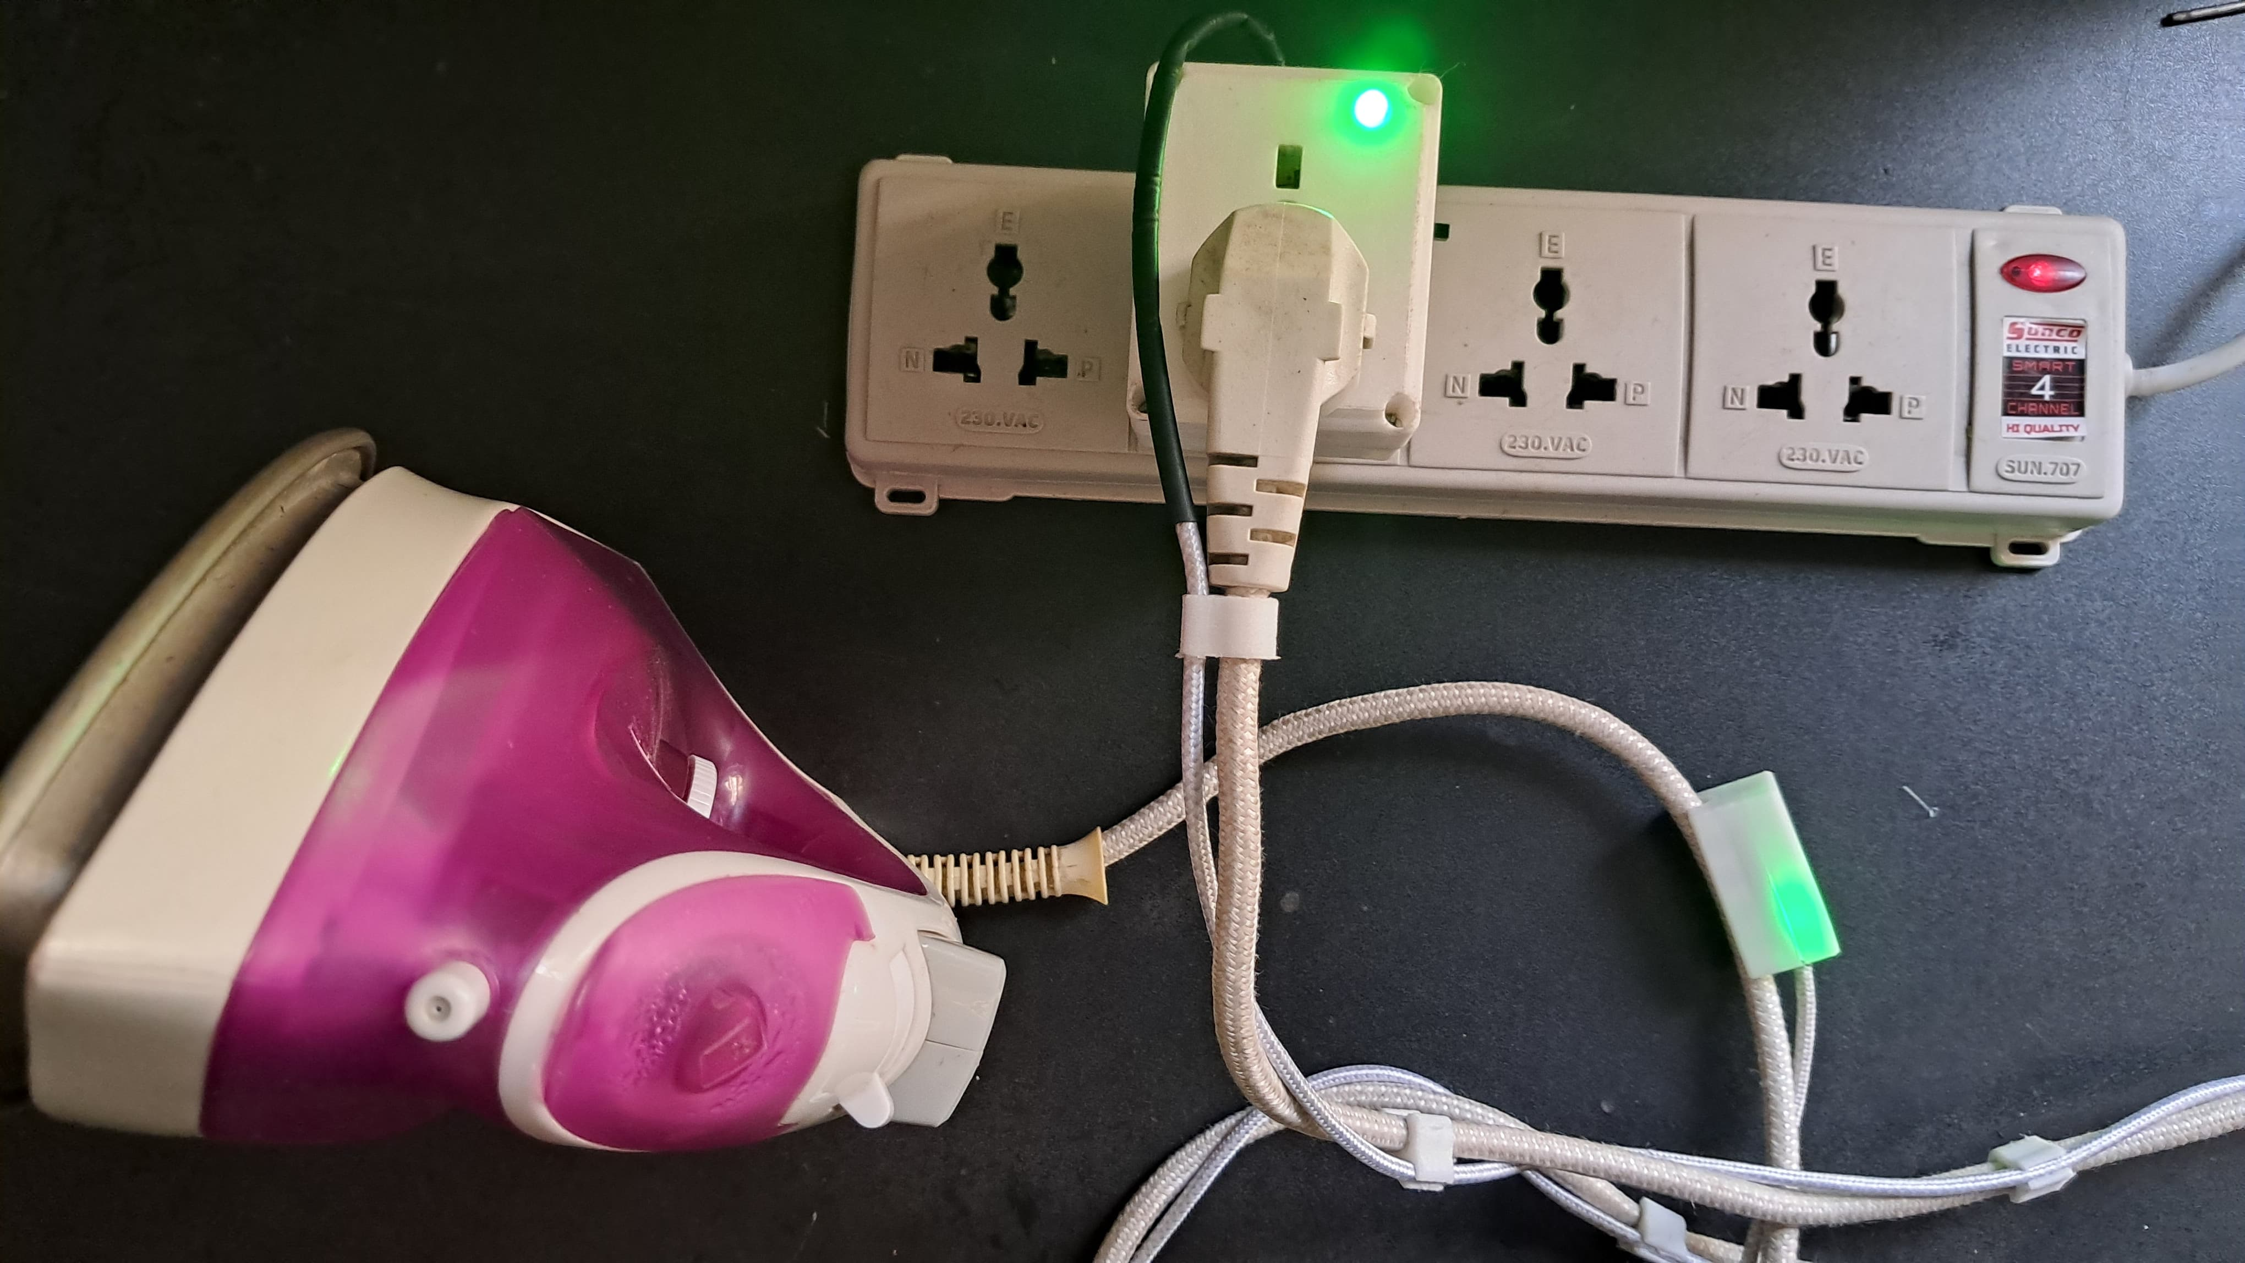
Final Product

Slide 10
Applications and Extensions
Our smart auto-off multiplug socket has a wide range of practical applications in both residential and commercial environments. It can be used to control dry irons, soldering irons, heaters, or any electrical appliance where motion-based automation can improve safety and save energy. The device is especially useful in households, hostels, tailoring shops, and labs where users often forget to switch off high-power appliances
As an extension, this smart socket can be adapted to work with any standard electrical appliance, allowing users to switch between automatic and manual modes. It also supports future integration with mobile apps for custom timers and notifications, transforming regular appliances into smart devices and enabling better energy management and smart home compatibility

Slide 11
Team Task Allocation
Name | Task Allocation
W.U. Deshan – 230130E | Assembling , Enclosure Design , Sensor integration and testing , Soldering
K.T.G.N. Dhananjaya – 230138K | Assembling , Enclosure Design , Sensor integration and testing , Enclosure Testing
D.M.D.P. Dissanayaka - 230155J | Circuit Design , Microcontroller Programming , PCB Design , Soldering
U. Saruka - 230585C | Enclosure Testing , Sensor integration and testing , Code-Debugging

Slide 12
The End

