Slide 1
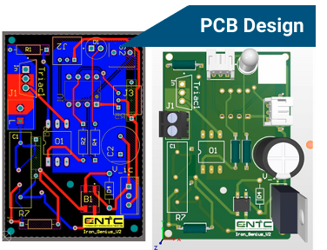
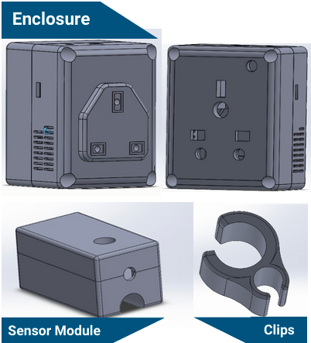
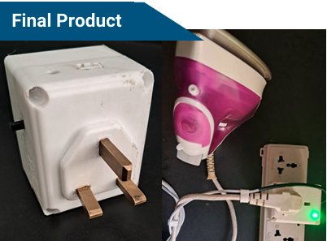
Automated Switch For Clothing Iron using wired motion Sensor (IronGenius)
Problem identification:
Most of the people iron clothes daily. With the busy lifestyle and less mindfulness, we can forget to turn off the iron from the plug and leave it on until someone see it.
This can cause waste of power and sometimes it can burn the clothes if we put it on the clothes for a long time.
Our solution:
An autonomous switch to turn off the iron after some time of inactivity.
As an additional feature this product can be used as a normal multiplug socket as well.
Implementation:
We introduce this as separate module that can be attached to the iron and the plug. It has two modules.
Plug module: The power supply to the iron comes through this unit. The control circuit is inside this module
Sensor module: This is attached to the iron’s power cable. It is used to identify the motion/ inactivity of the iron.
The two modules are connected via a thermal resistive wire (Fabric covered wire).
Components used:
Microcontroller-12F675
SW-420 Motion Sensor
5V Power Supply Module
BTA16 600 TRIAC
MOC3021 optocoupler
As a later development we can integrate the device into the iron which will make it more convenient to the users.
EN1190 ENGINEERING DESIGN PROJECT
IRON GENIUS

