Slide 1

KingaAPI
It’s them, not you.
API dependency monitoring for African developers
Deborah · Sifa · Gisele
kinga = “protection” in Swahili
Notes:
Gisele opens. "We are KingaAPI: Deborah, Sifa and Gisele. Kinga means protection in Swahili."

Slide 2
Payment APIs fail. Often.
GISELE · 40 S · THE PROBLEM
608
A payment just failed.
Is it my code, or is M-Pesa down?
mobile money operator incidents in 90 days, logged by one aggregator
41%
Developers debug their own code for hours,
while customers abandon checkout.
of teams learn about outages from their customers
M-Pesa · MTN MoMo · Airtel Money · Orange Money · Flutterwave · Paystack · Wave
Notes:
Gisele, 40 seconds. "African apps depend on payment APIs that fail often. One aggregator logged 608 mobile money operator incidents in 90 days, and 41% of teams learn about outages from their own customers. When a payment fails, a developer cannot tell quickly whether their code broke or the provider is down."

Slide 3
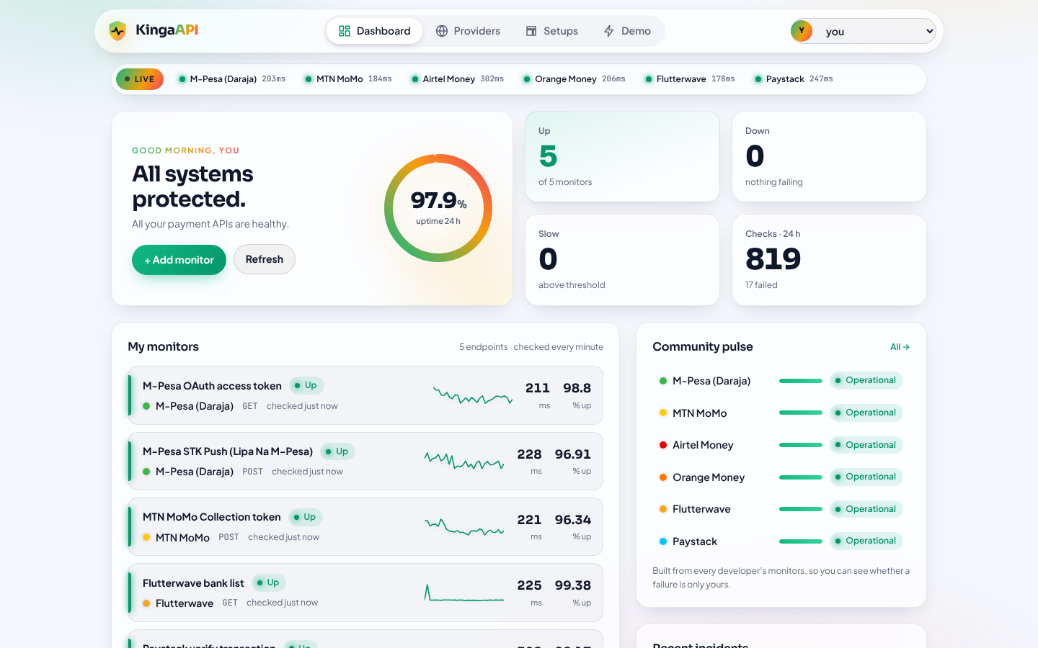
KingaAPI: is it them or you?
GISELE · 20 S · THE SOLUTION
1
Checks every minute
Calls each endpoint exactly as your app does: status, speed and JSON fields
2
Diagnoses the failure
Auth, rate limit, provider error, timeout or a silent schema change
3
Tells you whose problem it is
Compares with every other developer on the same provider
The dashboard: every payment API a developer depends on
Notes:
Gisele, 20 seconds. "KingaAPI. Kinga means protection. It monitors the provider APIs you depend on every minute and tells you whose problem a failure is."

Slide 4
How a check becomes a diagnosis
DEBORAH · 40 S · HOW IT WORKS
1
2
3
4
Check
Classify
Compare
Report
Every minute, exactly the way the app calls it
Status code, response time and the JSON fields the code needs
Are other developers on this provider failing too?
Expected vs. what came back, and what to check next
8 failure types
Auth 401/403
Rate limit 429
Server error 5xx
Timeout
Connection
Bad format
Unexpected status
Slow
Notes:
Deborah, 40 seconds. "Every minute, KingaAPI calls each endpoint a developer depends on, exactly as their app would, with their method, headers and body. We don't just check whether it answered. We check the status code, the speed, and whether the JSON still has the fields their code needs. Every failure is classified: wrong credentials, rate limit, provider error, timeout, or a silent schema change. That classification drives the report: instead of a vague error, the developer gets the exact cause and the next thing to check."

Slide 5
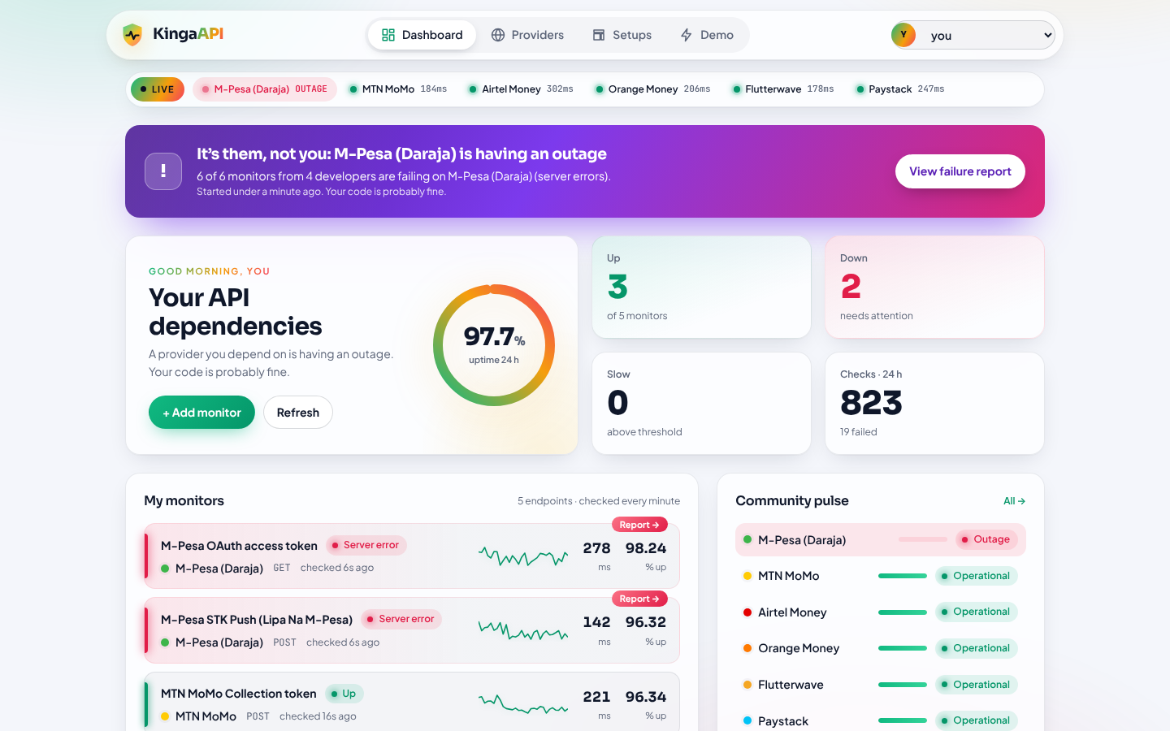
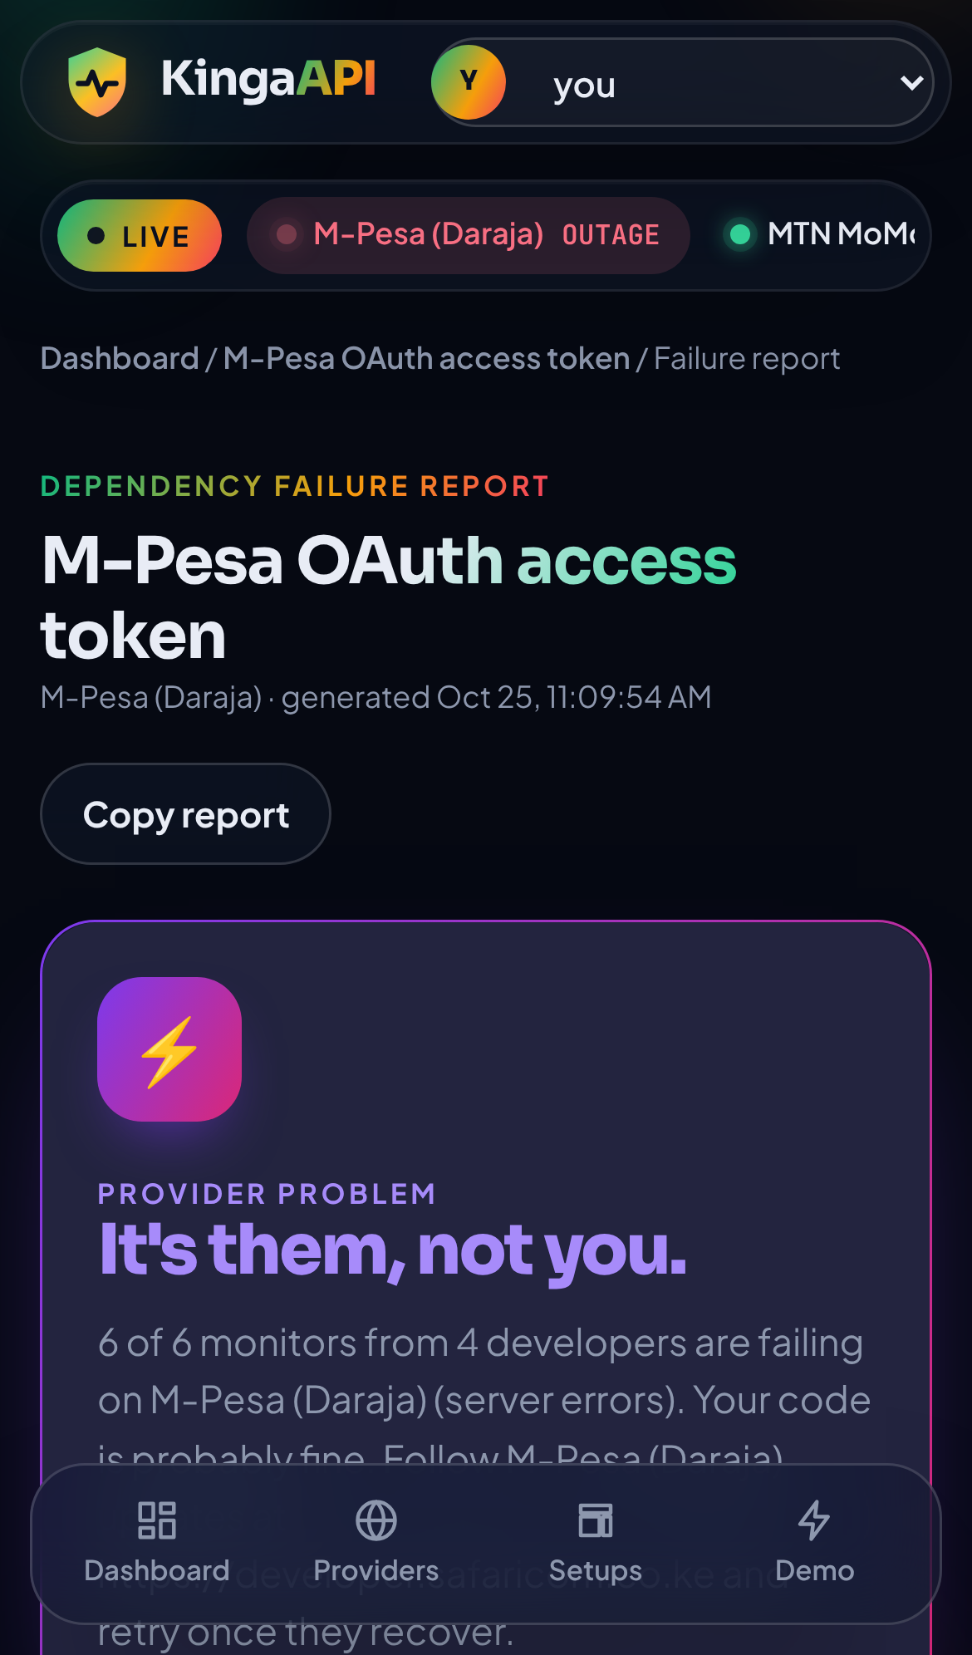
What the developer sees
SIFA · 40 S · WHAT THE DEVELOPER SEES
Verdict first
them, you or unclear
Then the evidence
expected vs. actual, response body, next steps
Updates live
every 5 seconds
Laptop: the purple “It’s them, not you” banner
Phone: the failure report
Notes:
Sifa, 40 seconds. "This is what a developer sees. Every payment API they depend on is checked once a minute: status, speed and response format. When M-Pesa goes down, they don't get a vague error. They get this banner: it's them, not you. One click opens the Dependency Failure Report: what we expected, what came back, the exact response, and what to check next. On a phone it works the same, so a developer can tell in seconds, wherever they are, whether to fix their code or just wait for the provider."

Slide 6
Live demo: three stories
GISELE · 2 MIN · LIVE DEMO
1
It’s them
2
It’s you
3
Silent breakage
Do
Set M-Pesa to 503 error
What happens
6 of 6 M-Pesa monitors from 4 developers fail at once
KingaAPI says
Purple banner: “It’s them, not you.”
Do
Break my key on MTN MoMo
What happens
Only my monitor fails; 4 others from 3 developers are fine
KingaAPI says
Verdict: “Probably your setup”
Do
Paystack schema change
What happens
Still HTTP 200, but the JSON fields changed
KingaAPI says
Report lists exactly which fields are missing
Runs offline on the laptop with built-in mock providers. Backup video: docs/demo/kinga-demo-backup.mp4
Notes:
Gisele, 2 minutes. Before you start: Demo control, Reset everything, open the Dashboard as "you".
0:00 Dashboard: "This developer depends on M-Pesa, MTN MoMo, Flutterwave and Paystack. All green, 24 hours of history."
0:15 Demo, M-Pesa, 503 error, back to Dashboard: "Now M-Pesa goes down, for everyone."
0:25 Point at the purple banner: "KingaAPI sees 6 of 6 M-Pesa monitors from 4 different developers failing at once. So it tells you: it's them, not you."
0:40 View failure report: "Expected 200, got 503, here's the response body and what to do: retry with backoff, queue payments, check the status page."
1:00 Demo, Reset everything, then Break my key for MTN MoMo: "Different story: this time only my key is wrong."
1:10 Open the MTN monitor's report: "Only my monitor fails. 4 other MTN monitors from 3 developers are fine, so KingaAPI says probably your setup, and points to credentials and token expiry."
1:30 Demo, Paystack, Schema change, open the Paystack report: "The scariest failure: HTTP 200, but the fields changed. KingaAPI lists exactly which fields disappeared."
1:45 Shared setups page: "Developers share ready-made setups for African providers. One click and you're monitoring."
2:00 Reset everything.
If the live demo fails, play docs/demo/kinga-demo-backup.mp4.

Slide 7
Why KingaAPI is different
GISELE · 20 S · WHY IT’S DIFFERENT
Generic uptime tools
KingaAPI
See only your own endpoint
Answer “is it up?”
Check the status code only
Generic, worldwide services
Sees every developer on the provider
Answers “whose problem is it?”
Checks status, speed and JSON fields
Built for African payment providers
M-Pesa · MTN MoMo · Airtel Money · Orange Money · Flutterwave · Paystack · Wave
Notes:
Gisele, 20 seconds. "What makes KingaAPI different is shared data across developers. Generic tools like UptimeRobot only see your endpoint. KingaAPI sees the whole community, so it can say it's them, not you. And it is built for M-Pesa, MoMo, Airtel, Orange, Flutterwave, Paystack and Wave."

Slide 8
Next steps
1
Real accounts
2
SMS and WhatsApp alerts
Sign-in, teams and encrypted API keys
Reach developers where they already are
3
Public status pages
4
More providers
One live page per provider, built from community data
Chipper Cash, MTN in more countries, banks
Thank you
github.com/Ideborah-tech/kinga-api
Notes:
Team, 20 seconds. "Next: real accounts, SMS and WhatsApp alerts, public status pages per provider, and more providers. Thank you." Then take questions; the answers to likely judge questions are in each person's spec in docs/.

