Slide 1
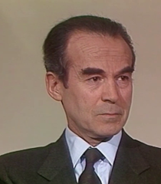
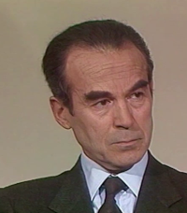
redimStatic.py
Program which take as input a list of images and give as output recized images. Two cases test and train.
Test case check size of all input images compare to final size and fix the zoom value as the lowest value of zoom. This case aims to apply the same zoom on all images. Train case juste apply the maximum zomm on images.
Input images
Desired output size = 500x500
210x240
200x228

Slide 2
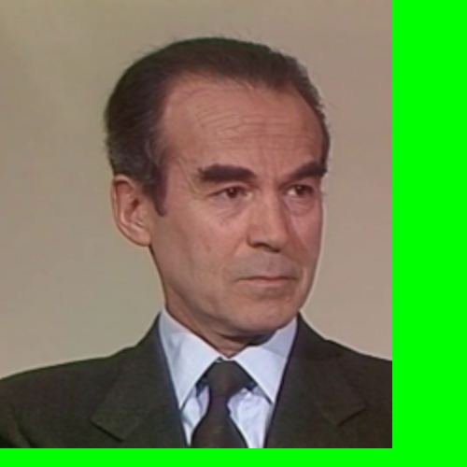
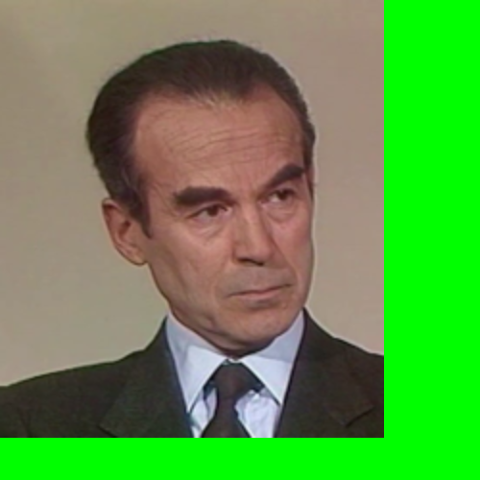
redimStatic.py
Test case
max_zoom =
500/240 = 2.08 ~ 2
210x240
500 x 500
Final_zoom = Min(2,2.1) = 2
max_zoom =
500/228 = 2.19 ~ 2.1
200x228

Slide 3
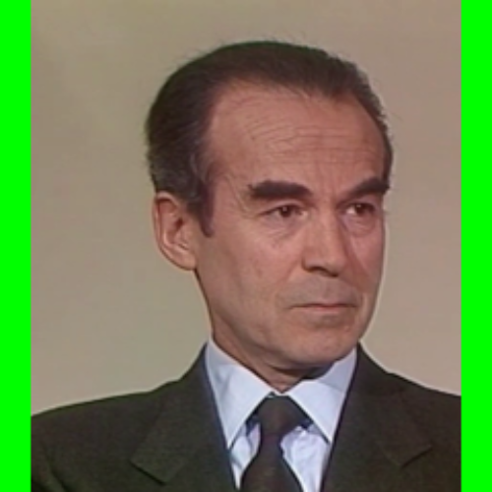
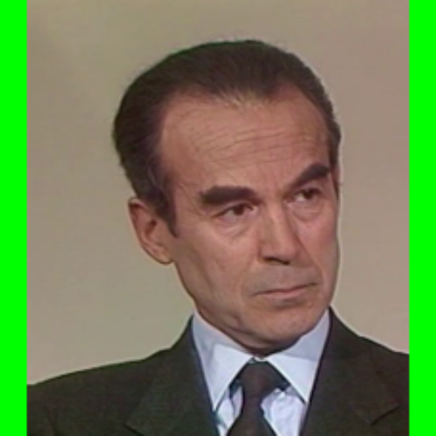
redimStatic.py
Train case
max_zoom =
500/240 = 2.08
210x240
500 x 500
max_zoom =
500/228 = 2.19
200x228

