Slide 1
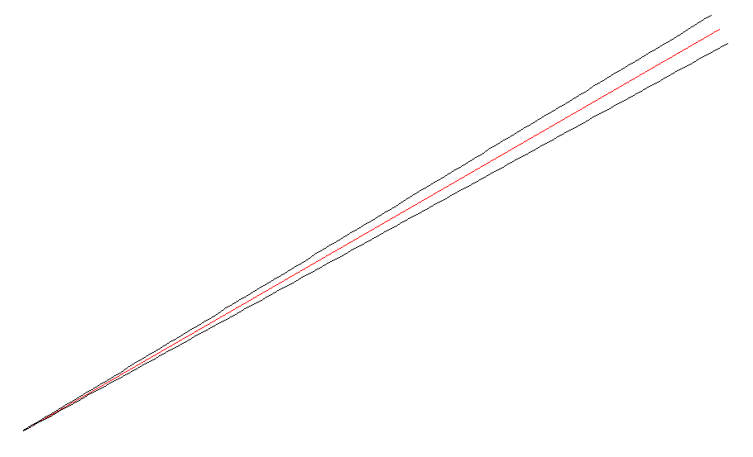
y
length
dirAngle
x
Origin (pos, qx, qy, wx, wy, P, optDist, Gouyx, Gouyy)

Slide 2
AR
HR
ARcenter
HRcenterC
wedgeAngle
x
normVectHR
normVectAR
HRcenter
center (= (HRcenterC + ARcenter)/2)

Slide 3
Interaction of a beam with a mirror
Mirror.hitFromHR(beam): This function generates a dictionary of beam objects.
The resultant dictionary contains reflected & deflected beams.
The names of the beams are shown below.
input: A copy of the beam object
given to hitFromHR() function
with the length set to the distance
between the pos of the beam to the
point where the beam hit the mirror.
r2
r1
input
. . . . .
. . . . .
s2
s1
s3
. . . . .
t2
t1

Slide 4
Specifying Directions
In gtrace, there are many occasions where a direction has to be specified.
Examples are, beam propagation direction and mirror surface normal.
A direction can be specified in two ways: a direction angle and a 2D vector
In most cases, you can use either way. For example, a GaussianBeam object
hold its propagation direction in two attributes: beam.dirVect and beam.dirAngle.
If you change one of those, e.g. beam.dirAngle = pi, the other will be updated
automatically, i.e. beam.dirVect becomes [0,1]. This functionality is provided by
the HasTraits class, which is the parent class of all the classes in gtrace.
dirAngle is measured counter clock-wise
from the positive x-axis.
y
dirVect
dirAngle
x

