Slide 1
gtrace: a Gaussian Beam Ray Tracing Library
Aug. 25 2010
Yoichi Aso
Department of Physics, University of Tokyo

Slide 2
What is gtrace ?
gtrace is a 2D optical ray tracing library, which can track the evolution
of Gaussian beam propagation.
Features
Calculate the reflection and deflection of a beam by an optics.
Track the Gaussian beam evolution (beam size, ROC, and Gouy phase) as a beam propagates.
Optical path length is correctly calculated when transmitting optical components.
Astigmatism is included on non-normal incidences to optics.
DXF files can be generated.
Fully object-oriented.

Slide 3
Basic Components of gtrace
There are two fundamental classes in gtrace: GaussianBeam and Mirror
GaussianBeam Class
A class to represent a Gaussian beam.
It is a beam having a certain q-parameter at its origin and propagating
to a certain direction.
Some parameters, such as q-parameter and Gouy phase, are stored as a
pair, like (q0x, q0y). x and y means the x and y axes of the cross section
of the beam. These values differ for elliptic beams.
Basic attributes are ...
pos: position of the beam origin
dirVect, dirAngle: Propagation direction
q0x, q0y: q-parameter of the beam at the origin.
wl: Wavelength
Accumulated values
These values are stored in a GaussianBeam object and accumulated
as the beam propagates.
optDist: Optical distance traveled by the beam
Gouyx, Gouyy: Gouy phase accumulated by the beam propagation

Slide 4
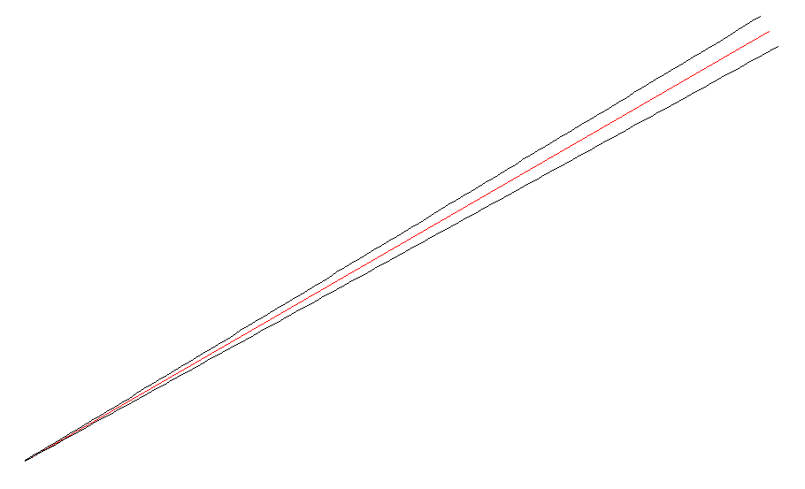
Concept of a beam
y
length
dirAngle
x
Origin (pos, qx, qy, wx, wy, P, optDist, Gouyx, Gouyy)

Slide 5
Basic Components of gtrace
Mirror class
Mirror class represent a cylindrical mirror. It can also be used to represent
a beam splitter.
AR
HR
ARcenter
HRcenterC
wedgeAngle
x
normVectHR
normVectAR
HRcenter
center (= (HRcenterC + ARcenter)/2)

Slide 6
Interaction of a beam with a mirror
Mirror.hitFromHR(beam): This function generates a dictionary of beam objects.
The resultant dictionary contains reflected & deflected beams.
The names of the beams are shown below.
input: A copy of the beam object
given to hitFromHR() function
with the length set to the distance
between the pos of the beam to the
point where the beam hit the mirror.
r2
r1
input
. . . . .
. . . . .
s2
s1
s3
. . . . .
t2
t1

Slide 7
Specifying Directions
In gtrace, there are many occasions where a direction has to be specified.
Examples are, beam propagation direction and mirror surface normal.
A direction can be specified in two ways: a direction angle and a 2D vector
In most cases, you can use either way. For example, a GaussianBeam object
hold its propagation direction in two attributes: beam.dirVect and beam.dirAngle.
If you change one of those, e.g. beam.dirAngle = pi, the other will be updated
automatically, i.e. beam.dirVect becomes [0,1]. This functionality is provided by
the HasTraits class, which is the parent class of all the classes in gtrace.
dirAngle is measured counter clock-wise
from the positive x-axis.
y
dirVect
dirAngle
x

