Slide 1
gtrace: a Gaussian Beam Ray Tracing Library
Tutorial
NAOJ
Yoichi Aso

Slide 2
Basic workflow of gtrace
r1
r2
beam1
A beam object
A mirror object
Mirror1
s1
beam1
Mirror1
s2
s3
Interact
Mirror2
t2
t1
r1
s1
t1
Draw
DXF File
beam1
beam2
beam3
Mirror1
Mirror2

Slide 3
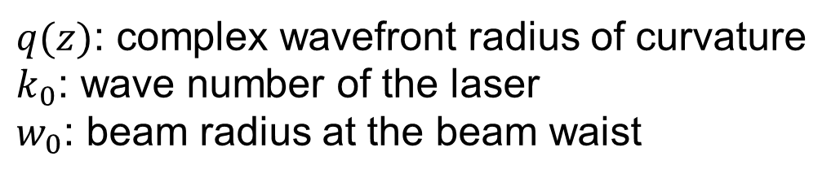
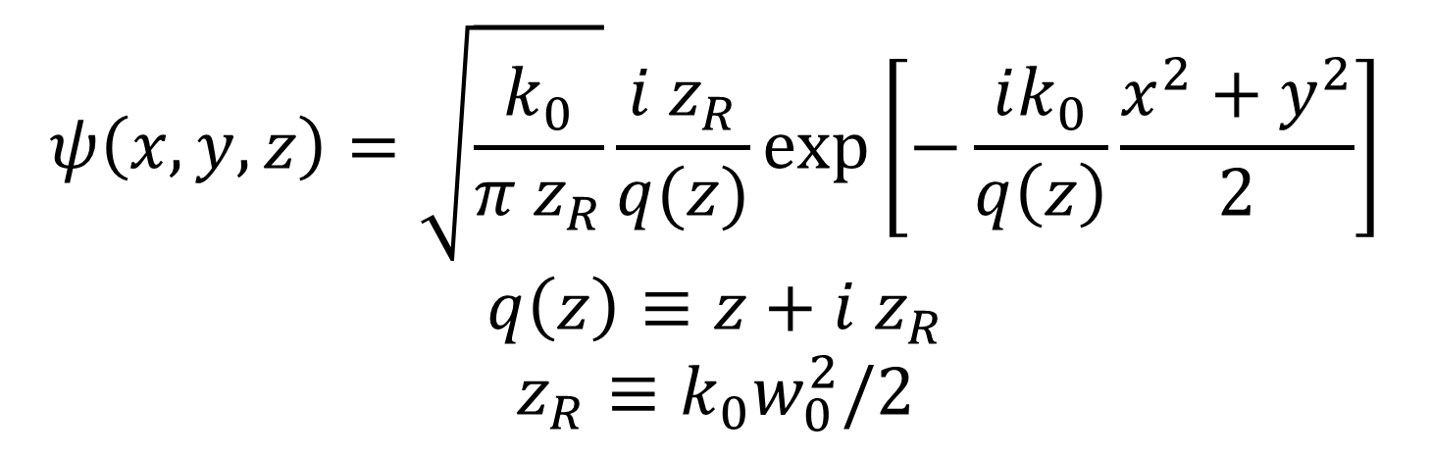
Gaussian beam
$$ψ\left(x,y,z\right)=\sqrt{\frac{k_{0}}{π z_{R}}}\frac{i z_{R}}{q(z)}\text{exp}\left[−\frac{ik_{0}}{q\left(z\right)}\frac{x^{2}+y^{2}}{2}\right]$$
$$q\left(z\right)≡z+i z_{R}$$
$$z_{R}≡k_{0}w_{0}^{2}/2$$
Field amplitude
$q(z)$: complex wavefront radius of curvature
$k_{0}$: wave number of the laser
$w_{0}$: beam radius at the beam waist
A Gaussian beam is fully determined by specifying $q$ and $k_{0}$.

Slide 4
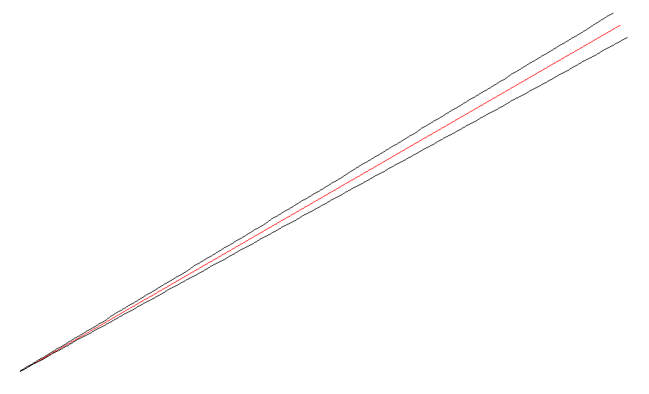
y
A Gaussian beam object
length
dirAngle
x
Origin (pos, qx, qy, wx, wy, P, optDist, Gouyx, Gouyy)

Slide 5
A mirror object
AR
HR
ARcenter
HRcenterC
wedgeAngle
normVectHR
x
normVectAR
HRcenter
center (= (HRcenterC + ARcenter)/2)

Slide 6
Interaction of a beam with a mirror
input
r2
r1
. . . . .
. . . . .
s2
s1
s3
. . . . .
t2
t1

Slide 7
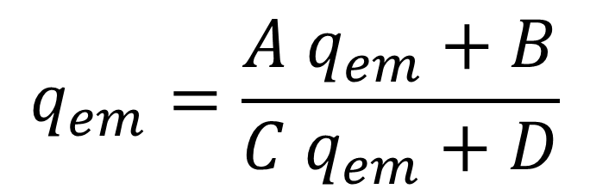
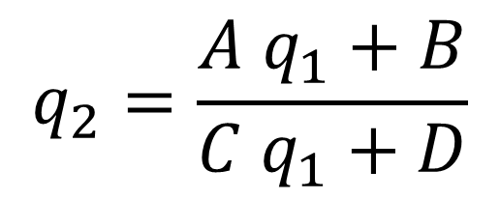
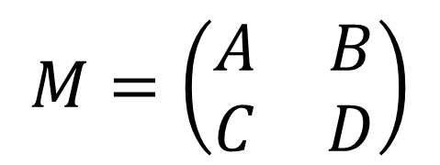
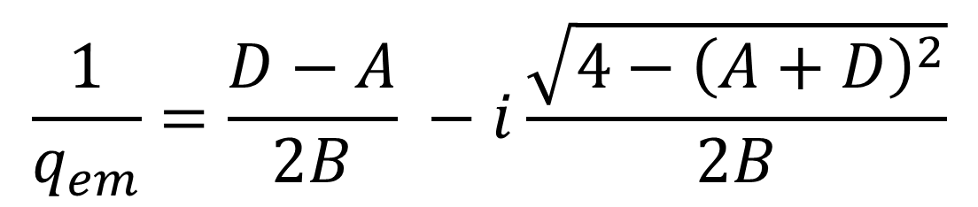
ABCD transformation
Ray-transfer matrix
Transformation of q-parameter
$$M=\left(\begin{matrix}A & B \\ C & D\end{matrix}\right)$$
$$q_{2}=\frac{A q_{1}+B}{C q_{1}+D}$$
Eigenmode
$$q_{em}=\frac{A q_{em}+B}{C q_{em}+D}$$
$$\frac{1}{q_{em}}=\frac{D−A}{2B} −i\frac{\sqrt{4−{\left(A+D\right)}^{2}}}{2B}$$

Slide 8
Installation
Installation of gtrace package
>pip install gtrace
Dependencies
numpy, scipy, matplotlib, traits
Recommended
Jupyter Lab
TOC extension
Source
https://github.com/asoy01/gtrace
Documentation
https://gtrace.readthedocs.io/en/latest/

Slide 9
Limitations
Non-spherical surface is not supported
Beam clipping is ignored
Only 2D

Slide 10
(Planned) Future Improvements
Multiple-wavelength
Polarization
Composite optics
Drawing objects
Migration to ezdxf library
More output formats (png, pdf, etc)
GUI ?
Frequency shift ?
Higher-order modes ?

