Slide 1
BIG Data – Data Processing
Audience platform

Slide 2

Agenda
Data Processing Framework
MapReduce
Summary

Slide 3
Agenda
Data Processing Framework
MapReduce
Summary

Slide 4
Data processing framework (1)
Batch
No time requirement
High throughput
Example: log process
Interactive
Run within minutes
Example: data query
Streaming
Time critical, processing records within seconds
Example: ad service

Slide 5
Data processing framework (2)
Real-Time
Interactive
Non-
Interactive
Batch
Online systems
R-T analytics
CEP
Parameterized
Report
Drilldown
Visualization
Exploration
Data preparation
Incremental
batch Processing
Dashboards
/Scorecards
Operational batch processing
Enterprise
Reports
Data Mining
0~5s
5s~1m
1m~1h
1h+
From Hortonworks PPT：“Stinger Initiative: Deep Dive”

Slide 6
Data processing framework (3)
MR
Hive
Spark
Tez
Batch
Shark
Stinger
Batch
DAG and Iterative
Storm
Spark
Streaming
Impala
Presto
Samza
Interactive
streaming/realtime

Slide 7
Agenda
Compute Engine
MapReduce
Summary

Slide 8
MapReduce
What is MapReduce
Why MapReduce
Execution model
Architecture
Refinement
Beyond MapReduce
Summary

Slide 9
What is MR (1)
MapReduce is a parallel programming model for processing and generate large dataset based on Google published paper
Hadoop MapReduce is the open source implementation, running on clusters of commodity machines
Functions borrowed from functional programming languages (se. Lisp)

Slide 10
What is MR (2)
Map -> Shuffle -> Reduce
Just write map and reduce function
framework handles all the rest
Scale free, from MB to PB
Notes:
MapReduce包括三个阶段，map，shuffle，reduce。

Slide 11
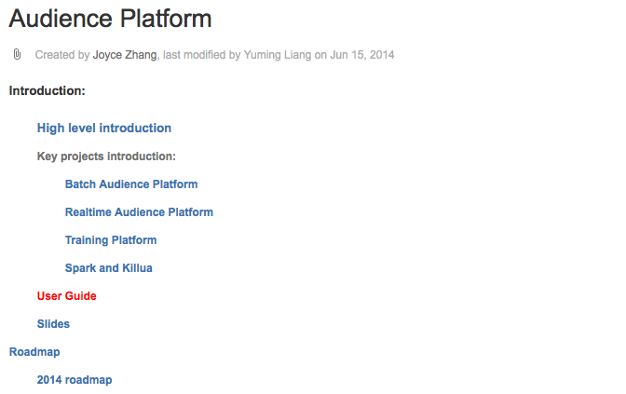
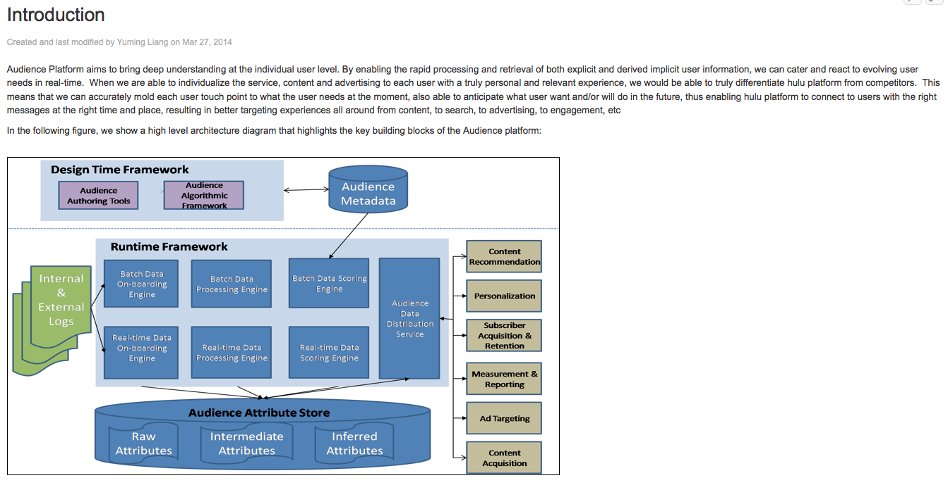
Why MR (1)
Count the word frequency of our Wiki
Notes:
MapReduce包括三个阶段，map，shuffle，reduce。

Slide 12
Why MR (2)
#!/bin/bash
cat all_hulu_wiki/* | tr -s '[:space:]' '\n' | sort | uniq -c
$> cat wiki.txt
spark pig tez
map reduce
spark
map map map
$> cat ap.txt | tr -s '[:space:]' '\n’
spark
pig
tez
map
reduce
spark
map
map
map
$> cat ap.txt | tr -s '[:space:]' '\n' | sort
map
map
map
map
pig
reduce
spark
spark
tez
$> cat ap.txt | tr -s '[:space:]' '\n' | sort | uniq -c
4 map
1 pig
1 reduce
2 spark
1 tez
Notes:
MapReduce包括三个阶段，map，shuffle，reduce。

Slide 13
Why map / reduce (3)
cat all_hulu_wiki/* | tr -s '[:space:]' '\n' | sort | uniq –c
Can we speed it up?
Two ways
run parts of the program in parallel
use more effective algorithm and data structure

Slide 14
Why map / reduce (4)
cat all_hulu_wiki/* | tr -s '[[:punct:][:space:]]' '\n' | sort | uniq -c
Process each wiki doc in parallel
Use hash instead of sort
Process sorted data in parallel
Notes:
MapReduce包括三个阶段，map，shuffle，reduce。

Slide 15
Why map / reduce (5)
Each task run time is not same, one way is to split the file into fixed-size chunks.
Handle task failure
Need a master to coordinate each tasks
If memory is not enough, need to partition data or use external sort
Limited by processing capacity of single machine
Notes:
MapReduce包括三个阶段，map，shuffle，reduce。

Slide 16
Why mapreduce (6)
Although it’s feasible to parallelize the processing, in practice it’s messy
Hadoop MapReduce framework can take of these issues.
Notes:
MapReduce包括三个阶段，map，shuffle，reduce。

Slide 17
Execution model – key concept
Map
Independent record transformations
(K1, V1) -> List(K2, V2)
Reduce
Aggregate results from map phase
(K2, List(V2)) -> List(K3, V3)
MapReduce Framwork
Splits inputs
Schedules and re-runs tasks
Move map outputs to reduce inputs
Receive reduce output
Notes:
Process a key/value pair to generate intermediate k/v pairs
Process a key and all its values to generate result k/v pairs

Slide 18
Execution model – Example (1)
map(long key, string value)
// key: offsite in the file
// value: content of one line
foreach word in value
EmitIntermediate(word, 1)
reduce(string key, iterator<int> values)
// key: word
// value: list of counts
int countSum = 0
foreach count in values
countSum += count
Emit(key, countSum)

Slide 19
Execution model – Example (2)
local write
A 1
C 1
C 1
---------
B 1
A
B C C
B B
C D
D C
A
read
A 1
B 1
C 1
C 1
remote
read
A
B C C
write
A
B C C
map
A [1,1]
C [1,1,1,1]
A 2
C 4
B 1
B 1
C 1
D 1
reduce
output 1
B B
C D
B B
C D
map
B [1,1,1]
D [1,1]
B 3
D 2
D 1
C 1
A 1
D C
A
reduce
output 2
D C
A
map
input
map
shuffle
reduce
output
Notes:
将这个图片转换成一个动画来演示。 参考MapR的动画 https://www.mapr.com/resources/videos/intro-mapreduce
带入 wordcount

Slide 20
Execution model – Overview
mapper
reducer
input
merge
sort
reduce
output
format
input
format
map
partitioner
sort
combiner
local
disk
output 1
input split 2
local
disk
map
reduce
output 2
input split 3
local
disk
map
input
map
shuffle
reduce
output
Notes:
将这个图片转换成一个动画来演示。 参考MapR的动画 https://www.mapr.com/resources/videos/intro-mapreduce

Slide 21
Execution model – input format (1)
mapper
reducer
C
B A C
B B
C D
D C
A
merge
sort
reduce
output
format
input
format
map
partitioner
sort
combiner
local
disk
output 1
C
B A C
input split 2
local
disk
map
reduce
output 2
input split 3
local
disk
map
input
map
shuffle
reduce
output
Notes:
将这个图片转换成一个动画来演示。 参考MapR的动画 https://www.mapr.com/resources/videos/intro-mapreduce

Slide 22
Execution model – input format (2)
MapReduce can process many different types of data formats, from flat text files to DataBase
InputFormat
Split Input, logically
Read records from split
Data Location
Ready to use
FileInputFormat
DBInputFormat
…
Notes:
MR可以处理

Slide 23
Execution model – Map (1)
mapper
reducer
input
merge
sort
reduce
output
format
input
format
map
partitioner
sort
combiner
local
disk
output 1
(C)
(B A C)
(C, 1)
(B, 1)
(A, 1)
(C, 1)
input split 2
local
disk
map
reduce
output 2
input split 3
local
disk
map
input
map
shuffle
reduce
output
Notes:
将这个图片转换成一个动画来演示。 参考MapR的动画 https://www.mapr.com/resources/videos/intro-mapreduce

Slide 24
Execution model – map (2)
map
Independent record transformations
(K1, V1) -> List(K2, V2)
(A, 1)
(B, 1)
(A, 1)
(A B A)

Slide 25
Execution model – Overview
mapper
reducer
input
merge
sort
reduce
output
format
input
format
map
partitioner
sort
combiner
local
disk
output 1
(C, 1)
(B, 1)
(A, 1)
(C, 1)
reduce 1
reduce 2
reduce 1
reduce 1
input split 2
local
disk
map
reduce
output 2
input split 3
local
disk
map
input
map
shuffle
reduce
output
Notes:
将这个图片转换成一个动画来演示。 参考MapR的动画 https://www.mapr.com/resources/videos/intro-mapreduce

Slide 26
Execution model – partitioner (2)
Partitioner
Decide record goes to which reducer
The same key on different mapper will go to the same reducer
(K1, V1, reducer_num) -> reduce id
Ready to use
HashPartitioner (Default)
BinaryPartitioner
…
…

Slide 27
Execution model – Combiner (1)
mapper
reducer
input
merge
sort
reduce
output
format
input
format
map
partitioner
sort
combiner
local
disk
output 1
(A, 1)
(C, 1)
(C, 1)
--------
(B, 1)
(A, 1)
(C, 2)
--------
(B, 1)
input split 2
local
disk
map
reduce
output 2
input split 3
local
disk
map
input
map
shuffle
reduce
output
Notes:
将这个图片转换成一个动画来演示。 参考MapR的动画 https://www.mapr.com/resources/videos/intro-mapreduce

Slide 28
Execution model – combiner (2)
Combiner
Combine data in map side
(K2, List(V2)) -> List(K2, V2)
vs Reducer
(K2, List(V2)) -> List(K3, V3)
Use reducer as combiner in most case(word count)
(A, 1)
(B, 1)
(A, 1)
(A, 2)
(B, 1)

Slide 29
Execution model – Combiner (3)
A 1
C 2
---------
B 1
A 1
B 1
C 1
C 1
A 1
B 1
C 2
remote
read
A
B C C
write
A
B C C
A [1,1]
C [2,1,1]
map
combiner
A 2
C 4
B 1
B 1
C 1
D 1
B 2
C 1
D 1
reduce
output 1
B B
C D
B B
C D
map
combiner
B [1,2,1]
D [1,1]
B 3
D 2
D 1
C 1
A 1
D 1
C 1
A 1
D C
A
reduce
output 2
D C
A
map
combiner
input
map
shuffle
reduce
output
Notes:
将这个图片转换成一个动画来演示。 参考MapR的动画 https://www.mapr.com/resources/videos/intro-mapreduce
带入 wordcount

Slide 30
Execution model – reduce (1)
mapper
reducer
input
merge
sort
reduce
output
format
input
format
map
partitioner
sort
combiner
local
disk
output 1
A, [1, 1]
C, [1, 2, 1]
A, 2
C, 4
input split 2
local
disk
map
reduce
output 2
input split 3
local
disk
map
input
map
shuffle
reduce
output
Notes:
将这个图片转换成一个动画来演示。 参考MapR的动画 https://www.mapr.com/resources/videos/intro-mapreduce

Slide 31
Execution model – reduce (2)
Reducer
Aggregate results from map phase
(K2, List(V2)) -> List(K3, V3)
(A, List(1, 2, 1))
(A, 4)

Slide 32
Execution model – output format (1)
mapper
reducer
input
merge
sort
reduce
output
format
input
format
map
partitioner
sort
combiner
local
disk
output 1
input split 2
local
disk
map
reduce
output 2
input split 3
local
disk
map
input
map
shuffle
reduce
output
Notes:
将这个图片转换成一个动画来演示。 参考MapR的动画 https://www.mapr.com/resources/videos/intro-mapreduce

Slide 33
Execution model – output format (2)
MapReduce can process many different types of data formats, from flat text files to DataBase
OutputFormat
Validate the output-specification of the job. For example, check dir exist
Write output into files or DB
Ready to use, mostly paired with InputFormat
FileOutputFormat
DBOutputFormat
…
Notes:
MR可以处理

Slide 34
Execution model – Shuffle (1)
mapper
reducer
input
merge
sort
reduce
output
format
input
format
map
partitioner
sort
combiner
local
disk
output 1
shuffle
input split 2
local
disk
map
reduce
output 2
input split 3
local
disk
map
input
map
shuffle
reduce
output
Notes:
将这个图片转换成一个动画来演示。 参考MapR的动画 https://www.mapr.com/resources/videos/intro-mapreduce

Slide 35
Execution model – shuffle (2)
map phase
partition sort combie phase
copy phase
merge sort phase
reduce phase
MapTask
ReduceTask
partition, sort, combine and spill to disk
remote fetch
merge
reduce
output
input split
map
buffer in memory
merge on disk
merge
merge
partitions
memory and disk
other mappers
other reducers
Notes:
将这个图片转换成一个动画来演示。 参考MapR的动画 https://www.mapr.com/resources/videos/intro-mapreduce

Slide 36
Execution model – shuffle (3)
map phase
partition sort combie phase
MapTask
partition, sort, combine and spill to disk
input split
map
buffer in memory
merge on disk
partitions
Notes:
将这个图片转换成一个动画来演示。 参考MapR的动画 https://www.mapr.com/resources/videos/intro-mapreduce

Slide 37
Execution model – shuffle (4)
map phase
partition sort combie phase
copy phase
merge sort phase
reduce phase
MapTask
ReduceTask
partition, sort, combine and spill to disk
remote fetch
merge
reduce
output
input split
map
buffer in memory
merge on disk
merge
merge
partitions
memory and disk
other mappers
other reducers
Notes:
将这个图片转换成一个动画来演示。 参考MapR的动画 https://www.mapr.com/resources/videos/intro-mapreduce
----- Meeting Notes (14/9/11 14:04) -----
shuffle的目的，同一个key出现在同一个reducer，并且该key的所有value剧集在一起
partition
sort的目的，其他可替代的实现方式
group
map写磁盘

Slide 38
Execution model – summary
mapper
reducer
input
merge
sort
reduce
output
format
input
format
map
partitioner
sort
combiner
local
disk
output 1
input split 2
local
disk
map
reduce
output 2
input split 3
local
disk
map
input
map
shuffle
reduce
output
Notes:
将这个图片转换成一个动画来演示。 参考MapR的动画 https://www.mapr.com/resources/videos/intro-mapreduce

Slide 39
Architecture (1)
JobTracker
Only one in cluster
Manage resource
Schedule task
Manage job
Monitor task status
Failover
TaskTracker
One on each machine
Run command from jobtracker
Report task status
Client
User code to submit MR job

Slide 40
Architecture (2)
machine
MR User
Program
submit job
JobTracker
job tracker
framework
of cluster
reduce task
framework
per job
jobtracker node
user implement
heartbeat
heartbeat
map
TaskTracker
TaskTracker
Reduce Task
Map Task
Reduce Task
Map Task
reduce
map
reduce
map
tasktracker node
tasktracker node
Notes:
这里介绍 jobtracker, tasktracker, 他们之间通过heartbeat传递消息。 taskTracker和各个task之间也是通过类似heartbeat的方式传递消息

Slide 41
Architecture – job execution
MR User
Program
Job
2. get job ID
JobTracker
machine
1. run job
4. submit job
5. initialize job
framework
of cluster
job tracker
client JVM
framework
per job
reduce task
client node
6. retrieve
input splits
jobtracker node
static void main() {
Job job = new Job()
job.setInputFormat(…)
job.setMapper(…)
job.setReducer(…)
job.runJob()
}
7. heartbeat (return tasks)
map
user implement
3. copy job resources
HDFS
8. retrive job resources
TaskTracker
TaskTracker
9. launch
launch
9. launch
launch
launch
Map Task
Map Task
Reduce Task
Map Task
map
map
reduce
map
tasktracker node
tasktracker node
Notes:
----- Meeting Notes (14/9/3 15:39) -----
容错
JobTracker TaskTracker task 挂掉了怎么办
word count在这里的流程图

Slide 42
Architecture – status report
MR User
Program
Job
JobTracker
machine
getStatus
getJobStatus
job tracker
framework
of cluster
client JVM
framework
per job
reduce task
client node
jobtracker node
heartbeat
map
user implement
HDFS
TaskTracker
TaskTracker
update status
9. launch
MapTask
Map Task
Reduce Task
Map Task
map
map
reduce
map
tasktracker node
tasktracker node
Notes:
----- Meeting Notes (14/9/3 15:39) -----
容错
JobTracker TaskTracker task 挂掉了怎么办
word count在这里的流程图

Slide 43
Refinement - Failure tolerance
In the real world, processes crash, and machines fail. One of the major benefits of using Hadoop is its ability to handle such failures and allow your job to complete.
Task Failure
TaskTracker Failure
JobTracker Failure

Slide 44
Refinement - Task failure
MR User
Program
Job
JobTracker
machine
job tracker
framework
of cluster
client JVM
framework
per job
reduce task
client node
jobtracker node
heartbeat
map
user implement
HDFS
TaskTracker
TaskTracker
heartbeat
re-launch
9. launch
MapTask 1
Map Task 1
Map Task 2
map
map
map
tasktracker node
tasktracker node
Notes:
----- Meeting Notes (14/9/3 15:39) -----
容错
JobTracker TaskTracker task 挂掉了怎么办
word count在这里的流程图

Slide 45
Refinement – Task Tracker failure
MR User
Program
Job
JobTracker
machine
job tracker
framework
of cluster
client JVM
framework
per job
reduce task
client node
jobtracker node
heartbeat
map
user implement
HDFS
TaskTracker
TaskTracker
heartbeat
9. launch
re-launch
re-launch
MapTask 1
Map Task 2
Map Task 1
Map Task 2
map
map
map
map
tasktracker node
tasktracker node
Notes:
----- Meeting Notes (14/9/3 15:39) -----
容错
JobTracker TaskTracker task 挂掉了怎么办
word count在这里的流程图

Slide 46
Refinement – job tracker failure
MR User
Program
Job
JobTracker
machine
job tracker
framework
of cluster
client JVM
framework
per job
reduce task
client node
jobtracker node
heartbeat
map
user implement
HDFS
TaskTracker
TaskTracker
heartbeat
9. launch
MapTask 1
Map Task 2
Reduce Task 1
Map Task 3
map
map
reduce
map
tasktracker node
tasktracker node
Notes:
----- Meeting Notes (14/9/3 15:39) -----
容错
JobTracker TaskTracker task 挂掉了怎么办
word count在这里的流程图

Slide 47
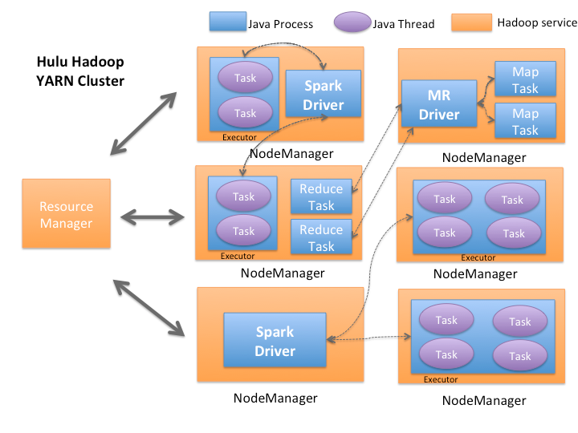
Architecture – mR 2.0
Yarn service

Slide 48
Refinement – speculative tasks
A MapReduce job is dominated by the slowest task
MapReduce attempts to locate slow tasks (stragglers) and run redundant (speculative) tasks that will optimistically commit before the corresponding stragglers
Whichever copy (among the two copies) of a task commits first, it becomes the definitive copy, and the other copy is killed by JT

Slide 49
Refinement – Locality
Network resource is relatively scarce resource
Attempt to launch map task near a replica of that task’s input data.
Same Node > Same Rack > Same DataCenter
Reduce task is no locality, it fetch data from all the map

Slide 50
Beyond MR
DAG
SQL
Pig Latin
SQL
Pig Latin
Scalding
Hive
PIG
Hive
PIG
MAPrEDUCE
TEZ
spark
Next
Generation

Slide 51

Beyond MR – scalding (1)
Scalding is a Scala library written on top of Cascading that makes it easy to define MapReduce programs

Slide 52
Beyond MR – scalding (2)
MapReduce limitation
Programming model limited to the map/reduce phases model
Many operators must be implemented from scratch
一E.g. Join, groupBy, sort
Not easy to write an efficient MapReduce Program
一Too many adjustable parameters

Slide 53
Beyond MR – scalding (3)
TextLine("hdfs://…")
.flatMap('line -> 'word) { line.split(" ") }
.groupBy('word) { word.size }
.write( Tsv( args("output") ) )

Slide 54
Beyond MR – scalding (4)
Rich operators
Map-like functions
map, flatMap, mapTo, flatMapTo
project, discard
insert, rename, limit，unique，pack, unpack
Grouping functions
groupBy, groupAll, groupRandomly, shard
Group/Reduce Operations
reduce, foldLeft，take & sorting，reducers
Join operations
joinWithSmaller，joinWithLarger，joinWithTiny
Generate optimized MapReduce job

Slide 55

Beyond mR - TEz
Tez is a computing engine for complex directed-acyclic-graph（DAG） data processing

Slide 56
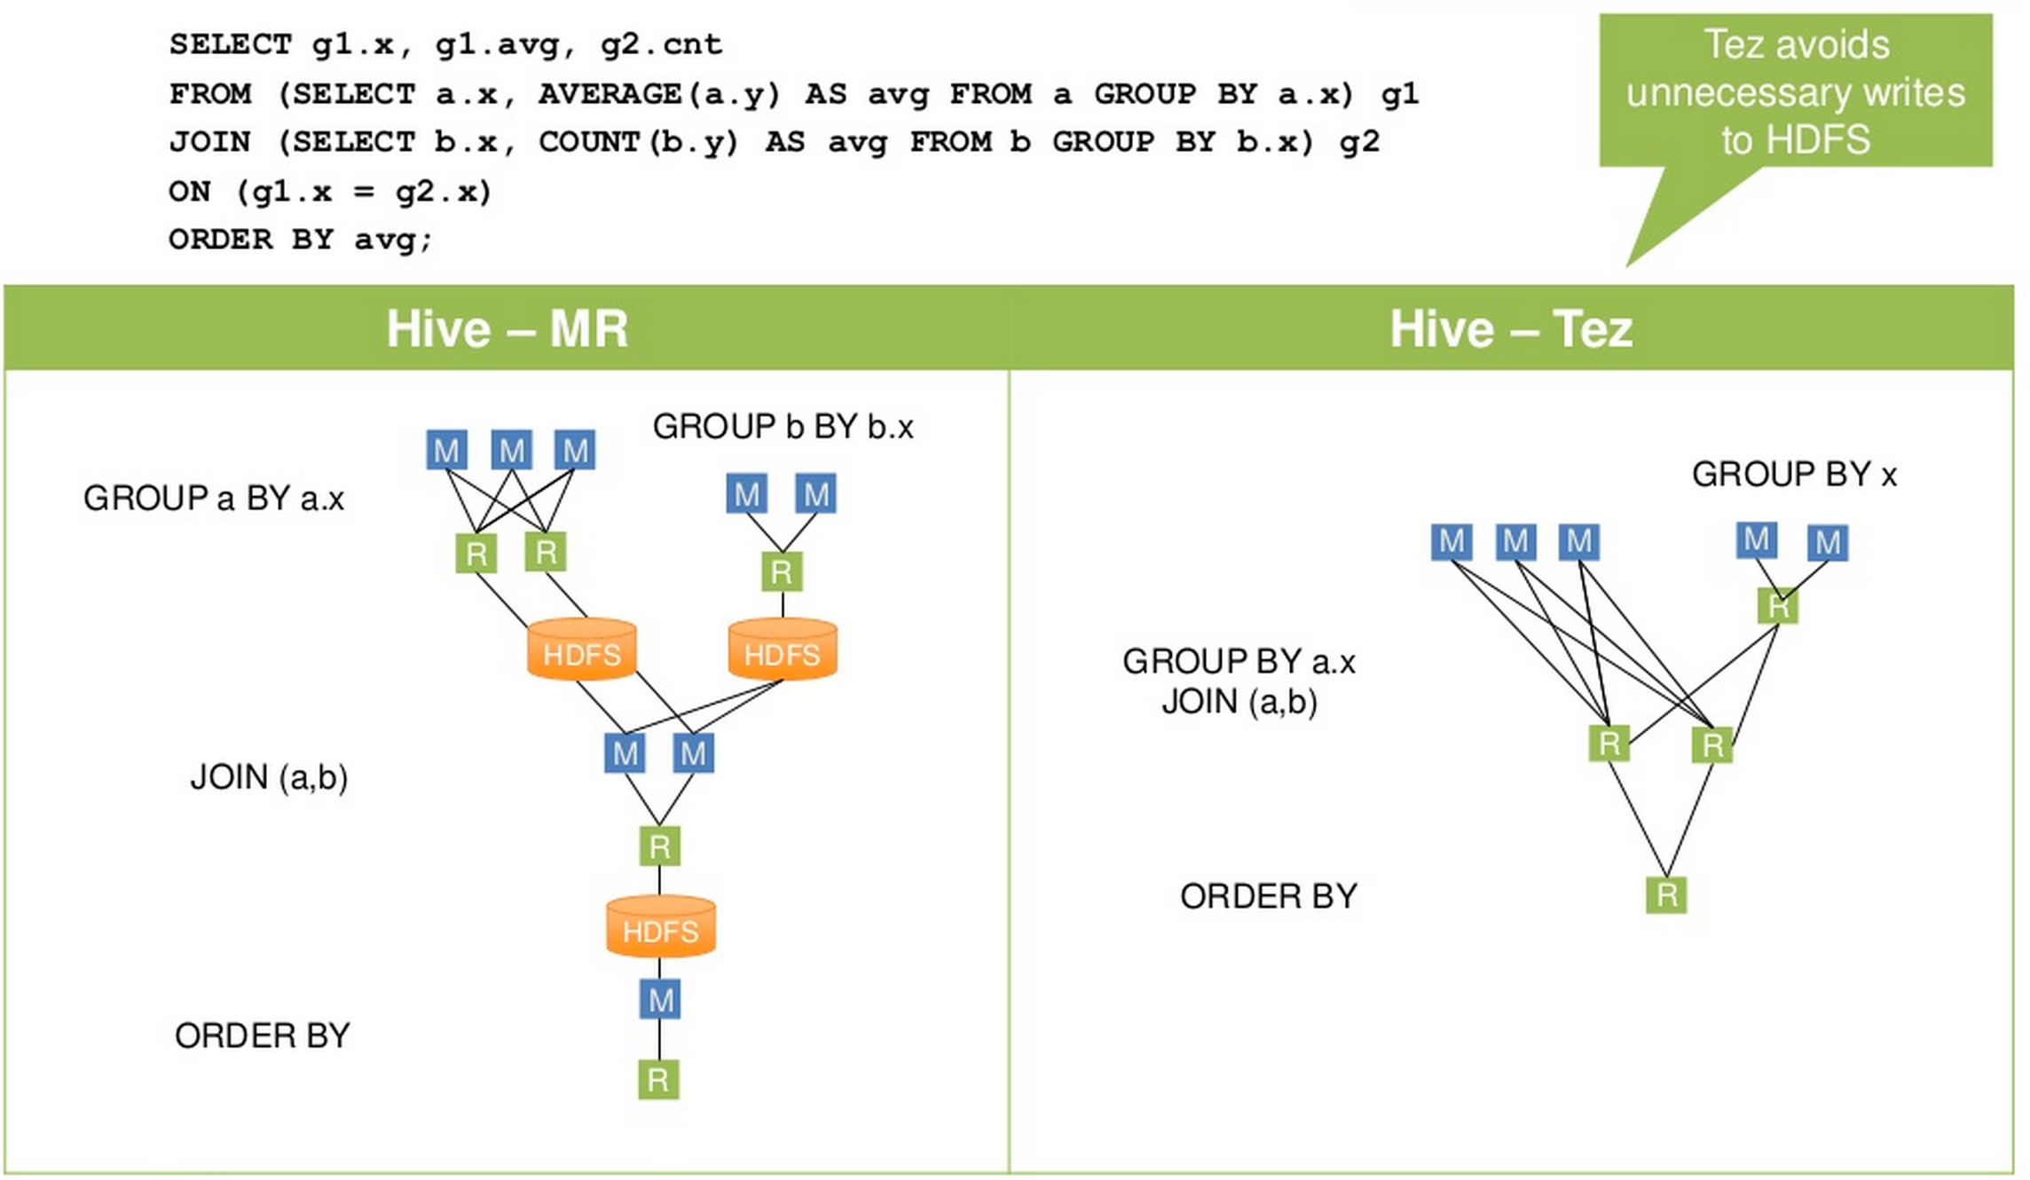
Beyond MR – Tez (2)

Slide 57
Beyond mR – Tez (3)
Low level data-processing execution engine
Use it for the base of MapReduce, Hive, Pig, Cascading etc.
Does not write intermediate output to HDFS
– Much lighter disk and network usage

Slide 58
Agenda
Compute Engine
MapReduce
Summary

Slide 59
COMPUTE ENGINE in Hulu
dB
HBase
Web
M/R
Mobile
Akamai
NGinx
Flume
HDFS
HIVE
LR
Spark
KAFKA
DRUID
SCalding
M/R
M/R
Cassandra
M / R
HDFS
HBase
Memcached
Hive
Service
DB
Spark
HBase
CDC
Spark Streaming
KAFKA
CouchBase
dB
HDFS
YARN + Zookeeper + Azkaban
Notes:
使用动画来highlight计算引擎涉及的部分

Slide 60

Q & A
60

