Slide 1




Slide 2


PB1090 – Objekt orientert programmering
Vår 2026
Forelesning #uke11
lars.e.opdal@usn.no

Slide 3
PB1090 –Agenda uke 11
Mandag:
Rep. Uke 10 – Oppsummering av unntakshåndtering
Checked exceptions:
FileNotFoundException, IOException
Lesing av filer og innhold
ArrayList .demo
Fredag:
Oblig2: Gjennomgang – alt. løsning med arrayList
Kapittel 17: Behandling av binære data (filbehandling)
Web Crawler (Demo)
Copy file (Demo )
Nytt keyword :try(with-resources)
NB. try != try-catch blokk
https://docs.oracle.com/javase/tutorial/java/nutsandbolts/_keywords.html
Vanlig tekstfiler:
https://en.wikipedia.org/wiki/List_of_file_formats#Text_files
Noen binære filer:
https://en.wikipedia.org/wiki/List_of_file_formats#Binary_files

Slide 4
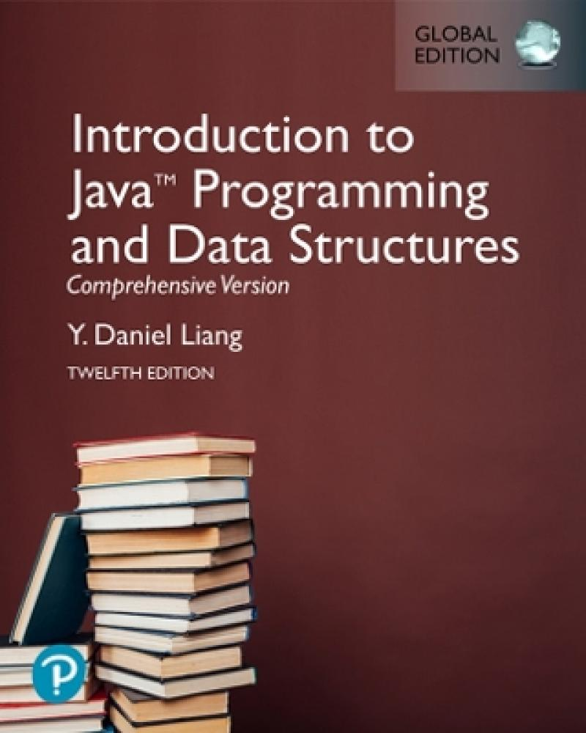

Introduction to Java Programming and Data Structures
Twelfth Edition
Chapter 17
Binary I/O
Copyright © 2020 Pearson Education, Inc. All Rights Reserved
Notes:
If this PowerPoint presentation contains mathematical equations, you may need to check that your computer has the following installed:
1) MathType Plugin
2) Math Player (free versions available)
3) NVDA Reader (free versions available)
Slides in this presentation contain hyperlinks. JAWS users should be able to get a list of links by using INSERT+F7

Slide 5
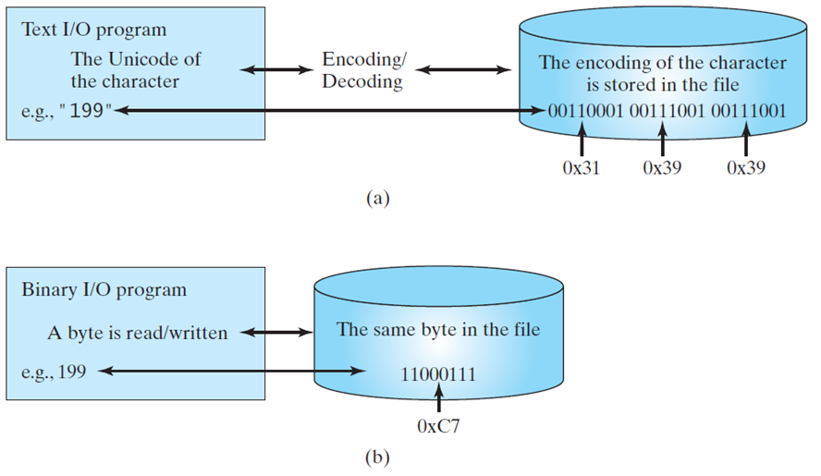
Motivations
You cannot read binary files. They are designed to be read by programs.
For example, Java source programs are stored in text files and can be read by a text editor, but Java classes are stored in binary files and are read by the J V M.
The advantage of binary files is that they are more efficient to process than text files.
Unicode Character Table - Full List of Unicode Symbols (◕‿◕) SYMBL

Slide 6
Objectives
17.1 To discover how I/O is processed in Java (§17.2).
17.2 To distinguish between text I/O and binary I/O (§17.3).
17.3 To read and write bytes using FileInputStream and FileOutputStream (§17.4.1).
17.7 To serialize arrays (§17.6.2).

Slide 7
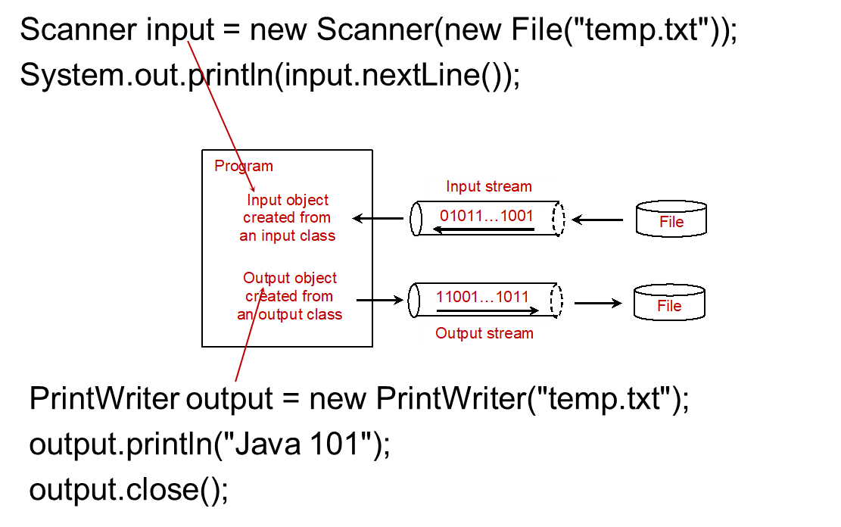
How is I/O Handled in Java?
A File object encapsulates the properties of a file or a path, but does not contain the methods for reading/writing data from/to a file
Les fil fra disk (HD), inn i minne (RAM)
Les fra minne (RAM) og skriv til disk (HD),
Notes:
It has 5 lines. Line 1, Scanner input equal to new Scanner open parenthesis new File open parenthesis double quote temp period txt double quote close parenthesis close parenthesis semicolon. Line 2, System period out period print ln open parenthesis input period next Line open parenthesis close parenthesis close parenthesis semicolon. Line 3, Print Writer output equal to new Print Writer open parenthesis double quote temp period txt double quote close parenthesis semicolon. Line 4, output period print ln open parenthesis double quote Java 101 double quote close parenthesis semicolon. Line 5, output period close open parenthesis close parenthesis semicolon. An object shows the Java I or O classes. It has one box and four cylindrical shapes and they are interrelated with each other. Box 1, has divided into 3 parts. Part 1, shows the Program. Part 2, shows the Input object created from an input class. Part 3, Output object created from an output class. Now, first cylindrical shape shows the 01011 blank 1001 which indicates the Input Stream. Second, cylindrical shape shows the 11001 blank 1011 which indicates the Output Stream. Third and fourth, cylindrical shapes shows the File.

Slide 8
How is I/O Handled in Java?
In order to perform I/O, you need to create objects using appropriate Java I/O classes.
Notes:
It has 5 lines. Line 1, Scanner input equal to new Scanner open parenthesis new File open parenthesis double quote temp period txt double quote close parenthesis close parenthesis semicolon. Line 2, System period out period print ln open parenthesis input period next Line open parenthesis close parenthesis close parenthesis semicolon. Line 3, Print Writer output equal to new Print Writer open parenthesis double quote temp period txt double quote close parenthesis semicolon. Line 4, output period print ln open parenthesis double quote Java 101 double quote close parenthesis semicolon. Line 5, output period close open parenthesis close parenthesis semicolon. An object shows the Java I or O classes. It has one box and four cylindrical shapes and they are interrelated with each other. Box 1, has divided into 3 parts. Part 1, shows the Program. Part 2, shows the Input object created from an input class. Part 3, Output object created from an output class. Now, first cylindrical shape shows the 01011 blank 1001 which indicates the Input Stream. Second, cylindrical shape shows the 11001 blank 1011 which indicates the Output Stream. Third and fourth, cylindrical shapes shows the File.

Slide 9
Text File versus Binary File
Data stored in a text file are represented in human-readable form. Data stored in a binary file are represented in binary form.
The advantage of binary files is that they are more efficient to process than text files.
The decimal integer 199 is stored as the sequence of three characters: '1', '9', '9' in a text file and the same integer is stored as a byte-type value C7 in a binary file, because decimal 199 equals to hex C7.
human-readable form: 199 = ‘1’,’9’,’9’ (char array)
3 byte
binary form: 199 = 1100 0111 = C7
1 byte

Slide 10
Text I/O VS. Binary I/O
Text I/O requires encoding and decoding (PROCESSING).
The J V M converts a Unicode to a file specific encoding when writing a character and coverts a file specific encoding to a Unicode when reading a character.
ASCII = enkel, gammel, kun engelske tegn. Unicode = moderne, global, dekker nesten alle tegn og språk.
Notes:
It has 2 boxes and 2 cylindrical shapes but it's divided into two parts that is (a) and (b). Part (a), has 1 box and 1 cylindrical shape but they are interrelated with each other. Box 1, Text I or O program, The Unicode of the character and e.g. comma double quote 199 double quote. In the mid, shows the Encoding or Decoding and represents the Box 1 and first cylindrical shape. First cylindrical shape, The encoding of the character is stored in the file 00110001, which indicates the 0 times 31, 00111001 which indicates the 0×39, 00111001 which indicates the 0×39. Part (b), also has 1 box and 1 cylindrical shape but they are interrelated with each other. Box 1, Binary I or O program, A byte is read or written, e.g. comma 199. Second cylindrical shape, The same byte in the file, 11000111, which indicates the 0×C7.

Slide 11
Text I/O VS. Binary I/O
Binary I/O does not require conversions!
When you write a byte to a file, the original byte is copied into the file.
When you read a byte from a file, the exact byte in the file is returned.
Ex. CopyDemo.java
Notes:
It has 2 boxes and 2 cylindrical shapes but it's divided into two parts that is (a) and (b). Part (a), has 1 box and 1 cylindrical shape but they are interrelated with each other. Box 1, Text I or O program, The Unicode of the character and e.g. comma double quote 199 double quote. In the mid, shows the Encoding or Decoding and represents the Box 1 and first cylindrical shape. First cylindrical shape, The encoding of the character is stored in the file 00110001, which indicates the 0 times 31, 00111001 which indicates the 0×39, 00111001 which indicates the 0×39. Part (b), also has 1 box and 1 cylindrical shape but they are interrelated with each other. Box 1, Binary I or O program, A byte is read or written, e.g. comma 199. Second cylindrical shape, The same byte in the file, 11000111, which indicates the 0×C7.

Slide 12
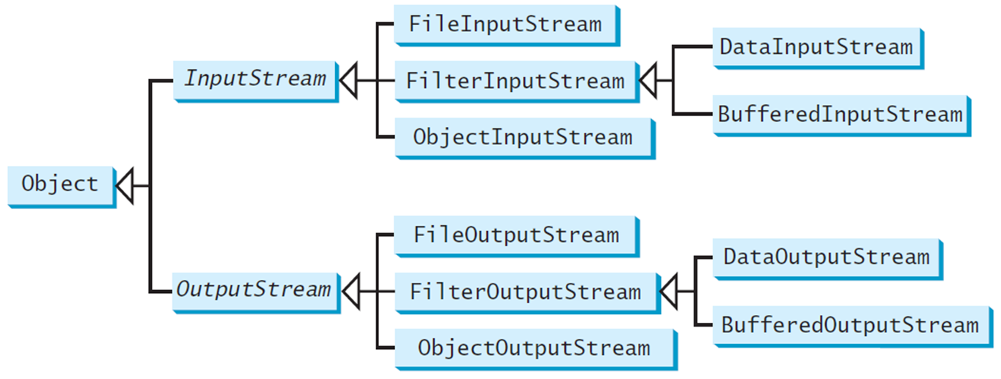
Binary I/O Classes
Notes:
It has different types of boxes. Box 1, shows the Object but it's divided into two parts. Part 1, shows the Input Stream and it's also divided into three parts that is Filter Input Stream, Filter Input Stream, Object Input Stream but File Input Stream is divided into 2 parts that is Data Input Stream and Buffered Input Stream. Part 2, shows the Output Stream and it's also divided into 3 parts that is File Output Stream, Filter Output Stream, Object Output Stream but Filter Output Stream is divided into 2 parts that is Data Output Stream and Buffered Output Stream.

Slide 13
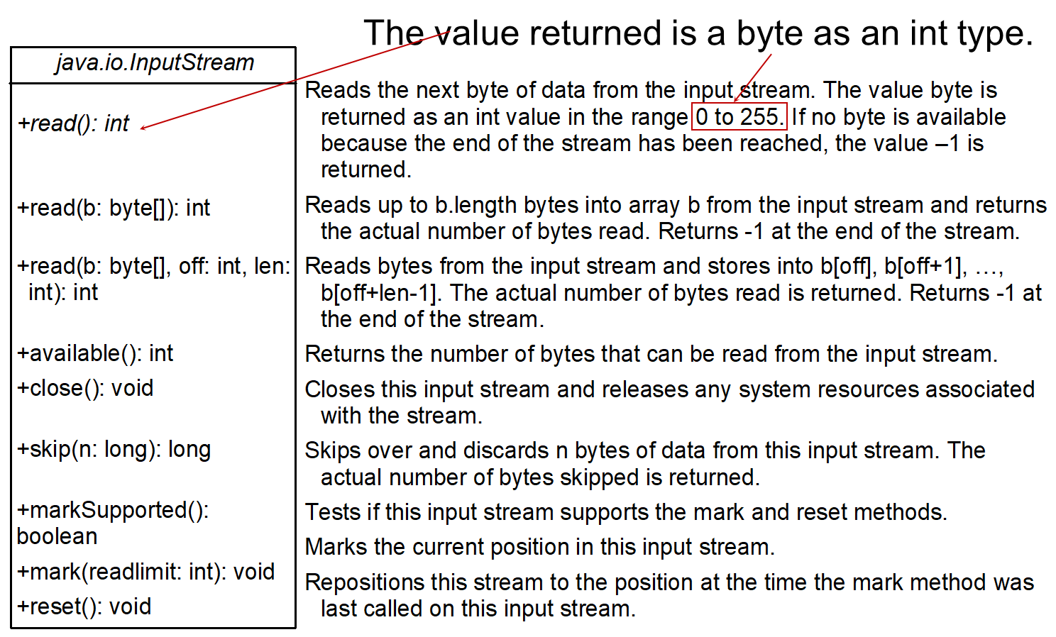
InputStream
Notes:
The computer code contains 10 lines. Line 1, java period io period InputStream Line 2, plus read open parenthesis close parenthesis colon int Line 3, plus read open parenthesis b colon byte open bracket close bracket close parenthesis colon int Line 4, plus read open parenthesis b colon byte open bracket close bracket comma off colon int comma len colon int close parenthesis colon int Line 5, plus available open parenthesis close parenthesis colon int Line 6, plus close open parenthesis close parenthesis colon void Line 7, plus skip open parenthesis n colon long close parenthesis colon long Line 8, plus markSupported open parenthesis close parenthesis colon Boolean Line 9, plus mark open parenthesis readlimit colon int close parenthesis colon void Line 10, plus reset open parenthesis close parenthesis colon void.

Slide 14
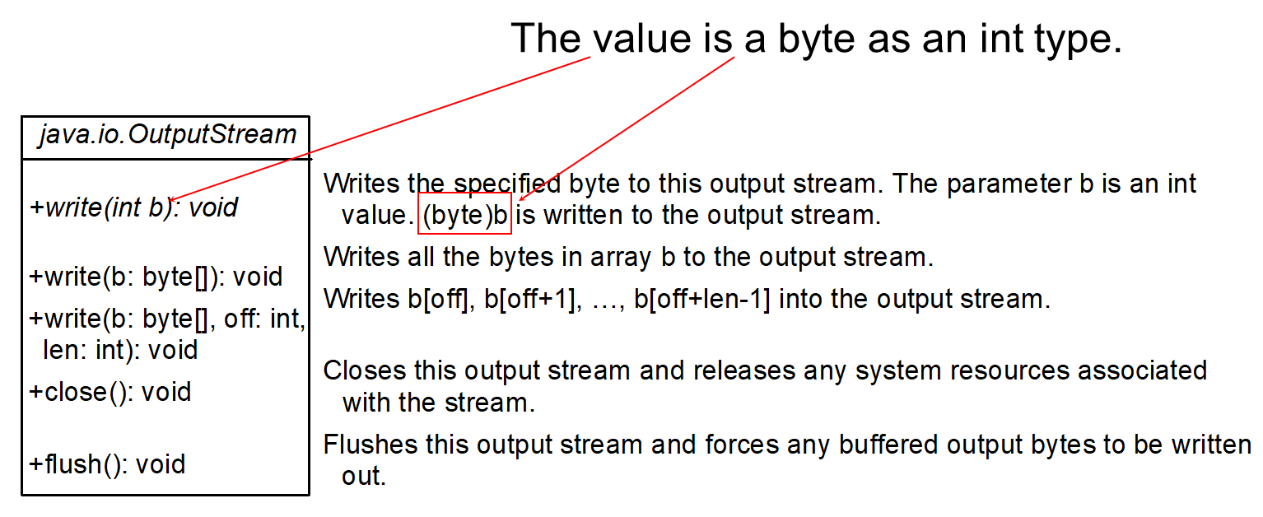
OutputStream
Notes:
The computer code contains 6 lines. Line 1, java period io period OutputStream Line 2, plus write open parenthesis int b close parenthesis colon void Line 3, plus write open parenthesis b colon byte open bracket close bracket close parenthesis colon void Line 4, plus write open parenthesis b colon byte open bracket close bracket comma off colon int comma len colon int close parenthesis colon void Line 5, plus close open parenthesis close parenthesis colon void Line 6, plus flush open parenthesis close parenthesis colon void.

Slide 15
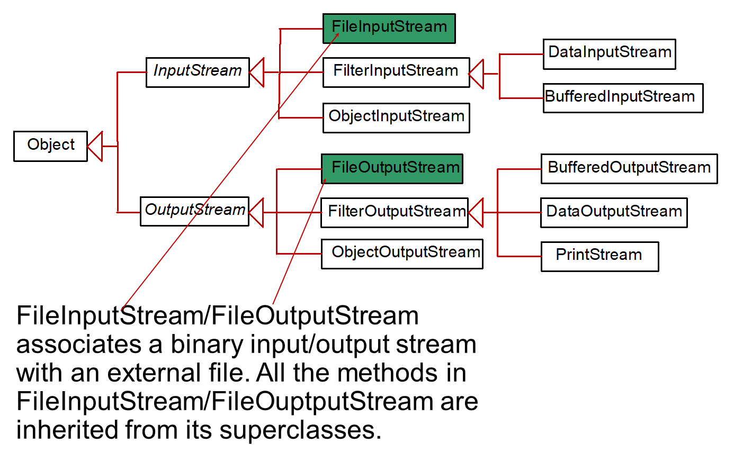
FileInputStream/FileOutputStream
Notes:
It has different types of boxes. Box 1, shows the Object but it's divided into two parts. Part 1, shows the Input Stream and it's also divided into three parts that is File Input Stream is coloured by green colour, Filter Input Stream, Object Input Stream but Filter Input Stream is divided into 2 parts that is Data Input Stream and Buffered Input Stream. Part 2, shows the Output Stream and it's also divided into 3 parts that is File Output Stream is coloured by green colour, Filter Output Stream, Object Output Stream but Filter Output Stream is divided into 3 parts that is Buffered Output Stream, Data Output Stream and Print Stream.

Slide 16
FileInputStream
To construct a FileInputStream, use the following constructors:
public FileInputStream(String filename)
public FileInputStream(File file)
A java.io.FileNotFoundException would occur if you attempt to create a FileInputStream with a nonexistent file.

Slide 17
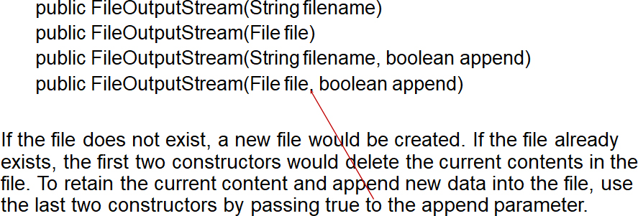
FileOutputStream
Append betyr her at det blir lagt til data i en eksisterende fil!
TestFileStream
Notes:
TestFileStream: https://liveexample.pearsoncmg.com/html/TestFileStream.html

Slide 18
Characters and Strings in Binary I/O
Why U T F-8? What is U T F-8? [ æ ][ ø ][ å ]
U T F-8 is a coding scheme that allows systems to operate with both A S C I I and Unicode efficiently.
Most operating systems use A S C I I i.e. in Unix/Linux with C/C++.
Java uses Unicode. (platform independent)

Slide 19
Characters and Strings in Binary I/O
Since most applications need only the A S C I I character set, it is a waste to represent an 8-bit A S C I I character as a 16-bit Unicode character.
The U T F-8 is an alternative scheme that stores a character using 1, 2, or 3 bytes.
A S C I I values (less than 0x7F) are coded in one byte. Unicode values less than 0x7FF are coded in two bytes. Other Unicode values are coded in three bytes.
0x7F=[0111 1111] = 127 > values (1 byte)
0x7FF = 01 11111 11111 = 2047 > value > 127 = (2 byte)

Slide 20
Concept of Pipe Line
Notes:
It has 6 boxes but they are interrelated with each other and 2 lines. Box 1, shows the Data Input Stream. Box 2, shows the File Input Stream. Box 3, External File. Line 1, shows the int comma double comma String comma blank space 01000110011 blank. Box 4, shows the Data Output Stream. Box 5, shows the File Output Stream. Box 6, shows the External File. Line 2, shows the int comma double comma String comma blank space 01000110011 blank.

Slide 21
Order and Format
CAUTION: You have to read the data in the same order and same format in which they are stored.
Checking End of File:
TIP: If you keep reading data at the end of a stream, an EOFException would occur.
So how do you check the end of a file? You can use input.available() to check it. input.available() == 0 indicates that it is the end of a file.
(-1 also possible)

Slide 22
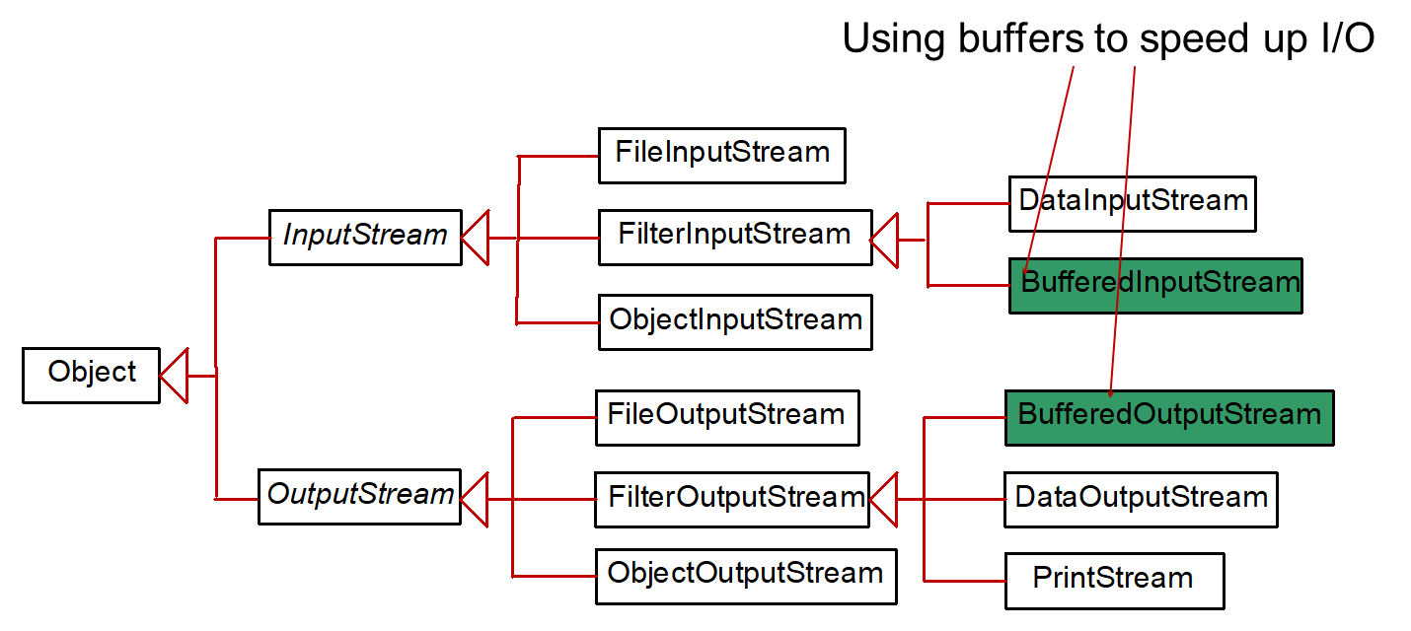
BufferedInputStream/BufferedOutputStream
BufferedInputStream/BufferedOutputStream does not contain new methods. All the methods BufferedInputStream/BufferedOutputStream are inherited from the InputStream/OutputStream classes.
Notes:
It has different types of boxes. Box 1, shows the Object but it's divided into two parts. Part 1, shows the Input Stream and it's also divided into three parts that is File Input Stream, Filter Input Stream, Object Input Stream but Filter Input Stream is divided into 2 parts that is Data Input Stream, and Buffered Input Stream is coloured by green colour. Part 2, shows the Output Stream and it's also divided into 3 parts that is File Output Stream, Filter Output Stream, Object Output Stream but Filter Output Stream is divided into 3 parts that is Buffered Output Stream is coloured by green colour and Print Stream.

Slide 23
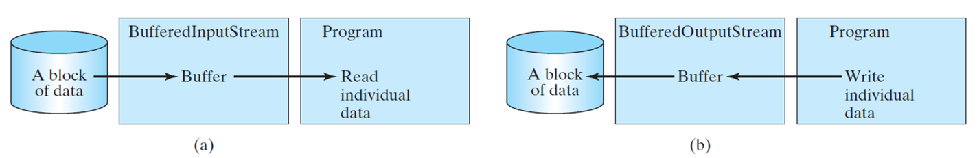
Constructing BufferedInputStream/BufferedOutputStream
// Create a BufferedInputStream
public BufferedInputStream(InputStream in)
public BufferedInputStream(InputStream in, int bufferSize)
// Create a BufferedOutputStream
public BufferedOutputStream(OutputStream out)
public BufferedOutputStream(OutputStreamr out, int bufferSize)
Notes:
It has 2 cylindrical shapes, 4 boxes, and they are divided into 2 parts: (a) and (b). Part (a), has 1 cylindrical shape,2 boxes and they are interrelated with each other. First cylindrical shape, shows the A block of data. Box 1, Buffered Input Stream and Buffer. Box 2, Program, Read individual data. Part (b) has 1 cylindrical shape,2 boxes and they are interrelated with each other. First cylindrical shape, shows the A block of data. Box 1, Buffered Output Stream and Buffer. Box 2, Program, Write individual data.

Slide 24
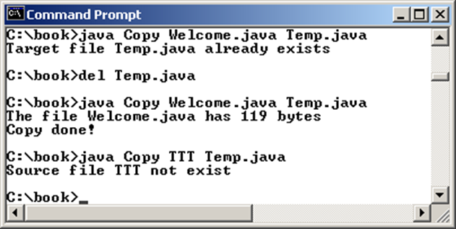
Case Studies: Copy File
This case study develops a program that copies files.
The user needs to provide a source file and a target file as command-line arguments using the following command:
java Copy source target
Copy
Notes:
The panel shows the 9 lines. Line 1, C colon forward slash book greater than java Copy Welcome period java Temp period java. Line 2, Target file Temp period java already exists. Line 3, C colon forward slash book greater than del Temp period java. Line 4, C colon forward slash book greater than java Copy Welcome period java Temp period java. Line 5, The file Welcome period java has 119 bytes. Line 6, Copy done exclamation mark. Line 7, C colon forward slash book greater than java Copy TTT Temp period java. Line 8, Source file TTT not exist. Line 9, C colon forward slash book greater than slash.
Copy: https://liveexample.pearsoncmg.com/html/Copy.html

Slide 25
Case Studies: Copy File
java Copy source target
The program copies a source file to a target file and displays the number of bytes in the file.
If the source does not exist, tell the user the file is not found.
If the target file already exists, tell the user the file already exists.
Copy
Notes:
The panel shows the 9 lines. Line 1, C colon forward slash book greater than java Copy Welcome period java Temp period java. Line 2, Target file Temp period java already exists. Line 3, C colon forward slash book greater than del Temp period java. Line 4, C colon forward slash book greater than java Copy Welcome period java Temp period java. Line 5, The file Welcome period java has 119 bytes. Line 6, Copy done exclamation mark. Line 7, C colon forward slash book greater than java Copy TTT Temp period java. Line 8, Source file TTT not exist. Line 9, C colon forward slash book greater than slash.
Copy: https://liveexample.pearsoncmg.com/html/Copy.html

Slide 26
The Serializable Interface
Not all objects can be written to an output stream.
Objects that can be written to an object stream is said to be serializable.
A serializable object is an instance of the java.io.Serializable interface.
So the class of a serializable object must implement Serializable.

Slide 27
The Serializable Interface
The Serializable interface is a marker interface.
It has no methods, so you don't need to add additional code in your class that implements Serializable.
Implementing this interface enables the Java serialization mechanism to automate the process of storing the objects and arrays.

Slide 28
Serializing Arrays
An array is serializable if all its elements are serializable.
So an entire array can be saved using writeObject into a file and later restored using readObject.
Here is an example that stores an array of five int values and an array of three strings, and reads them back to display on the console.
TestObjectStreamForArray
Notes:
TestObjectStreamForArray: https://liveexample.pearsoncmg.com/html/TestObjectStreamForArray.html

Slide 29

Copyright
This work is protected by United States copyright laws and is provided solely for the use of instructors in teaching their courses and assessing student learning. Dissemination or sale of any part of this work (including on the World Wide Web) will destroy the integrity of the work and is not permitted. The work and materials from it should never be made available to students except by instructors using the accompanying text in their classes. All recipients of this work are expected to abide by these restrictions and to honor the intended pedagogical purposes and the needs of other instructors who rely on these materials.

