Slide 1
Generative AI

Slide 2
What Is Generative AI?
Generative AI can already do a lot. It’s able to produce text and images, spanning blog posts, program code, poetry, and artwork. The software uses complex machine learning models to predict the next word based on previous word sequences, or the next image based on words describing previous images.
It doesn’t do the work of prediction. That’s why its different from predictive AI. Its creative but not predictive in nature.

Slide 3
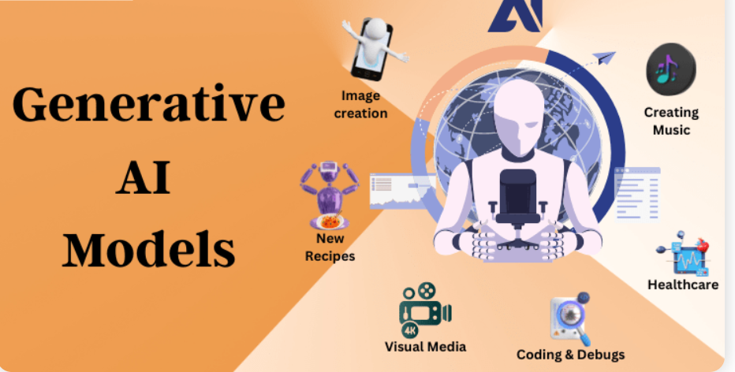

Slide 4
Gen AI Jargons
Tokens – LLM’s do not interpret natural language that we speak. Natural language is converted into an array of numerical values called as tokens.
Prompt Engineering – The instructions that you provide to the GPT engine instructing it to do something is called as prompt engineering. It’s an art in itself and includes important concepts like few-shot prompting, contextual prompting, output structurization etc.
Chat Completions API – SDK exposed to let you interact with your GPT engine in a chat-like manner by making API calls.

