Slide 1
WeSay
Eric Albright
John Hatton
Mainland Southeast Asia

Slide 2
Why another Dictionary Application?
He doesn’t
He already has one
Notes:
Dictionaries have always been a collaborative effort, and many native speakers are able to use current tools. WeSay aims to expand the number of situations where language communities can do the non-technical aspects on their own.

Slide 3
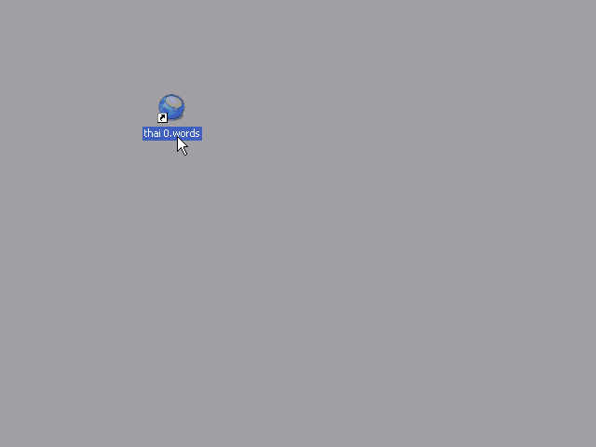

Slide 4
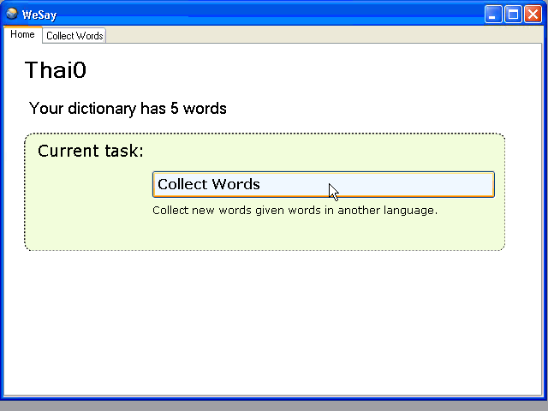

Slide 5
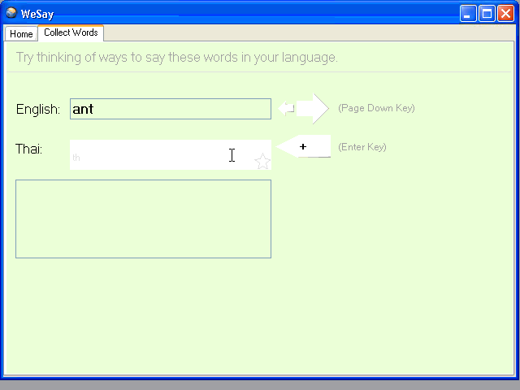

Slide 6
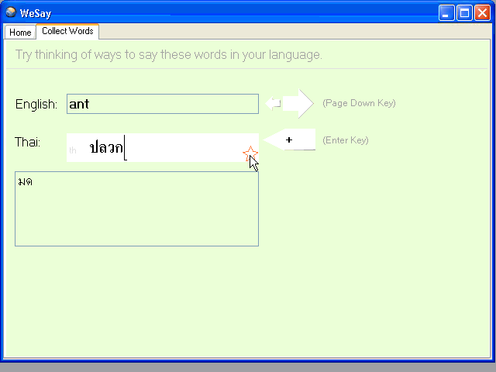

Slide 7
Collecting Word List

Slide 8
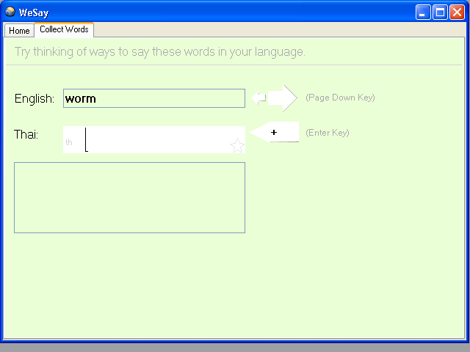
Collecting Word List

Slide 9

Training
w to write good examples

Slide 10
Adding Examples

Slide 11
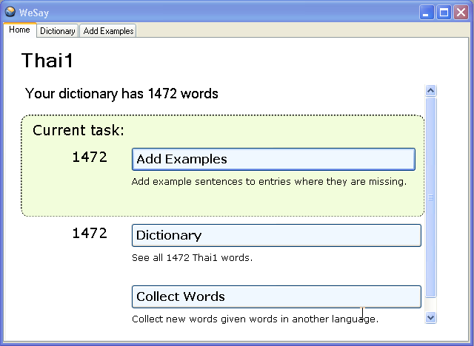

Slide 12
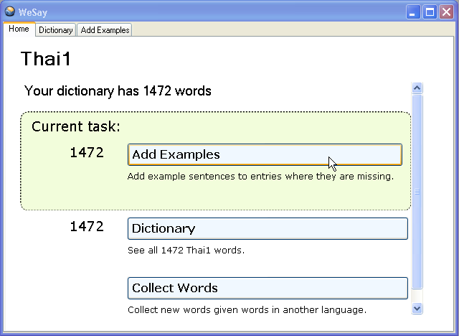

Slide 13
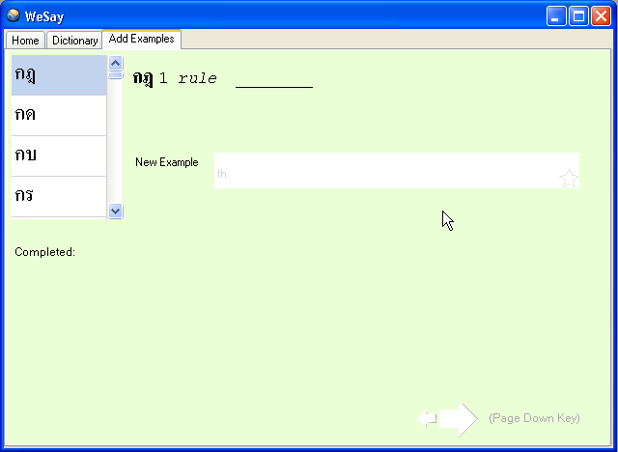

Slide 14
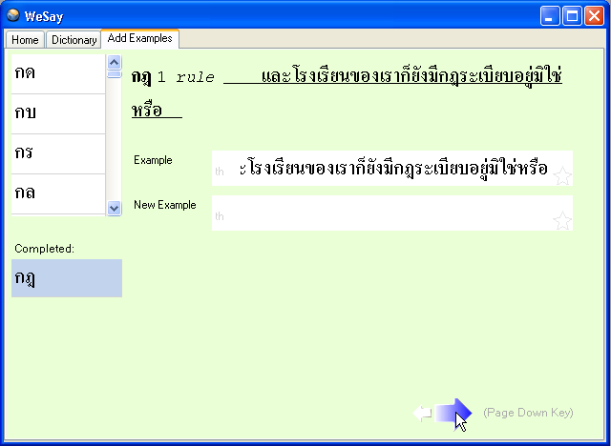

Slide 15
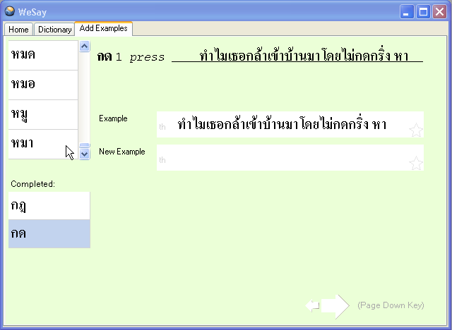

Slide 16
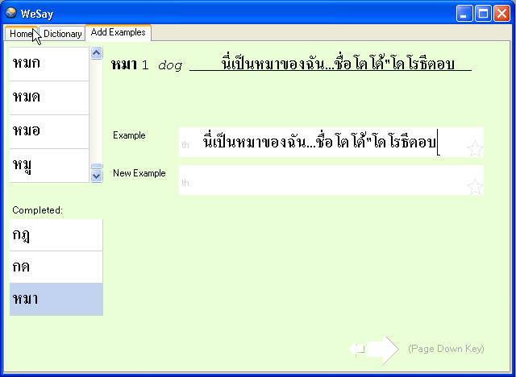

Slide 17
New Idea

Slide 18
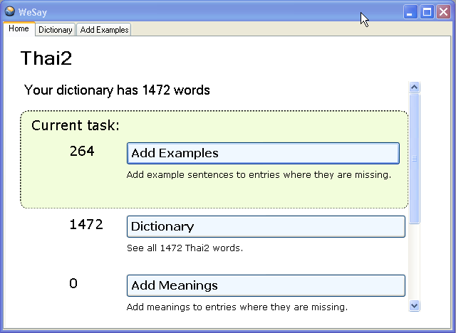

Slide 19
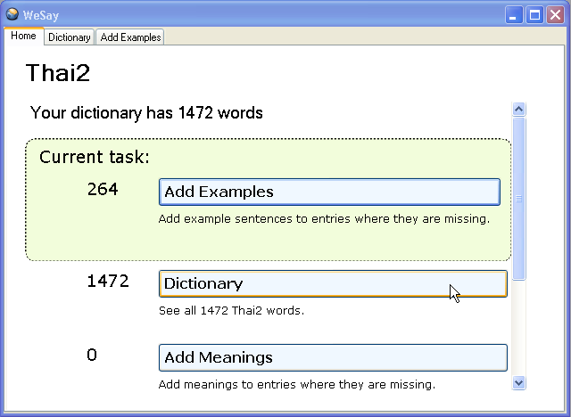

Slide 20
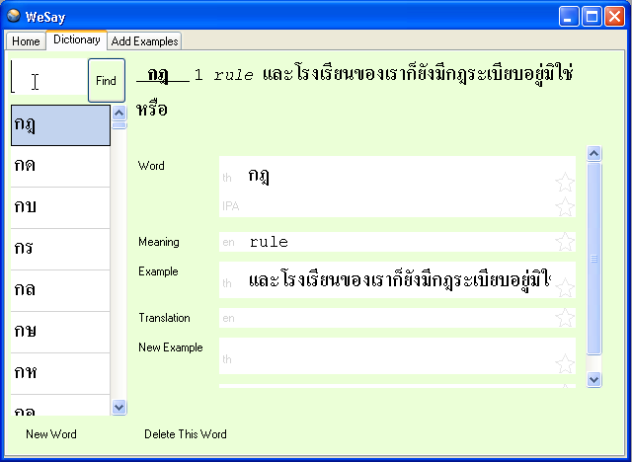

Slide 21
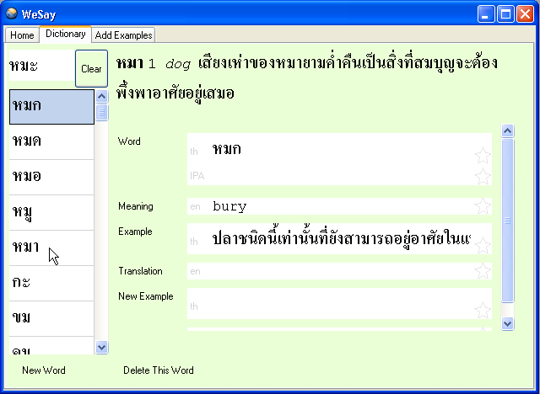

Slide 22
WeSay Admin
Run WeSay Admin
Notes:
The advisor uses the Admin program to setup projects, sequence tasks, & progressively unveil more features as the user advances.

Slide 23
Distinctives
Low training/support
Task oriented
No file system access
Easy to localize
Automated backup

Slide 24
Distinctives
Deployment Options
Windows Boxes
Linux
2B1 Laptop (OLPC)

Slide 25
Distinctives
Cooperation
Native speaker ←→ advisor
Community
Notes:
Interaction with FLEX, Toolbox (with SOLID)
Community: simple printouts, impressive-looking reports

Slide 26
Near Future
Graphite
Semantic Domains
Sorting
Fast Search
Printouts
2B1-laptop

Slide 27
Possible Future
Extensions via Python/.net
Language Learning
Custom fields
Email integration

Slide 28
Roadmap
November Gather Feedback
Jan Trial Runs
“1.0” March

Slide 29
WeSay
He’s Ready

