Slide 1
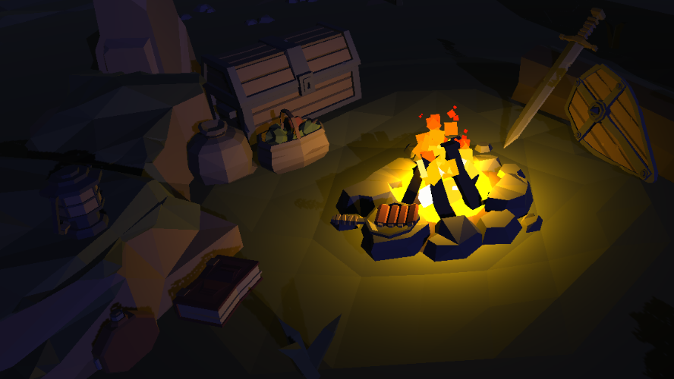
Monster Hunter
By
Ido isaac

Slide 2
Table of content
Game Developers
Game Concept
Game Mechanics
Major Components
Development Issues

Slide 3
Game developers
Ido Isaac – Code, level design, UI, Animations

Slide 4
Game concept
Genre: Action Role Playing Game
View: 3D, Top-Down view
Setting: Medieval Fantasy
Protagonist: Human fighter
Antagonist: Dragons
Objective: Defeat all enemies then reach the exit portal

Slide 5
Game mechanics
Health
Sprint
Attack
Respawn
Enemies
Health packs
Damage zones
Pause Menu
Portal To Next Level

Slide 6
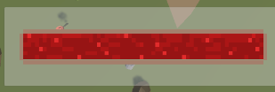
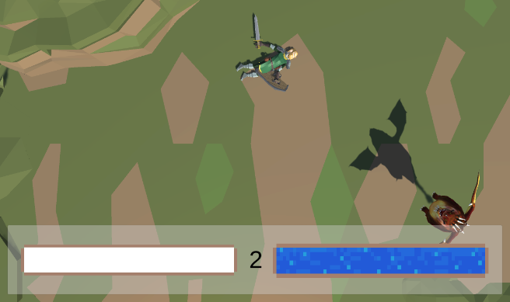
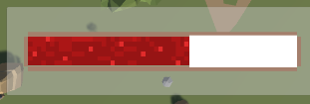
Major Components
Health
Player has an integer representing his health
Several mechanics cause the player to lose health
An animation plays whenever the player takes damage
When reaching 0 health the player dies

Slide 7
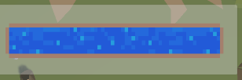
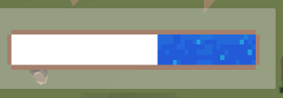
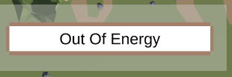
Major Components
Sprint
Doubles player move speed when pressing shift
Has a sprint animation and “Out of Energy” message
Depletes the energy bar while sprinting
Regenerates energy when not sprinting

Slide 8
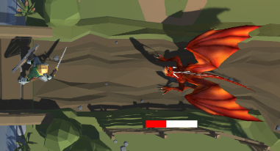
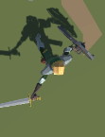
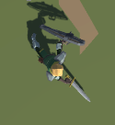
Major Components
Attack
When the player clicks the left mouse button, an attack is triggered
Attacks hit anything tagged “Enemy” within the attack area causing 2 points of damage
Attacks also destroy enemy projectiles
Attacks also cause a knockback that pushes enemies away
Attack speed limits the frequency in which attacks can be made, currently every 2 seconds

Slide 9
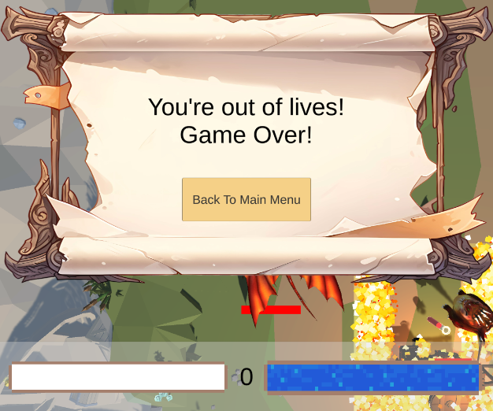
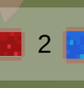

Major Components
Respawn
Player has an integer representing respawns left
When the player dies, health and position are reset and the number of respawns left is reduced by one
If no respawns are left, the lose screen is displayed
Lose screen button takes you back to the main menu

Slide 10
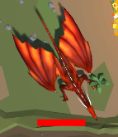
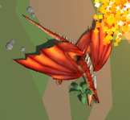
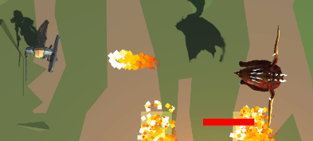
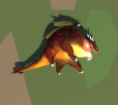
Major Components
Enemies
Melee enemies have 10 health
They run at the player when they’re within their range, on collision they cause 2 points of damage and knockback the player
If the player gets too far, enemies return to their start position
Ranged enemies have 6 health
They approach to a certain distance and back away if too close to the player
They shoot a fireball that deals 1 point of damage
If the player gets too far, enemies return to their start position

Slide 11
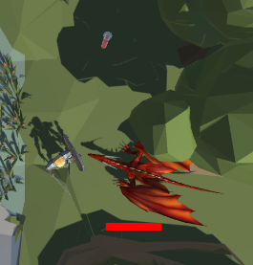

Major Components
Health Packs
There are three types of health packs, Minor, Medium and Major
They heal the player by 2 , 5 and 10 respectively
They are one use only, and are destroyed when picked up
Scattered throughout the level for the player to find

Slide 12
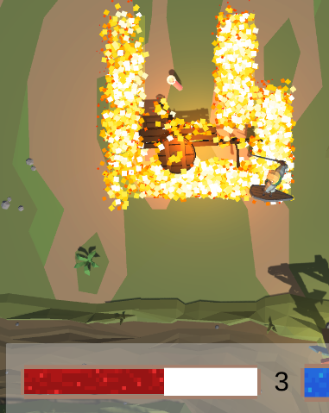
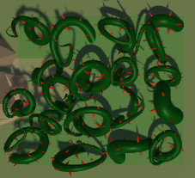
Major Components
Damage Zones
Damage zones periodically deal damage to the player when they’re inside the area of effect
Currently they deal 1 damage every 2 seconds
All damage zones are marked by a translucent square on the ground below them

Slide 13
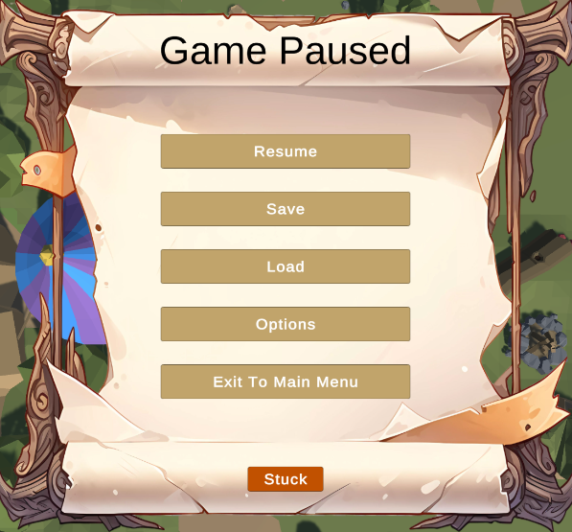
Major Components
Pause Menu
When the “Escape” button is clicked the game is paused and the pause menu opens
While paused, clicking the “Escape” button or pressing “Resume” will close the menu and un-pause
The “Exit To Main Menu” option returns you to the main menu
The “Stuck” button closes the menu, un-pauses the game and resets the player position to the respawn point
The other options do not have any functionality yet

Slide 14

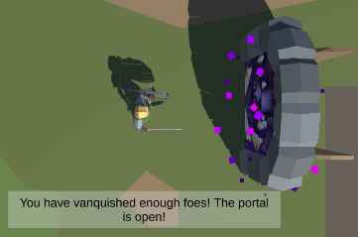
Major Components
Portal To Next Level
To advance to the next level, sufficient foes must be defeated
If the player collides with the exit portal a message will display the remaining number of foes that must be defeated
The same message will be displayed at the beginning of each level
When enough foes have been defeated a message will appear to inform the player
After that, colliding with the portal takes the player to the next level

Slide 15
Development Issues
Problem: Health and energy bars are connected to a slider, when the values on the slider change (like when sprinting) the bars were stretching and ruining the animation
Solution: Connected the slider to a white box that covers the bars rather than to the bars themselves
Problem: Sprinting animation was triggering when holding shift but not moving.
Solution: Changed sprint code to only allow sprinting when movement != Vector3.zero
Problem: Three animations can happen from any state, attack, take damage and die. This caused the attack and take damage animations to play even after the player dies
Solution: Added a Boolean value that locks functionalities like moving, attacking etc. when the player dies.
Problem: The player could only attack in a circle or square centered on the player, rather than in front of the player
Solution: Moved the “Player Attack” script to an empty child object of the player and offset its position

