Slide 1



Information Retrieval Final Project
Building a Search Engine for English Wikipedia!
Bar Dolev
Ido Paretsky
1

Slide 2

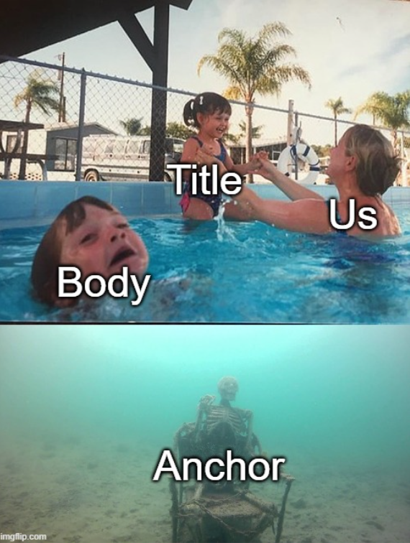
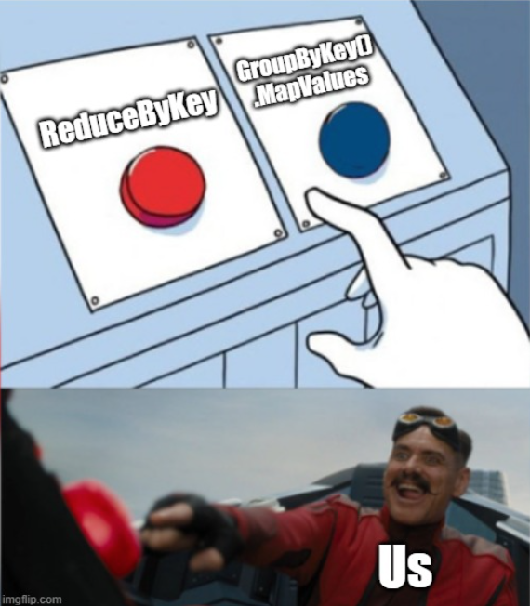

Main Takes

Slide 3
Main Takes (for real)
Title, Body &
Anchor Inverted
Indexes with DL
ID, Title, PageRank
& PageViews exported
to .csv and then .pkl
mapped to dict
PageRank & PageViews
MinMax Scaling and
Zero-Imputing
Boolean Search
secondary sort by
PageRank (tie-break)
TfIdf & CosSim Search
Anchor Text and
Normalization set aside
Title-Oriented
Search Vs. Body-
Oriented Search
Optimization of
Scoring Weights
on Train Set
Runtime Optimization
Posting Lists Upload
to Instance’s SSD
3

Slide 4


Title-Oriented Search (Entity / Event) Vs. Body-Oriented Search (Explanation)
Length of Tok. Query < 3
Or
Matching a Year’s pattern
Length of Query > 4
Or
Ends with a question mark
Query
Explanation-Oriented
Weights
Body = 0.8
PageRank = 0.1
PageViews = 0.1
Entity-Oriented
Weights
Title = 0.8
PageRank = 0.1
PageViews = 0.1
42

Slide 5
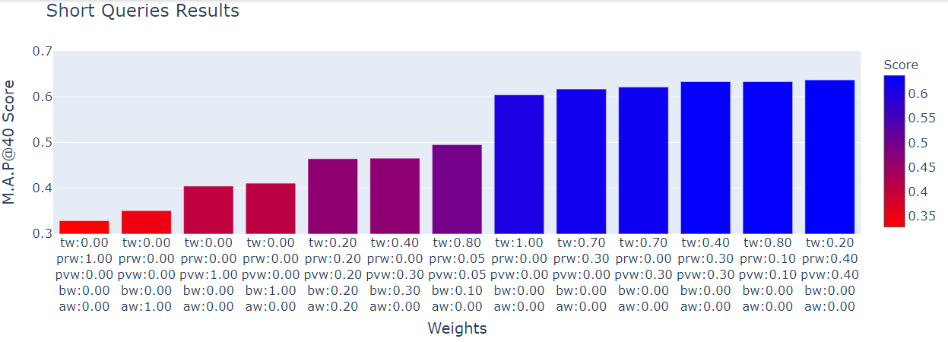
Title-Oriented Search (Entity / Event) Weights Optimization
Average M.A.P@40: 0.585
Entity / Event – Top 5
Explanation – Top 10
43

Slide 6
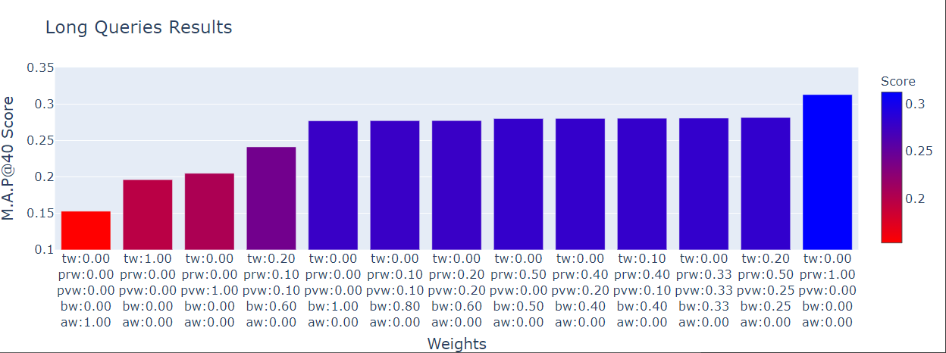
Body-Oriented Search (Explanation) Weights Optimization
Average M.A.P@40: 0.585
Entity / Event – Top 5
Explanation – Top 10
43

Slide 7
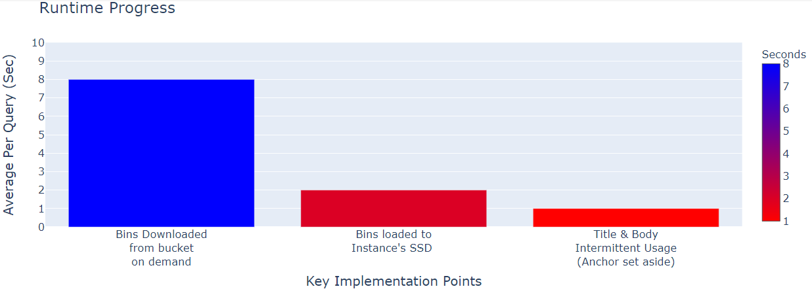
Runtime Optimization
43

