Slide 1
Classification project
Ido Shirat
July 21

Slide 2

Goal
I was hired by "cod-cod" company.
Company would like to create a new boardgame blog for popular boardgames.
Thus, my goal is to gain data about boardgames and predict boardgame rating and share it with the board.

Slide 3
Scoring
Board expect me to reach a minimum of 95% accuracy

Slide 4
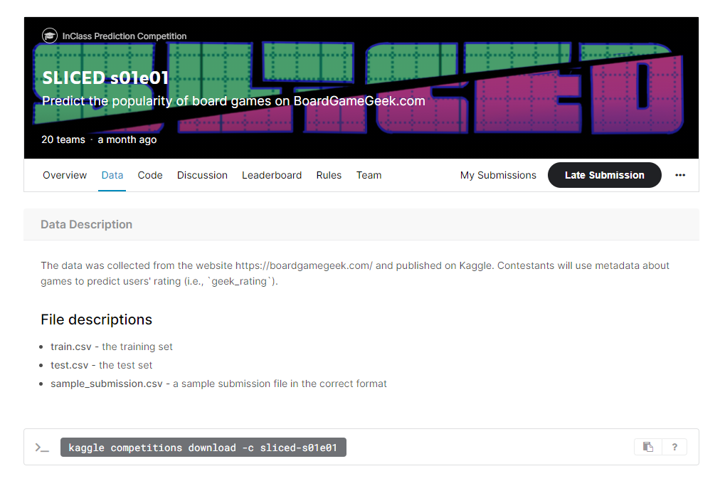
The data
Link: https://www.kaggle.com/c/sliced-s01e01/overview

Slide 5
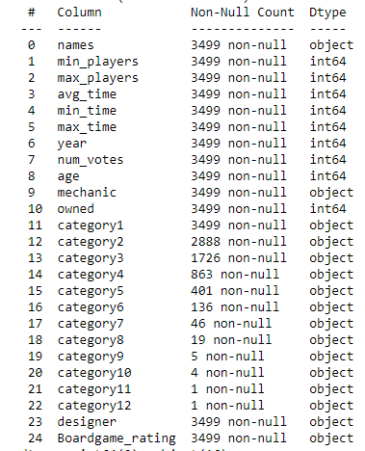
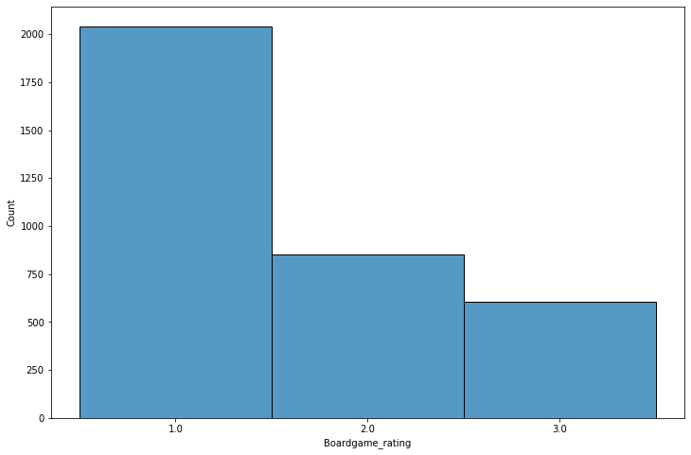
Data exploration
https://www.kaggle.com/c/sliced-s01e01/overview

Slide 6
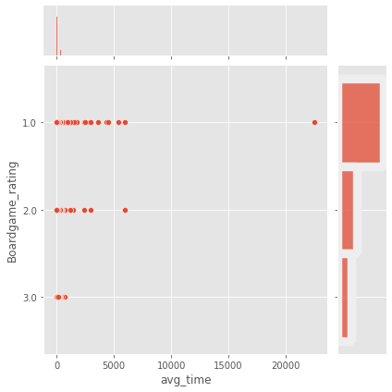
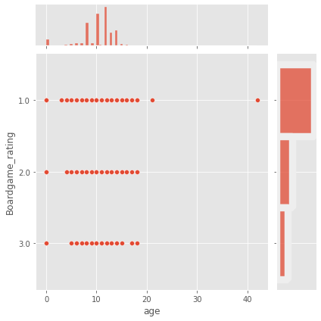
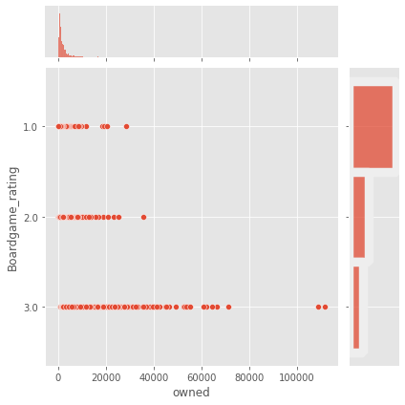
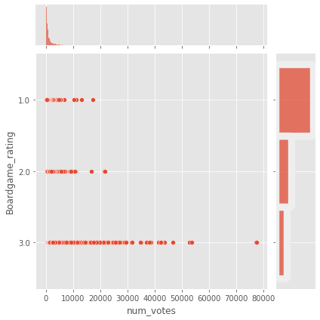
Data exploration
Avg time to rating
age to rating
Owned amount to rating
Number of votes to rating

Slide 7
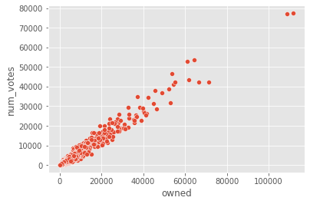
Data exploration
Main difficulty

Slide 8
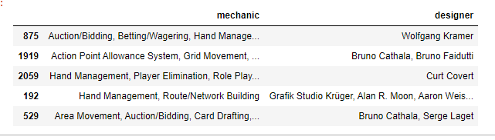
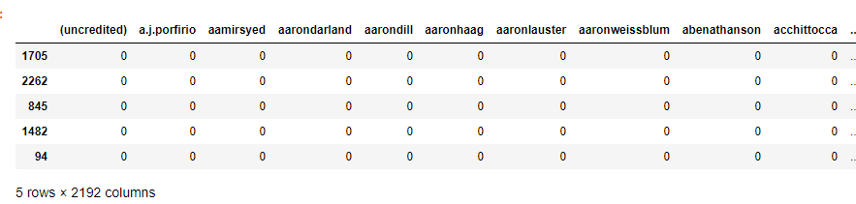
Data pre- processing
Duplications: Only for new version of games
Nans: Only for boardgames with just few in categories
Outliers clean:
Categorial features clean: manual
Continuous features clean: 3 sigma filter

Slide 9
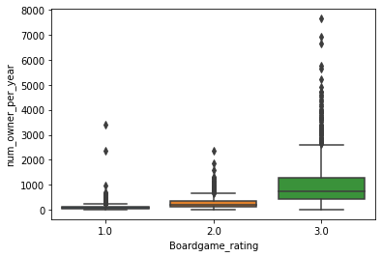
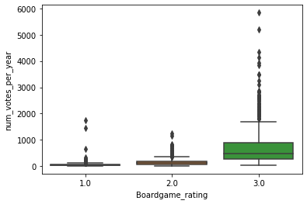
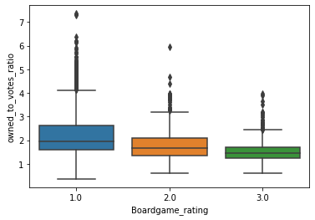
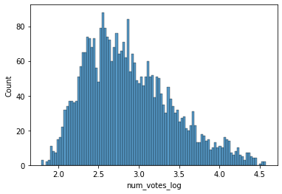
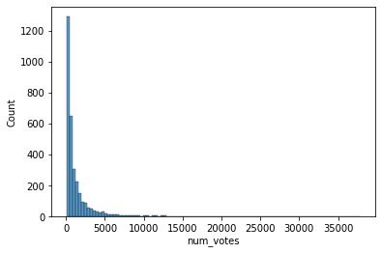
Feature engineering
Num of owner per year to rating
Num of votes per year to rating
(Owned / Num of votes ) to rating
log to num of votes

Slide 10
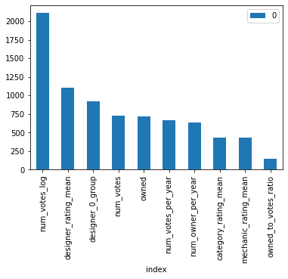
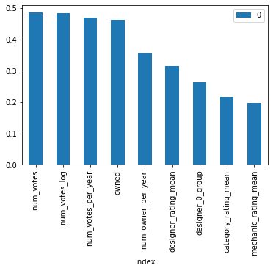
Feature selection
f_classif
f_mutual_info_classif

Slide 11

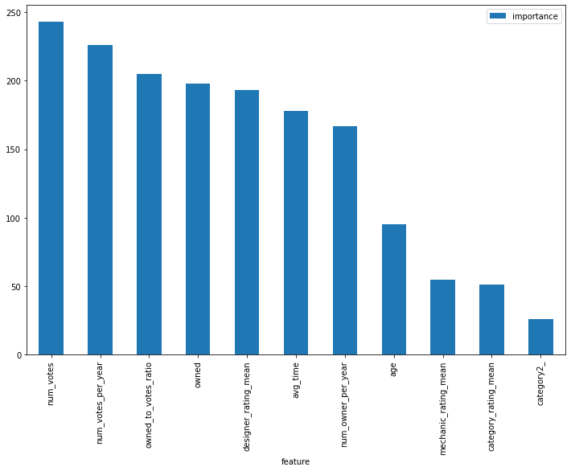
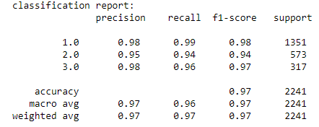
Model
Gradient boosting
Hyperparamters: {'learning_rate': 0.1, 'max_depth’: 3, 'n_estimators’: 300}
Loss function: ‘accuracy’

Slide 12

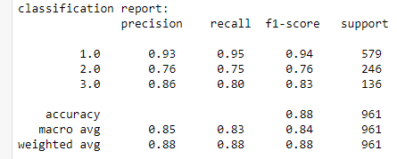
Test set validation
Gradient boosting

Slide 13

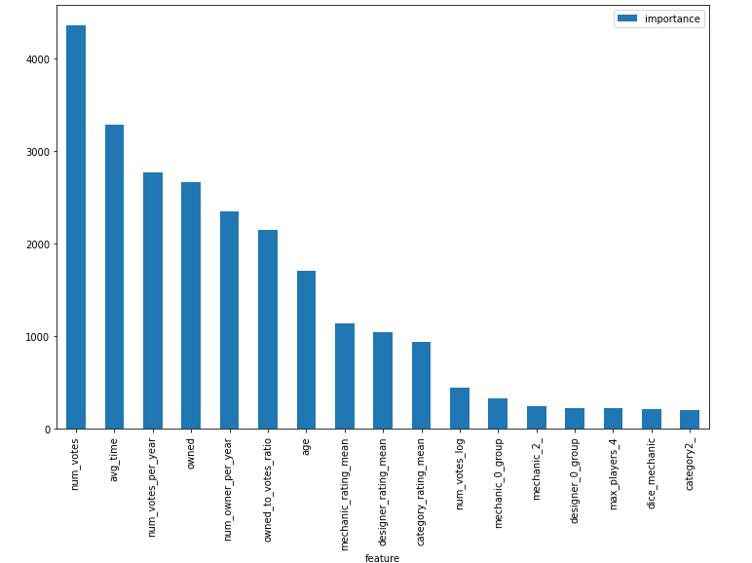
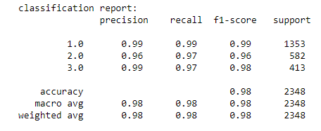
Model
Random forest
Hyperparamters: {'learning_rate': 0.25, 'max_depth': 12, 'n_estimators': 100}
Loss function: ‘accuracy’

Slide 14

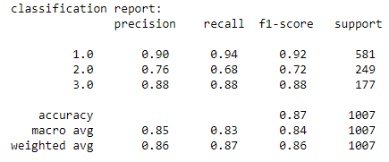
Test set validation
Random forest

Slide 15
Summary
Train set: accuracy= 98%
Test set: accuracy= 88%
What is missing from my point of view?
Feature engineering

Slide 16
Conclusions
One should manage his time when deciding to run a model
Next time I should choose a dataset which has more business practicality
Feature engineering is crucial!

