Slide 1
PROJET PRESETATION OF SUPERMARKET DATABASE
IDOWU OYINKANSOLA

Slide 2
Meaningful Insights OF THE DATA
1.City Impact on sales: Yangon (Branch A) appears to generate a significant portion of the sales, suggesting the key market. Naypyidaw (Branch C) also contributes substantially, while Mandalay (Branch B) might need strategies to boost sales.
2.Customer Type Influence: Member customer tend to contribute a larger share of sales compared to Normal customer, indicating the effectiveness of the membership program in driving revenue.
3.Gender Preferences: Female customer seem to be more frequent purchasers overall, which could inform targeted marketing campaigns and product selections.
4.Product Line Performance: Electronic accessories and Health and beauty product are frequently purchased, suggesting high demand. Strategies to optimize inventory and marketing for these line be beneficial.
5.Payment Method Trends: Ewallet and credit card payment are popular, indicating a preference for digital payment method. Enduring seamless integration and security for these options is crucial.
6.Profitability Considerations: The gross margin percentage is consistently 4.78%, suggesting a standardized pricing strategy. Analyzing the gross income per transaction could reveal opportunities to optimize pricing or reduce costs.

Slide 3
DATA INTERPRETATION Supermarket data visualization report introduction, This report provides an overview of supermarket data for fiscal year 2023 using various views in Power BI. The data encompasses various customer demographics, product lines, payment methods and sales.
1.The total sales by city of branch Chart type: Stacked chart explain: this is the average transaction value for each branch, by the city the branch is located in. it shows the average spending transaction across different locations.
2. The total unit price made by each gender of city Chart type: Stacked area chart explain: This reveals the total revenue generated from unit sales by gender within the city. It helps identify any significant differences between males and female customers in all the city.
3. The average transaction made by each payment by branch Chart Type: stacked chart explain: The chart shows an insight into how customer in different branches prefer to pay. Knowing this helps optimize payment options and potentially identify issues with certain payment methods in specific locations.
4. The total sum of product line Chart type: dounut chart explain: This shows while product line contribute the most to overall revenue. A higher total sum indicates higher pricing within that product line.
5. The quantity of each product line by customer type Chart type: Stacked area chart explain: this shows the amount of product line by customer type, this shows which product are more popular among members and normal customer. This can inform targeted promotions and product placement based on customer type preferences.
6. The gross margin percentage and gross margin product line Chart type: Stacked area This shows which product line contribute of the gross margin percentage and gross income. The gross margin percentage is consistently 4.78%, suggesting a standardized pricing strategy. Analyzing the gross income per transaction could reveal opportunities to optimize pricing or reduce costs.

Slide 4
Recommendations
1.Optimize branch performance: In (branch A) capitalize on the strong market presence by expanding product offering and optimizing marketing effort. In (branch B) implement targeted marketing campaigns, introduce popular product line. In (branch C) maintain the current sales by focusing on customer retention strategies and exploring opportunities for expansion.
2.Inventory and marketing optimization: prioritize inventory management for Electronic accessories and Health and beauty product to meet high demand, Develop marketing strategies to promote these popular product line and attract new customer.
3.Payment method integration: Ensure seamless integration and security for ewallet and credit card payment options to cater to customer preferences.
4.Targeted marketing campaigns: Develop marketing campaigns tailored to female customers focusing on product lines and promotions that resonate with their preferences.

Slide 5
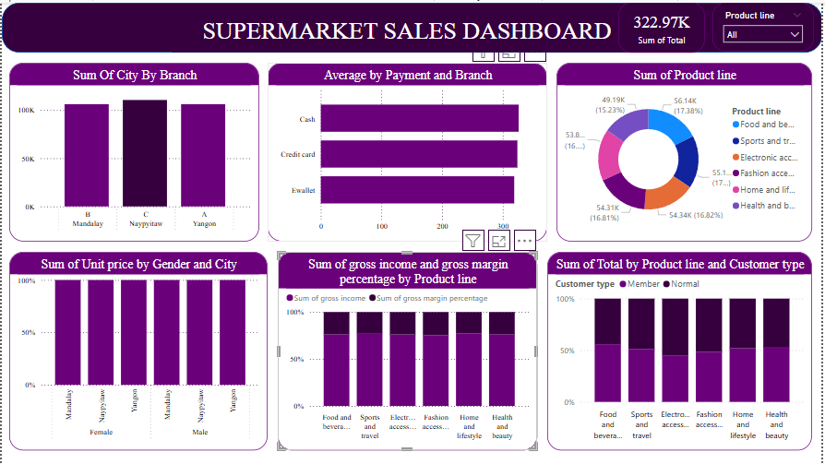
DATA VISUALIZATION

Slide 6
Conclusion
The analysis of the sales data reveals valuable insights into customer sales, product performance, branch specific dynamics and city transactions. Yangon (branch A) stands out as a key market, while Mandalay (branch) requires strategic interventions to boost sales. Member customer are valuable contributors to revenue, demonstrating the success of the loyalty program. Female customer are more frequent purchasers. Electronic accessories and health and beauty product are popular across all customer segment. Digital payment such as ewallet and credit card should be encourage. By implementing the recommended strategies the retail business can optimize its operations enhance customer engagement, and drive revenue growth across all branches, a data-drive approach to decision making will enable the business to adapt to changing market conditions and maintain a competitive edge.

Slide 7
THANK YOU

