Slide 1
Containerizing Data Pipelines with Docker and Docker-compose Idowu Oselumhe Ilekura

Slide 2




ABOUT ME
As an accomplished data professional with over 3 years of immersive experience in the dynamic field of data, I share my insights on tech-related topics through Medium and actively contribute as a technical writer to international companies
Idowu Oselumhe Ilekura
Contact
https://www.linkedin.com/in/ilekuraidowu/
https://twitter.com/idowuilekura
https://medium.com/@idowuilekura

Slide 3
Overview of Data Pipelines

Slide 4
EXTRACT
TRANSFORM
LOAD

Slide 5

Stages of Building a data pipeline
01
Build all components of the Pipeline
02
Test the pipeline
03
Deploy the pipeline in production

Slide 6
Stages of Building Data Pipelines Locally
Build the pipeline
Test the pipeline
Deploy Locally
Local Computer

Slide 7
Stages of Building Data Pipelines with Remote Collaboration and in production
Build the pipeline locally
Test the pipeline locally
Deploy the pipeline on a remote server
Remote module versions/OS different from local versions (leads to breakage)
Local module versions
Local module versions

Slide 8
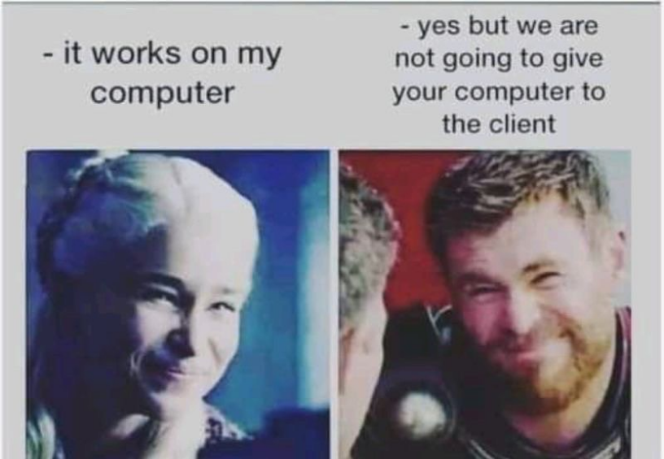

Slide 9

Process of solving breakage of code in remote servers/production environment
What if I bundle my entire system with the configurations, versions and OS and replicate on the production server

Slide 10
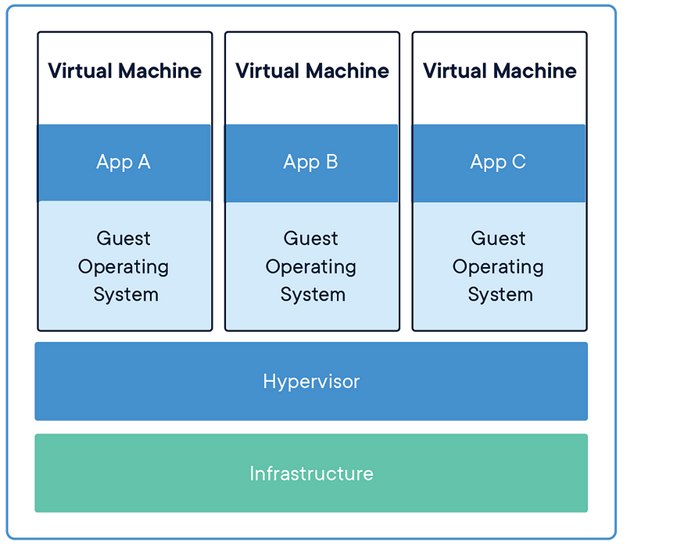
Process of solving breakage of code in remote servers/production environment (VM)

Slide 11
Process of solving breakage of code in remote servers/production environment (VM)
Cons
Pros
You can virtualize any operating system and hardware
You can bundle your system configurations into another system and run your code/ pipeline on the system
Resource intensive to run
The number of VMs to run depends on the underlying system infrastructure in production
You have to spin the right OS and environment for the production server.

Slide 12
Process of solving breakage of code in remote servers/production environment
What if I freeze the versions of my modules and install the same version on the production server

Slide 13
Process of solving breakage of code in remote servers/production environment
(virtual environment/ requirements.txt)
Build the pipeline locally
Test the pipeline locally
Deploy the pipeline on a remote server
Local module versions (freeze the modules version into requirement.txt)
Install the freezed requirements.txt file
Local module versions

Slide 14
Process of solving breakage of code in remote servers/production environment (module freeze & virtual environment)
Cons
Pros
Lighter in comparison to a VM
Doesn’t account for the differences in how different OS handles python modules/ other system modules that python depends on

Slide 15

Deep Dive into Linux Namespaces
Linux has different namespaces for isolating stuff on it such as:
The Process (Process Identifier) Namespace: Isolate the running of a process or program on Linux without affecting other processes.
The Network Namespace: Deals with isolating the network related activities
Mount Namespace: Isolate the file that is mounted and prevent it from working on other namespaces
User Namespace: Isolate the user and prevents conflict between users on a system
Cgroup
Cgroup manages the namespaces in Linux, memory, resources and others.
Local module versions

Slide 16
Linux Namespace and Cgroup
Python process 2 running
Python process 3 running
Python process 1 running
Linux OS

Slide 17
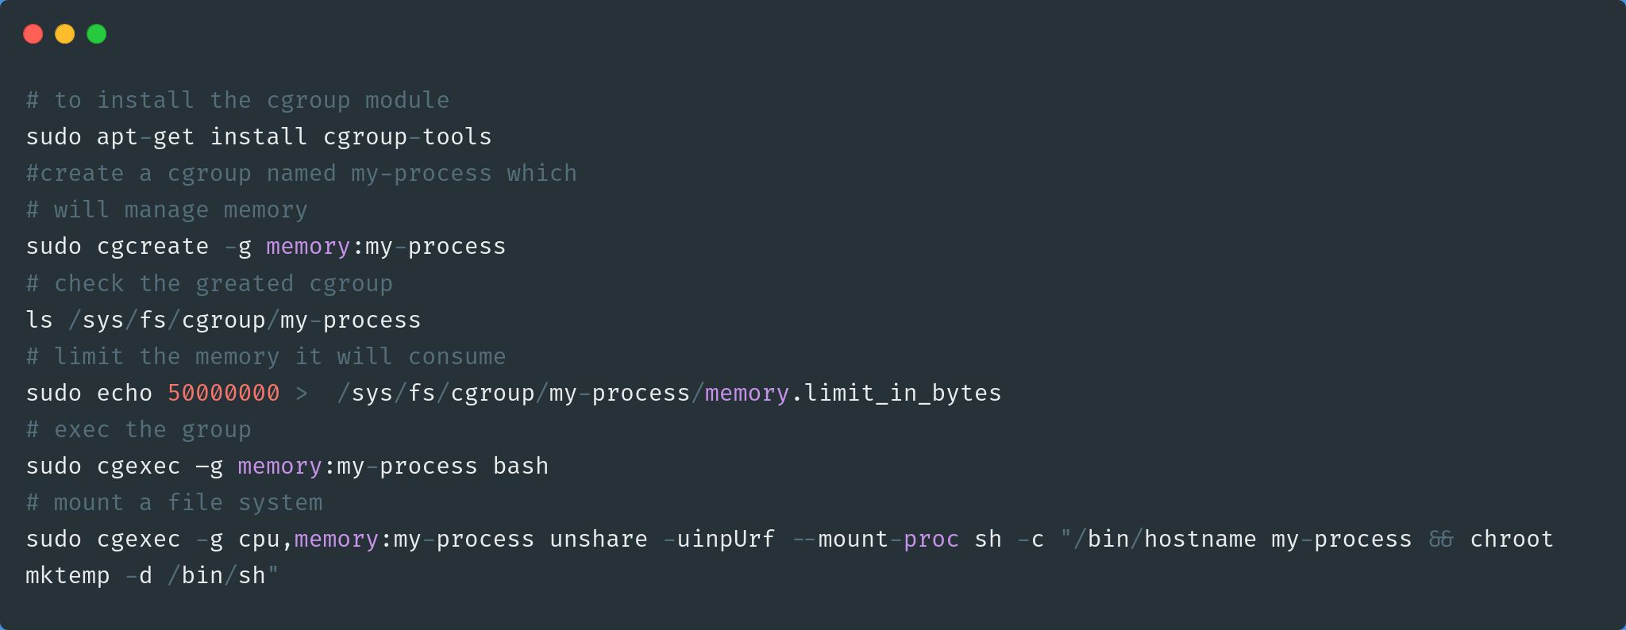
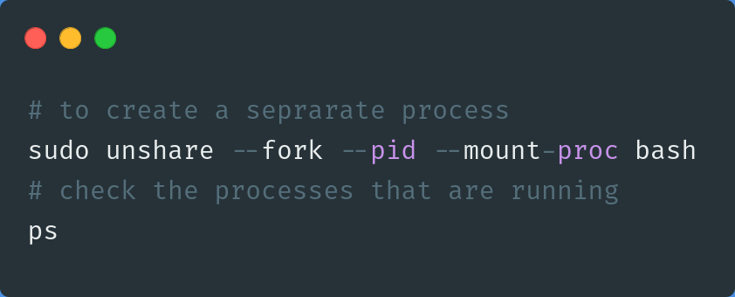
Deep Dive into Linux (creating and running files with namespace)
Working with Cgroups
Notes:
demo the go run container stuff

Slide 18

Process of solving breakage of code in remote servers/production Linux Namespace
Running code with cgroups looks nice and I think I will go with this.

Slide 19

Process of solving breakage of code in remote servers/production Linux Namespace
How can I manage more than two process running inside the cgroups

Slide 20
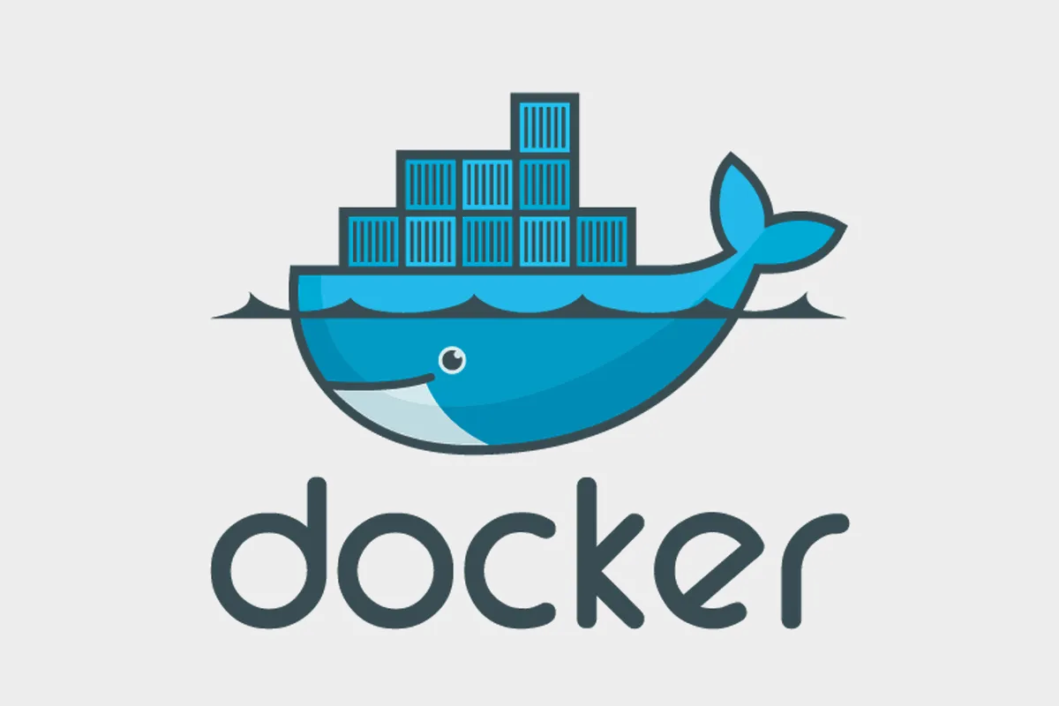
Process of solving breakage of code in remote servers/production environment (Docker)

Slide 21
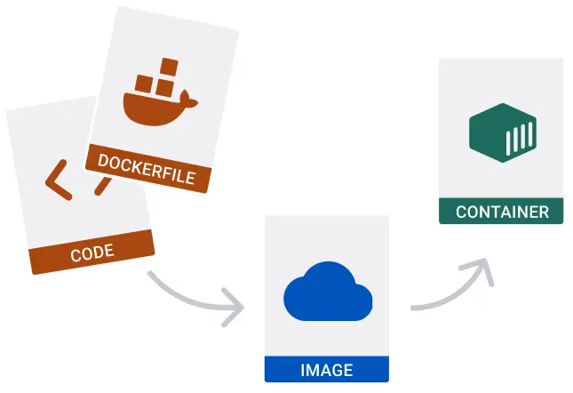
Deep Dive into Docker Internals

Slide 22
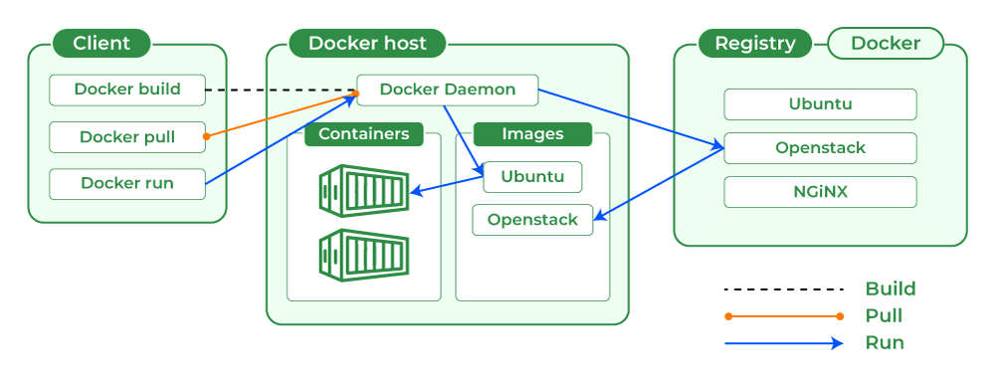
Deep Dive into Docker Internals

Slide 23
Process of solving breakage of code in remote servers/production Linux Namespace
Windows and Mac are not built on Linux, so how come docker can run on them?

Slide 24
Build your first Docker Image from Scratch
FROM scratch
ADD alpine-minirootfs-3.10.3-x86_64.tar.gz /
COPY pydock.py pydock.py
CMD ["sh"]

Slide 25
Build and run your first Docker Image with dependencies
FROM ubuntu
COPY pydock.py pydock.py
CMD ["/bin/echo",”hello”]
docker build -t docker_webinar .
docker history docker_webinar make changes to the docker pydock file and rerun again
docker history docker_webinar
Notes:
for this remove the python file from the container

Slide 26
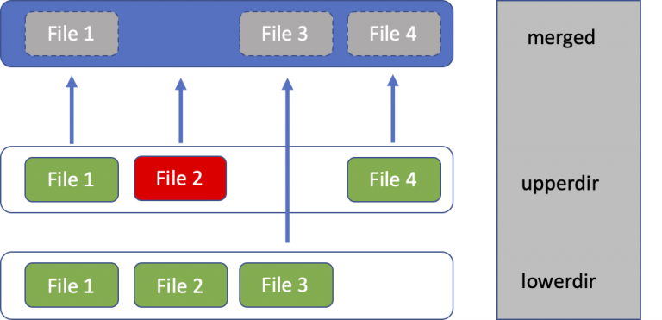
Overview of the overlay system

Slide 27
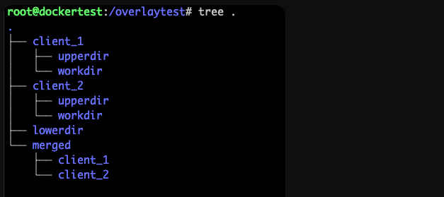
A look at how overlay works
echo “DATA 1” > lowerdir/file1.txt
echo “DATA 2” > lowerdir/file2.txt
echo “DATA 3” > lowerdir/file3.txt
mount -t overlay overlay \
-o lowerdir=/overlaytest/lowerdir \
-o upperdir=/overlaytest/client_1/upperdir \
-o workdir=/overlaytest/client_1/workdir \
/overlaytest/merged/client_1

Slide 28
A look at how overlay works
mount -t overlay overlay \
-o lowerdir=./overlaytest/lowerdir \
-o upperdir=./overlaytest/client_2/upperdir \
-o workdir=./overlaytest/client_2/workdir \
./overlaytest/merged/client_2
cd merged/
tree .
# let us modify the files in the client_1 directory
# check the structure with tree .

Slide 29
Hands on Practice (Building ETL Pipelines with Docker

Slide 30
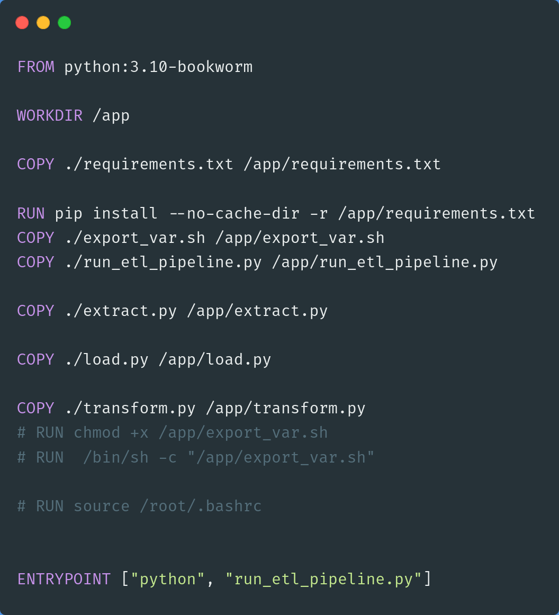
Building your first Dockerized ETL Pipeline

Slide 31
Differences between CMD and Entrypoint
“CMD commands are ignored by Daemon when there are parameters stated within the docker run command.
ENTRYPOINT instructions are not ignored, but instead, are appended as command-line parameters by treating those as arguments of the command”

Slide 32
Running data pipelines with docker and non-docker
Run the pipeline_without_docker
Build and run your first docker container
docker run --name docker_intro_cont -e POSTGRES_USER=$POSTGRES_USER \
-e POSTGRES_PASSWORD=$POSTGRES_PASSWORD -e POSTGRES_PORT=$POSTGRES_PORT \
-e POSTGRES_HOST=$POSTGRES_HOST -e POSTGRES_DW=$POSTGRES_DW \
-e CSV_URL=$CSV_URL -p 5432:5432 docker_workshop
Fixing the error
create a network
docker network create network-docker

Slide 33
Docker network
etl docker image
Postgres(container name as host)
5432
docker network

Slide 34
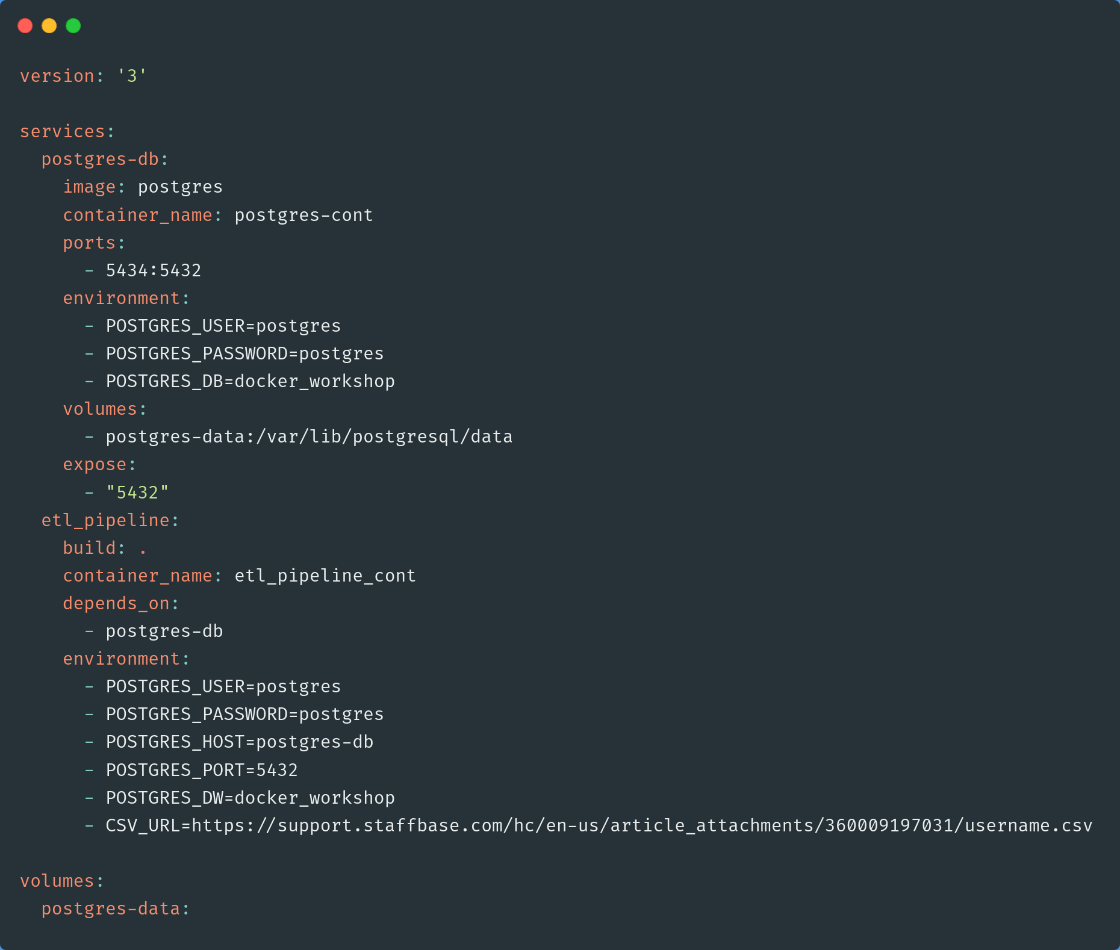
Docker-composing everything

Slide 35
References/ Additional Resources
https://medium.com/techbeatly/container-internals-deep-dive-5cc424957413
https://blogs.cisco.com/developer/373-containerimages-03
https://www.bmc.com/blogs/docker-cmd-vs-entrypoint/#:~:text=Use%20ENTRYPOINT%20instructions%20when%20building,when%20a%20Docker%20container%20runs.

