Slide 1
Planning
Muhammad Ahmad Raza 70092942

Slide 2
What is Planning
Planning is the Process of Setting Objectives for a Given Period Formulating Various Courses of action to achieve them, and then Selecting the Best Possible Alternative from among the various courses of action available.
A good planning is half work done.
Planning involve idea, determination and method to achieve ideas.

Slide 3
Author's definition for Planning
According to Koontz O'Donnell, "Planning is an intellectually demanding process; it requires conscious determination of course of action and basing of directions on purpose, knowledge and considered estimates.“
According to Mary Cushing Niles, "Planning is the conscious selection and developing the best course of action to accomplish an objective. It is the basis from which the future management action spring“.
According to George R Terry, "Planning is the selecting and relating of facts and the making and using of assumptions regarding the future in the visualisation and formulation of proposed activities, believed necessary to achieve the desired results."

Slide 4
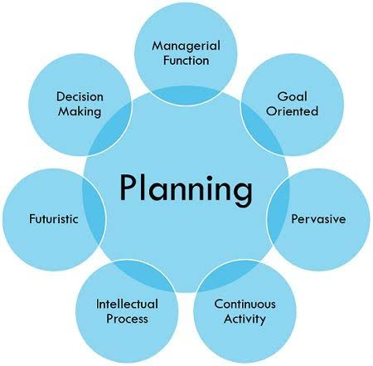

Slide 5
Characteristics of Planning
It focuses on Achieving objectives
It is a Primary Function of Management
It is Pervasive
It is Continuous
It involves Decision-Making
It is a Mental Exercise.

Slide 6
Importance of Planning
It Provides Directions.
Feature Planning Reduces the Risks of Uncertainty.
Planning Reduces Overlapping and Wasteful Activities
Planning Promotes Innovation Ideas.
Planning Facilitates Decision-Making.
Planning Establishes Standards for Controlling.

Slide 7
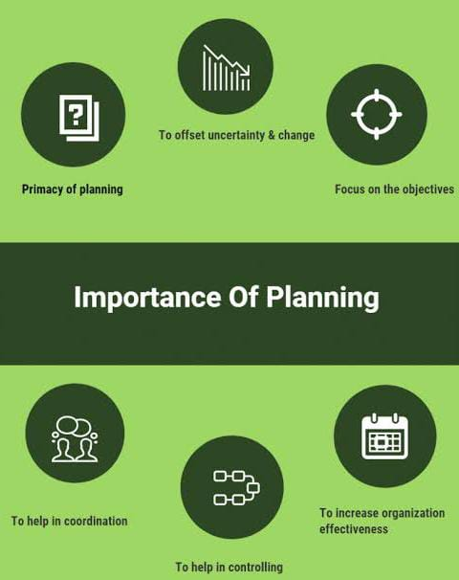

Slide 8
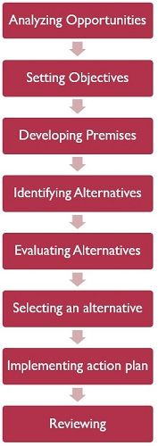
Planning Process

Slide 9
Purpose of planning
Sense of direction
Planning in part a sense of direction to achieve the objective of organization
Planning augments the employees to work on common direction
Prerequisite-for management functions
Planning is prerequisite for the function of the management i.e. controlling, coordinating ,organization and leading
Anticipate problems and cope up with problems
Planning, paves, way to anticipate upcoming problems and helps to eradicate inevitable problems.

Slide 10
Conti…
Decision making
Planning is the first step for the management to execute decision making in different operations to achieve the goal of organization.
Establishment of team
Planning is mandatory for establishment of team in an organization.
Scattered and diverse department cannot achieve common goals.
Determination of employees
Planning enhance attention and determination of the employees to achieve goals of the organization.

Slide 11
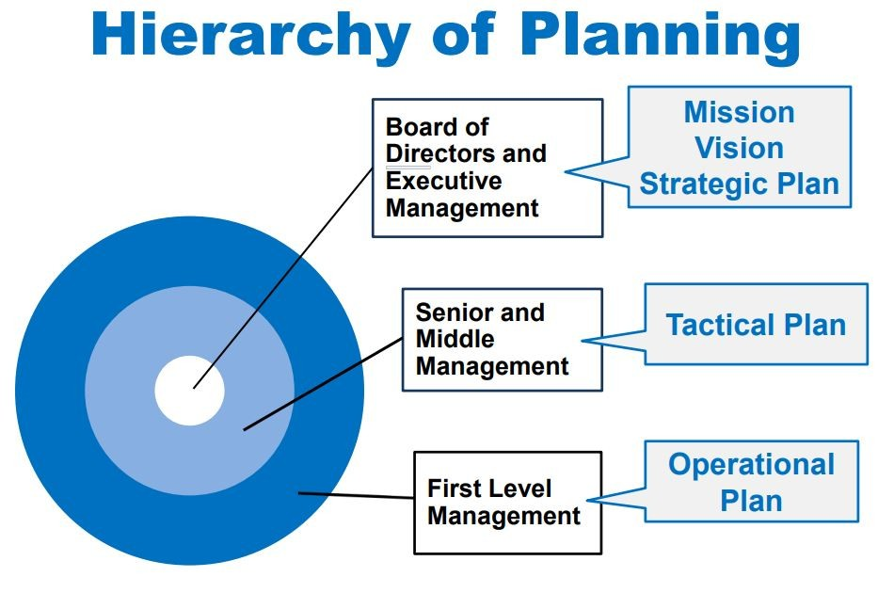

Slide 12
Types of planning
Strategic plans
Strategic planning looks at the long-term issues of the organization, and helps develop a plan for growth or change of business function.
Goals developed at the strategic planning-level are often increased by dividing them into tactical and operational levels.
Operation plans
Operations planning focuses on day-to-day issues, such as staffing levels or inventory quantities.
Operational-level planning includes more detailed objectives with concrete deadlines and task assignment

Slide 13
Conti…
Tactical plans
Tactical planning is used to reach the goals set out by strategic and operational planning.
Tactical planning includes short-term objectives and tasks designed to create specific results within a limited time span. Tactical plans often include operational level plans, and make way for the development of contingency level plans.
Contingency plan
Contingency-level planning includes more detailed action items with specified responses in case of unexpected events or emergencies, such as natural disasters or extreme weather events that disrupt business operations.

Slide 14
Conti…
Project Plan
These plan involve one time planning by the manager.
Program plans
These are the procedures which involve human efforts to achieve objectives.

Slide 15
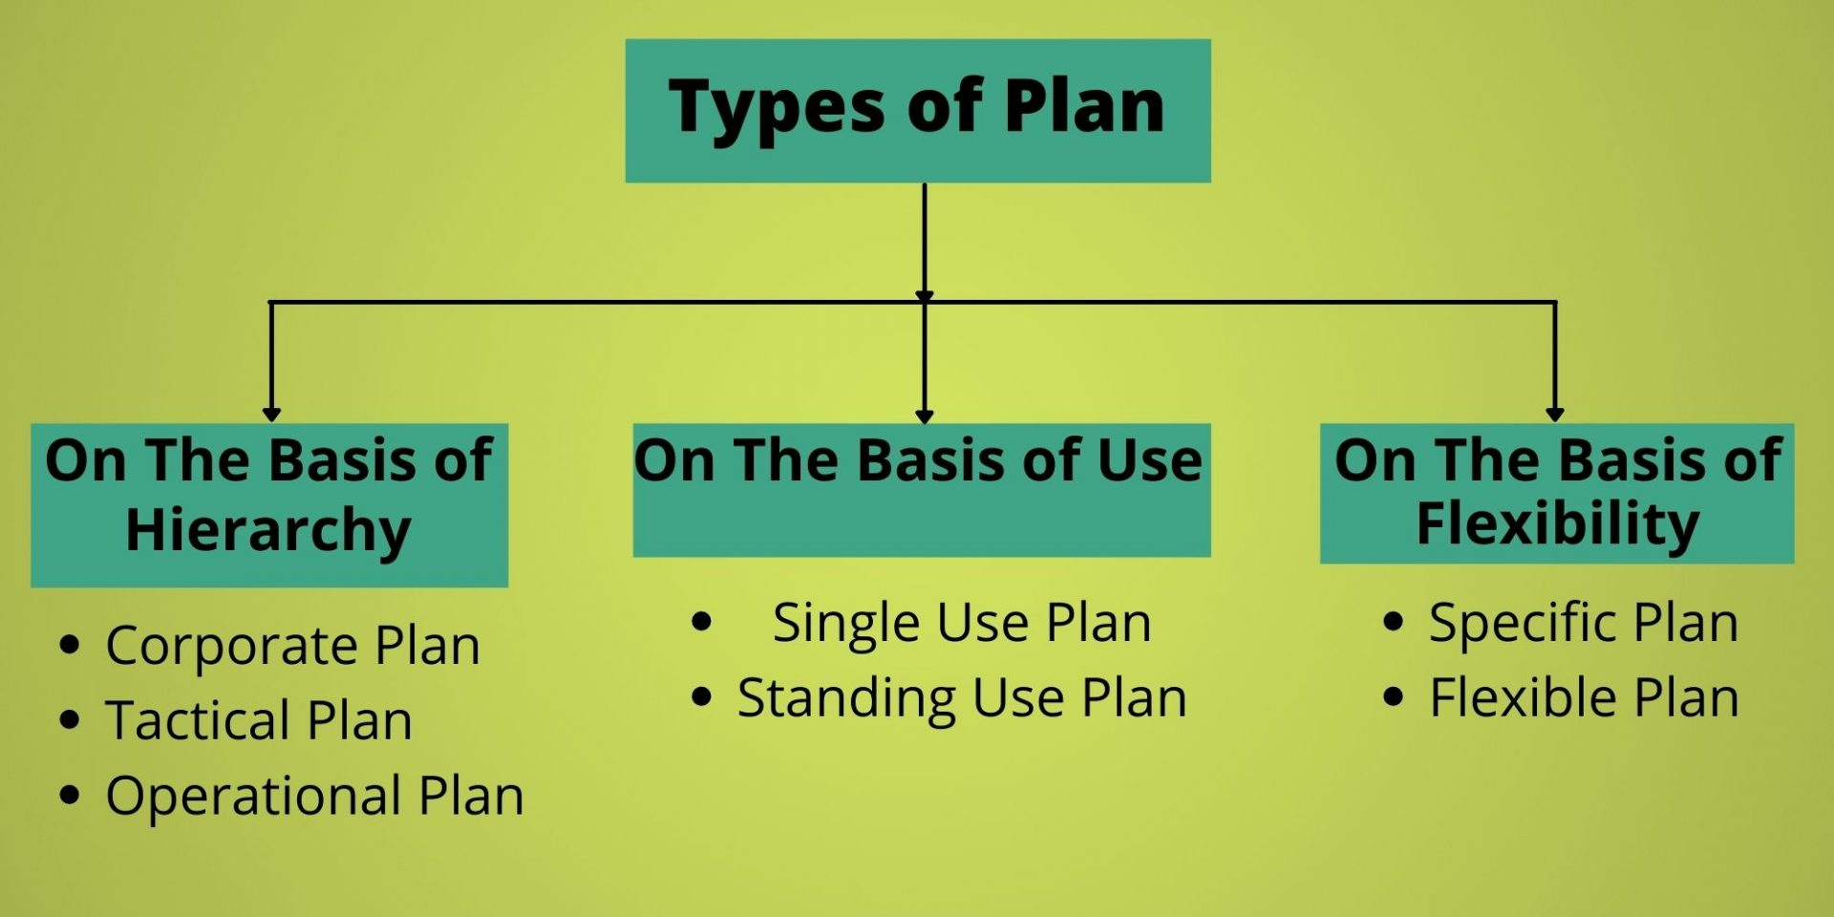

Slide 16
Steps in planning
Following are the steps to achieve effecting planning.
Establishment of objectives
Establishment of objective is mandatory for the planning by an organization.
Collection of data and analysis
The collection of authentic data or up to date data is dire need of planning the data related to planning.
3. Identification and defining the problems
The identification and defining of problems related to planning is performed by the manager to execute the planning effectively.

Slide 17
Conti…
4 : Determination of planning premises
These are the assumptions for the planning base.
It is the forecasting of the future conditions. For example taste of customer.
5: Determination of alternative course of action
The manager of the organization should keep alternative course of action to fulfil the objective of organization.

Slide 18
Conti…
6: Evaluation of alternative course of action
It is the first step to determine the cost ,time ,quantity , and quality of alternative.
7: Selection of best possible course of action
It involve the selection of best possible course of action.
8: Follow up
After the selection of best possible course of action implementation is performed to achieve the objective of organization

Slide 19
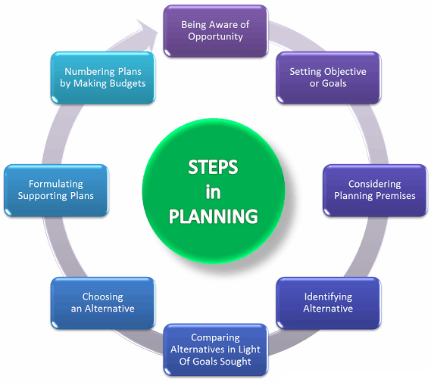

Slide 20
Barriers in planning
Inadequate planning
For proper adequate planning manager must have background education, technical skills, expertise, to execute planning.
If a manager lack such parameters then planning done by him will be inadequate panning.
Lack of commitment and determination.
If a manager don’t have commitment and determination then the planning done by him will not be effective.

Slide 21
Conti…
Inferior planning
Out-dated data and old version data may lead to inferior planning.
For example customer taste, marketing competition
Focus on short term problems at the expense of long term problems
Emphasis on short term at the expense of long term cannot lead to effective planning.
Too much reliance on planning department
To much reliance on planning department is another barrier in achievement of objectives. Because planning department in many industries are responsible for planning but they don’t implement.

Slide 22
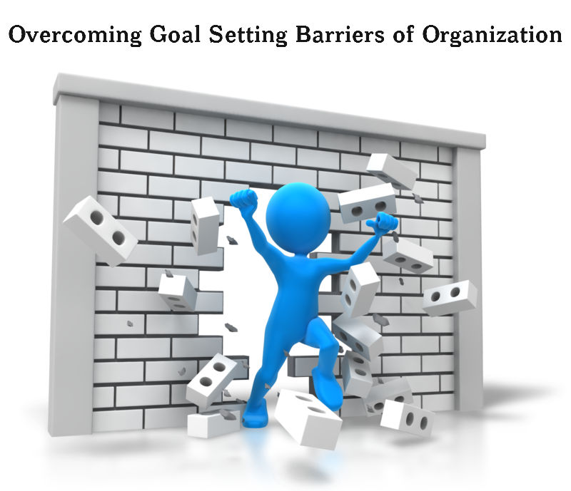

Slide 23


