Slide 1
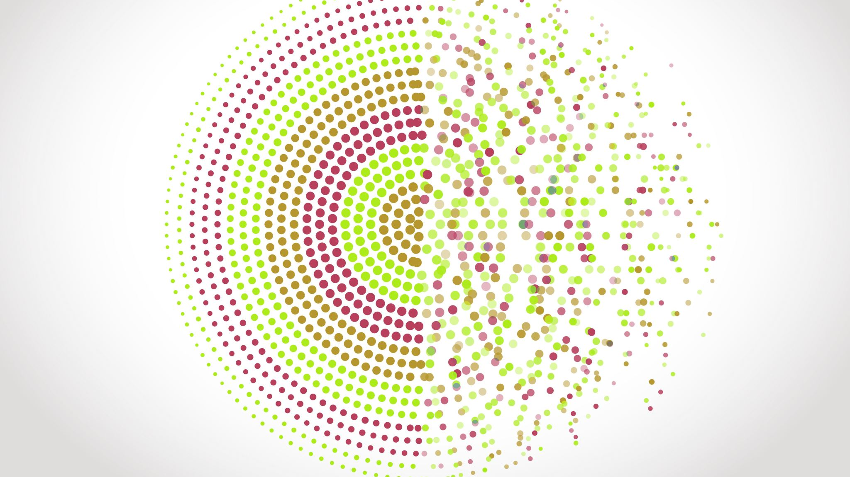
Pixels to circles
Group 25
Idris, Sigmund and Lavanyan

Slide 2

Agenda
Introduction
Problem statement
Lossless
Lossy
Conclusion

Slide 3
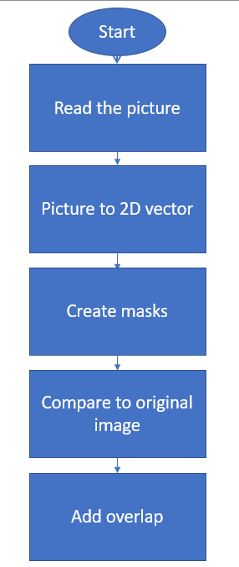

Pixels to circles
Input
Two-dimensional image
$n x n$ square of b/w pixles
Circles
Lossy/Lossless representation

Slide 4
Problem statement
Comparing the approximation of a given n x n image with fitting circles using lossy and lossless representation

Slide 5
Lossless

Slide 6
Processes for lossless
Random method
Pair method

Slide 7
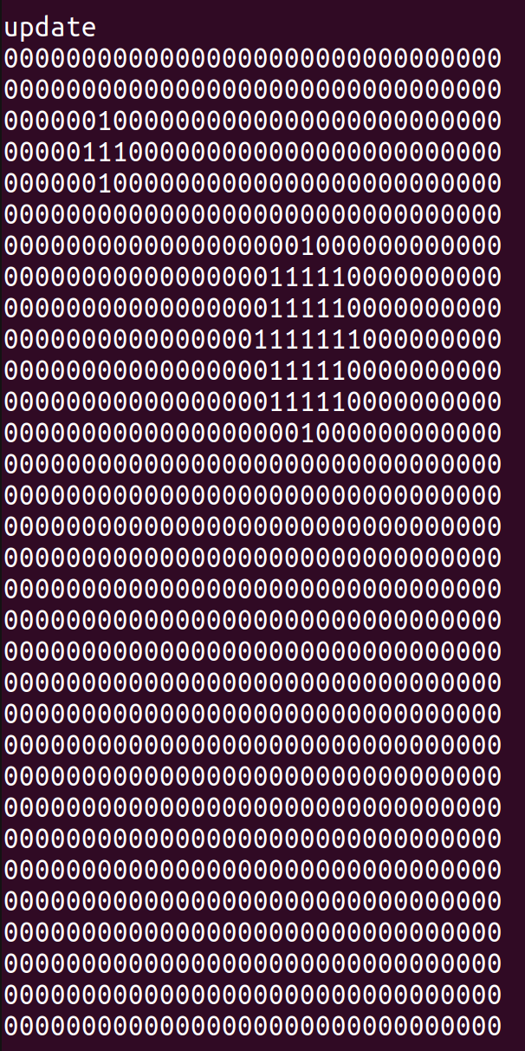
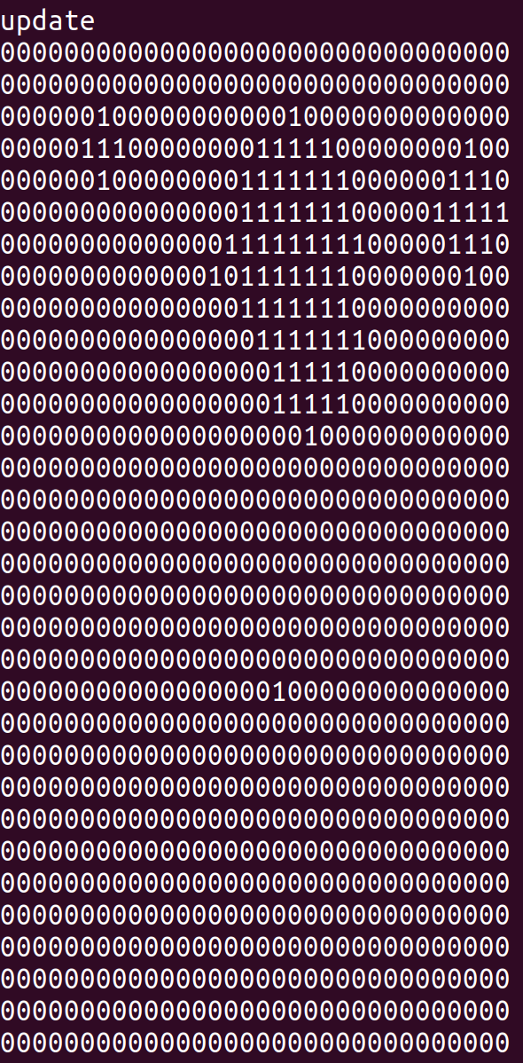
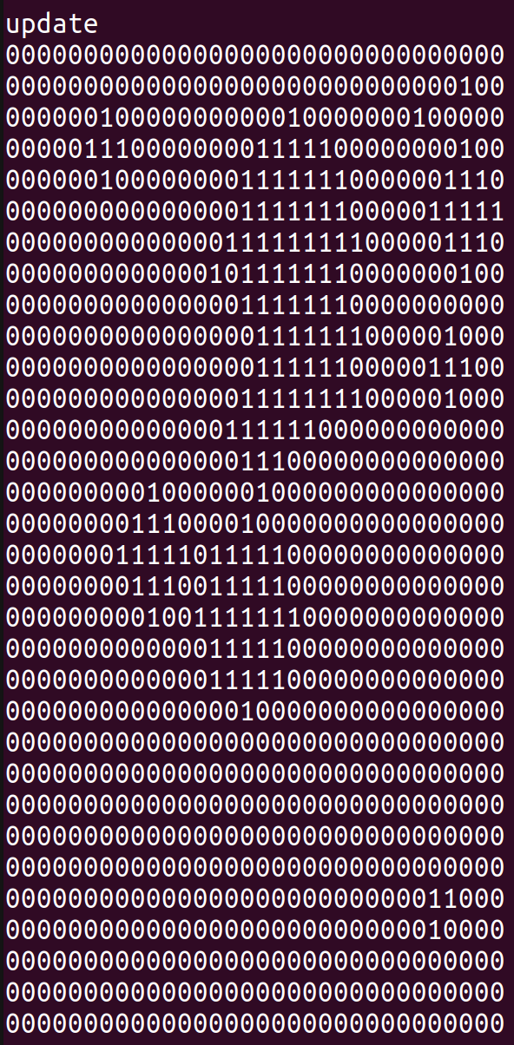
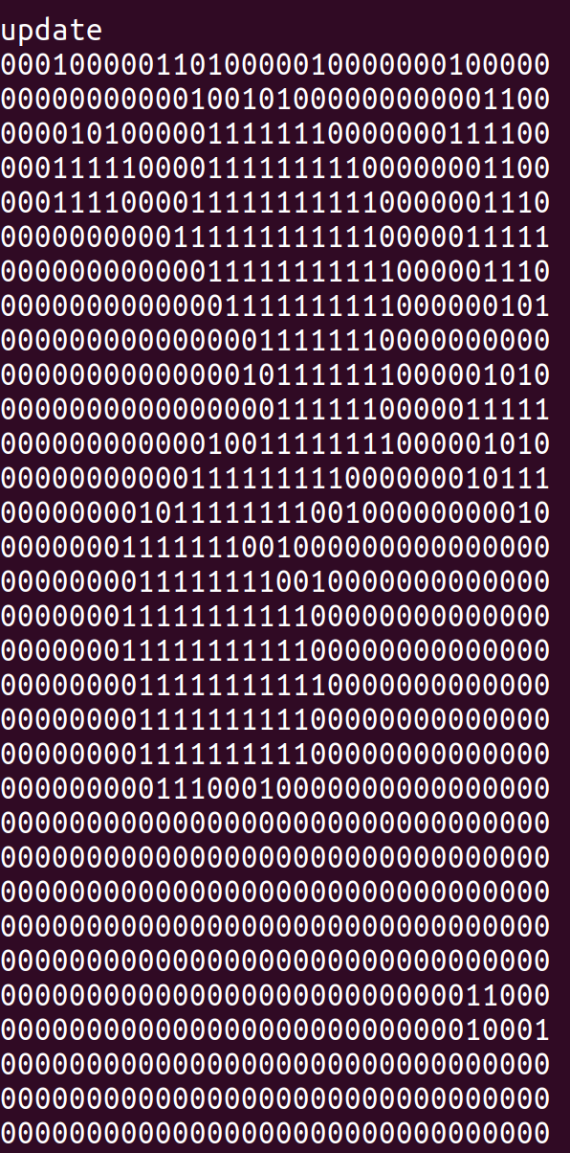
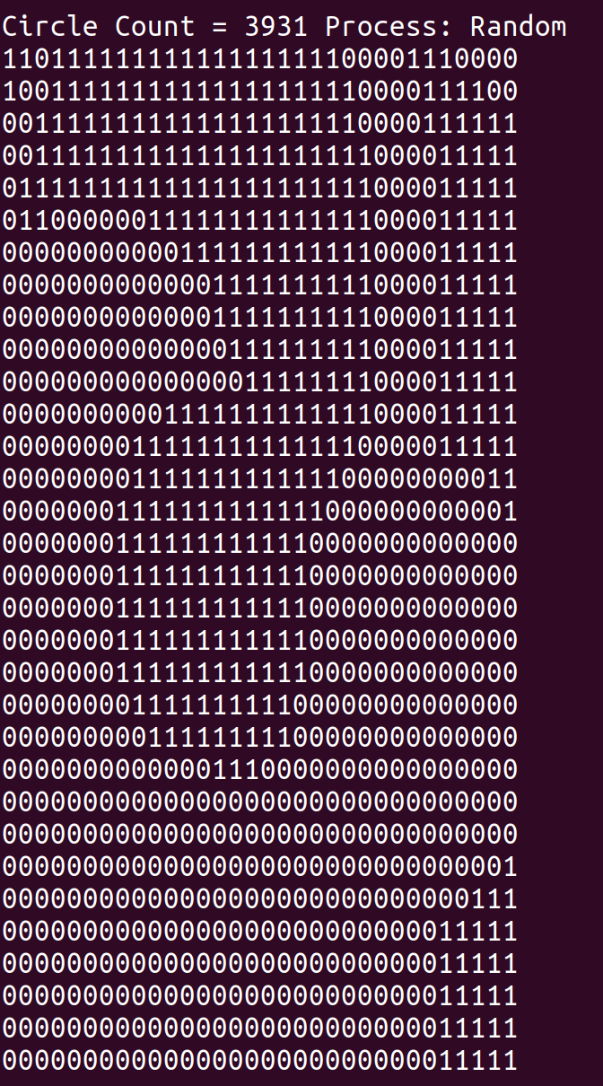
Results for random

Slide 8
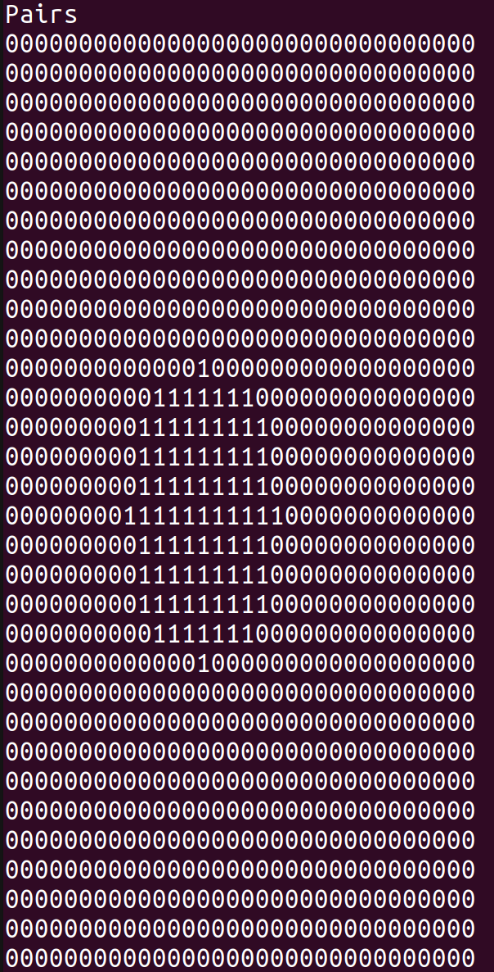
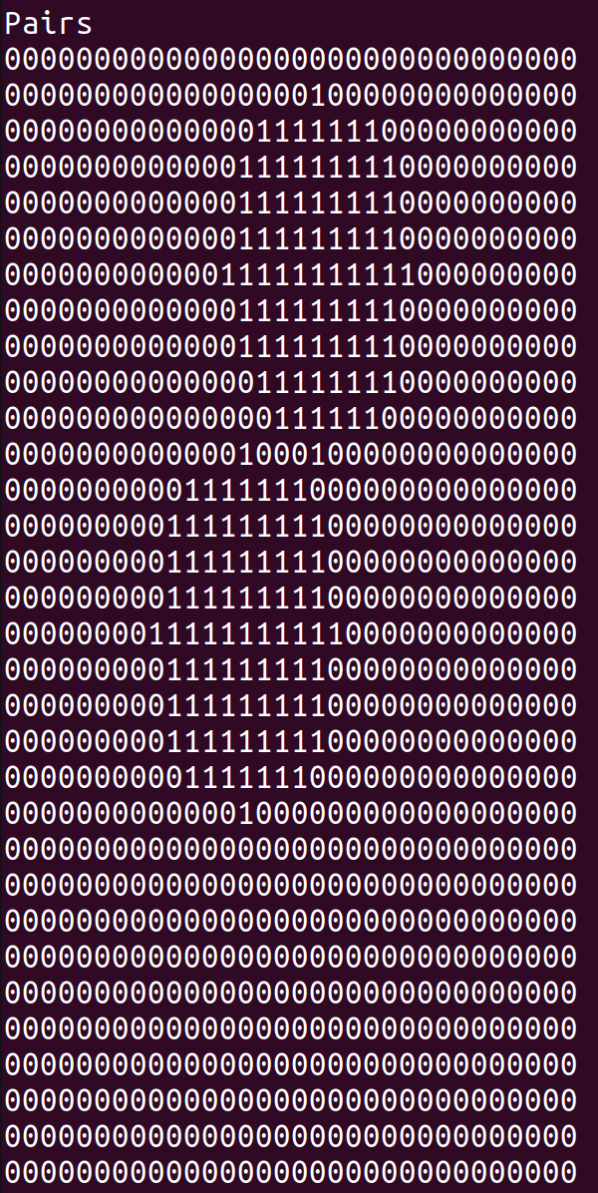
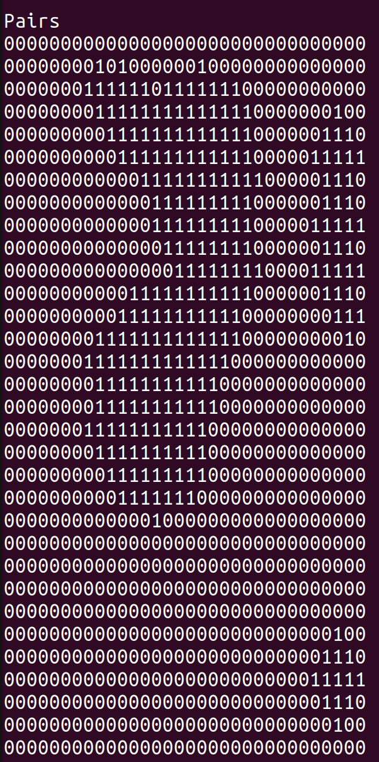
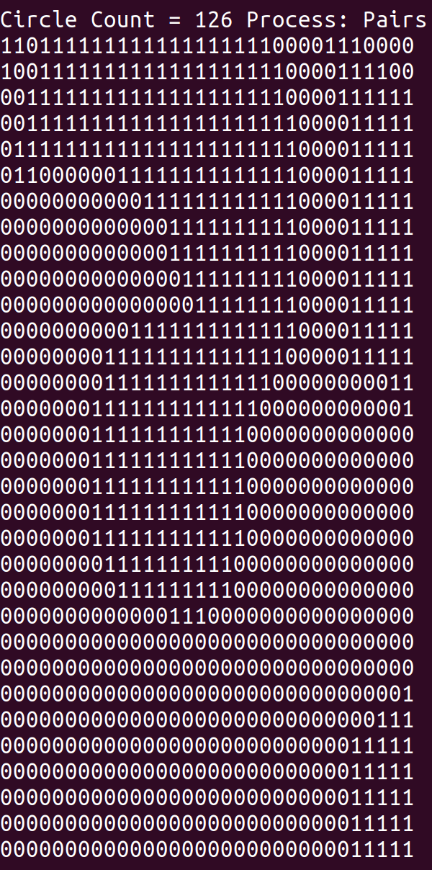
Results from pair

Slide 9
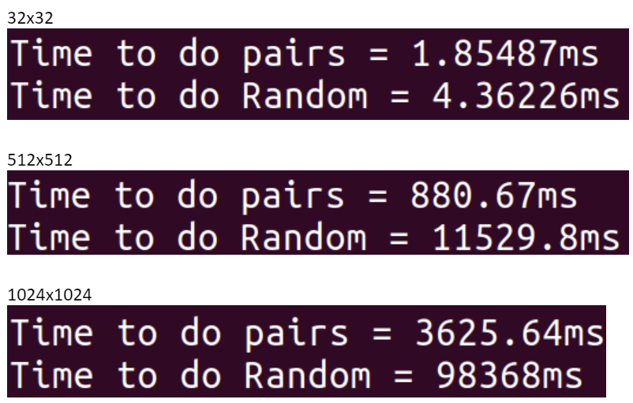
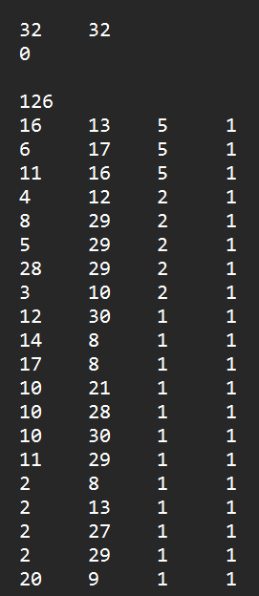
OpenMP and disk data
Run both methods simultaneous with one processor each

Slide 10
Lossy

Slide 11
Method in lossy
Maps max radius
Filters the radii map

Slide 12
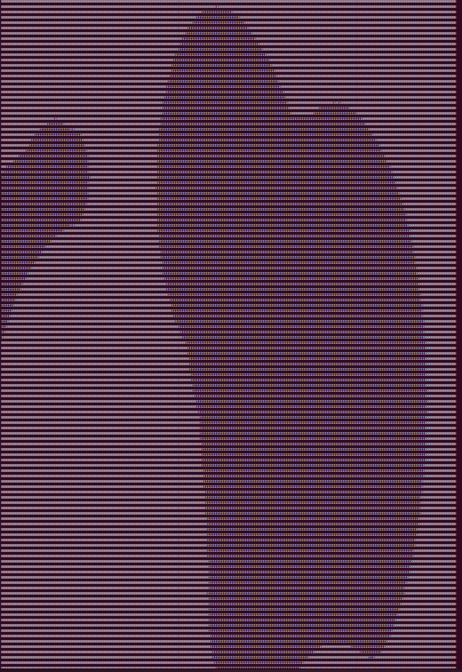

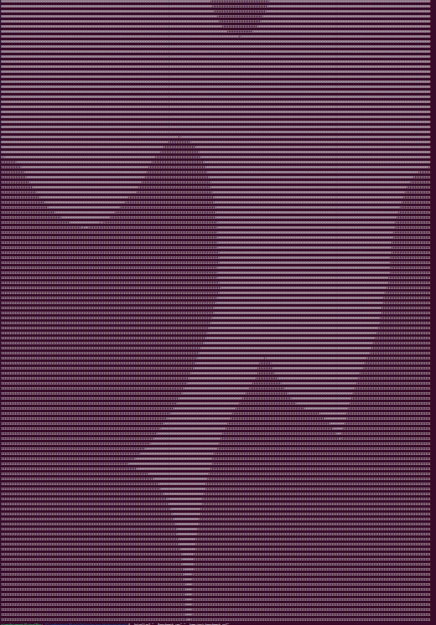
Results
When printed to the terminal the colors are reversed

Slide 13
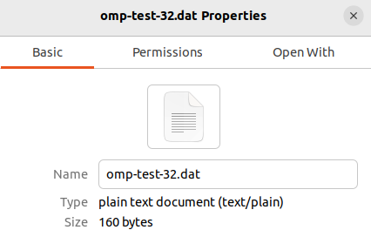

OpenMP 4 core
512x512

Slide 14

Conclusion

