Slide 1
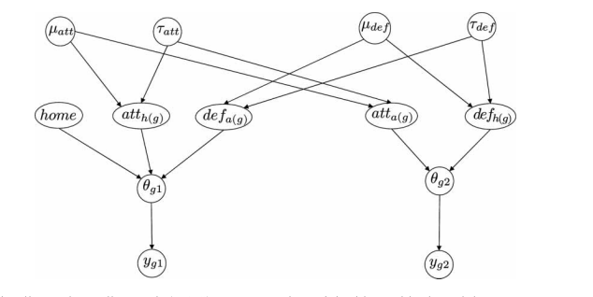
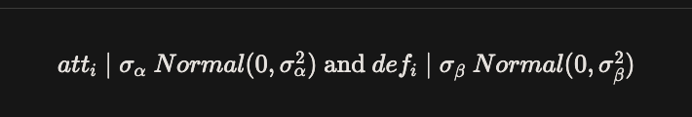
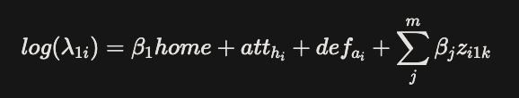










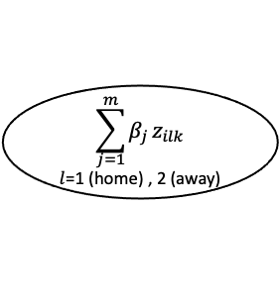

\sum^m_j\beta_jz_{i1k}
$$σ_{att}^{2}$$
$$σ_{def}^{2}$$
$$home$$
$${att}_{h_{i}}$$
$${def}_{a_{i}}$$
$$\sum_{j=1}^{m}{β_{j}}z_{ilk}$$
$l$=1 (home) , 2 (away)
$${att}_{a_{i}}$$
$${def}_{h_{i}}$$
$$λ_{1i}$$
$${ λ}_{2i}$$
$$y_{1i}$$
$$y_{2i}$$

