Slide 1
evolvate
C O N S U L T I N G
Brand guidelines
Common Ground identity · Working edition · September 2026
Notes:
The selected logo direction and brand story come from the Evolvate website project and the user-approved Common Ground concept. Working edition pending client approval and trademark review.

Slide 2
Brand basis
02
Clear decisions.
Connected expertise.
Business
Finance
Projects
Controls
Evolvate helps founders, growing businesses, and established organizations connect business direction with financial reality and delivery.
The identity should feel composed, useful, and confident.
Notes:
Source: PRODUCT.md, docs/requirements.md, and current site copy in app/page.tsx and components/services.tsx.

Slide 3
The story behind the mark
03
Two perspectives, one working view
The two frames stand for the different parts of a business that must make sense together.
Their overlap is where strategy meets financial and operational reality.
The warm line marks the shared decision that moves work forward.
Notes:
Interpretive design rationale for the approved Common Ground mark. It is a proposed brand story, not a factual claim about company history.

Slide 4
Logo anatomy
04
Frame one
The business context and direction.
Frame two
The people, resources, and delivery plan.
Connection
The point where those views inform a decision.
Notes:
Mark components use the geometry and colors in brand-explorations/common-ground-refined/primary.svg.

Slide 5
Logo family
05
evolvate
evolvate
C O N S U L T I N G
C O N S U L T I N G
PRIMARY
REVERSED
evolvate
C O N S U L T I N G
ONE COLOR
SYMBOL
Notes:
Editable vector versions of the selected logo are stored in brand-explorations/common-ground-refined/.

Slide 6
Clear space and minimum size
06
Give the mark room to work
Keep empty space around every side. Use the width of the copper bridge as the minimum clear space.
evolvate
C O N S U L T I N G
Digital minimums
Full logo: 160 px wide
Symbol: 24 px wide
Do not crowd the mark with copy, edges, or other logos.
Notes:
Minimum sizes and clear-space rule are initial brand recommendations for the working identity. Check print reproduction with the chosen supplier.

Slide 7
Brand colors
07
Strategy Ink
Forest
Sage
Copper
Journal Paper
#20382E
#2D5142
#7FA390
#BD7351
#F5F6F0
Use copper sparingly for the connecting detail and selected points of emphasis.
Notes:
Exact HEX values come from the refined SVG logo. RGB colors are for digital design. Print conversions require proofs on the intended material.

Slide 8
Color use
08
evolvate
evolvate
C O N S U L T I N G
C O N S U L T I N G
Paper carries the main experience. Dark green gives high contrast and authority.
Use the reversed logo on deep green. Keep the copper accent rare.
Notes:
Color application guidance based on PRODUCT.md and DESIGN.md, with the selected logo palette.

Slide 9
Typography
09
Georgia
Inter
For considered headlines and editorial moments.
For navigation, body copy, data, and calls to action.
Clear thinking for consequential decisions.
Evolvate combines business development, financial management, and project controls in one practical view.
PowerPoint fallback: Arial for Inter. Keep headlines short and body text easy to scan.
Notes:
Inter is the website font in app/layout.tsx. Georgia is a proposed editorial companion from the design direction in DESIGN.md. The deck uses Arial where Inter may be unavailable.

Slide 10
Brand voice
10
Calm, direct, specific
Say what we support
“Bring cost and progress into one view.”
Name the decision
“See where growth can come from before you commit.”
Stay measured
“We help make the options clearer.”
Notes:
Examples are adapted from the current Evolvate website copy and PRODUCT.md. Avoid invented statistics, guarantees, and jargon.

Slide 11

Photography direction
11
Show work in context
Choose real people, working materials, and environments that make the service tangible. Use natural light and composed framing. Leave room for a clear headline.
Avoid stock handshakes and staged boardrooms.
Notes:
Visual direction from PRODUCT.md and DESIGN.md. Image: existing project asset public/images/working-session.png.

Slide 12
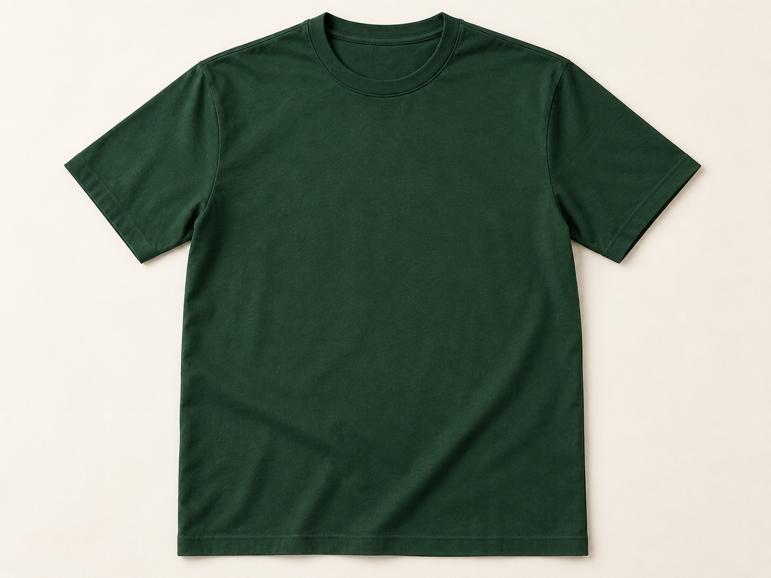
Application: team shirt
12
A small mark, worn with confidence
Place the symbol on the upper chest in the light version. Keep the mark modest so the shirt feels like professional team wear.
Suggested finish: embroidery
Notes:
Conceptual product mockup generated with imagegen using a blank T-shirt prompt. Logo overlay is editable native PowerPoint geometry. Final production placement should be proofed with the supplier.

Slide 13

Application: notebook
13
Make the working object feel considered
On a warm paper cover, use the full primary logo with generous space around it. Keep the rest of the cover quiet.
evolvate
C O N S U L T I N G
Suggested finish: flat print or deboss
Notes:
Conceptual product mockup generated with imagegen using a blank notebook prompt. Logo overlay is editable native PowerPoint geometry. Final print color and size require a physical proof.

Slide 14
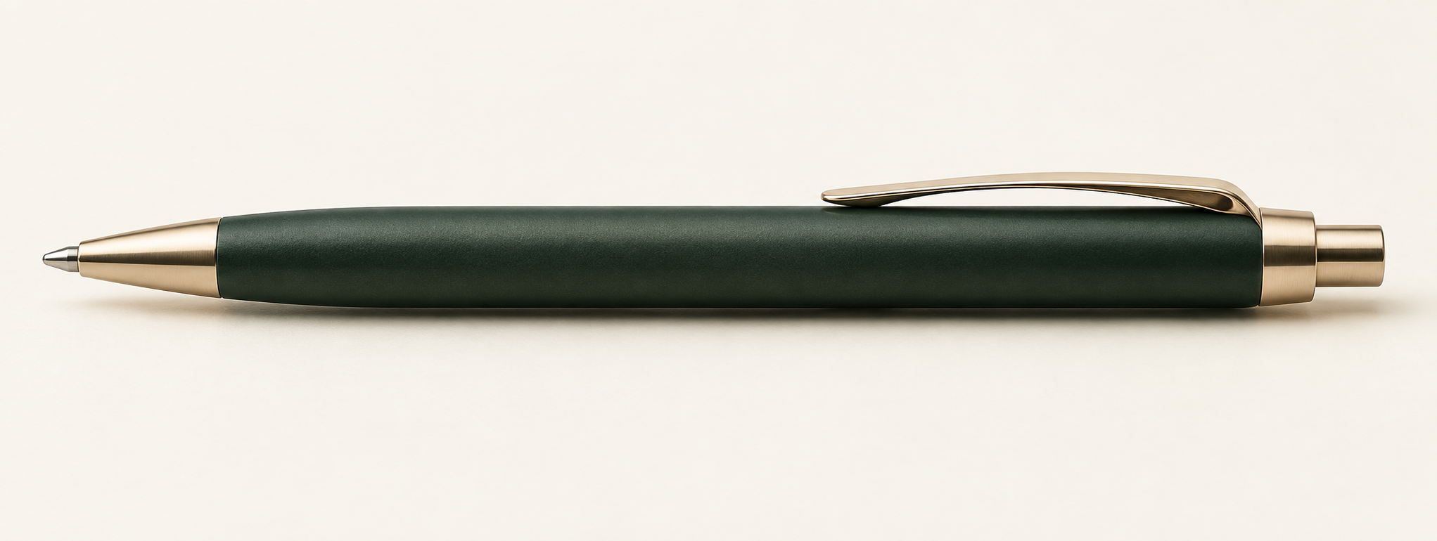
Application: pen
14
Keep small surfaces simple
Use the wordmark without the descriptor when space is limited.
evolvate
Notes:
Conceptual product mockup generated with imagegen using a blank pen prompt. The wordmark overlay is editable text. Verify production at actual barrel size.

Slide 15
Logo misuse
15
Protect the structure that makes the mark recognizable
Do not stretch
Do not recolor freely
Keep both frames square and preserve the overlap.
Use only the specified color or one-color versions.
Do not decorate
Do not crop
Avoid shadows, gradients, outlines, and extra effects.
Keep the full symbol and required clear space.
Notes:
Initial usage rules for the selected Common Ground identity.

Slide 16
Working files and next approvals
16
A practical identity, ready to refine
Included in this deck
Editable guidance and layouts
Color and type specifications
Conceptual merchandise applications
Before public launch
Approve final lettering and logo master
Check trademark availability
Proof print colors and embroidery
Export outlined production artwork
Source vectors: brand-explorations/common-ground-refined/
Notes:
The identity is a working brand proposal. Trademark review, production artwork, and physical proofs remain required before launch.

