Slide 1
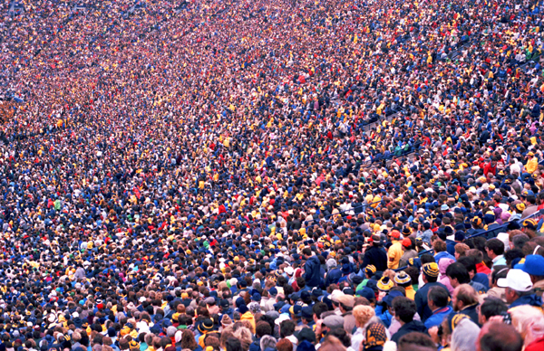
Crowd Simulation
Exploring local avoidance (and behavioural) models to replicate realistic human motion

Slide 2
Main Focus
Local avoidance models to replicate human motion:
  Flocking rules
  Social forces
  Reciprocal Velocity Obstacle (RVO) avoidance
Global navigation:
  Flocking rules
  A* path finding
Behaviour
  Agent behaviour affecting paths chosen
  Agent goal oriented behaviour – more AI direction

Slide 3
Local avoidance
Collision avoidance
Smooth movement – perceiving obstacles in advance, avoid oscillation
Neighbouring agents affect movement –
Octree to speed up check
Natural phenomena – forming groups, following in a line

Slide 4
RVO

Slide 5
Behaviour
Agent type:
  Big, medium, small
Agent brain:
  Perceive obstacles
  Influences e.g. type of obstacle, big person = scared
  Mood e.g. agitated – rush,
  relaxed – slow,
  happy – act normal,
  scared – quick sharp movement

Slide 6
Parallelize?
The way RVO can be implemented, it may be possible to parallelize this method.
Each thread on the GPU would do the calculations for a single agent.
Using GLSL shaders, pass certain attributes:
  Neighbour positions & velocities,
  Agents desired velocity & admissible velocities,
  Agents current position and velocity,

Slide 7
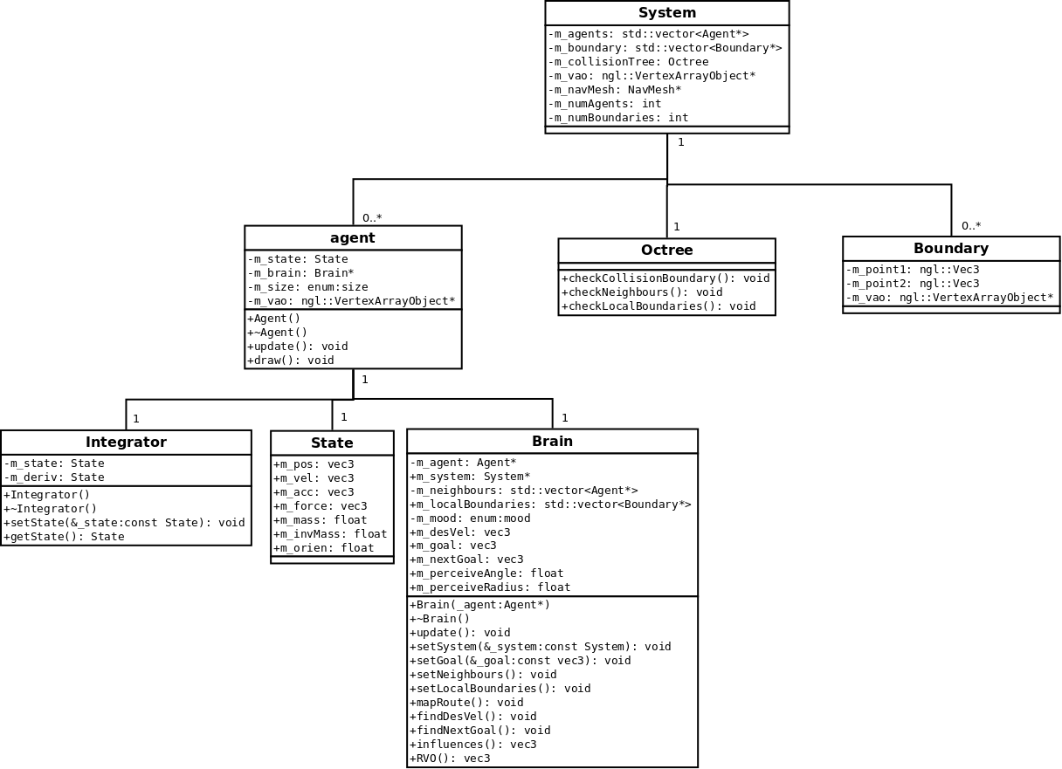
UML design

