Slide 1
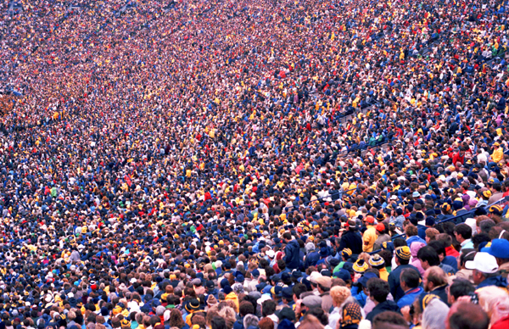
Crowd Simulation
Exploring local avoidance (and behavioural) models to replicate realistic human motion
Idris Miles

Slide 2
Main Focus
Local avoidance models to replicate human motion:
  Flocking rules
  Social forces
  Reciprocal Velocity Obstacle (RVO) avoidance
Global navigation:
  Flocking rules
  A* path finding – way points
Behaviour
  Agent behaviour affecting paths chosen
  Agent goal oriented behaviour – more AI direction

Slide 3
Local avoidance
Collision avoidance
Smooth movement – perceiving obstacles in advance, avoid oscillation
Neighbouring agents affect movement –
Octree to speed up check
Natural phenomena – forming groups, following in a line

Slide 4
Reciprocal Velocity Obstacle - RVO
Based on Velocity Obstacle method:
  VO^{A}B(vB ) = {vA | λ(pA , vA − vB ) ∩ B ⊕ −A = ∅}
The velocity obstacle VO^{A}B(vB ) of agent B to A is the set of velocities VA for A that will result in a collision with B moving at velocity VB.
Idea is to find a new velocity for the agent A that is outside the Velocity Obstacle of B (thus will not lead to a collision later on)
Difference with RVO and VO – instead of finding velocity outside the VO of B we find the average between the velocity outside and the current velocity.
Produces smoother movement

Slide 5
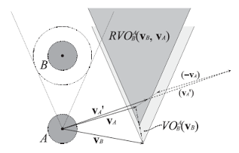
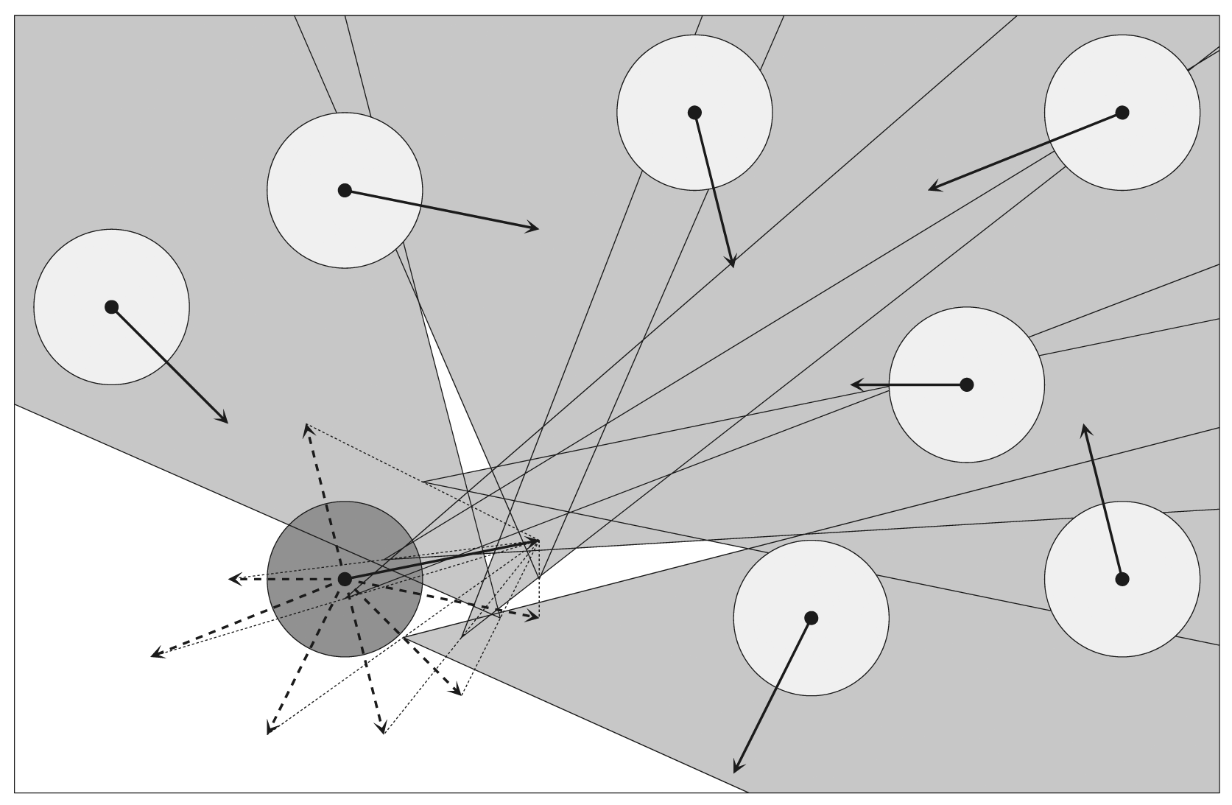
Reciprocal Velocity Obstacle - RVO

Slide 6
Behaviour
Agent type:
  Big, medium, small
Agent brain:
  Perceive & reacts to obstacles
  Influences e.g. type of obstacle, big person = scared
  Mood e.g. agitated – rush,
  relaxed – slow,
  happy – act normal,
  scared – quick sharp movement

Slide 7
Parallelize?
The way RVO can be implemented, it may be possible to parallelize this method.
Individual threads on the GPU would do the calculations for a single agent.
Using GLSL shaders, pass certain attributes:
  Neighbour positions & velocities,
  Agents desired velocity & admissible velocities,
  Agents current position and velocity,
OR Compute shaders? OR CUDA/OpenCL?

Slide 8
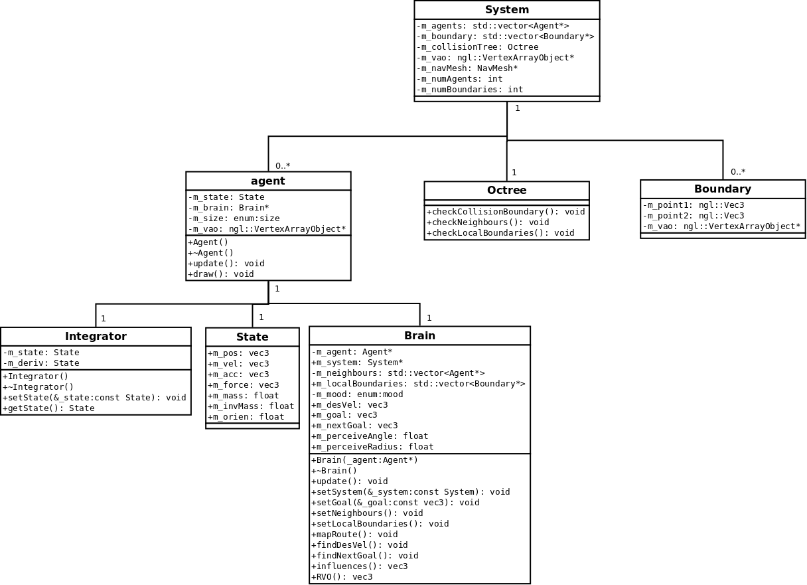
UML design

