Slide 1
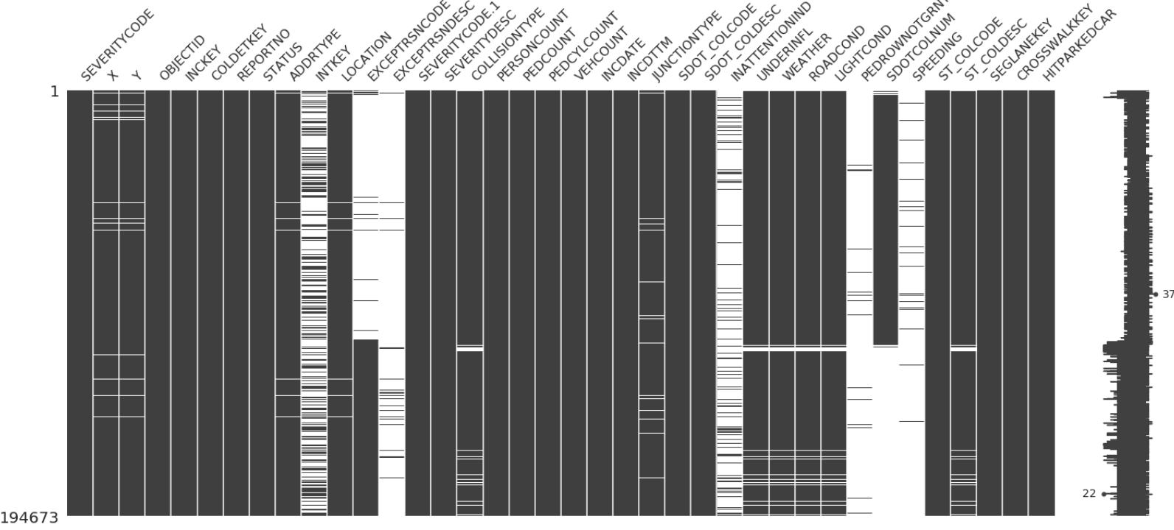
Data Feature and missing value Fixed
Before

Slide 2
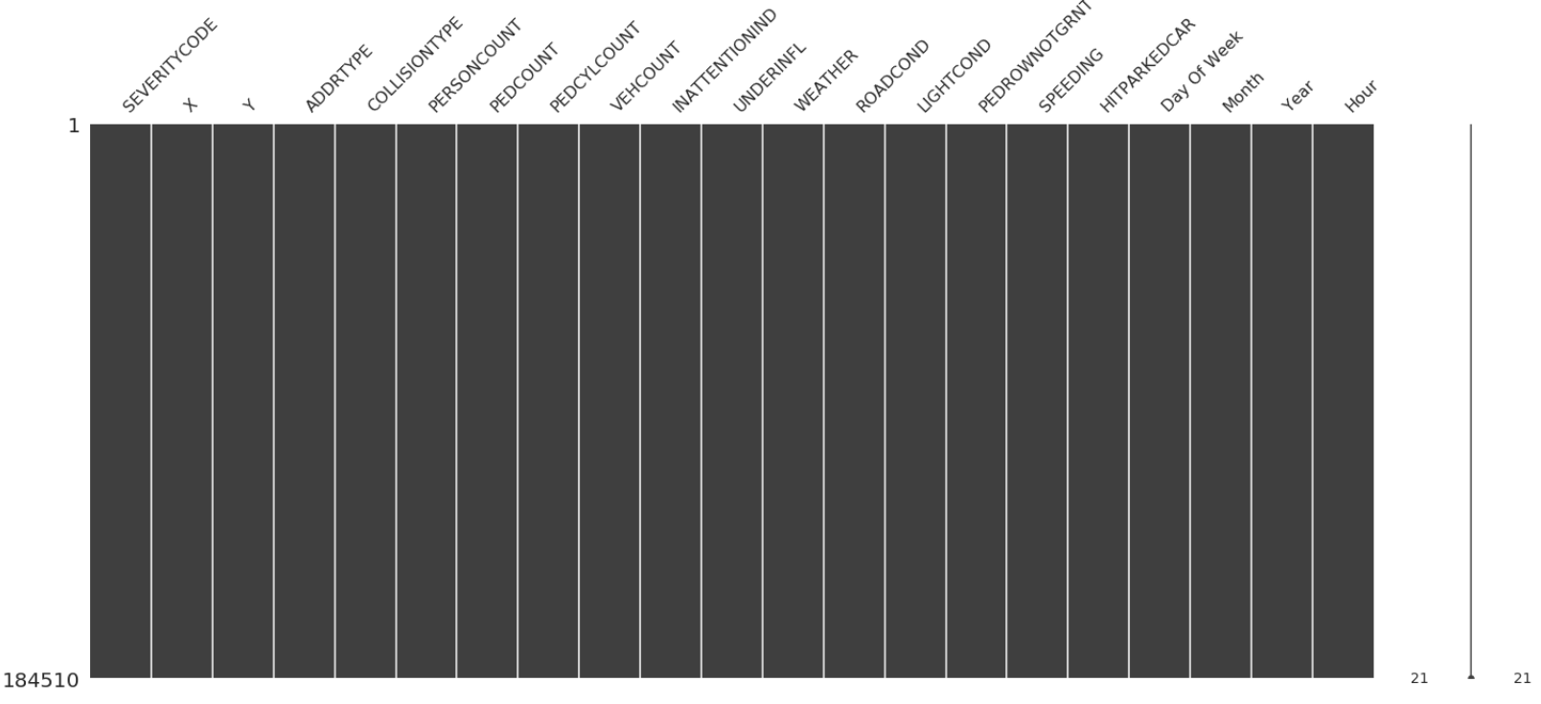
Data Feature and missing value Fixed
After

Slide 3
Exploratory data analysis

Slide 4
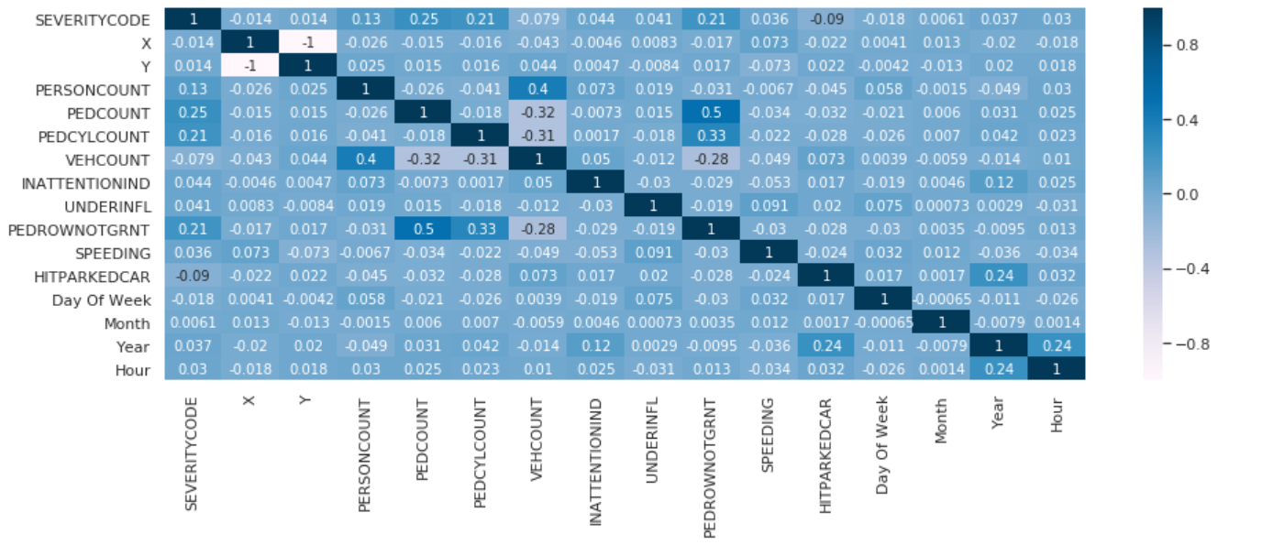
Correlation Matrix
The most correlation we have are:
Independent variable:
PEDROWNOTGRANT – PEDCYLCOUNT (0.5)
VEHCOUNT – PERSONCOUNT (0.4)
SPEEDING- PEDCYLCOUNT(0.33)
Dependent variable:
SEVERIYCODE- PEDCOUNT(0.25)
SEVERIYCODE- PEDCYLCOUNT(0.21)
SEVERIYCODE- PEDROWNOTGRANT (0.21)

Slide 5
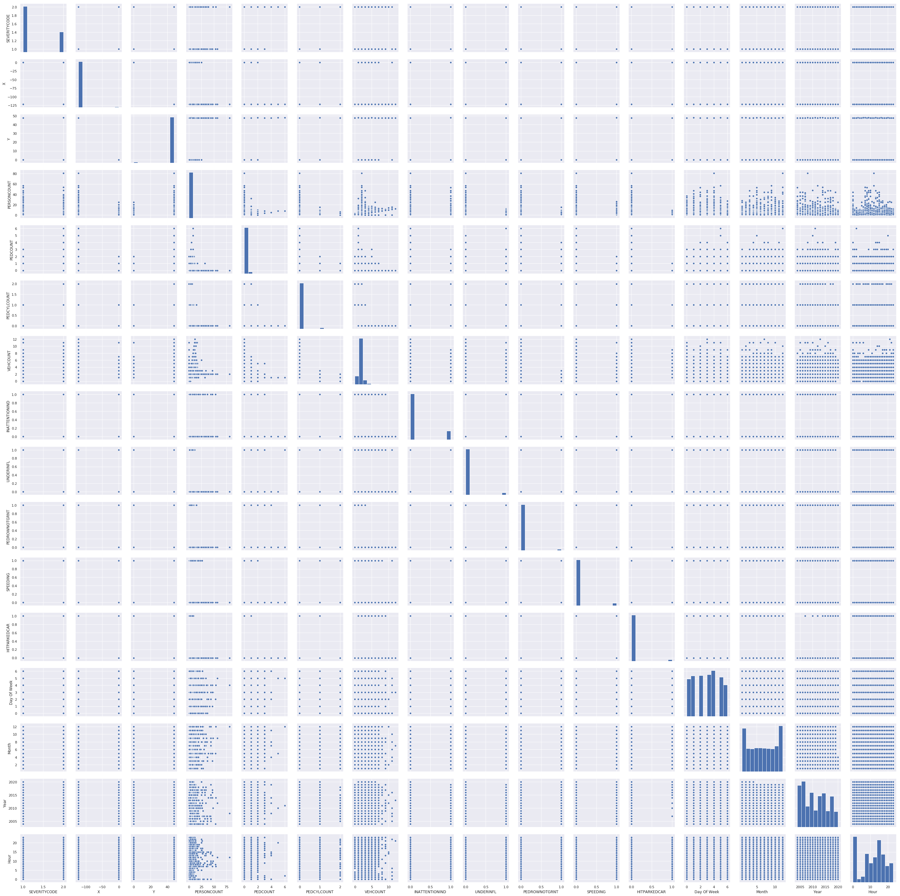
Pair plot
There is no probability distribution function
That we recognize for a feature.

Slide 6
Categorical Data impact on collision and collision severity

Slide 7
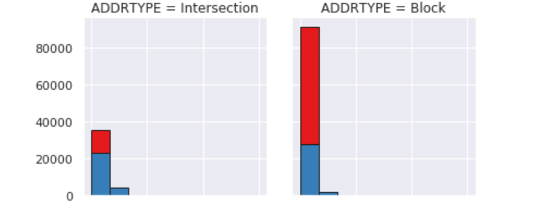
 | 2
 | 1
Collison address Type

Slide 8
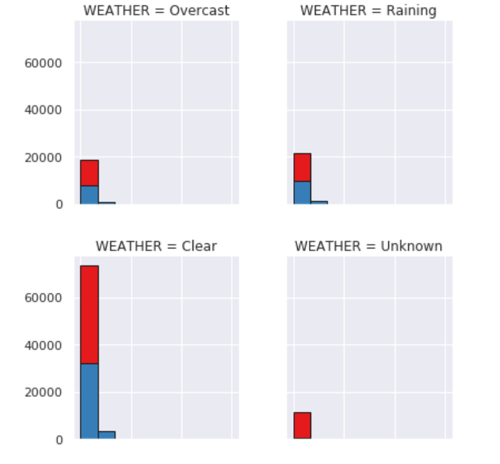
 | 2
 | 1
Weather

Slide 9
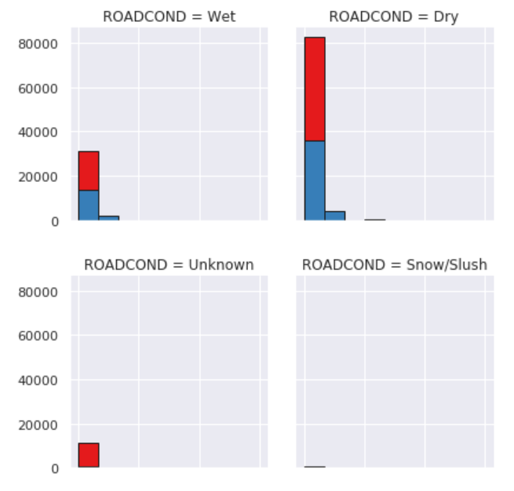
 | 2
 | 1
Road Condition

Slide 10
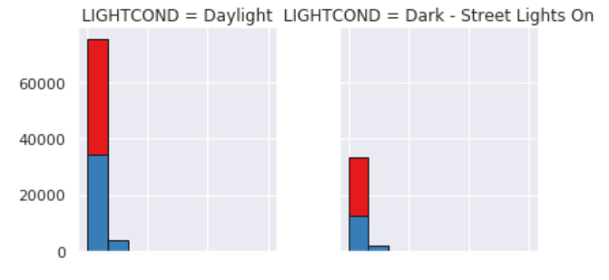
 | 2
 | 1
Light Condition

Slide 11
Predictive Model

Slide 12
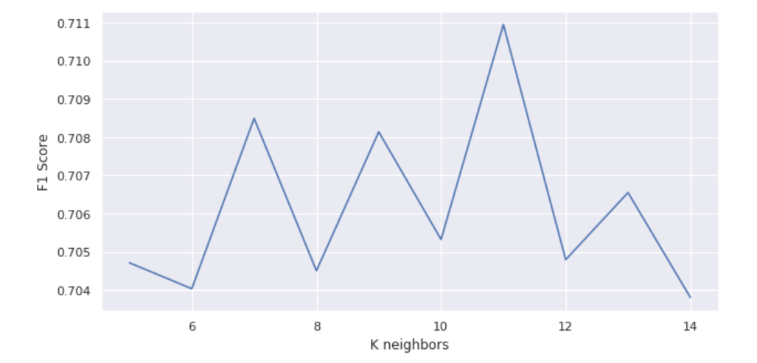
K choice
We choose k=11

Slide 13
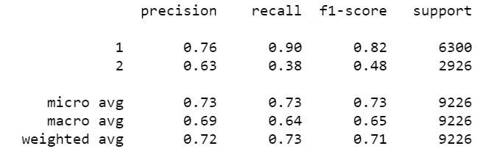
The model has a very interesting precision for both classes.
The recall for class1 is nearly perfect while it’s lower for the 2 class.
The f1 score is pretty much good in average
Model of choice:
KNN Classifier with 11 neighbors as parameter

