Slide 1
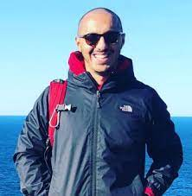



Advisors: Görel Hedin, Christoph Reichenbach and Niklas Fors
Idriss Riouak
Research Interests:
Static analysis (intra/inter procedural)
Reference attributed grammars
Compilers
In WASP Because:
Hired by WASP as PhD Student to do research on “Explainable Declarative Programming Analysis”
My supervisors are very active in the WASP community.
Cluster expectations:
Discuss common problems in the field with other WASP PhD students
Organise visiting to other WASP affiliated university and work for 1 or 2 weeks with other WASP PhD students
Being updated on the WASP (software) research results.
References:
Riouak, I., Reichenbach, C., Hedin, G., & Fors, N. (2021, September). A Precise Framework for Source-Level Control-Flow Analysis. In 2021 IEEE 21st International Working Conference on Source Code Analysis and Manipulation (SCAM)(pp. 1-11). IEEE.

