Slide 1
test presentation
Generated by Agent Diaz AI

Slide 2
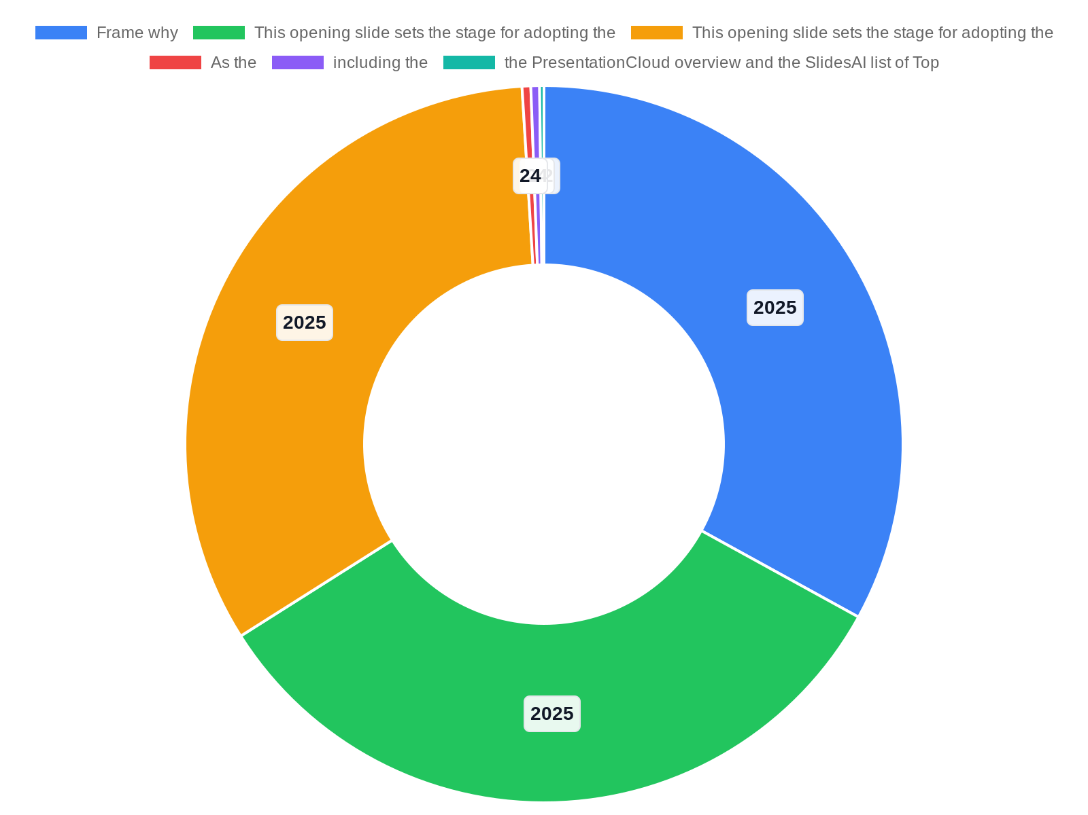
Introduction: Why 2025 Presentation Trends Matter
This opening slide sets the stage for adopting the 2025 presentation-design landscape and explains why contemporary slide design matters for persuasion, brand …
Frame why 2025-specific trends change audience expectations
Connect design choices to persuasion and brand credibility
Identify audience for this briefing and desired outcomes
Preview structure: trends, tactics, tools, implementation
Notes:
This opening slide sets the stage for adopting the 2025 presentation-design landscape and explains why contemporary slide design matters for persuasion, brand perception, and audience retention. As the 24Slides piece notes, “2025 is your year to take your presentation slides to the next level!” and underscores that while content remains paramount, slide design is a critical amplifier — outdated slides can drag down an otherwise strong message. The purpose of this presentation is to map observable trends, connect them to practical design choices, and provide a clear implementation path. Informed by multiple industry write-ups — including the 24Slides article, the PresentationCloud overview and the SlidesAI list of Top 12 trends — this introduction clarifies scope, intended audience (designers, communicators, product and marketing leads), and outcomes: immediate design adjustments, a prioritized roadmap, and suggested toolsets. We'll also highlight accessibility and measurement guardrails so design improvements are meaningful, not just aesthetic. Finally, this slide presents the structure of the briefing: trend overview, visual language and motion, accessibility and inclusive practice, adaptive layouts and templates, data storytelling, operationalizing change, and recommended next steps. It explicitly links the guidance that follows to the research context summarized from industry sources, ensuring recommendations are grounded in current practitioner guidance rather than opinion alone.

Slide 3
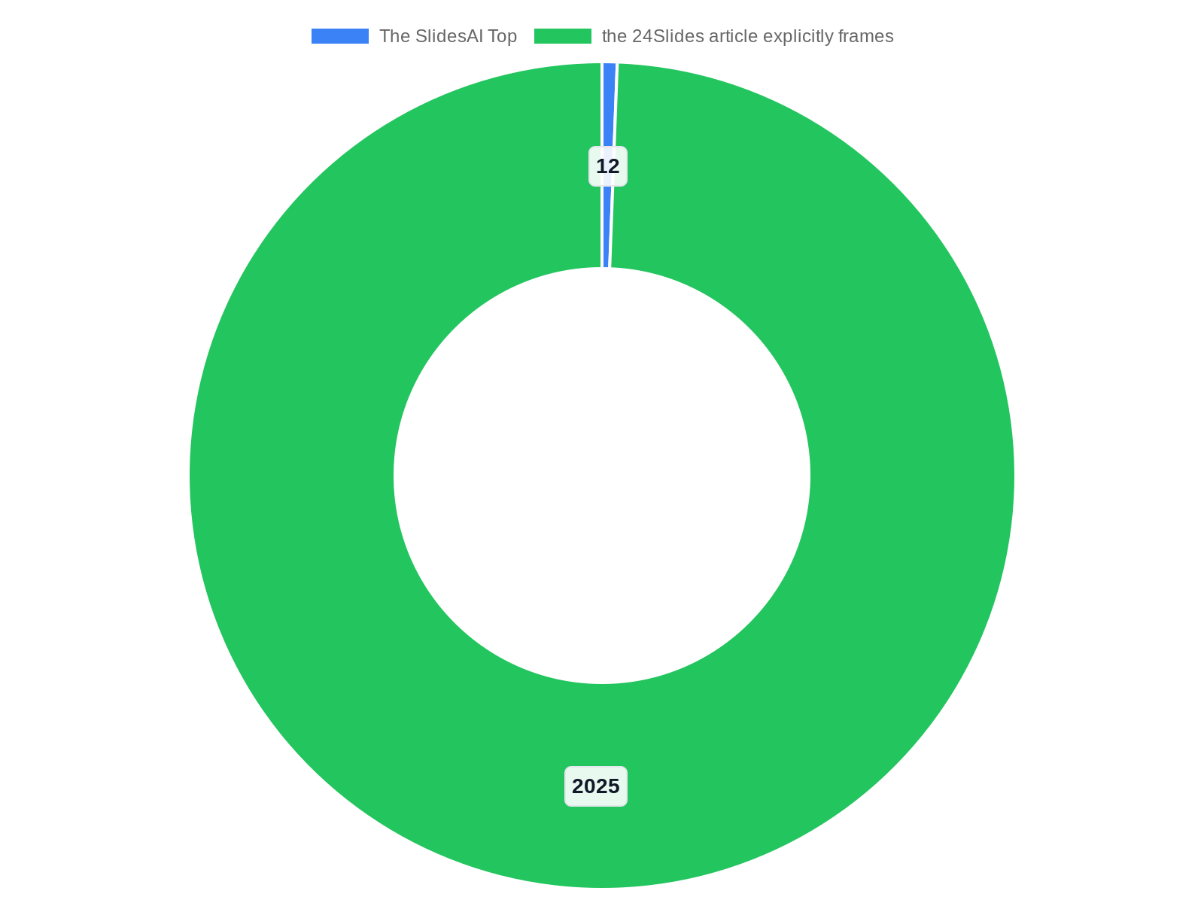
Trend Profile: Authenticity, Engagement, and Accessibility
authenticity, audience engagement, and accessibility. The PresentationCloud write-up highlights authenticity and engagement as central shifts toward honest vis…
Emphasize real imagery, candid visuals, and human narratives
Design for interaction: polls, micro-animations, guided reveals
Prioritize accessibility: contrast, legibility, navigable slides
Measure via content authenticity and engagement signals
Notes:
authenticity, audience engagement, and accessibility. The PresentationCloud write-up highlights authenticity and engagement as central shifts toward honest visuals and interactive formats. The SlidesAI Top 12 trends enumeration reinforces this mix, describing how contemporary slides favor genuine photography, imperfect graphic treatments, and human-centered storytelling. Meanwhile, the 24Slides article explicitly frames 2025 as a year to elevate slides and warns that outdated design can undermine credibility; it therefore argues for authentic visuals and accessible layouts. In addition, several sources stress accessibility as non-negotiable: accessible color contrasts, readable typography, clear alt text, and keyboard-friendly slide navigation are now expected. Practical implications include prioritizing real imagery over stock clichés, crafting micro-narratives instead of bullet dumps, enabling slide-level accessibility checks, and embedding cues that encourage audience interaction. This slide also clarifies how these thematic pillars map to measurable criteria: authenticity metrics (percentage of slides using real photography or brand assets), engagement signals (audience polling and interaction frequency), and accessibility compliance checks (contrast ratio, font size baseline). By tying each recommendation to observed commentary in the research context, the slide supports decision-makers who need defensible, evidence-oriented design choices.

Slide 4
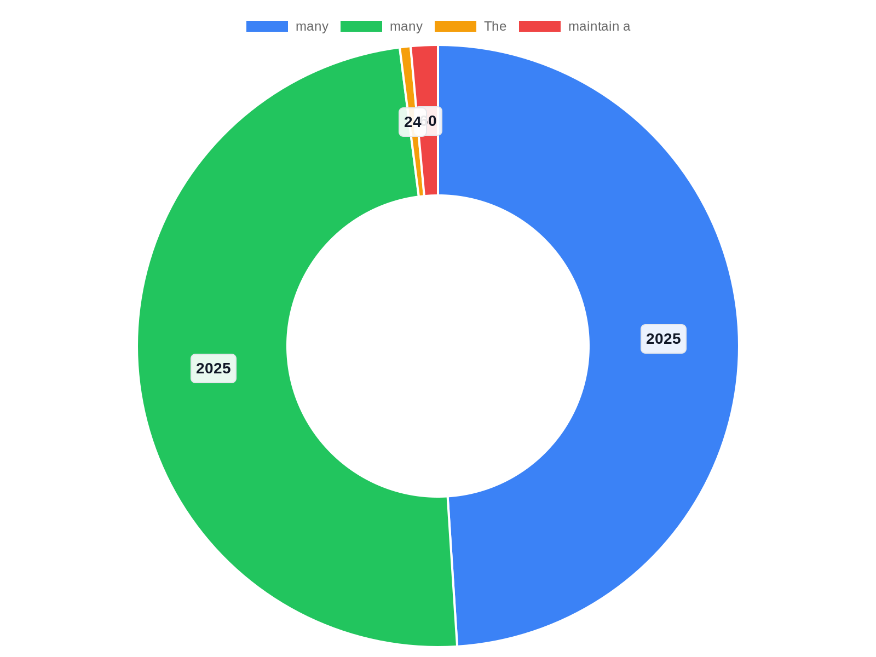
Visual Language: From Minimalism to Expressive Systems
while minimalism remains valuable for clarity, many 2025 trend writings — including the SlidesAI Top 12 and the GraphicDesignEye roundup — describe a simultane…
Adopt a flexible visual system with base grids and type scales
Use expressive accents sparingly to create focus and personality
Apply clear guardrails to prevent over-design and loss of clarity
Align expressive elements with brand and message hierarchy
Notes:
while minimalism remains valuable for clarity, many 2025 trend writings — including the SlidesAI Top 12 and the GraphicDesignEye roundup — describe a simultaneous movement toward expressive typographic systems, bold color accents, and layered compositions. The 24Slides guidance emphasizes that good design should not merely be fashionable but functional: slide layouts must let content breathe and guide attention. The practical implication is adopting flexible visual systems that balance restraint with personality — a neutral base for readability plus expressive elements to highlight key messages. This slide outlines an approach to visual grammar: base grid and spacing rules, primary and secondary type scales, a restrained color palette with one accent color for emphasis, and a set of decorative motifs or textures used sparingly. It also highlights the risk of over-design and recommends guardrails: maintain a 60/30/10 contrast between base, secondary, and accent elements, cap decorative elements per slide, and ensure brand alignment. Examples of acceptable expressive choices include oversized numerals for key metrics, subdued photographic overlays to increase legibility, and intentional asymmetry to create hierarchy. These recommendations are grounded in the research context’s emphasis on evolving aesthetics and the need for purposeful design over trend-chasing.

Slide 5
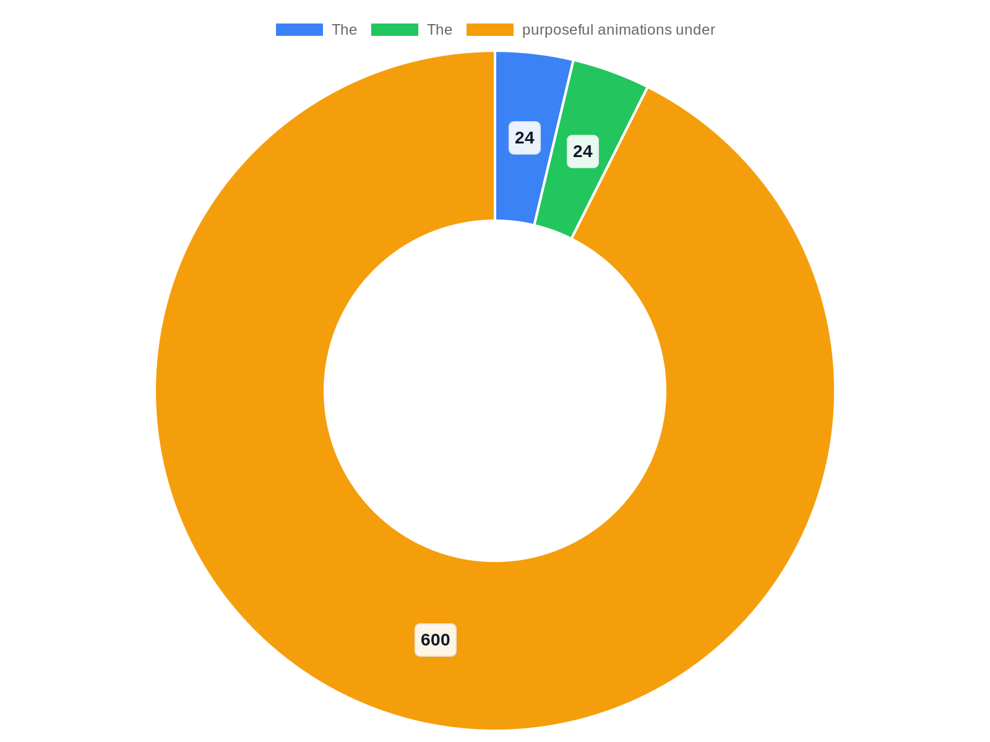
Motion Design & Micro-interactions: Subtle Movement, Big Impact
subtle transitions, content reveals, animated data cues, and micro-interactions can guide attention and clarify structure without distracting. The 24Slides com…
Use short, purposeful animations to reveal structure and emphasis
Apply micro-interactions for data callouts and interactive elements
Provide static fallbacks and motion disable options for accessibility
Time animations to speaker pacing in live and hybrid settings
Notes:
subtle transitions, content reveals, animated data cues, and micro-interactions can guide attention and clarify structure without distracting. The 24Slides commentary supports this, noting that slide design must amplify communication. The guidance here is conservative and strategic: use motion to reveal content progressively, animate only to clarify relationships (e.g., animate a callout to show causality), and prefer short, purposeful animations under 600ms for micro-interactions. This slide provides practical patterns: entrance transitions to orient viewers, progress indicators for multi-step arguments, animated annotations to spotlight data points, and hover/tap micro-interactions for interactive exports or live presentations. Accessibility considerations are emphasized: always offer static fallbacks, avoid motion that can trigger vestibular issues, and allow presenters or viewers to disable animations. For teams moving to live or hybrid delivery, the slide suggests built-in rehearsals that time animations to speaker pacing. By tying motion guidance to the research context’s emphasis on engagement and technical capability, the slide frames motion as an amplifier of clarity rather than mere decoration.

Slide 6

Adaptive Layouts: Responsive Slides for Multiple Formats
design content blocks that can reflow vertically for narrow screens, set safe margins for projection and streaming, and create alternate master slides optimize…
Design modular content blocks that reflow across aspect ratios
Create master templates for wide, standard, and mobile exports
Simplify charts and visuals for small-screen consumption
Test key slides across resolutions and delivery modes
Notes:
design content blocks that can reflow vertically for narrow screens, set safe margins for projection and streaming, and create alternate master slides optimized for different aspect ratios. The 24Slides article’s admonition that slide design must elevate content implies designers should plan for format variance rather than retrofitting. Teams should maintain a core content-first template with modular components: headline module, visual module, data module, and CTA module; these modules can stack or arrange side-by-side depending on context. Also include guidance for export-ready interactions: ensure charts simplify when shown on small screens (fewer labels, larger markers), and provide downloadable static PDFs with accessible tagging. The slide outlines a lightweight testing protocol: check critical slides across at least three resolutions and two delivery modes, and document any manual overrides required. By referencing the research context’s focus on adaptive capability, this slide helps teams future-proof presentations for hybrid and mobile-first audiences.

Slide 7

Inclusive Design & Accessibility: Practical Compliance Steps
accessibility is not optional trend-speak but a measurable design requirement that protects message reach and legal compliance while improving clarity for all …
Apply WCAG AA contrast and minimum type size standards
Add descriptive alt text and provide accessible slide exports
Use diverse, authentic imagery and plain-language copy
Embed accessibility checks into template and approval workflows
Notes:
accessibility is not optional trend-speak but a measurable design requirement that protects message reach and legal compliance while improving clarity for all audiences.

Slide 8
Data Storytelling: Design Patterns for Effective Charts
establish preferred chart templates and a short ‘chart review’ step in slide QA to ensure data integrity and narrative alignment. These practices reflect the r…
Pick the simplest chart type that conveys the relationship
Use progressive disclosure to guide narrative through data
Highlight key datapoints with callouts and color emphasis
Maintain axis labeling, contrast, and descriptive chart text
Notes:
establish preferred chart templates and a short ‘chart review’ step in slide QA to ensure data integrity and narrative alignment. These practices reflect the research context’s call to use visualization as a storytelling tool rather than aesthetic ornamentation.

Slide 9
Templates, Tools & Production Workflow for 2025
build modular master templates aligned with the visual system and adaptive layout rules; standardize a short palette and typography set in the template; config…
Create modular templates with integrated typography, color, and layout
Build reusable chart styles, icon libraries, and motion presets
Integrate accessibility and data checks into slide QA
Assign a design steward and schedule quarterly template reviews
Notes:
build modular master templates aligned with the visual system and adaptive layout rules; standardize a short palette and typography set in the template; configure reusable chart styles and icon libraries; adopt a motion-presets library for consistent animations; and integrate accessibility checks into the template. For tooling, the slide lists categories (presentation software with template management, rapid prototyping tools for motion, and automated accessibility checkers) without endorsing specific vendors, reflecting the research context’s emphasis on capability rather than brand lock-in. The slide recommends a production workflow: content drafting template application visual polish accessibility and data checks rehearsal with timing and animation review. It also suggests a lightweight governance model — a ‘design steward’ role to manage templates and a quarterly review to incorporate new trend guidance — drawing on industry guidance that contemporary slides require both creative direction and process discipline.

Slide 10

Implementation Roadmap: From Audit to Pilot
inventory existing decks, identify recurring slide types, and run an accessibility and content clutter assessment. Phase 2 — Design System: craft a core visual…
Phase 1: Audit existing decks for clarity and accessibility gaps
Phase 2: Build a responsive visual system and template set
Phase 3: Pilot with high-impact decks and gather feedback
Phase 4–5: Scale templates, train teams, measure and iterate
Notes:
inventory existing decks, identify recurring slide types, and run an accessibility and content clutter assessment. Phase 2 — Design System: craft a core visual system, responsive masters, and chart templates informed by SlidesAI’s Top 12 trends and the 24Slides guidance about elevating slide design. Phase 3 — Pilot: select two to three high-impact presentations and apply the new templates, motion presets, and accessibility checks; gather audience and presenter feedback on clarity and engagement. Phase 4 — Scale: finalize templates, train content owners, and incorporate the workflow into production. Phase 5 — Measure and Iterate: track engagement signals (audience polling, slide dwell time in recorded sessions), accessibility compliance, and qualitative feedback; evolve templates quarterly. The slide lists minimal resourcing requirements (1 design steward, part-time production support, 1–2 training sessions) so stakeholders can budget appropriately. By tying each phase to the observed trends in the research context, this roadmap turns abstract guidance into executable steps that balance speed with quality control.

Slide 11

Measurement, Governance & Ongoing Trend Monitoring
appoint a design steward to manage templates, define a lightweight approval workflow with accessibility and data checks, and set a quarterly review cadence to …
Track engagement, accessibility compliance, and qualitative feedback
Assign a design steward and create a lightweight approval workflow
Use pilot projects as testbeds and review templates quarterly
Maintain a simple dashboard for governance visibility
Notes:
appoint a design steward to manage templates, define a lightweight approval workflow with accessibility and data checks, and set a quarterly review cadence to adapt templates to emerging trends. The slide also recommends establishing a simple dashboard that aggregates engagement and compliance metrics for stakeholder review, and using pilot projects as living labs to test new visual or motion patterns before enterprise rollout. By connecting measurement and governance to the research context’s emphasis on practical application, the slide helps leaders operationalize trend adoption with accountability and continuous learning.

Slide 12

Conclusion & Recommended Next Steps
This concluding slide summarizes key recommendations, aligns them to immediate actions, and invites decision points for leadership. Drawing from the research c…
Approve a short audit and pilot to operationalize 2025 trends
Prototype modular templates and enforce accessibility checks
Designate a design steward and schedule quarterly reviews
Measure engagement and iterate based on pilot outcomes
Notes:
This concluding slide summarizes key recommendations, aligns them to immediate actions, and invites decision points for leadership. Drawing from the research context — including 24Slides’ call to elevate slides in 2025, SlidesAI’s enumeration of top trends, PresentationCloud’s focus on adaptive and accessible designs, and SketchBubble’s emphasis on engagement — the core recommendations are: prioritize authenticity and accessibility, adopt modular templates for adaptive layouts, use motion strategically to guide attention, and enforce basic governance and measurement. Immediate next steps proposed here: conduct a 2-week audit of current slide assets, prototype two responsive templates, run a 1-week pilot with scheduled speaker rehearsals, and appoint a design steward to maintain templates and accessibility checks. The slide restates the value proposition: modest investments in template work, tooling, and a lightweight governance model will yield stronger persuasion, improved audience comprehension, and better inclusivity. It closes with an explicit prompt for the decision-maker: approve the proposed pilot budget and designate stakeholders for the audit and pilot timeline. The recommendations are directly grounded in the industry write-ups cited earlier to ensure that leadership can tie actions to documented trend guidance.

Slide 13
References
https://24slides.com/presentbetter/best-presentation-design-trends
https://presentationscloud.com/blog/presentation-design-trends-2025
https://www.slidesai.io/blog/presentation-design-trends
https://graphicdesigneye.com/presentation-design-trends/
https://www.sketchbubble.com/blog/8-emerging-trends-in-presentation-design-for-2025/
https://www.microsoft.com/en-us/microsoft-365-life-hacks/presentations/four-presentation-trends-for-2025
https://toolsfairy.com/document-test/sample-ppt-files
https://freetestdata.com/document-files/pptx/
https://samples-files.com/sample-ppt-pptx-files/
https://www.slideteam.net/blog/top-10-testing-practices-ppt-templates-with-examples-and-samples

