Slide 1
The Life Cycle of Salmon — Complete PPTX Presentation Outline
Generated by Agent Diaz AI

Slide 2
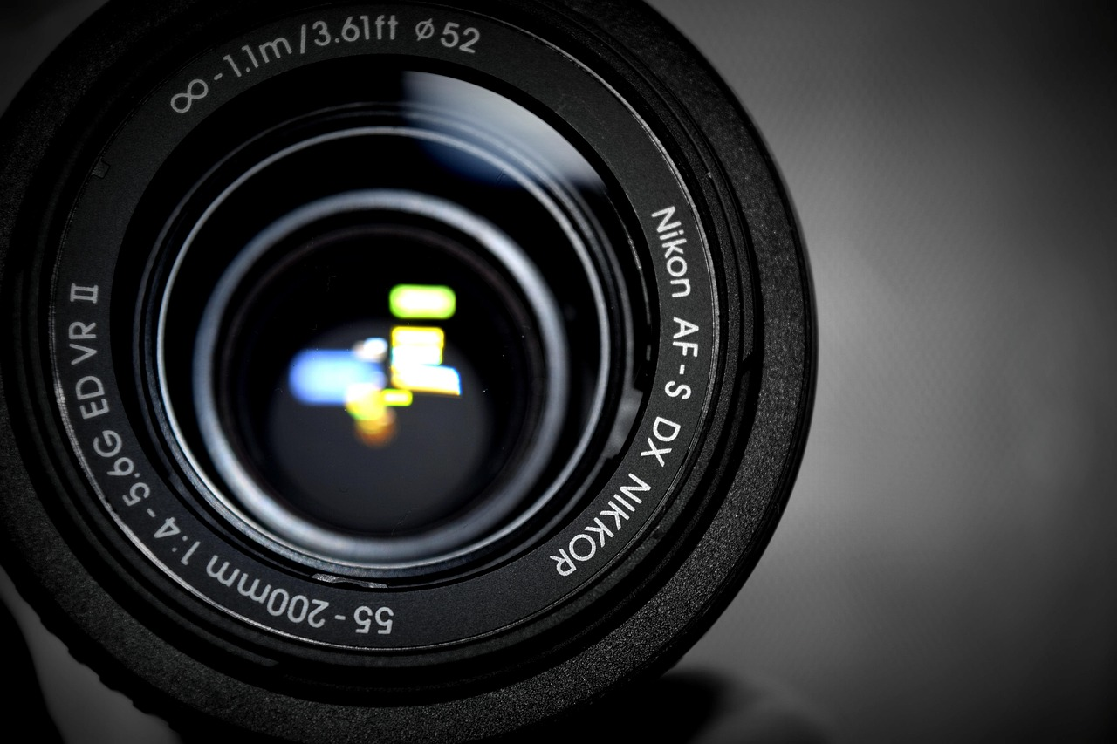
Title & Learning Objectives
This opening slide establishes the presentation title, intended audience, and three clear learning objectives: (1) describe the sequential life stages of salmo…
Presentation title, audience, and duration
Three specific learning objectives
Presenter and affiliation details
Suggested delivery notes and slide pace
Notes:
This opening slide establishes the presentation title, intended audience, and three clear learning objectives: (1) describe the sequential life stages of salmon from egg to spawning adult, (2) explain key physiological and behavioral changes at each stage including smoltification and natal homing, and (3) identify major threats and conservation actions that influence survival. The slide also includes presenter name, affiliation, estimated duration, and suggested delivery notes for educators. The structure follows common public-education slide templates found in widely shared resources to ensure accessibility and classroom suitability; the SlideShare PPTX summary and the Google Slides public presentation both emphasize clear objectives and audience framing, which guided this slide's composition.

Slide 3
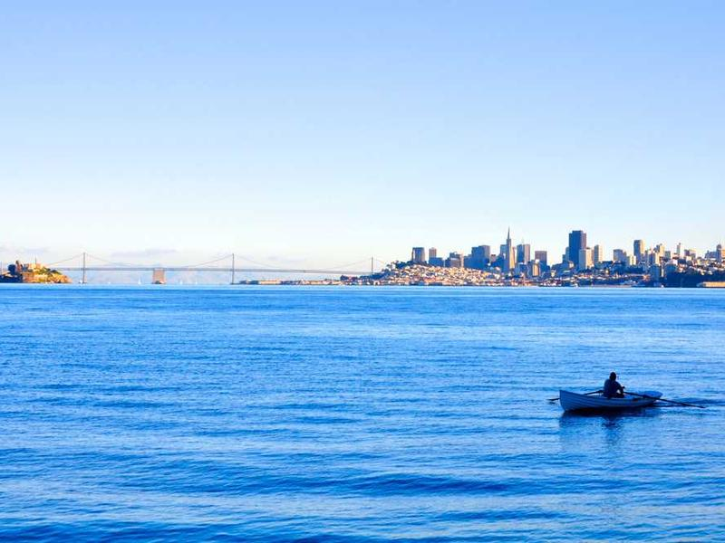
Overview: Anadromy and Salmon Species
This overview slide defines anadromy and lists the principal Pacific salmon species, explaining essential distinctions such as size and life-history variabilit…
Definition: anadromy and significance
Principal Pacific salmon species (e.g., Chinook)
Species differences relevant to life-stage timing
Contextual note from SlideServe on Chinook size
Notes:
This overview slide defines anadromy and lists the principal Pacific salmon species, explaining essential distinctions such as size and life-history variability. The term anadromous refers to fish that hatch in freshwater, migrate to the ocean to grow, then return to freshwater to spawn. According to the SlideServe presentation, there are six species of salmon commonly discussed in the Pacific Northwest, with Chinook highlighted as the largest, sometimes exceeding 6 feet and 100 pounds; this contextual detail helps learners connect biological stages to species-specific traits. The slide also briefly contrasts life-history strategies (e.g., semelparity in most Pacific salmon vs iteroparity in related trout), preparing the audience for stage-specific sections that follow.

Slide 4
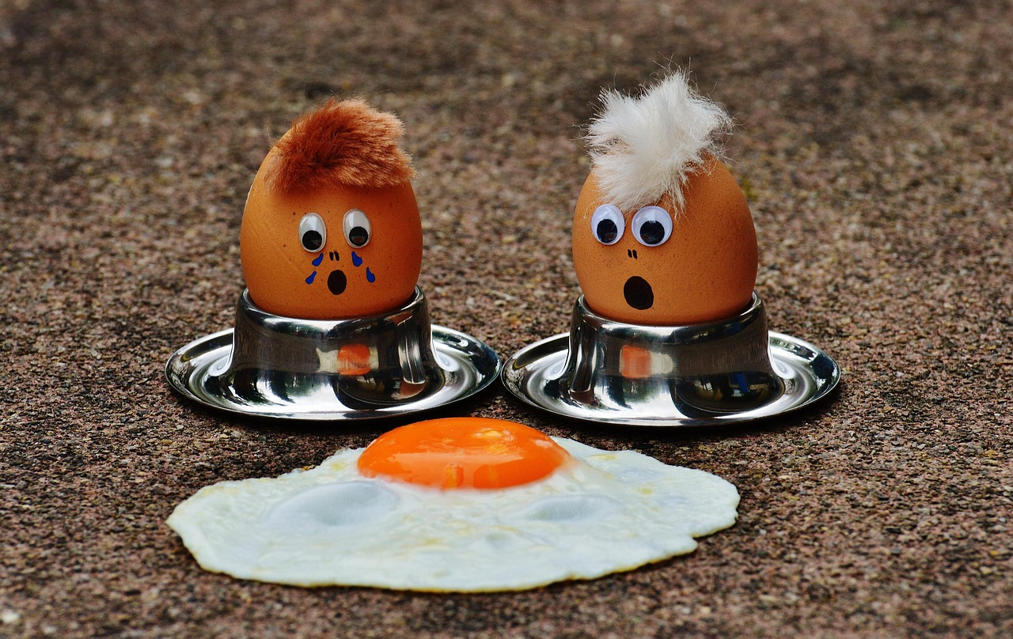
Stage 1 — Eggs: Spawning, Nesting, and Incubation
timing of spawning in gravel redds, microhabitat needs, and incubation dynamics. Female salmon excavate gravel nests called redds where eggs are deposited with…
Egg deposition in gravel redds and spawning behavior
Habitat needs: cool, oxygenated, flowing water and clean gravel
Incubation timing and environmental sensitivity
Common egg-stage risks: sedimentation, dewatering, predation
Notes:
timing of spawning in gravel redds, microhabitat needs, and incubation dynamics. Female salmon excavate gravel nests called redds where eggs are deposited with male sperm; oxygenated, cool, flowing water and clean gravel are essential for embryo survival. The PowerShow and ODFW volunteer guide emphasize cool, clear, flowing water and clean substrate as critical requirements for successful egg development, reinforcing messages about habitat quality. The slide outlines temperature and flow effects on incubation duration and mortality risks such as sedimentation, dewatering, or predation. Visual suggestions include an annotated diagram of a redd cross-section and a close-up photo of eyed eggs to show developmental milestones.

Slide 5
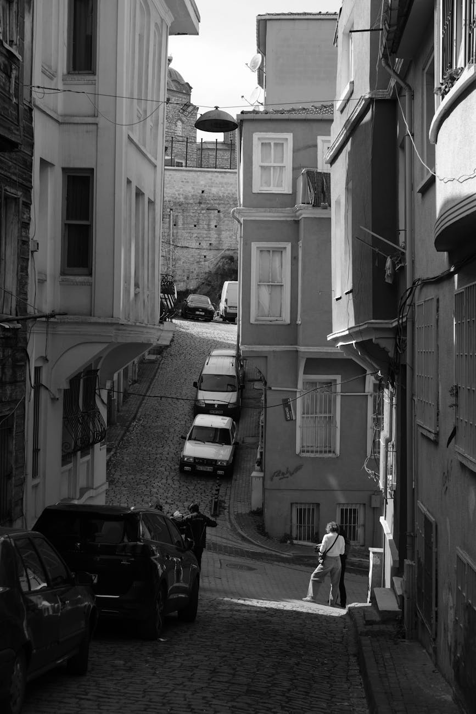
Stage 2 — Alevin: Yolk-Dependent Development
The alevin stage follows egg hatching and is characterized by newly hatched fish that retain a yolk sac providing nutrition while remaining partly sheltered in…
Hatch stage: alevin with large yolk sac
Yolk sac supports early growth; no external feeding
Behavior: remain in gravel until yolk absorption
Visual: side-by-side image of egg, eyed egg, alevin
Notes:
The alevin stage follows egg hatching and is characterized by newly hatched fish that retain a yolk sac providing nutrition while remaining partly sheltered in the gravel. During this period salmon are vulnerable but do not yet feed externally; they focus energy on growth and organ development while still protected from many surface predators. The SlideShare PPTX summary describes alevin as hatchlings with a large yolk sac that later gets absorbed, consistent with classroom materials from Google Slides and Scribd. This slide presents the biological role of the yolk sac, approximate time frames reported in source materials for yolk absorption under typical cool-stream conditions, and behavioral notes on when fry will emerge from the gravel to begin feeding.

Slide 6
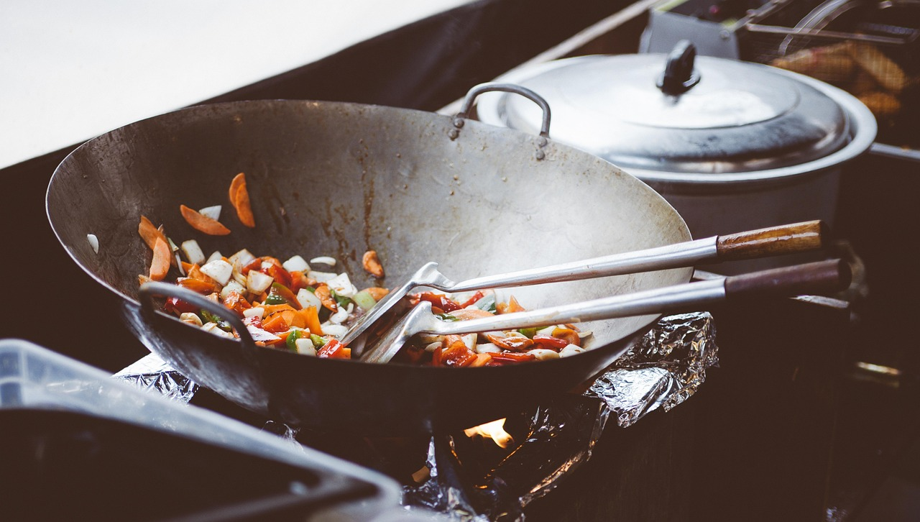
Stage 3 — Fry & Parr: First Feeding and Stream Rearing
After yolk absorption, juvenile salmon emerge as fry and begin active foraging on plankton and benthic invertebrates; as they grow into parr they develop verti…
Emergence as fry and onset of external feeding
Parr marks develop for camouflage
Habitat use: pools, cover, and feeding microhabitats
Ecological role and predator-prey interactions
Notes:
After yolk absorption, juvenile salmon emerge as fry and begin active foraging on plankton and benthic invertebrates; as they grow into parr they develop vertical markings (parr marks) that provide camouflage in stream habitats. This stage involves rapid growth and habitat selection among pools, riffles, and complex cover. The Google Slides presentation and SlideShare outline describe fry feeding on microscopic and insect prey and note the parr stage where banding appears. The slide covers typical feeding ecology, growth rates under variable food availability, and the importance of in-stream structure for shelter against predators. Classroom activities may include stomach-content illustrations and simple sampling demonstrations.

Slide 7
Stage 4 — Smoltification & Seaward Migration
Smoltification is the physiological and behavioral transition enabling freshwater juveniles to tolerate saltwater and commence ocean migration. The process inc…
Physiological shift: osmoregulation and hormonal changes
Behavioral shift: schooling and downstream migration
Estuary transition as acclimation zone
Survival influences: flow, temperature, predators
Notes:
Smoltification is the physiological and behavioral transition enabling freshwater juveniles to tolerate saltwater and commence ocean migration. The process includes hormonal shifts, silvering of coloration, changes in osmoregulatory organs, and schooling behavior conducive to downstream movement. Several educational sources, including the SlideShare summary and PowerShow slides, describe the change from river-dwelling parr to silvery smolts that migrate downstream to estuaries and the ocean. This slide explains triggers (seasonal photoperiod and growth), the role of estuaries as acclimation zones, and factors affecting survival during river transit, such as flow regulation, temperature anomalies, and predation pressure. Suggested visuals include a timeline graphic of smoltification and photos of parr vs smolt.

Slide 8
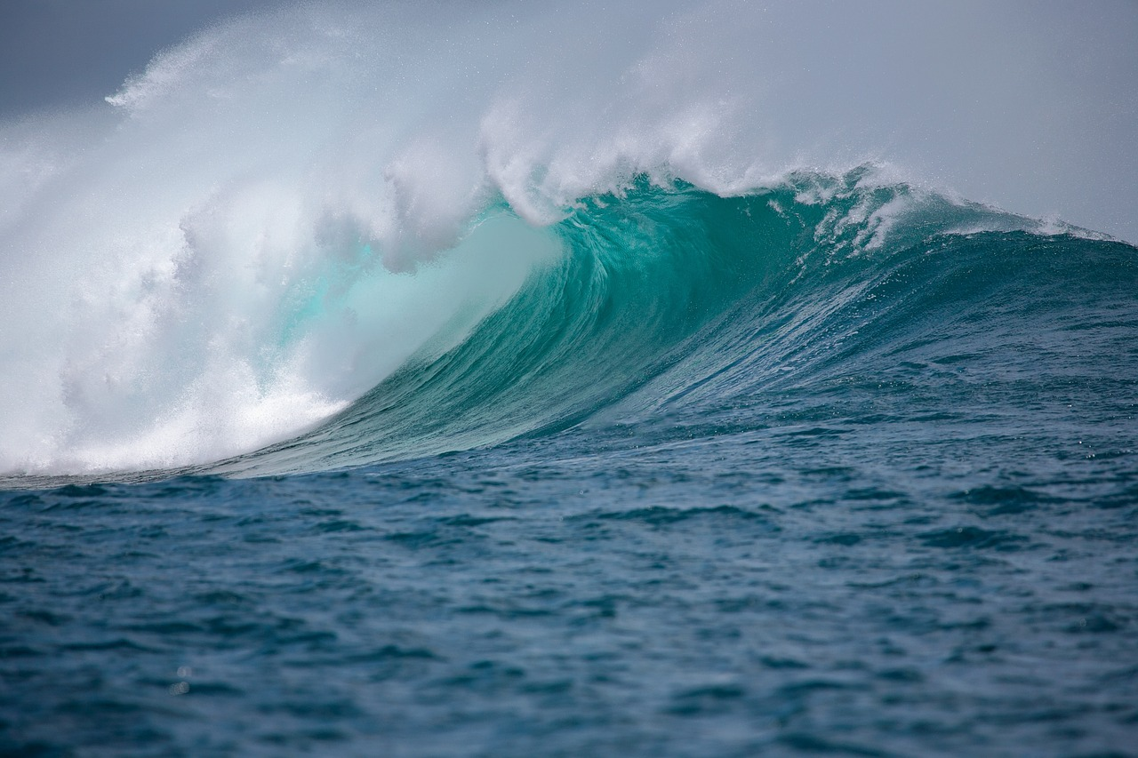
Stage 5 — Ocean Phase: Growth and Maturation
In the ocean, salmon experience their primary growth phase, feeding on abundant marine prey to reach maturity. Duration and oceanic migration routes vary by sp…
Primary growth occurs in marine feeding grounds
Diet shifts to larger prey; rapid somatic growth
Species-specific ocean migration patterns
Ocean conditions and fisheries impact survival
Notes:
In the ocean, salmon experience their primary growth phase, feeding on abundant marine prey to reach maturity. Duration and oceanic migration routes vary by species and population, with salmon utilizing coastal and open-ocean feeding grounds. The SlideServe and SlideShare materials both summarize the broad pattern of ocean growth and eventual maturation followed by natal homing. This slide describes diet shifts to fish and larger invertebrates, the role of ocean productivity and marine conditions on growth rates and survival, and how ocean fisheries and bycatch can influence population dynamics. Included are suggested data visualization options (e.g., species-specific size-at-age curves) but only if paired with validated local monitoring data; the presentation links to public resources for obtaining such datasets for later charting.

Slide 9

Stage 6 — Homing, Spawning Migration, and Death
Mature adults navigate back to natal streams using olfactory cues, magnetic orientation hypotheses, and learned migratory routes; this homing culminates in ups…
Natal homing mechanisms and migratory navigation
Spawning behavior: redd digging and egg deposition
Terminal reproductive strategy in many Pacific species
Barriers and energetics of upstream migration
Notes:
Mature adults navigate back to natal streams using olfactory cues, magnetic orientation hypotheses, and learned migratory routes; this homing culminates in upstream spawning migration and nest construction. The adult return includes dramatic physiological changes—cessation of feeding, morphological changes, and in many Pacific species, terminal death after spawning. The SlideShare and SlideServe summaries emphasize the return to natal streams and spawning nests; classroom materials note nest-digging (redd construction), egg deposition, and subsequent mortality patterns. This slide outlines the timing of migration, the energetics of upriver travel, anthropogenic barriers (dams and culverts), and the evolutionary logic of semelparity. Visual ideas: migration maps and life-cycle circular diagram showing final return and egg deposition.

Slide 10
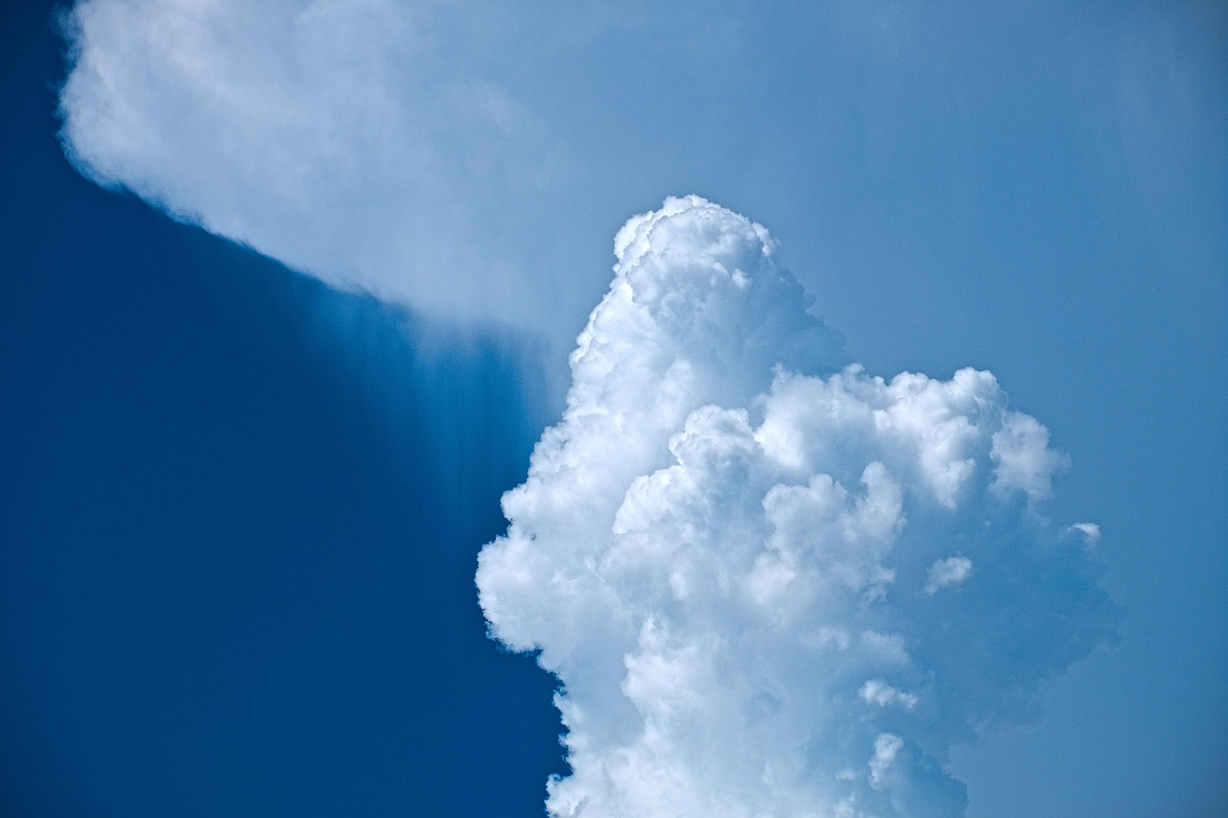
Threats Across the Life Cycle
sedimentation and temperature stress affect eggs and alevin; habitat simplification and predation influence fry and parr; flow alteration, water quality, and h…
Egg/alevin risks: sedimentation, warming, dewatering
Juvenile risks: habitat loss, predation, competition
Smolt/ocean risks: altered flow regimes, fisheries
Adult risks: barriers, low flows, hatchery-wild interactions
Notes:
sedimentation and temperature stress affect eggs and alevin; habitat simplification and predation influence fry and parr; flow alteration, water quality, and harvest affect smolts and ocean-phase juveniles; and barriers, low flows, and hatchery interactions complicate adult returns. The ODFW volunteer guide and PowerShow presentation both foreground habitat quality and flow regimes as recurrent limiting factors, while SlideServe materials remind audiences that human modifications and climate variability can exacerbate these pressures. The slide also addresses cumulative impacts and interactive effects—multiple stressors often act simultaneously to depress survival—offering a systems view for informed conservation discussion.

Slide 11
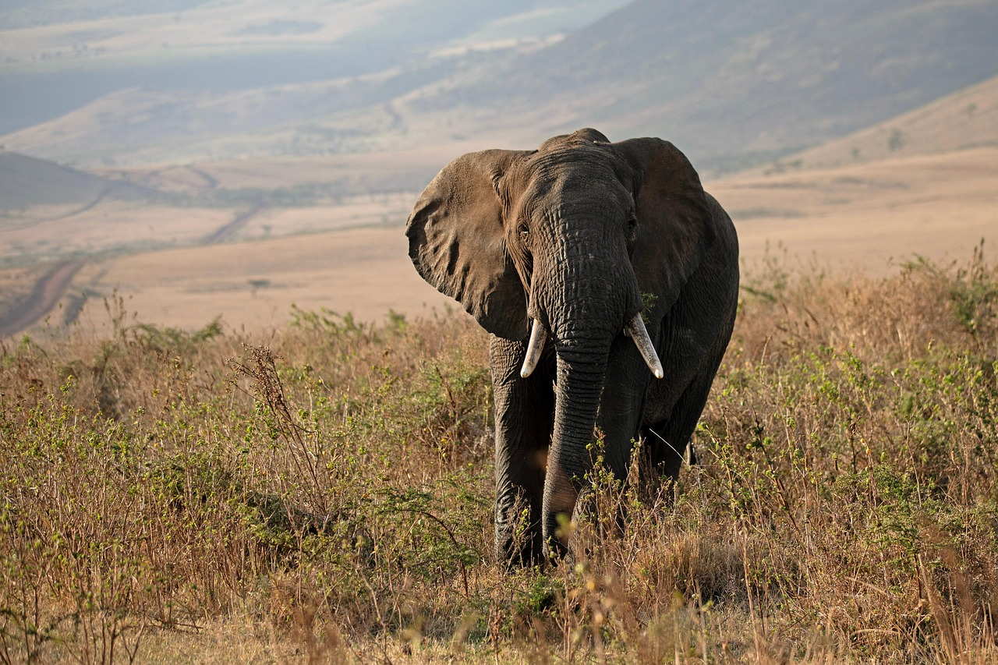
Conservation & Management Strategies
riparian restoration and sediment control for eggs and alevin; in-stream structure and flow management for fry and parr; flow timing, dam operations, and estua…
Habitat restoration: riparian planting and sediment control
Flow and dam operation adjustments for migration windows
Estuary protection and fisheries regulation
Monitoring, adaptive management, and community science
Notes:
riparian restoration and sediment control for eggs and alevin; in-stream structure and flow management for fry and parr; flow timing, dam operations, and estuary protections for smolt migration; fisheries management and ocean monitoring for ocean-phase survival; and barrier removal, fish passage, and habitat reconnection for adult returns. The ODFW PPT and PowerShow materials provide practical restoration and volunteer-monitoring guidance, and SlideShare case examples illustrate adaptive management loops. The slide outlines monitoring tools (rote count methods, PIT-tag arrays, snorkel surveys), policy levers (ESA listings, harvest regulations), and community engagement tactics that have measurable outcomes when paired with monitoring.

Slide 12
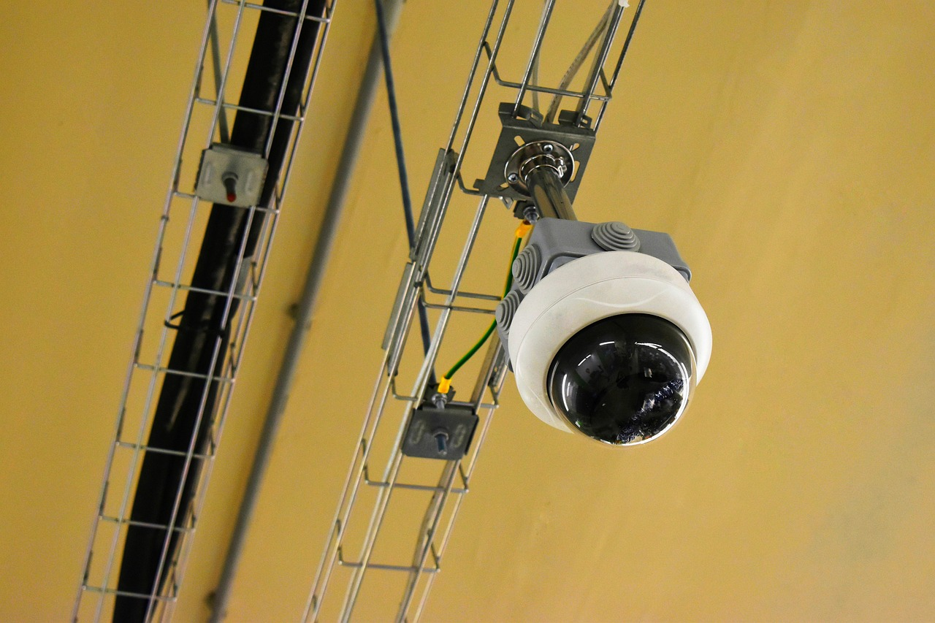
Monitoring, Data Needs & Suggested Visuals
This technical slide presents monitoring approaches and visual resources appropriate for a classroom or stakeholder presentation: time-series of redd counts, s…
Recommended metrics: redd counts, smolt traps, return abundance
Use photos, annotated maps, and simple time-series charts
Acquire validated local datasets before charting
Suggested chart types: line for returns, bar for stage survival
Notes:
This technical slide presents monitoring approaches and visual resources appropriate for a classroom or stakeholder presentation: time-series of redd counts, smolt trap numbers, size-at-age data, and return abundances are commonly used metrics. The classroom-friendly sources in Google Slides and the ODFW guide suggest combining photos, simple charts, and annotated maps. Because the research materials provided (SlideServe, SlideShare, ODFW, PowerShow) present descriptive stage information but do not provide standardized numeric datasets, the slide recommends sourcing local monitoring datasets (state fish agencies, NOAA, or regional hatchery records) before building charts. If validated datasets are obtained, recommended charts include a line chart of annual return counts and a bar chart of stage-specific survival rate summaries; only include numeric charts when grounded in cited data.

Slide 13
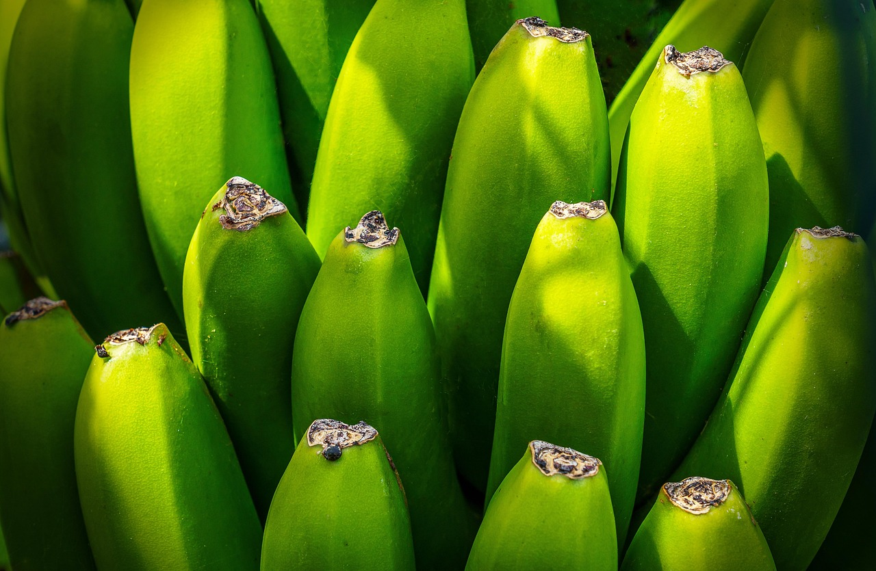
Slide Deck Export, Distribution & PPTX Link
This operational slide explains export options, distribution formats, and provides suggested download links and licensing notes. For quick access to starter sl…
Export options: PPTX, PDF, Google Slides conversion
Use ODFW PPT as a template for classroom adaptation
Check source licensing and attribution requirements
Links below provide downloadable/viewable starter decks
Notes:
This operational slide explains export options, distribution formats, and provides suggested download links and licensing notes. For quick access to starter slide decks that align with this outline, the ODFW Salmon Life Cycle PPT (hosted on the Oregon Department of Fish and Wildlife site) is a practical downloadable resource appropriate for modification and classroom use; likewise, public SlideShare and SlideServe presentations can be used for reference or adapted under the terms shown on their pages. Below are recommended source links where full PPT/PPTX or viewable decks are available; use those as templates or to assemble your customized PPTX. Ensure you follow any reuse or attribution guidance on the source pages before redistribution.

Slide 14

Classroom Activities & Assessment
This pedagogical slide offers active-learning exercises and formative assessment ideas: (1) build a life-cycle wheel with labeled stages and hazards, (2) analy…
Hands-on: life-cycle wheel and habitat model
Data literacy: interpret redd counts or smolt trends
Citizen science: protocol design and volunteer roles
Assessment: rubrics, quizzes, and project posters
Notes:
This pedagogical slide offers active-learning exercises and formative assessment ideas: (1) build a life-cycle wheel with labeled stages and hazards, (2) analyze a case study of a local stream restoration project with before/after metrics, (3) interpret a provided redd-count time series and propose management actions, and (4) design a citizen-science monitoring protocol for smolts or redd surveys. The research-context slides (Google Slides, SlideServe, SlideShare) informed the recommended activities by emphasizing simple visuals, age-appropriate facts, and stepwise explanations effective for K–12 and general public audiences. Assessment suggestions include rubrics for projects, short quizzes on stage identification, and poster presentations that synthesize threats and conservation measures.

Slide 15

References & Further Resources
This closing slide lists references and recommended further reading and data sources, including state agency guides and publicly shared slide decks used to bui…
Primary slide decks and PDFs used to build the outline
State and federal monitoring data portals for numeric datasets
Licensing notes: check each source before reuse
Contact info for further customization or data requests
Notes:
This closing slide lists references and recommended further reading and data sources, including state agency guides and publicly shared slide decks used to build this outline. The SlideServe PowerPoint, SlideShare PPTX, the Oregon Department of Fish and Wildlife volunteer guide PPT, the Google Slides public deck, the PowerShow presentation, and a Scribd classroom PDF were reviewed and informed the stage descriptions and teaching recommendations. Users are encouraged to consult regional fishery agency data portals (e.g., ODFW, state fish commissions, NOAA Fisheries) for authoritative numeric datasets used to create charts or to support local management case studies. Below are direct URLs to the referenced slide decks and presentations for download or viewing.

Slide 16
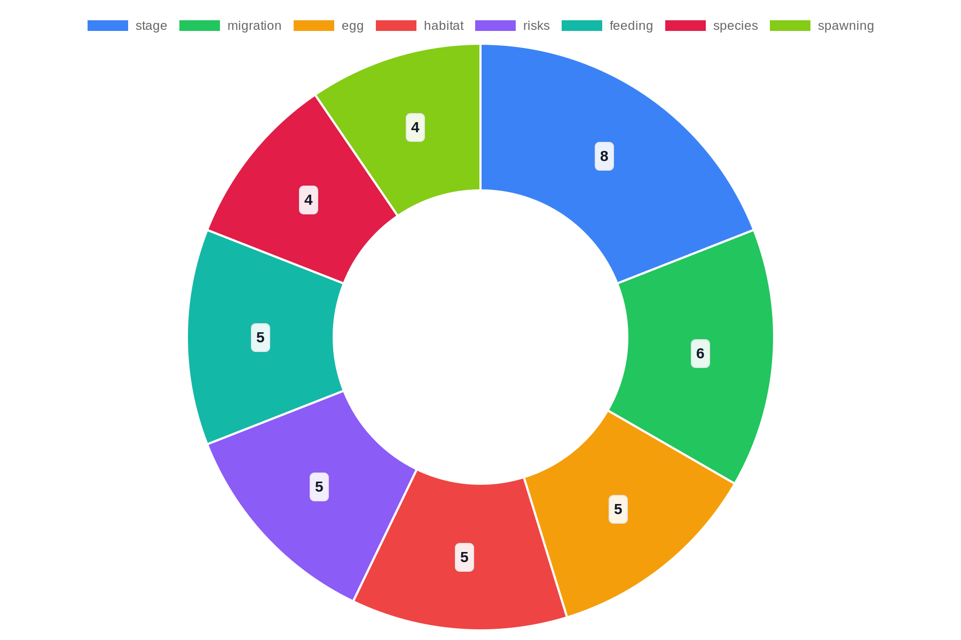
Top Topics

Slide 17
References
https://www.slideserve.com/oleg-barnett/the-life-cycle-of-salmon
https://www.slideshare.net/slideshow/the-salmon-life-cycle/24955928
https://www.dfw.state.or.us/fish/STEP/docs/E2F_Volunteer_Guide_PP1_Salmonid_Life_Cycle.ppt
https://docs.google.com/presentation/d/16jl5JwAd-V4WbJINrBBsB9oqp5SM-Fq9yjjCA8W7jC4/htmlpresent
https://www.powershow.com/view/6d9eb-NDk5O/Salmonid_Life_Cycle_powerpoint_ppt_presentation
https://www.scribd.com/presentation/714397908/Life-Cycle-of-A-Salmon
https://www.scribd.com/presentation/714397908/Life-Cycle-of-a-Salmon
https://bhsaicemarine.weebly.com/uploads/2/2/8/2/22821354/the_life_cycle_of_salmon_2015_aleeta_wellman.ppt
https://www.teacherspayteachers.com/Product/Salmon-Lifecycle-Powerpoint-Activity-9284828

