Slide 1
Salmon Life Cycle — Educational Presentation
Generated by Agent Diaz AI

Slide 2
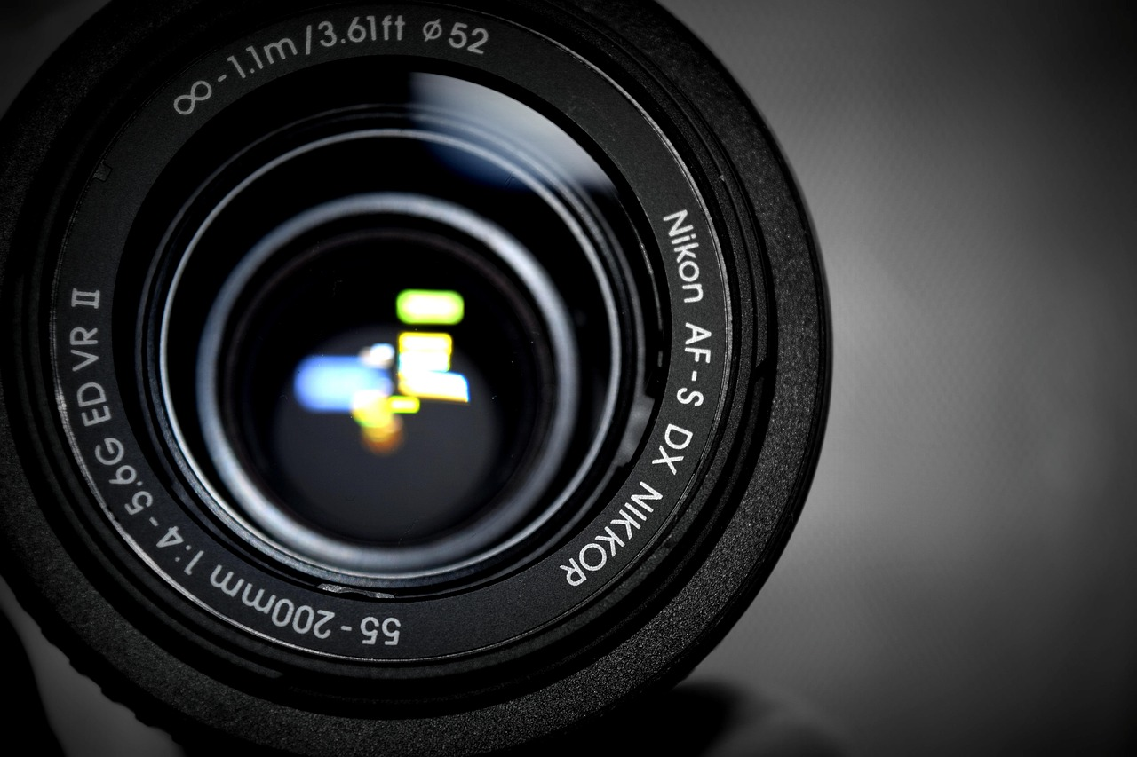
Purpose, Audience, and Learning Objectives
This opening slide frames the presentation goals: to explain the stages of the salmon life cycle, highlight ecological and cultural importance, and present pra…
Define presentation goals and target audiences
Set three measurable learning objectives
Recommend timing, activities, and assessments
Advise presenters on tailoring technical detail
Note that research sources underpin later slides
Notes:
This opening slide frames the presentation goals: to explain the stages of the salmon life cycle, highlight ecological and cultural importance, and present practical conservation actions. It identifies the intended audience — middle and high school students, educators, resource managers, and community stakeholders — and sets measurable learning outcomes: learners will be able to list the major life stages of salmon, describe the habitat requirements at each stage, and explain human impacts and mitigation strategies. The slide establishes structure for the deck and includes guidance on time allocation, recommended activities, and suggested assessment prompts (formative quiz items and a brief project prompt). This slide also notes sources used for the scientific descriptions that follow and advises presenters to adapt technical depth to the group's background. It prepares the audience for the more detailed, research-grounded slides that follow and emphasizes that images, diagrams, and local data should be added when converting this outline into a live slide deck.

Slide 3
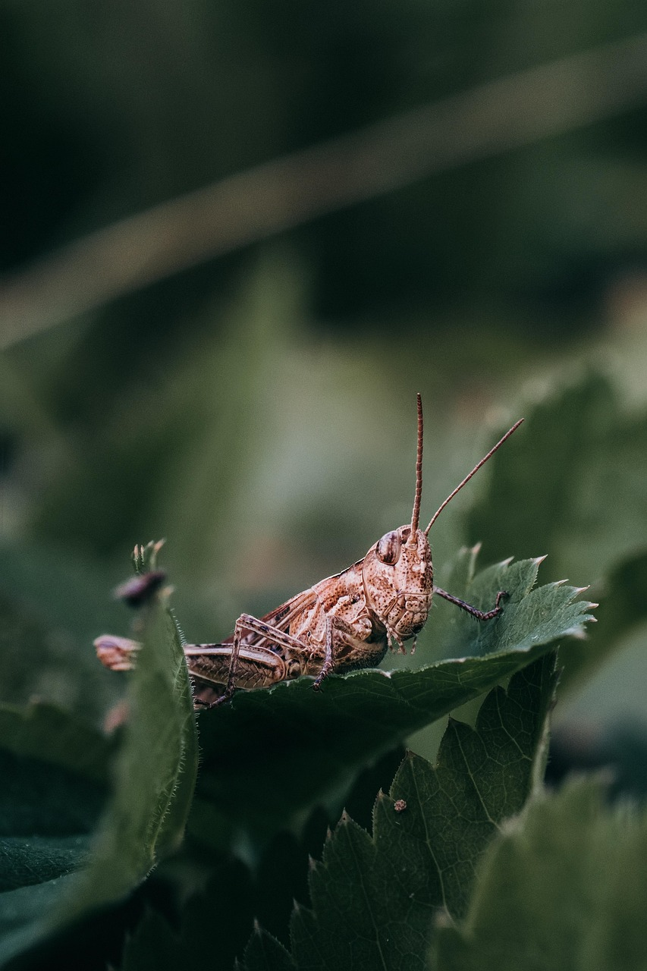
Salmon Biology and Key Terms
anadromy (freshwater spawning, ocean growth), natal homing, and life-stage nomenclature (egg, alevin, fry, parr, smolt, adult, spawning adult). It presents qui…
Define anadromy, natal homing, and life-stage names
Summarize regional species diversity and size variation
Clarify measurement and age-class terminology
Connect terms to later-stage habitat needs
Recommend a simple glossary slide for novices
Notes:
anadromy (freshwater spawning, ocean growth), natal homing, and life-stage nomenclature (egg, alevin, fry, parr, smolt, adult, spawning adult). It presents quick facts to ground the audience: salmon are anadromous fish that migrate between freshwater and the ocean to complete their life cycle; the Google Slides summary used in our research context emphasizes that salmon always return to their natal stream to spawn. The SlideServe presentation referenced in our research notes that there are six species of salmon in the Pacific Northwest and highlights Chinook as the largest species, with individuals sometimes exceeding 6 feet in length and very large weights in exceptional cases. This slide clarifies taxonomic and geographic scope and defines common measurement terms (length, weight, age classes) so the audience can interpret later content about growth and survival. Presenter note: include images of species differences and a short glossary of terms for non-technical audiences.

Slide 4
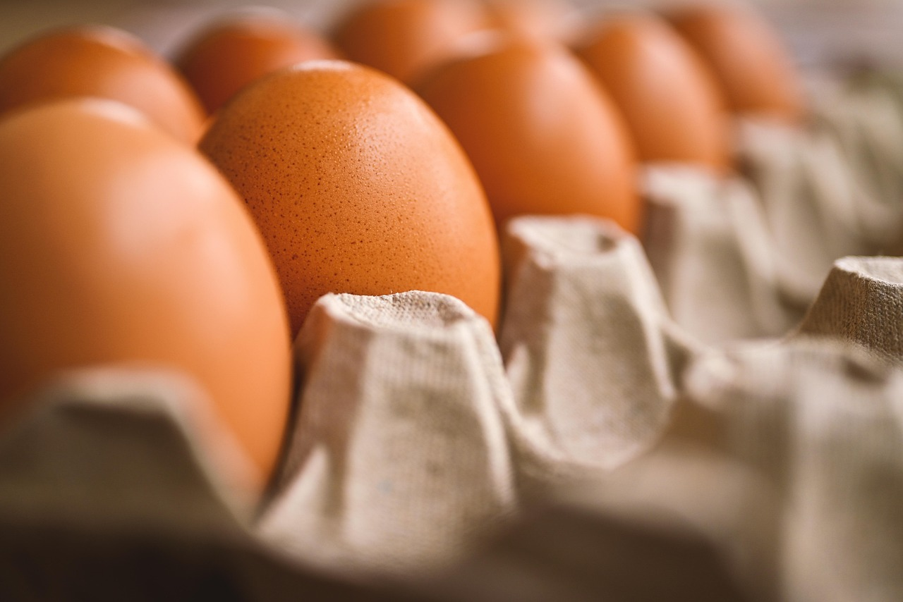
Egg Deposition and Incubation
egg survival rates, substrate composition, and water temperature logs.
Explain redd construction and external fertilization
Summarize incubation timing (6–12 weeks typical)
List substrate and flow requirements for eggs
Identify threats: siltation, temperature, dewatering
Recommend monitoring metrics and demonstration ideas
Notes:
egg survival rates, substrate composition, and water temperature logs.

Slide 5

Alevin: Development Inside the Gravel
newly hatched salmon that still depend on yolk sacs for nutrition. According to the SlideShare and Google Slides resources used in our research context, eggs h…
Describe alevin physiology and yolk-sac dependence
Emphasize need for stable, oxygenated gravel habitat
Cite research context descriptions of alevin behavior
List threats: sedimentation and flow disruption
Suggest observation methods and ethical activities
Notes:
newly hatched salmon that still depend on yolk sacs for nutrition. According to the SlideShare and Google Slides resources used in our research context, eggs hatch into alevin that remain in the gravels while absorbing large yolk sacs. The slide explains physiological and behavioral characteristics of alevin: limited mobility, translucent appearance in many species, and reliance on yolk-derived energy while gill structures and other organs complete development. Habitat requirements emphasize stable gravel interstices and cool, oxygenated water; disruption of the redd by foot traffic, sedimentation, or heavy flow events can disproportionately affect alevin. The slide also discusses detection methods (careful redd observation, controlled egg-box experiments), ethical considerations for handling, and classroom activities to demonstrate energy reserves and metamorphosis without disturbing natural nests.

Slide 6
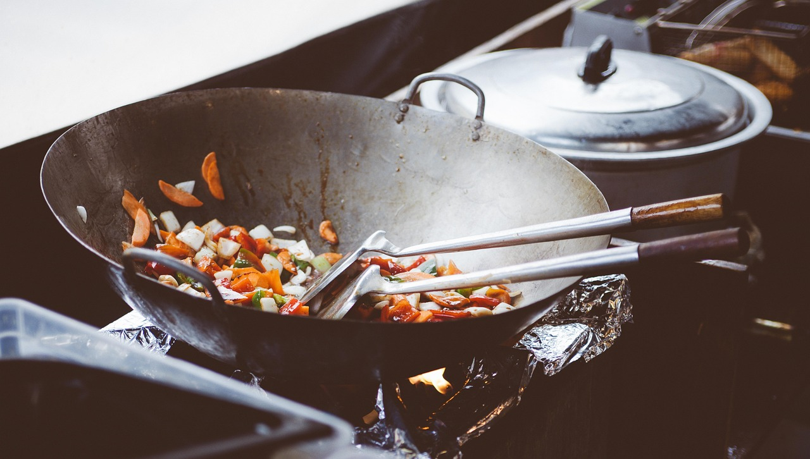
Fry: Emergence and Early Rearing
shallow riffles and stream margins with abundant macroinvertebrate prey, cover from predators (overhanging vegetation, woody debris), and suitable flow velocit…
Explain transition from yolk-dependent to active feeding
Describe fry habitat: riffles, margins, and cover
Link food availability to growth and survival
Identify human impacts reducing fry habitat
Recommend habitat restoration measures
Notes:
shallow riffles and stream margins with abundant macroinvertebrate prey, cover from predators (overhanging vegetation, woody debris), and suitable flow velocities for foraging. The slide highlights growth rates and the importance of food availability: well-fed fry develop more quickly into parr, improving survival odds during downstream migration. It also covers anthropogenic impacts that reduce fry habitat quality, such as channelization, bank hardening, and removal of large wood, and recommends restoration actions — reestablishing floodplain connectivity, restoring riparian vegetation, and adding in-stream complexity to increase foraging opportunities and refugia.

Slide 7
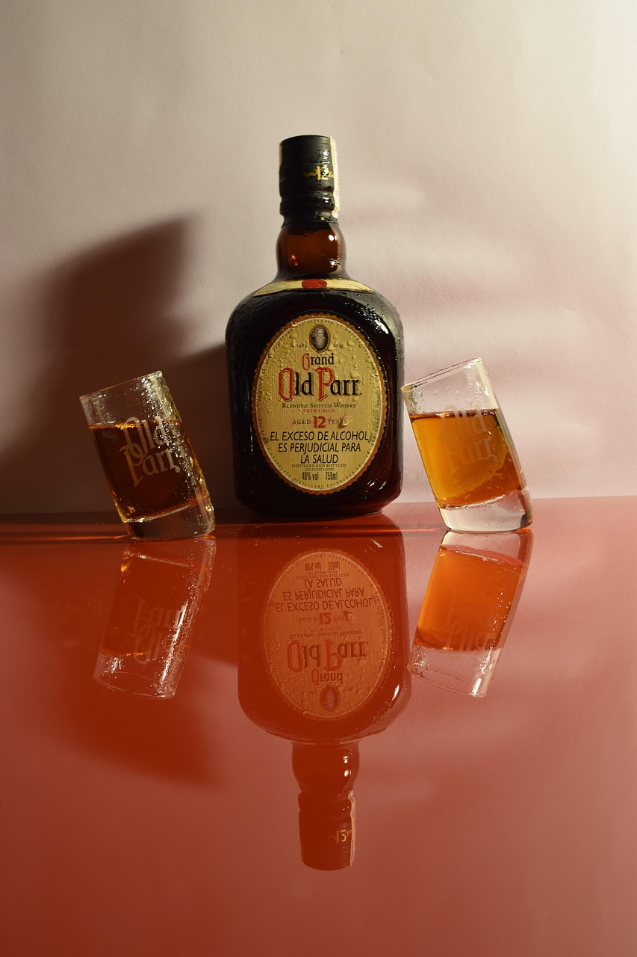
Parr: Freshwater Growth and Markings
parr occupy stream reaches with structured habitat, feed on aquatic and terrestrial insects, and establish small home ranges. Age-at-smoltification varies amon…
Describe parr marks and freshwater growth patterns
Explain variable age-at-smoltification among populations
List key habitat needs: structure, food, stable flows
Provide common growth metrics for monitoring
Discuss management levers that affect parr survival
Notes:
parr occupy stream reaches with structured habitat, feed on aquatic and terrestrial insects, and establish small home ranges. Age-at-smoltification varies among species and populations; some exhibit yearling smolt migration while others rear multiple years as parr. The slide covers growth metrics used by biologists (fork length, weight, condition index), predation and competition pressures, and management implications: flow regimes, habitat complexity, and food-web integrity strongly influence parr survival and the timing of smoltification.

Slide 8

Smoltification: Physiological Change and Migration
This slide explains smoltification — the physiological and behavioral transition that prepares juveniles for marine life — and the downstream migration that fo…
Define smoltification and key physiological changes
Describe migration cues and estuarine bottlenecks
Cite source descriptions of silvering and adaptation
Summarize monitoring tools: trapping, PIT tags, otoliths
Recommend estuary restoration and flow management
Notes:
This slide explains smoltification — the physiological and behavioral transition that prepares juveniles for marine life — and the downstream migration that follows. The research context presentations emphasize that smolts change appearance (often turning silver) and physiology (osmoregulatory adaptations) prior to entering the ocean; the SlideShare and Google Slides materials explicitly note this silvering and transition. This slide describes cues that trigger smoltification (photoperiod, temperature, and growth conditions), the physiological changes (ion regulation, schooling behavior, morphological changes), and the downstream migration pathways through estuaries to the ocean. It highlights critical bottlenecks at the estuary interface where predation, altered flow regimes, and habitat degradation can cause mortality. Practical monitoring methods — smolt traps, PIT tagging, and otolith microchemistry to track freshwater residence and marine entry — are summarized, as are mitigation strategies such as flow management and estuary restoration to improve smolt survival.

Slide 9
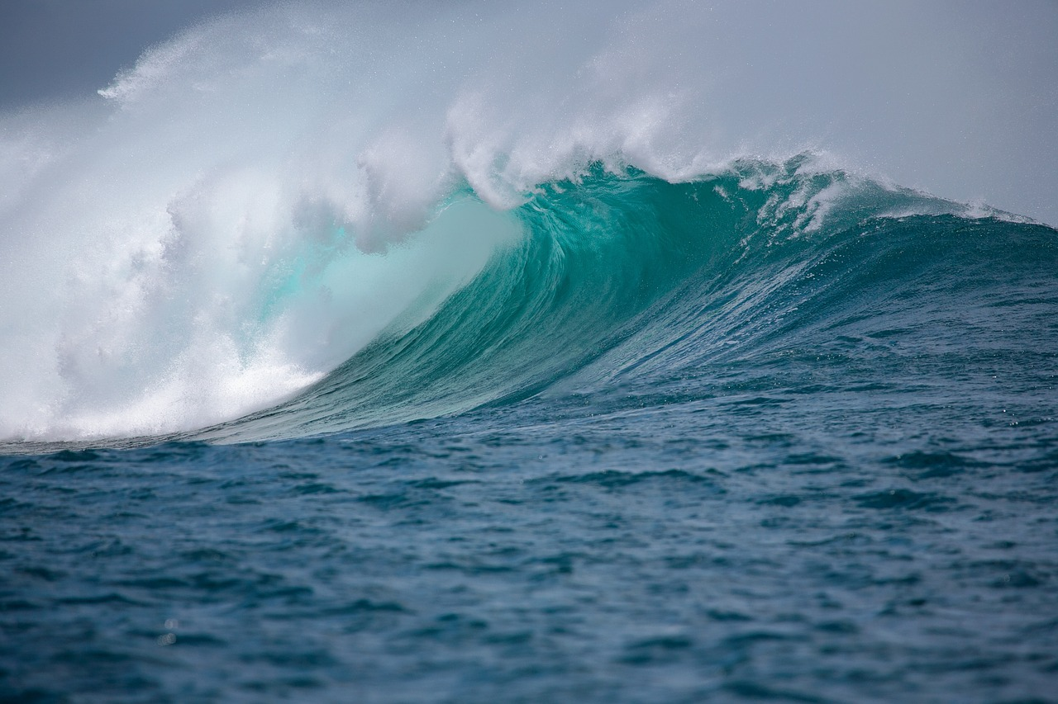
Ocean Phase: Growth, Diet, and Mortality
predation, bycatch in fisheries, disease, and changing ocean conditions (temperature shifts, prey availability). The slide concludes with monitoring approaches…
Describe ocean habitats and diet shifts for growth
Connect marine productivity to growth and size outcomes
Cite classroom sources noting Chinook size potential
Identify ocean-phase mortality drivers and monitoring
Highlight adaptive management for variable marine survival
Notes:
predation, bycatch in fisheries, disease, and changing ocean conditions (temperature shifts, prey availability). The slide concludes with monitoring approaches (fisheries catch data, tagging programs, and integrated stock assessments) and points to adaptive fisheries management that considers marine survival trends.

Slide 10
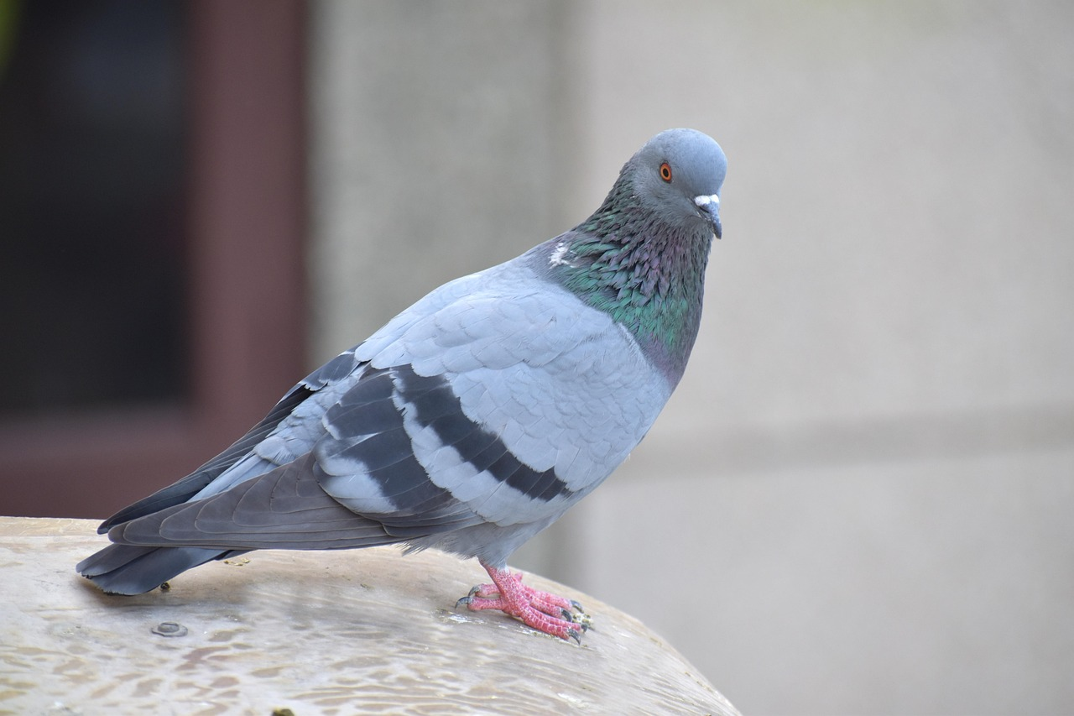
Homing, Spawning Migration, and Senescence
This slide describes the adult return migration, homing behavior, and terminal spawning events. Research summaries used in preparing this deck emphasize that s…
Explain natal homing and navigational cues for returns
Describe energy constraints during upriver migration
Summarize spawning behavior and post-spawn senescence
Identify migration barriers and flow-management needs
Recommend targeted actions: passage projects and timed flows
Notes:
This slide describes the adult return migration, homing behavior, and terminal spawning events. Research summaries used in preparing this deck emphasize that salmon return to their natal streams to spawn; the Google Slides life-cycle presentation and other classroom summaries underscore this natal homing. The slide outlines navigational cues (olfactory imprinting, geomagnetic inputs, and environmental conditioning), the energetics of non-feeding upriver migrations, and the construction of redds by returning adults. It explains species- and population-specific timing windows for runs, mating systems, and the typical senescent die-off after spawning that completes the semelparous life cycle for Pacific salmon. Management implications covered include barriers to migration (dams, culverts), the impacts of reduced freshwater flows on migration success, and strategic actions such as fish passage improvements and timed flow releases to support migration.

Slide 11
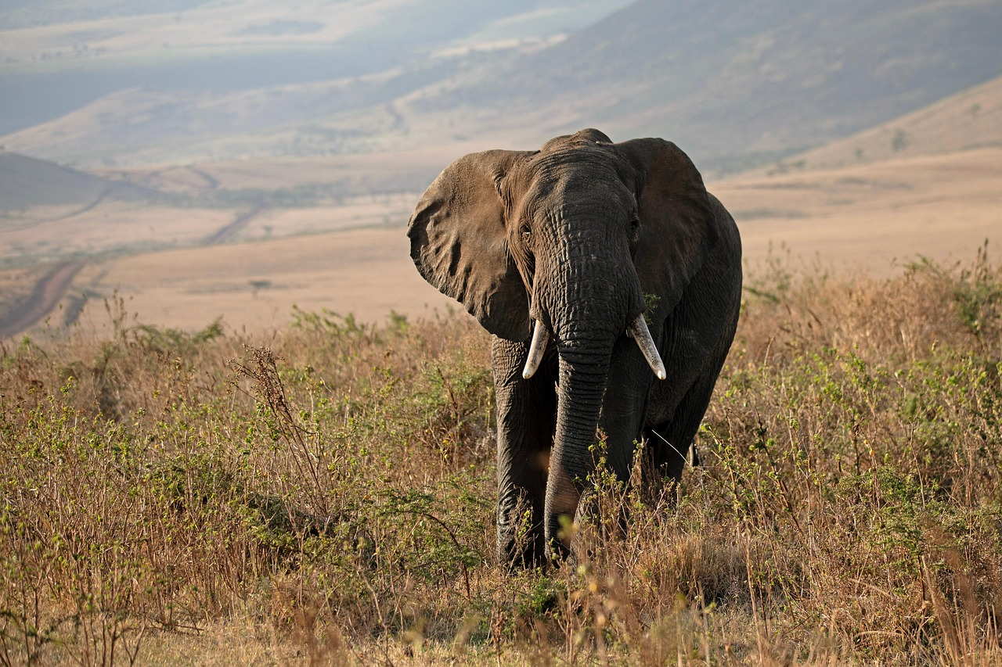
Threats, Conservation Strategies, and Community Actions
This final substantive slide synthesizes threats across life stages and outlines conservation strategies and community-level actions. Drawing on the aggregated…
List cross-cutting threats across all life stages
Summarize habitat- and population-level conservation tactics
Advocate community science and stakeholder engagement
Suggest success metrics: SARs, redd counts, juvenile surveys
Provide next steps for localized action planning
Notes:
This final substantive slide synthesizes threats across life stages and outlines conservation strategies and community-level actions. Drawing on the aggregated classroom and PPT resources in the research context, it enumerates primary stressors: habitat loss and fragmentation, water withdrawals and altered flows, sedimentation and poor water quality, hatchery interactions, overfishing and bycatch, and climate-driven changes in stream and ocean conditions. The slide surveys proven and emerging approaches: riparian and floodplain restoration, barrier removal and fish passage retrofit, flow augmentation, estuary rehabilitation, and adaptive harvest management informed by monitoring. It also emphasizes community engagement measures — citizen science monitoring, landowner outreach on riparian practices, and cross-jurisdictional coordination — and suggests metrics for evaluating success, such as smolt-to-adult return rates, redd counts, and juvenile density trends. The slide closes with guidance for developing localized action plans that translate the life-stage insights from earlier slides into priority interventions.

Slide 12
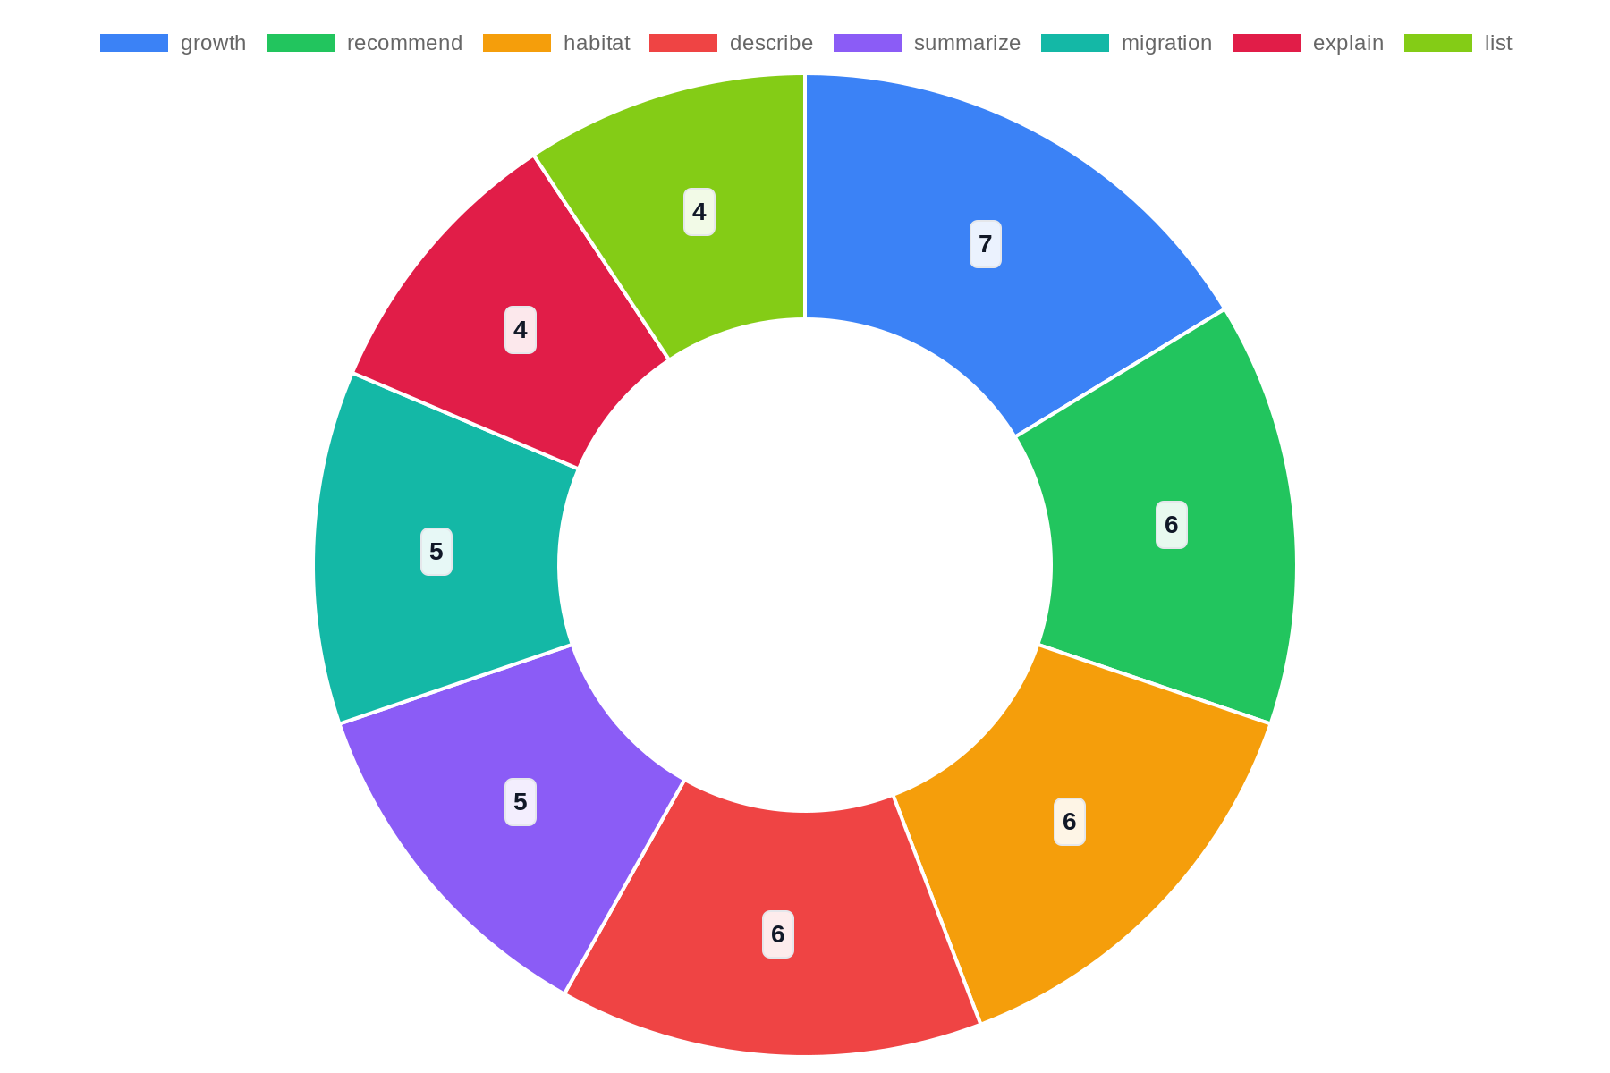
Top Topics

Slide 13
References
https://www.slideserve.com/oleg-barnett/the-life-cycle-of-salmon
https://docs.google.com/presentation/d/16jl5JwAd-V4WbJINrBBsB9oqp5SM-Fq9yjjCA8W7jC4/htmlpresent
https://www.slideshare.net/slideshow/the-salmon-life-cycle/24955928
https://www.scribd.com/presentation/714397908/Life-Cycle-of-A-Salmon
https://sciencewithmsforehand.weebly.com/uploads/3/1/6/2/31627175/salmon_life_cycle_ppt_teacher.pptx
https://www.scribd.com/presentation/714397908/Life-Cycle-of-a-Salmon
https://www.riverdee.org.uk/f/documents/Salmon-Life-Cycle-PPT-Lesson.pptx
https://www.dfw.state.or.us/fish/STEP/docs/E2F_Volunteer_Guide_PP1_Salmonid_Life_Cycle.ppt
https://www.slideserve.com/ardice/salmon-life-cycle

