Slide 1
Best Practices in Pharmacy in 2025: A Canadian Perspective
Generated by AgentFire AI

Slide 2

Introduction to Pharmacy Practices in 2025
Overview of the pharmacy industry
Evolution over the past decade
Importance of adapting to new practices

Slide 3
Current Trends in Canadian Pharmacy
Rise of telepharmacy services
Integration of AI and machine learning
Focus on patient-centered care

Slide 4
Technological Innovations
Electronic prescriptions and digital health records
Utilization of robotics for dispensing
Blockchain in supply chain management

Slide 5

Telepharmacy: Expanding Access

Slide 6
AI and Machine Learning in Pharmacy

Slide 7
Regulatory Changes and Compliance
Updates in pharmaceutical regulations
Ethical considerations
Ensuring compliance with digital health practices

Slide 8

Patient-Centered Care Approaches
Personalized medicine
Enhanced consultation services
Chronic disease management

Slide 9
Sustainability in Pharmacy Operations
Reducing carbon footprint in pharmaceutical processes
Sustainable supply chains
Eco-friendly packaging

Slide 10
Impact of Digital Health Records

Slide 11
Conclusion and Future Outlook
Summary of key practices
Future growth and trends
Recommendations for pharmacists

Slide 12
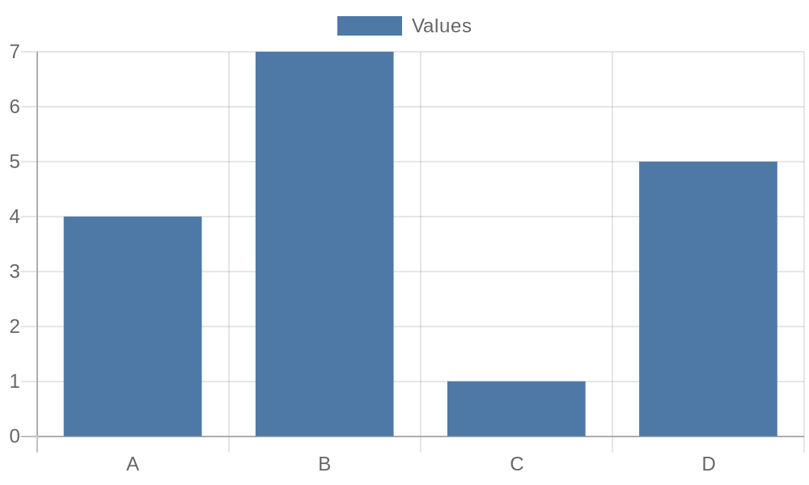
Additional Data 3

Slide 13
Additional Data 4

Slide 14
Additional Data 5

