Slide 1
Best Pharmacy Practices 2025: Strategy, Operations, and Compliance
Generated by AgentFire AI

Slide 2
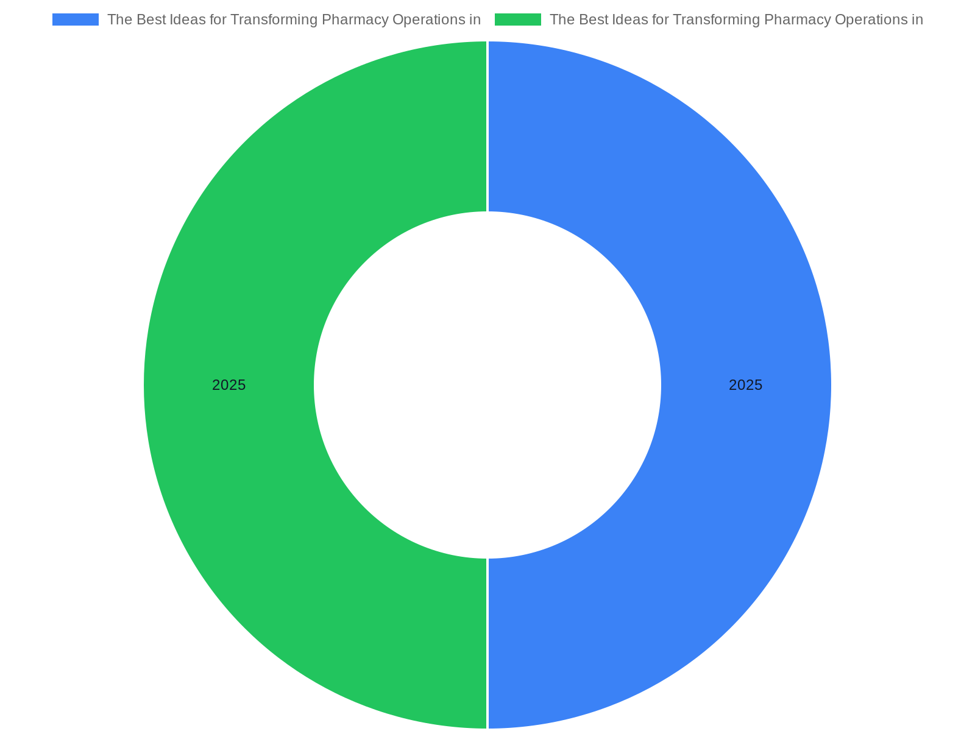
Executive summary: imperatives for 2025
Research context: The Best Ideas for Transforming Pharmacy Operations in 2025 emphasizes that to thrive in 2025 pharmacies must become more data driven and pat…
Consolidated strategic priorities: tech, patient focus, operations, compliance
Short-term wins vs long-term transformation: governance guidance
Expected investments: interoperability, workforce training, service expansion
Primary measures: patient outcomes, fill time, revenue per visit
Risk focus: regulatory changes and documentation readiness
Notes:
Research context: The Best Ideas for Transforming Pharmacy Operations in 2025 emphasizes that to thrive in 2025 pharmacies must become more data driven and patient centric, optimize operations, diversify services, and navigate regulatory challenges. This slide synthesizes those imperatives into a concise view of priorities for leaders preparing budgets, staffing plans, and technology roadmaps. It highlights the convergence of three forces: accelerated technology adoption (automation, analytics, and integration), shifting service mix (clinical services, home delivery, and telepharmacy), and an intensified compliance environment requiring proactive policy and documentation updates. The summary frames the rest of the presentation by listing clear strategic objectives, near-term investments, and measures of success that pharmacy leaders should adopt this year. It sets expectations for what follows: tactical steps for IT and workflows, people and culture interventions, regulatory risk mitigation, and commercial/service diversification. The summary also frames trade-offs—investing in electronic interoperability may require deferring nonessential capital projects; expanding clinical services requires new credentialing and payer engagement—and suggests governance mechanisms to balance operational continuity with innovation. Finally, it identifies quick wins and high-impact investments with short payback timelines to sustain momentum while larger transformation initiatives proceed.

Slide 3
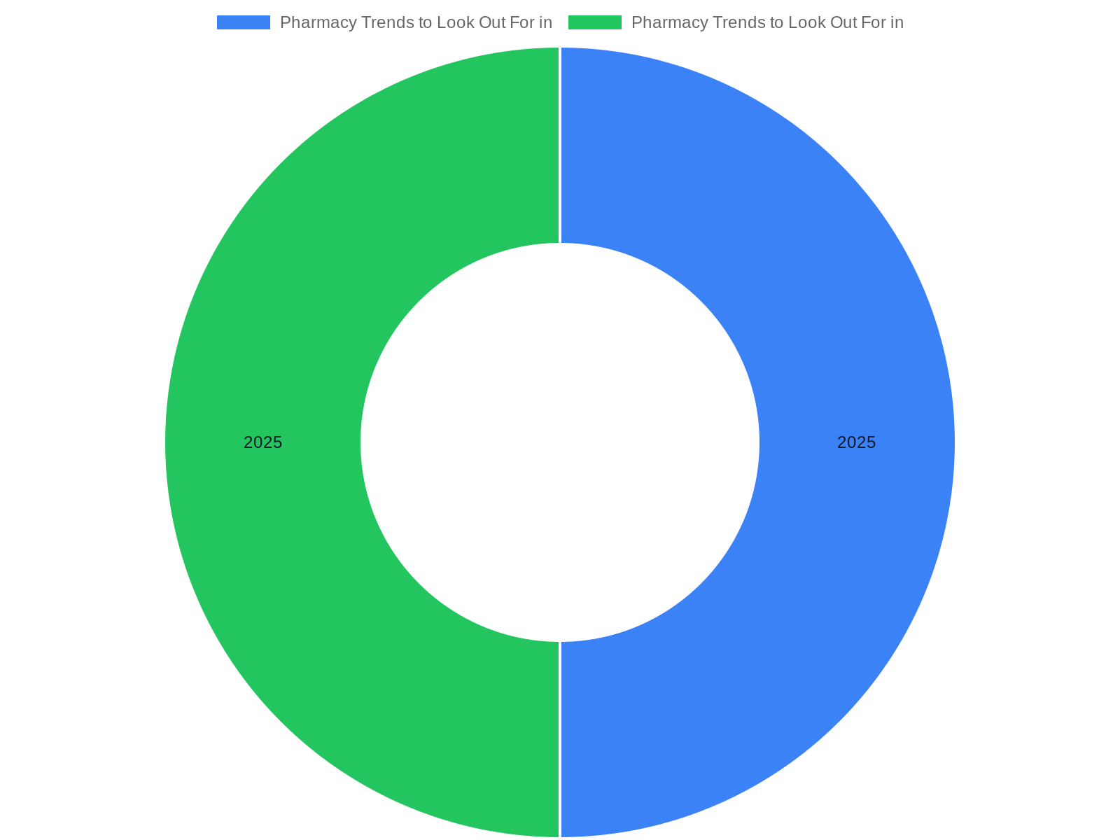
Technology & data infrastructure: foundation for scale
Research context: Pharmacy Trends to Look Out For in 2025 (and PioneerRx Features That Can Help) and The Best Ideas for Transforming Pharmacy Operations in 202…
API-first pharmacy systems and prioritized EHR interfaces
Unified clinical-transactional database and analytics layer
Data governance: identifiers, coding, consent, PDMP linkage
Phased sequencing: core interfaces, automation, predictive tools
Vendor selection criteria: interoperability, support SLAs
Notes:
Research context: Pharmacy Trends to Look Out For in 2025 (and PioneerRx Features That Can Help) and The Best Ideas for Transforming Pharmacy Operations in 2025 both underscore that pharmacies must accelerate technology adoption and build data capabilities. This slide describes the specific infrastructure components that leaders should prioritize: modern dispensing systems with API-first integration, a unified clinical and transactional database, analytics for adherence and inventory optimization, and secure patient engagement platforms. It explains integration priorities—pharmacy management systems, EHRs, lab interfaces, and payer portals—and provides guidance on selecting vendors with robust interoperability and open APIs. The narrative emphasizes data governance: master patient index, consistent medication codings, consent and privacy controls, and a single source of truth for medication histories to enable safe clinical decision support. It also discusses pragmatic sequencing: start with interfacing your core pharmacy system to the most-used EHRs and the state PDMP, then expand to automated dispensing and predictive analytics. The slide enumerates technical debt assessments, total cost of ownership considerations, and the need for in-house or contracted analytics expertise to convert data into action. It concludes with operational expectations for uptime, backup, and business continuity in a patient-facing environment.

Slide 4
Patient-centric care models and engagement
Research context: The Best Ideas for Transforming Pharmacy Operations in 2025 highlights the need for pharmacies to be more patient centric; practical trends d…
Segment patients by clinical and adherence risk
Automate routine outreach; reserve pharmacists for exceptions
Implement telepharmacy and home delivery for access
Measure patient outcomes and align reimbursement
Pilot, measure, and scale successful patient services
Notes:
Research context: The Best Ideas for Transforming Pharmacy Operations in 2025 highlights the need for pharmacies to be more patient centric; practical trends documented in industry sources include expanded clinical services, telepharmacy, and personalized adherence interventions. This slide describes a framework for making care more patient centric: segmentation of patient populations by risk and service needs; creating tailored touchpoints such as adherence calls, automated reminders, and virtual counseling; and deploying outcome-focused metrics (e.g., avoidance of hospital readmission, adherence increases). It also covers how to operationalize patient centricity within limited staffing: use technology to automate routine communications, train technicians for specific counseling tasks, and create standardized protocols so pharmacists spend time on clinical exceptions. The slide addresses equity and access: multilingual communication, home delivery for mobility-limited patients, and virtual access for rural populations. It provides steps for piloting new patient services, including setting inclusion criteria, measuring clinical and financial outcomes, and scaling successful models into standard operating procedure. Finally, it suggests aligning reimbursement strategies and payer contracting to sustain expanded patient-centered services.

Slide 5
Operational optimization & workflow redesign
Research context: The Best Ideas for Transforming Pharmacy Operations in 2025 and several workflow-focused resources recommend optimizing operations through wo…
Standardize dispensing steps; allocate tasks by role
Target automation for high-volume, repetitive tasks
Use daily huddles and visual management to track flow
Cross-train staff and redesign workspace for efficiency
Monitor KPIs: fill time, accuracy, labor per script
Notes:
Research context: The Best Ideas for Transforming Pharmacy Operations in 2025 and several workflow-focused resources recommend optimizing operations through workflow redesign, automation, and clearer role definitions. This slide details approaches to reduce cycle time, minimize errors, and improve throughput: standardize core dispensing steps, create role-based task allocation (technician, pharmacist, clerk), and introduce automation where it yields highest ROI (packaging, labeling, inventory replenishment). It also outlines techniques for continuous improvement: daily huddles, visual workflow boards, and time-motion studies to identify bottlenecks. The slide emphasizes balancing automation and human oversight — deploy robotics for repetitive tasks but maintain pharmacist review for clinical checks. It provides guidance on layout optimization for retail and outpatient settings, queue management strategies for peak hours, and cross-training to handle fluctuations in demand. Operational KPIs to track include fill time, accuracy rate, queue length, and labor minutes per script. Finally, it addresses change management—communicating goals, documenting new SOPs, and using pilot areas to prove benefits before systemwide rollout.

Slide 6
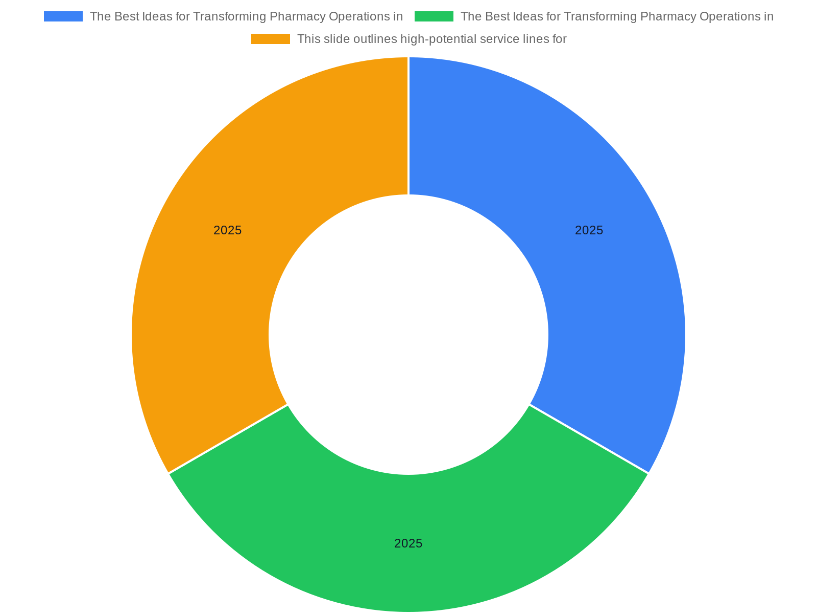
Service diversification & new revenue streams
Research context: The Best Ideas for Transforming Pharmacy Operations in 2025 calls for diversifying services to remain competitive; the PioneerRx materials id…
High-potential services: immunizations, MTM, test-and-treat
Billing readiness: documentation templates and codes
Assess scope of practice and credentialing before launch
Pilot services, measure clinical & financial outcomes
Consider hybrid retail-clinic and digital subscription models
Notes:
Research context: The Best Ideas for Transforming Pharmacy Operations in 2025 calls for diversifying services to remain competitive; the PioneerRx materials identify practical product and service features that enable that diversification. This slide outlines high-potential service lines for 2025 and the operational and financial considerations for each: expanded immunization and preventive services, chronic care management and medication therapy management (MTM), test-and-treat programs on appropriate state protocols, point-of-care testing, and specialty pharmacy partnerships. It explains payer and billing implications—how to document clinical encounters, submit CPT codes or other appropriate claims, and collect appropriate patient consent. The slide also discusses hybrid retail-clinic models that co-locate clinical services and the pharmacy, and digital-first services such as medication synchronization and subscription models for chronic therapy. For each service line it provides readiness checks: regulatory authority and state scope of practice, staff credentials, inventory and supply chain needs, documentation templates, and a basic pricing/rate card approach. Finally, it gives a staged go-to-market approach: pilot, measure clinical and revenue results, refine SOPs, then scale and market to the patient base.

Slide 7

Regulatory compliance and risk management
Research context: The NABP Targeting Best Practices Webinar Handout and ASHP forecast materials emphasize that regulatory complexity is increasing and that pha…
Maintain a regulatory inventory and policy review calendar
Integrate PDMPs and document controlled substance workflows
Use audits and system logs for proactive monitoring
Designate compliance owner and executive oversight
Embed incident reporting and corrective actions into SOPs
Notes:
Research context: The NABP Targeting Best Practices Webinar Handout and ASHP forecast materials emphasize that regulatory complexity is increasing and that pharmacies must proactively manage compliance risk. This slide presents a structured compliance program: inventory of applicable regulations (federal, state boards, DEA, payers), a schedule for policy review and SOP updates, role-based training programs, and an incident reporting and corrective action workflow. It addresses specific risk areas for 2025—controlled substances management in the era of telehealth, PDMP integration expectations, vaccine documentation and cold-chain stewardship, and expanded clinical services that require new documentation standards. The slide outlines monitoring mechanisms: routine audits, targeted sampling, and use of pharmacy management system logs for exception reporting. It also recommends governance: compliance officer designation, executive oversight, and periodic external compliance reviews. For practical implementation the slide offers templates: a policy review calendar, an audit checklist, and a sample corrective action plan to remediate identified gaps. The emphasis is on embedding compliance into daily operations rather than treating it as periodic checkbox activity.

Slide 8

Workforce development, roles, and culture
Research context: The ASHP Student Pharmacy Forecast Workshop slides and other industry commentary highlight workforce pressures and the need for new role defi…
Redefine roles; elevate technician responsibilities with training
Create competency frameworks and career ladders
Use flexible staffing models and contingency plans
Drive change with cross-functional pilot teams
Measure staff competency, productivity, and engagement
Notes:
Research context: The ASHP Student Pharmacy Forecast Workshop slides and other industry commentary highlight workforce pressures and the need for new role definitions, training, and retention strategies. This slide outlines a workforce plan to support expanded services and technology adoption: role redesign to elevate technicians, competency frameworks for new clinical tasks, ongoing training pathways for pharmacists on population health and reimbursement, and career ladders tied to new responsibilities. It addresses recruitment and retention: flexible scheduling, focused on-work training time, and recognition programs for quality outcomes. The slide also covers culture and change management—creating cross-functional teams to lead pilots, communicating early wins, and soliciting frontline input on SOPs. Additionally, it provides practical recommendations for staffing models under different volumes (community retail, outpatient clinic, and high-volume specialty), contingency planning for vacations and surges, and use of per-diem or contract clinicians to cover specialized services. Finally, the slide recommends measurement of workforce effectiveness using competency checklists, service financial contribution per FTE, and staff engagement surveys to ensure culture aligns with strategic goals.

Slide 9

Pharmacy safety, quality assurance, and targeting best practices
Research context: The NABP Targeting Best Practices Webinar Handout and other safety-focused resources stress the importance of systematic safety programs. Thi…
Implement error reporting and RCA for significant events
Use barcode verification and tuned automated alerts
Target high-risk medication classes for focused interventions
Maintain standardized counseling and competency rechecks
Integrate safety data into continuous improvement cycles
Notes:
Research context: The NABP Targeting Best Practices Webinar Handout and other safety-focused resources stress the importance of systematic safety programs. This slide describes an integrated safety and quality framework: error reporting systems, root cause analysis (RCA) for significant events, standardized double-checks for high-risk medications, and continuous monitoring of near-miss data to identify system vulnerabilities. It includes medication safety tactics such as barcode verification, automated alerts tuned to reduce alert fatigue, prefilled counseling scripts for high-risk therapies, and periodic competency re-assessments for staff involved in clinical dispensing. The slide recommends a targeting approach: use data to identify high-volume, high-risk medication classes (e.g., anticoagulants, opioids) and design focused interventions. It also outlines communication expectations for safety events—timely internal notification, patient outreach as required, and documentation to support corrective action. In addition, the slide explains how integrating safety monitoring with analytics from pharmacy systems can reveal patterns over time and allow targeted training or workflow changes before events recur. Practical tools include a near-miss dashboard, RCA templates, and a schedule for safety drills and audits.

Slide 10
Metrics, analytics, and performance measurement
Research context: The Best Ideas for Transforming Pharmacy Operations in 2025 recommends becoming more data driven; this slide defines a practical metrics arch…
Core KPIs: fill time, accuracy, adherence, revenue per visit
Assign ownership for each metric and set quarterly targets
Build phased dashboards from operational to clinical metrics
Use cohort analysis to link interventions to outcomes
Leverage metrics to inform training and process changes
Notes:
Research context: The Best Ideas for Transforming Pharmacy Operations in 2025 recommends becoming more data driven; this slide defines a practical metrics architecture to translate that recommendation into actionable dashboards. It describes essential metric categories: operational (fill time, accuracy, inventory turns), clinical (adherence rates, immunization rates, MTM outcomes), financial (revenue per transaction, margin by service line), and regulatory/compliance metrics (audit findings, PDMP query completion). The slide provides advice on metric selection and governance—avoid vanity metrics, tie each KPI to a named owner, and set quarterly targets with revision cycles. It also covers analytic capability needs: time-series reporting, cohort analysis for patient outcomes, and drill-down capabilities to correlate staffing and workflow with outcomes. The slide suggests a phased dashboard rollout—start with a core operations dashboard, then add clinical and financial views as data quality permits. Finally, it emphasizes feedback loops: use metrics to inform training, process redesign, and vendor SLAs, and report outcomes to leadership and frontline teams to sustain engagement.

Slide 11
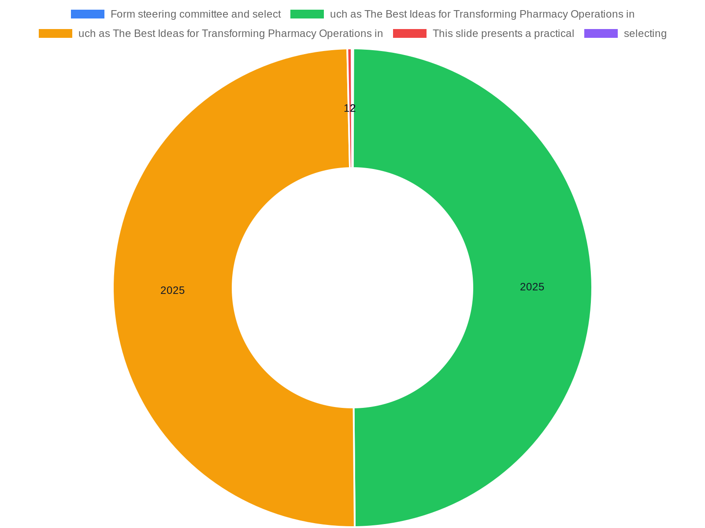
Implementation roadmap and pilot design
Research context: Industry thought pieces such as The Best Ideas for Transforming Pharmacy Operations in 2025 and vendor guidance in PioneerRx emphasize piloti…
Form steering committee and select 2–3 measurable pilots
Apply agile cycles: plan, pilot, measure, iterate
Define success criteria across clinical, financial, and ops
Scale by geography/service after pilot thresholds met
Include regulatory and payer checkpoints in timeline
Notes:
Research context: Industry thought pieces such as The Best Ideas for Transforming Pharmacy Operations in 2025 and vendor guidance in PioneerRx emphasize piloting and phased implementations. This slide presents a practical 12–18 month roadmap for implementation across technology, operations, services, and compliance. It recommends forming a steering committee, selecting 2–3 pilot initiatives with measurable outcomes, and applying agile cycles (plan, pilot, measure, iterate). Typical pilot choices include: (1) medication synchronization plus adherence outreach; (2) a telepharmacy counseling pilot tied to a chronic disease cohort; and (3) automated dispensing integration for weekend fills. The slide outlines pilot success criteria—predefined clinical and financial targets, staff competency benchmarks, and patient satisfaction thresholds—and specifies data collection plans and evaluation cadence. It provides guidance on scaling: expand pilots in phased geographies or service lines after meeting thresholds, document revised SOPs, and transition from project to BAU governance. The roadmap includes checkpoints for regulatory review and payer engagement to ensure reimbursement channels are established prior to wide release.

Slide 12
Financial planning and return-on-investment
Research context: The Best Ideas for Transforming Pharmacy Operations in 2025 and related vendor materials stress balancing upfront investments with sustainabl…
Model costs: capital, implementation, training, and maintenance
Forecast revenues: new services, improved throughput, retention
Validate assumptions: uptake, reimbursement, productivity timelines
De-risk via phased payments, pilots, and subscription models
Track ROI across financial and risk-reduction benefits
Notes:
Research context: The Best Ideas for Transforming Pharmacy Operations in 2025 and related vendor materials stress balancing upfront investments with sustainable revenue models. This slide explains how to build a conservative financial case for transformation projects: estimate initial capital and operating costs (software, hardware, training), forecast incremental revenues from new services and efficiency gains, and compute payback periods under different adoption scenarios. It highlights common assumptions to validate—patient uptake rates for clinical services, reimbursement levels, and time-to-productivity for cross-trained staff. The slide also presents methods to de-risk investments: phased vendor payments tied to milestones, pilot-funded expenditures, and use of lease or subscription models to preserve capital. It recommends tracking ROI not only in financial terms but also in operational resilience and risk reduction (fewer audit penalties, fewer safety events). Lastly, it suggests integrating financial metrics into the governance cadence so that investment decisions are revisited as business contexts shift.

Slide 13

Communication, stakeholder alignment, and change management
Research context: ASHP forecast materials and industry reviews emphasize that technology and service transformation succeed when stakeholders are aligned and c…
Map stakeholders and tailor messages by audience
Maintain regular cadence: leadership, frontline, patient comms
Use pilot champions and job aids to accelerate adoption
Collect feedback and iterate SOPs to reduce resistance
Recognize teams that achieve pilot milestones
Notes:
Research context: ASHP forecast materials and industry reviews emphasize that technology and service transformation succeed when stakeholders are aligned and change is managed deliberately. This slide lays out a communications and stakeholder alignment plan: identify internal stakeholders (pharmacists, technicians, operations, finance, IT), external stakeholders (payors, prescribers, regulators, patients), and craft audience-specific messages about why changes are happening, what will change, and how success will be measured. It outlines cadence and channels—regular leadership updates, frontline huddles, job aids, and patient-facing messaging for new services. The slide also includes training plans tied to role-based competencies and suggests using pilot champions to surface issues early. It gives guidance on handling resistance: gather feedback, present pilot data, and iterate SOPs to reflect practical realities. Finally, it recommends a celebration and recognition plan for teams that meet pilot objectives to sustain engagement for broader rollouts.

Slide 14
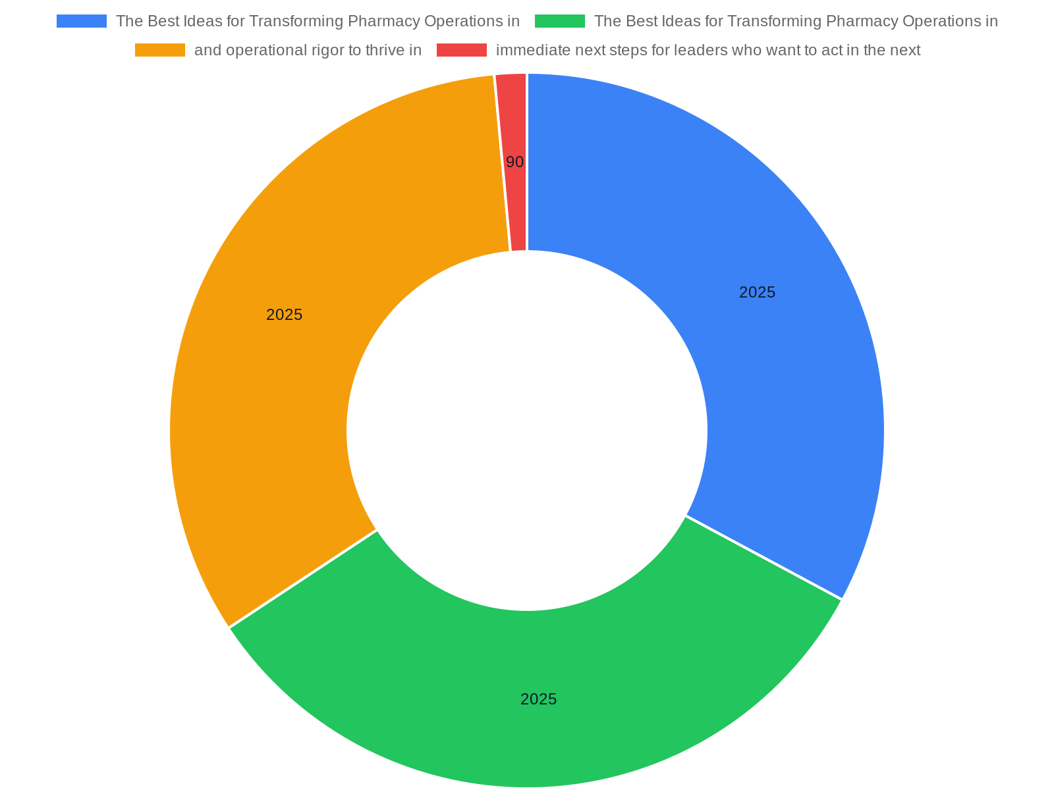
Conclusion and immediate next steps
Research context: The Best Ideas for Transforming Pharmacy Operations in 2025 and additional industry resources provide a clear mandate: combine technology, pa…
Form steering committee and run a rapid gap assessment
Choose a high-impact pilot and secure pilot funding
Update critical SOPs and refresh staff competencies
Begin vendor outreach for prioritized integrations
Set short-term, measurable targets to prove progress
Notes:
Research context: The Best Ideas for Transforming Pharmacy Operations in 2025 and additional industry resources provide a clear mandate: combine technology, patient centricity, and operational rigor to thrive in 2025. This concluding slide summarizes immediate next steps for leaders who want to act in the next 90 days: establish a cross-functional steering committee, perform a rapid assessment of technology and workflow gaps, select one high-impact pilot (technology, clinical service, or safety improvement), and secure a modest pilot budget. It recommends quick operational actions: update critical SOPs that affect patient safety, begin vendor outreach for prioritized integrations, and start competency refresh training for staff in clinical services you plan to pilot. It also suggests short-term metric targets to demonstrate progress—reduce average fill time by a modest percent, complete PDMP integration for controlled prescriptions, or launch one telepharmacy clinic slot per week. The slide closes with a statement on leadership priorities: keep patient safety and regulatory compliance at the center while pursuing efficiency and new services, and use measured pilots to build organizational confidence in transformation.

Slide 15
References
https://www.ptmreview.com/p/the-best-ideas-transforming-pharmacy-2025
https://nabp.pharmacy/wp-content/uploads/2025/07/ISMP-Targeting-Best-Practices-Presentation-Handouts.pdf
https://www.pioneerrx.com/blog/pharmacy-trends-to-look-out-for-in-2025-and-pioneerrx-features-that-can-help
https://www.ashp.org/-/media/assets/about-ashp/docs/Leadership-Center/Forecast-Workshop/ASHP-Student-Pharmacy-Forecast-Workshop-Slides-2025-PDF.pdf
https://www.slideteam.net/top-10-pharmacies-powerpoint-presentation-templates
https://goodshephealthinstitute.org/pharmacy-trends-to-watch-in-2025/
https://lumistry.com/blog/2025-pharmacy-trends/
https://www.ajmc.com/view/the-future-of-pharmacy-trends-threats-transformations
https://www.pharmexec.com/view/the-shifting-pharmacy-landscape-in-2025
https://academic.oup.com/ajhp/article/82/2/17/7917650

