Slide 1
Best Pharmacy Practices in 2025 — Data-Driven Visualizations & Dashboards
Generated by AgentFire AI

Slide 2
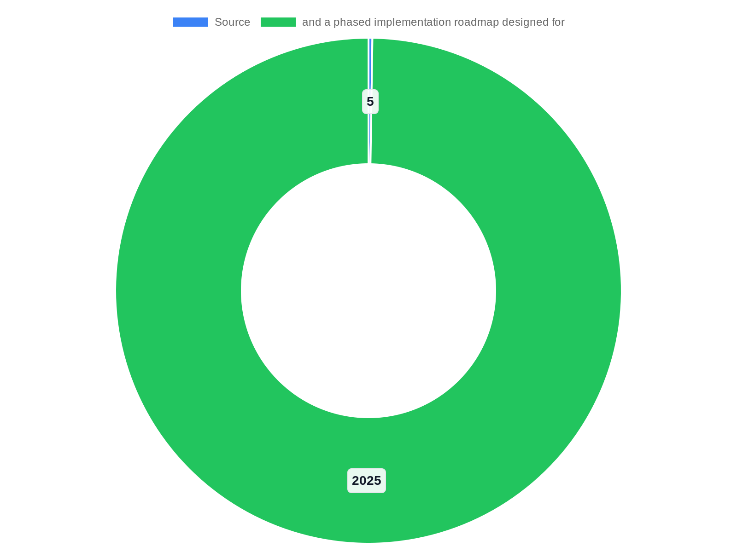
Cover: Data-Driven Pharmacy Practices for 2025
This opening slide establishes scope, objectives and the role of visualization in modern pharmacy operations. It frames the presentation around improving clini…
Scope: clinical safety, operations, compliance, and procurement
Audience: pharmacy managers, clinicians, IT, compliance
Deliverables: KPIs, wireframes, governance checklist, roadmap
Framing informed by Research context guidance on clarity and audience focus
Decision intent: adopt standardized dashboards and training
Notes:
This opening slide establishes scope, objectives and the role of visualization in modern pharmacy operations. It frames the presentation around improving clinical outcomes, operational efficiency, and regulatory compliance through clear, evidence-based data visualizations. Research context: Source: 5 Best Practices for Effective and Good Data Visualizations URL: https://www.geeksforgeeks.org/data-visualization/5-best-practices-for-effective-and-good-data-visualizations/ Summary notes in the Research context emphasize clarity, audience focus and removing visual clutter. I will apply those principles to pharmacy use cases such as medication dispensing throughput, adverse event rates, inventory turnover, and patient adherence. The audience is multidisciplinary: pharmacy managers, informatics leads, clinical pharmacists, IT/dashboards teams, and compliance officers. Slide goals: orient stakeholders to the presentation structure, desired decisions (dashboard adoption, KPI standardization, training investment), and the link between visualization best practices and measurable pharmacy outcomes. This slide also outlines expected deliverables: recommended KPI sets, dashboard wireframes, governance checklist, and a phased implementation roadmap designed for 2025 technology stacks (EHR integrations, real-time inventory telemetry, and BI platforms).

Slide 3

Executive Summary: Why Visuals Matter for Pharmacies in 2025
This executive summary synthesizes the rationale for investing in better visualizations within pharmacy practice. Visuals accelerate insight and decision-makin…
Visuals speed clinical and operational decisions, reducing latency
Research context shows consistent best-practice rules adaptable to pharmacy needs
Pilot recommendations: operational dashboard and clinical safety dashboard
Success metrics: decision latency, error rate delta, inventory days of supply
Immediate next step: form cross-functional pilot team
Notes:
This executive summary synthesizes the rationale for investing in better visualizations within pharmacy practice. Visuals accelerate insight and decision-making—critical when preventing adverse drug events, optimizing order fulfillment, and managing constrained inventory. Research context: several sources in the Research context (GeeksforGeeks, DataTeams AI, GoodData, AI-for-Excel, Medium, Coefficient) converge on core best practices: choose the right chart, remove distractions, use color intentionally, add context with labels, and tailor visuals to the audience. Narrative evidence from the Research context supports that well-designed charts reduce error rates in interpretation and increase stakeholder buy-in for interventions. For pharmacy leaders, the bottom-line benefits include reduced medication errors, lower stockouts, faster dispensing times, and clearer audit trails for regulators. This slide presents a concise cost-benefit framing and recommended next steps: pilot one operational and one clinical dashboard, adopt visualization standards per Research context guidance, and schedule role-based training. It concludes with measurable success criteria for pilot evaluation: decision latency, error rate change, inventory days of supply and user satisfaction scores.

Slide 4

Pharmacy Data Landscape — 2025 Reality Check
the Research context content from DataTeams AI and GoodData highlights how modern visualization efforts must integrate heterogeneous data and prioritize data h…
Primary sources: EHR/EMR, PMS, procurement/EDI, pharmacovigilance, adherence apps
Common data quality risks: timestamps, duplicates, SKU mismatches
Visualization risk: poor aggregation choices lead to misleading trends
Infrastructure: define latency requirements (real-time vs batch)
Preconditions: canonical KPIs, data dictionary, governance
Notes:
the Research context content from DataTeams AI and GoodData highlights how modern visualization efforts must integrate heterogeneous data and prioritize data hygiene and schema alignment before visualization. The slide enumerates common data quality issues—timestamp misalignment, duplicate prescriptions, SKU mismatches, and incomplete adherence telemetry—and translates each into visualization risk (misleading trend charts, incorrect KPI denominators). It also outlines infrastructure considerations: real-time versus batch ingestion, data latency tolerances for operational dashboards, and privacy-preserving architectures for PHI. The slide concludes with recommended preconditions for successful visualization projects: canonical KPI definitions, a data dictionary mapped to source systems, and a lightweight governance structure that enforces consistent aggregations and refresh cadences.

Slide 5

Core Visualization Principles Applied to Pharmacy
The GeeksforGeeks '5 Best Practices for Effective and Good Data Visualizations' in the Research context emphasizes clarity, elimination of clutter, appropriate…
Follow Research context principles: clarity, minimal clutter, audience focus
Prefer line charts and small multiples for trend comparisons
Annotate supply disruptions and regulatory events for context
Always show denominators and time windows for clinical metrics
Design for accessibility: color-blind palettes, readable labels
Notes:
The GeeksforGeeks '5 Best Practices for Effective and Good Data Visualizations' in the Research context emphasizes clarity, elimination of clutter, appropriate chart selection, effective use of color, and audience tailoring—principles echoed by GoodData and DataTeams AI. Applied examples: use simple line charts for trends in medication error rate over time instead of 3D surfaces that obscure values; choose stacked bars sparingly when breakdowns lead to hard-to-read small segments; favor small multiples to compare per-ward dispensing rates rather than color-saturated single charts. This slide provides action rules: annotate anomalies (supply disruptions, recalls), always show denominators (doses dispensed vs orders placed), and design with accessibility in mind (color-blind palettes and label-first design). It also highlights the importance of contextual captions and short takeaways on each dashboard so frontline pharmacists can act immediately, aligning with Research context recommendations to add context and tailor visuals to user goals.

Slide 6
Choosing Chart Types for Pharmacy KPIs
GoodData and AI-for-Excel in the Research context stress selecting charts that match data relationships and user intent. Examples: use line charts for time-ser…
Line charts for time-series KPIs like dispensing throughput
Bar charts for categorical comparisons (shifts, units, suppliers)
Heatmaps for matrix problems (ward x medication class shortages)
Scatter plots for correlation exploration and root-cause leads
Avoid 3D/ornamentation—use drill-through and tables for audits
Notes:
GoodData and AI-for-Excel in the Research context stress selecting charts that match data relationships and user intent. Examples: use line charts for time-series (dispensing throughput, average time-to-dispense), bar charts for categorical comparisons (errors by shift or unit), heatmaps for matrix-like problems (ward vs medication class shortages), and scatter plots to explore correlations (prescription volume vs error rate). Avoid decorative or complex charts unless they add analytic value; Research context sources warn against 3D and excessive embellishments that impair cognition. The slide provides specific pairing guidance: KPI - recommended visualization - key annotation practices. It also calls out when to supplement charts with table snapshots (for audit trails) and when to enable drill-through for root cause analysis. Together this guidance reduces misinterpretation risk and improves operational decision throughput.

Slide 7

Color, Labels and Accessibility — Design Rules
DataTeams AI, GoodData and the Coefficient guidance in the Research context emphasize purposeful color use, accessible palettes, and direct labeling. Practical…
Use semantic color and do not rely on color alone to convey meaning
Direct labels and hover text for precise values; short ordered legends
Design for contrast and color-blind palettes (WCAG-aware)
Layout: primary KPI top-left, group related charts, show refresh status
Privacy: avoid PHI in shared summaries; enforce role-based access
Notes:
DataTeams AI, GoodData and the Coefficient guidance in the Research context emphasize purposeful color use, accessible palettes, and direct labeling. Practical rules for pharmacy dashboards: use semantic color consistently (e.g., red for critical stockouts or high error severity, amber for near-threshold inventory levels, green for within-target), avoid relying solely on color to convey meaning, and design with contrast ratios suitable for users with low vision. Always include direct labels or hover text for precise values and ensure legends are short and ordered by significance. The slide also prescribes typography and layout rules to improve scanability: prioritize the primary KPI in the top-left, group related charts, and maintain consistent refresh cadence indicators. Lastly, it notes compliance considerations—no PHI exposed in shared summary dashboards and role-based access for detailed screens—aligning with privacy expectations outlined in the Research context materials.

Slide 8

Operational Dashboard: Recommended Layout & Widgets
Master visualization practices from the Research context (GeeksforGeeks, GoodData, AI-for-Excel) inform a minimal, action-oriented layout. Top row: three high-…
Top KPIs: avg time-to-dispense, pending orders threshold, inventory days-of-supply
Middle: throughput trend line with annotations; bar chart by shift/location
Lower: sortable critical-SKU table and ward shortage heatmap
Interactions: filters for date range/ward/class and drill-through rows
Refresh cadence: near-real-time (5–15 min) with visible last-refresh
Notes:
Master visualization practices from the Research context (GeeksforGeeks, GoodData, AI-for-Excel) inform a minimal, action-oriented layout. Top row: three high-level KPIs (average time-to-dispense, orders pending over threshold, inventory days-of-supply). Middle area: time-series trend (line chart) of throughput with annotations for high-impact events, and a bar chart broken down by shift/location showing error counts. Lower panel: a sortable table of critical SKUs with days of supply and supplier lead-time, and a heatmap showing ward-level shortages. Interaction recommendations: filters for date range, ward, and medication class; drill-through rows to prescription-level audit. Operational rules: refresh cadence for this dashboard should be near real-time or every 5–15 minutes depending on system capability, with visible last-refresh timestamp to match expectations raised in the Research context guidance about latency and accuracy.

Slide 9

Clinical & Safety Dashboard: Key Features
Chart Smarter and Coefficient guidance in the Research context stress the need to highlight anomalies, show denominators, and provide context. Core widgets: ti…
ADE rate time-series with confidence intervals and denominators
Bar chart of ADEs by severity and medication class
Table of open safety incidents with owner and status
Timeline with recalls and safety alerts linked to actions
Access control: aggregated exec views vs clinician-level detail
Notes:
Chart Smarter and Coefficient guidance in the Research context stress the need to highlight anomalies, show denominators, and provide context. Core widgets: time-series of adverse drug event (ADE) rate with confidence intervals, bar chart of ADEs by severity and medication class, table of open safety incidents with status and assigned owner, and a timeline of recent recalls or safety alerts with direct links. Annotation best practices: flag periods with increased prescription volume or formulary changes and always display denominators such as doses administered or prescriptions filled. Access control: restrict detailed patient-level records to authorized clinicians, provide aggregated views for executives, and include an exportable audit trail for regulatory review. This slide also recommends integrating clinical decision support triggers and one-click actions (e.g., deplete/halt dispensing) when thresholds breach safety criteria.

Slide 10
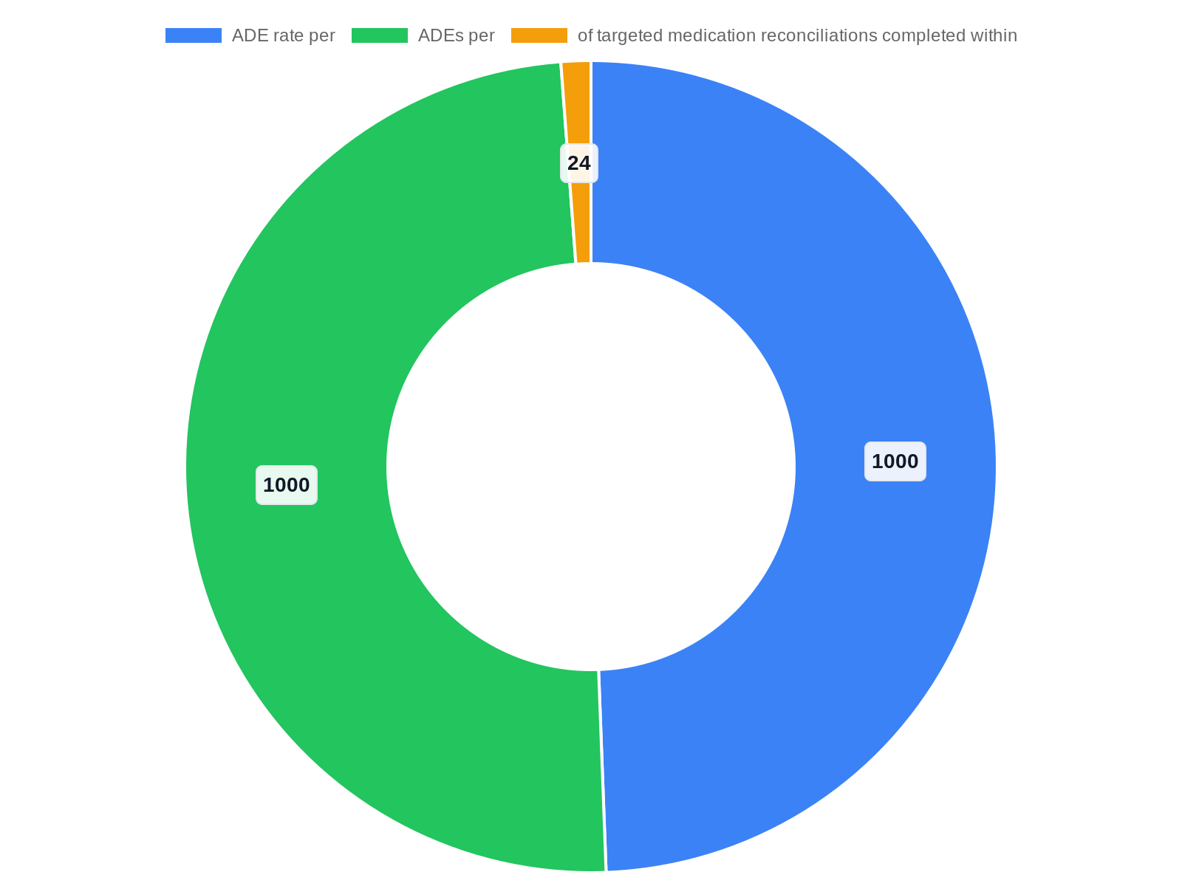
Defining KPIs: Operational and Clinical Metrics
The Research context materials (GoodData, DataTeams AI, AI-for-Excel) emphasize explicit definitions to avoid ambiguity. Operational KPIs include: average time…
Operational KPIs: avg time-to-dispense, fill-rate, days-of-supply, stockout frequency
Clinical KPIs: ADE rate per 1,000 doses, reconciliation compliance, adherence signals
Each KPI: numerator, denominator, cadence, visualization, alert threshold
Explicit definitions reduce cross-team disputes and improve trust
Recommend governance to lock canonical KPI calculations
Notes:
The Research context materials (GoodData, DataTeams AI, AI-for-Excel) emphasize explicit definitions to avoid ambiguity. Operational KPIs include: average time-to-dispense (median time from order receipt to verified dispense), fill-rate (fulfilled prescriptions divided by orders placed), inventory days-of-supply (on-hand units / average daily usage) and stockout frequency per SKU per month. Clinical KPIs include: ADE rate (ADEs per 1,000 doses administered), reconciliation compliance (% of targeted medication reconciliations completed within 24 hours), and medication adherence signals for monitored therapies. For each KPI this slide lists numerator, denominator, calculation cadence, preferred visualization, and suggested alert thresholds. Clear KPI definitions reduce disputes between pharmacy, nursing and procurement teams and create a single source of truth for performance conversations.

Slide 11

Governance, Compliance and Data Privacy
GoodData and DataTeams AI in the Research context emphasize governance as essential for trustworthy dashboards. Governance pillars: define stewards for each da…
Domain stewards for inventory, dispensing and clinical data
Style guide based on Research context best practices for visuals
Role-based access, audit logs, and automated de-identification
Visualization audits and change-control board for KPI changes
SLA with business owners for availability and data latency
Notes:
GoodData and DataTeams AI in the Research context emphasize governance as essential for trustworthy dashboards. Governance pillars: define stewards for each data domain (inventory, dispensing, clinical events), enforce a visualization style guide derived from Research context best practices (colors, labels, refresh rules), and maintain an approval workflow for dashboard publication. Compliance actions: role-based access controls with audit logs for PHI access, automated de-identification for shared analytics, and retention policies aligned with legal/regulatory requirements. The slide also prescribes periodic visualization audits to ensure accuracy after system or schema changes and a change-control board for KPI updates. Finally, it recommends a lightweight SLA with business owners for dashboard availability and data latency guarantees to manage expectations and operational risk.

Slide 12
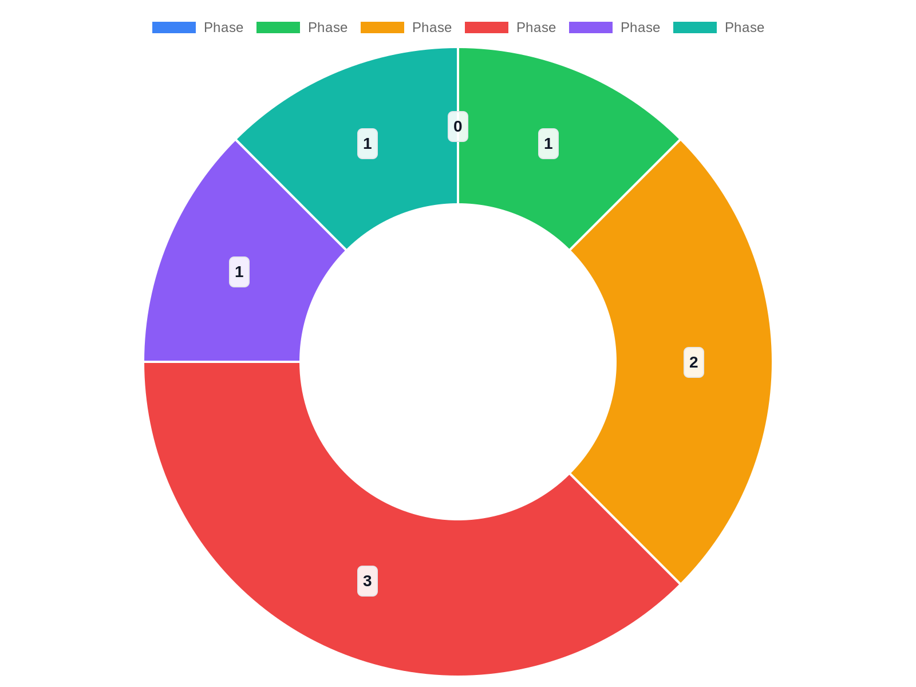
Implementation Roadmap: Phased Pilot to Enterprise Rollout
discovery and data readiness — inventory data sources, define KPIs, and build a data dictionary. Phase 1: rapid pilot — build an operational dashboard (ops) an…
Phase 0: discovery, KPI definitions, data dictionary (0–2 months)
Phase 1: pilot ops and safety dashboards for 2 wards (2–4 months)
Phase 2: expand sources, governance, SLAs (4–6 months)
Phase 3: enterprise rollout, automation and integration (6–9 months)
Team: product owner, data engineer, BI dev, clinical lead, change manager
Notes:
discovery and data readiness — inventory data sources, define KPIs, and build a data dictionary. Phase 1: rapid pilot — build an operational dashboard (ops) and clinical safety dashboard for two wards, gather user feedback, and run A/B style comparisons on alert thresholds. Phase 2: expand data sources and integrate procurement feeds, implement governance and role-based access, and harden data pipelines for SLAs. Phase 3: enterprise roll-out — standardize dashboards across sites, automate KPI generation, embed into daily workflows, and integrate with incident management tools. Research context: literature in the Research context (AI-for-Excel, DataTeams AI) advises iterative prototyping, user testing, and keeping visuals minimal during pilots to accelerate feedback cycles. The slide includes recommended timelines (0–2 months discovery, 2–4 months pilot, 4–9 months scaling) and resource requirements: cross-functional product owner, data engineer, BI developer, clinical lead and change manager.

Slide 13

Training & Change Management to Ensure Adoption
GoodData and Chart Smarter guidance in the Research context emphasize training for both interpretation skills and tool mechanics. Training program components: …
Role-based workshops: supervisors, frontline pharmacists, analysts
Quick reference cards capturing Research context visualization rules
Embed dashboards into shift handovers and decision playbooks
Monitor usage metrics and run targeted coaching for low adoption
Incentivize team improvements tied to validated KPI gains
Notes:
GoodData and Chart Smarter guidance in the Research context emphasize training for both interpretation skills and tool mechanics. Training program components: role-based workshops (supervisors: interpretation/decision rules; frontline pharmacists: drill-through use and incident reporting; analysts: data model & KPI ownership), quick reference cards summarizing visualization rules from the Research context (label-first, color semantics, denominators), and periodic review sessions where teams critique dashboards in light of real incidents. Adoption levers: embed dashboards into shift-handover processes, attach short decision playbooks to KPIs, and monitor usage metrics to identify low-adoption areas for targeted coaching. Finally, incentivize accuracy by tying a subset of operational bonuses or recognition to team-level KPI improvements, ensuring the organization values consistent measurement and visualization hygiene.

Slide 14

Monitoring, Iteration and Continuous Improvement
This final content slide defines how to monitor dashboard health and iterate. Key practices: instrument usage telemetry (view counts, drill-throughs, filter us…
Instrument telemetry: views, drill-throughs, filter usage to measure adoption
Maintain backlog and schedule quarterly visualization audits
Use A/B testing for layout or threshold changes; measure decision impact
Quarterly stakeholder reviews for KPI or visualization changes
Governance KPIs: uptime, mean time-to-fix, user satisfaction NPS
Notes:
This final content slide defines how to monitor dashboard health and iterate. Key practices: instrument usage telemetry (view counts, drill-throughs, filter usage), maintain an issues backlog for visualization errors or user confusion, and schedule quarterly visualization audits which compare KPI calculations to source-of-truth systems. Research context: several Research context sources recommend A/B testing and incremental changes rather than wholesale redesigns; adopt that approach for pharmacy dashboards by running controlled changes for layout, color or alert thresholds and measuring effect on decision latency and error rates. Continuous improvement also requires a cadence for stakeholder reviews where business owners sign off on KPI changes and new visualization needs. The slide closes with governance KPIs for the analytics program itself: dashboard uptime, mean time to fix (visualization defects), and user satisfaction NPS for dashboard utility.

Slide 15
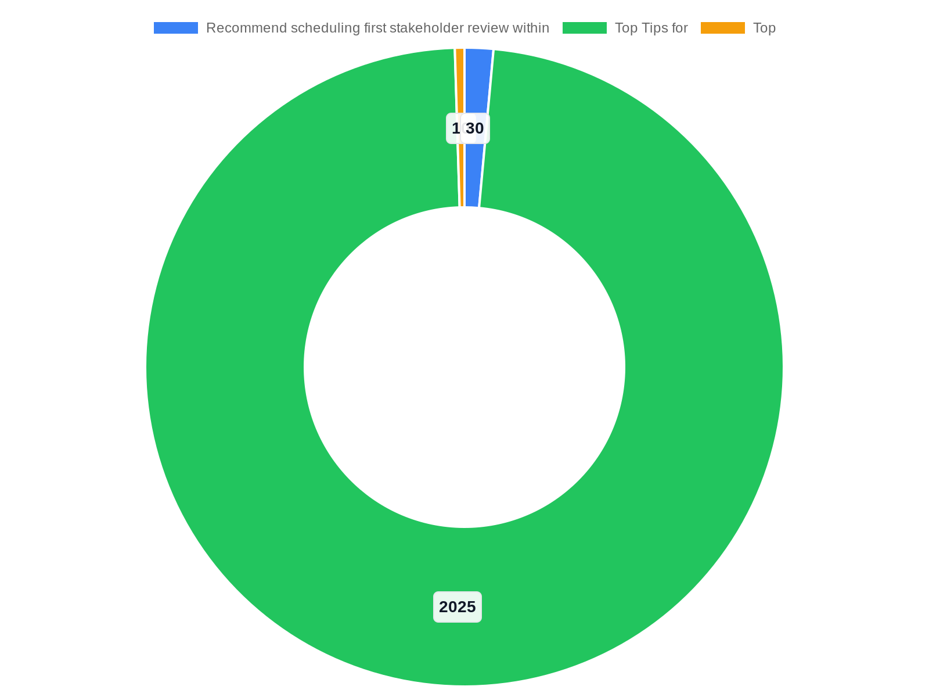
Appendix: Resources, Checklists and Next Steps
This appendix slide lists practical resources, checklists and immediate next steps for the leadership team. Resources include the Research context materials us…
Research context sources consolidated for visualization best-practice guidance
Checklists: dashboard readiness, visual design, governance
Immediate next steps: approve pilot, allocate resources, kickoff
Contacts: analytics lead, clinical lead, IT/data engineering
Recommend scheduling first stakeholder review within 30 days of kickoff
Notes:
This appendix slide lists practical resources, checklists and immediate next steps for the leadership team. Resources include the Research context materials used to shape recommendations: GeeksforGeeks '5 Best Practices for Effective and Good Data Visualizations', DataTeams AI 'Data Visualization Best Practices: Top Tips for 2025', GoodData's 'Top 10 Proven Data Visualization Best Practices', AI-for-Excel guidance on impactful charts, the Medium piece 'Chart Smarter', and Coefficient's '8 Tips to Create Stunning Charts'. Checklists: dashboard readiness checklist (data quality, refresh cadence, access control), visual design checklist (labels, color semantics, accessibility), and governance checklist (stewards, SLA, audits). Immediate next steps recommended: approve pilot charter, allocate pilot resources, and schedule stakeholder kickoff. The slide also offers contact points for follow-up: analytics lead for pilot scope, pharmacy clinical lead for KPI sign-off, and IT lead for data access and pipeline setup.

Slide 16
References
https://www.geeksforgeeks.org/data-visualization/5-best-practices-for-effective-and-good-data-visualizations/
https://www.datateams.ai/blog/data-visualization-best-practices
https://www.gooddata.com/blog/5-data-visualization-best-practices/
https://ai-for-excel.com/blog/data-visualization-best-practices
https://medium.com/data-science-collective/chart-smarter-how-to-design-data-visualizations-that-work-c9241b8b3f37
https://coefficient.io/data-analytics/data-visualization-best-practices
https://hevoacademy.com/data-management/data-visualization-best-practices/
https://www.xbyteanalytics.com/best-practices-of-data-visualization/
https://chartmakers.io/blog/data-visualization-best-practices-2025
https://www.lumeo.me/en/blog/data-visualization-best-practices

