Slide 1
Best Pharmacy Practices in 2025: Trends and Innovations
Generated by AgentFire AI

Slide 2
Introduction to Pharmacy Practices in 2025

Slide 3
Automation in Pharmacy Operations

Slide 4
Personalized Medicine: A New Frontier

Slide 5
Telepharmacy: Expanding Access to Care

Slide 6
Integration of Artificial Intelligence

Slide 7
Sustainability in Pharmacy Practices

Slide 8
Regulatory and Compliance Trends

Slide 9
Patient Engagement and Education

Slide 10
Challenges and Opportunities

Slide 11
Conclusion: The Future of Pharmacy

Slide 12
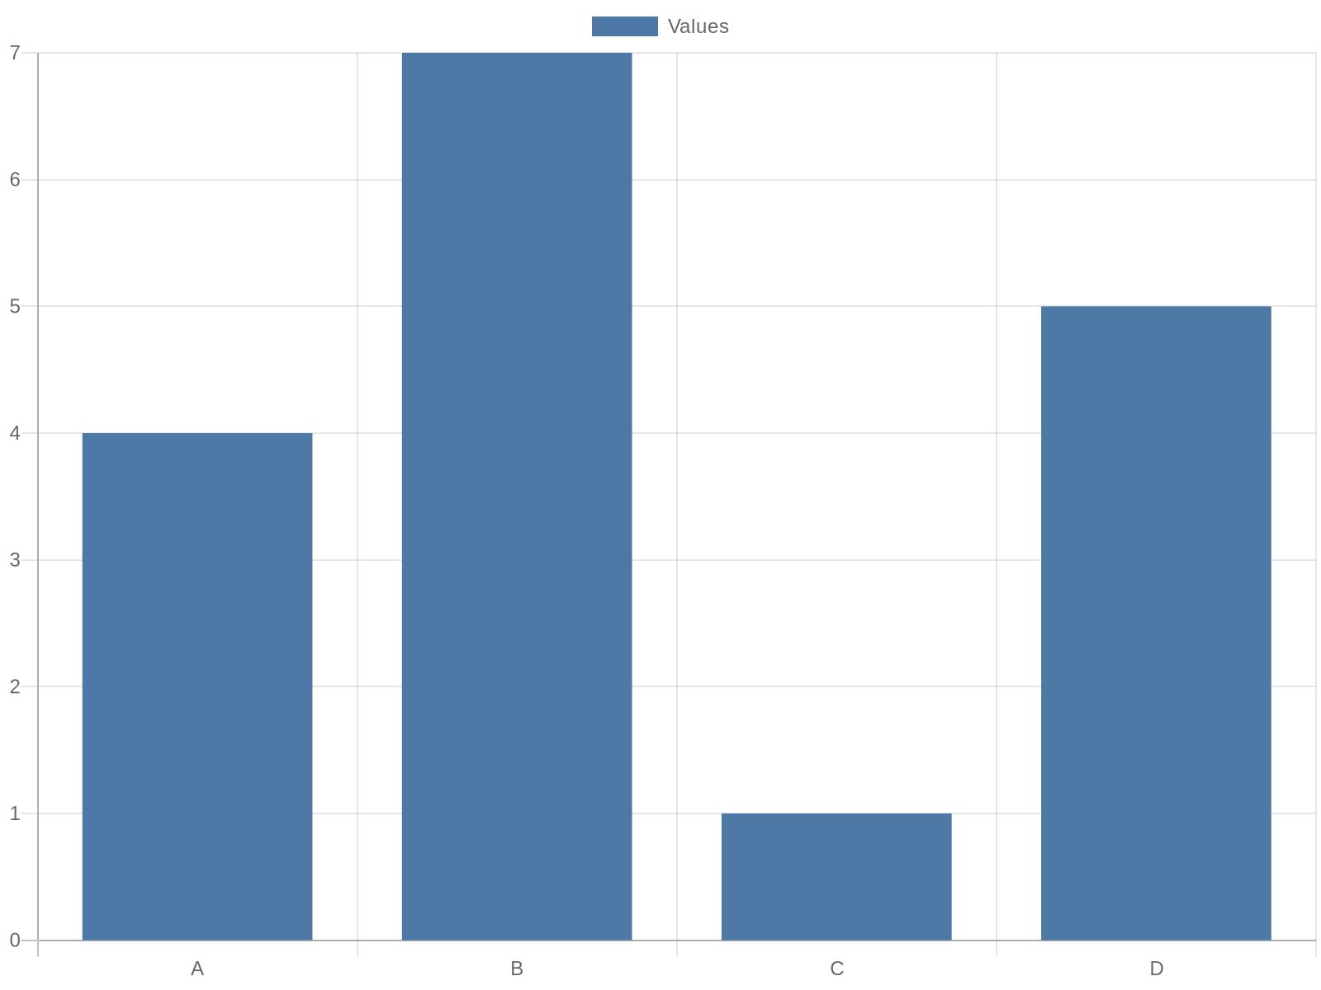
Additional Data 1

Slide 13
Additional Data 2

Slide 14
Additional Data 3

Slide 15
Additional Data 4

Slide 16
Additional Data 5

Slide 17

Additional Image 1

Slide 18

Additional Image 2

Slide 19

Additional Image 3

Slide 20
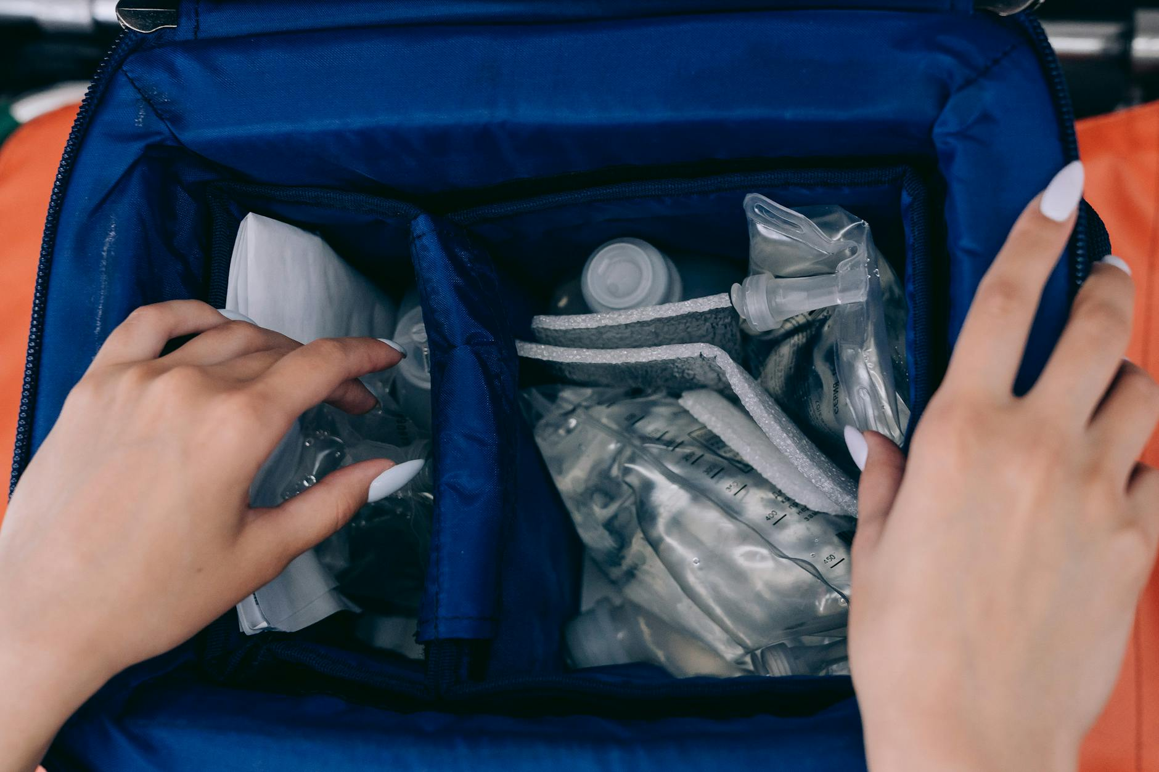
Additional Image 4

Slide 21

Additional Image 5

Slide 22
References
https://www.pharmacytimes.com
https://www.ncbi.nlm.nih.gov
https://www.ajpe.org
https://www.healthaffairs.org
https://www.sustainablepharmacy.org
https://www.fda.gov
https://www.cdc.gov
https://www.pharmacyeconomics.com
https://www.who.int

