Slide 1
Best Pharmacy Practices in British Columbia (2025): Standards, Services and Data-Driven Trends
Generated by AgentFire AI

Slide 2
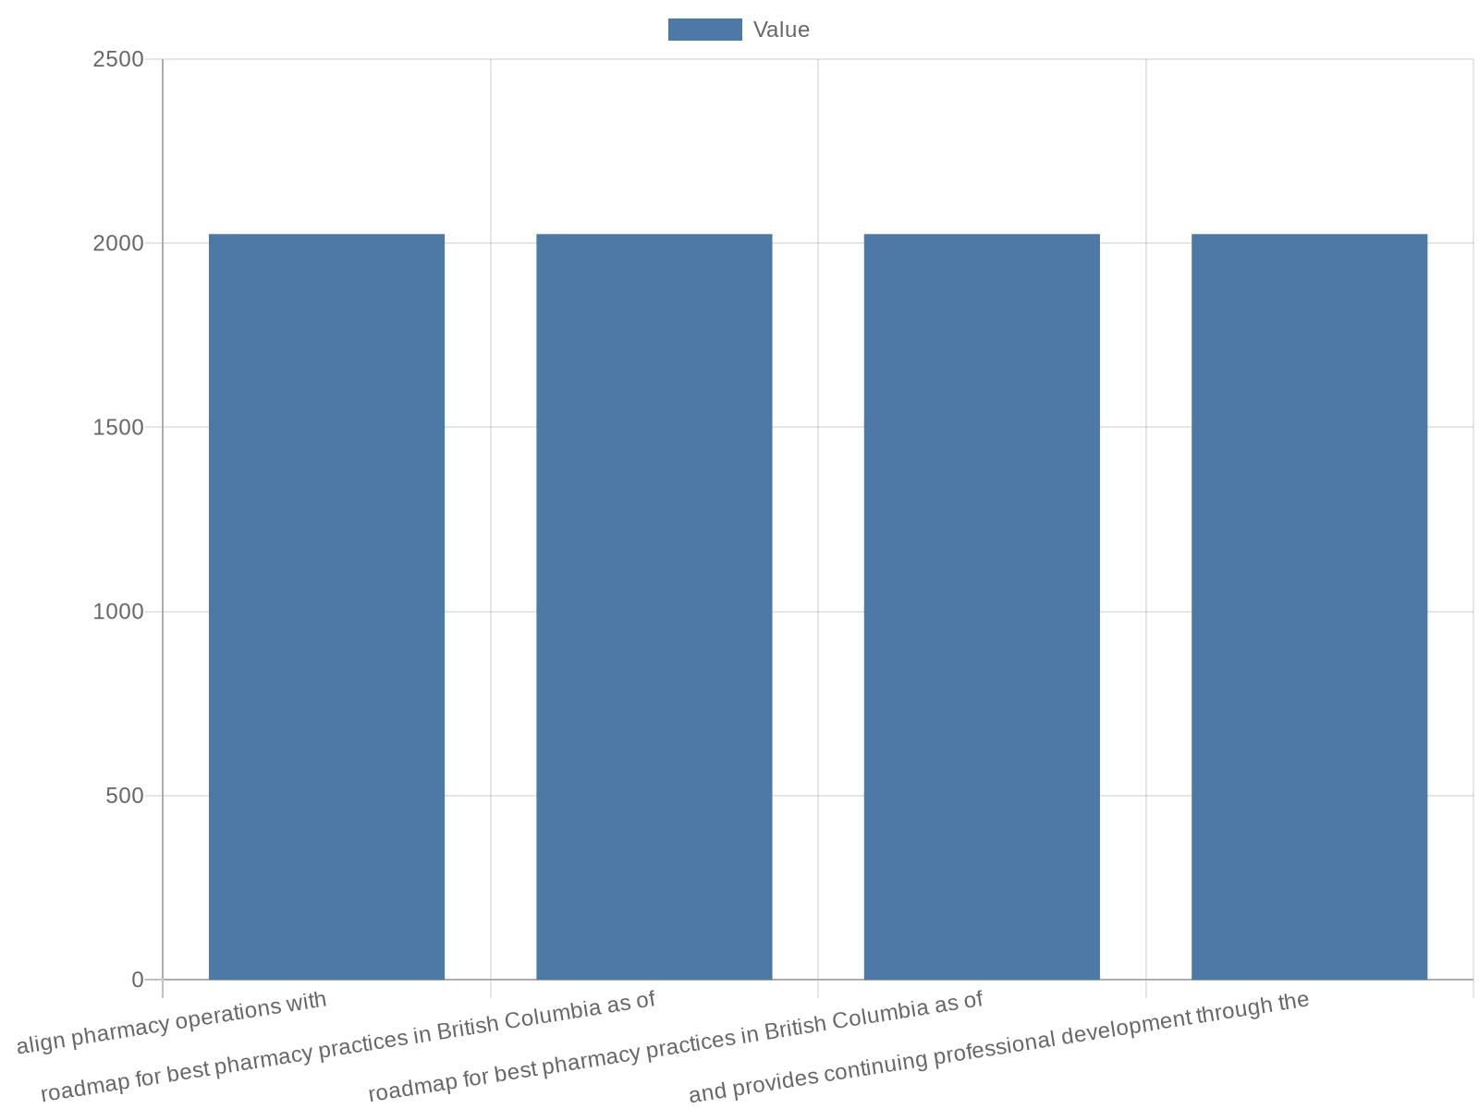
Executive summary and purpose
This presentation provides an operational and policy-focused roadmap for best pharmacy practices in British Columbia as of 2025. It synthesizes themes from pro…
Goal: align pharmacy operations with 2025 provincial practices and regulatory direction
Context: expansion of vaccination and minor ailment services across community pharmacies
Outcomes: practical actions, KPIs to track, and recommended governance steps
Audience: pharmacy owners, managers, clinical leads, and policy advisors
Notes:
This presentation provides an operational and policy-focused roadmap for best pharmacy practices in British Columbia as of 2025. It synthesizes themes from provincial organizations and recent association publications to orient pharmacy owners, managers, and clinicians toward evidence-informed actions. Research context: The BC Pharmacy Association highlights expanded scope services such as vaccines and minor ailment assessments and provides continuing professional development through the 2025 Conference. Research context: The College of Pharmacists of British Columbia signals regulatory change with the Health Professions and Occupations Act. This slide summarizes objectives: align clinical services with regulation, reduce business pressures, measure service uptake, and apply continuous quality improvement informed by provincial publications. The aim is to present practice-level actions, measurable indicators, and policy alignment steps that reflect current provincial discourse and operational realities.

Slide 3

Regulatory landscape and compliance priorities
Understanding regulatory change is foundational to safe and lawful practice. Research context: The College of Pharmacists of British Columbia emphasizes regula…
Update policies for HPOA changes and document delegation pathways
Perform quarterly compliance audits for controlled drugs, recordkeeping and consent
Integrate Business Pressures Tipline guidance into HR and risk workflows
Train staff on scope changes and revise job descriptions accordingly
Notes:
Understanding regulatory change is foundational to safe and lawful practice. Research context: The College of Pharmacists of British Columbia emphasizes regulatory modernization with the Health Professions and Occupations Act replacing the Health Professions Act; this creates new compliance priorities for documentation, supervision and scopes of practice. Research context: College channels also communicate operational tools such as the Business Pressures Tipline. Practical compliance priorities include updating delegation protocols, revalidating professional liability coverage under new scopes, and ensuring patient consent processes meet updated expectations. This slide lists required governance actions, recommended audit checks, and staff training cadence to remain compliant with evolving provincial regulation and college guidance, while maintaining public protection and service continuity.

Slide 4
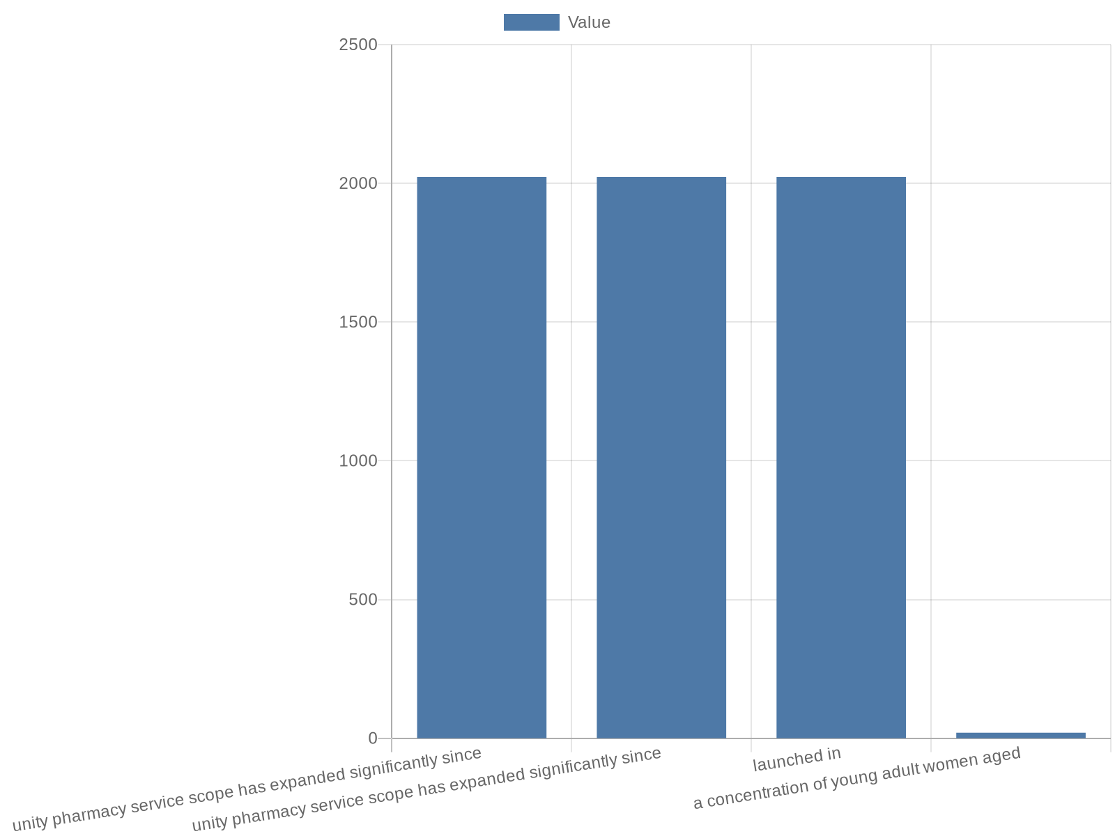
Service expansion: minor ailments, contraception and MACS
Community pharmacy service scope has expanded significantly since 2023. Research context: BC Pharmacy Association reporting notes the Minor Ailments and Contra…
Design private, efficient consultation workflows for MACS appointments
Forecast contraceptive inventory based on observed patient age cohorts
Track KPIs: consult volumes, prescription counts, follow-up rates, and wait times
Promote targeted outreach to demographic groups using MACS data
Notes:
Community pharmacy service scope has expanded significantly since 2023. Research context: BC Pharmacy Association reporting notes the Minor Ailments and Contraception Service (MACS) launched in 2023 and that contraceptives are the top category of prescriptions issued by pharmacists in recent reporting. This slide examines service design considerations, patient segmentation, and workflow redesign to handle MACS demand. It discusses patient demographics reported in association publications (for example, a concentration of young adult women aged 20–34 seeking contraception) and service-access implications for appointment management, private consultation spaces, and inventory forecasting. It also outlines KPIs to track MACS activity, such as consult volumes, prescription categories, patient return rates, and time-to-service metrics to monitor operational impact.

Slide 5

Immunization services: workflow and access
Vaccination delivery remains a core expanded service for community pharmacies in BC. Research context: The BC Pharmacy Association highlights pharmacist roles …
Establish scheduled clinic blocks and standby capacity for walk-ins
Maintain rigorous cold-chain logs and audit trails for each vaccine batch
Report and monitor vaccine administration trends monthly
Use provincial locators and association channels to increase patient awareness
Notes:
Vaccination delivery remains a core expanded service for community pharmacies in BC. Research context: The BC Pharmacy Association highlights pharmacist roles in flu and COVID-19 vaccinations and lists tools such as a Find-a-Pharmacy MMR vaccine locator. This slide details operational best practices to optimize immunization clinics: scheduled mass clinics vs. drop-in models, cold-chain documentation, adverse event reporting, and public communication. It also discusses service integration with provincial immunization registries and recommends measurable indicators to demonstrate trends: vaccine doses administered by month, no-show rates, and vaccine-type mix. Emphasis is placed on patient access equity, outreach to under-immunized groups, and leveraging association resources and locators to advertise available vaccines.

Slide 6

Workforce, business pressures and resilience
Pharmacies face operational stressors that require proactive workforce and financial management. Research context: The College of Pharmacists of British Columb…
Implement cross-trained teams and technician-led workflows to reduce pharmacist burden
Monitor KPIs: productive hours, overtime, vacancy rates and service mix
Adopt flexible scheduling for seasonal vaccination peaks
Use tipline insights and association guidance to shape resilience planning
Notes:
Pharmacies face operational stressors that require proactive workforce and financial management. Research context: The College of Pharmacists of British Columbia communications reference business pressures and a tipline to report related concerns. Research context: The BC Pharmacy Association's Summer and Winter 2025 publications discuss clinic strategies and service clinic growth affecting staffing models. This slide addresses staffing models, cross-training, resiliency planning and financial controls to absorb service expansion. It proposes monitoring staffing KPIs such as productive hours per pharmacist, ratio of clinical to dispensing activities, overtime incidence, and vacancy rates. It also outlines mitigations including workload redistribution, use of pharmacy technicians in extended roles, and contingency planning for supply disruptions or sudden demand spikes.

Slide 7

Medication safety, quality improvement and documentation
Continuous quality improvement (CQI) is essential as scope and volumes increase. Research context: The College of Pharmacists of British Columbia underscores p…
Standardize documentation templates for MACS, immunizations and medication reviews
Implement near-miss reporting and quarterly RCA (root cause analysis)
Track medication reconciliation completion rates and counselling documentation
Use CQI cycles to reduce recurrence of identified safety issues
Notes:
Continuous quality improvement (CQI) is essential as scope and volumes increase. Research context: The College of Pharmacists of British Columbia underscores public protection as a regulatory priority; research context: BC Pharmacy Association articles highlight clinical service growth requiring strong documentation. This slide presents practical CQI tactics: medication reconciliation protocols, standardized counselling checklists, error-reporting pathways, and quarterly root cause analysis for near-miss events. It recommends documentation standards for MACS, immunizations and minor ailment assessments to ensure regulatory defensibility and continuity of care. Proposed measurable outputs include rates of documented counselling, acceptance of medication reviews, and incident reporting frequency to drive quality interventions.

Slide 8

Patient access, equity and community engagement
Improving equitable access is a strategic priority as pharmacies assume broader primary care functions. Research context: BC Pharmacy Association materials pro…
Use locators and outreach to reduce access gaps for vaccines and MACS
Offer extended hours and mobile or pop-up clinics in underserved areas
Collect demographic data to monitor equity and target interventions
Partner with community organizations for culturally appropriate outreach
Notes:
Improving equitable access is a strategic priority as pharmacies assume broader primary care functions. Research context: BC Pharmacy Association materials promote services 'From flu and COVID-19 vaccines to minor ailment assessments,' and provide tools like pharmacy locators for vaccine access. This slide covers appointment accessibility, walk-in vs booked service balance, and outreach to vulnerable populations. It emphasizes multilingual communication, barrier-reducing hours (evenings/weekends), and partnerships with community organizations. Measurable indicators include percentage of services provided outside business hours, demographic breakdown of service users (age, gender, postal-code mapping), and proportion of services for underserved groups to monitor equity outcomes.

Slide 9

Data strategy: KPIs, reporting and trend monitoring
A robust data strategy is required to translate service activity into actionable trends. Research context: BC Pharmacy Association publications and college com…
Define KPIs: volumes by service, prescription categories, wait times and margins
Integrate POS and clinical logs for automated trend reporting
Establish weekly operational dashboards and monthly trend reviews
Assign data stewards and ensure PHIPA/PIPA-compliant handling
Notes:
A robust data strategy is required to translate service activity into actionable trends. Research context: BC Pharmacy Association publications and college communications describe rising service scopes that should be paired with measurement. This slide recommends a focused KPI set: consult volumes by service type (MACS, immunizations, minor ailments), prescription categories dispensed by pharmacists (with contraceptives noted as a top category in BC Pharmacy Association reporting), monthly vaccine administrations, appointment lead times, and financial margins per clinical service. It outlines data capture methods (POS integration, clinical service logs), reporting cadence (weekly operational dashboards, monthly trend reviews), and governance (data stewards and privacy safeguards). The slide does not invent numerical values but prescribes the metrics and analytic cadence necessary to produce trustworthy numerical trends locally and provincially.

Slide 10

Operational checklist: layout, inventory and patient flow
Operational detail determines service quality and throughput. Research context: BC Pharmacy Association articles about clinic strategies highlight the need for…
Designate private consultation and vaccine zones with clear patient flow
Forecast inventory for high-demand categories and maintain safety stock
Streamline POS to clinical documentation hand-offs and reduce double entry
Conduct monthly operational audits and patient flow time-motion checks
Notes:
Operational detail determines service quality and throughput. Research context: BC Pharmacy Association articles about clinic strategies highlight the need for physical and process redesign to host pharmacy clinics and increased clinical service delivery. This slide provides a practical checklist for pharmacy layout and flows: dedicated consultation rooms, vaccine administration zones with clear sightlines, streamlined point-of-sale and clinical documentation hand-offs, and inventory forecasting for high-use categories such as contraceptives noted in provincial reporting. It includes steps for inventory safety stock calculations (based on internal service volumes), signage and patient privacy protocols, and routine operational audits to maintain throughput and safety as service mix evolves.

Slide 11
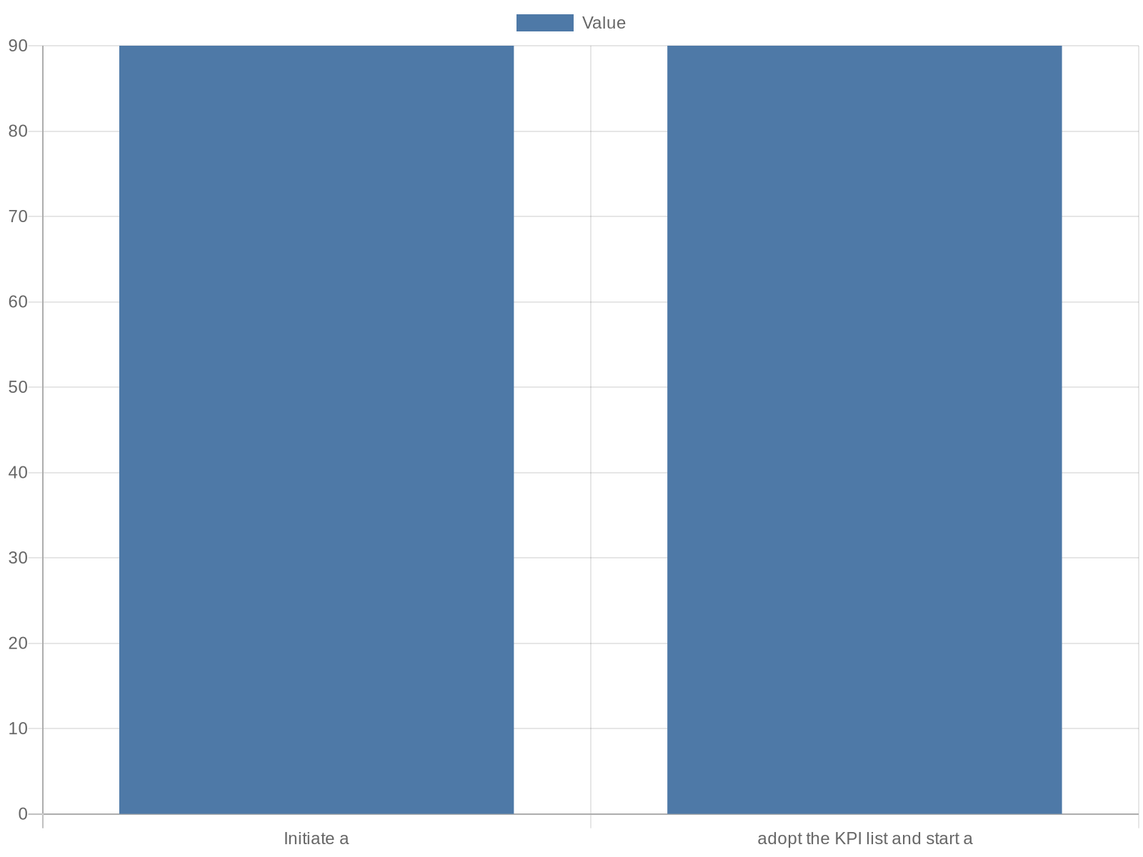
Recommendations, next steps and governance
This final slide converts prior analysis into a prioritized implementation plan. Research context: BC Pharmacy Association resources, including conference mate…
Initiate a 90-day KPI sprint and baseline data capture for primary services
Update policies to reflect regulatory changes and document delegation
Create a clinical-services steering committee and monthly dashboard reviews
Leverage BC Pharmacy Association education and College guidance for staff training
Notes:
This final slide converts prior analysis into a prioritized implementation plan. Research context: BC Pharmacy Association resources, including conference materials and publications, provide educational and advocacy avenues to support implementation; research context: The College of Pharmacists of British Columbia emphasizes regulatory oversight and business pressure supports that should inform governance. Recommended immediate actions include: adopt the KPI list and start a 90-day measurement sprint; update policies to reflect the HPOA transition; invest in staff training for MACS and immunizations; and map patient outreach targeting groups identified in association reports. Establish a governance cadence with a clinical-services steering committee, monthly operational dashboards, and a quarterly review that references provincial association guidance and college directives to ensure alignment and public protection.

Slide 12
References
https://www.bcpharmacy.ca/
https://www.bcpharmacists.org/
https://www.bcpharmacy.ca/publications/summer-2025
https://www.bcpharmacy.ca/publications/winter-2025
https://static1.1.sqspcdn.com/static/f/920943/28528028/1655160117493/BC+Case+Presentation+Resident+Guide_FINAL+June+2022.pdf
https://www2.gov.bc.ca/gov/content/health/practitioner-professional-resources/professional-regulation/pharmacy
https://www2.gov.bc.ca/gov/content/health/practitioner-professional-resources/pharmacare/pharmacare-publications
https://resources.telushealth.com/en-ca/the-future-of-technology-innovation-in-pharmacy-trends-for-2025
https://www.bcpharmacists.org/professional-practice-policies-and-guides
https://www.slideshare.net/bcpharmacists

