Slide 1
Best Practices in Pharmacy: Canada 2025
Generated by AgentFire AI

Slide 2
Introduction to Pharmacy Best Practices

Slide 3
Patient-Centered Care

Slide 4
Technological Innovations

Slide 5
Medication Management Strategies

Slide 6
Interprofessional Collaboration

Slide 7
Regulatory Changes and Compliance

Slide 8
Public Health Initiatives

Slide 9
Training and Education for Pharmacists

Slide 10
Challenges Facing Pharmacy Practices

Slide 11
Key Takeaways

Slide 12
Call To Action

Slide 13
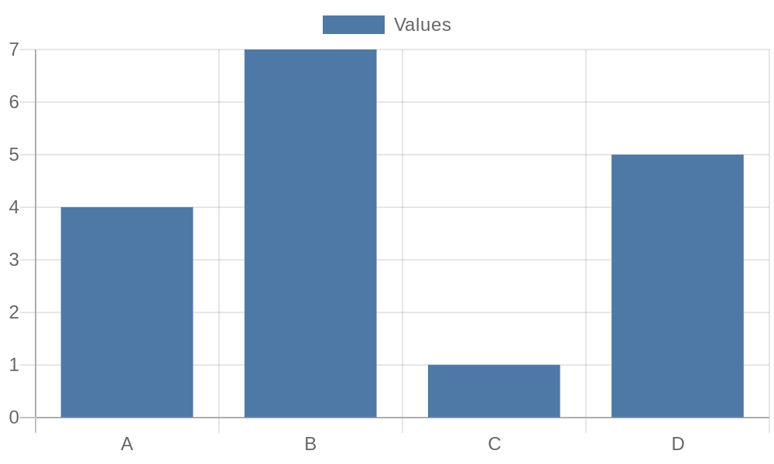
Additional Data 1

Slide 14
Additional Data 2

Slide 15
Additional Data 3

Slide 16
Additional Data 4

Slide 17
Additional Data 5

Slide 18
References
https://www.canada.ca/en/health-canada/services/drugs-health-products.html
https://www.cpha.ca/pharmacy-practice
https://www.cps.ca/en
https://www.pharmacists.ca
https://www.ncbi.nlm.nih.gov/pmc/articles/PMC7411235/
https://www.sciencedirect.com/science/article/pii/S155174111930048X
https://www.cbc.ca/news/health/pharmacy-accessibility-1.5401234
https://www.who.int/publications/i/item/9789241516391

