Slide 1
Best Practices in Pharmacy — Canada 2025: Technology, Operations, and Trends
Generated by AgentFire AI

Slide 2
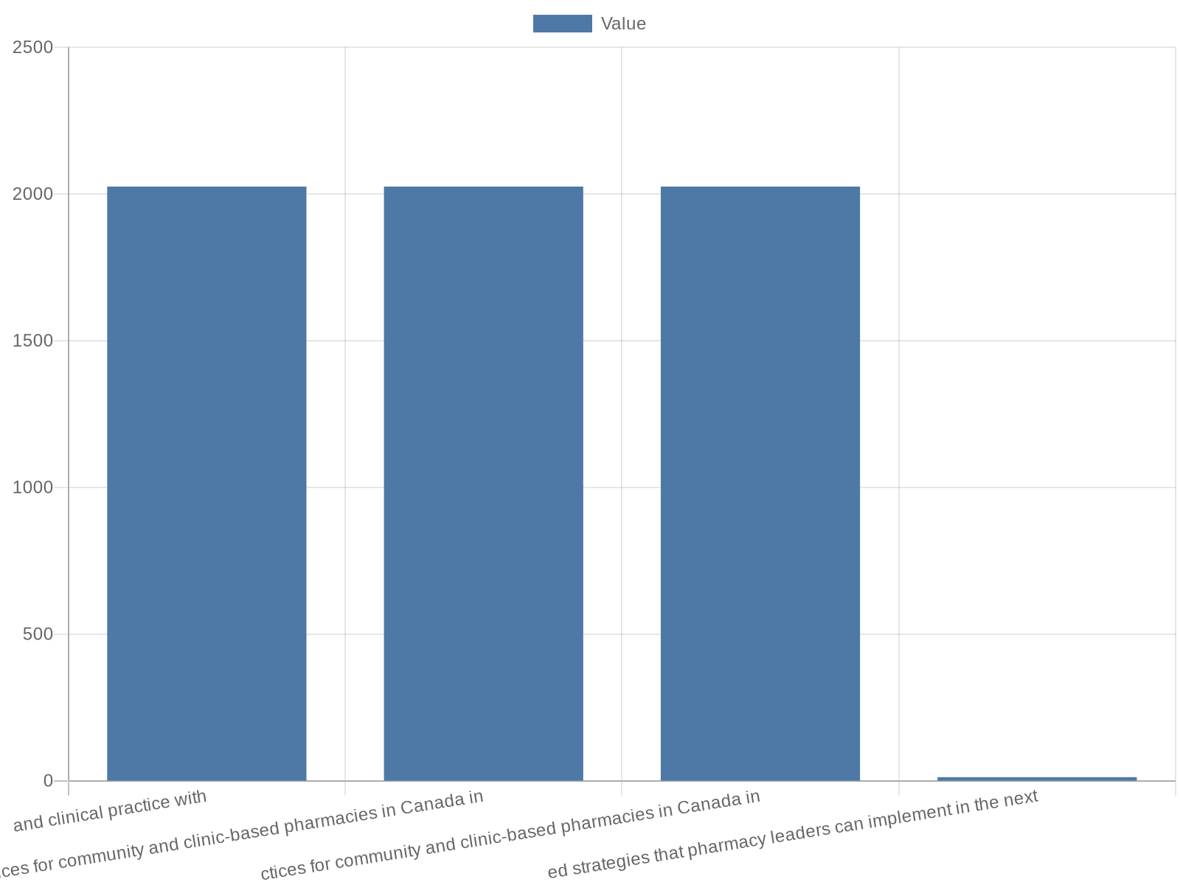
Title & Purpose
This presentation outlines best practices for community and clinic-based pharmacies in Canada in 2025, with a focus on technology adoption, operational efficie…
Purpose: align operations, technology, and clinical practice with 2025 trends
Audience: pharmacy owners, managers, clinical leads, health system partners
Scope: community pharmacies, clinic-integrated pharmacies, digital services
Outcome: prioritized, actionable best practices and implementation steps
Notes:
This presentation outlines best practices for community and clinic-based pharmacies in Canada in 2025, with a focus on technology adoption, operational efficiency, clinical scope expansion, workforce resilience, and data-driven decision making. It situates practical recommendations within recently observed trends and sector analysis. The material draws on industry reporting and thought leadership that characterize pharmacies as an increasingly central access point in primary care, and addresses how pharmacies can respond to labour shortages, rising administrative burdens, and regulatory changes while enhancing patient outcomes and financial sustainability. The objective is to provide actionable, prioritized strategies that pharmacy leaders can implement in the next 12–24 months to align operations with patient expectations and provincial regulatory evolutions.

Slide 3
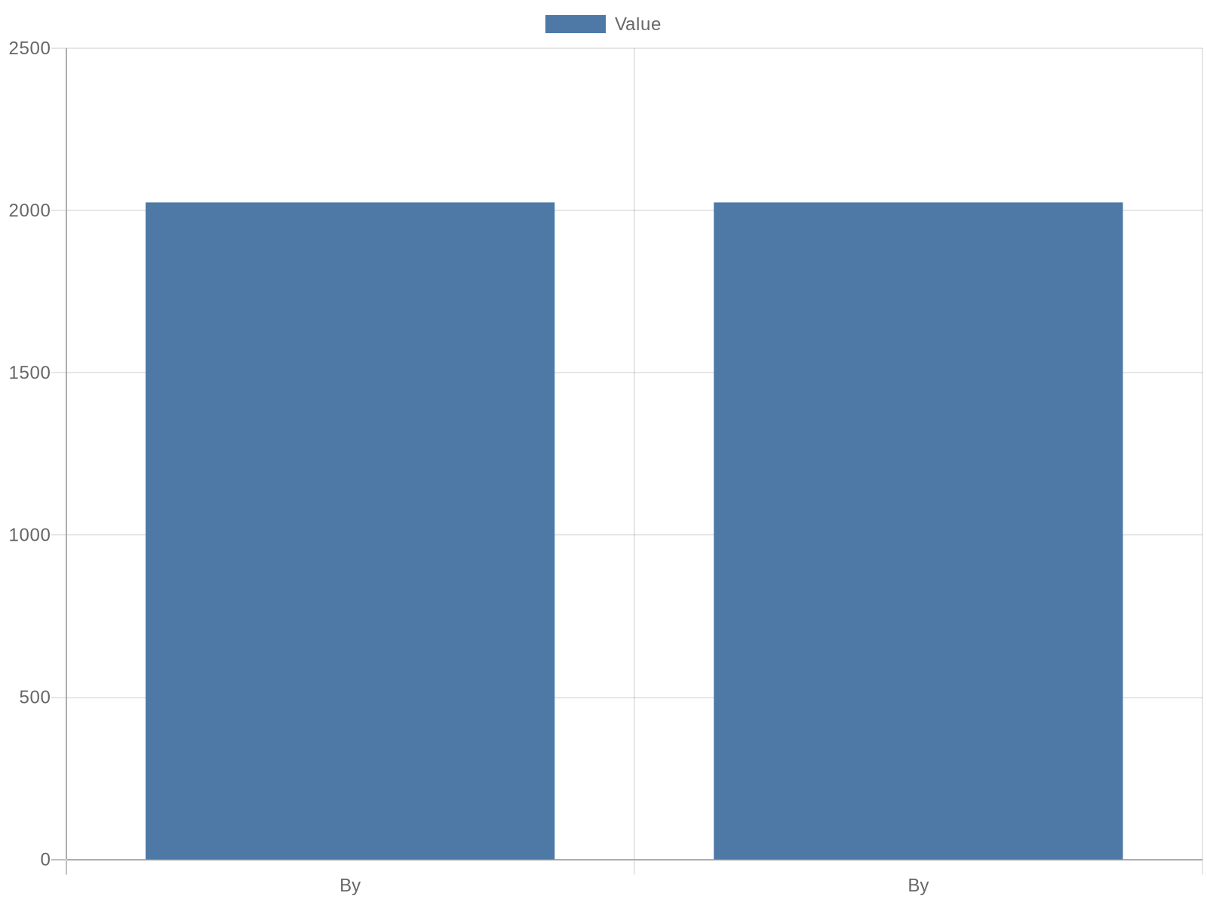
Executive Summary: Opportunities & Challenges
By 2025 the pharmacy sector in Canada faces a unique convergence of opportunity and challenge: expanded clinical scope, growing patient expectations, and accel…
Pharmacies are primary-care access points with expanded clinical roles
Labour shortages and administrative work limit capacity for care
Digital tools and automation can restore clinical time
Measure outcomes: operational KPIs + clinical impact
Notes:
By 2025 the pharmacy sector in Canada faces a unique convergence of opportunity and challenge: expanded clinical scope, growing patient expectations, and accelerating digital innovation come together with persistent workforce shortages and administrative strain. TELUS Health reports that pharmacies are becoming the 'first stop in the primary care journey' for many Canadians, and provincial changes — for example in British Columbia — illustrate rapid scope expansion and a shift toward more prescriptive and preventive services. At the same time, industry analysis highlights labour pressures and time-consuming administrative tasks that limit capacity for clinical care. This slide summarizes the top strategic imperatives: adopt smart automation to reduce administrative burden, reconfigure workflow to prioritize clinical encounters, invest in digital patient engagement, and build a data governance foundation to measure impact and guide continuous improvement.

Slide 4

Current Canadian Landscape: Scope, Regulation, Workforce
The Canadian regulatory and operational landscape is evolving quickly. Several provinces have expanded pharmacists’ prescribing authorities for minor ailments …
Provincial variability in prescribing authority and remuneration
Labour shortages impact service capacity and patient access
Expanded scope increases documentation and communication needs
Strategic response: protocols, staffing models, policy engagement
Notes:
The Canadian regulatory and operational landscape is evolving quickly. Several provinces have expanded pharmacists’ prescribing authorities for minor ailments and increased public remuneration for clinical services; British Columbia has been an early example of scope expansion that reshapes how pharmacies operate in the primary care pathway. Industry reporting emphasizes that scope expansion is not uniform across provinces, creating variability in service models and revenue streams. Alongside regulatory shifts, the sector is contending with labour shortages that affect both capacity and the pace of innovation adoption. Insurance Portal and other coverage-focused analyses note that the expanded scope of practice is changing workflows, documentation requirements, and interprofessional communication. For pharmacy leaders, the implications are clear: standardize clinical protocols where possible, invest in targeted staffing models that reflect service mix, and pursue advocacy for consistent provincial policy to support sustainable service delivery.

Slide 5

Technology Trend: Smart Automation & AI
Smart automation and artificial intelligence are central enablers for reducing administrative burden and scaling services efficiently. TELUS Health’s 2025 phar…
Prioritize automation for high-volume administrative tasks
Use AI for decision support, not sole clinical decision-making
Integrate automation into existing pharmacy information systems
Pilot technologies and measure time-saved and clinical impact
Notes:
Smart automation and artificial intelligence are central enablers for reducing administrative burden and scaling services efficiently. TELUS Health’s 2025 pharmacy trends reporting highlights how AI-driven automation can relieve routine administrative tasks—refill processing, prior authorizations, reconciliation—and free pharmacists for clinical work. The industry report also emphasizes the importance of integrating automation with pharmacy information systems to avoid introduction of new silos. Practical best practices include prioritizing technology that automates repeatable, high-volume tasks; adopting clinical decision support that augments rather than replaces pharmacist judgment; and implementing phased pilots to validate workflow integration before broad rollout. Investment in vendor partnerships, staff training, and change management is critical to derive measurable time savings and improved patient throughput.

Slide 6

Operational Best Practices: Workflow & Staffing
Operational redesign is required to translate expanded scope and digital tools into better patient care. Sources recommend moving from task-based staffing to s…
Shift to role-based staffing: technicians handle admin-intensive tasks
Design physical and digital triage to prioritize clinical encounters
Employ appointment systems to reduce peak-hour overload
Use SOPs and cross-training to improve consistency and resilience
Notes:
Operational redesign is required to translate expanded scope and digital tools into better patient care. Sources recommend moving from task-based staffing to skill-and-role-based models that allocate technicians and assistants to dispensing and administrative workflows while freeing pharmacists for clinical encounters. Optimize physical layout for privacy and triage, establish formal triage protocols for walk-ins and virtual consults, and use scheduling and appointment systems to smooth demand peaks. TELUS Health and industry commentary suggest digital intake forms, automated refill triage, and delegated immunization workflows to reduce interruptions. Investing in cross-training, documented SOPs, and frequent cycle reviews will increase resilience amid labour shortages and support consistent quality across shifts.

Slide 7

Clinical Best Practices: Prescribing & Preventive Care
Clinical practice in pharmacies must align with expanded prescribing authorities and a stronger emphasis on preventive care. TELUS Health notes increasing phar…
Adopt standardized assessment templates for prescribing and triage
Create evidence-based pathways for common minor ailments
Document encounters for billing, continuity, and quality assurance
Integrate preventive care: immunizations, chronic care check-ins
Notes:
Clinical practice in pharmacies must align with expanded prescribing authorities and a stronger emphasis on preventive care. TELUS Health notes increasing pharmacist-led management of minor ailments, and the PTM Review highlights the need to become more patient-centric and data-driven in clinical services. Best practices include standardized assessment templates, evidence-based therapeutic pathways for common conditions, robust documentation to support billing and continuity of care, and clear communication protocols with primary care providers. Pharmacists should also formalize immunization programs, chronic disease check-ins, and medication reviews that leverage bundled care models. Training, clinical oversight, and quality metrics are necessary to ensure safety, demonstrate value, and secure sustainable remuneration.

Slide 8
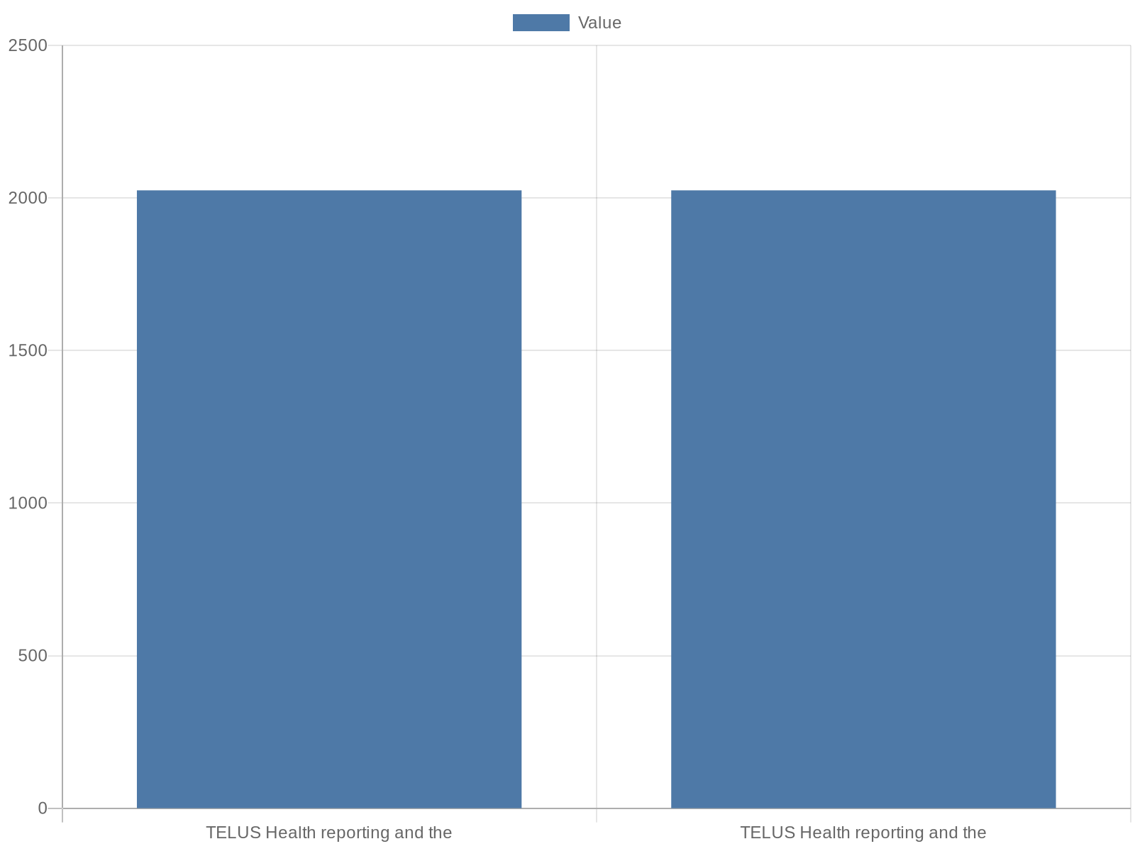
Digital Patient Engagement & Telepharmacy
Digital channels are reshaping patient expectations for access and convenience. TELUS Health reporting and the 2025 pharmacy trends report indicate that patien…
Offer hybrid appointment models with clear virtual triage protocols
Use secure portals for messaging, refills, and remote counseling
Automate reminders and digital consents to reduce no-shows
Measure digital access, satisfaction, and conversion to services
Notes:
Digital channels are reshaping patient expectations for access and convenience. TELUS Health reporting and the 2025 pharmacy trends report indicate that patients are turning to pharmacies as a first point of contact, increasingly expecting virtual touchpoints alongside in-person services. Best practices include offering hybrid appointment models (in-person and virtual), deploying secure patient portals for messaging and prescription management, and using automated reminders and digital consent workflows. Telepharmacy services should have clear protocols for identifying cases suitable for virtual management, escalation pathways to in-person assessment, and privacy safeguards that meet provincial regulations. Measurement should include access metrics, patient satisfaction, and conversion rates from digital contact to billable clinical service.

Slide 9
Data & Analytics: KPIs and Governance
A data-driven approach underpins sustainable transformation. The PTM Review and TELUS Health materials emphasize that pharmacies must become more data driven t…
Define core KPIs across clinical, operational, and financial domains
Build consolidated dashboards for daily and strategic decision-making
Implement data governance and privacy controls aligned to provinces
Begin with a focused metric set and expand as data quality improves
Notes:
A data-driven approach underpins sustainable transformation. The PTM Review and TELUS Health materials emphasize that pharmacies must become more data driven to optimize operations and demonstrate clinical value. Establish a concise KPI set: clinical services delivered per pharmacist-hour, time-to-service for walk-ins, medication adherence rates, revenue per clinical encounter, and technology time-saved metrics. Implement dashboards that combine operational, clinical, and financial data to enable daily management and strategic planning. Equally important is data governance: define ownership, privacy controls aligned with provincial rules, and reporting standards for payers and partners. Start with modest, high-impact metrics and expand measurement capability as workflows stabilize and data quality improves.

Slide 10

Revenue & Financial Strategies
Financial sustainability requires diversifying revenue beyond retail dispensing margins and aligning services with billable clinical activities where permitted…
Diversify revenue: billable clinical services, bundled care, point-of-care testing
Measure cost-to-serve and margin by service line
Invest in technology with clear ROI on labour or revenue uplift
Explore partnerships with clinics and payers for shared-care models
Notes:
Financial sustainability requires diversifying revenue beyond retail dispensing margins and aligning services with billable clinical activities where permitted. Industry analysis including TELUS Health’s 2025 trends suggests pharmacies should identify billable service opportunities—minor ailment prescribing, immunizations, chronic care management—and bundle services (e.g., medication reviews plus follow-up teleconsults) to create predictable revenue streams. Evaluate cost-to-serve by service type, and invest selectively in technologies that demonstrably reduce labour costs or increase billable clinical time. Consider partnerships with clinics and payers for shared-care models, and pursue patient-facing services (point-of-care testing, preventive clinics) that attract new foot traffic and deepen patient relationships. Maintain robust financial tracking per service to inform pricing and staffing decisions.

Slide 11

Workforce & Change Management
Successful implementation depends on workforce engagement and deliberate change management. TELUS Health and trade reporting highlight that labour shortages ar…
Prioritize retention: career pathways and protected clinical hours
Upskill staff with role-specific training and competency checks
Use pilots, champions, and phased rollouts to manage change
Measure workforce KPIs: turnover, coverage, and clinical hours
Notes:
Successful implementation depends on workforce engagement and deliberate change management. TELUS Health and trade reporting highlight that labour shortages are a central constraint; therefore focus should be on retention, upskilling, and role redesign. Best practices include structured onboarding for new tech and clinical protocols, protected time for pharmacist clinical practice within schedules, career pathways for technicians, and regular feedback loops to surface workflow bottlenecks. Change management activities—stakeholder mapping, phased pilots, training roadmaps, and frontline champions—reduce disruption. Align incentives where possible to clinical performance and patient experience outcomes, and track workforce KPIs such as staff turnover, role coverage, and clinical hours per pharmacist.

Slide 12
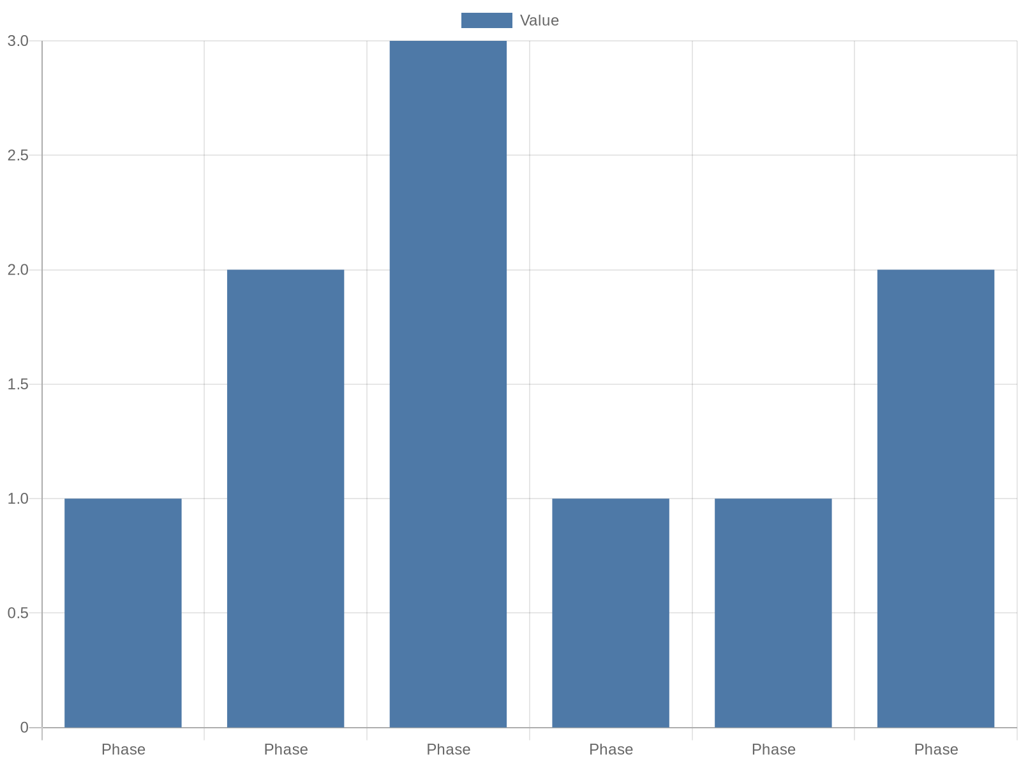
Implementation Roadmap: 12–24 Month Plan
Turn strategy into action with a prioritized, phased roadmap across technology, operations, and clinical services. Phase 1 (0–6 months): stabilize core operati…
Phase 1 (0–6m): pilot automation, define KPIs, targeted training
Phase 2 (6–12m): scale pilots, launch telepharmacy and dashboards
Phase 3 (12–24m): expand billable services, optimize staffing, partner
Use governance gates and ROI checks at each phase
Notes:
Turn strategy into action with a prioritized, phased roadmap across technology, operations, and clinical services. Phase 1 (0–6 months): stabilize core operations, select and pilot automation tools for administrative burden, establish KPI definitions, and run targeted staff training. Phase 2 (6–12 months): scale proven pilots, introduce telepharmacy workflows, standardize clinical templates, and implement dashboards for daily monitoring. Phase 3 (12–24 months): expand billable clinical services, optimize staffing models across sites, and negotiate partnerships with payers or primary-care networks. TELUS Health’s trends reporting supports a staged approach where automation is validated in small pilots prior to broad rollout; the PTM Review underscores the need to be data-driven at each stage. Include governance checkpoints, ROI gates, and continuous improvement cycles to ensure momentum and learning.

Slide 13

Risk Management & Compliance
Managing risk and compliance is essential when expanding clinical services and adopting digital technologies. Provincial regulatory variability requires carefu…
Ensure local compliance for prescribing, documentation, and privacy
Adopt audit-ready documentation and standardized consents
Enforce cybersecurity: RBAC, encryption, and vendor due diligence
Perform regular audits and maintain incident response plans
Notes:
Managing risk and compliance is essential when expanding clinical services and adopting digital technologies. Provincial regulatory variability requires careful local compliance checks for prescribing, documentation, and privacy. Adopt standardized consent and documentation templates, and maintain audit-ready records for clinical encounters and remote consultations. Cybersecurity and privacy safeguards must meet provincial and federal expectations; implement role-based access controls, encrypted communications for telepharmacy, and vendor assessments for data handling. TELUS Health and industry sources highlight automation’s benefits but caution that technology must integrate with governance frameworks to avoid new operational risks. Regular audits, incident response planning, and ongoing regulatory monitoring are recommended.

Slide 14
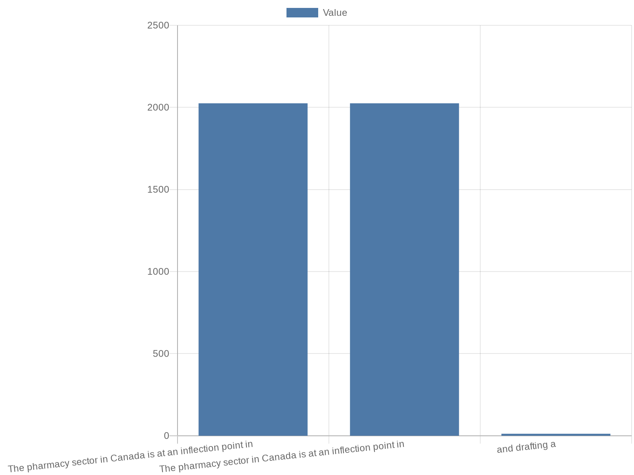
Conclusion & Next Steps
The pharmacy sector in Canada is at an inflection point in 2025: expanded scope and accelerating digital tools create a pathway to greater clinical impact, but…
Immediate: select pilot automation, define core KPIs, train staff
12–24 months: scale what works, expand billable services, partner
Measure success via access, outcomes, workforce capacity, revenue
Maintain governance and continuous improvement cycles
Notes:
The pharmacy sector in Canada is at an inflection point in 2025: expanded scope and accelerating digital tools create a pathway to greater clinical impact, but labour constraints and regulatory variability require careful operational and financial planning. The evidence and industry reporting point toward a coherent strategy: reduce administrative burden through targeted automation, redesign workflows to concentrate pharmacist time on clinical care, develop data and governance foundations, and diversify revenue with billable clinical services. Immediate next steps include selecting a limited automation pilot, defining a focused KPI set, running staff training cycles, and drafting a 12–24 month implementation plan with governance checkpoints. Success will be judged by improved patient access, measurable clinical outcomes, staff capacity for clinical work, and sustainable financial performance.

Slide 15
References
https://resources.telushealth.com/en-ca/the-future-of-technology-innovation-in-pharmacy-trends-for-2025
https://go.telushealth.com/en-ca/2025-pharmacy-trends-report
https://www.ptmreview.com/p/the-best-ideas-transforming-pharmacy-2025
https://retail-insider.com/retail-insider/2025/05/telus-health-report-reveals-pharmacy-sector-at-centre-of-canadas-healthcare-transformation/
https://insurance-portal.ca/article/expanded-scope-of-practice-changing-how-pharmacies-operate-in-canada/
https://www.telus.com/about/news-and-events/media-releases/new-report-telus-healths-inaugural-pharmacy-trends-market-analysis-unveils-canadian-pharmacies-poised-for-1-9b-tech-driven-transformation
https://goodshephealthinstitute.org/pharmacy-trends-to-watch-in-2025/
https://www.statista.com/outlook/hmo/pharmacies/canada
https://www.ashpfoundation.org/pharmacyforecast
https://www.ashp.org/professional-development/ashp-podcasts/hot-topics-in-pharmacy-practice

