Slide 1
Best Practices in Pharmacy: Data-Driven Strategies for 2025
Generated by AgentFire AI

Slide 2
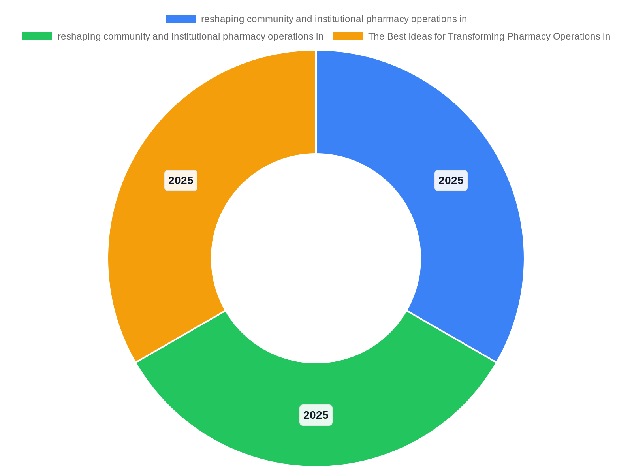
Executive Summary: Pharmacy in 2025
This executive summary synthesizes the strategic forces reshaping community and institutional pharmacy operations in 2025 and sets the stage for the presentati…
2025 theme: data-driven, patient-centric, operationally optimized
Converging drivers: AI, analytics, regulatory change, service diversification
Priority: measurable clinical outcomes and financial ROI
Immediate focus areas: technology, workforce, compliance
Notes:
This executive summary synthesizes the strategic forces reshaping community and institutional pharmacy operations in 2025 and sets the stage for the presentation. Key trends include the rapid adoption of data analytics, AI-assisted workflows, diversification into clinical services, and heightened regulatory compliance pressures. As noted in the PTM Review piece 'The Best Ideas for Transforming Pharmacy Operations in 2025', thriving organizations will be both data driven and patient centric, and must optimize operations while navigating regulatory change. The PioneerRx blog reinforces the importance of platform capabilities that support these trends, and the Digital Health Coalition highlights AI and personalization as cross-cutting drivers. The summary also recognizes DSCSA milestones described by TrackTraceRX and the need to present findings with clarity as recommended by the data-driven presentation guidance included in the PPTX resource. This slide frames the rationale for the subsequent tactical and operational recommendations, prioritizing investments that produce measurable clinical and financial outcomes, support workforce change, and reduce regulatory risk.

Slide 3
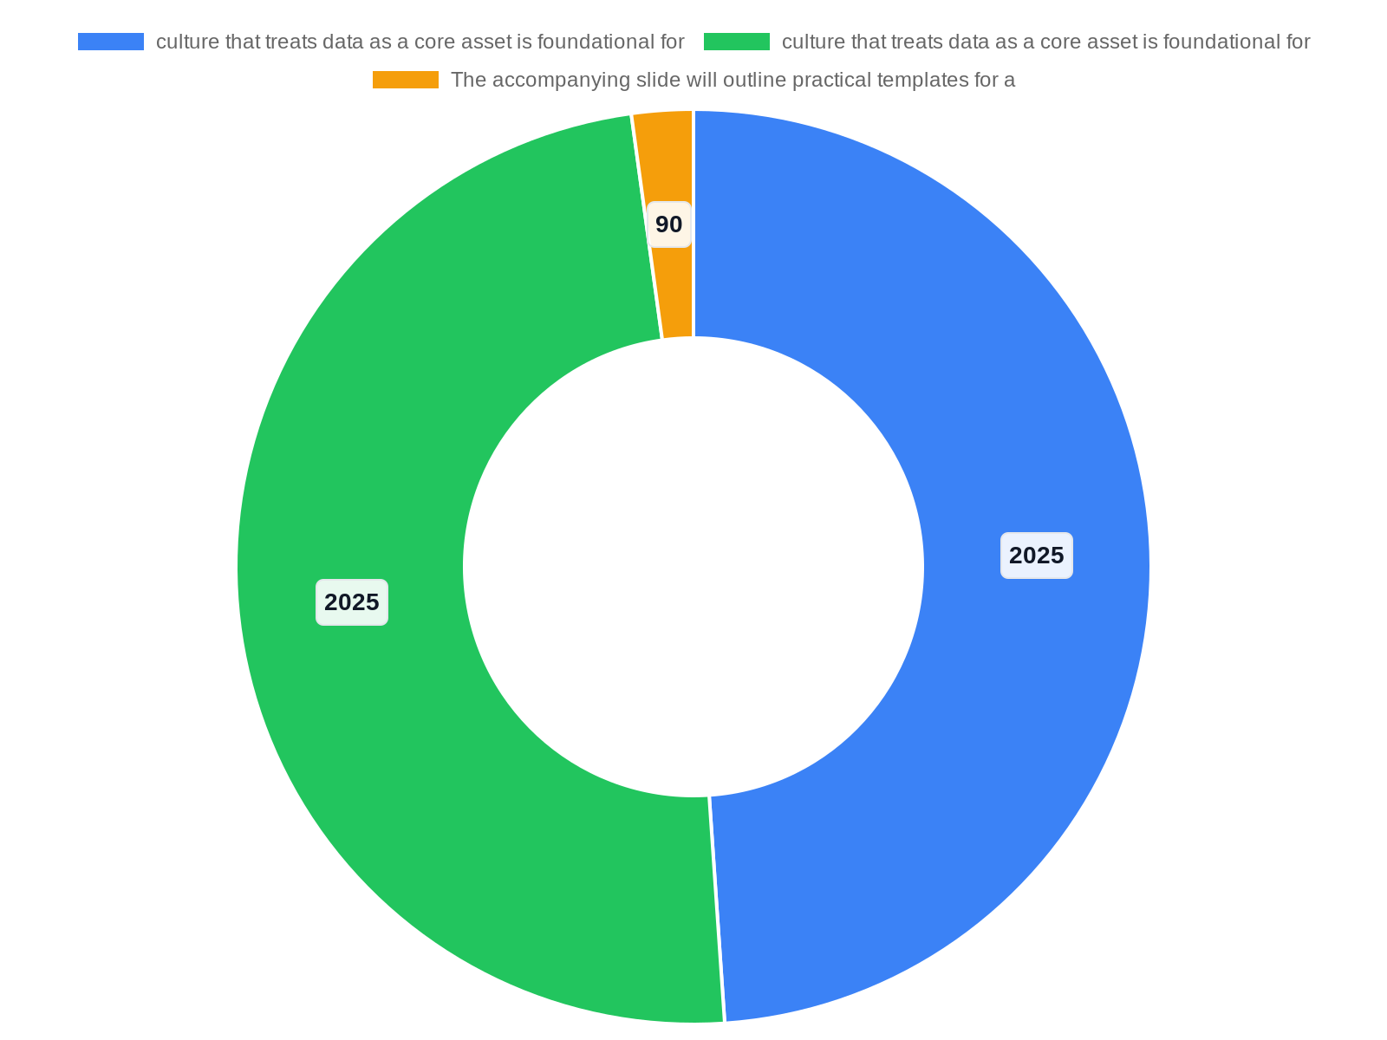
Building a Data-Driven Culture & Capabilities
Creating an organizational culture that treats data as a core asset is foundational for 2025 pharmacy success. The PTM Review emphasizes becoming more data dri…
Embed data governance and shared KPIs across teams
Leverage PioneerRx-capable reports for near-term wins
Map data sources: dispensing, clinical encounters, finances
Train staff on data literacy and decision frameworks
Notes:
Creating an organizational culture that treats data as a core asset is foundational for 2025 pharmacy success. The PTM Review emphasizes becoming more data driven and patient centric; practical steps include governance, shared KPIs, and training that shift decisions from intuition to evidence. PioneerRx identifies system features that enable operational reporting and patient engagement, highlighting the need for vendor partnerships that facilitate access to real-time dispensing, adherence, and revenue data. The Digital Health Coalition's trend analysis reinforces investments in analytics and personalization to improve outcomes. Operationalizing data requires: (1) data governance policies, (2) mapped data flows from point-of-sale and clinical documentation through business intelligence, and (3) role-based training for pharmacists and technicians. The accompanying slide will outline practical templates for a 90-day data maturity assessment, common pitfalls in data quality, and a sample governance RACI to accelerate adoption.

Slide 4
Technology Stack: AI, Analytics, and Interoperability
Selecting and integrating the right technology stack is a top priority in 2025. Sources highlight AI and advanced analytics as enabling higher-value care; the …
Core: API-first dispensing/POS and robust reporting
Analytics layer: operational + clinical dashboards
AI tools: adherence prediction and triage support
Interoperability: EHR/HIE and DSCSA traceability
Notes:
Selecting and integrating the right technology stack is a top priority in 2025. Sources highlight AI and advanced analytics as enabling higher-value care; the Digital Health Coalition predicts personalization and AI-driven workflows will be mainstream. PTM Review advises embracing technology to become more data driven and patient centric, while PioneerRx describes practical product features that support inventory management, clinical services, and reporting. TrackTraceRX underscores the importance of DSCSA-compliant serialization and tracing for supply-chain integrity. A modern pharmacy stack includes: a dispensing and POS core with open APIs, an analytics/BI layer for operational and clinical reporting, an AI-assisted clinical decision support tool for adherence and interventions, and secure interoperability connectors (HIE, EHR, payer). This slide will also discuss vendor selection criteria, integration sequencing to avoid workflow disruption, and risk controls for AI outputs.

Slide 5

Operational Optimization & Workflow Automation
Optimized operations reduce cost, errors, and staff burnout while enabling expanded clinical services. PTM Review explicitly calls for optimizing operations as…
Redesign workflows to prioritize clinical services
Automate routine dispensing and refill tasks first
Use robotics and barcode scanning where ROI supports
Measure throughput, errors, and staff time freed
Notes:
Optimized operations reduce cost, errors, and staff burnout while enabling expanded clinical services. PTM Review explicitly calls for optimizing operations as a pillar for success in 2025; this encompasses workflow redesign, automation, and continuous process measurement. PioneerRx feature guidance shows how automation in dispensing and refill workflows can free pharmacist time for patient care. Practical measures include standard operating procedures for high-volume processes, barcode and robotics-assisted dispensing where ROI-positive, centralized refill processing, and use of rules-based exceptions to reduce manual interventions. The slide will describe a stepwise automation roadmap: identify high-effort processes, pilot automation with measurable KPIs, scale proven automations, and continuously monitor throughput and error rates. A focus on change management ensures staff buy-in and sustainable benefits.

Slide 6
Patient-Centric Services & Diversification
Diversifying services to include immunizations, chronic-condition management, pharmacogenomic counseling, and point-of-care testing shifts pharmacies from tran…
Select services by population need and reimbursement potential
Enable programs with analytics-driven patient identification
Standardize protocols and documentation templates
Measure outcomes and revenue per patient
Notes:
Diversifying services to include immunizations, chronic-condition management, pharmacogenomic counseling, and point-of-care testing shifts pharmacies from transactional to clinical care hubs. The PTM Review stresses becoming more patient centric; PioneerRx also highlights features enabling clinical program tracking. The Digital Health Coalition identifies personalization and DTP (direct-to-patient) models as growth areas that increase capture of clinical value. This slide outlines service selection criteria: population health needs, payer reimbursement pathways, staff skill requirements, and technology enablement. It provides an implementation checklist for a pilot service (e.g., hypertension management): patient identification using analytics, standardized clinical protocols, documentation templates, outcome measures, and contracting for reimbursement. The slide emphasizes measuring clinical outcomes and revenue per patient to validate long-term investment.

Slide 7

Regulatory Environment & DSCSA Compliance
Navigating regulatory requirements is non-negotiable in 2025, particularly with DSCSA full implementation and updated FDA guidance. TrackTraceRX discusses DSCS…
Ensure DSCSA-compliant systems for serialization and traceability
Update SOPs for returns, recalls, and investigations
Maintain audit trails for privacy and controlled substances
Run periodic recall and compliance drills
Notes:
Navigating regulatory requirements is non-negotiable in 2025, particularly with DSCSA full implementation and updated FDA guidance. TrackTraceRX discusses DSCSA milestones and the operational impacts of serialization and traceability obligations. PTM Review flags regulatory navigation as a strategic imperative while emphasizing innovation within compliance boundaries. Practical actions include ensuring vendor systems support DSCSA transaction history and unit-level tracing, updating standard operating procedures for returns and investigations, and training supply-chain staff on traceability workflows. The slide also covers privacy and controlled-substance monitoring obligations, highlighting the importance of audit trails, secure messaging with providers, and a compliance calendar for state and federal reporting. Clear escalation paths for recalls and a tested recall drill are recommended to minimize patient risk and reputational damage.

Slide 8

Workforce Transformation & Training
Workforce strategy is central to implementing technological and service changes. PTM Review and PioneerRx both note that transforming operations requires staff…
Shift technicians into advanced, protocol-driven roles
Train pharmacists on clinical documentation and AI tools
Use competency-based assessments and mentorship
Cross-train staff for scheduling flexibility
Notes:
Workforce strategy is central to implementing technological and service changes. PTM Review and PioneerRx both note that transforming operations requires staff capability shifts—technicians taking advanced roles and pharmacists focusing on clinical interventions. Training should cover data literacy, new clinical protocols, technology use (including AI-assisted decision tools), and customer-centered communication. This slide provides a phased training plan: baseline skills assessment, role redesign workshops, competency-based training modules, and an ongoing mentorship program. It emphasizes measurable competency checks and cross-training to improve scheduling flexibility. The slide also addresses recruitment strategies for hard-to-fill roles and retention levers like career pathways tied to expanded service delivery.

Slide 9

Revenue Models & Diversification Strategies
Sustainable revenue requires moving beyond fill-based margins to fee-for-service and value-based arrangements. The PTM Review advocates diversifying services; …
Prioritize fee-for-service and value-based contracts
Model margins and time-to-break-even for new services
Use PioneerRx billing features to track service revenue
Negotiate payer arrangements with documented outcomes
Notes:
Sustainable revenue requires moving beyond fill-based margins to fee-for-service and value-based arrangements. The PTM Review advocates diversifying services; PioneerRx outlines product features that support service billing and tracking. The Digital Health Coalition highlights direct-to-patient models and targeted HCP engagement as commercial levers. This slide details revenue levers: billable clinical services (immunizations, medication therapy management), payer contracts and CAP agreements, point-of-care testing with throughput models, and retail optimization. It includes a decision framework for prioritizing services based on margin potential, capital intensity, and time-to-break-even. Practical considerations include contracting templates, coding guidance, and systems for capturing service-level revenue and outcomes to support payer negotiations.

Slide 10

Metrics & KPIs for 2025 Pharmacies
Defining and tracking the right metrics turns strategy into measurable performance. The research context emphasizes measurement as core to becoming data driven…
Track financial, operational, clinical, and compliance KPIs
Define data sources and reporting cadence for each KPI
Use baseline vs. target tiers for early and mature programs
Institute governance rhythms for KPI review and action
Notes:
Defining and tracking the right metrics turns strategy into measurable performance. The research context emphasizes measurement as core to becoming data driven; PTM Review and PioneerRx both stress operational and clinical KPIs. Recommended KPI categories include financial (fill margin, service revenue, EBITDA contribution), operational (turnaround time, error rate, staff productivity), clinical (adherence rates, immunization uptake, clinical intervention acceptance), and compliance (traceability audit pass rate, recall response time). This slide provides sample KPI definitions, data sources, frequency of reporting, and acceptable targets for early adopters versus mature programs. It also outlines a KPI governance rhythm with weekly operational huddles, monthly executive reviews, and quarterly strategy recalibration tied to measured outcomes.

Slide 11
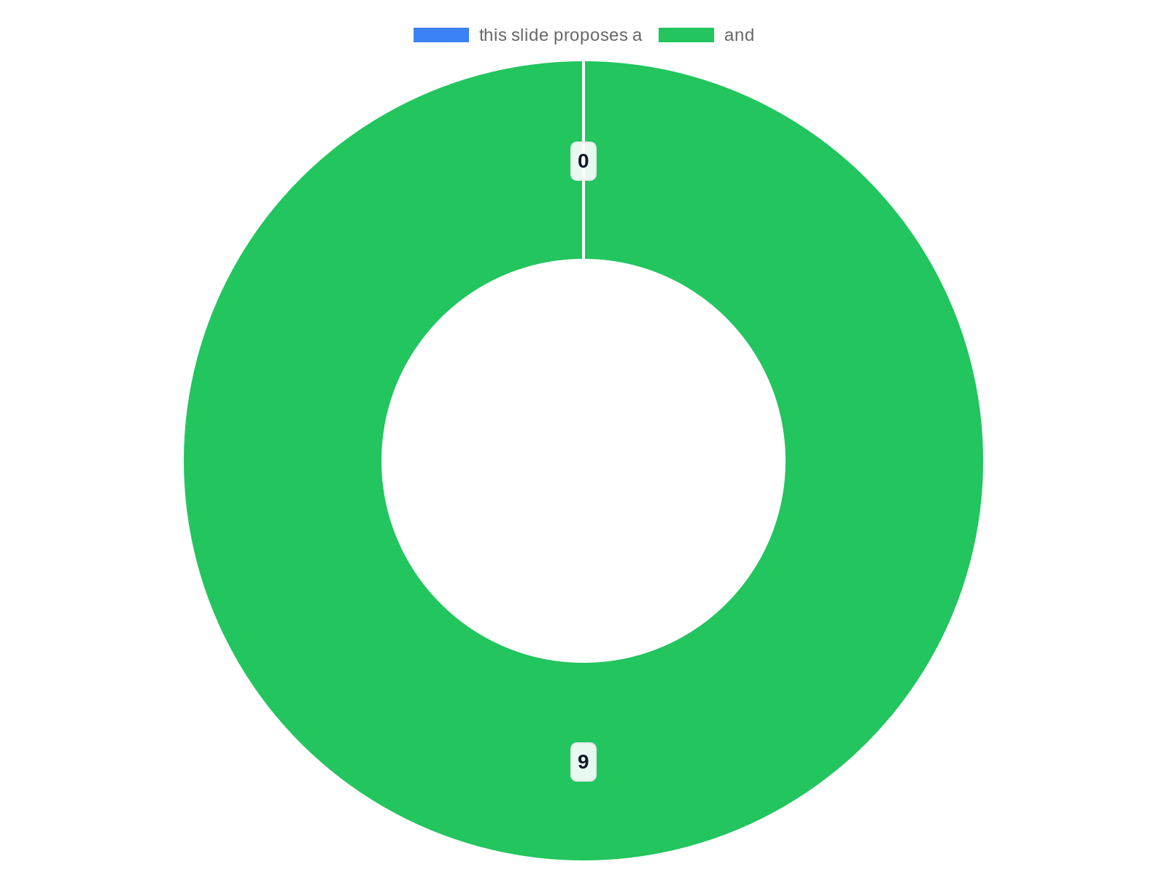
Implementation Roadmap: Quick Wins to 18 Months
An actionable roadmap accelerates transformation while managing risk. Drawing on the PTM Review's recommendation to embrace technology and optimize operations,…
0–90 days: reporting, refill standardization, pilot one clinical service
90–270 days: analytics dashboards, workflow automation pilots, DSCSA readiness
9–18 months: scale services, payer contracting, AI tool pilot
Use gating criteria and MVP checklists to manage scope
Notes:
An actionable roadmap accelerates transformation while managing risk. Drawing on the PTM Review's recommendation to embrace technology and optimize operations, and PioneerRx's feature-based guidance, this slide proposes a 0–90 day, 90–270 day, and 9–18 month sequencing. Quick wins: deploy high-value reports, standardize refill workflows, and launch one pilot clinical service using existing staff. Medium-term: integrate analytics dashboards, implement select automation (barcode/robotics), and formalize DSCSA traceability if not already in place, consistent with TrackTraceRX guidance. Longer term: scale clinical services, negotiate payer contracts, and deploy AI-assisted decision support informed by Digital Health Coalition insights. The roadmap includes gated criteria for scale decisions, owner assignments, and a minimal viable product (MVP) checklist to limit scope creep.

Slide 12
Risk Management & Cybersecurity
As pharmacies digitize, cyber and operational risk management become paramount. The research context stresses technology adoption; with that comes responsibili…
Conduct asset-based cyber risk assessments and vendor due diligence
Implement role-based access controls and encryption for PHI
Maintain tested incident response and backup procedures
Train staff on phishing and social engineering defenses
Notes:
As pharmacies digitize, cyber and operational risk management become paramount. The research context stresses technology adoption; with that comes responsibility for data protection and system resilience. This slide outlines an enterprise approach: risk assessment for digital and physical assets, vendor security due diligence, role-based access controls, and regular penetration testing and vulnerability scanning. It recommends encrypting PHI in transit and at rest, maintaining secure backups, and having an incident response playbook that maps to regulators' reporting expectations. Training front-line staff on phishing and social engineering is emphasized. Finally, the slide covers third-party risk, particularly for cloud vendors and robotics suppliers, and suggests contractual security requirements and periodic audits.

Slide 13
Case Studies, Metrics, and Next Steps
Closing with practical examples and an actionable checklist helps teams convert insight to action. This slide will summarize anonymized case studies illustrati…
Anonymized case studies showing operational and clinical gains
Documented metrics: turnaround time, adherence, compliant traceability
Lessons learned and common pitfalls for scaling
Prioritized next-steps with owners and timelines
Notes:
Closing with practical examples and an actionable checklist helps teams convert insight to action. This slide will summarize anonymized case studies illustrating: (1) a community pharmacy that reduced refill turnaround 30% and redeployed pharmacist hours to clinical services after PioneerRx-driven workflow changes; (2) an independent that implemented DSCSA traceability practices aligned with TrackTraceRX guidance and avoided a recall escalator; and (3) a pilot program that used data-driven patient segmentation to lift medication adherence for a chronic cohort, an approach consistent with PTM Review and Digital Health Coalition recommendations. Each case includes the problem, intervention, measurable outcomes, and lessons learned. The slide ends with a prioritized next-steps checklist—immediate actions, medium-term investments, and governance items—so leadership can convene a transformation sprint with clear owners and timelines.

Slide 14
References
https://www.ptmreview.com/p/the-best-ideas-transforming-pharmacy-2025
https://www.pioneerrx.com/blog/pharmacy-trends-to-look-out-for-in-2025-and-pioneerrx-features-that-can-help
https://cebbidoh.org/wp-content/uploads/2025/01/DATA-DRIVEN-PRESENTATION.ppt.pptx
https://www.tracktracerx.com/reinventing-pharmacy-in-2025-whats-next/
https://digitalhealthcoalition.org/predicting-2025-trends/
https://careset.com/9-key-pharma-industry-trends-shaping-2025-strategies/
https://www.slideteam.net/top-10-pharmacies-powerpoint-presentation-templates
https://pmc.ncbi.nlm.nih.gov/articles/PMC5085323/
https://academic.oup.com/ajhp/article/82/2/17/7917650
https://pmc.ncbi.nlm.nih.gov/articles/PMC8554595/

