Slide 1
Growth Best Practices in Vaccine Administration and Prescription: The Role of Pharmacists in Canada 2025
Generated by AgentFire AI

Slide 2
Introduction to Vaccine Administration

Slide 3
The Impact of Pharmacists on Vaccine Administration

Slide 4
Best Practices in Vaccine Administration

Slide 5
Current Trends in Vaccine Administration

Slide 6
Statistics on Vaccine Uptake

Slide 7
Challenges in Vaccine Administration

Slide 8
The Future of Pharmacy Practices in Vaccine Administration

Slide 9
Case Studies of Successful Pharmacy Initiatives

Slide 10
Recommendations for Enhancing Vaccine Administration

Slide 11
Key Takeaways

Slide 12
Call To Action

Slide 13
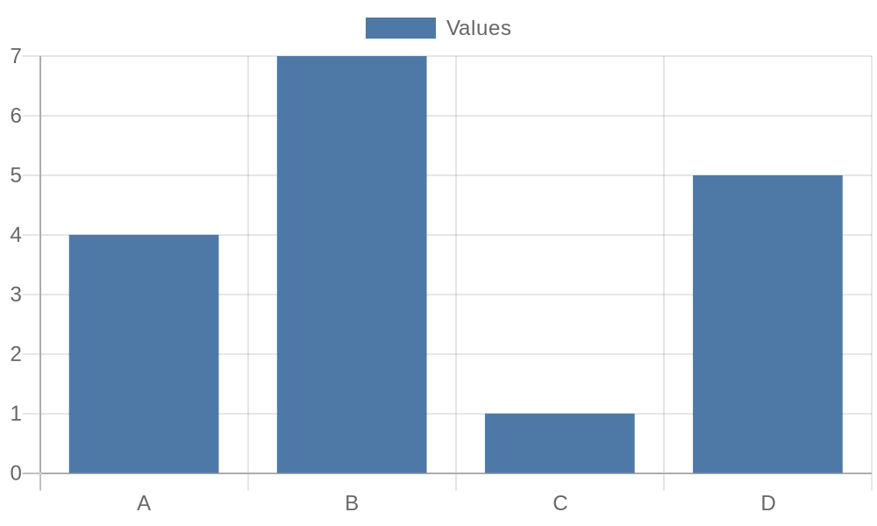
Additional Data 1

Slide 14
Additional Data 2

Slide 15
Additional Data 3

Slide 16
Additional Data 4

Slide 17
Additional Data 5

Slide 18

Additional Image 1

Slide 19
Additional Image 2

Slide 20
Additional Image 3

Slide 21
Additional Image 4

Slide 22
Additional Image 5

Slide 23
References
https://www.cpha.ca
https://www.pharmacists.ca
https://www.canada.ca/en/public-health.html
https://www.statcan.gc.ca
https://www.pharmacytechnicians.ca
https://www.ncbi.nlm.nih.gov
https://www.worldhealthorganization.org
https://www.health.gov.on.ca/en/pro/programs/immunization
https://www.pharmacytimes.com

