Slide 1
Pharmacy Best Practices in 2025 and Impact of Pharmacists in British Columbia
Generated by AgentFire AI

Slide 2
Introduction to Pharmacy Best Practices 2025

Slide 3
Technological Advancements in Pharmacy

Slide 4
Patient-Centered Care in Pharmacy

Slide 5
Expanded Roles of Pharmacists in 2025

Slide 6
Digital Tools in Pharmacy Practice

Slide 7
Impact of Pharmacists in British Columbia

Slide 8
Challenges and Opportunities in Pharmacy 2025

Slide 9
Key Takeaways

Slide 10
Call to Action

Slide 11
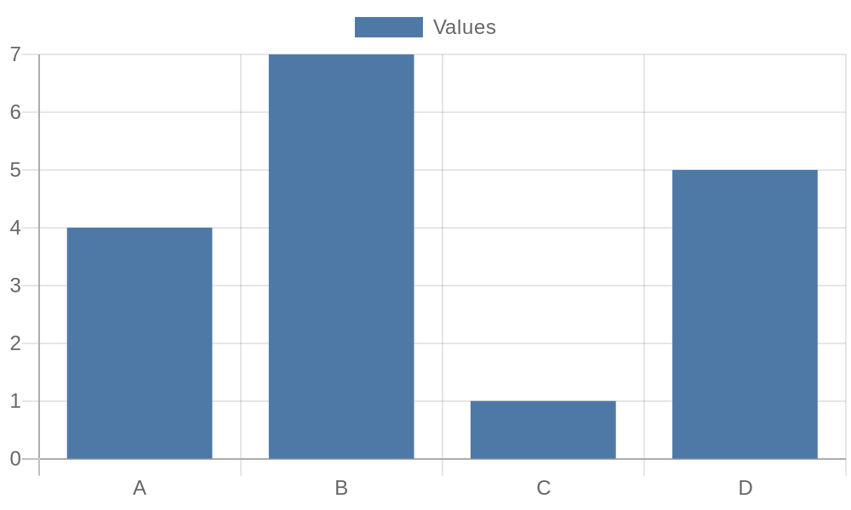
Additional Data 1

Slide 12
Additional Data 2

Slide 13
Additional Data 3

Slide 14
Additional Data 4

Slide 15
Additional Data 5

Slide 16

Additional Image 1

Slide 17
Additional Image 2

Slide 18
Additional Image 3

Slide 19
Additional Image 4

Slide 20
Additional Image 5

Slide 21
References
https://www.pharmacypractice.ca
https://www.pharmacists.ca
https://www.bccdc.ca
https://www.health.gov.bc.ca
https://www.canada.ca/en/health-canada.html
https://www.who.int
https://www.cdc.gov
https://www.pharmacytimes.com

