Slide 1
Pharmacy Best Practices in Canada in 2025
Generated by AgentFire AI

Slide 2

Introduction to Pharmacy Best Practices
Overview of key practices
Importance of best practices
Impact on healthcare

Slide 3
Emerging Trends in Pharmacy
Integration of AI technology
Telepharmacy services
Personalized medicine advances

Slide 4

Evolving Role of Pharmacists
Expanded patient care roles
Collaborative practices with healthcare teams
Increased focus on preventive care

Slide 5
Regulatory Developments
Updated pharmaceutical regulations
Compliance requirements
Impact of regulation on practice

Slide 6
Digital Transformation in Pharmacies
Adoption of e-prescriptions
Digital health records management
Cybersecurity measures

Slide 7
Patient Engagement Strategies
Enhancing patient education
Building trust and loyalty
Utilization of mobile apps

Slide 8
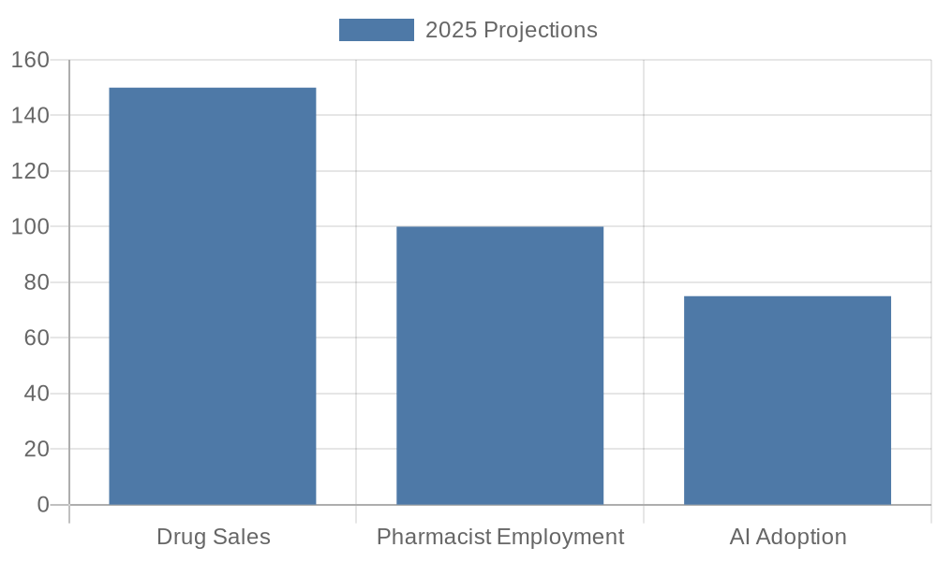
Chart: Canadian Pharmacy Market Statistics 2025

Slide 9
Case Study: Best Practices Implementation
Summary of successful initiatives
Challenges and solutions
Results and impact

Slide 10
Image: Future of Pharmacies

Slide 11
Conclusion and Future Prospects
Summarization of key points
Future outlook for pharmacies
Continuous improvement strategies

Slide 12
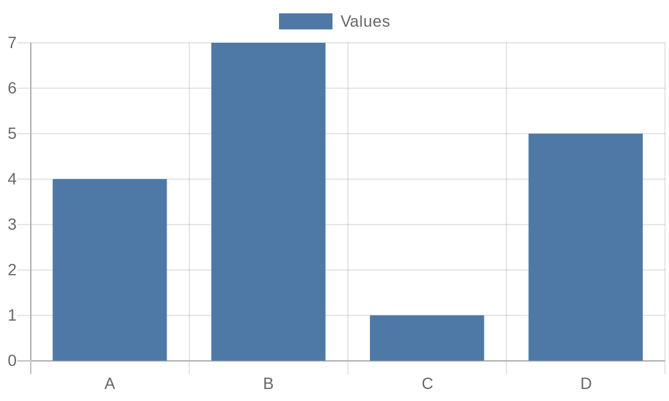
Additional Data 2

Slide 13
Additional Data 3

Slide 14
Additional Data 4

Slide 15
Additional Data 5

