Slide 1
Student Engagement: Why It Matters and How to Present It
Generated by AgentFire AI

Slide 2

Cover & Presentation Objectives
present the title, presenter name, affiliation, date, and three clear objectives for the deck — define student engagement, explain why it matters for learning …
Title, presenter, affiliation, date
Three clear learning objectives for the deck
Design note: minimal, high-contrast layout
Data provenance: use institutional LMS/assessment data
Timing and Q&A expectations
Notes:
present the title, presenter name, affiliation, date, and three clear objectives for the deck — define student engagement, explain why it matters for learning and retention, and show how to visualize engagement data effectively for stakeholders. Use the research context to justify slide design choices and audience expectations: Ten simple rules for effective presentation slides emphasizes clarity, minimal text per slide, and consistent visual language; Microsoft's guidance on creating and delivering effective presentations reinforces the need for readable typography, accessible color contrast, and purposeful slide sequencing. State that charts included in later slides are illustrative and that institution-level LMS or assessment data should feed the visualizations. End with a brief note on timing and interaction: indicate slide count and suggested Q&A time. This slide should be visually minimal, using a single high-contrast title, a professional headshot or logo, and three concise objective bullets so the audience immediately knows what to expect. Use the Research context to support the choice of minimalism and legible design, and note that later slides will reference presentation design best practices for accessibility and audience engagement.

Slide 3
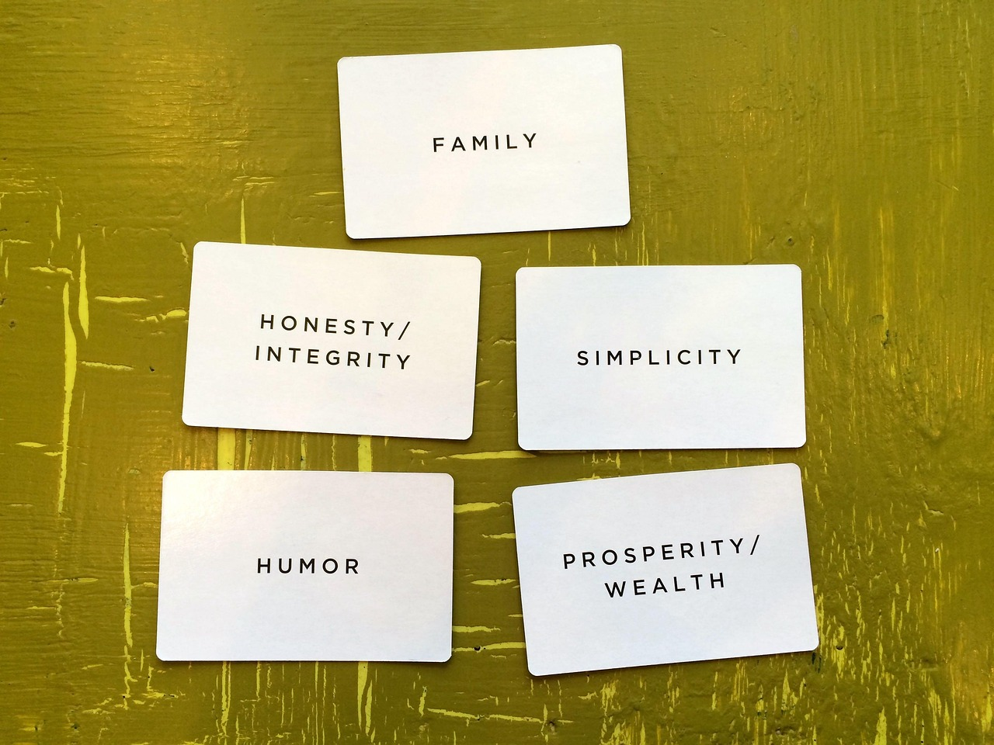
Why Student Engagement Matters
engagement is a multi-dimensional construct that includes behavioral, emotional, and cognitive components, and it correlates with improved persistence, deeper …
Engagement = behavioral + emotional + cognitive components
Observable indicators: attendance, participation, LMS activity
Link to outcomes: persistence, learning depth, completion
Use local data sources; avoid invented figures
Disaggregate metrics for equity-focused action
Notes:
engagement is a multi-dimensional construct that includes behavioral, emotional, and cognitive components, and it correlates with improved persistence, deeper learning, and higher course completion rates when measured and supported. Use the Research context to frame messaging: the Ten simple rules for effective presentation slides highlights clarity and narrative flow—so present this slide as a short narrative: define engagement, state its observable indicators (attendance, participation, assignment submission, LMS interactions), and connect those indicators to institutional priorities such as retention and equity. Microsoft's guidance on presentations suggests keeping each slide focused on a single idea; here, the single idea is the causal importance of engagement to learning outcomes and institutional goals. Avoid presenting fabricated statistics; instead instruct the audience on how to pull verifiable metrics from their own systems (institutional research, LMS analytics, course evaluations). Conclude with a call to action: measure engagement regularly, disaggregate by student subgroups for equity insights, and prioritize interventions with clear evaluation plans. Cite the Research context narrative to justify the slide's structure and to remind presenters that effective slides foreground one idea per slide.

Slide 4

Key Metrics to Track (and Where to Get Them)
course attendance and synchronous participation logs, LMS interaction metrics (logins, page views, assignment submissions, discussion posts), assessment outcom…
Behavioral: attendance, LMS logins, submission timestamps
Cognitive: quiz attempts, assignment completion rates
Emotional: survey responses, qualitative feedback
Source guidance: institutional research + LMS exports
Operational notes: standardize definitions and respect privacy
Notes:
course attendance and synchronous participation logs, LMS interaction metrics (logins, page views, assignment submissions, discussion posts), assessment outcomes (formative quiz attempts, grades), and qualitative signals (student surveys, instructor observations). The Research context supports presenting this content concisely: Ten simple rules for effective presentation slides recommends that complex data be introduced incrementally and visually, while Microsoft's tips recommend showing only the most relevant metrics per stakeholder. Provide practical guidance: prioritize 3–6 metrics per course to avoid information overload, align metrics to learning objectives, and document definitions and collection windows to ensure comparability. Advise pulling raw counts and timestamps from LMS exports and matching them to enrollment and demographic data from institutional research offices to enable disaggregation. Warn about common pitfalls: inconsistent definitions across courses, privacy constraints (FERPA/GDPR considerations), and over-reliance on a single metric. Suggest scheduling regular data checks and establishing a small dashboard for operational use, emphasizing that the Research context highlights the value of clarity and audience-tailored visuals when presenting such dashboards.

Slide 5
Designing Effective Charts for Engagement
Ten simple rules for effective presentation slides emphasizes restraint—avoid cluttered charts and favor simple, readable graphics. Microsoft's presentation ti…
Line charts for trends; bar charts for group comparisons
Stacked bars for composition; scatter plots for relationships
Annotate key points; include a single takeaway caption
Use colorblind-safe palettes and readable fonts
Prepare an appendix with detailed analytical charts
Notes:
Ten simple rules for effective presentation slides emphasizes restraint—avoid cluttered charts and favor simple, readable graphics. Microsoft's presentation tips recommend legible fonts, clear labels, and use of contrast. Recommend chart choices tied to analytic goals: line charts for time-series engagement trends (e.g., weekly LMS activity), bar charts for comparing groups (e.g., engagement by cohort or demographic subgroup), stacked bars for composition (e.g., types of interactions), and scatter plots for relationship exploration (e.g., engagement vs. grades). For audience-facing slides, favor aggregated summary visuals with clear annotations and avoid showing raw transaction-level logs. Stress accessibility: use color palettes that are colorblind-safe, include data labels or callouts for key points, and provide a single takeaway caption under each chart. Finally, advise preparing an appendix with more granular charts for analysts. This slide should reference the Research context to justify the focus on clarity, accessibility, and single-message visual design.

Slide 6
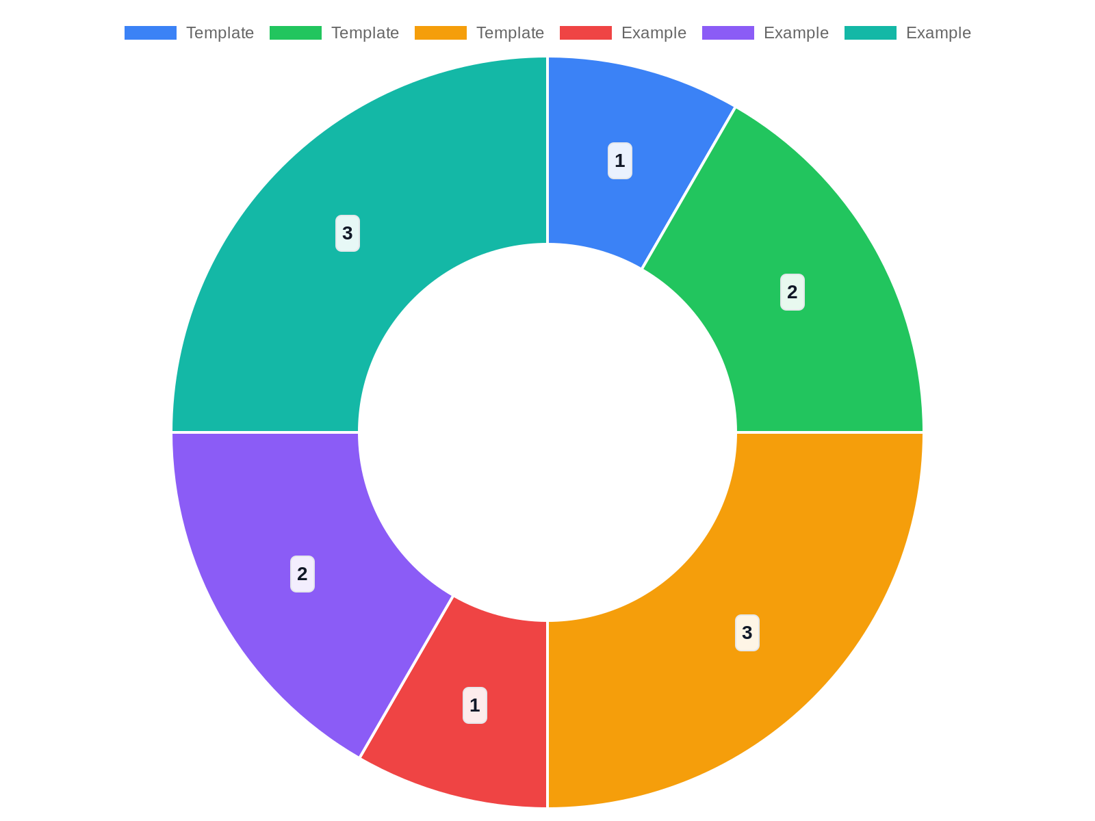
Example Visualizations (Templates & Guidance)
Instead of supplying fabricated figures, this slide presents practical templates and step-by-step instructions for building engagement visuals from institution…
Template 1: Weekly active users — line chart, filters: section/modality
Template 2: Engagement vs. performance — scatter plot with trendline
Template 3: Engagement by subgroup — grouped bar chart, show spread
Data prep: dedupe IDs, normalize timestamps, define scoring windows
Validate charts against academic calendar events
Notes:
Instead of supplying fabricated figures, this slide presents practical templates and step-by-step instructions for building engagement visuals from institutionally sourced data. Each template includes the analytic question, recommended visualization type, filters to apply, and suggested narrative. Example 1: 'Weekly active users' — analytic question: how does student platform activity evolve over the term? Visualization: line chart of unique weekly learners; filters: course section and delivery modality. Example 2: 'Engagement vs. performance' — analytic question: do higher interaction rates align with better outcomes? Visualization: scatter plot of cumulative LMS interactions vs. final grade with a fitted trendline; filters: assignment completion status. Example 3: 'Engagement by subgroup' — analytic question: are there equity gaps? Visualization: grouped bar chart showing average weekly activity by demographic subgroup with confidence intervals or interquartile ranges. For each template, the Research context suggests keeping visuals uncluttered and annotated with concise takeaways, and Microsoft's guidance recommends choosing clear axis labels and limiting series per chart. Provide instructions for exporting the required data from LMS and for basic cleaning steps: de-duplicate user IDs, normalize timestamps to course timezone, and create consistent scoring windows. Include a note on validating visualizations against known events (e.g., midterm week) to ensure spikes or drops have plausible explanations and are not artifact of data processing.

Slide 7

Interpreting Visuals: Common Patterns & Pitfalls
steady increases in weekly activity may reflect sustained engagement interventions; abrupt drops often align with assessment windows or breaks and should be cr…
Check context: calendar events can cause spikes/dips
Pitfall: activity ≠ learning quality; avoid causal claims
Always show sample size and note missing data
Triangulate quantitative visuals with qualitative feedback
Pre-presentation checklist: question, labels, takeaway, caveat
Notes:
steady increases in weekly activity may reflect sustained engagement interventions; abrupt drops often align with assessment windows or breaks and should be cross-checked with calendar events. Then discuss pitfalls: conflating activity volume with learning quality, misreading correlation as causation, and overgeneralizing from small sample sizes. Use the Research context to support communication technique: Ten simple rules for effective presentation slides recommends signaling uncertainty and providing context rather than presuming the audience will infer limitations. Microsoft's tips emphasize clear legends and avoiding overlong axis labels that can obscure meaning. Recommend including a short 'limitations' footnote under each visual: mention sample size, missing data, and potential confounders (e.g., assignment deadlines). Advise analysts to run follow-up checks before broadcasting conclusions: check for bots or automated activity, examine subgroup denominators, and triangulate with qualitative feedback. Finally, provide a short checklist presenters can use to confirm a chart is ready for an audience: clarity of question, correct labeling, a single takeaway, and an explicit caveat or limitation statement.

Slide 8

Design & Delivery Best Practices
focus slides on single messages, use large readable fonts, limit bullet counts, and employ progressive disclosure for complex findings. Microsoft's guidance co…
Single-message slides, large readable fonts, minimal bullets
Rehearse transitions and use presenter view for speaker notes
Lead with takeaway, then show the visual, then unpack it
Ensure accessibility: contrast, alt-text, verbal descriptions
Provide links to interactive dashboards instead of raw tables
Notes:
focus slides on single messages, use large readable fonts, limit bullet counts, and employ progressive disclosure for complex findings. Microsoft's guidance complements this with delivery tips: rehearse transitions, use the presenter view for notes, and make live demos or dashboards accessible via links rather than embedding large tables. Emphasize rhetorical moves for charts: lead with the takeaway, then show the visual briefly before unpacking key elements, and finally close with action recommendations. Discuss accessibility and inclusivity: use sufficient color contrast, include alt-text for critical visuals in shared slide decks, and describe visuals verbally for remote or visually impaired participants. Recommend practicing with timing, especially if walking stakeholders through interactive dashboards. Conclude by reminding presenters that design discipline (as recommended in the Research context) supports audience comprehension and decision-making, and that thoughtful delivery amplifies the impact of data-driven narratives about student engagement.

Slide 9
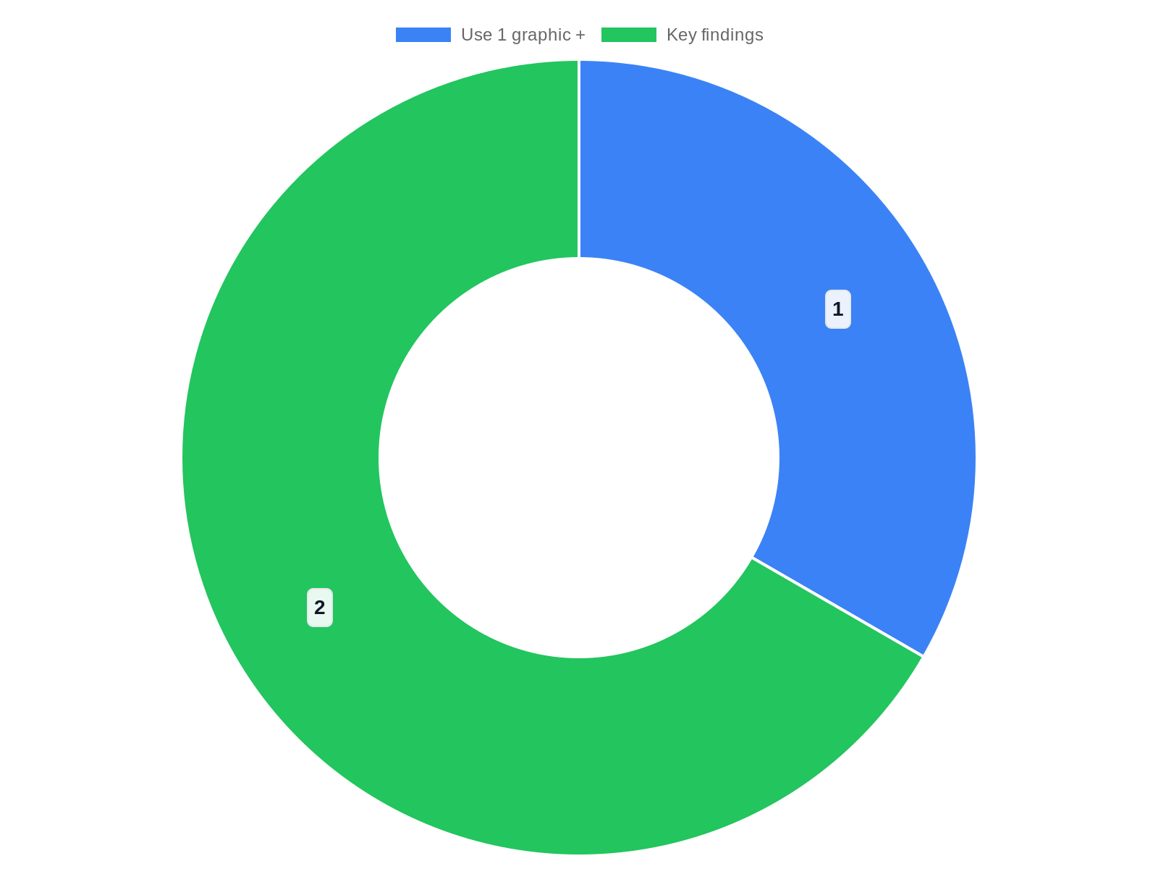
Case Study Framework for Stakeholder Presentations
Ten simple rules for effective presentation slides recommends thinking about audience needs and tailoring content accordingly, while Microsoft's tips emphasize…
Three-segment structure: context, key findings, recommendations
Tailor messages: faculty = actionable; leaders = strategic
Use 1 graphic + 1 takeaway per findings slide
Include an appendix for technical detail and subgroup analyses
Rehearse Q&A and be ready to show appendix on demand
Notes:
Ten simple rules for effective presentation slides recommends thinking about audience needs and tailoring content accordingly, while Microsoft's tips emphasize clarity and relevance. The framework uses three segments: (1) Context & question — one slide stating the strategic question and data sources; (2) Key findings — 2–3 slides each with a single graphic and a one-sentence takeaway; (3) Recommendations & next steps — one slide with prioritized actions and owners. For faculty, emphasize actionable classroom interventions and examples; for chairs, highlight resource and policy implications; for leadership, present high-level trends and risk indicators. Recommend an appendix containing technical methods, raw tables, and additional subgroup analyses. Advise presenters to rehearse responses to expected questions and to be prepared to show the appendix on demand. Cite the Research context to support why this modular approach improves clarity and respects stakeholders' time and decision needs.

Slide 10

Measuring Impact & Continuous Improvement
define intended actions, hypothesized mechanisms, and measurable outcomes. Recommend simple quasi-experimental designs where randomized control is impractical:…
Define a theory of change linking actions to outcomes
Use pre/post, interrupted time-series, or matched comparisons
Report variability and document implementation fidelity
Schedule regular checkpoints and iterate on signals
Maintain a clean data pipeline and an evaluation folder
Notes:
define intended actions, hypothesized mechanisms, and measurable outcomes. Recommend simple quasi-experimental designs where randomized control is impractical: pre/post comparisons with matched cohorts, interrupted time-series aligned to intervention start dates, and difference-in-differences where policy changes affect some groups but not others. Emphasize the Research context's guidance on clarity and transparency: Ten simple rules for effective presentation slides argues for explicitly stating assumptions, while Microsoft's guidance favors clear visual depictions of change over time. Advise documenting implementation fidelity, reporting both intended and unintended consequences, and including confidence intervals or measures of variability when possible. Stress the importance of ongoing monitoring: schedule regular checkpoints, iterate on interventions based on early signals, and maintain a clean data pipeline. Conclude by suggesting a lightweight dashboard for leadership with a small number of leading indicators plus a research folder for deeper evaluation work.

Slide 11

Next Steps, Resources & References
Conclude with a concise action plan and curated resources for implementation. Provide immediate next steps: obtain data extracts from LMS and institutional res…
Immediate steps: get data, align definitions, build prototype charts
Pilot in one course; schedule 6–8 week review
Team: data analyst, instructional designer, faculty lead, IR
Design resources: Ten simple rules, Microsoft tips, Storydoc
Request offer: template PPTX export or tailored package
Notes:
Conclude with a concise action plan and curated resources for implementation. Provide immediate next steps: obtain data extracts from LMS and institutional research, align metric definitions with stakeholders, build a prototype visualization set (3–5 charts), pilot with one course or program, and schedule a follow-up review in 6–8 weeks. Include recommended resources from the Research context to support presenters and designers: reference Ten simple rules for effective presentation slides for slide design principles, Microsoft's 'Tips for creating and delivering an effective presentation' for delivery and accessibility techniques, Storydoc and Design Spinners materials for deck structure and visual polish, and LinkedIn guidance on slide narratives. Also recommend internal resources: data governance, privacy office, and learning designers. Provide contact suggestions: who should be on the project team (data analyst, instructional designer, faculty lead, institutional research representative). Finish with explicit links to the source materials and a brief invitation to request a PPTX export or a templated slide package tailored to the institution. This slide should also note that all charts shown in the deck were templates; any numeric displays for stakeholder meetings should be populated with validated institutional data prior to presentation.

Slide 12
References
https://pmc.ncbi.nlm.nih.gov/articles/PMC8638955/
https://support.microsoft.com/en-us/office/tips-for-creating-and-delivering-an-effective-presentation-f43156b0-20d2-4c51-8345-0c337cefb88b
https://designspinners.com/the-power-of-a-polished-presentation-why-professional-powerpoint-design-matters/
https://www.storydoc.com/blog/how-to-make-a-slide-deck
https://www.linkedin.com/pulse/create-effective-slide-deck-krishna-jothi-r-reqqe/
https://graphicdesignresource.com/how-to-create-a-professional-slide-deck-for-business-presentations-in-powerpoint/
https://slideuplift.com/blog/professional-presentation-tips-to-make-a-professional-presentation/
https://sites.duke.edu/lodtraininghub/2025/01/30/create-an-effective-slide-deck/
https://www.slidegenius.com/cm-faq-question/how-can-i-create-a-professional-looking-slide-deck-for-my-presentation
https://www.slidegenius.com/cm-faq-question/how-can-i-create-a-professional-slide-deck-for-my-presentation

